Slide 1
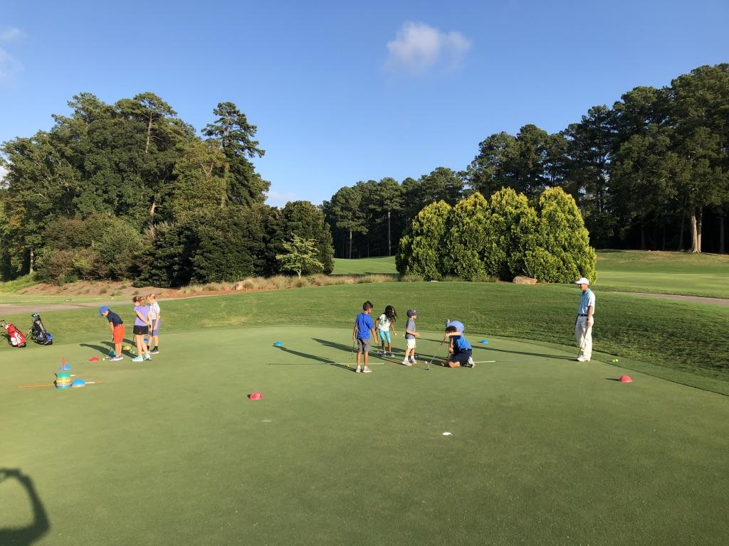
Hidden Lake Golf Club
JUNIOR ACADEMY
TUITION & SCHEDULE
STANDARD
PROGRAM TUITION
$370 per semester
• (8) Academy Classes
• (4) Op 36 9-Hole Events
• Op 36 Mobile App
FAMILY DISCOUNTS
10% off 2nd Juniors Tuition
20% off 3rd Juniors Tuition
$185/mo
ADDITIONAL SERVICES & FEES
Annual Enrollment Fee - $50/student
(Annually for Registration App Access & Special Events)
Op 36 Starter Kit - $75

Slide 2
Hidden Lake Golf Club
JUNIOR ACADEMY
TUITION & SCHEDULE
MOST POPULAR
RECREATION PACKAGE
CHALLENGE PACKAGE
PLAYERS PACKAGE
ACADEMY PACKAGE
$130/mo
$185/mo
$285/mo
$385/mo
$260 per semester
(4) Academy Classes
Op 36 Mobile App
$370 per semester
(4) Academy Classes
(2) Op 36 9-Hole Events
Op 36 Mobile App
$570 per semester
(4) Academy Classes
(2) Op 36 9-Hole Events
(4) Supervised Practices
Op 36 Mobile App
$670 per semester
(4) Academy Classes
(2) Op 36 9-Hole Events
(4) Supervised Practices
(2) 40 Min Private Lessons
Op 36 Mobile App
ADDITIONAL SERVICES & FEES
Annual Enrollment Fee - $50/student
(Annually for Registration App Access & Special Events) Op36 Starter Kit - $75
FAMILY DISCOUNTS
10% off 2nd Student Tuition
20% off 3rd Student Tuition

Slide 3
Hidden Lake Golf Club
SEMESTER 1
SEMESTER 2
SEMESTER 3
SEMESTER 4
MAY 6th - JUNE 25th
JULY 1st - AUG 19th
SEPT 2nd - OCT 21st
FEB 4th - MAR 25th
We split our academy into semesters. Once enrolled in a class you hold your spot for the entire semester as well as
priority for future semesters. If you would like to drop enrollment your spot may be filled by wait-listed students.
ACADEMY CLASS SCHEDULE
AGES 7-10
AGES 10-13
PRACTICE
6:1 Student to Coach
FRIDAY
4:30-5:30 PM
FRIDAY
5:30-6:30 PM
WEDNESDAY
4:30-5:30 PM
Explore the dates in your junior’s age group and contact coach for availability. This will be the date and time your junior attends each week throughout the entire semester and works through the Operation 36® Curriculum. 4 person minimum
to conduct the class.
SATURDAY
9:30 AM-10:30 AM
SATURDAY
8:30-9:30 AM
9-HOLE EVENTS
The Operation 36® 9-Hole Events provide a great experience for juniors to challenge themselves and test their skills on the course. Caddy required for golfers Division 1-3. To learn more about Operation 36 9-Hole Events: CLICK HERE
SUNDAYS (Tee times at 5:00 PM) MONDAYS (Tee-Times at 6:00 PM)
Semester 1
5/15 or 5/16
5/29 or 5/30
6/12 or 6/13
6/26 or 6/27
Semester 2
7/10 or 7/11
7/24 or 7/25
8/7 or 8/8
8/21 or 8/22
Semester 3
9/11
9/25
10/9
10/23
Semester 4
NA
NA
NA
NA
9-Hole events for Semester 3 will probably be held on Sunday afternoons due to reducing daylight hours.
Start time will be 4:00 PM. TBA.
Ready to get started? Email which semester you want your junior to start and the class schedule (day & time), to: David at dbanks@clublink.ca

