Slide 1
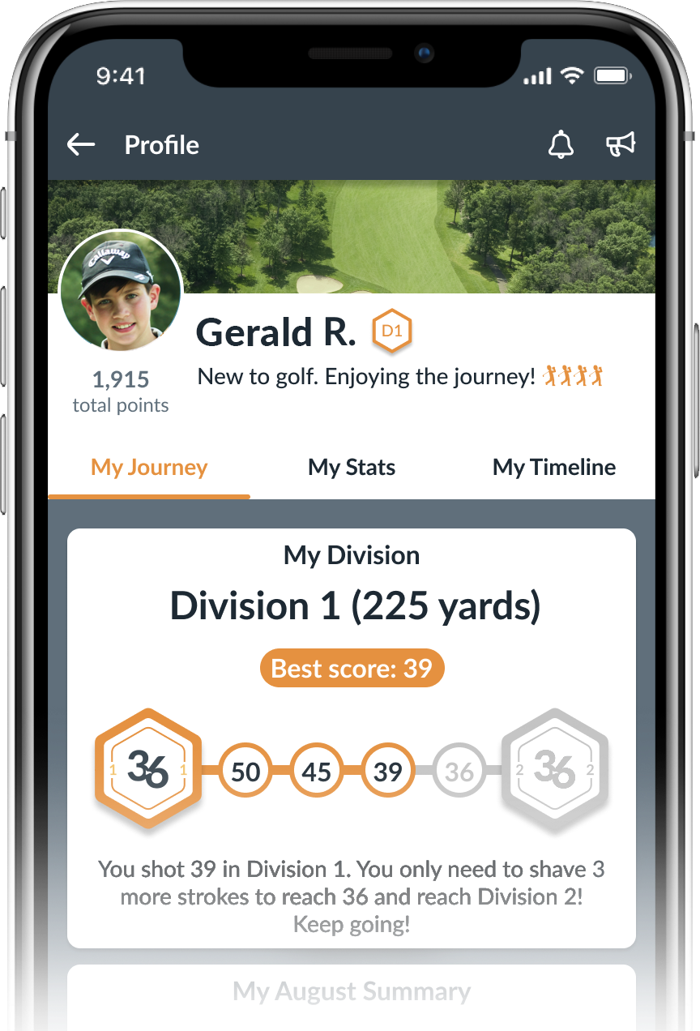
Hidden Lake Golf Club
WOMEN’S ACADEMY TUITION & SCHEDULE
STANDARD
PROGRAM TUITION
$390 per semester
• (8) Academy Classes
• (4) Op 36 9-Hole Events
• Op 36 Mobile App
FAMILY DISCOUNTS
10% off 2nd Student Tuition
20% off 3rd Student Tuition
$195/mo
ADDITIONAL SERVICES & FEES
Annual Enrollment Fee - $50/student
(Annually for Registration App Access & Special Events)

Slide 2
Hidden Lake Golf Club
WOMEN’S ACADEMY TUITION & SCHEDULE
MOST POPULAR
RECREATION PACKAGE
CHALLENGE PACKAGE
PLAYERS PACKAGE
ACADEMY PACKAGE
$140/mo
$195/mo
$295/mo
$395/mo
$280 per semester
(8) Academy Classes
Op 36 Mobile App
$390 per semester
(8) Academy Classes
(4) Op 36 9-Hole Events
Op 36 Mobile App
$590 per semester
(8) Academy Classes
(4) Op 36 9-Hole Events
(8) Supervised Practices
Op 36 Mobile App
$790 per semester
(8) Academy Classes
(4) Op 36 9-Hole Events
(8) Supervised Practices
(2) 40 Min Private Lessons
Op 36 Mobile App
ADDITIONAL SERVICES & FEES
Annual Enrollment Fee - $50/student
(Annually for Registration App Access & Special Events)
FAMILY DISCOUNTS
10% off 2nd Student Tuition
20% off 3rd Student Tuition

Slide 3
Hidden Lake Golf Club
SEMESTER 1
SEMESTER 2
SEMESTER 3
SEMESTER 4
MAY 3th - JUNE 25th
JUNE 28th - AUG 20th
AUG 30th - OCT 21st
TBA
We split our academy into semesters. Once enrolled in a class you hold your spot for the entire semester as well as
priority for future semesters. If you would like to drop enrollment your spot may be filled by wait-listed students.
ACADEMY CLASS SCHEDULE
WEDNESDAY
TUESDAY
SATURDAY
6:1 Student to Coach
5:30-6:30 PM
10:00-11:00 AM
11:45-12:45 AM
Explore the dates for the academy and contact coach for availability. This will be the date and
time you’ll attend each week throughout the
entire semester and work through the
Operation 36® Curriculum.
4 participant minimum to conduct the class.
6:30-7:30 PM
THURSDAY
10:00-11:00 AM
9-HOLE EVENTS
The Operation 36® 9-Hole Events provide a great experience for students to challenge themselves and test their skills on the course. No previous experience needed! Use the Operation 36 Mobile App to log casual rounds for practice.
TUESDAYS (6:00 PM TEE TIME APPROX)
Semester 1
5/14 or 5/17
5/28 or 5/31
6/11 or 6/14
6/25 or 6/28
Semester 2
7/9 or 7/12
7/23 or 7/26
8/6 or 8/9
8/20 or 8/23
Semester 3
9/10
9/24
10/8
10/22
Semester 4
NA
NA
NA
NA
9-Hole events for Semester 3 will probably be held on Sunday afternoons due to reducing daylight hours.
Start time will be 4:00 PM. TBA.
Ready to get started? Email which semester you want to start and the class schedule (day & time)
to: David at dbanks@clublink.ca

