Slide 1

Kelly Plantation
Homeowners Association
Annual Meeting
October 6th, 2016
6:00 pm

Slide 2
Agenda
Introductions
KP - Information
Year-in Review
    2016 Activities
    Plans for 2017
    Open Board/Committee Positions
Financial Report
Grounds/Facilities Report
Covenants Report
Architectural Committee Report
Neighborhood Watch Report
Event Committee Report
Questions & Answers

Slide 3
Introductions
Board Members
  President – Todd Watts
  Vice-President – Toni Bradley
  Treasurer – Mark Schoenig (acting – looking for volunteer)
  Secretary – Tracie McEnery
  VP Grounds/Facilities – Mark Schoenig
  VP Covenants – Shawn Levy
  VP Electronic Security – Gina Bradley
Non-Board Members
  Neighborhood Watch – Gina Bradley (acting – looking for volunteer)
  Event Committee –Rhonda Schoenig (outgoing)
  Welcome Committee – Lisa Taylor
  Architectural Review Committee – Toni Bradley, Jon Yobs
  Clubhouse Trustee – Tracie McEnery

Slide 4
Kelly Plantation - Information
Emails
  hoaboard@kellyplantationhoa.net
  kphoasecretary11@gmail.com
Facebook
  Search for Kelly Plantation HOA, Harvest, AL
  https://www.facebook.com/groups/111454125545380/
Webpage
  www.kellyplantationhoa.net
  username: kphoa, password: kphoa12
Other
  Monthly Meeting Minutes – emailed to KP Distribution

Slide 5
Year-in Review
Welcome New Residents
Overview of 2016
Plans for 2017

Slide 6
Open Positions
Board Position:
  Treasurer
    Responsible for Collecting annual dues and maintains records of payments• Makes financial recommendations to the Board • Coordinates preparation of annual tax return • Monitors ownership Changes• Works with Secretary and Welcome Committee Chair to maintain an updated KPHOA Directory of resident names, addresses, phone numbers and email addresses • Supplies quarterly financial report • Writes checks, makes deposits and balances account • Provides written receipts for cash payments.
Committee Position:
  Neighborhood Watch Chair
    Duties listed within Neighborhood Watch section of the slides.

Slide 7

Financial Report
Revenue
Expenses
My Dues-Where did they go?
Balance Sheet
2016-2017 Budget

Slide 8
2016 Financial Review - Revenue
INCOME | Budgeted Amount | Actual Amount | Difference = Actual - Budgeted
Starting Funds | 6,668.75 | 6,668.75 | 0.00
2014-2015 Dues (176 Homes + 8 Vacant lots) | 85,480.00 | 88,005.68 | 2,525.68
Clubhouse Rentals | 2,500.00 | 2,925.00 | 425.00
Miscellaneous Income (Late Fees) | 150.00 | 1,310.00 | 1,160.00
Miscellaneous Income (Interest/Fines) | 80.00 | 121.38 | 41.38
Miscellaneous Income (ACS-Cards) | 110.00 | 60.00 | -50.00
TOTAL INCOME | $ 94,988.75 | $ 99,090.81 | $ 4,102.06

Slide 9
2016 Financial Review – Expenses
EXPENSES | Budgeted Amount | Actual Amount | Difference ($) = Actual - Budgeted
Huntsville Utilities | 6,350.00 | 6,333.20 | 16.80
Harvest-Monrovia Water | 6,350.00 | 6,371.68 | -21.68
Pool Service & Supplies | 6,700.00 | 6,280.00 | 420.00
Lawn/Grounds Service/Mtnc | 33,600.00 | 33,501.00 | 99.00
Insurance | 6,000.00 | 6,261.00 | -261.00
Clubhouse Supplies & Cleaning | 1,900.00 | 1,261.34 | 638.66
Property Taxes | 2,121.00 | 2,120.67 | 0.33
Legal Fees | 500.00 | 51.50 | 448.50
Security Patrols | 1,000.00 | 1,125.00 | -125.00
Tax Preparation | 150.00 | 175.00 | -25.00
Neighborhood Improvements | 13,717.75 | 13,187.00 | 530.75
Social Committee | 1,500.00 | 1,500.00 | 0.00
Miscellaneous/copies/mail | 700.00 | 227.74 | 472.26
Pond Care & Maint. | 600.00 | 327.67 | 272.33
Repair to Common Assets | 8,800.00 | 8,341.37 | 458.63
Contingency Reserve | 5,000.00 | 5,000.00 | 0.00
 | $ 94,988.75 | $ 92,064.17 | $ 2,924.58

Slide 10
2016 Financial Review – Dues Breakout
$300 Dues & $180 Special Assessment
Huntsville Utilities | $32.61
Harvest-Monrovia Water | $32.82
Pool Service & Supplies | $32.32
Lawn/Grounds Service/Mtnc | $183.06
Insurance | $32.31
Clubhouse Supplies & Cleaning | $6.89
Property Taxes | $11.59
Legal Fees | $0.28
Security Patrols | $6.15
Tax Preparation | $0.96
Neighborhood Improvements | $63.04
Social Committee | $8.20
Miscellaneous/copies/mail | $1.24
Pond Care & Maint | $1.71
Repair to Common Assets | $42.50
Contingency Reserve | $24.32
TOTAL: | $480.00

Slide 11
2016 Financial Review - Balance Sheet
BALANCE SHEET
ASSETS
CASH IN BANK
Checking - Redstone Federal Credit Union | $ 434.75
Savings Account/Emergency Funds | $ 17,909.00
Money Market - Redstone Federal Credit Union | $ 4,899.87
 |  | $ 23,243.62
FIXED ASSETS
221 Kelly Ridge Boulevard - Clubhouse and Pool | $ 279,700.00
Back Pond 5.88 Acres | $ 31,500.00
 |  | $ 311,200.00
TOTAL ASSETS |  | $ 340,748.33
LIABILITIES & EQUITY
LIABILITIES
None | $ -
 |  | $ -
EQUITY
Owner's Equity | $ 340,748.33
 |  | $ 340,748.33
TOTAL LIABILITIES & EQUITY |  | $ 340,748.33

Slide 12
2016-2017 Projected Budget
INCOME
Starting Funds | 5,334.62
2016-2017 Dues (184 Homes + 8 Vacant lots) | 89,320.00
Clubhouse Rentals | 2,500.00
Miscellaneous Income (Late Fees) | 250.00
Miscellaneous Income (Interest/Fines) | 100.00
Miscellaneous Income (ACS-Cards) | 50.00
TOTAL INCOME | $ 97,554.62
EXPENSES
Huntsville Utilities | 6,300.00
Harvest-Monrovia Water | 6,350.00
Pool Service & Supplies | 6,400.00
Lawn/Grounds Service/Mtnc | 33,600.00
Insurance | 6,250.00
Clubhouse Supplies & Cleaning | 1,300.00
Property Taxes | 2,121.00
Legal Fees | 1,500.00
Security Patrols | 1,000.00
Tax Preparation | 175.00
Neighborhood Improvements | 11,300.00
Social Committee | 1,500.00
Miscellaneous/copies/mail | 700.00
Pond Care & Maint. | 600.00
Repair to Common Assets | 13,458.62
Contingency Reserve | 5,000.00
TOTAL EXPENSES | $ 97,554.62

Slide 13
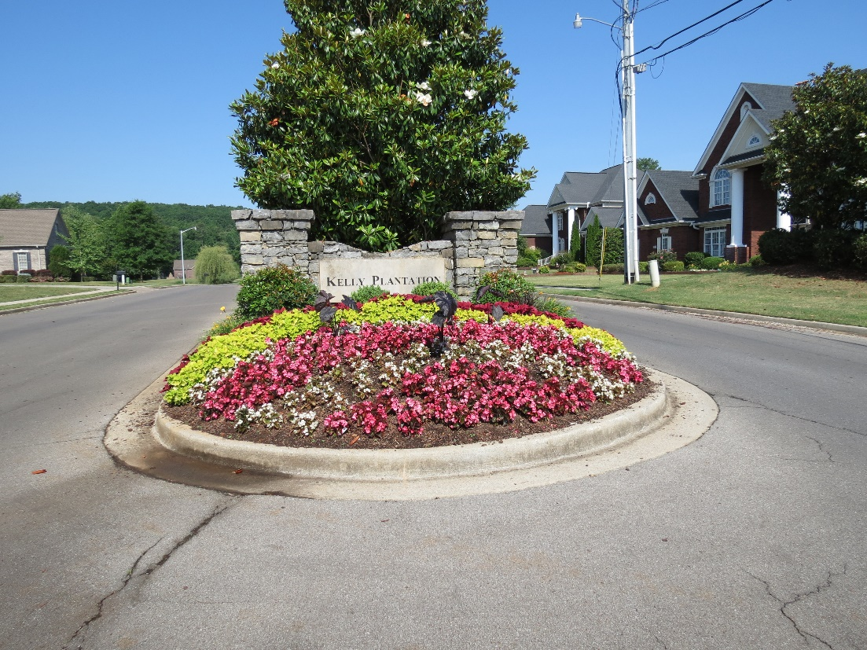
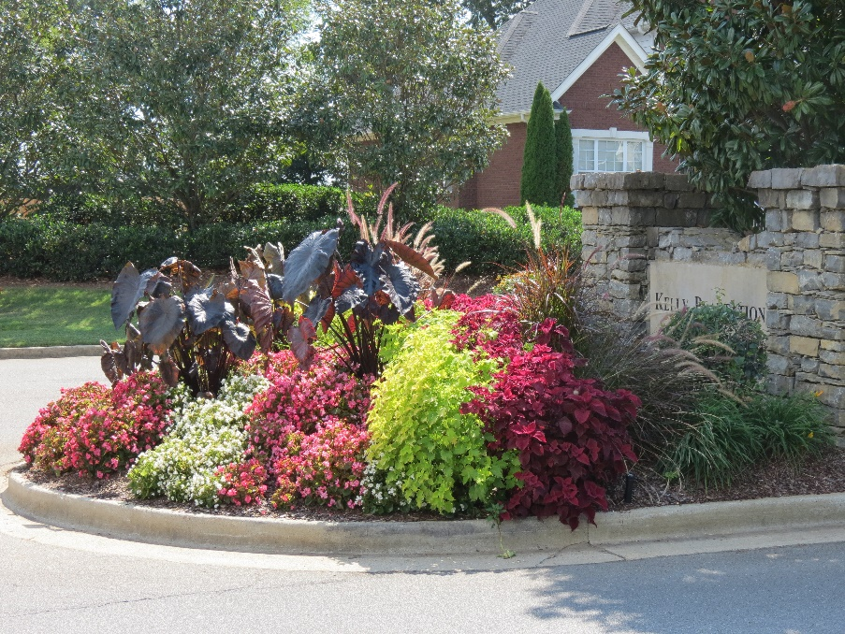
Grounds Report
  Grounds
    Area of Coverage
  2015/2016 Improvements
  Repairs
  2017 Projects

Slide 14
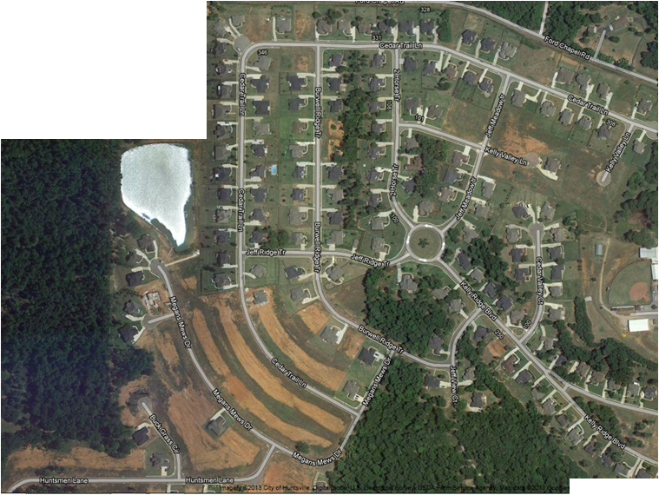
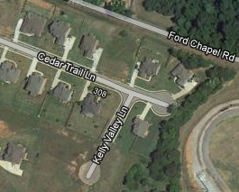
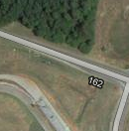
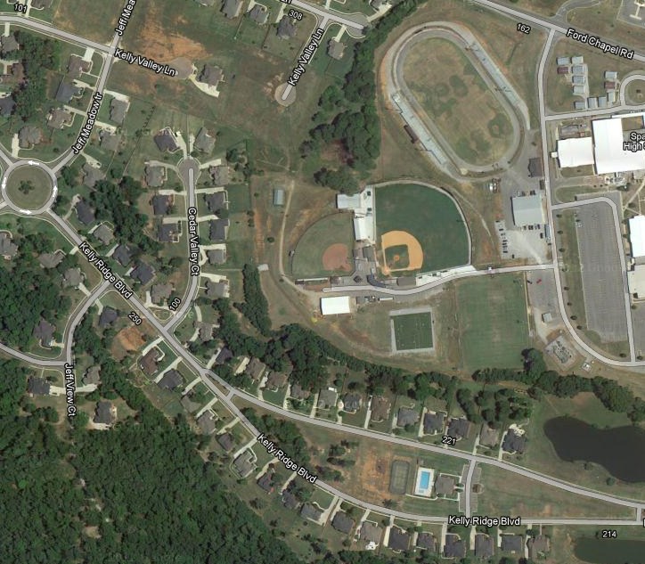
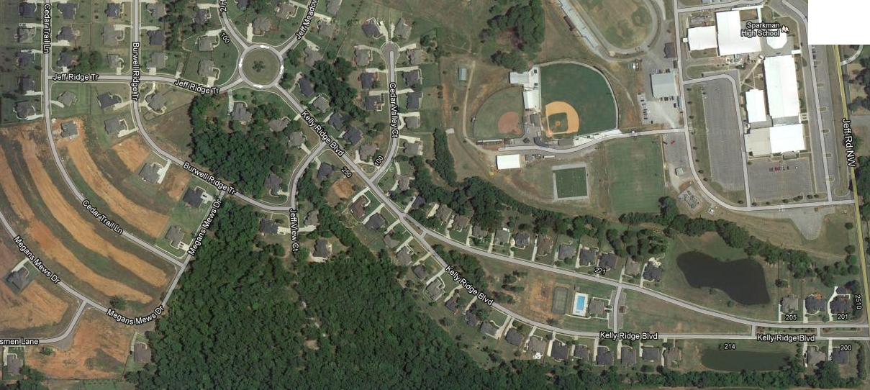

Grounds Report
Lawn Maintenance
  Covers approximately 18 Acres, 3 Ponds, 4 Islands, 1 Round-about
Club
House

Slide 15
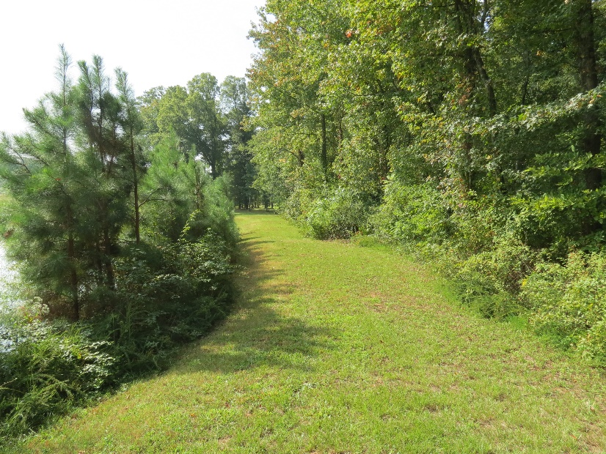
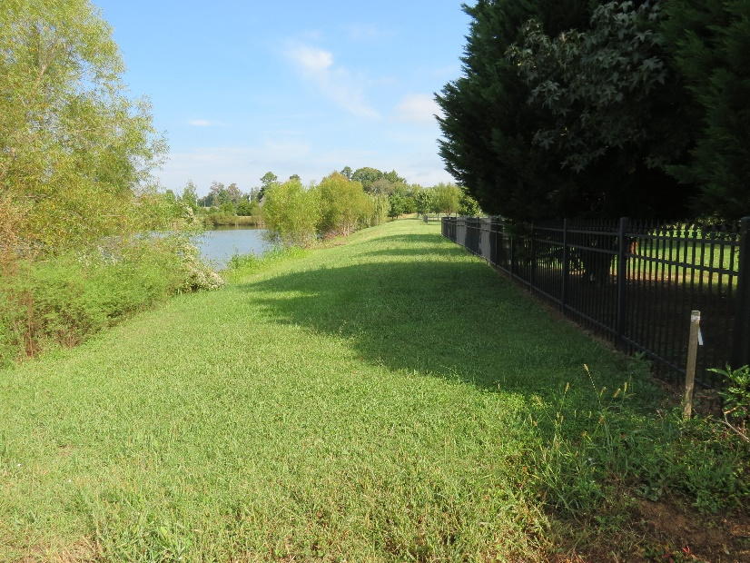
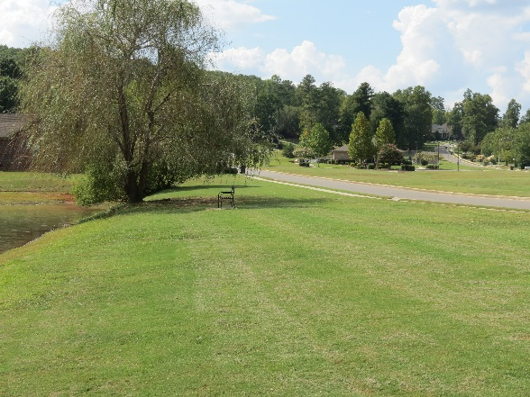
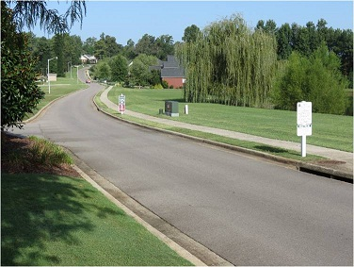
Grounds Report
Lawn Maintenance
  Contract Increased Mowing to Back Pond to a Wkly Schedule
  Weed Control & Fertilization
    Weekly mowing Day Wed – May Chg in 2017
  HOA’s Largest Expense

Slide 16
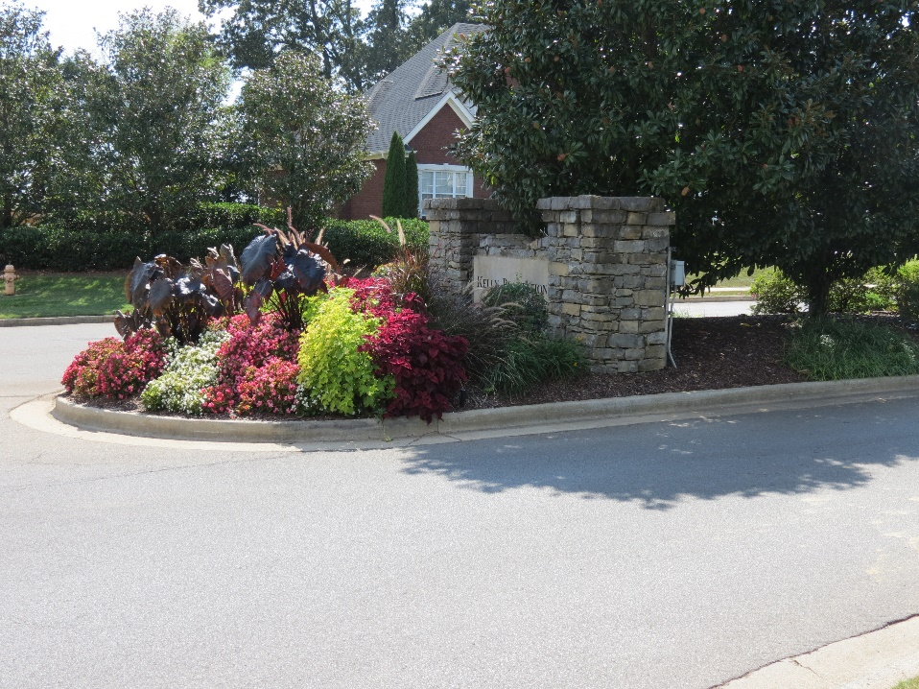
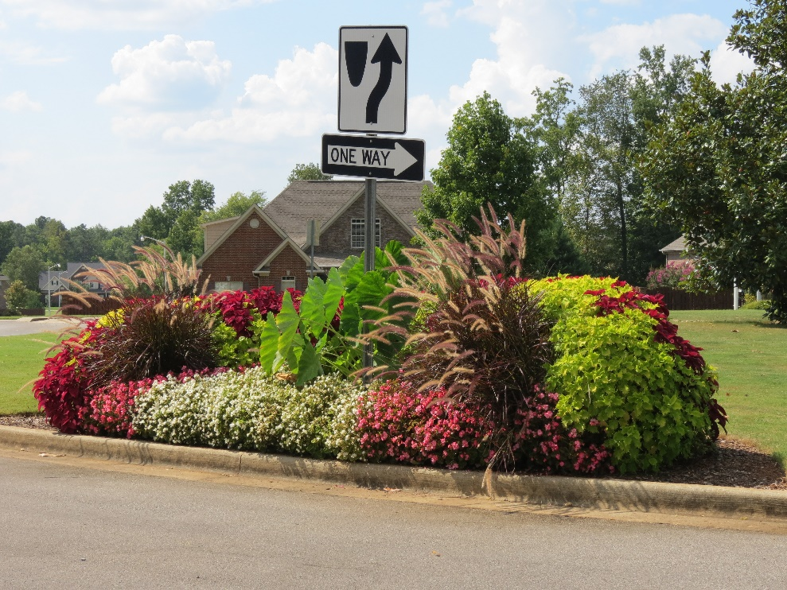
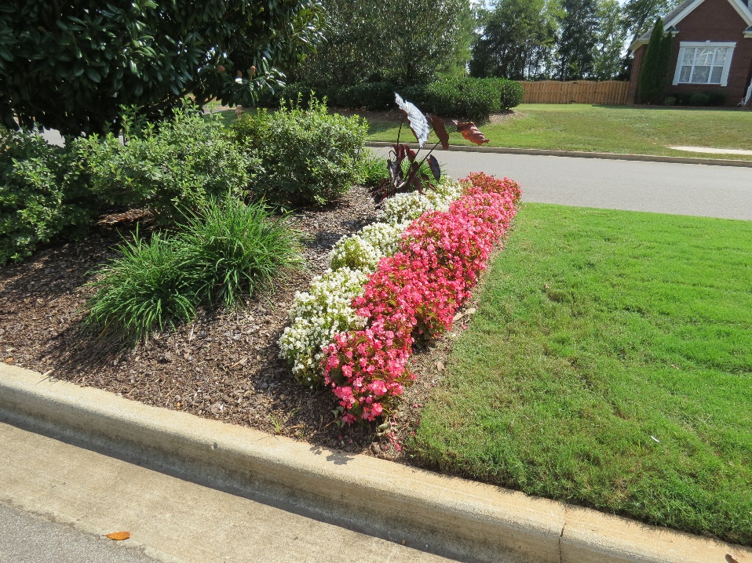
Grounds Report
Improvements:
  Main Entrance
    Adjusted Flower Plan
    Added New Soil
    Adjusted Sprinkler Valves
  Added New Flower Design to the Back Side of Entry Sign & Top of KRB

Slide 17
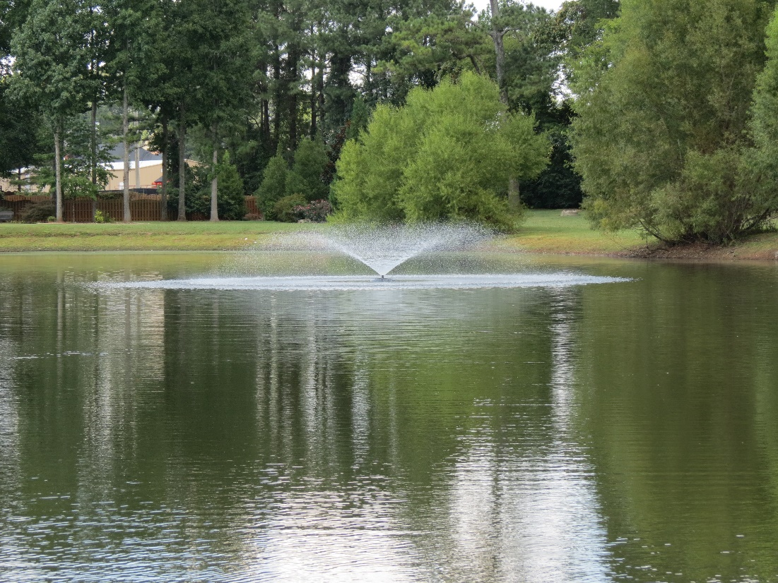
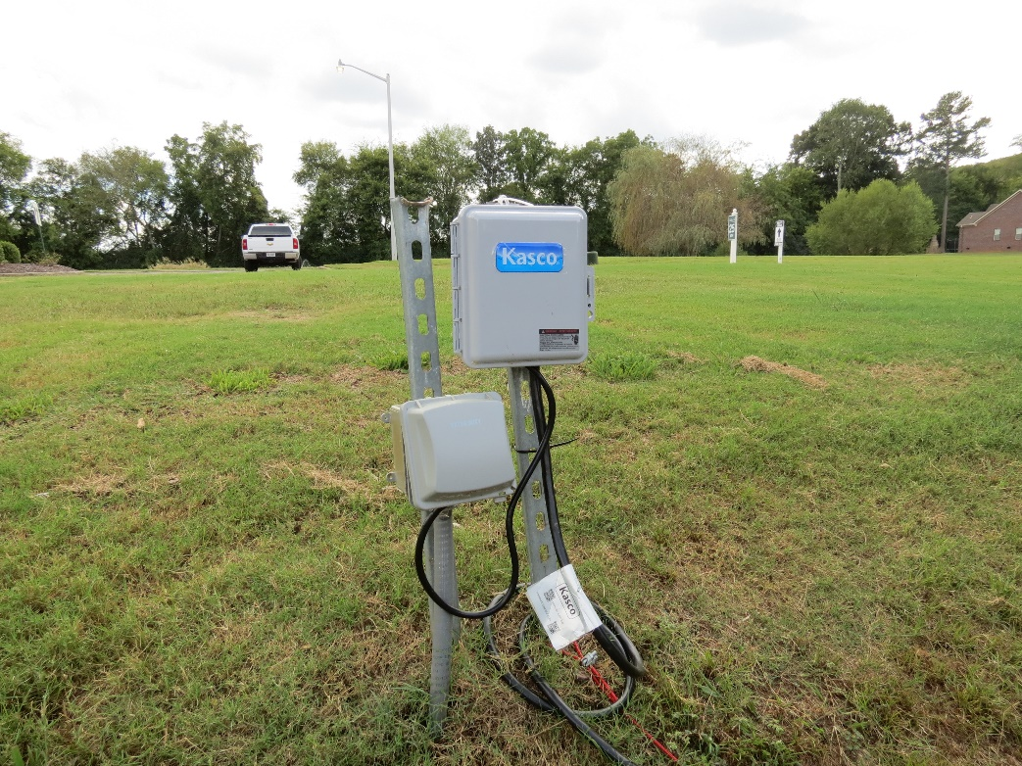
Grounds Report
Improvements:
  Electric added to North Pond
  Added North Pond Fountain

Slide 18
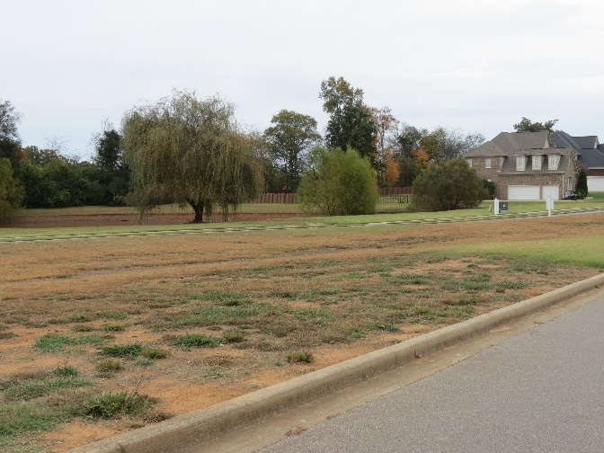
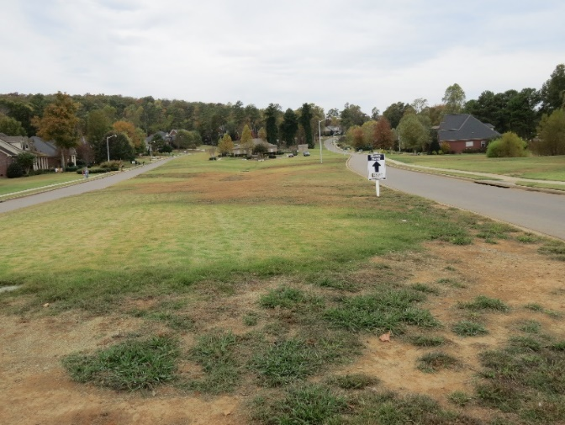
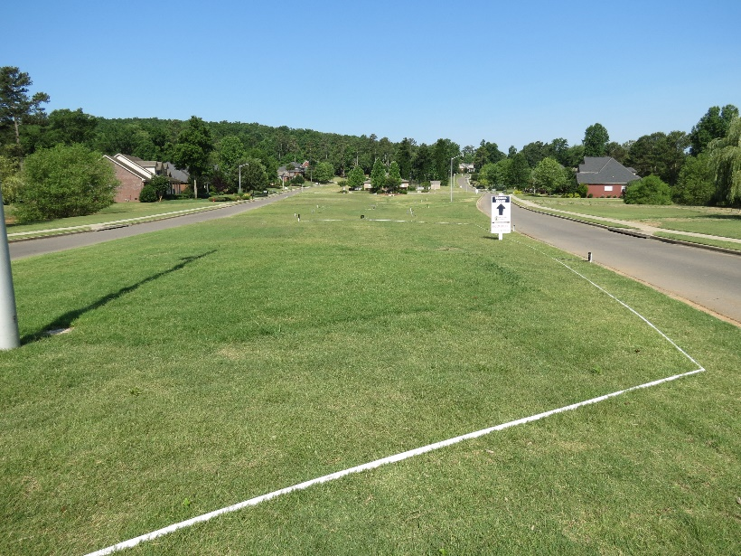
Grounds Report
Improvements
  Purchased 29,000 SQ Ft of Sod to Large Center Island
    Cost included temporary above ground Sprinkler, Prep Work, and Installation
    Largest Improvement Expense
  Order Quantity Error
    Made by Sod Company
    KPHOA Favor
    No additional Cost(s) to HOA
    Gained additional Sod to North Pond area
    Hard Root Start w/o Water

Slide 19

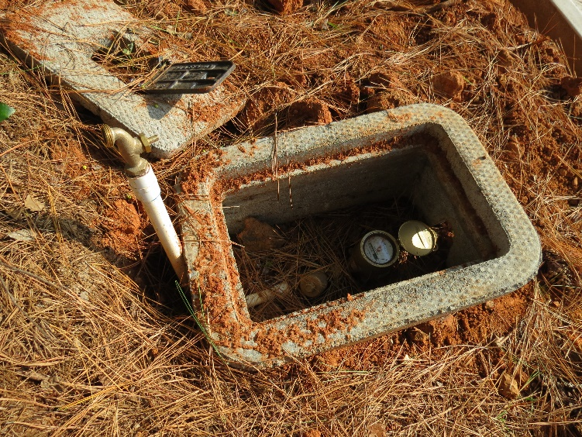
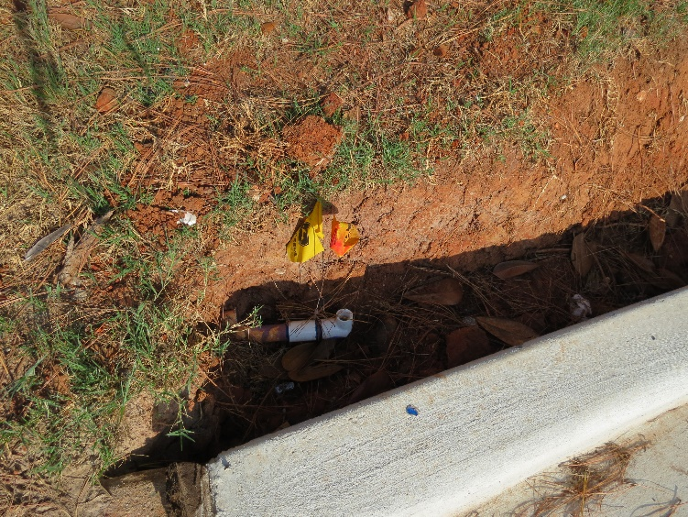
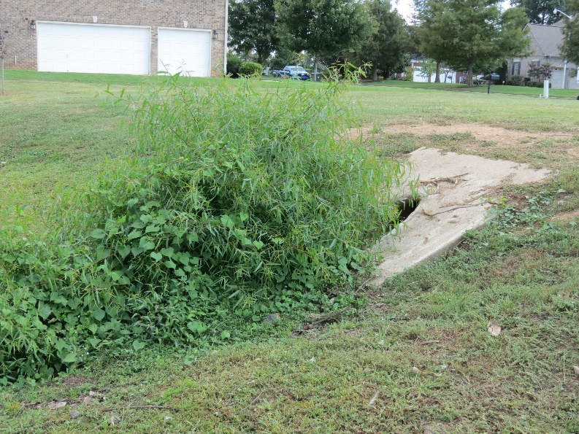
Grounds Report
Challenges
  Jeff Road Widening Project
    Approx 30 days No Water to front Island
  KRB Flooding
    County Removed Vegetation Growth in Drain

Slide 20
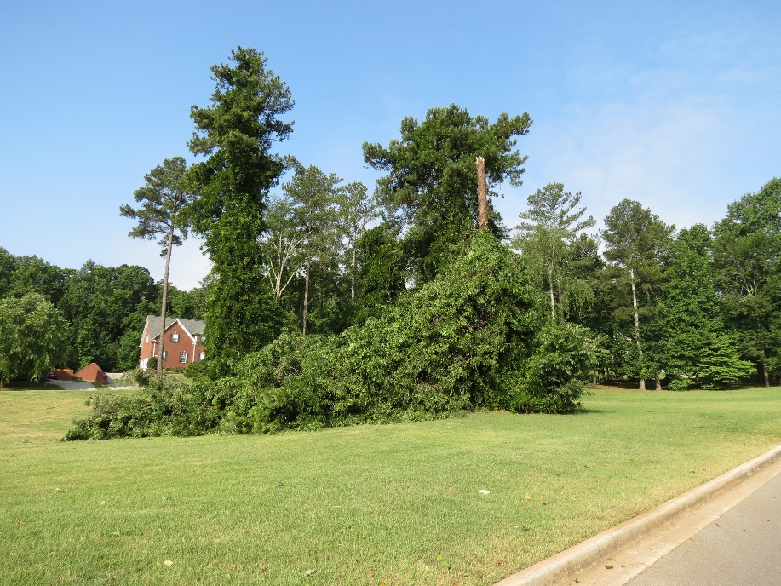
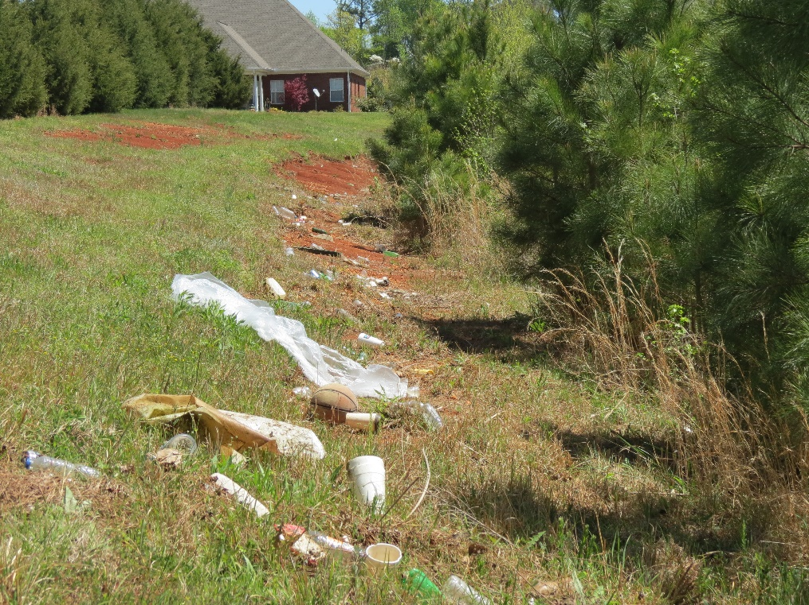
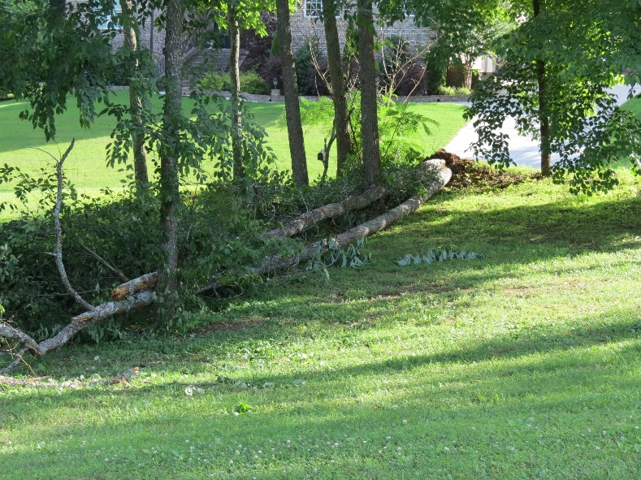
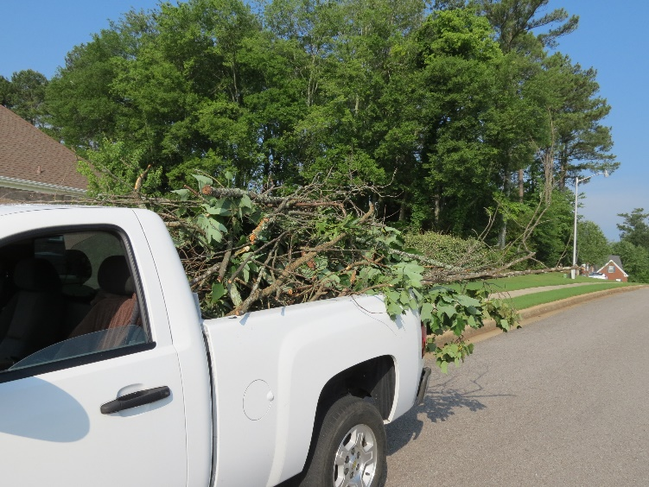
Grounds Report- Maintenance
June 2016 Storm
Removed 2 Fallen Pine Tree/Stump Grind
6-Irrigation Repairs
Trash Clean up at Back Pond

Slide 21
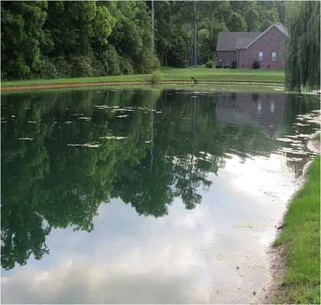
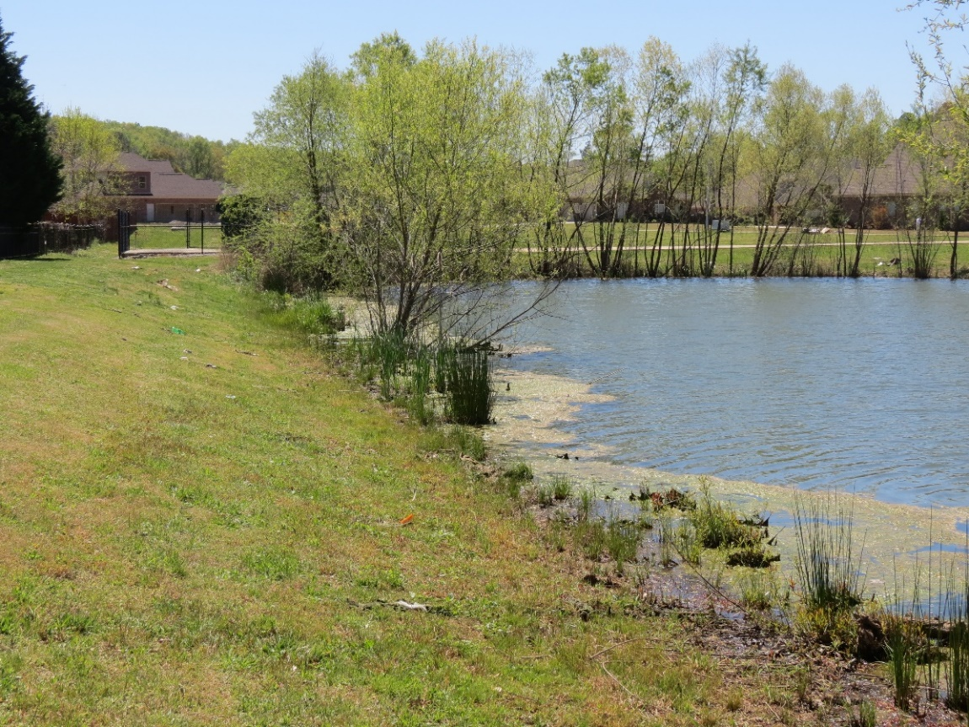
Grounds Report
Routine Maintenance Cont…
  Increase in Algae to Back Pond
  Budgeted for in 2016-2017

Slide 22
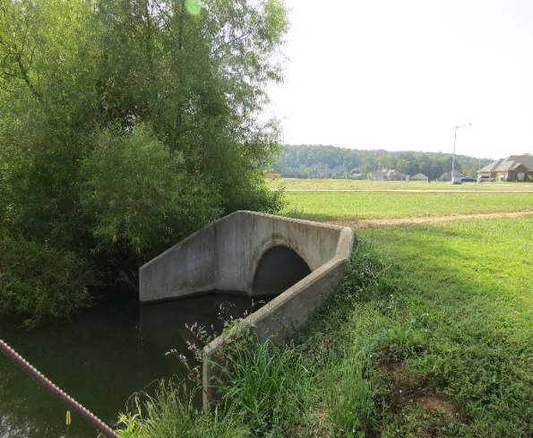
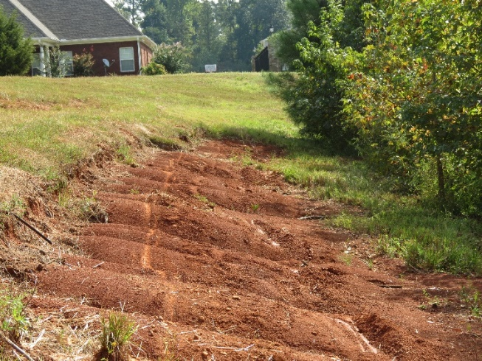
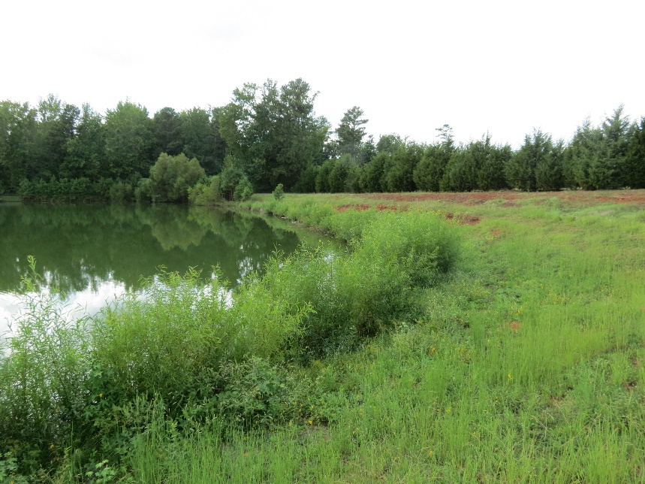
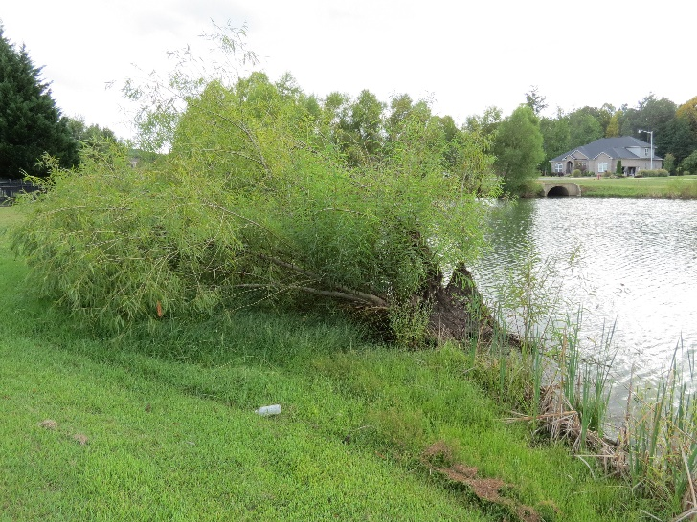
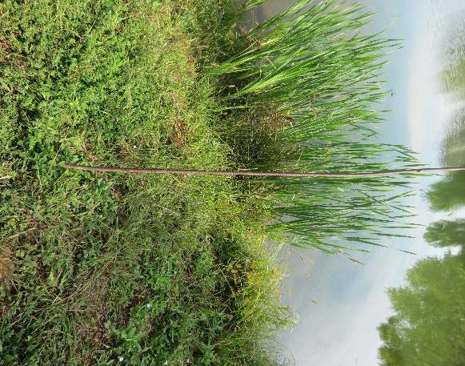
Grounds Report – Project Planning 2017
Back Pond
  Railing
  Remove Rebar
  Tree Growth/removal
  Erosion Fix
    Sod area

Slide 23
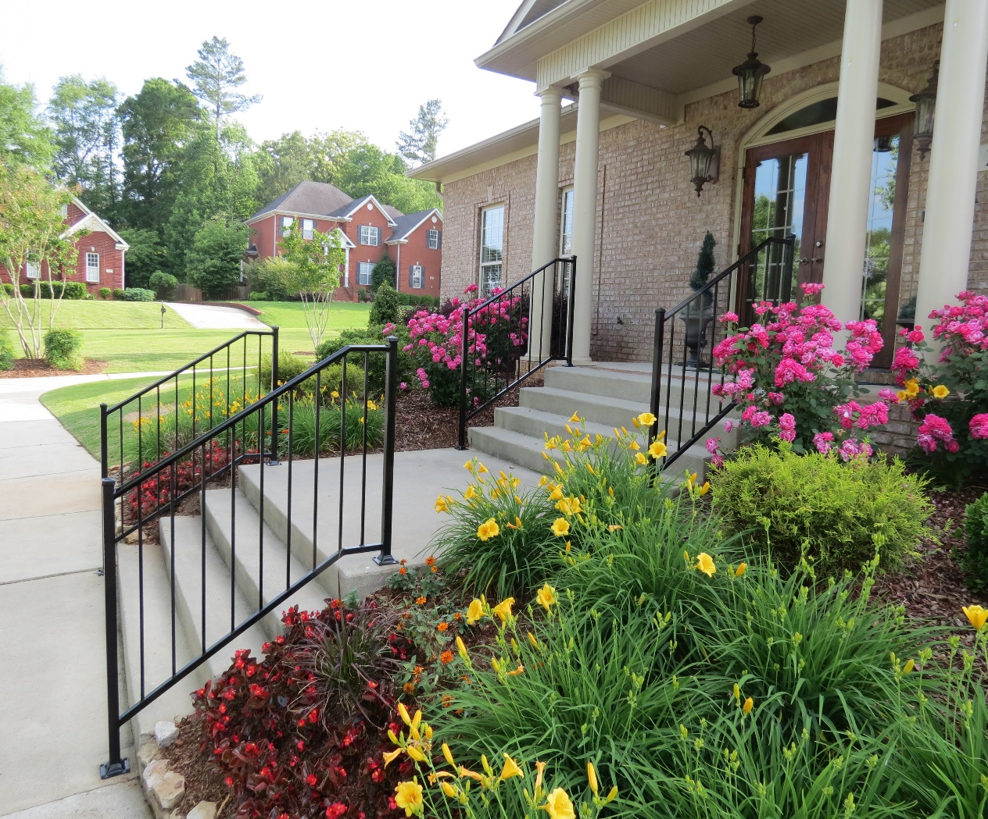
Facilities Report
Improvements/Repairs
Upcoming Maintenance
Items – “On the Watch”

Slide 24
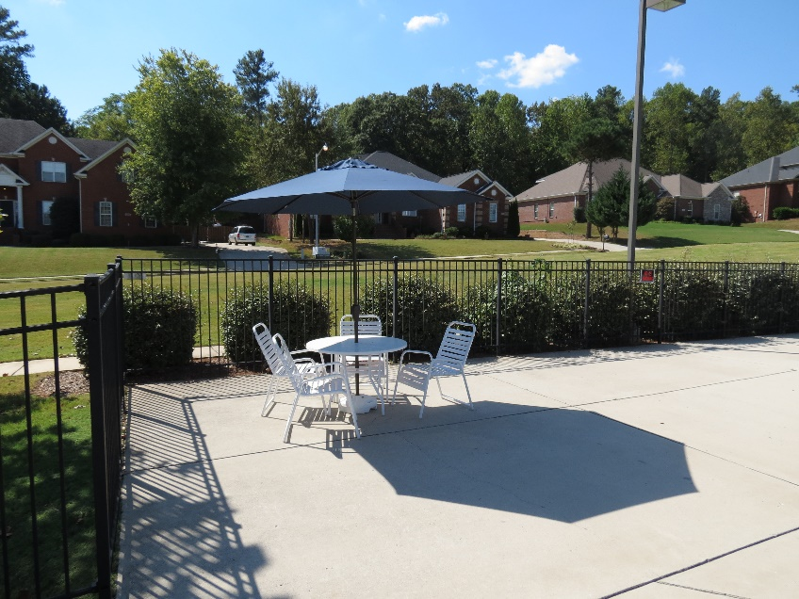
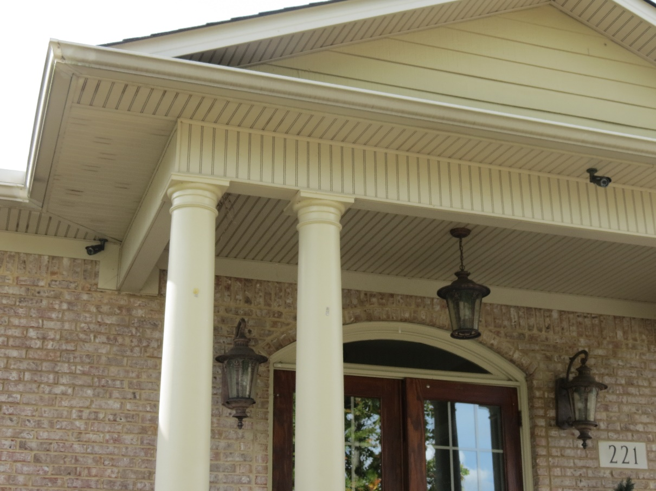
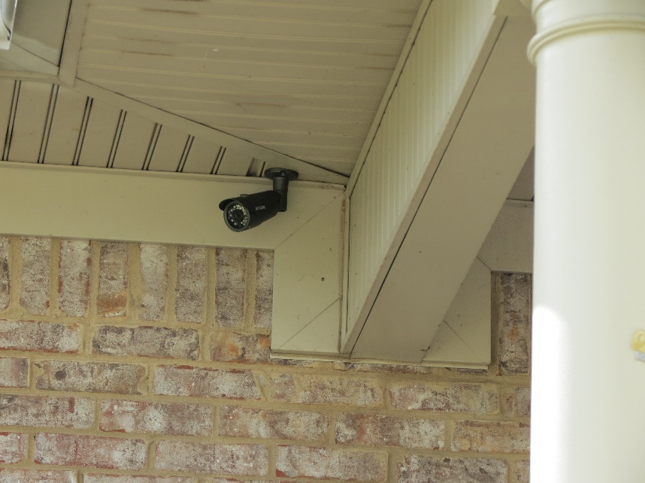
Facilities Report - Improvements
6 Pool Umbrellas Replaced
Added 3 Security Cameras to Front of Club House

Slide 25
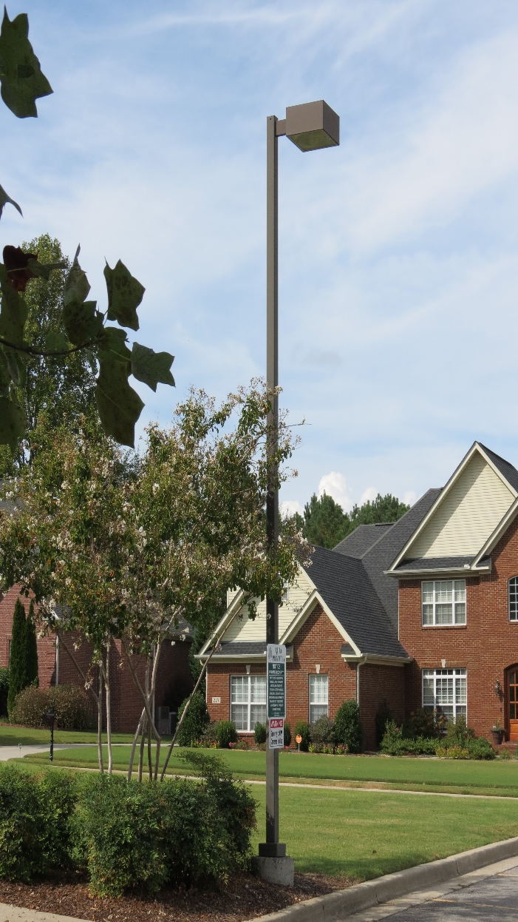
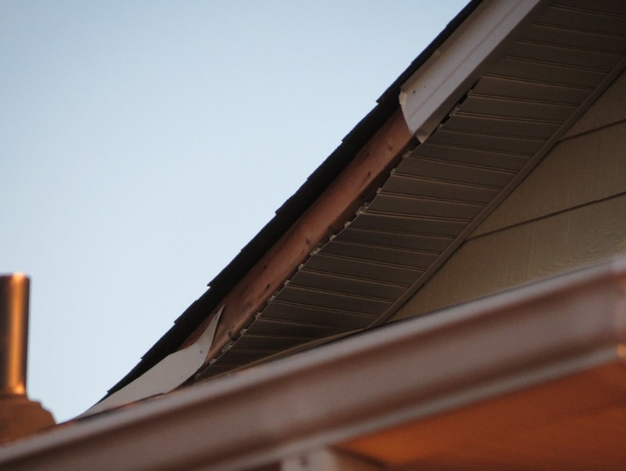
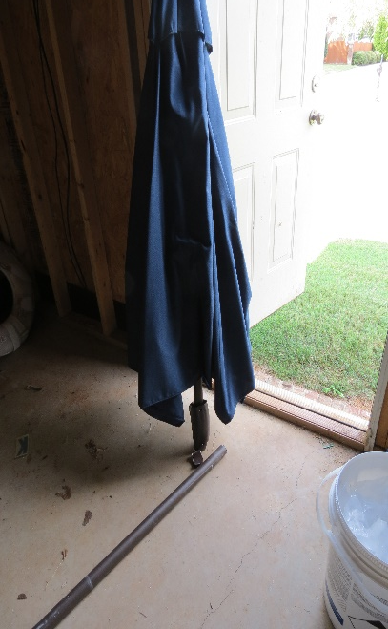
Facilities Report - Repairs
Clubhouse Fascia
  Unrelated to June Storm
Clubhouse Parking Lot Lights
1-Pool Umbrella
  June Storms

Slide 26
Facilities Report – “Routine Maintenance”
Winterize Pool Furniture
  Wash/Dry and Stored (Completed 3 Oct)
Pool
  Pump shut off in November
Clubhouse
  Install Water Bib Covers
  Replace HVAC Filters
Winterize All Sprinkler Zones

Slide 27
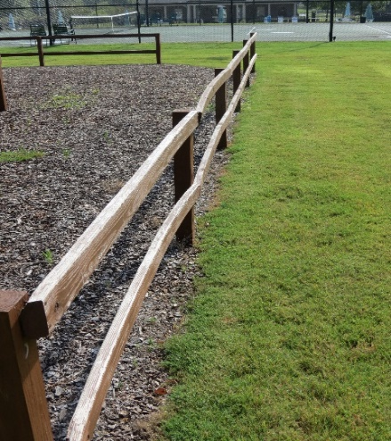
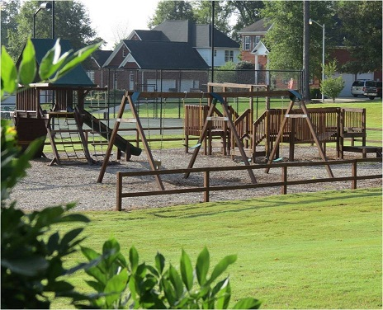
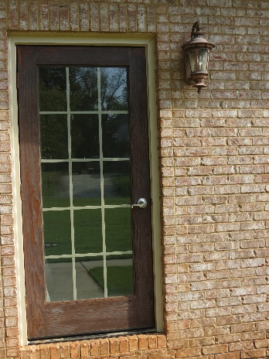
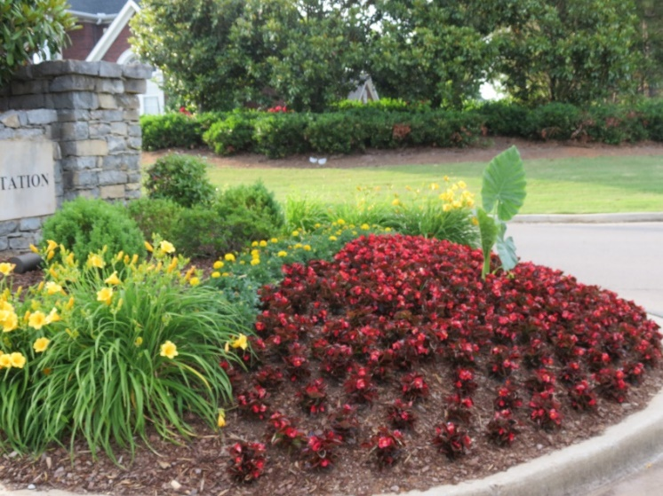
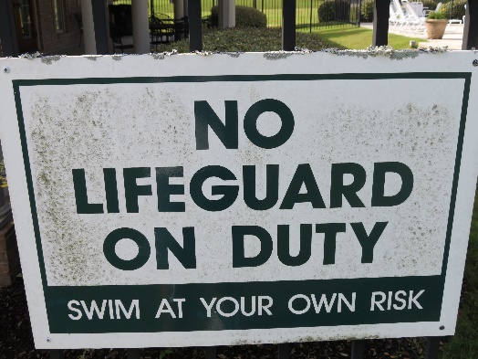
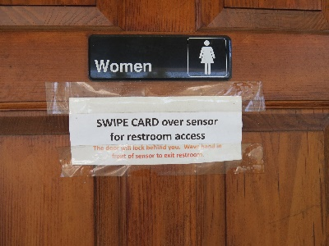
Facilities Report – “Items On the Watch”
Pool (Aging)
CH Door Staining
CH Flooring/Furniture
Ground Signs
  Fading
  Upgrade Paper to Plastic
Tier Layer to Entry flower bed
Playground Wood Fence
  Warped boards; Apply stain

Slide 28
Covenants Report
Covenants enforcement on-going
  Continued focus on weeded yards, flower beds and fences
Reminder of placing lawn debris/bulk items to the curb on designated weekend only. Designated week for Kelly Plantation bulk pick up is the 2nd Monday of each month.

Slide 29
Architectural Committee Report
Architectural Guidelines updated
  Available to all homeowners on Kelly Plantation homepage
Unapproved Fences
  Homeowners are reminded that ALL fences and structures must be pre-approved BEFORE starting construction.

Slide 30

Your Neighborhood Watch Program
Introductions
  Neighborhood Watch Chair Duties
  Know Your Block and Block Captain
  Safe House Program
Tools and Information
  Kelly Plantation Web-Site
  Internet Tools
Activities
  Increased Sheriff Patrols
  Increased Video Security
  Classes by the Sheriffs Dept.
Your Neighborhood Watch Program was created by the residents of the Kelly Plantation Neighborhood and serves as a sub-committee to the Kelly Plantation Homeowners Association. The purpose of the Kelly Plantation Neighborhood Watch Program is to obtain community involvement and build partnerships in preventing residential crime and improving neighborhood safety, to educate and distribute relevant safety and crime prevention information, and to promote good citizen-law enforcement relations and community pride.

Slide 31
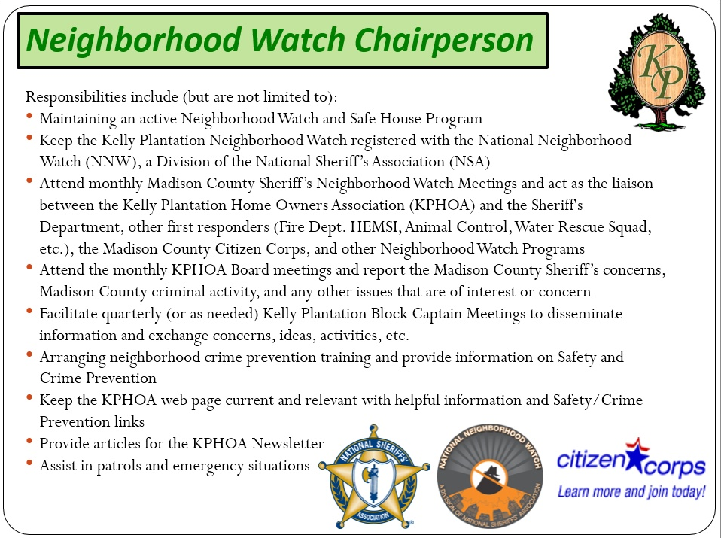

Slide 32




Introductions
Know Your Neighborhood
Watch Chair
?
?
Know Your Blocks
Your Name Here?
Safe House
?????
D
C
B
Cutwater
Court
Club
House
E
A

Slide 33
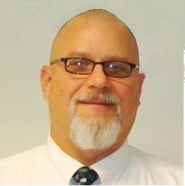
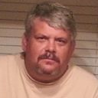
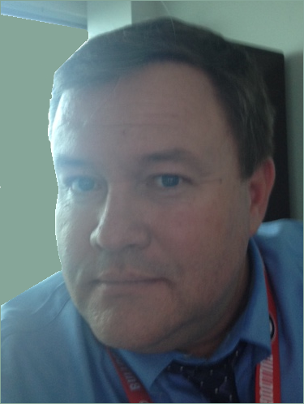


Introductions
Know Your Block Captains
D
C
Block
Captain
Block
Captain
Mike Peto
(256) 837-6605
Jeff Rasmussen
(256) 830-9510
E
B
A
Block
Captain
Block
Captain
Block
Captain
Your
picture
here
John Williamson
(256) 698-1649
Your Name here
Sue Bish
(256) 922-1636

Slide 34

Introductions
Know Your “Safe House” Program
Sue Bish
(256) 922-1636
Your Name Here?
Purpose of a Safe House:
To provide a temporary safe haven and assistance to children who are lost, frightened, feel threatened, who have just witnessed a crime, or involved in any other emergency situation.
Safe House participants are concerned adults who have volunteered to be available for the protection and assistance of children in need. Participation in the Safe House program is not restricted to the parents of school age children, but is open to any adult who is concerned about the safety of children. You do not need to be home all of the time either, children need aid in the evenings and on weekends as well.

Slide 35


Tools and Information
Kelly Plantation Web-Site: Home Security Booklet, Home Security Checklist, Vacation Checklist, Reporting Suspicious Activities, Lighting Audit, Duties of a Block Captain, etc…
Internet Tools:
  www.madisoncountyal.gov/sheriff/contact.html
  https://nextdoor.com
  National Neighborhood Watch Institute
  USAonWatch
  Child Predator Map
  Accuweather.com
  Alabamasaftnet.com
  Crimepush.com
  Nixle.us
Weather Info/Smart Phone Apps
Measures and Activities
Increased Sheriff Patrols
Increased Video Security
Sheriffs Department Classes at the Kelly Plantation Club House (Women's Self-Defense, Home Security Measures, Understanding Gun Laws, etc…)

Slide 36
Event Committee Report
Completed 2016 Events:
  Spring Yard Sale – April 23rd
  Movie Night – June 23rd
  Fourth of July Celebration – July 2nd
  Fall Yard Sale – September 24th
Upcoming Events:
  Bonfire Bash – November 5th
  Cookies with Santa – December 10th

Slide 37
Closing Remarks
Questions?

