Slide 1

Kelly Plantation
Homeowners Association
Annual Meeting
October 25th, 2018
6:00 pm

Slide 2
Agenda
Introductions
Year-in Review
Open Board Positions
KP - Information
Financial Report
Grounds/Facilities Report
Covenants Committee Report
Architectural Committee Report
Neighborhood Watch Report
Event Committee Report
Questions & Answers

Slide 3
Introductions
Board Members
  President – Toni Bradley
  Vice-President – Mark Schoenig
  Treasurer –Irene Bussey
  Secretary – Tracie McEnery
  VP Grounds/Facilities – Mark Schoenig
  VP Electronic Security – Gina Bradley
Non-Board Members
  Neighborhood Watch Chair –Rachel Bolyard
  Event Committee Chair – Dawn Irons
  Architectural Review Committee Chair – Jon Yobs
  Covenants Committee Chair – Bill Rice
  Clubhouse Trustee – Tracie McEnery

Slide 4
Year-in Review
Welcome New Residents
Opening Remarks
Open Board Positions

Slide 5
Open Positions
Board Positions:
  Two positions currently open
  Seeking volunteers now to provide smooth transition
Committee Positions:
  Neighborhood Watch Block Captain
  Covenant Committee Members

Slide 6
Kelly Plantation - Information
Emails
  Email links for the Board and all Committees are located on the KP Webpage
  Some of the emails asked for most often:
    hoaboard@kellyplantationhoa.net
    covenants@kellyplantationhoa.net
    Architecturalapproval@kellyplantationhoa.net
    Secretary@kellyplantationhoa.net
    clubhousereservations@kellyplantationhoa.net
    neighborhoodwatch@kellyplantationhoa.net
Facebook
  Search for Kelly Plantation HOA, Harvest, AL
  https://www.facebook.com/groups/111454125545380/
Webpage
  www.kellyplantationhoa.net
Other forms of Communication
  All KPHOA Board Meeting Minutes – emailed to KP Distribution and posted to KP Webpage
  Quarterly Financial Statements – posted to KP Webpage

Slide 7
2017-2018 Financial Report
Statement of Financial Activities
  October 1, 2017 – September 30, 2018
Balance Sheet
  As of September 30, 2018
Projected Budget
  October 1, 2018 – September 30, 2019

Slide 8
2017-2018 Financial Review
Revenues: | Budgeted | Actual | Variance | Notes
Check Book Balance @10/01/2017 | 5,617.94 | 5,617.94
2017/2018 Dues + Special Assessment | 95,605.00 | 92,756.04 | (2,848.96) | Estimated: 196 Homes +5 Vacant Lots
Clubhouse Rentals | 2,400.00 | 2,550.00 | 150.00 | 34 Rentals
Misc Income: Late Fees | 175.00 | 125.00 | (50.00) | Collected < projected
Misc: Interest | 100.00 | 503.88 | 403.88 | Bank Interest> than projected for period 10/01/2017-9/30/2018
Misc Income: Access Control Key Cards | 50.00 | 500.00 | 450.00 | Issued 25 Cards
Contingency: Capital Improvement -Pool | 30,000.00 | 30,000.00 | 0.00 | Allocated: Pool Repair
Total Revenues | 133,947.94 | 132,052.86 | (1,895.08)
Expenditures:
Covenants Management | 7,800.00 | 4,667.82 | 3,132.18 | Hughes Properties (Cancelled Contract )
Huntsville Utilities/Internet | 7,350.00 | 7,023.10 | 326.90
Harvest-Monrovia Water | 6,350.00 | 3,655.98 | 2,694.02
Pool Service & Supplies | 6,500.00 | 8,235.20 | (1,735.20)
Lawn/Grounds:Repair & Maintenance | 33,600.00 | 37,863.00 | (4,263.00) | Sprinkler System Repairs, Tree Removal
Insurance | 6,260.00 | 6,140.00 | 120.00
Clubhouse Cleaning | 1,300.00 | 848.64 | 451.36
Property Taxes | 2,121.00 | 2,120.67 | 0.33
Legal Fees | 1,500.00 | 0.00 | 1,500.00
Penalty/Fines | 0.00 | 50.00 | (50.00) | Late Filing Penalty: State of Alabama
Security Patrols | 1,000.00 | 649.60 | 350.40
Tax Preparation | 175.00 | 200.00 | (25.00)
Neighborhood Improvements | 10,000.00 | 0.00 | 10,000.00
Social Committee | 1,500.00 | 1,500.00 | 0.00
Misc: Office Supplies/Postage | 700.00 | 1,111.42 | (411.42) | Purchased 100 ACS cards
Common Assets: Repair/Replace | 12,191.94 | 3,216.05 | 8,975.89 | Repaired Gate and Replaced: Timer, Database CPU,Clubhouse Refrigerator
Pond Maintenance | 600.00 | 187.58 | 412.42
Contingency Reserve | 5,000.00 | 0.00 | 5,000.00
Contingency: Capital Improvement-Pool | 30,000.00 | 29,556.00 | 444.00 | Replace Coping/Brick. Plaster Pool & Install LED lights
Total Expenditures | 133,947.94 | 107,025.06 | 26,922.88

Slide 9
2017-2018 Balance Sheet
Assets
 |  | Current Assets
 |  | Checking |  | $ 2,336.58
 |  | Savings |  | $ 3,322.05
 |  | Money Market |  | $ 22,127.61
 |  | Events Committee |  | $ 1,030.61
 |  | Fixed Assets
 |  | 221 Kelly Ridge Blvd: Clubhouse and Swimming Pool |  | $279,700.00
 |  | Back Pond 5.88 Acres |  | $ 31,500.00
 |  | Uncollectible Accounts
 |  | Due from Homeowners |  | ($11,171.50)
Total Assets |  |  |  | $328,845.35
Liabilities |  |  |  | $ -
Total Liabilities & Net Assets |  |  |  | $328,845.35

Slide 10
2018-2019 Projected Budget
Revenues: | Projected Budget | Basis |  | Notes
Operating Account | 2,337 | Actuals |  | RFCU Checkbook Balance @10/01/2018
Dues Collection | 99,840 | Estimated |  | 208 Units
Clubhouse Rentals | 2,400 | Estimated |  | 32 rentals @$75
Fines | 175 | Estimated |  | Late fees and Covenant Violations
Bank Dividends | 100 | Estimated |  | Based on last years estimate
Access Control Key Cards | 750 | Estimated
Reserve Accounts | 25,450 | Actuals |  | RFCU Money Market and Savings Balance @10/01/2018
Total Revenues | 131,052
Expenditures:
Huntsville Utilities | 6,000 | Estimated |  | Clubhouse, Street Lights, Fountains
Internet Services | 1,100 | Historical |  | Clubhouse Internet & Wireless Services
Harvest-Monrovia Water | 5,000 | Estimated |  | Clubhouse and Sprinkler Systems
Pool Services & Supplies | 10,000 | Estimated |  | Pool Cleaning, Chemicals and Water Monitoring
Lawn/Grounds:Repair & Maintenance | 43,000 | Estimated |  | Mowing/Edging, Maintain Trees and Shrubs
Miscellaneous-Office Supplies | 1,200 | Historical |  | Office Supplies
Clubhouse Maintenance | 4,500 | Estimated
Common Asset Repair | 2,000 | Estimated |  | HVAC/Filters/Housekeeping/Light Bulbs/Supplies (Cleaning &Paper)
Social Committee | 1,500 | Historical |  | KPHOA Community Events
Security Patrols | 1,000 | Estimated |  | Clubhouse Parking Lot, Neighbor Hood Safety
Legal Fees | 1,500 | Estimated |  | Covenant Enforcement
Insurance | 6,200 | Historical |  | Property Liability and Directors Insurance
Tax Preparation | 300 | Estimated
Property Taxes | 2,200 | Historical |  | Clubhouse Real Estate Tax. Appraised Value: Clubhouse $279,700 Back Pond $31,500
Contingency Reserve | 5,444 | Historical
Capital Improvements | 40,108 | Estimated |  | Note (1) Playground Equipment Clubhouse: Furniture/Flooring
Total Expenditures | 131,052
Note (1) | A capital improvement is the addition of a permanent structural change or the restoration of some aspect of a property that will either enhance the property's overall value, increase its useful life or adapt it to new uses.

Slide 11
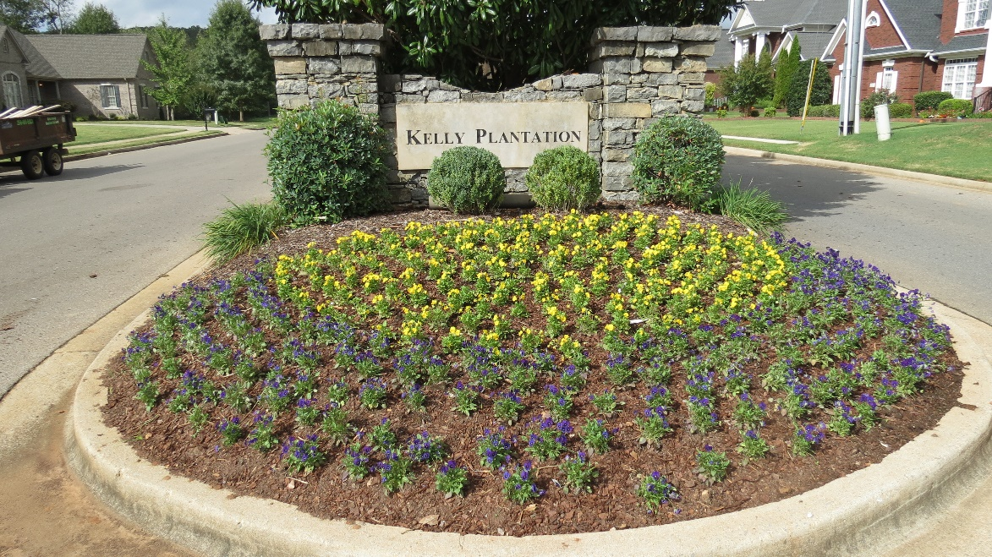
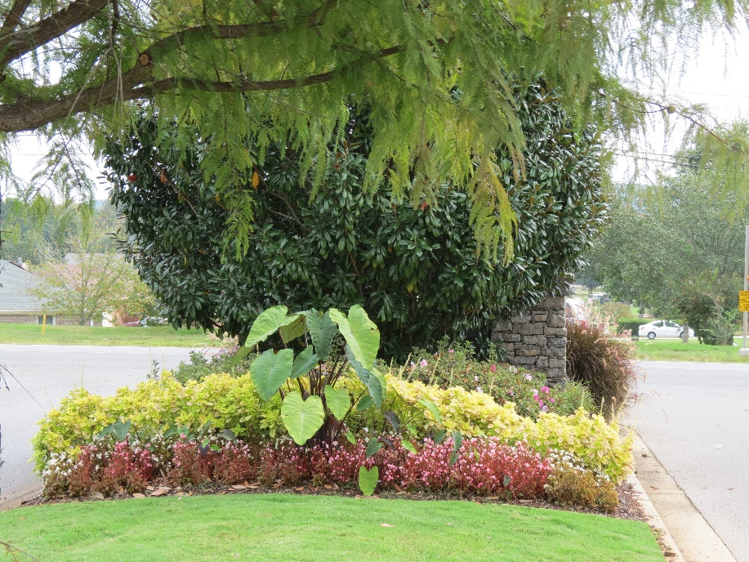
Grounds Report
  Grounds
    Area of Coverage
  2017 - 2018 Improvements
  Repairs
  2019 Projects

Slide 12
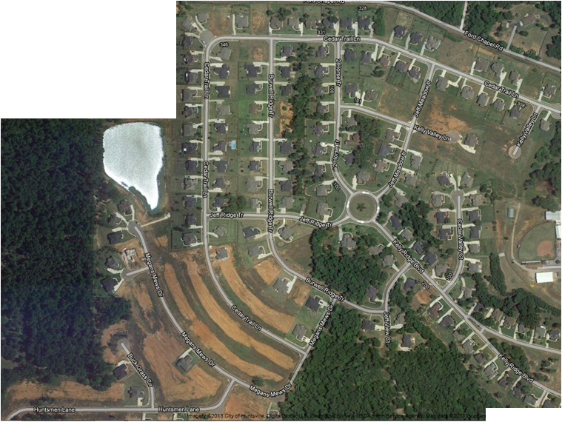
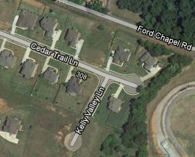
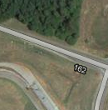
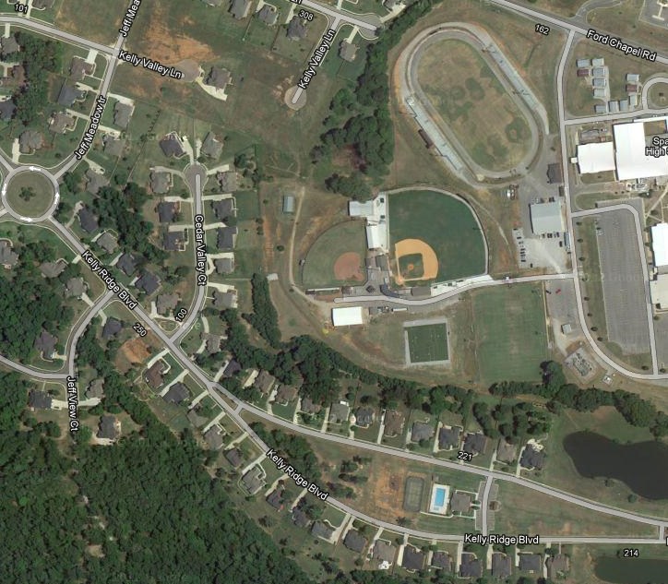
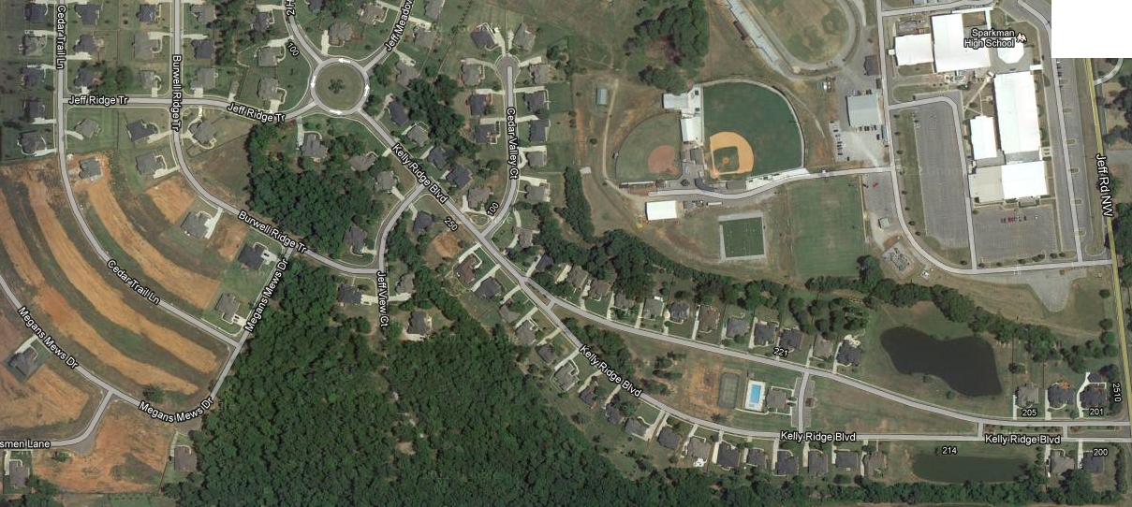

Grounds Report
Lawn Maintenance
  Covers approximately 18 Acres, 3 Ponds, 4 Islands, 1 Round-about
Club
House

Slide 13
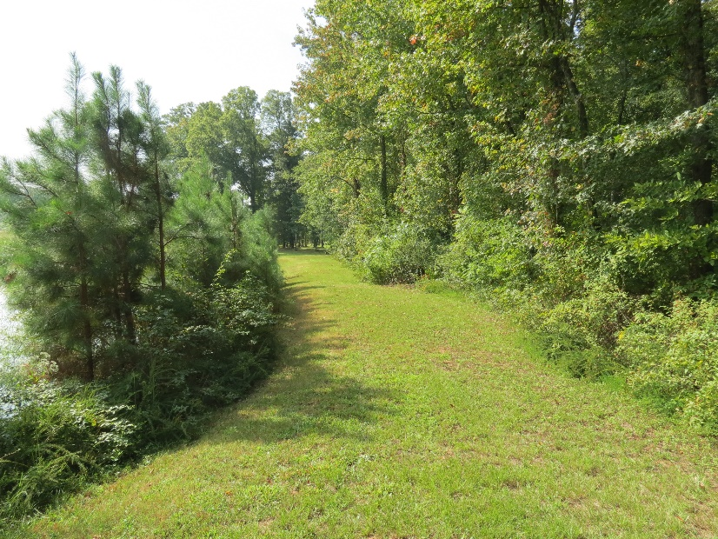
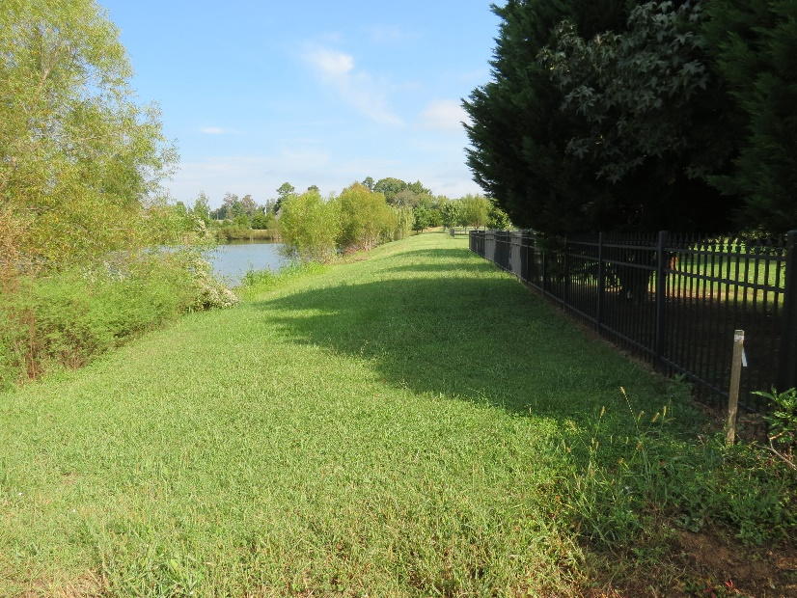
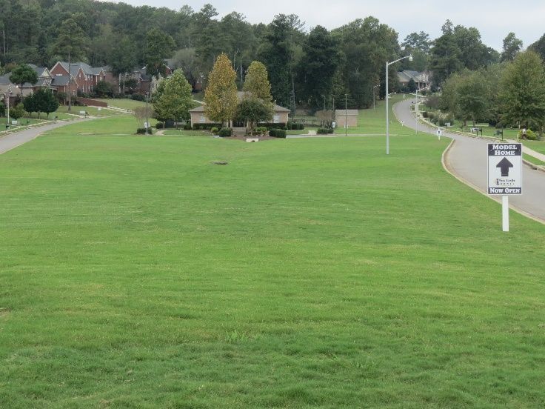
Grounds Report
Grounds Contract
  Lawn Maintenance – Cut & Trim Grass weekly in growing season; edge walks; keep leaves & trash picked up bi-weekly during fall & Winter months
  Prune Shrubs, Provided Spring Mulch Shrub & lawn care, install annual flowers (Spring & Fall) Irrigation adjustments (Spring & Winterize in Fall)
  Back Lake – Cut grass weekly in growing season; bi-weekly clean up in Fall & winter months; bush hog back area up to 5 times/per year (as needed)
  HOA’s Largest Expense/1 Year Extension (30Sept19)

Slide 14
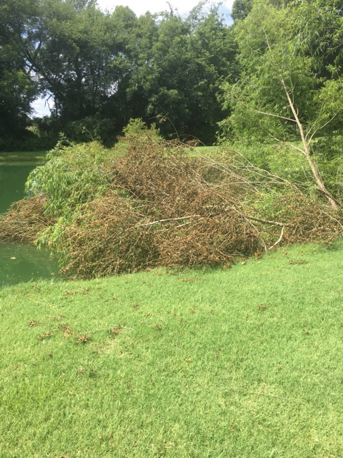
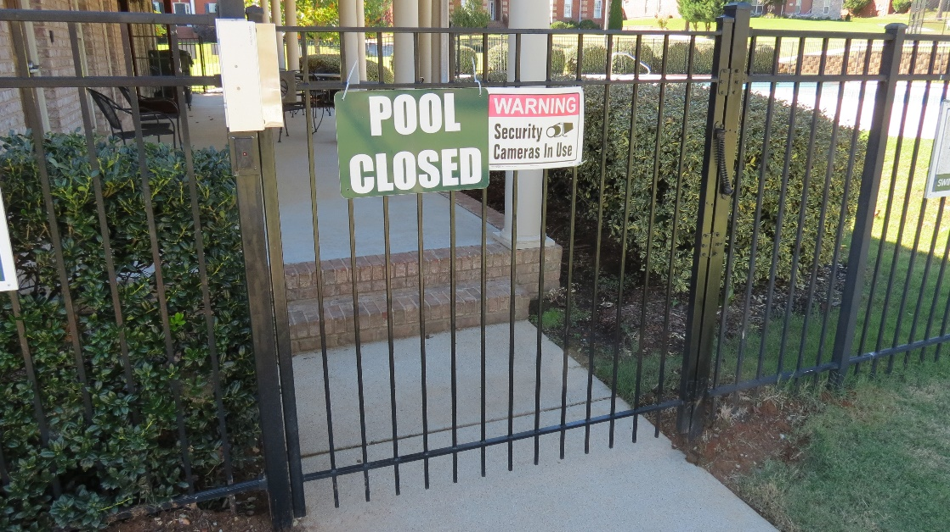
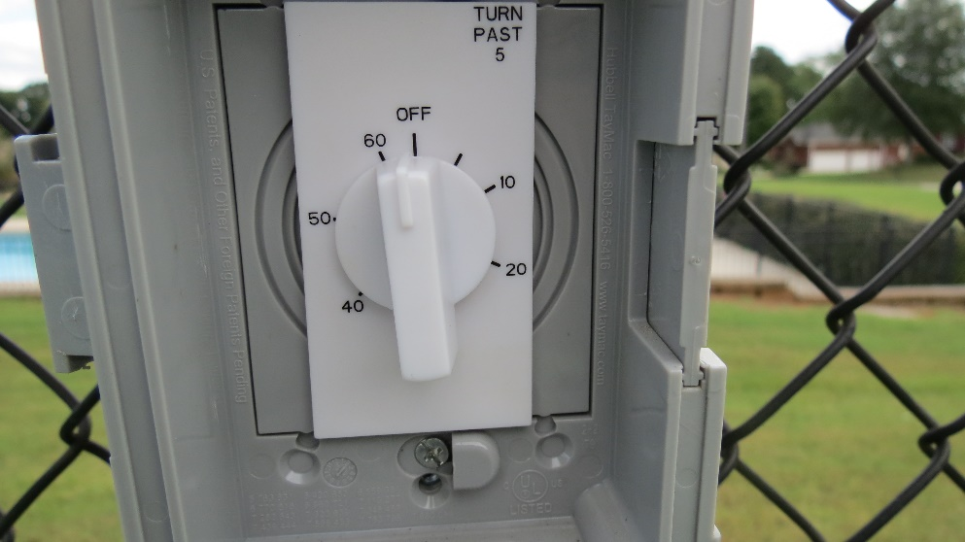
Grounds Report
Repairs:
  Replaced Broken Timer for Tennis Court Lights
  Removed Dead/Fallen Willow Trees at South & North Ponds
  Reinforced North Pool Gate

Slide 15
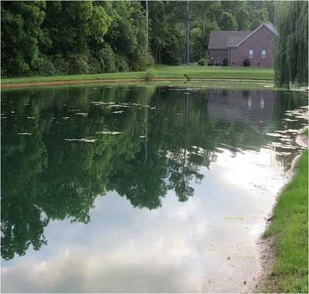
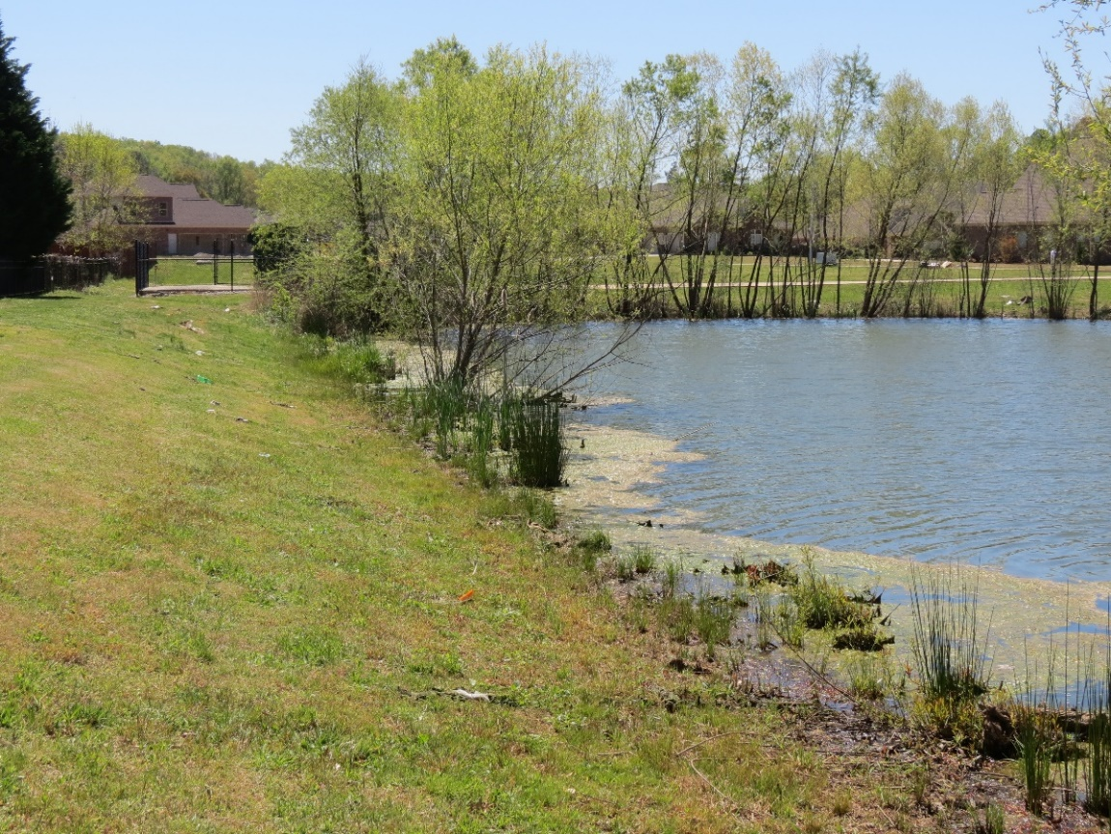
Grounds Report
Routine Maintenance Cont…
  Increase in Algae to Back Pond / Dye Application
  Budgeted for in 2018-2019

Slide 16
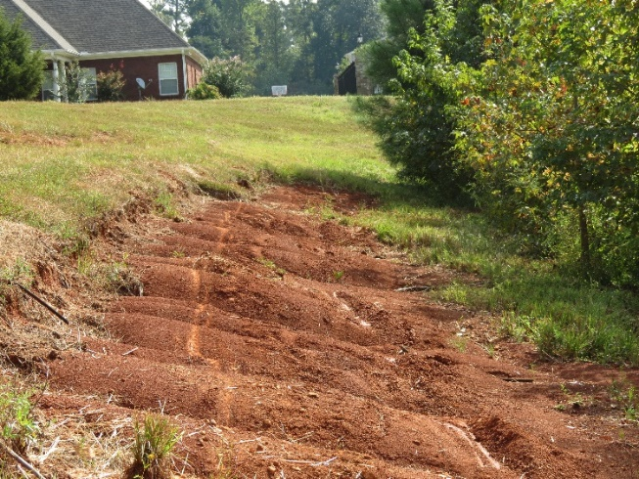
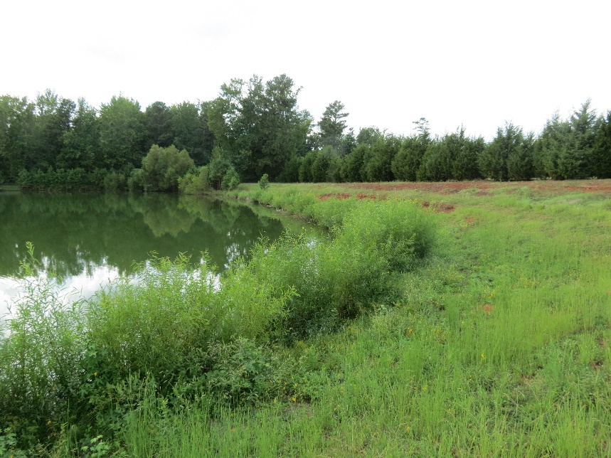
Grounds Report – Project Planning 2019
Back Pond
  Reoccurring Tree Growth/removal
  Erosion Fix
    Sod area

Slide 17
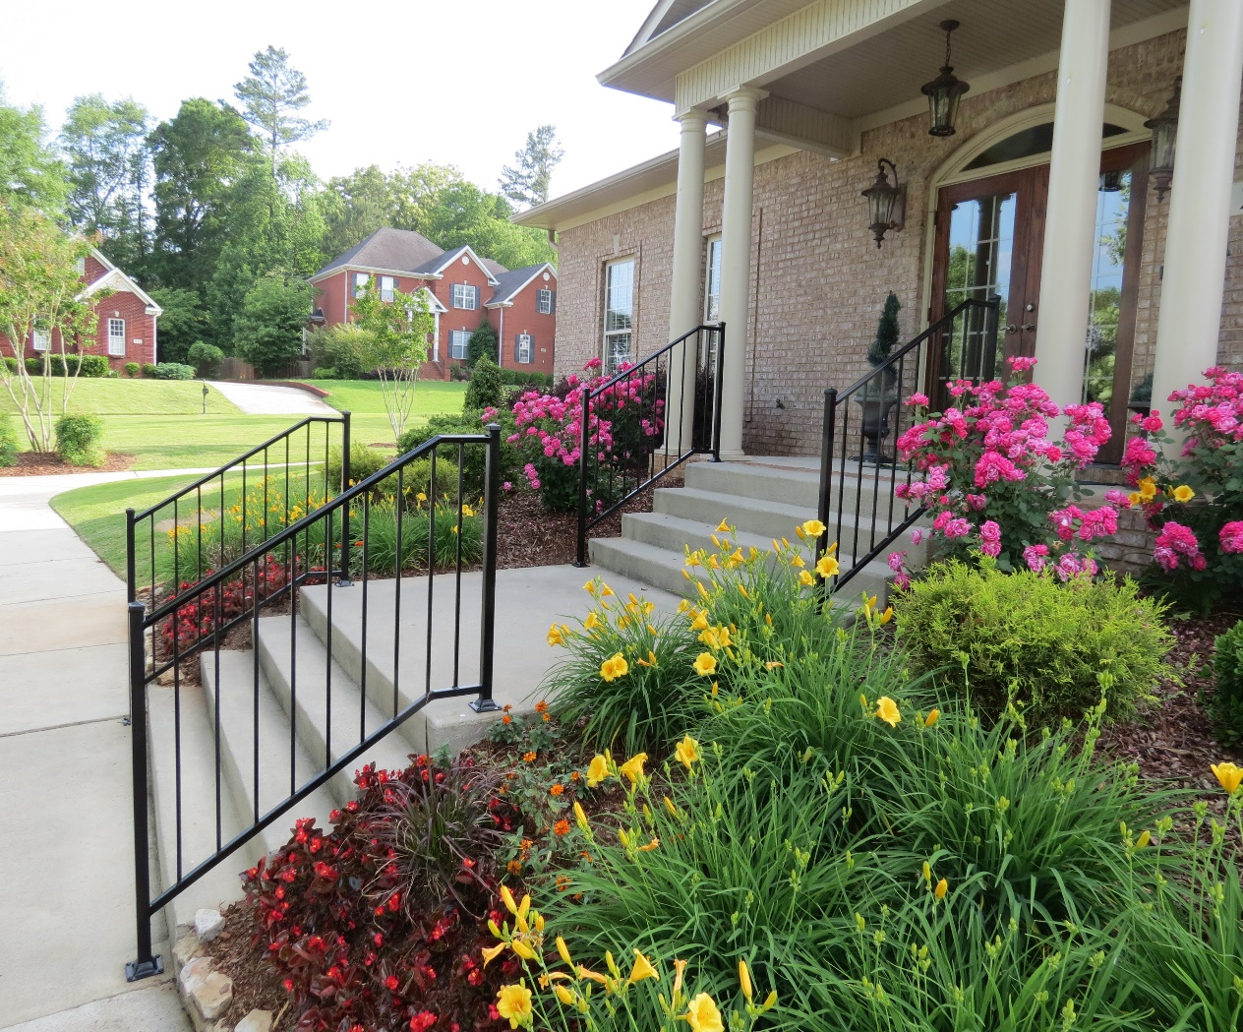
Facilities Report
Improvements/Repairs
Items – “On the Watch”
Maintenance

Slide 18
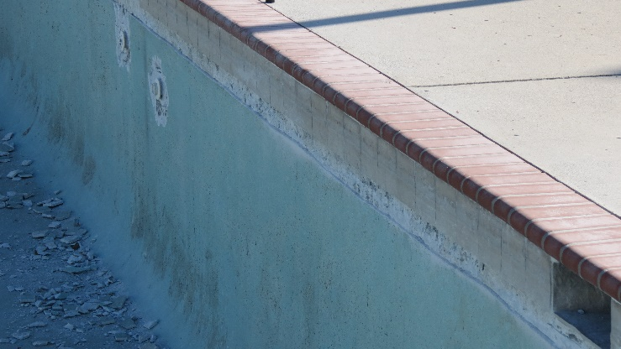
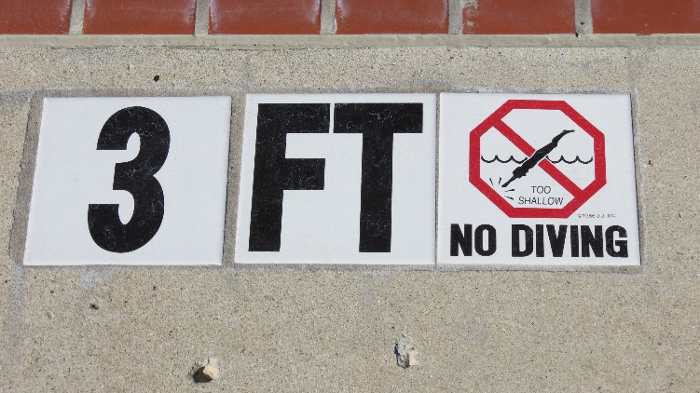
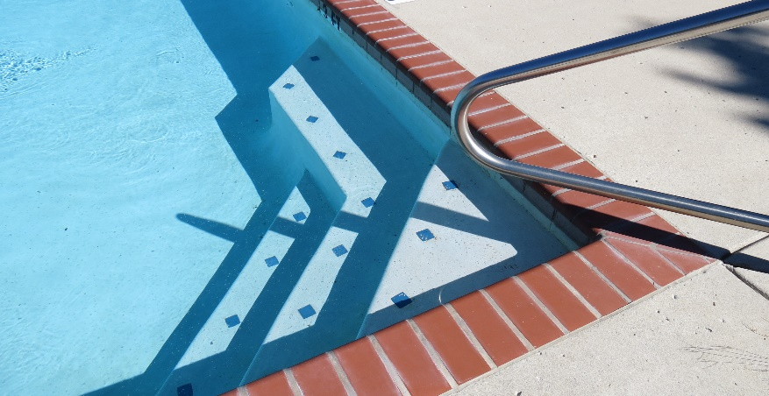
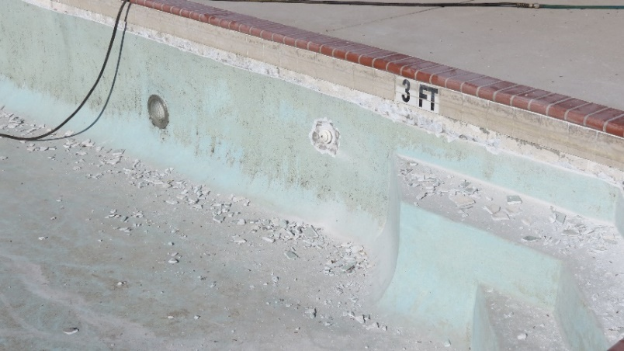
Facilities Report – Improvements/Repairs
POOL:
  Three Contract Bids (Dec 2017)
  Resurfaced the interior (Main & Baby Pool)
  Installed New Coping & Krystalkrete Blue Quartz
  Added New Depth Title & International no-diving
  Replaced Old Lights with LED and Rewired with new transformer
  Pool Service Contract
  Pool Opened on Schedule in May

Slide 19
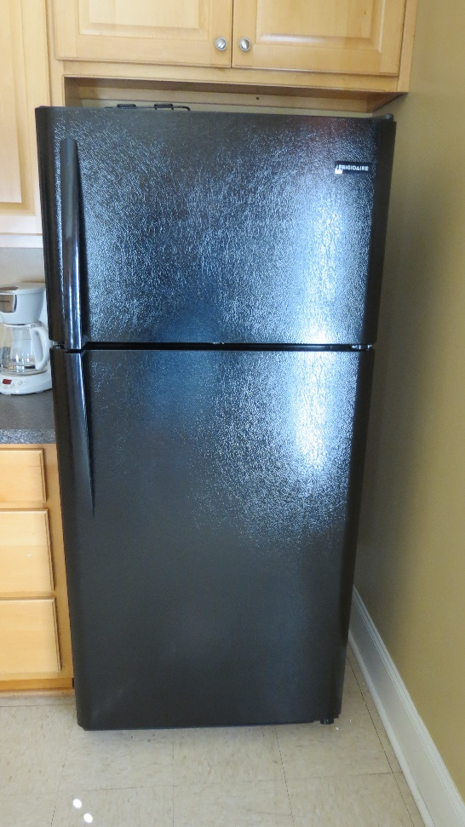
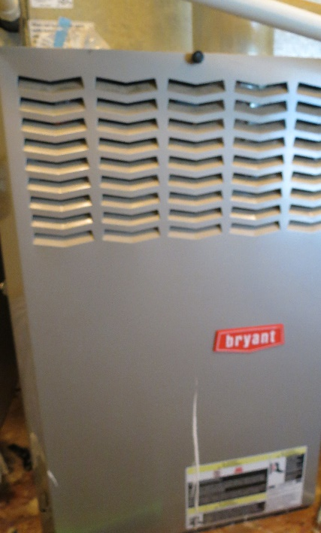
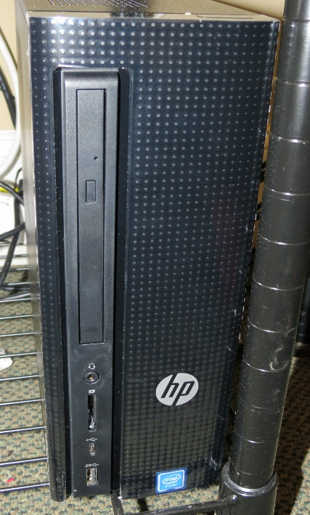
Facilities Report – Improvements/Repairs
CLUBHOUSE:
  Replaced Hard Drive For Access Control System
  Replaced Refrigerator
  Replaced Motor in HVAC

Slide 20
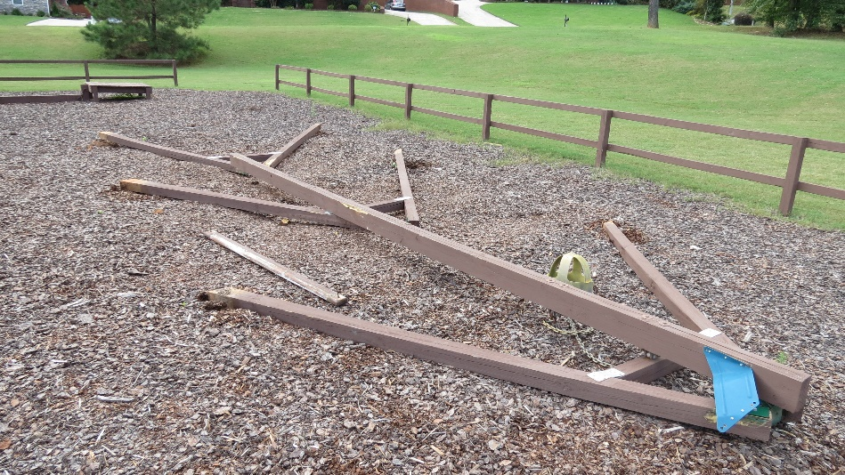
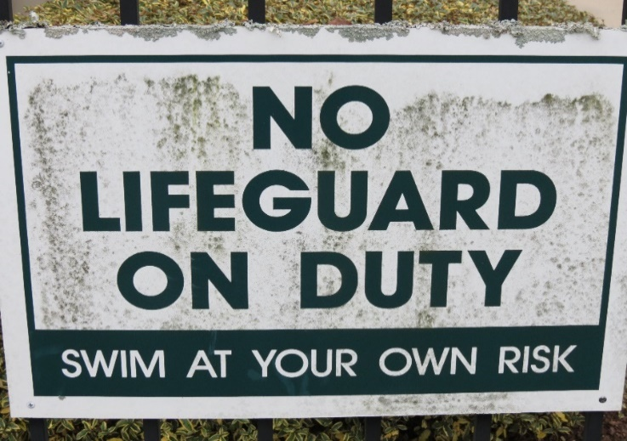
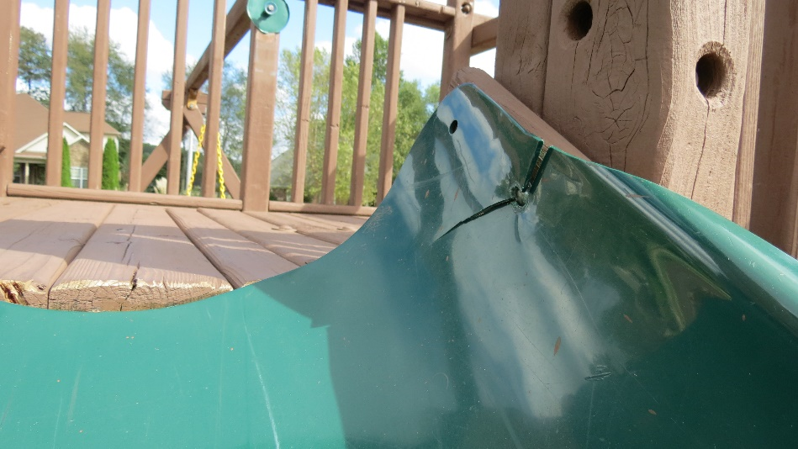
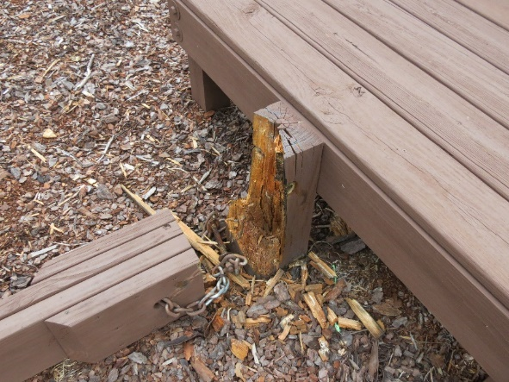
Facilities Report – “Needed Repairs”
Ground Signs
  Aging & Deteriorating
Playground Repairs/Replacement

Slide 21
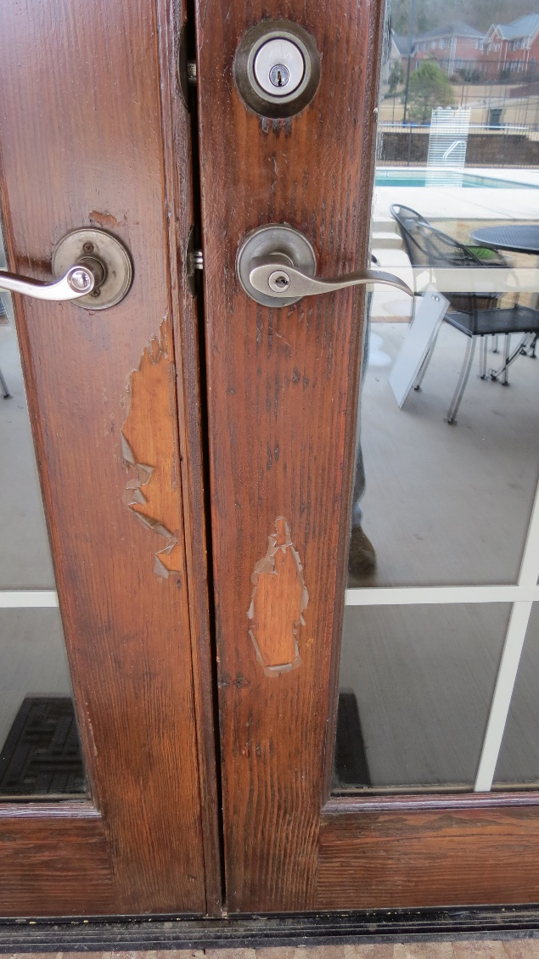
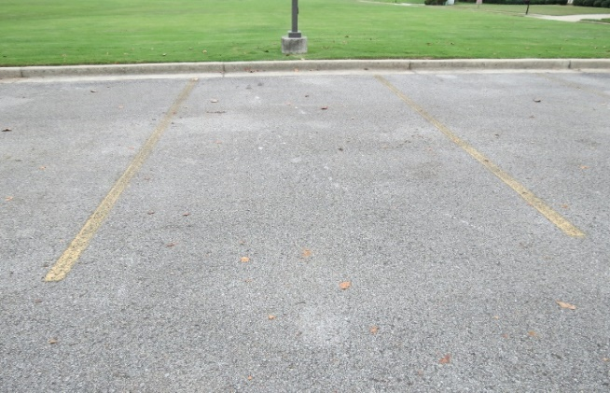
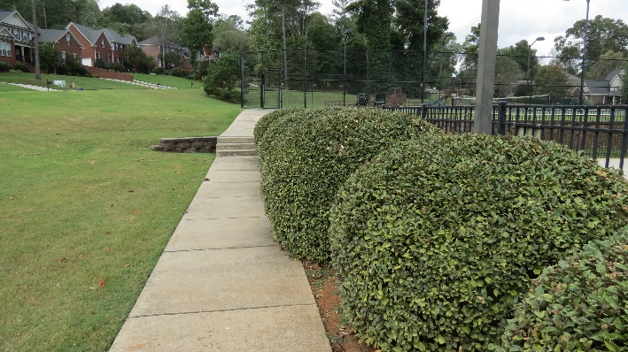
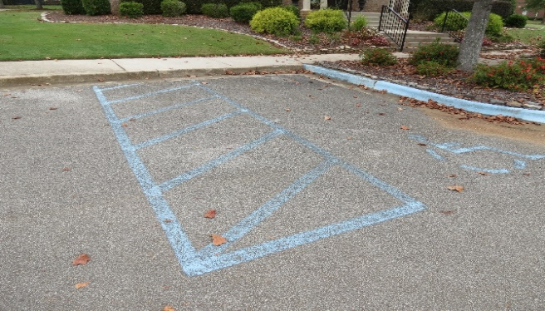
Facilities Report – “Items On the Watch”
Varnish Club House Doors
Paint Fading Parking Lot Stripes
Add Trees around South Pond
Remove or cut back Pool Shrubs
  Estimates being Worked

Slide 22
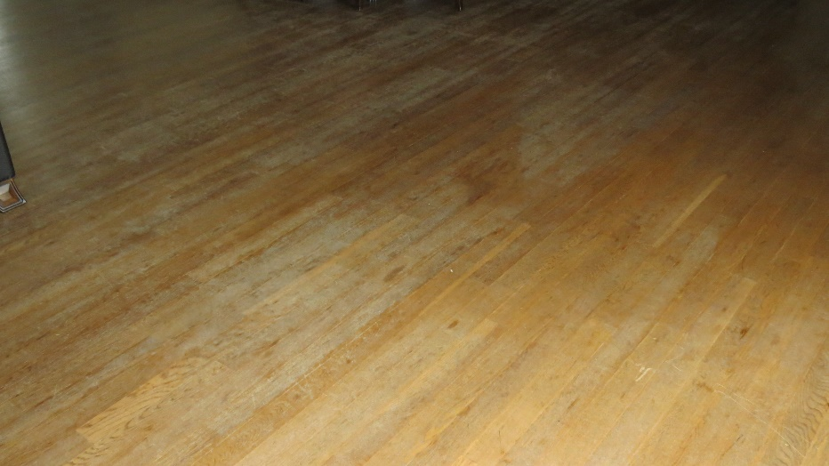
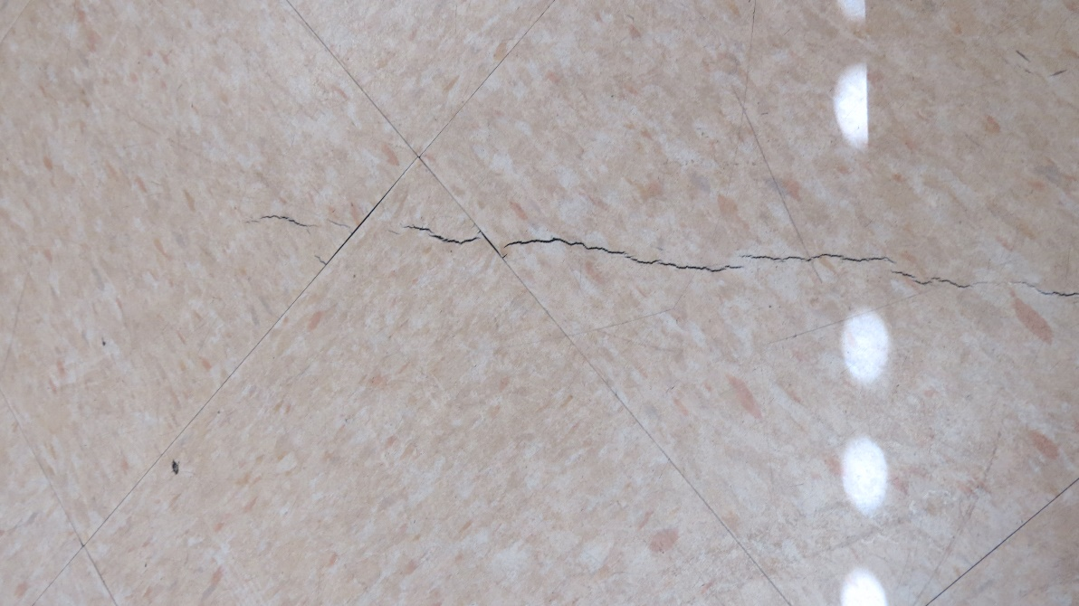
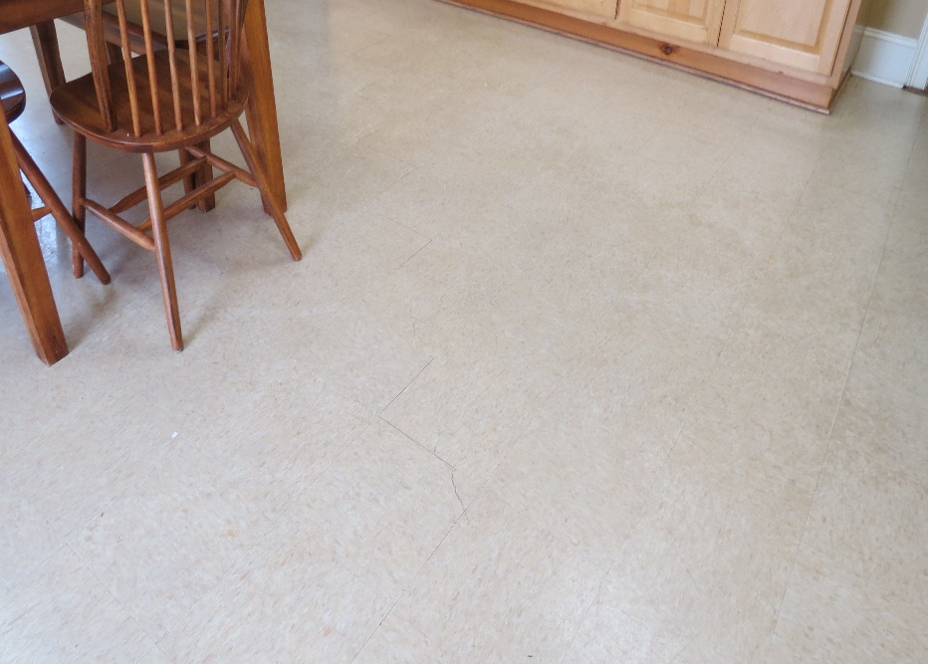
Facilities Report – “Items On the Watch”
Club House Flooring
Shade Replacement
Locks
  Estimates Pending

Slide 23
Facilities Report – “Routine Maintenance”
Winterize Pool Furniture (Completed)
Pool
  Pump shut off in December
Clubhouse
  Install Water Bib Covers (To Do)
  Replace HVAC Filters (To Do)
Winterize All Sprinkler Zones

Slide 24
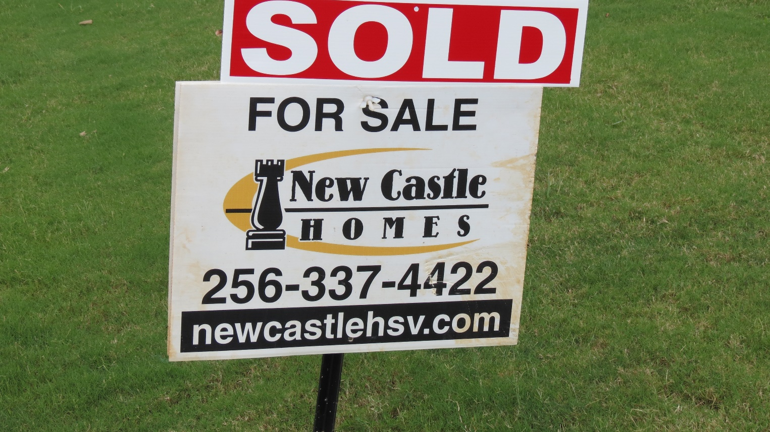
Facilities Report – “ KP Home Resales”
1 Oct 2017 - Present
35 Homes Sold! (17 New Builds - 18 Resales)
  Added Work to Secretary/Covenants/Treasurer/ACS

Slide 25
Covenants Enforcement Committee (CEC) Report
Covenants enforcement is now being handled by Kelly Plantation homeowner volunteers.
  Continued focus:
    Yard maintenance (weeds, mowing, edging, etc.)
    Fences (repairs and staining)
    Covenant infractions (parking, trailers in driveways, etc.)
Place lawn debris/bulk items on the curb on designated weekend only. Designated week for Kelly Plantation bulk pick up is the 2nd Monday of each month
  November 13th (Monday is a holiday)
  December 10th
Positive Communications is the key to Success!

Slide 26
Architectural Committee (ARC) Report
Architectural Committee Members
  Jon Yobs (Chair)
  Kory Torgersen
  Natasha Baldwin
  Chris Miller
Thus Far – 29 Requests through the ARC
  Mostly landscaping and fences
  2 New Home constructions
  28 approved, 1 rejected
  THANK YOU for submitting your requests!!

Slide 27
Architectural Review Process
What requires approval?
  Exterior construction or modification, decks, fences, driveways, landscaping, addition/removal of large trees, and many others. Consult the "Declaration of Protective Covenants" document on the website.
BEFORE starting projects or signing contracts, contact us.
Download the form from kellyplantationhoa.net (under “More”)
Complete and email to architecturalapproval@kellyplantationhoa.net
  Include supporting diagrams, illustrations, other supplemental information.
If your request is within Covenant guidelines and you provide appropriate supporting info, you will be approved!
If your request is outside the Covenants or in a gray area, we will try to work with you to establish a suitable alternative.
  Site visit may be necessary.
  Many projects/improvements went unchecked in the past and resulted in non-compliant situations. Those aren’t a precedent for future decisions.
  Nothing personal, we are trying to maintain a consistent look and feel to our neighborhood.
We are people too, and also neighbors! Thanks for your patience as we are a volunteer committee.

Slide 28

Your Neighborhood Watch Program
Introductions
  Neighborhood Watch Chair Duties
  Know Your Block and Block Captain
Tools and Information
  Kelly Plantation Web-Site
  Internet Tools
Activities
  Regular Foot and Vehicle Patrols
  Increased Video Security - Ring
  Classes by the Sheriffs Dept
Your Neighborhood Watch Program was created by the residents of the Kelly Plantation Neighborhood and serves as a sub-committee to the Kelly Plantation Homeowners Association. The purpose of the Kelly Plantation Neighborhood Watch Program is to obtain community involvement and build partnerships in preventing residential crime and improving neighborhood safety, to educate and distribute relevant safety and crime prevention information, and to promote good citizen-law enforcement relations and community pride.

Slide 29
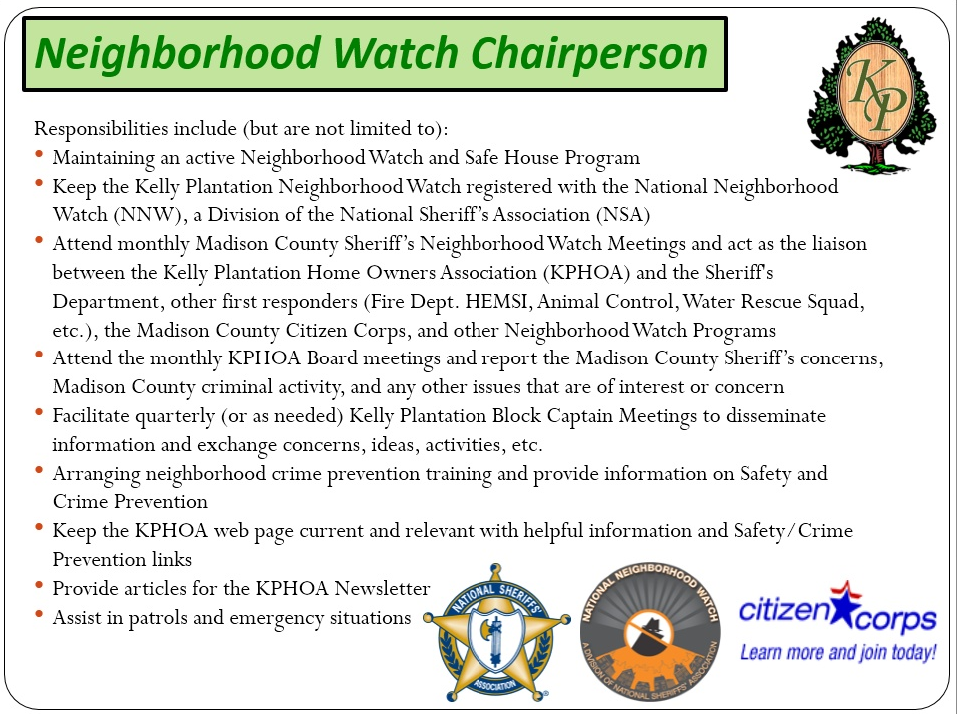

Slide 30


Introductions
Rachel Bolyard, Neighborhood Watch
Know Your Blocks
Safe House
D
C
B
Cutwater
Court
Club
House
E
A

Slide 31
Introductions
Know Your Block Captains
Block
Captain
A
Volunteer Needed!
Block
Captain
B
Sue Bish, B
Block
Captain
C
Chris Miller, C
Block
Captain
D
Melinda Dellert, D
Block
Captain
E
John Williamson, E

Slide 32
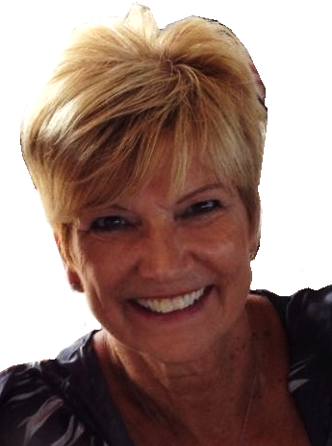
Introductions
Know Your “Safe House” Program
Coming Soon!
Sue Bish
(256) 922-1636
Purpose of Safe House:
To provide a temporary safe haven and assistance to children who are lost, frightened, feel threatened, who have just witnessed a crime, or involved in any other emergency situation.
Safe House participants are concerned adults who have volunteered to be available for the protection and assistance of children in need. Participation in the Safe House program is not restricted to the parents of school age children, but is open to any adult who is concerned about the safety of children.

Slide 33
Things We’ve Accomplished
Re-established communications with the Madison County Sheriff, and are once again acknowledged to have an active community watch program
New volunteers for Block captains and patrols
  Foot patrols
  Vehicle patrols
Watch met just prior to school opening to discuss increased vigilance and activity to suppress mischief
Increased visibility – we have vehicle placards and will hopefully soon also have safety vests. Visibility is our primary deterrent

Slide 34
Things to Keep Your Household Safe
Get a dog. Dogs are difficult to defeat and generally make criminals consider a different residence. Even a small dog barking is enough to alert the homeowner of potential trouble. Your neighbors can hear the dog too, alerting them as well.
Vary your routine. If a criminal is interested in your belongings, they may surveil your activities. If you leave your house every day at 8am, they’ll observe this, and plan accordingly. However, if you leave a half an hour early or late, it messes up their plans.
Have an alarm installed. Although alarm systems aren’t the deterrent they once were, they’re still quite effective when combined with other measures.
Install cameras. A camera covering the entrance(s) to your home will offer a deterrent to malcontents. There are many DIY camera systems available that don’t require much knowledge to install. Every major store in the area, Home Depot, Lowe’s, Best Buy and more all display prominently these systems. They’ll send alerts to your phone, turn on lights, and can be integrated into home management systems.
Talk to your neighbors. This sounds obvious, but sometimes we live in isolation. Introduce yourselves, and say hello. Folks who know one another tend to take better care of one another.

Slide 35
Things to Keep Your Household Safe
Have your mail collected. If you’re leaving on vacation, have someone pick up your mail, or stop delivery until you return. A full mailbox, or papers laying on the driveway signal others that you’re not home.
Keep an eye open. If you notice a strange car parked somewhere you’ve not seen it before, make a mental note, or even better, snap a photo. If something happens, you’ve got a tip that may be useful to the sheriff. If you see strange chalk marks, or other markings, report it to the non emergency number at the sheriff’s office. Many times, criminals will use marks on the sidewalk or curb to signal potential targets. Keep in mind that utility companies mark lines too so try not to waste the sheriff’s time.
Install fencing. If you live up along one of the main roads, or the fields, having a fence forces a criminal to negotiate the obstacle.
Leave your blinds -open-. This one sounds counter intuitive, but if your blinds are closed when you’re not home, no one can observe what’s happening inside.

Slide 36
Event Committee Report
Completed 2018 Events:
  Easter Egg Hunt – March 18th
  Spring Yard Sale – April 7th
  Pool Opening Celebration – June 2nd
  Fall Yard Sale – September 29th
  Bonfire Bash – October 20th
Upcoming 2018 Events:
  Canned Food Drive – November 3rd
  Clubhouse Christmas Decorating – November 3rd
  Breakfast with Santa – December 8th

Slide 37
Event Committee Report
KP HOA Event Committee runs on the Calendar Year from January – December
Volunteers for event ideas, date setting, planning & event support are needed and ALWAYS welcome
Event Committee Planning 2019:
  January 2019 – EC Yearly Kick-Off Budgeting & Planning Meeting
    Spring Event
    Spring Yard Sale
    Summer Event #1
    Summer Event #2
    Fall Yard Sale
    Fall Event
    Canned Food Drive
    Clubhouse Christmas Decorating
    Winter Event
Please Come Join Us for Fun & More!!!!

Slide 38
Closing Remarks
Questions?

