Slide 1

Kelly Plantation
Homeowners Association
Annual Meeting
October 24th, 2019
6:00 pm

Slide 2
Agenda
Introductions
Year-in Review
Open Board Positions
KP - Information
Financial Report
Grounds/Facilities Report
Covenants Committee Report
Architectural Committee Report
Neighborhood Watch Report
Event Committee Report
Questions & Answers

Slide 3
Introductions
Board Members
  President – Todd Watts
  Treasurer – Irene Bussey
  Secretary – Tracie McEnery
  VP Grounds/Facilities – Mike Bish
  VP Electronic Security – Gina Bradley
Non-Board Members
  Neighborhood Watch Chair –Rachel Bolyard
  Event Committee Chair – Dawn Irons
  Architectural Review Committee Chair – Jon Yobs
  Covenants Committee Chair – Sue Bish
  Clubhouse Trustee – Tracie McEnery

Slide 4
Year-in Review
Opening Remarks/Welcome New Residents
Open Board and Committee Positions
Special Assessment/Dues

Slide 5
Open Positions
Board Positions:
  Three positions currently open
  Introduce volunteers
Committee Positions:
  Neighborhood Watch Block Captains
  Covenant Committee Chairperson and Members
  Event Committee Members
  Clubhouse Trustee

Slide 6
Kelly Plantation - Information
Emails
  Email links for the Board and all Committees are located on the KP Webpage
  Some of the emails asked for most often:
    hoaboard@kellyplantationhoa.net
    covenants@kellyplantationhoa.net
    Architecturalapproval@kellyplantationhoa.net
    Secretary@kellyplantationhoa.net
    clubhousereservations@kellyplantationhoa.net
    neighborhoodwatch@kellyplantationhoa.net
Facebook
  Search for Kelly Plantation HOA, Harvest, AL
  https://www.facebook.com/groups/111454125545380/
Webpage
  www.kellyplantationhoa.net
Other forms of Communication
  All KPHOA Board Meeting Minutes – emailed to KP Distribution and posted to KP Webpage
  Quarterly Financial Statements – posted to KP Webpage

Slide 7
Financial Report
Statement of Financial Activities
  October 1, 2018 – September 30, 2019
Balance Sheet
  As of September 30, 2019
Projected Budget
  October 1, 2019 – September 30, 2020

Slide 8
2018-2019 Financial Review
Revenues: |  | Budgeted |  | Actual |  | Variance
Check Book Balance |  | 2,337.00 |  | 2,904 |  | 567
KPHOA Dues + Special Assessment |  | 99,840.00 |  | 102,119 |  | 2,279
Real Estate Closings (New Homes) |  | 0.00 |  | 1,564 |  | 1,564
Clubhouse Rentals |  | 2,400.00 |  | 2,925 |  | 525
Late Fees and Fines |  | 175.00 |  | 1,245 |  | 1,070
Bank Dividends |  | 100.00 |  | 1,123 |  | 1,023
Misc Income: Access Control Key Cards |  | 750.00 |  | 140 |  | (610)
Reserve Accounts |  | 25,450.00 |  | 54,312 |  | 28,862
Total Revenues |  | 131,052.00 |  | 166,332 |  | 35,280
Expenditures:
Capital Improvements |  | 40,108 |  | 9,347 |  | 30,761
Clubhouse Maintenance |  | 4,500 |  | 739 |  | 3,761
Common Asset Repair/Replace |  | 2,000 |  | 4,245 |  | (2,245)
Contingency Reserve |  | 5,444 |  | - |  | 5,444
Harvest-Monrovia Water Authority |  | 5,000 |  | 3,586 |  | 1,414
Huntsville Utilities |  | 6,000 |  | 6,989 |  | (989)
Insurance |  | 6,200 |  | 5,639 |  | 561
Internet/Website |  | 1,100 |  | 1,209 |  | (109)
Lawn /Common Area Maintenance |  | 43,000 |  | 33,795 |  | 9,205
Legal Fees |  | 1,500 |  | - |  | 1,500
Miscellaneous/Office Supplies |  | 1,200 |  | 794 |  | 406
Pool Service/Supplies |  | 10,000 |  | 8,050 |  | 1,950
Property Tax |  | 2,200 |  | 2,121 |  | 79
Security Patrols |  | 1,000 |  | 1,020 |  | (20)
Social Committee |  | 1,500 |  | 1,500 |  | 0
Tax Preparation |  | 300 |  | 400 |  | (100)
Total Expenditures |  | 131,052.00 |  | 79,434.00 |  | 51,618

Slide 9
2018-2019 Balance Sheet
Assets
 |  | Current Assets
 |  | Checking |  | $ 5,468.77
 |  | Savings |  | $ 830.72
 |  | Money Market |  | $ 53,481.14
 |  | Events Committee |  | $ 1,020.74
 |  | Fixed Assets
 |  | 221 Kelly Ridge Blvd: Clubhouse and Swimming Pool |  | $ 296,300.00
 |  | Back Pond 5.88 Acres |  | $ 33,000.00
 |  | Uncollectible Accounts
 |  | Due from Homeowners |  | ($11,171.50)
Total Assets |  |  |  | $ 378,929.87
Liabilities |  |  |  | $ -
Total Liabilities & Net Assets |  |  |  | $ 378,929.87

Slide 10
2019-2020 Projected Budget
Estimated Revenues:
Checkbook Balance | 2,904
KPHOA Annual Dues | 108,480
Real Estate Closing (New Homes) | 1,500
Clubhouse Rentals | 2,925
Late Fees and Fines | 1,245
Bank Dividends | 1,000
Access Control Key Cards | 200
Reserve Accounts | 54,312
Total Estimated Revenues | 172,566
Proposed Expenditures:
Capital Improvements | 40,167
Clubhouse Maintenance | 1,500
Common Asset Repair/Replace | 5,355
Contingency Reserve | 50,444
Harvest-Monrovia Water Authority | 5,000
Huntsville Utilities | 8,000
Insurance | 6,200
Internet/Website | 1,300
Lawn /Common Area Maintenance | 37,000
Legal Fees | 1,500
Miscellaneous/Office Supplies | 800
Pool Service/Supplies | 10,000
Property Tax | 2,200
Security Patrols | 1,200
Social Committee | 1,500
Tax Preparation | 400
Total Proposed Expenditures: | 172,566
Note (1) | A capital improvement is the addition of a permanent structural change or the restoration of some aspect of a property that will either enhance the property's overall value, increase its useful life or adapt it to new uses.

Slide 11
Grounds/Facilities Report
  Lawn Maintenance
  2018 - 2019 Improvements
  2018 - 2019 Repairs
  2020 Projects

Slide 12
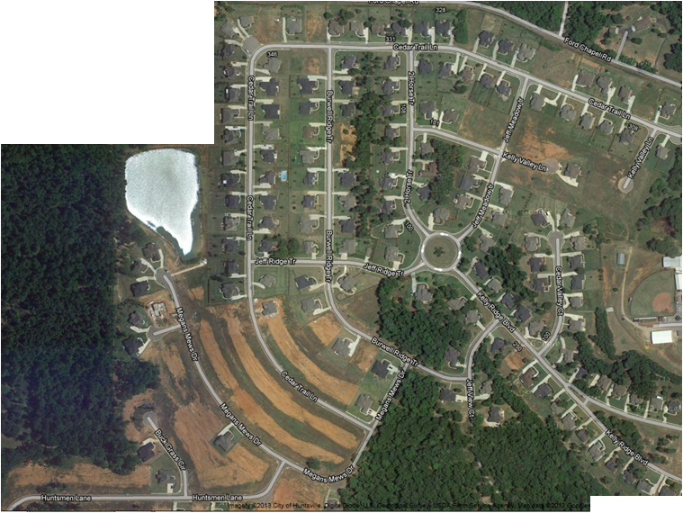
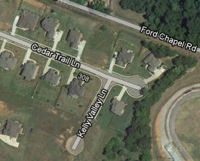
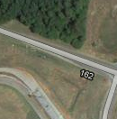
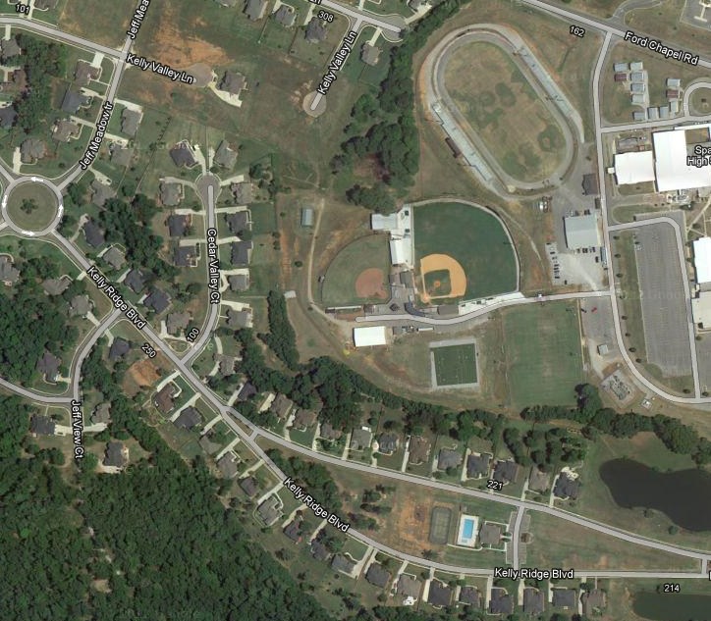
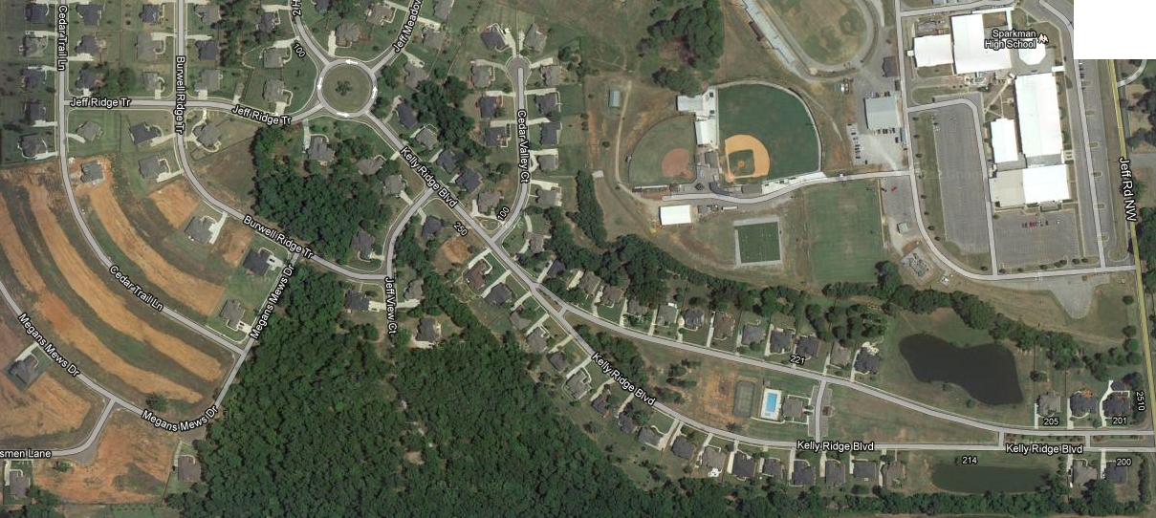

Grounds/Facilities Report
Lawn Maintenance
  Covers approximately 18 Acres, 3 Ponds, 4 Islands, 1 Round-about
Club
House

Slide 13
Grounds/Facilities Report
Grounds Contract
  Lawn Maintenance – Cut & Trim Grass weekly in growing season; edge walks; keep leaves & trash picked up bi-weekly during Fall & Winter months
  Prune Shrubs, Provided Spring Mulch Shrub & lawn care, install annual flowers (Spring & Fall) Irrigation adjustments (Spring & Winterize in Fall)
  Back Lake – Cut grass weekly in growing season; bi-weekly clean up in Fall & winter months; bush hog back area up to 5 times/per year (as needed)
  HOA’s Largest Expense
  New Contract awarded October 1st to Epp Lawn and Landscaping

Slide 14
Grounds/Facilities Report
Improvements:
  New Contract awarded to America Swimming Pool (ASP).
  New Contract awarded for cleaning of clubhouse and restrooms.
  Refinished wood floors at the clubhouse.
  Installation of five Motion Detection Lights on Clubhouse and pool.
  Playground – New Swing, Jungle Gym Repaired, and New Picnic Table.
  Five new rugs, Credenza and Kitchen Chairs purchased and installed at the Clubhouse.
  Two new trees planted in the front north pond.
  Storage racks installed in Pool Pump House for all pool furniture.
  All Locks replaced and rekeyed at clubhouse. Installed new locks on pool pump house.
  Purchased New Sidewalk sign to announce community events.

Slide 15
Grounds/Facilities Report
Repairs and Routine Maintenance:
  Replacement of Pool Pump on main pool with a Variable Speed Pump.
  Repair multiple leaks in Main Pool.
  Repair Drain on Baby Pool.
  Roof Repair, Gutters Cleaned, Gates and Fans repaired at Clubhouse.
  Sprinkler system repaired.
  Center Island Tree and Branch removal and cleanup.
  Installation of No Parking signs on North and South pond areas.
  Parking lot striping.
  Repaired light switch, net supports and installed new trash can in tennis court.

Slide 16
Grounds/Facilities Report
Upcoming Projects:
  Saltwater conversion for Main Pool.
  Update and replace the camera security system for the clubhouse/pool.
  Replacement of Kitchen floor and carpet in Sitting Room.
  Furniture Replacement (Couch, Loveseat and chair) that are broken.
  Pool Furniture replacement (6 chairs and 2 recliners) (Stolen).
  Parking lot repair and sealed.
  Pond fountain on North pond needs replaced.
  Installation of 2 concrete pads and benches in back pond.
  Repair, stain and seal all outside doors to the clubhouse.
  Paint the interior of the clubhouse.
  Install upper storage racks for the utility room in clubhouse.
  Replace the outdoor fans and light fixtures in the covered veranda.
  Stock back pond with multiple variety of fish in Spring.

Slide 17
Covenants Enforcement Committee (CEC) Report
Covenants enforcement is currently being handled by Kelly Plantation homeowner volunteers.
Covenants Committee in need of new Chairperson and volunteers
  Continued focus:
    Yard maintenance (weeds, mowing, edging, etc.)
    Fences (repairs and staining)
    Covenant infractions (parking, trailers in driveways, etc.)
Place lawn debris/bulk items on the curb on designated weekend only. Designated week for Kelly Plantation bulk pick up is the 2nd Monday of each month
Positive Communications is the key to Success!

Slide 18
Architectural Committee (ARC) Report
Architectural Committee Members
  Jon Yobs (Chair)
  Kory Torgersen
  Natasha Baldwin
  Chris Miller
  YOU! We can always use volunteers
Since Oct 2018: 23 Requests through the ARC
  Mostly landscaping and fences
  2 New Home constructions
  Most are approved, many only requiring quick clarifications
  THANK YOU for submitting your requests!!

Slide 19
Architectural Review Process
What requires approval?
  Exterior construction or modification, decks, fences, driveways, landscaping, addition/removal of large trees, and many others. Consult the "Declaration of Protective Covenants" document on the website.
BEFORE starting projects or signing contracts, contact us.
Download the form from kellyplantationhoa.net (under “More”)
Complete and email to architecturalapproval@kellyplantationhoa.net
  Include supporting diagrams, illustrations, other supplemental information.
If your request is within Covenant guidelines and you provide appropriate supporting info, you will be approved!
If your request is outside the Covenants or in a gray area, we will try to work with you to establish a suitable alternative.
  Site visit may be necessary.
  Many projects/improvements went unchecked in the past and resulted in non-compliant situations. Those aren’t a precedent for future decisions.
  Nothing personal, we are trying to maintain a consistent look and feel to our neighborhood.
We are people too, and also neighbors! Thanks for your patience as we are a volunteer committee.

Slide 20

Your Neighborhood Watch Program
Introductions
  Neighborhood Watch Chair Duties
  Know Your Block and Block Captain
Tools and Information
  Kelly Plantation Web-Site
  Internet Tools
Activities
  Regular Foot and Vehicle Patrols
  Increased Video Security - Ring
  Classes by the Sheriffs Dept
Your Neighborhood Watch Program was created by the residents of the Kelly Plantation Neighborhood and serves as a sub-committee to the Kelly Plantation Homeowners Association. The purpose of the Kelly Plantation Neighborhood Watch Program is to obtain community involvement and build partnerships in preventing residential crime and improving neighborhood safety, to educate and distribute relevant safety and crime prevention information, and to promote good citizen-law enforcement relations and community pride.

Slide 21
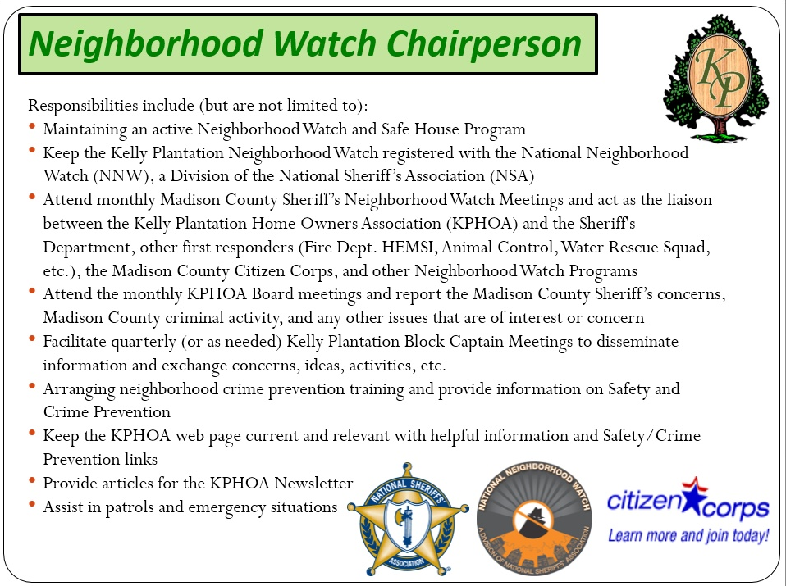

Slide 22


Introductions
Rachel Bolyard, Neighborhood Watch
Know Your Blocks
Safe House
D
C
B
Cutwater
Court
Club
House
E
A

Slide 23
Introductions
Know Your Block Captains
Block
Captain
A
Volunteer Needed!
Block
Captain
B
Sue Bish, B
Block
Captain
C
Chris Miller, C
Block
Captain
D
Melinda Dellert, D
Block
Captain
E
John Williamson, E

Slide 24
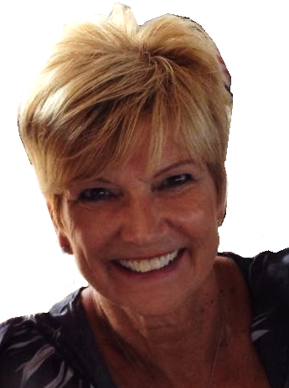
Introductions
Know Your “Safe House” Program
Sue Bish
(256) 922-1636
Purpose of Safe House:
To provide a temporary safe haven and assistance to children who are lost, frightened, feel threatened, who have just witnessed a crime, or involved in any other emergency situation.
Safe House participants are concerned adults who have volunteered to be available for the protection and assistance of children in need. Participation in the Safe House program is not restricted to the parents of school age children, but is open to any adult who is concerned about the safety of children.

Slide 25
Neighborhood Watch - Accomplishments
Continued communications with the Madison County Sheriff, we are acknowledged to have an active community watch program
New volunteers for Block captains and patrols
  Foot patrols
  Vehicle patrols
Watch met just prior to school opening to discuss increased vigilance and activity to suppress mischief
Increased visibility – we have vehicle placards. Visibility is our primary deterrent

Slide 26
Things to Keep Your Household Safe
Close your garage doors - It only takes a moment to become a victim of petty theft.
Lock your car doors - If you keep a car or trailer outdoors, ensure they’re locked up. Thieves look for easy targets.
Get a dog - Dogs are difficult to defeat and generally make criminals consider a different residence. Even a small dog barking is enough to alert the homeowner of potential trouble. Your neighbors can hear the dog too, alerting them as well.
Vary your routine - If a criminal is interested in your belongings, they may surveil your activities. If you leave your house every day at 8am, they’ll observe this, and plan accordingly. However, if you leave a half an hour early or late, it messes up their plans.
Have an alarm installed - Although alarm systems aren’t the deterrent they once were, they’re still quite effective when combined with other measures.

Slide 27
Things to Keep Your Household Safe
Have your mail collected - If you’re leaving on vacation, have someone pick up your mail, or stop delivery until you return. A full mailbox, or papers laying on the driveway signal others that you’re not home.
Install fencing - If you live up along one of the main roads, or the fields, having a fence forces a criminal to negotiate the obstacle.
Install cameras - A camera covering the entrance(s) to your home will offer a deterrent to malcontents. There are many DIY camera systems available that don’t require much knowledge to install. Every major store in the area, Home Depot, Lowe’s, Best Buy and more all display prominently these systems. They’ll send alerts to your phone, turn on lights, and can be integrated into home management systems.
Talk to your neighbors - This sounds obvious, but sometimes we live in isolation. Introduce yourselves, and say hello. Folks who know one another tend to take better care of one another.

Slide 28
Event Committee Report
Completed 2019 Events:
  Spring Yard Sale – April 6th
  4th of July Celebration – June 29th
  Fall Yard Sale – October 5th
  Note: Spring Easter Egg Hunt was cancelled due to weather. Fall Bonfire Bash was cancelled due to location issues.
Upcoming 2019 Events:
  Canned Food Drive – November
  Clubhouse Christmas Decorating – November
  Breakfast with Santa – December

Slide 29
Event Committee Report
KP HOA Event Committee runs on the Calendar Year from January – December
Volunteers for event ideas, date setting, planning & event support are needed and ALWAYS welcome
  If you are interested in planning our 2020 Events, please contact Dawn Irons @ dawnirons75@gmail.com
Event Committee Planning 2020
  January 2020 – EC Yearly Kick-Off Budgeting & Planning Meeting
    Spring Event
    Spring Yard Sale
    Summer Event #1
    Summer Event #2
    Fall Yard Sale
    Fall Event
    Canned Food Drive
    Clubhouse Christmas Decorating
    Winter Event
Please Join Us for Fun & More!!!!

Slide 30
Closing Remarks
Questions?

