Slide 1


Intro to Commercial
Real Estate
Rich Stone, CCIM

Slide 2

Course Goal
This course is designed to:
  Introduce the various commercial property types
  Review some of the similarities and differences between residential and commercial brokerage
  Introduce many of the concepts, terminology and tools employed by commercial agents in their business
  Provide additional resources for those of you who are interested in pursuing a career in commercial real estate

Slide 3

About CID
  The Commercial Investment Division (CID) of the New Orleans Metropolitan Association of REALTORS®, Inc.(NOMAR) is the commercial arm of the association. CID provides its members with opportunities to gain extra professional knowledge in the marketing and management of commercial and investment properties in New Orleans and Louisiana.
  Social networking events to share new listings and "wants and needs," and seminars by qualified specialists providing overviews and updates on relevant topics of interest to members.
  Numerous commercial real estate classes so that members can obtain the required 12 hours of annual CE in commercial topics. Members attend free.
  CID annual dues are $70 for REALTOR® members, $95 for affiliate members.
  CID members must hold current membership as a REALTOR® or Institute Affiliate in any board.
  discount of $60/quarter (from $180 to $120)

Slide 4
Am I allowed to sell/lease commercial real estate?
Louisiana Real Estate Commission
There are no specific limitations on commercial –vs- residential imposed by the LREC when issuing salesperson or broker real estate licenses.
National Association of Realtors
Article 11 of Code of Ethics & Standards of Practice
…REALTORS® shall not undertake to provide specialized professional services concerning a type of property or service that is outside their field of competence unless they engage the assistance of one who is competent on such types of property or service, or unless the facts are fully disclosed to the client. Any persons engaged to provide such assistance shall be so identified to the client and their contribution to the assignment should be set forth. (Amended 1/10)

Slide 5

Discussion Questions
  What is your attraction to transitioning into or exploring commercial real estate as a career?
  What challenges do you anticipate encountering as you proceed into commercial real estate?
  As a residential practitioner, what skills do you feel will easily transfer to commercial real estate?

Slide 6
Key Differences – Commercial Brokerage
  “Commercial” property can be any number of property types – office, retail, industrial, vacant land, multi-family, hospitality, business opportunities, and “hybrid” combinations
  Most long-term commercial practitioners gravitate towards a property specialty rather than a single neighborhood
  Clients include users, investors, buyers, sellers, landlords and tenants
  Some amount investment analysis needed for most transactions
  Pertinent property information is generally more difficult to obtain and interpret – both for available properties and historic sale and lease info

Slide 7
Key Differences – Broker’s Roles
  Business Hours
  Business vs. Personal
      Clients will be less emotional than residential
  Coordination of expanded number of experts typically used
  Transaction Timeline
      30-45 days for residential, months – years for commercial

Slide 8
Key Differences – Broker’s Roles
Due Diligence – Purchase Contracts
  Zoning
  Physical Inspections
  Environmental Issues
  Tax/tax credit investigation
  Traffic, roads, ingress and egress
  Building plans and surveys
  Neighborhood outreach
  Financing
  Permitting
  Costs of Development
  Engineering/Architectural
  Title exam
  Ownership structure
  Pre-marketing

Slide 9
Zoning/Rezoning
  Rules are unique to each municipality including parishes and incorporated cities
  Govern allowed use, building height, set-back, parking, number of units, etc.
  Municipalities use different acronyms for similar zoning classifications
  Land covenants can trump zoning
  Non-conforming uses possible
  https://library.municode.com/
  https://property.nola.gov/
  https://atlas.geoportalmaps.com/jefferson
  http://www.stpgov.org/gis-portal
Additional Resources:

Slide 10
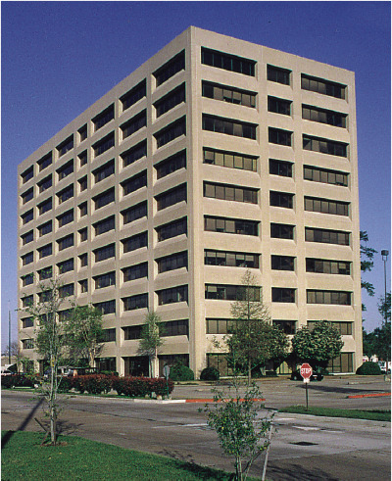
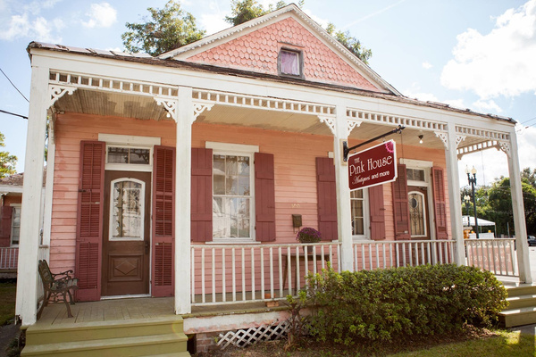
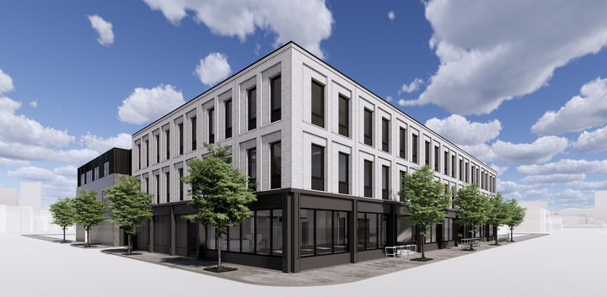

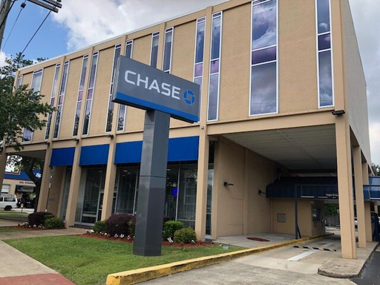
Office
  Converted homes
  Low-rise
  Mid-rise
  High-rise
  Specialty

Slide 11


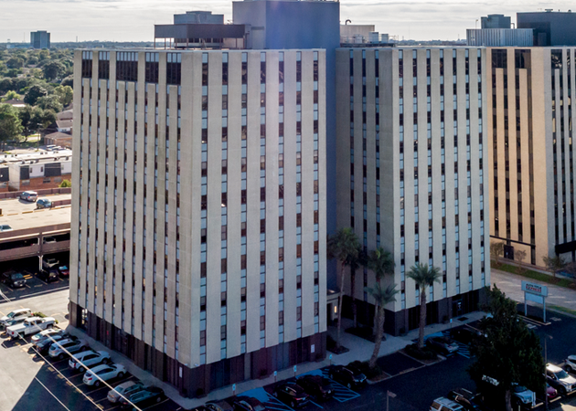
Office Building Class Definitions
Class A
Most prestigious buildings competing for premier office users with rents above average for the area. Buildings have high quality standard finishes, state of the art systems, exceptional accessibility and a definite market presence.
Class B
Buildings competing for a wide range of users with rents in the average range for the area. Building finishes are fair to good for the area. Building finishes are fair to good for the area and systems are adequate, but the building does not compete with Class A at the same price.
Class C
Buildings competing for tenants requiring functional space at rents below the average for the area.
In a normal market, Class A rents are much higher than Class B, which are above Class C. This makes sense because Class A buildings offer higher quality to the tenants and cost more to provide.

Slide 12













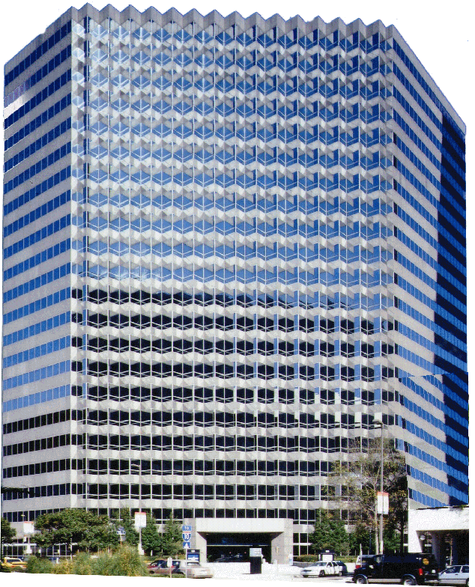

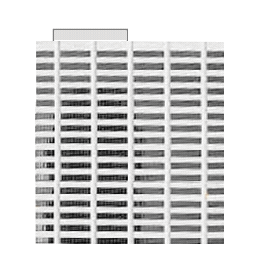

New Orleans Class A Skyline
1972
1979
1980
1983
1984
1985
1989
  Current Class A Inventory: 9,043,318 SF in 15 buildings
  61% completed between 1980 and 1985
  Last addition (now Benson Tower) was back in 1989

Slide 13
Key Factors Considered by Office Users
  Price/Occupancy Cost
  Amenities Nearby (Restaurants, Retail, Daycare)
  Space Size and Configuration
  Incentives–Local, State, National
  Convenience to Other Businesses
  Buy vs. Lease

Slide 14





“Green Buildings” and “LEED”
  The U.S. Green Building Council (USGBC) is a non-profit composed of leaders from every sector of the building industry. Its mission is to transform the way buildings and communities are designed, built and operated, enabling an environmentally and socially responsible, healthy, and prosperous environment that improves the quality of life.
www.usgbc.org
  What is LEED? The LEED (Leadership in Energy and Environmental Design) Green Building Rating System is the national benchmark for high performance green buildings.
  Projects pursuing LEED certification earn points for various green building strategies across several categories based on the number of points achieved, a project earns one of four LEED rating levels: Certified, Silver, Gold or Platinum
Goal is to save energy, water, resources, generate less waste, support human health
Platinum
80+ points earned
Gold
60-79 points earned
Silver
50-59 points earned
Certified
40-49 points earned
LEED is the most widely used green building rating system

Slide 15
Office – Professional Development
The SOCIETY OF INDUSTRIAL AND OFFICE REALTORS® is the leading global professional office and industrial real estate association. With 3,600 members in 45 countries and 722 cities, SIOR represents today's most knowledgeable, experienced, and successful commercial real estate brokerage specialists.
www.sior.com

Slide 16
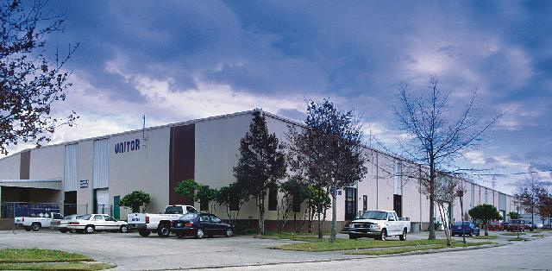
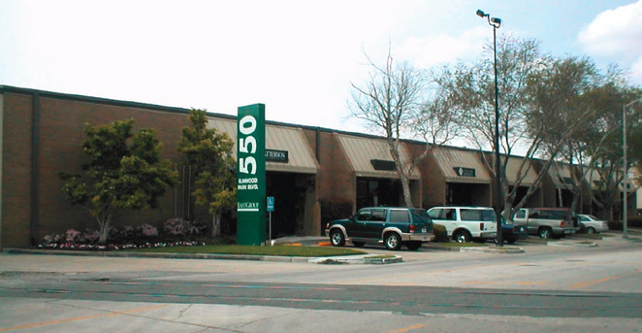

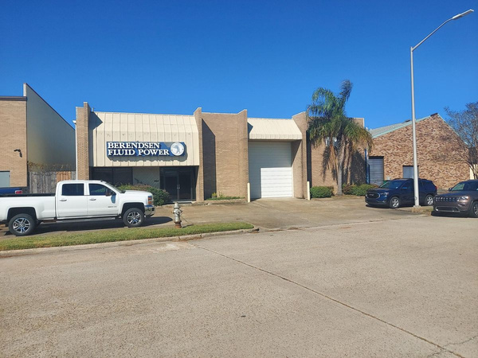
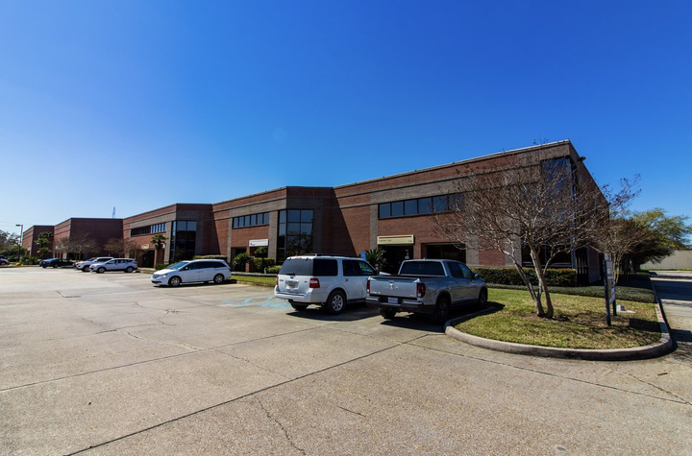
Industrial
  Warehouse
  Office/Showroom
  Office/Warehouse
  Manufacturing
  “Flex” Space

Slide 17
Key Factors Considered by Industrial Users
  Price
  Space Configuration
  Ceiling Heights
  Clear Span
  Utilities
  Location of labor pool for manufacturing facilities
  Transportation–Access to major highways, rail, ports, airports
  Location–Proximity to end users/customers
  Floor Loads
  Sprinkler Systems
  Docking Areas/loading/truck access
  Incentives–Local, State, National
  Allowed Uses on the Property (Zoning and Covenants)
  Buy vs. Lease

Slide 18
Industrial – Professional Development
The SOCIETY OF INDUSTRIAL AND OFFICE REALTORS® is the leading global professional office and industrial real estate association. With 3,600 members in 45 countries and 722 cities, SIOR represents today's most knowledgeable, experienced, and successful commercial real estate brokerage specialists.
www.sior.com

Slide 19
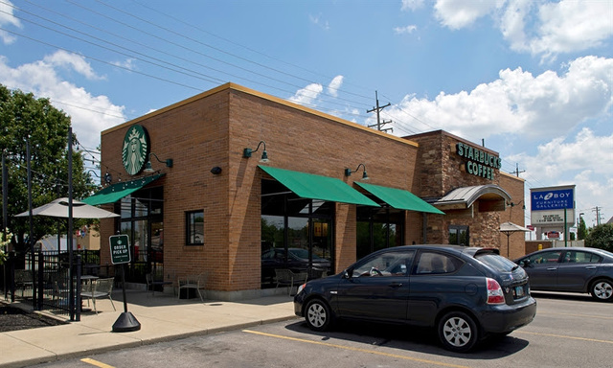
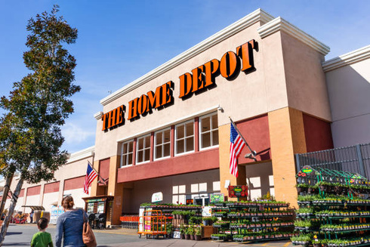
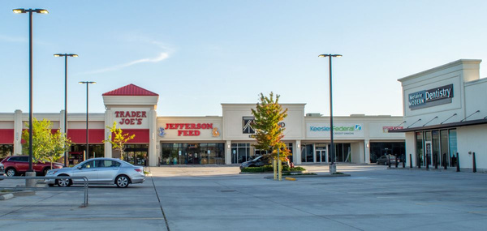
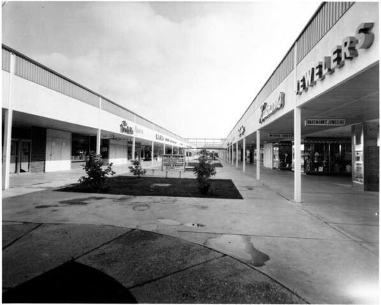


Retail
  Single user (freestanding)
  Credit tenants
  Big Box
  Small strip center
  Neighborhood shopping center
  Community shopping center
  Regional shopping center
  Specialty center

Slide 20
Key Factors Considered by Retail Users
  Price (total after NNN)
  Location (trade area)
  Space Configuration
  Traffic
  Visibility
  Demographics
  Co-tenants
  Ingress/Egress
  Location of Competitors (and symbiotic retailers)
  Parking
  Zoning

Slide 21
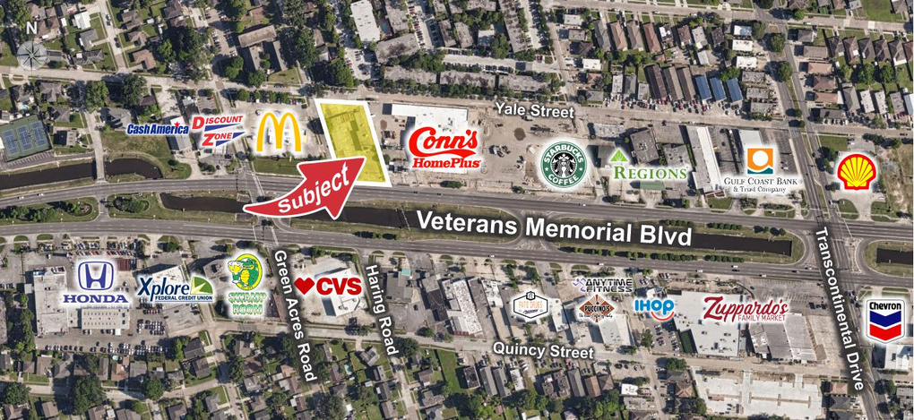
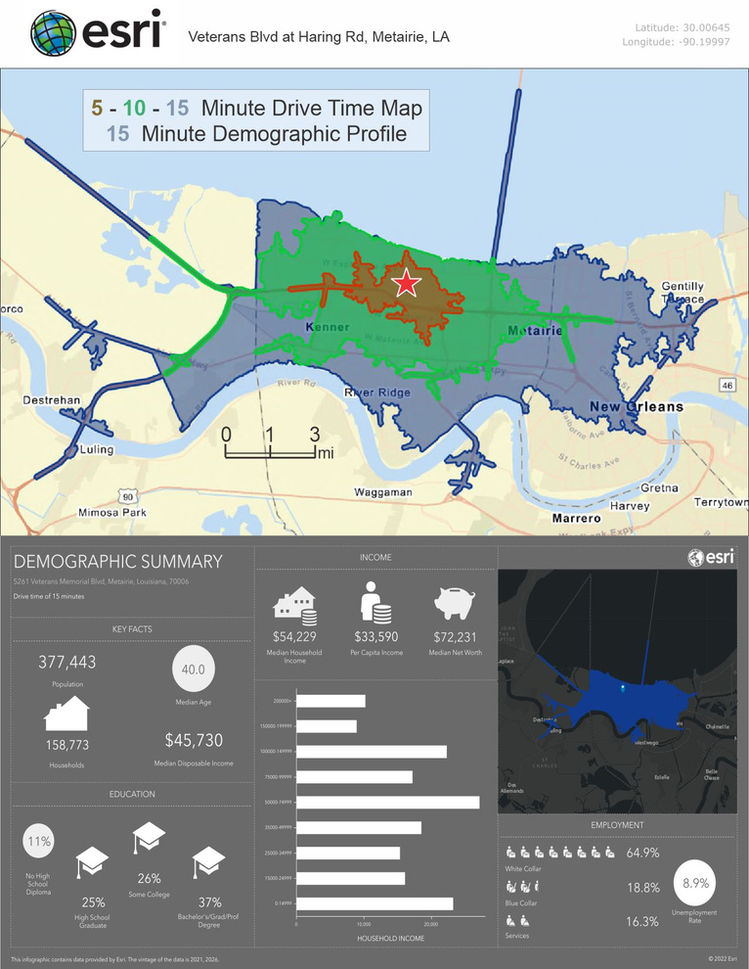
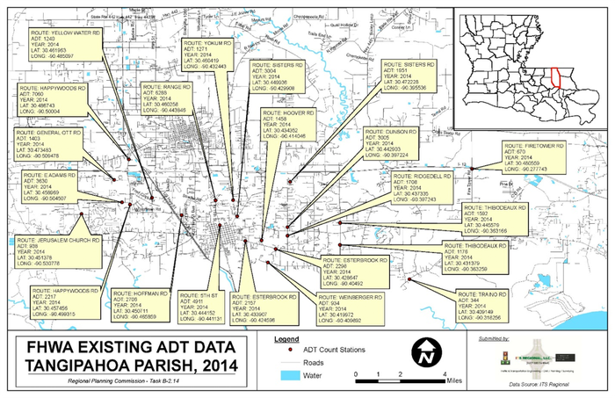
Important info for Retailers
Current Aerial Photography
Demographics
Traffic Counts

Slide 22

Retail – Professional Development
International Council of Shopping Centers.
The member organization for industry advancement, ICSC promotes and elevates the marketplaces and spaces where people shop, dine, work, play and gather as foundational and vital ingredients of communities and economies.
www.icsc.com

Slide 23

Vacant (Unimproved) Land
Land Sales May or May Not:
  Be Zoned for the Intended Use
  Have Utilities Available
  Have Accessibility
  Have Suitable Soils
  Be “Developable” because of Soils, Environmental Issues, Local Issues, and Archaeological Issues
  Have Needed Amenities Nearby
Additional resources:
www.rliland.com

Slide 24
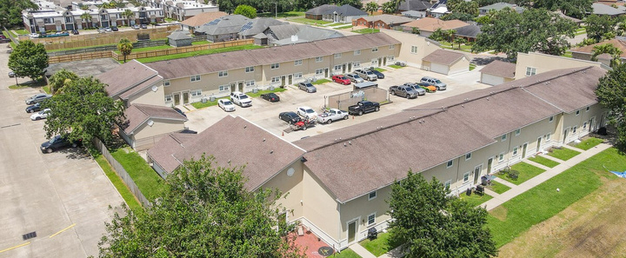
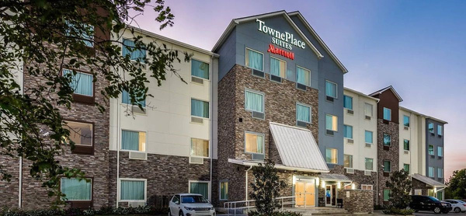
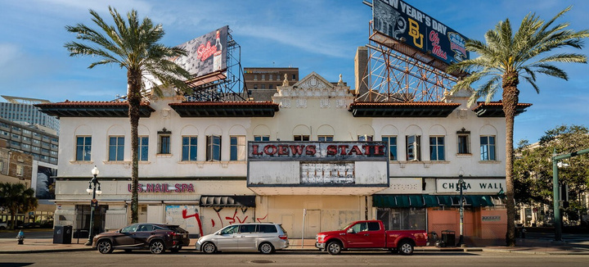
Additional Commercial Real Estate Categories
  Multi-family
  Hospitality (Hotel/STR)
  Special purpose (Church, theater, etc.)
  Business Opportunities (with or without real estate)
  “Hybrid” properties – combination of two or more types

Slide 25
How Commercial Lease Prices are Quoted
  Class A and B Office:
  Shopping Centers:
  Industrial Space/Flex Space:
  Apartment rents:
  Older/Hybrid properties:
Price PSF/yr. Gross with stops over base year
Price PSF/yr. Usually NNN
Price PSF/yr. Usually NNN
Price PSF/mo
Many times a “modified” gross arrangement - Better ask!
Be careful of net leases for short-term leases on older properties.

Slide 26
Representation, Compensation
Agreements and Practices
  Many, if not most commercial properties do not appear in any MLS
    IDX –vs- Commercial Information Exchange
  Examples of Representation Agreements
    One-Time Showing Agreement
    Non-Exclusive
    Co-brokerage
    Territory Specific
    Property Specific

Slide 27
Commercial Purchase Contracts
  No required standardized form – be careful out there!
  Some crafted by agents, others by attorneys
  Legalese may be really weighted towards one party or the other
  Legal counsel involvement frequently needed
  Due diligence/inspection periods often longer with much leeway given to purchasers to terminate the agreement in the initial stages

Slide 28
Commercial Leases
  Initial negotiations frequently start with a Letter of Intent (LOI)
  Most Class A, Class B offices and shopping centers have their own standardized lease
  Little standardization among property types – many leases are tailored to the use
  Listing side usually provides the initial lease draft to the leasing side once the basic terms are established
  Depending on the lease complexity, it is not uncommon for the attorneys to eventually talk/negotiate directly

Slide 29
Typical Lease Terminology and Clauses
  Term
  Rent Commencement
  Use
  Tenant Improvements
  Default Issues
  Notices
  Net Lease vs. Gross Lease
  Usable –vs- Rentable Space
  Reimbursements/Stops
  Assignments, Subletting
  Insurance
  Options/Extensions

Slide 30
Common Mistakes in Commercial Contracts
Sales
  Unclear inspection/due diligence term (active –vs- passive)
  The “short sentence syndrome”
  Deadlines for counter-offers
  “Fuzzy” requirements/obligations (i.e. “subject to being free of environmental issues” or “subject to appraisal”)
  Lease renewal terms and rates not explicitly stated
  Authorized ownership and tenant signatures
Leases

Slide 31
Commission Structure
  Usually a straightforward percentage, but splits can vary depending on the situation and number of brokers involved
  Can be a flat fee
  Always ask early in the process – don’t assume
Sales
  A percentage of the gross lease value, may be paid up-front, annually, monthly, or otherwise
  Paid as a dollar per square foot calcuation
  Value of the lease but capped by years or primary term
  Some combination thereof
Leases
Note: Any examples of commission structure or other compensation are for the purpose of explanation of concepts. These are not to be used as suggestions for compensation. Practitioners should refer to their office policy when structuring any commission or compensation structure.

Slide 32

Some thoughts on Property Management
  Usually includes collecting rent, handling repairs and routine maintenance
  Responsibilities may or may not include leasing and tenant upfitting
  There needs to be a written property management agreement outlining the duties of the manager
IREM: Institute of Real Estate Management
WWW.IREM.ORG

Slide 33
Investments
  Can be any type of property including residential and commercial
  Most investors have certain criteria – ask!
  As a listing agent, it is important to provide accurate and pertinent financial information so that prospective buyers can make informed decisions
  “Capitalization Rate” (or “CAP Rate” for short) is the most widely used measure of investment return.
  Other measures of return include IRR, FMRR, Gross Rent Multiplier, Cash on Cash Return, and various other methods.

Slide 34
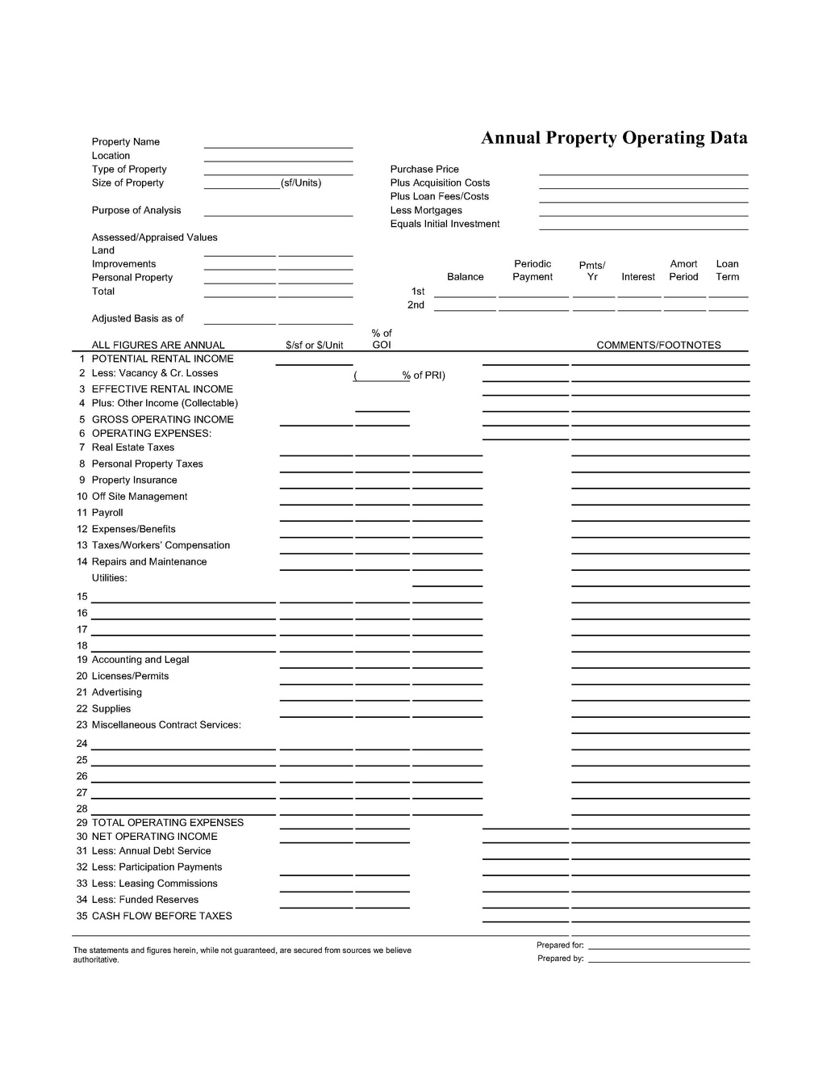
Deriving a CAP Rate Using the Annual Property Operating Data (“APOD”) form

Slide 35
Deriving a CAP Rate - Example
Potential Rental Income
Less Vacancy (ex: 10%)
=Gross Operating Income (GOI)
Minus Expenses
=Net Operating Income (NOI)
$180,000
($18,000)
$162,000
($75,000)
$87,000
NOI/Sale Price = Capitalization Rate (“CAP” Rate)
(also: NOI/CAP Rate = Sale Price)
If this building sold for $1,050,000, then the CAP Rate
would be $87,000/$1,050,000, or 8.29%

Slide 36
Deriving a CAP Rate - Example
NOI ÷Sales Price = Cap Rate
1. Sales price = $1,500,000, NOI = $150,000
2. Sales price = $1,500,000, NOI = $100,000
3. Sales price = $1,500,000, NOI = $200,000

Slide 37
Deriving a CAP Rate - Example
NOI ÷Sales Price = Cap Rate
1. $150,000 ÷ $1,500,000 = 10% (.10)
2. $100,000 ÷ $1,500,000 = 6.7% (.067)
3. $200,000 ÷ $1,500,000 = 13.3% (.133)

Slide 38
CLASS ASSIGNMENT:
Derive a CAP Rate Using the Annual Property Operating Data (“APOD”) form
Assumptions
  5,000 SF building
  Purchase price of $480,000
  Gross Rental of $18.00 psf/yr
  Use a 7% vacancy in your projection
  80% loan at 5% interest rate, 20-year amortization (Note: this doesn’t affect the CAP rate, only the cash flow before taxes)
  Real estate taxes based on building being 80% of total value of property
  Use millage rate of $150 per $1,000 of assessment (remember - no homestead exemption in commercial property
  Hazard Insurance of $7,200/yr
  Flood Insurance of $3,500/yr
  Repairs and maintenance of $4,000/yr
  Outside electric light bill of $60/mo paid by owner
  Water bill of $80/mo paid by owner
  Accounting costs of $300/yr
  Supplies cost of $700/yr
  Miscellaneous costs of $1,200/yr
  6% leasing commission
  Reserves of 3% of GOI/yr
What is the projected Net Operating Income (NOI)?
What is the projected Capitalization Rate (CAP Rate)?

Slide 39
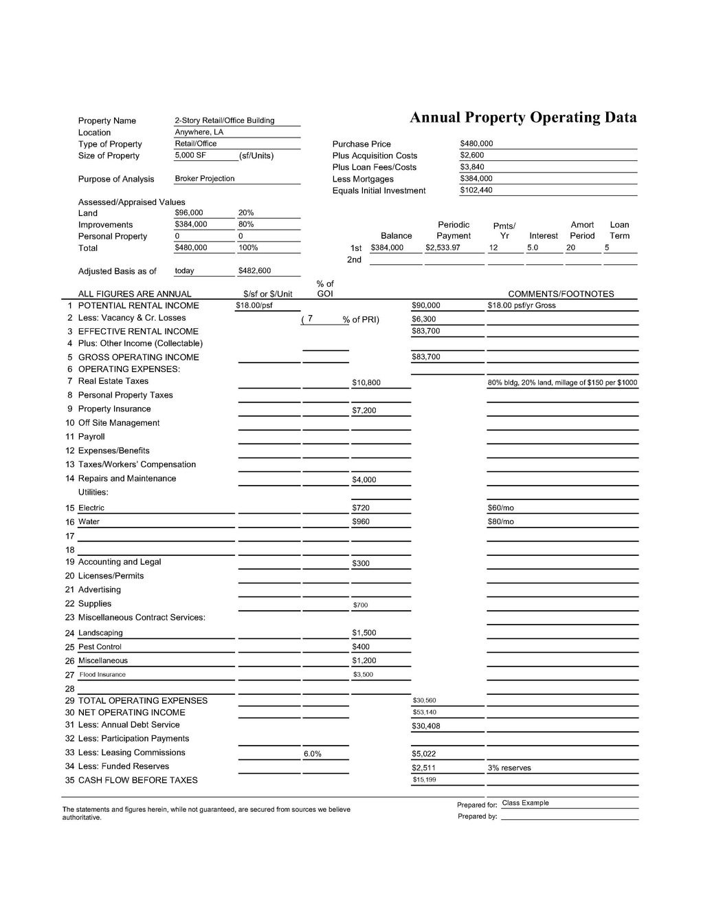
Class Example –
Sample Retail Building
CAP Rate =
NOI of $53,140/
Purchase Price of $480,000
= 11.07%

Slide 40

Investments – Professional Development
The CCIM Designation is conferred upon commercial real estate leaders who have a proven record of success in the field and have demonstrated a mastery of financial, market, and investment analysis. CCIM Designees come from a variety of professional backgrounds including asset management, brokerage, banking, development, property management, law, and accounting.
www.ccim.com
www.louisianaccim.org
  $110 CCIM National Designees and National Candidates
  $125 Regular (REALTOR®) and Affiliate Members

Slide 41

THANK YOU!
www.nomarcid.org

