Slide 1
presents:
What Every Agent Should Know about the 2024 Property Disclosure
SPEAKER:
Danny Douglass
ATTORNEY AT LAW

Slide 2
Crescent Title Offices
METAIRIE OFFICE UPTOWN OFFICE NORTHSHORE OFFICE
1421 N. Causeway Blvd. 7835 Maple St. 1748 N. Causeway Blvd.
Metairie, LA 70001 New Orleans, LA 70118 Mandeville, LA 70471
Daniel M. Douglass – Attorney Robert J. Bergeron – Attorney Kirk J. Frosch – Attorney
Phone: 504-888-1919 – Fax: 504-888-1977 Lauren B. Griffin – Attorney Phone: 985-626-3445 – Fax: 985-626-3704
Danny@CrescentTitle.com Phone: 504-866-5151 – Fax: 866-5858 Kirk@CrescentTitle.com
LindseyS@CrescentTitle.com Bob@CrescentTitle.com Kristi@CrescentTitle.com
Lauren@CrescentTitle.com
LAKEVIEW OFFICE RIVER PARISHES OFFICE
6270 Canal Blvd. 12 Storehouse Ln., Unit B
New Orleans, LA 70124 Destrehan, LA 70047
Jason P. Hernandez – Attorney Abbey A. Mack – Attorney
Phone:484-0700 – Fax: 504-484-0710 Phone: 985-307-1515 – Fax: 985-307-1818
Jason@CrescentTitle.com Abbey@CrescentTitle.com
Josie@CrescentTitle.com
HISTORIC OFFICE HAMMOND OFFICE
831 Elysian Fields Ave. 220 W. Thomas St.
New Orleans, LA 70117 Hammond, LA 70401
Ian G. Fisher – Attorney Matthew R. Emmons – Attorney
Phone: 504-218-4679 – Fax: 504-218-4689 Phone: 985-269-7700 – Fax: 985-269-7701
Ian@CrescentTitle.com Matt@CrescentTitle.com
Josie@crescenttitle.com

Slide 3
BASIC REVIEW OF PROPERTY DISCLOSURE
LAW THAT REQUIRES DISCLOSURE
WHO IS REQUIRED TO DISCLOSE

Slide 7
BEST PRACTICES
ACTUAL KNOWLEDGE
OR
CONSTRUCTIVE KNOWLEDGE
Notes:
Actual knowledge means just that; the agent actually knew of an issue with the property and allowed the PDD to be sent to the Buyer anyway knowing that the PDD was inaccurate. Basically, unless the agents are actually aware that the information in the Property Disclosure Document is incorrect, there will be no liability.

Slide 8
KEY DEFINITIONS

Slide 10
Key Definitions
Residential Real Property
Known defect
EXPLAIN REAL ESTATE TERMS!

Slide 11
CASE STUDY REVIEW
Notes:
Orr v. Jones, a Jefferson Parish case which dealt with an older version of the PDD that did not specifically ask for information from Sellers about “foundation repairs,” still provides insight into “repairs” and the PDD. In that case, Sellers were sued for bad faith redhibition and agents for misrepresentation, for allegedly failing to disclose a defect with a foundation. The Court found the Sellers and Agent not liable because the evidence at trial shows that they believed the foundation to be repaired at the time of the disclosure to the Buyer and had no intent to mislead or defraud the Buyer. It is important to note that the true belief was the basis of the finding of no liability. Information that could have called that into question, such as an inspection report from a previous buyer who did not close on the property which called into question whether the foundation was truly repaired, could change a Court’s decision.

Slide 12
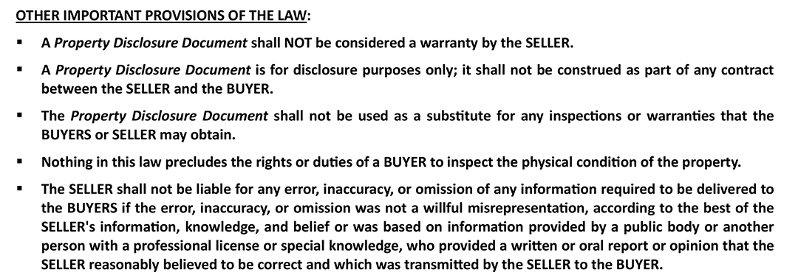

Slide 13
EXEMPTION FORM

Slide 16
BEST PRACTICES
CHECK ALL THAT APPLY
LEFT UNCHECKED HERE COULD CAUSE CONFUSION

Slide 17
SELLER ACKNOWLEDGEMENTS

Slide 18
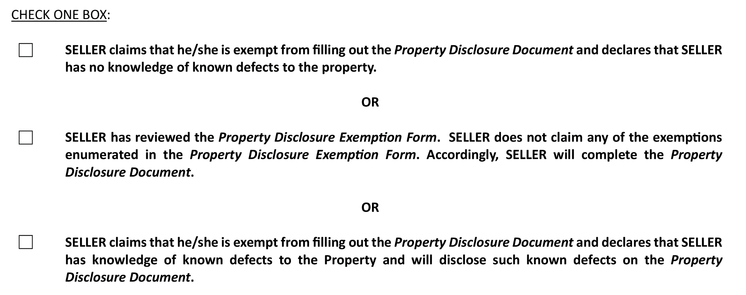

Slide 19
BEST PRACTICES
WHY A THIRD OPTION WAS ADDED HERE
REMEMBER SELLER’S REQUIREMENTS ESPECIALLY KNOWN DEFECTS EVEN IF EXEMPT
Notes:
This is a great addition by the LREC, and as discussed above, makes disclosure
obligations more clear. It helps to take the spotlight, or more appropriately the blame, off the agents
when a Seller attempts to state that “the Agent told me I was exempt from the disclosure form.”
Now, for example, a succession administrator, who is exempt, is having to either acknowledge
they have no knowledge of defects or will have to fill out a PDD even if exempt

Slide 20
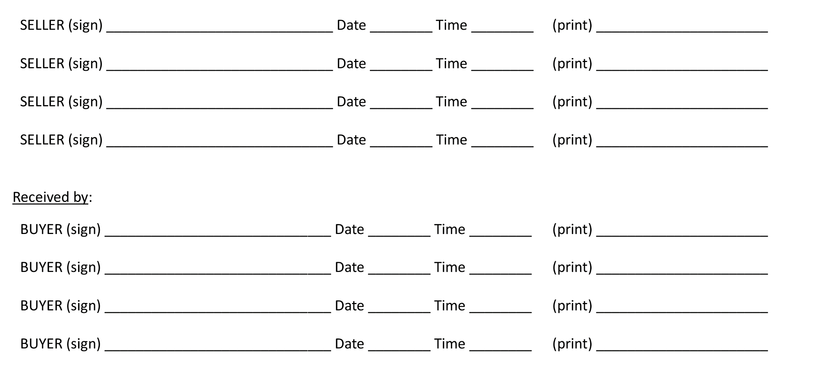

Slide 21
BEST PRACTICES
ENSURE PROPER SIGNATURES/DATE/TIME
MUST SIGN HERE AND END OF PDD FORM

Slide 23
BEST PRACTICES
DIFFERENCE IN “Y”, “N”, AND “NK”
RELATE BACK TO ACTUAL KNOWLEDGE
Notes:
In discussing the responses to the Property Disclosure Form questions, reading the
above box which explains that the disclosure is based upon “actual knowledge” is a great practice.
The actual knowledge standard is heightened, one must know about the issue – full stop.

Slide 24
PDD- SECTION 1

Slide 25
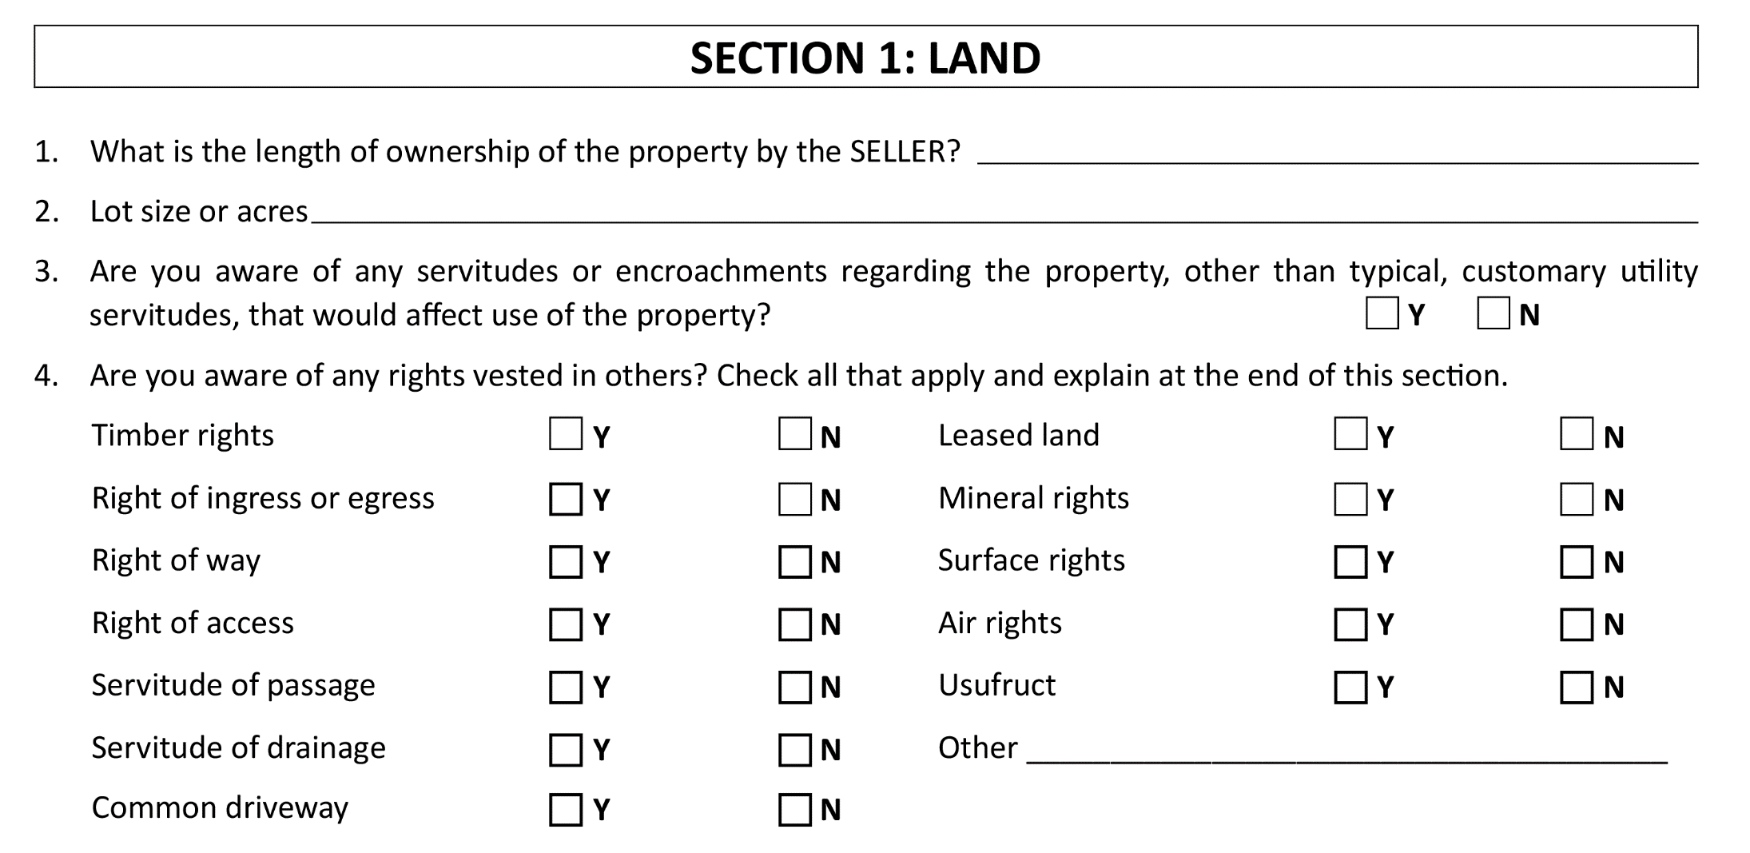
Notes:
Point out addition of leased land option.

Slide 26
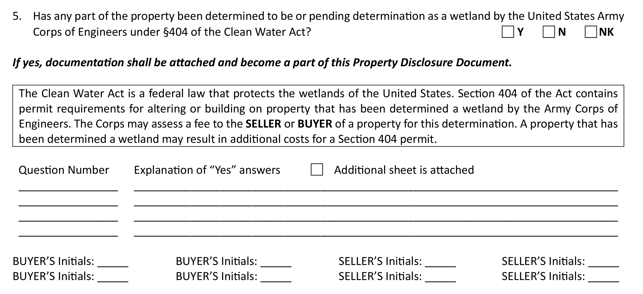
Notes:
Nothing has really changed in this section of the form. As a good reminder each
section includes an area such as you’ll notice here for additional information and explanation for
“Yes” answers.

Slide 27
BEST PRACTICES

Slide 28
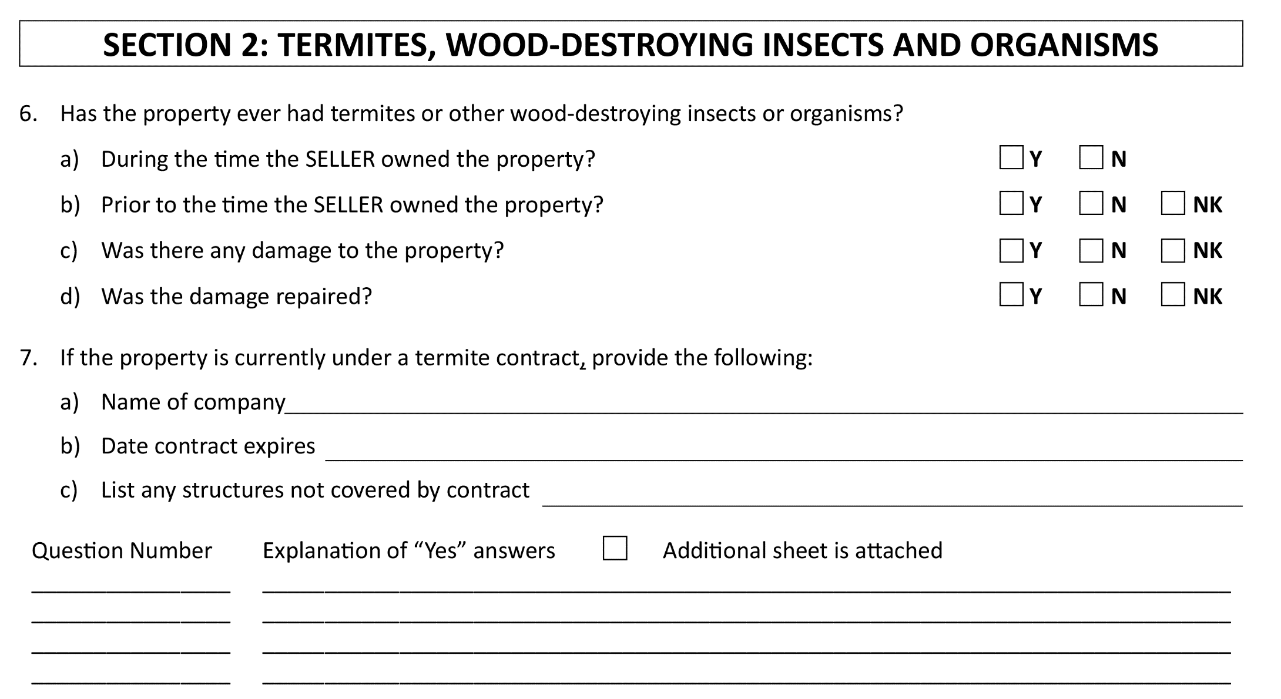
Notes:
In this section the only slight change was the addition of the “N” choice box for
items c and d under choice 6. Previously the only choice here was either “Y” or “NK”, and the
“N” box was added for clarity from the seller. For instance, if the seller’s knowledge is that there
was no damage to the property and/or nothing was repaired then a clear no is likely a better
choice than simply Not Known.

Slide 29
BEST PRACTICES
WRITING EXPLANATION OF “Y” ANSWERS
EACH SECTION HAS AN AREA FOR EXPLANATION
Notes:
The written “Explanation of Yes Answers” sections found throughout the Property
Disclosure Form is where a lot of Sellers, and sadly by association, their agents, get into trouble.
Numerous lawsuits have been filed arising out of situations such as “yes the seller stated there was
prior flooding, but only wrote about a hose leak in a laundry room and not the 5 feet of water from
Hurricane Ida.” That is obviously a glaring example, but arguments do get made that explanations
are not detailed enough, so it is best to tell your clients to be sure they are providing an explanation
to all issues when they mark “Yes” to a question that calls for more detail.

Slide 30
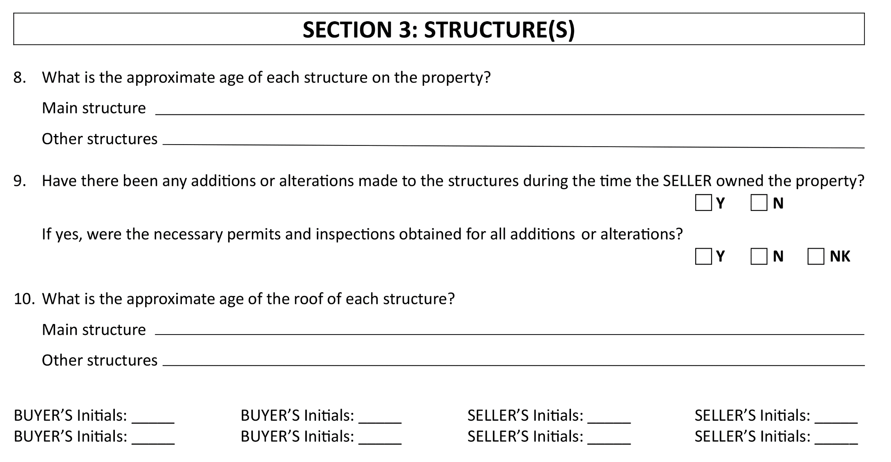

Slide 31
BEST PRACTICES
WHEN/WHY TO PROVIDE DOCUMENTATION
IMPORTANCE OF ADDING “N” AS A CHOICE
Notes:
Termite disclosures are the root of a lot of litigation in Louisiana. And the
failure to provide full documentation or explanation to the termite section is usually a
reason for it. “Repairs” were discussed earlier, but it must be restated – you need to have a
legitimate belief that the repairs fixed all of the issues in order to avoid liability such as past
termite issues. Almost every agent in Louisiana has dealt with a Seller who discloses that their
property had termites, but that it was repaired. There are also many agents who know of Sellers
who report that way, but were also in possession of information, such as a Wood Destroying
Insect Report (WIDR), that calls into question whether or not the repairs were complete and
Seller failed to disclose the same. Sellers need to explain this information clearly and fully.

Slide 32
PDD – SECTION 3

Slide 33
Notes:
Only slight change here to the wording on #8 to better match the area below
where the disclosure asks for details on the age of the main structure as well as other structures.
By using the language “each structure,” a seller should separate each structure and provide the
approximate age of each structure separately in the area provided.

Slide 34
PDD – SECTION 4

Slide 35
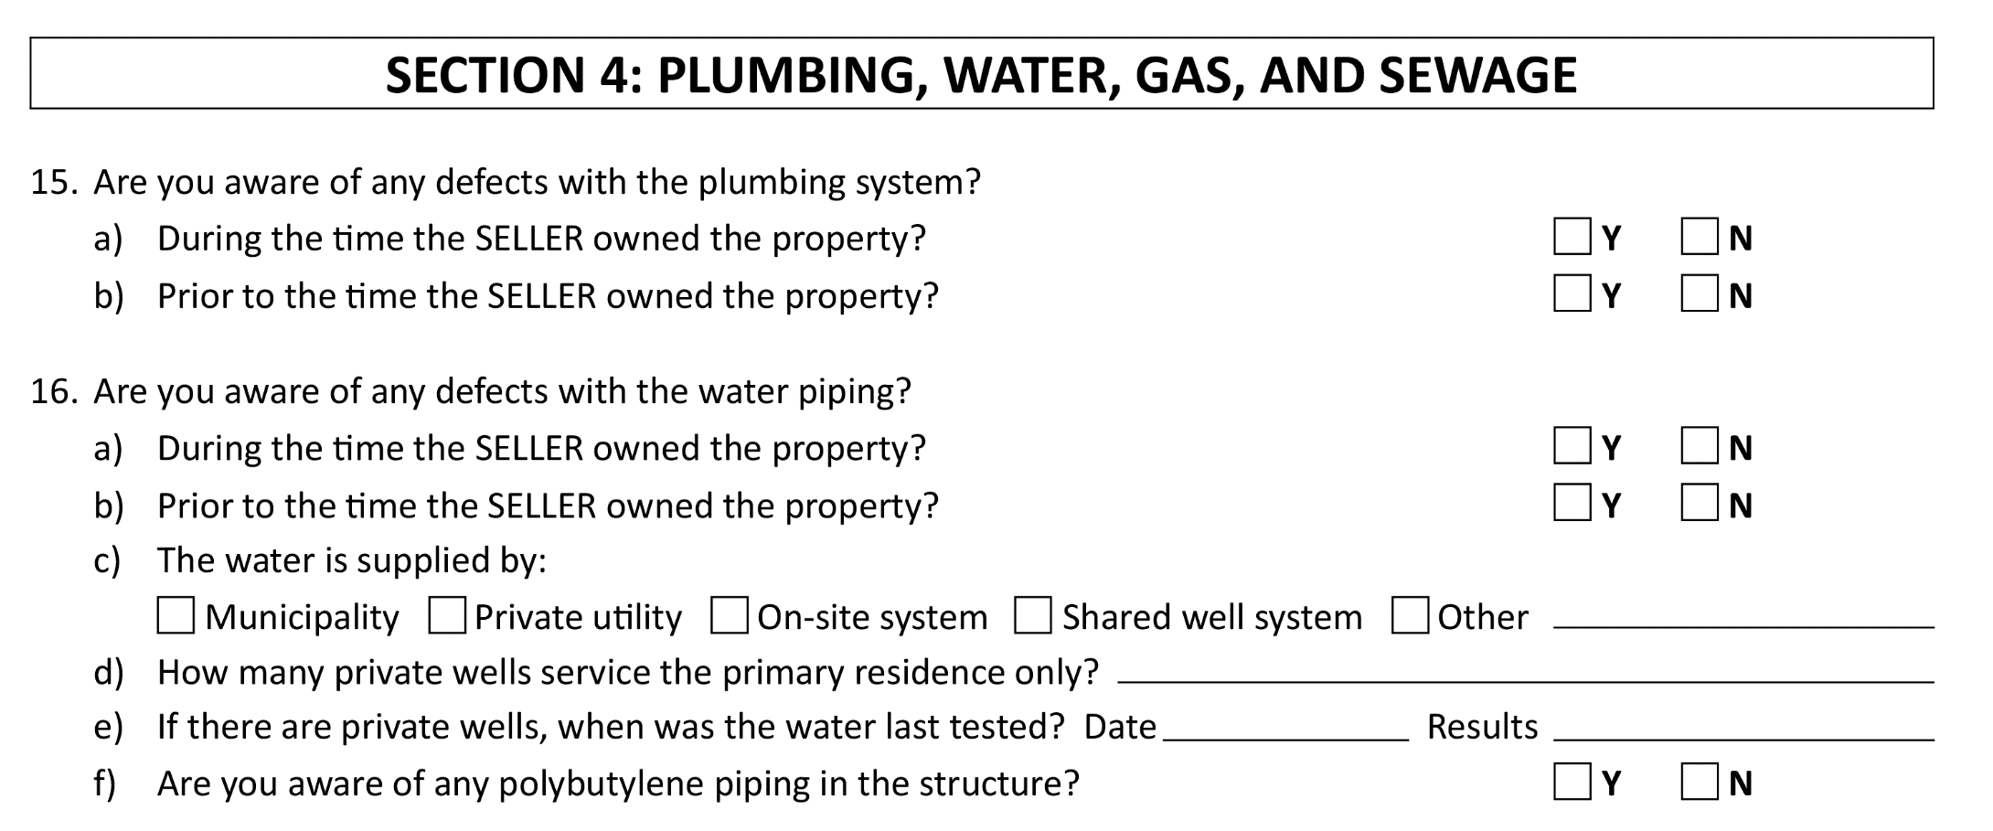
Notes:
In this section you’ll notice some changes in the way the disclosure questions are
worded and as a result changes to the selection choices. For instance, in several places the phrase
“are there any known” is replaced by the phrase “are you aware of any” defects. As a result, in
these same areas you’ll also see that the “NK” choice was removed.

Slide 36
Notes:
The difference in the amended language here better matches the law and the key definitions laid
out earlier in the PDD. The seller is being asked if “they are aware” - which eliminates the need
for a “NK” choice. Therefore, a seller should carefully consider each item asked about in this
section and choose the best selection based on the best of their knowledge. As a reminder, any
further details, or explanations can be provided in the blanks provided at the end of the section.

Slide 37
BEST PRACTICES
WATCH FOR “PRIOR TO OWNED” QUESTIONS!
Notes:
Beware the “prior to the time Seller owned the Property” questions. Issues have arisen where the Seller marked no, but the Plaintiff was able to go back to the transaction file of the Seller’s own purchase of the property and locate past property disclosure forms which stated there was an issue. The Seller may not even remember that, but that is powerful evidence against a Seller. It is good practice to remind Seller to think back at their past closing file when it comes to the “prior to the time Seller owned the Property” questions.

Slide 38
PDD - SECTION 5

Slide 39
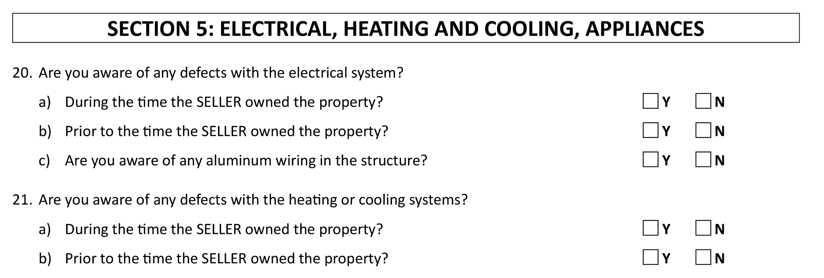
Notes:
Very similar to the previous section, you’ll notice the main questions asked for each item number now utilize the same phrase “are you aware” of any defects. Just as before the “NK” selection was also removed to better match the question as it is asked here. Another reminder as to the importance of those key terms and definitions previously outlined.

Slide 41
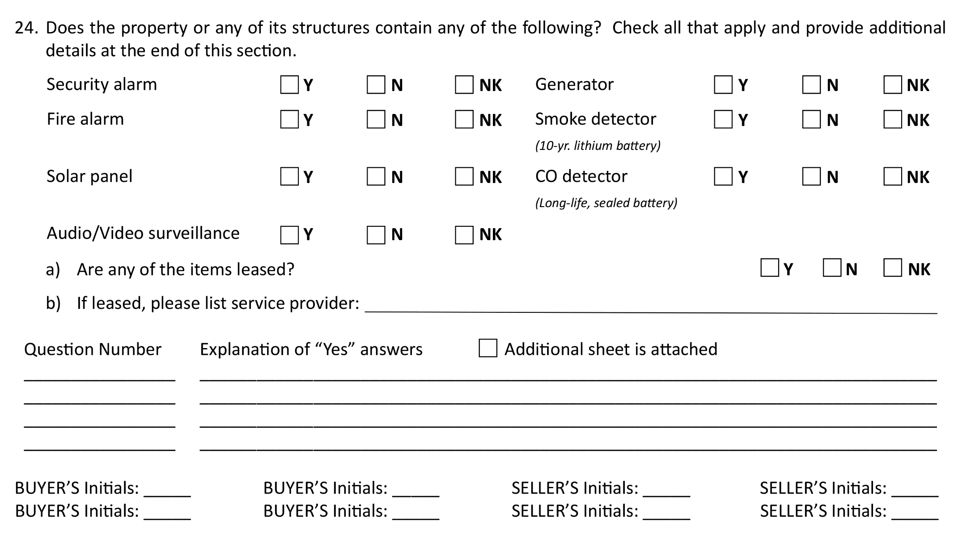
Notes:
: You’ll notice some changes here within Question 24 under Section 5. Previously this section only addressed installed security systems. Now you’ll see it has been expanded to cover various security-related items including solar panels, generators, smoke detectors, Carbon Monoxide (CO) detectors etc. Later in the document you’ll see that questions that used to address these such as solar panels (former question #53) have been removed.

Slide 42
BEST PRACTICES
SELLER SHOULD KNOW THESE ANSWERS
THERE IS A DIFFERENCE BETWEEN “N” AND “NK!”
Notes:
A Seller should know the answers to these questions, so there should rarely be mistakes on them. But be wary of questions with Generators, especially with whether it is a “whole home generator.” As silly as it sounds, people have different expectations as to what a “whole home generator” is; i.e. covers the major appliances or ia able to cover every plugged in iPhone, iPad, and every other appliance and light running simultaneously while four loads of laundry and dishes are running. As crazy as it sounds, multiple claims and lawsuits have been filed on this issue, which are a waste of time, but you would rather not deal with it. So be careful.

Slide 43
Notes:
Only one small update here to the FEMA-related websites where flood map and risk zone information can be found

Slide 44
BEST PRACTICES
THIS INFORMATION IS AS IMPORTANT AS EVER!
LICENSEES SHOULD MAKE EFFORTS TO GATHER SUPPORTING DOCUMENTATION
Notes:
At this point in Louisiana, Courts (and most Louisiana residents) are not sympathetic to a Seller who does not know its flood zone classification or misstated it. Make sure the Seller is aware of their designation.

Slide 45
Notes:
The last sentence in bold print has been added in this section. The addition reiterates the importance of the seller’s requirement to disclose any and all known defects. Therefore, if something has materially changed the parties to the document should be notified in writing

Slide 46
BEST PRACTICES
WHEN AND WHY TO UPDATE THE PDD!
Notes:
The last sentence - This is a great inclusion which will help to clear up years of arguments by Plaintiffs’ attorneys that even though they were informed via email or text of an issue/defect that popped up, since the Property Disclosure Form was not amended, there is still potential liability. Make sure your client tells the other side of any change in writing; it protects them and likely you.

Slide 47
Thank you for joining us!
Please don’t forget to sign out!
Keep up to date with us at:
www.CrescentTitle.com
@CrescentTitle
@CrescentTitle
@Crescent–Title

