Slide 1
Preparing a CMA and
Understanding the Appraisal Process
_______________________________
Continuing Education
COURSE DEVELOPER: ROSALYN A. BRYANT
Louisiana State Certified Residential Real Estate Appraiser #R1179
rosalynb@bryantappraisalservices.com
(504) 828-2779

Slide 2
PART ONE
THE
CMA

Slide 3
      What is a CMA?

Slide 4
Wikipedia says:
A Comparative Market Analysis (CMA) is an estimate of the home’s value compared with others. This differs from an appraisal in that property currently for sale may be taken into consideration (competition for the subject property)

Slide 5
Another definition:
A method of determining the approximate market value
of a home by comparing the subject property
to other homes that have sold, are presently for sale, or did not sell in a given area.
Also called:
Competitive Market Analysis and Comparable
Market Analysis

Slide 6
Real estate agents use CMAs as part of their listing presentations.
A well-prepared CMA should reflect a range for the current market value of a home.

Slide 7
What is a COMPARABLE?

Slide 8
A comparable is
similar in size
similar in quality
similar in condition
with similar amenities
most proximate
most recent

Slide 9
Similar to WHAT?

Slide 10
Similar to the
SUBJECT PROPERTY

Slide 11
There is a difference between a
COMPARABLE
and a
CLOSED SALE

Slide 12
Every closed sale is NOT necessarily COMPARABLE to the subject property!!

Slide 13
What are the differences between a CMA and appraisal?

Slide 14
CMAs are typically prepared by licensed real estate agents (REALTORS®) to assist homeowners in developing a list price for their home.
CMAs typically consider recent sales and active listings in the subject neighborhood.

Slide 15
What is an APPRAISAL?
An unbiased opinion of market value, supported by extensive research and data

Slide 16
An APPRAISAL can ONLY be completed by a state licensed or state certified Real Estate Appraiser.

Slide 17
Preparing a CMA

Slide 18
Step 1: Define and choose the market area or neighborhood
Are there clear neighborhood boundaries?
Use the MLS map tool!

Slide 19
Step 2: Begin the search for comparable sales and listings
Start with 12 months past
Property type
Currently active or pending
Living area – 25% more or less
Condition – eliminate LEAST similar (new, fair, poor)
Amenities, if necessary/significant
Bedrooms/bathrooms, if necessary/significant

Slide 20
Step 3: Narrow the results to those sales and listings most recent AND comparable
Review EACH listing
Read all comments
Look at the photographs
Call the listing agent for more information

Slide 21
Step 4: Prepare the CMA!
Actions – CMA
Select contact name/create a new contact
Pages
Subject
Cover
Comparables
Map
Adjustments
Pricing
Finish!

Slide 22
Let’s do another one…….!

Slide 23
Now what?

Slide 24
How to read the CMA
And
Presenting the CMA to your client

Slide 25
Summary of Comparable Listings (includes Sold Listings)
A list of those comparable sales and listings chosen for the CMA
Explain to your client how these comparables were selected
Low, Median, Average, High

Slide 26
CMA Price Adjustments (if you made adjustments)
Each comparable “gridded” side-by-side with features compared to the subject
Explain, explain, explain!

Slide 27
Minimums and Maximums
If you’ve chosen comparable properties, these ranges will be very small

Slide 28
Number of Days On Market
Highest number of DOM, most likely priced above market indicators (“overpriced”) Or – the listing does not appeal to typical buyers.
Lowest number of DOM, priced at or slightly below market indicators.
Number of days on the market is a critical talking point with your client! No one wants their home to sit on the market for days and days. If the home is less appealing, possibly suggest pricing slightly below market indicators.

Slide 29
List Price and Sale Price
Illustrates the list to sale price ratio, what your client can expect if their home is price according to market indicators
Compare to the Days on Market graph
Another great talking point

Slide 30
CMA Pro Report
Details, including comments, about each sale and listing included
General overview of selected properties

Slide 31
CMA Summary
This is what your client is used to seeing
BE CAREFUL! If you haven’t chosen truly comparable properties, LP/SqFt and SP/SqFt will be skewed
PRICE PER SQUARE FOOT IN THE NEIGHBORHOOD IS NEVER A GOOD INDICATOR OF PRICING!

Slide 32
3-up Comparison
Compares the selected listings to each other

Slide 33
Pricing Recommendation
Valuable information for your client
Suggests factors to consider when pricing the home
Discusses pricing the home correctly and competitively
Also a good time to point out possible issues or suggest repairs

Slide 34
Activity vs. Timing
“My Guarantee to You”
The Effect of Over Pricing (!!)
The Benefits of Using A Professional REALTOR®
Market Analysis Explanation
The Importance of Pricing
Setting the Price
The Pitfalls of Overpricing
Where a Commission Goes
Sources of Buyers
Steps to a Positive Showing
What it takes to Show
CMA Map Layout

Slide 35
Time for a BREAK!

Slide 36
PART TWO
UNDERSTANDING
THE APPRAISAL PROCESS

Slide 37
What is an appraisal?

Slide 38
An appraisal is an unbiased opinion of value based on in-depth analysis of data

Slide 39
What is market value?

Slide 40
Fannie Mae says:
Market value is the most probable price that a property should bring in a competitive and open market under all conditions requisite to a fair sale, the buyer and seller, each acting prudently, knowledgeably and assuming the price is not affected by undue stimulus.

Slide 41
Who can order an appraisal?
Who is “the client” (to an appraiser)?

Slide 42
Purposes of an appraisal
Mortgage lending
To assist in making a decision
Cash purchase
Succession
Divorce
Court-ordered
And sometimes, just because!

Slide 43
Types of appraisals
Real Property – commercial and residential
Personal Property

Slide 44
Types of Residential Appraisals
Single-Family
Multi-Family (2-4 units)
Condominium
Vacant Land
Time Share

Slide 45
What does an appraiser do during the visit to the property?
Measures to obtain the living area and total area
Notes the condition
Notes the amenities
Notes any detrimental or unsafe condition
Takes lots and lots of photographs

Slide 46
FHA and VA Requirements:
The home must be safe, sanitary, and secure for the borrower.
Both have MPR – Minimum Property Requirements
Both require that the appraiser view the attic

Slide 47
As a listing agent, what is my role during the appraiser’s visit?
Provide access to the property
If desired, provide comparable sales used to develop the list price (or a CMA)
Provide a detailed list of any recent improvements, renovations, or remodeling
Insure the appraiser sees all of the home

Slide 48
As the buyer’s agent, can I go to the appraisal appointment?
What is my role during the appraiser’s appointment?

Slide 49
What about the owner/seller/buyer?

Slide 50
THE
APPRAISAL
REPORT

Slide 51
Why does the appraiser report the listing history of the subject (expired, withdrawn listings, etc)?

Slide 53
Why does the appraiser need a copy of the sales contract?

Slide 54
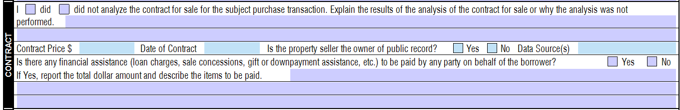

Slide 55
Who determines the condition of the property?

Slide 56
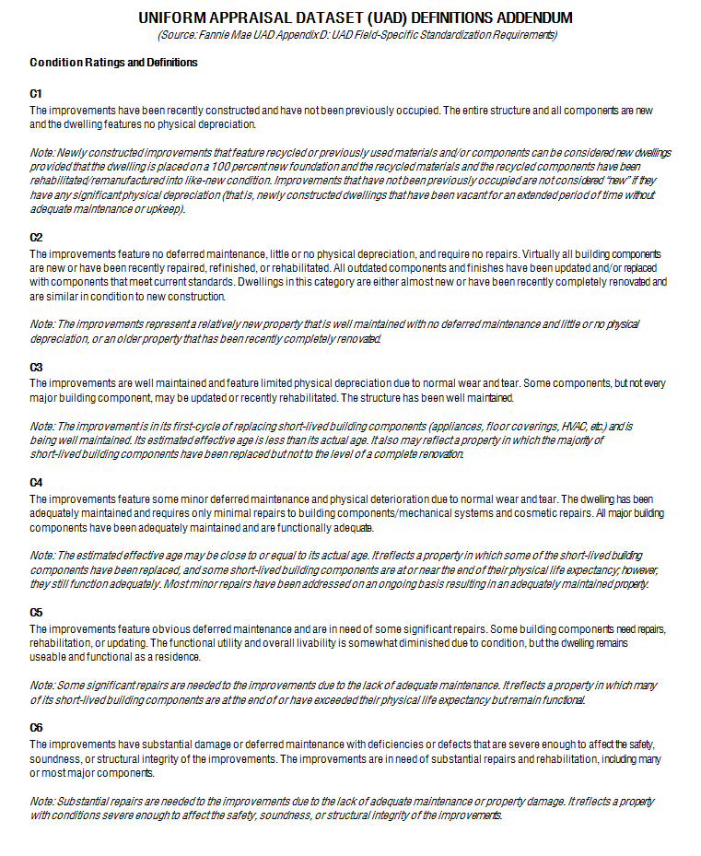

Slide 57
What is effective age?
How does effective age affect value?

Slide 58
Actual age is also called the Chronological Age. The Effective Age is the estimate of the age of a structure based on its utility and physical wear and tear. The effective age is the difference between the Economic Life of the structure and the Remaining Economic Life of the structure.

Slide 59
Economic life is the expected period of time during which an asset is useful to the average owner.
The remaining economic life is the estimated number of years that an improvement will continue to contribute to the property value.
The remaining economic life of an improvement is the total economic life minus its effective age

Slide 60
EXAMPLE:
Home is 40 years old.
Economic life of a typical home, 60 years
Newly and completed renovated, not yet occupied – effective age 8 years old
Remaining economic life of the home, 52 years (60 – 8 = 52)

Slide 61
THREE APPROACHES TO VALUE:
Sales Comparison Approach
Income Approach
Cost Approach

Slide 62
How does an appraiser determine
adjustments?
“Isn’t there just a standard list of adjustments?”
NO!!!!
An appraiser uses Matched Pairs analysis to determine adjustments.

Slide 63
Matched Pairs Analysis:
Two homes similar to each other in every way except the feature to be adjusted, sold within 12 months of each other, within the same neighborhood of the subject property (or a competing neighborhood)

Slide 64
Example:
123 Elm Street, 2450 sqft, 3BR/2BA, 2-car garage, renovated within the past two years, inground pool, sold 9/15/2018 for $275,000
123 Pine Street, 2425 sqft, 3BR/2BA, 2-car garage, renovated within the past two years, sold 5/15/2018 for $250,000.
In this example, a typical buyer will pay $25,000 more for a home with an inground pool in this neighborhood.

Slide 65
What is the cost approach to value?
The value of the property is the cost of the land plus the cost of the improvements new, less depreciation based on effective age.
?????

Slide 66
For homes 10 or more years old, the cost approach to value is not a good indicator of value because actual depreciation is very difficult to determine.

Slide 67
Site value
+ cost of improvements new
Depreciated cost of the improvements
= Value based on the cost approach

Slide 68
One method of determining depreciation:
Effective age: 10 years
Total economic life: 60 years
10/60 = 16.6% depreciation

Slide 69
What is site value?
The underlying value of the site with no improvements

Slide 70
How does an appraiser determine site value?
Recent sales of vacant sites in the neighborhood
Extraction method – separating the depreciated cost of the improvements from the sales price
Allocation method – ratio between the site value and the total value (historical data)

Slide 71
What is the income approach to value?
An appraiser determines the GRM (Gross Rent Multiplier) for the area and applies the GRM to the current or market rent for the subject to obtain a value based on the income approach

Slide 72
What is a GRM, Gross Rent Multiplier?
Selling price / gross rents = GRM
GRM x gross rents = market value based on GRM

Slide 73
Reconciliation –
“Bringing it all together”

Slide 74
What is the best indicator of value?
Typically, for single-family homes, the sales comparison approach is the best indicator of value because it reflects the actions of buyers and sellers in the market

Slide 75
The income approach to value is helpful in determining a value for income producing properties when there is sufficient data to determine and apply a GRM

Slide 76
The cost approach to value is not a good indicator of value for homes more than 10 years old because actual depreciation is difficult to determine. However, the cost approach is used for newly constructed homes.

Slide 77
The appraiser determines which approach to value is the best indicator of value for the subject property.
The appraiser explains all adjustments, weighs the comparable sales and listings, considers all data analyzed, and reconciles all approaches to value used to determine an opinion of market value.

Slide 78
The opinion of value is:
“As is”
“As repaired”
“Subject to completion”
“Subject to further inspections and the results of those inspections”

Slide 79
The 1004MC (Market Conditions) form and how it can be useful with your presentations and contract negotiations
NOTE: Fannie Mae retired the 1004MC August 2018.

Slide 80
Questions??
Thank you for attending!

