Slide 1


Ankle Fracture

Slide 2
HPI
A 55-year-old male presents with acute left ankle pain following a mechanical fall earlier today. He reports twisting his ankle and hearing a “pop,” followed by immediate severe pain, swelling, and inability to bear weight. The pain is described as sharp and constant, rated 8/10, and is worsened with any attempted movement. He notes associated swelling and stiffness but denies numbness, tingling, or open wounds. He has no prior history of ankle injury and has not experienced similar symptoms in the past.

Slide 3
What to do next?

Slide 4
Past Medical History: History of hypertension.
Past Surgical History: No history of surgical procedures.
Social History: Active lifestyle; plays recreational soccer. Denies smoking or illicit substance use. Admits to occasional alcohol consumption.
Medications: Lisinopril.
Allergies: Penicillin.
Review of Systems: Reports left foot and ankle pain with inability to bear weight. Denies numbness, tingling, fever, chills, cardiopulmonary symptoms, or additional joint or muscle pain.

Slide 5
What to do next?

Slide 6
Vitals
145
100
16
Blood Pressure: 155/100 mmHg
Heart Rate: 90 bpm
Respiratory Rate: 13 breaths/min
Temperature: 98.4°F (36.9°C)
Oxygen Saturation: 96% on room air
110
4.1
24
1.2

Slide 7
Physical Exam
General: Alert 55-year-old male in acute distress due to left ankle pain.
MSK: Left ankle demonstrates significant swelling and deformity with diffuse tenderness over the medial and lateral malleoli. Range of motion is severely limited due to pain. Patient is unable to bear weight on the left lower extremity.
DERM: Skin intact with moderate edema and ecchymosis around the ankle; no open wounds or fracture blisters.
VASC: Dorsalis pedis and posterior tibial pulses 2/4. Capillary refill <3 seconds. No signs of vascular compromise.
NEURO: Sensation intact to light touch; motor function limited by pain but grossly intact.

Slide 8
What to do next?

Slide 9
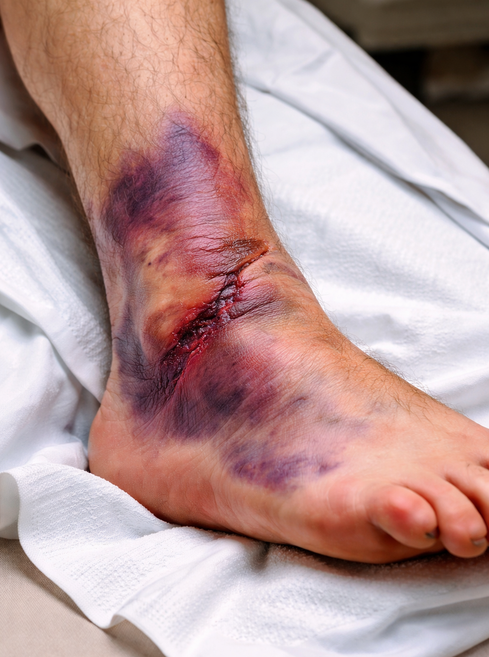
Describe the Clinical Image

Slide 10
What to do next?

Slide 11
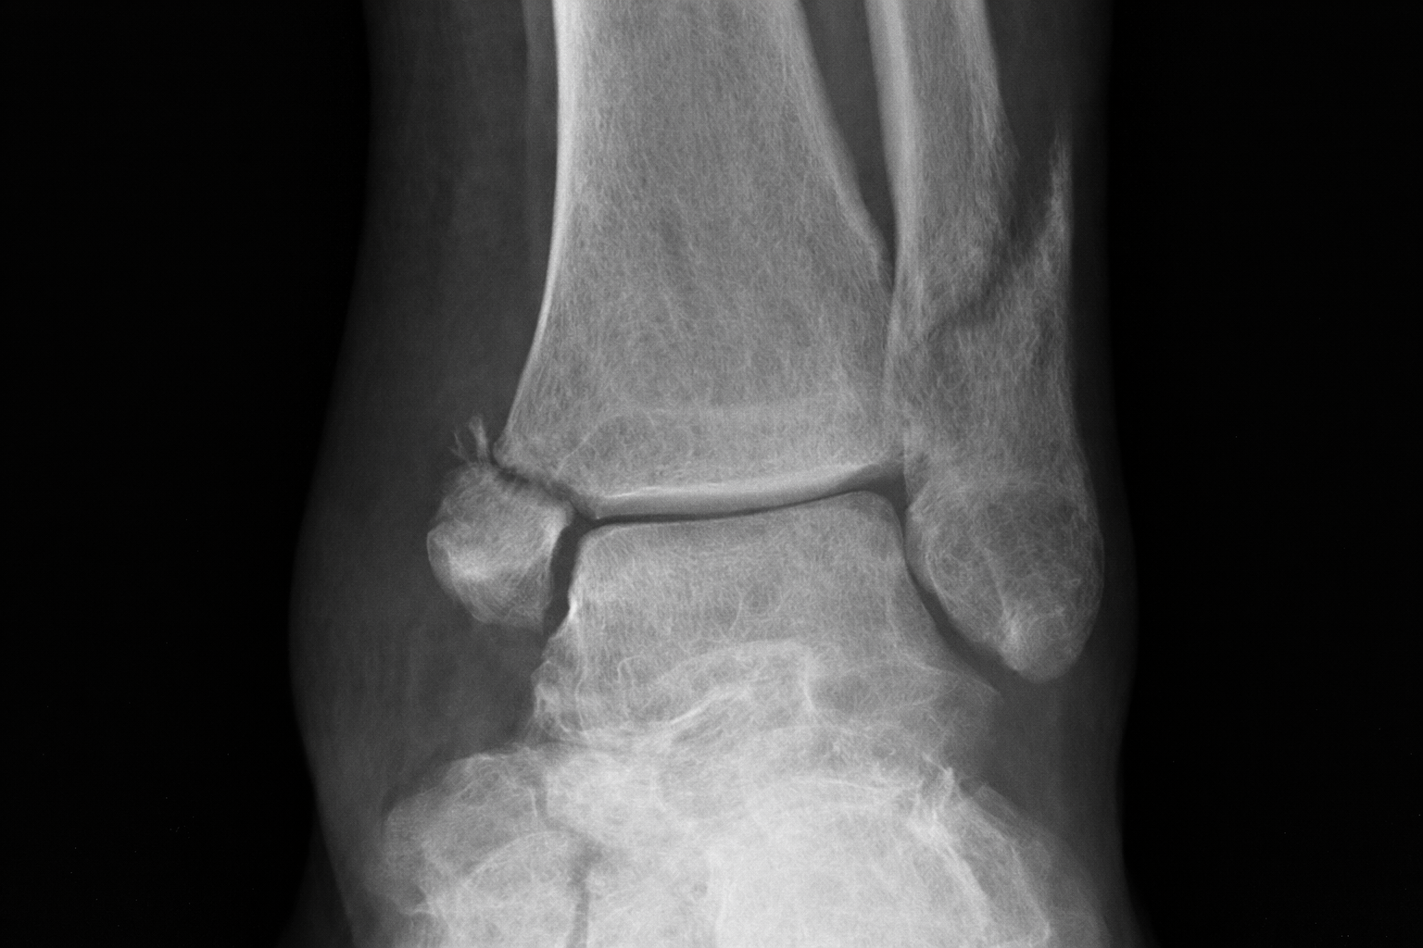
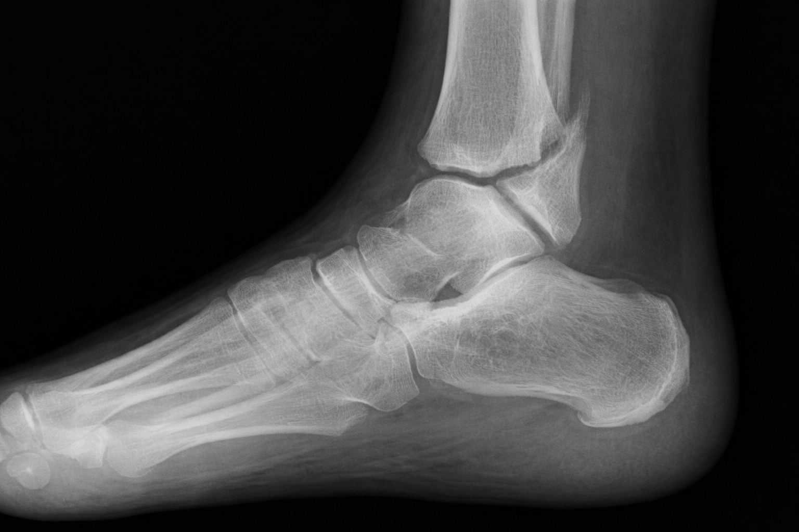
Read Images
L

Slide 12
How would you classify this fracture?

Slide 13
What is your treatment plan?

Slide 14
What Principal should be performed? Describe it?

Slide 15
Rapid fire questions
What is ring theory? Single midfoot fracture or dislocation should raise suspicion for additional occult injuries in the tarsometatarsal and transverse tarsal joints.
What antibiotics to use in Gustillo- Anderson Grade II? First-generation cephalosporin (e.g., Cefazolin / Ancef)
Most common type of ankle fracture? SERI IV
What is a posterior malleolus fracture called? Volkmann fracture
When to fix posterior malleolus fracture? If the fracture is more than 25%
6. Medications used in MRSA? Vancomycin, Linezolid, Daptomycin, Clindamycin, and Trimethoprim–sulfamethoxazole (Bactrim)
7. What antibiotics should be given to this patient? Clindamycin due to Penicillin Allergy

Slide 16
Rapid fire questions
8. What medications should be on hold for this patient prior to surgery? Lisinopril at. Least 24 hours prior.
9. Explain AO principal? Anatomic reduction, Preservation of blood supply, Stable fixation, and Early mobilization
10. What was the most recent thing that you fixed with your hands? Recently, I assembled and repaired a piece of furniture, making sure everything was properly aligned and stable, which taught me the importance of precision and attention to detail when working with my hands.
11. What complication is most predictive of poor outcome? Post-traumatic ankle arthritis.
12. Which Weber type has highest syndesmotic injury risk? Weber C.
13. What ligament injury is equivalent to a medial malleolus fracture? Deltoid ligament rupture.
14. Which fracture pattern always requires surgery? Bimalleolar or trimalleolar fractures.

Slide 17
Describe The Clinical Image This image shows a severely injured ankle with significant swelling, extensive bruising, and an open laceration over the joint. The findings suggest acute trauma with major soft-tissue injury, and there is concern for a serious underlying ankle injury,

Slide 18
Read Images
L
Spiral oblique fracture of the distal fibula at the level of the syndesmosis. Medial malleolar fracture. Medial clear space widening consistent with deltoid ligament disruption.
Posterior malleolar involvement visible on the lateral view.
Talar shift with mortise incongruity, indicating syndesmotic and ligamentous instability.

Slide 19
What Principal should be performed? Describe it? Charnley principle of fracture reduction. Exaggeration , Distraction, Reduction, Stabilization

Slide 20
How would you classify this fracture? SER IV, Weber B

Slide 21
What is your treatment plan?
An SER IV ankle fracture requires urgent immobilization and strict non–weight-bearing followed by definitive treatment with open reduction and internal fixation, often including syndesmotic stabilization. Postoperatively, the patient remains non–weight-bearing for approximately 6–8 weeks with gradual rehabilitation after radiographic healing.

