Slide 1


Achilles Tendon Rupture

Slide 2
HPI
A 38-year-old male presents with acute left foot pain after playing soccer, reporting a sudden “pop” while pushing off during play. He describes severe sharp and throbbing pain rated 9/10. Since the injury, he has been unable to bear weight on the left foot. He denies any direct trauma or prior symptoms before the incident.

Slide 3
What to do next?

Slide 4
PMH: No significant past medical history reported.
PSH: Denies any prior surgeries.
Social History: Physically active; plays recreational soccer. Denies tobacco use, illicit drug use; occasional alcohol use.
Medications: None.
Allergies: No known drug allergies (NKDA).
Review of Systems (ROS): Positive for left foot pain and inability to bear weight. Denies numbness, tingling, fever, chills, chest pain, shortness of breath, or other musculoskeletal complaints.

Slide 5
What to do next?

Slide 6
Physical exam
Vitals: Blood Pressure: 128/82 mmHg, Heart Rate: 92 bpm, Respiratory Rate: 18 breaths/min, Temperature: 98.4°F (36.9°C), Oxygen Saturation: 98% on room air
DERM: Mild posterior ankle edema and ecchymosis present; skin intact without open lesions.
VASC: Dorsalis pedis and posterior tibial pulses 2/4; capillary refill <3 seconds; no signs of vascular compromise.
NEURO: Sensation intact to light touch and pinprick; no motor deficits aside from plantarflexion weakness related to pain.
MSK: Left hindfoot demonstrates marked tenderness along the posterior heel and Achilles region with palpable defect in the tendon. Active plantarflexion is significantly weakened. Ankle range of motion is limited secondary to pain, and the patient is unable to perform a single-leg heel rise or bear weight on the left.

Slide 7
What to do next?

Slide 8
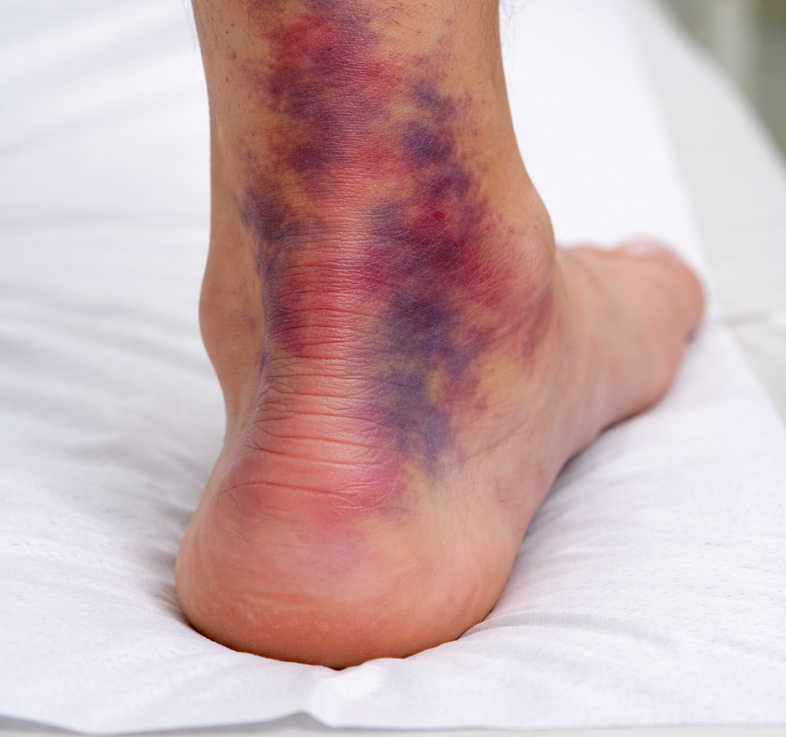
describe THE CLINICAL IMAGE

Slide 9
What to do next?

Slide 10
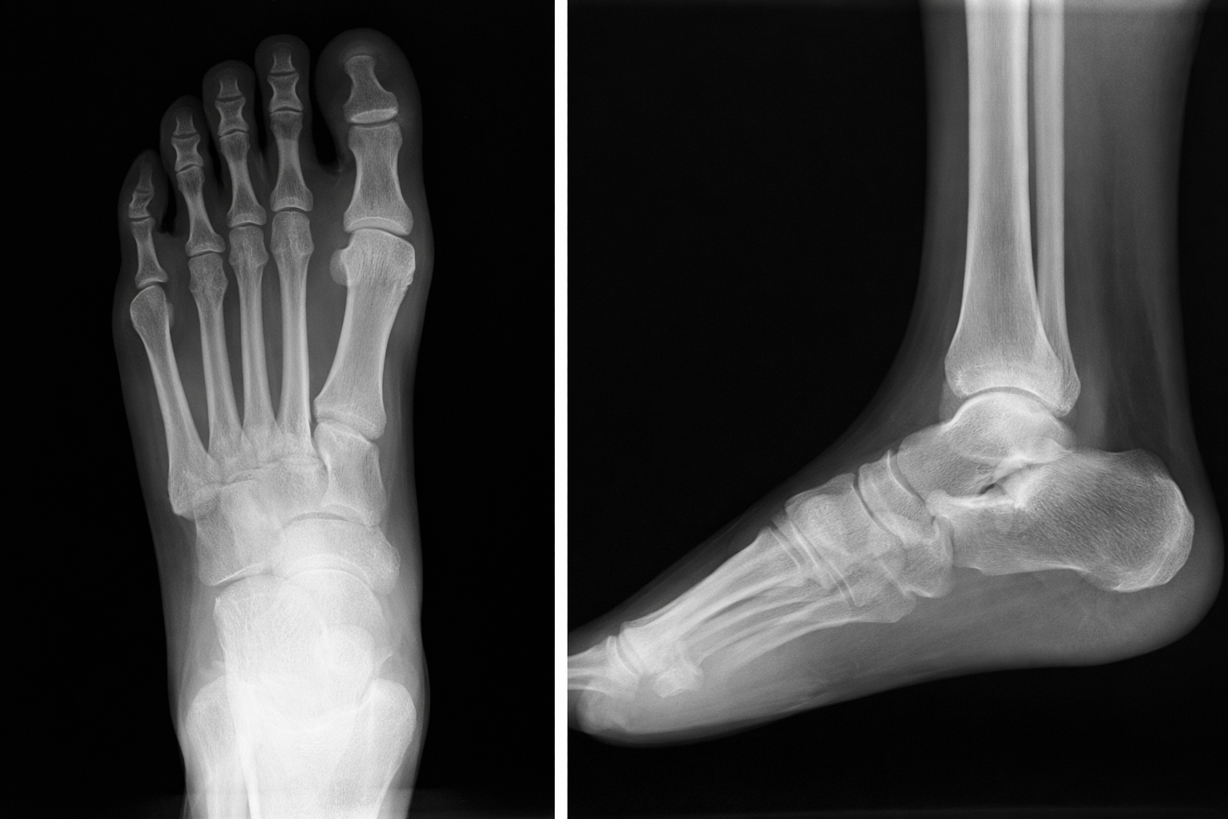
Read Images
L

Slide 11
What is your treatment plan?

Slide 12
Which classification system is used for Achilles tendon ruptures?

Slide 13
Rapid fire questions
Classic mechanism of Achilles tendon rupture?
Most sensitive physical exam test?
Most common age group?
Common risk factors (name 3)?
Best initial imaging?
Initial management in ED/clinic?
Operative vs non-operative key difference?
Most common complication?

Slide 14
Rapid fire questions
11. Location of rupture most commonly?
12. Can patients still plantarflex?
13. Why increased DVT risk?
14. Which structure lies immediately anterior to the Achilles tendon at the ankle?
15. Which nerve is at greatest risk during Achilles repair?
16. What fascial layer forms the Achilles paratenon?
17. Why does passive plantarflexion sometimes remain intact after rupture?

Slide 15
How long does a patient need to stay non-weight-bearing?

Slide 16
describe THE CLINICAL IMAGE The image shows the posterior aspect of the left ankle and heel with extensive ecchymosis and swelling along the course of the Achilles tendon. There is deep purple and reddish bruising extending from the distal calf to the calcaneal region, consistent with acute soft-tissue hemorrhage. The normal contour of the Achilles tendon appears blurred and thickened, suggesting tendon disruption.

Slide 17
Read Images
Osseous structures demonstrate normal alignment without evidence of acute fracture or dislocation. No calcaneal avulsion fracture is identified. Joint spaces are preserved. On the lateral view, there is loss of the normal sharp contour of Kager’s fat pad, suggesting posterior ankle soft-tissue abnormality.
L

Slide 18
What is your treatment plan?
1. Immobilize the left ankle in a posterior splint or CAM boot in plantarflexion.
2. Strict non-weight-bearing with crutches or knee scooter.
3. Order MRI (or diagnostic ultrasound) to confirm partial vs complete Achilles rupture and assess tendon gap.
4. Pain control: Ice, elevation, NSAIDs or acetaminophen as appropriate.

Slide 19
Which classification system is used for Achilles tendon ruptures?

Slide 20
Kuwada Classification:
Type I: Partial tear of the Achilles tendon with intact continuity.
Type II: Complete rupture with a tendon gap ≤ 3 cm.
Type III: Complete rupture with a tendon gap 3–6 cm.
Type IV: Complete rupture with a tendon gap > 6 cm, often chronic or neglected.
Clinical relevance: Lower-grade injuries (Types I–II) may be managed non-operatively or with primary repair, while higher-grade injuries (Types III–IV) often require surgical repair with tendon augmentation or reconstruction.

Slide 21
Rapid fire questions
Classic mechanism of Achilles tendon rupture? Sudden push-off or acceleration with a felt “pop.”
Most sensitive physical exam test? Thompson (calf squeeze) test.
Most common age group? Men aged 30–50 years.
Common risk factors (name 3)? Fluoroquinolones, corticosteroid use, weekend athletics.
Best initial imaging? Ultrasound (quick) or MRI (gold standard).
Initial management in ED/clinic? Posterior splint or CAM boot in plantarflexion, non-weight bearing.
Operative vs non-operative key difference? Lower re-rupture rate with surgery; similar function with modern functional rehab.
Most common complication? Re-rupture (non-op) or wound complications (operative).

Slide 22
Rapid fire questions
11. Location of rupture most commonly? 2–6 cm proximal to calcaneal insertion (watershed zone).
12. Can patients still plantarflex? Yes, due to intact accessory plantar flexors (FHL, FDL, peroneal).
13. Why increased DVT risk? Immobilization and calf muscle pump dysfunction.
14. Which structure lies immediately anterior to the Achilles tendon at the ankle? Kager’s fat pad
15. Which nerve is at greatest risk during Achilles repair? Sural Nerve
16. What fascial layer forms the Achilles paratenon? Deep Crural Fascia

Slide 23
How long does a patient need to stay non-weight-bearing? a patient typically remains non-weight-bearing for about 2–4 weeks. After this period, patients usually transition to protected weight bearing in a CAM boot with heel lifts, depending on whether treatment is operative or non-operative and the surgeon’s protocol.

