Slide 1


Bunion Case

Slide 2
HPI
A 59-year-old female with a history of smoking who presents with right foot bunion pain. She reports a sharp pain over the medial aspect of the right forefoot, which is significantly worsened when wearing high-heeled or narrow shoes. The pain has progressively increased over time and improves with shoe removal and rest. She denies recent trauma, numbness, or open skin changes.

Slide 3
What to do next?

Slide 4
PMH:
History of hypertension, hyperlipidemia, type 2 diabetes mellitus, and peripheral vascular disease. Longstanding tobacco use.
PSH:
Status post hysterectomy and prior right knee arthroscopy. No prior foot or ankle surgeries.
Social History:
Current smoker with a 30+ pack-year history. Wears high-heeled shoes regularly for work. Denies illicit drug use; occasional alcohol consumption. Limited exercise due to foot pain.
Medications:
Metformin, lisinopril, atorvastatin, aspirin.
Allergies:
No known drug allergies (NKDA).
Review of Systems (ROS):
Positive for chronic right foot bunion pain, described as sharp and worsened with prolonged standing and high-heeled shoe wear. Reports intermittent swelling and difficulty with ambulation. Denies open wounds, numbness, tingling, fever, chills, chest pain, or shortness of breath.

Slide 5
What to do next?

Slide 6
Physical Exam
DERM: Mild erythema and pressure callus over the medial first MTP joint; no open lesions or infection.
VASC: DP/PT pulses 2/4, capillary refill <3 seconds, no edema or color changes.
MSK: Right first MTP joint shows a prominent medial eminence with lateral deviation of the hallux and tenderness to palpation, consistent with hallux valgus; ROM is mildly limited and painful.
NEURO: Sensation intact to light touch and monofilament, motor function normal.

Slide 7
What to do next?

Slide 8
Vitals and Labs
Blood Pressure: 148/88 mmHg
Heart Rate: 86 bpm
Respiratory Rate: 18 breaths/min
Temperature: 98.1°F (36.7°C)
Oxygen Saturation: 96% on room air
138
102
28
198
4.6
23
1.4

Slide 9
Any Abnormalities?
Blood Pressure: 148/88 mmHg
Heart Rate: 86 bpm
Respiratory Rate: 18 breaths/min
Temperature: 98.1°F (36.7°C)
Oxygen Saturation: 96% on room air
138
102
28
198
4.6
23
1.4

Slide 10
What to do next?

Slide 11
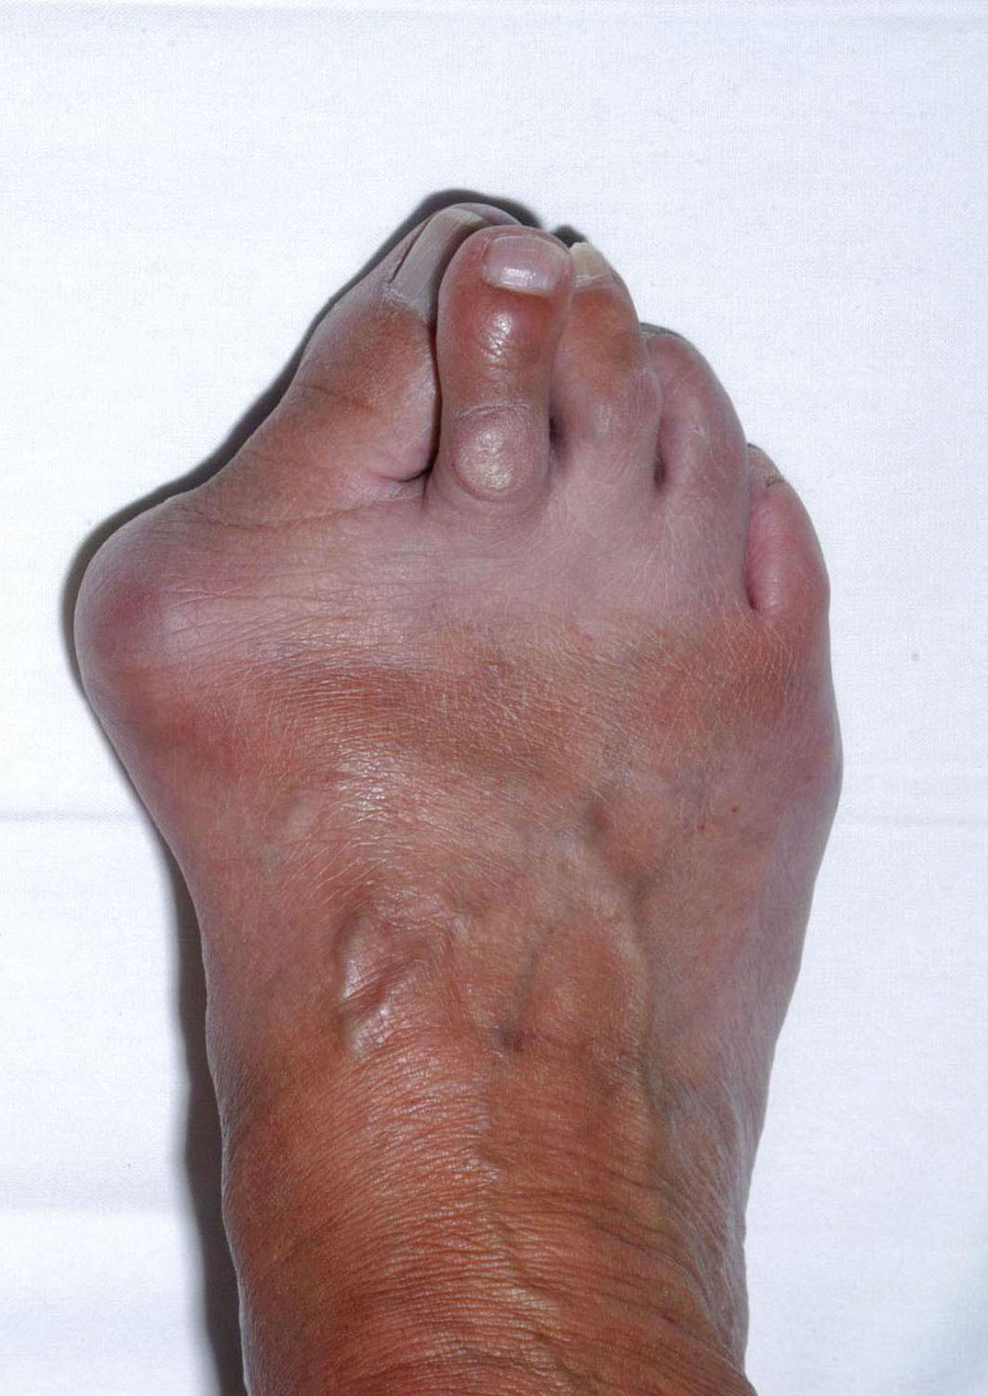

Describe The Clinical Image

Slide 12
What to do next?

Slide 13
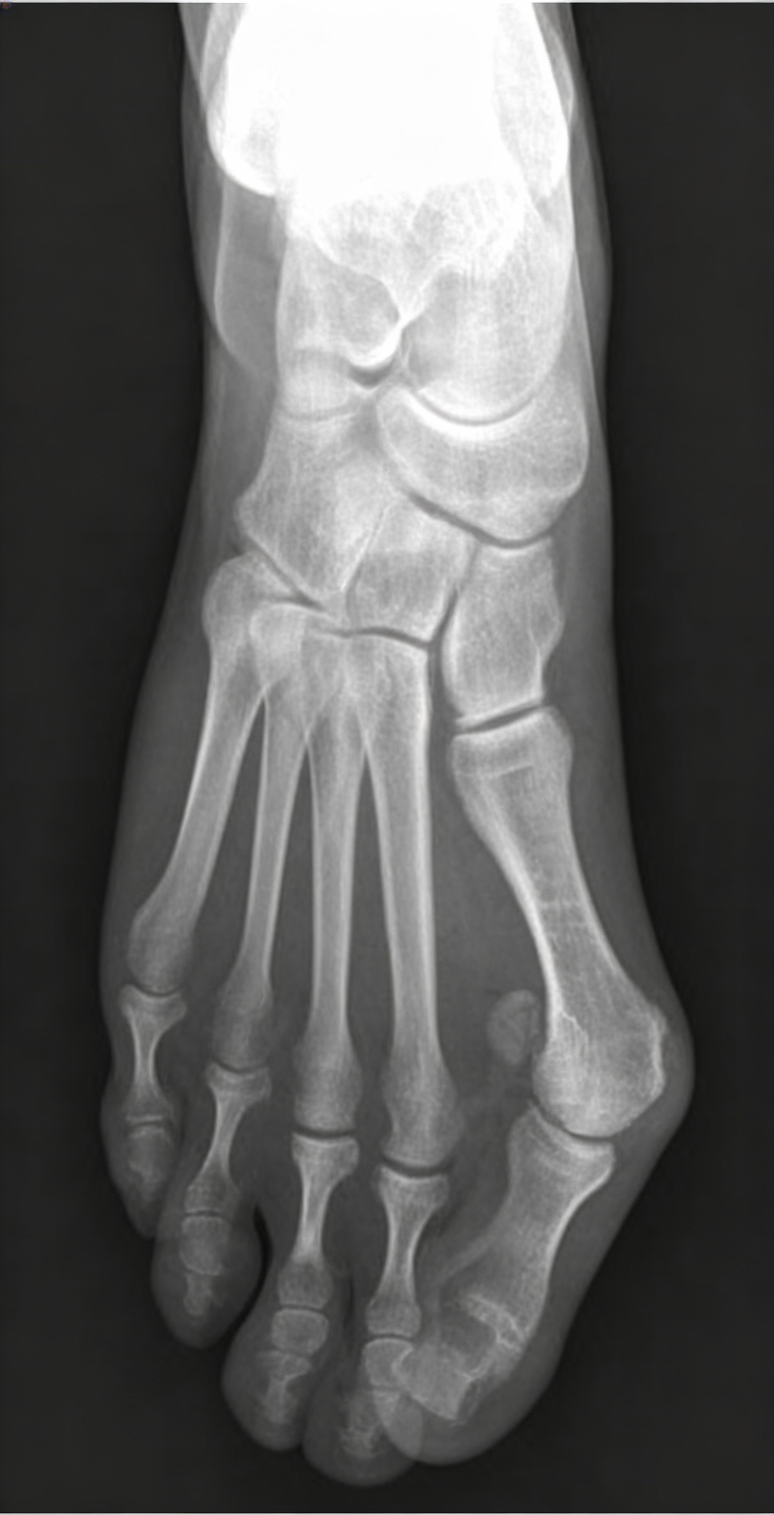
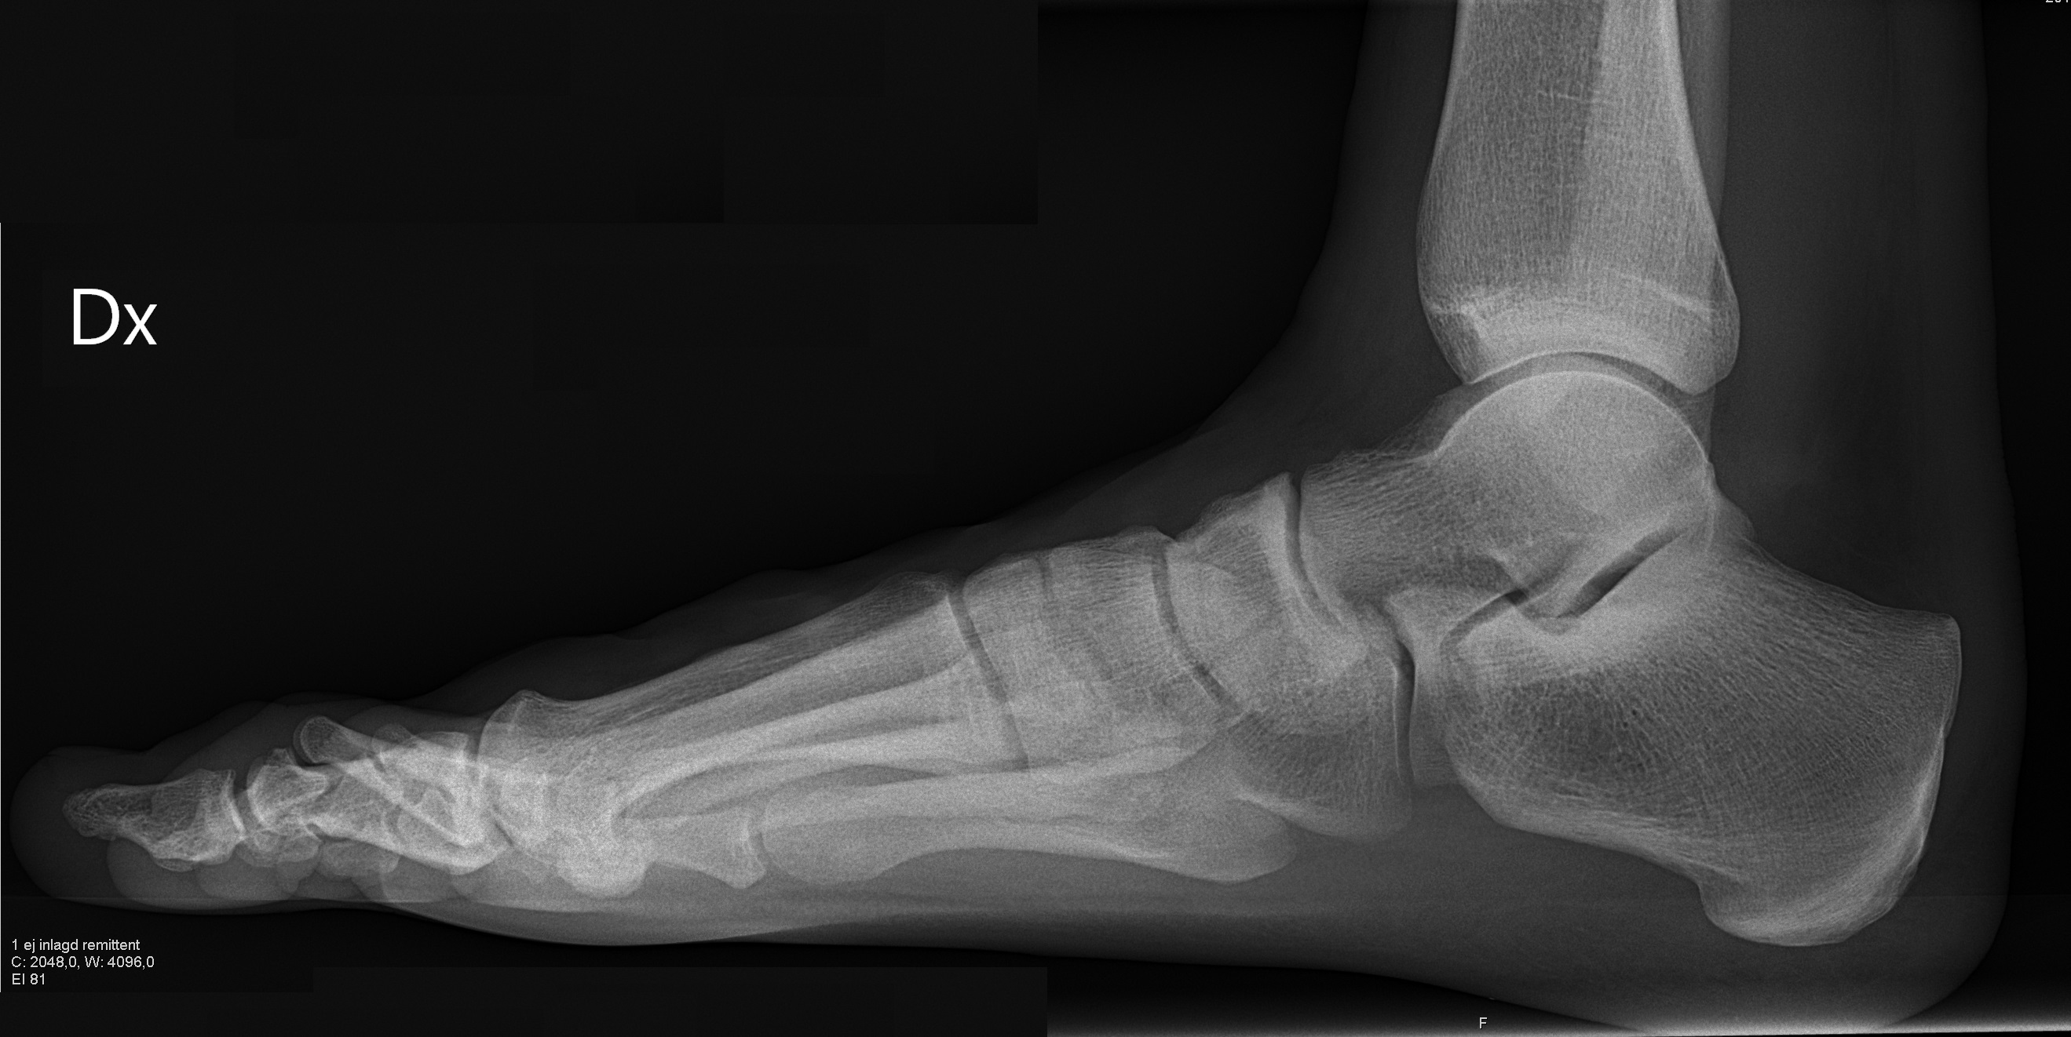
Read Images
L
R

Slide 14
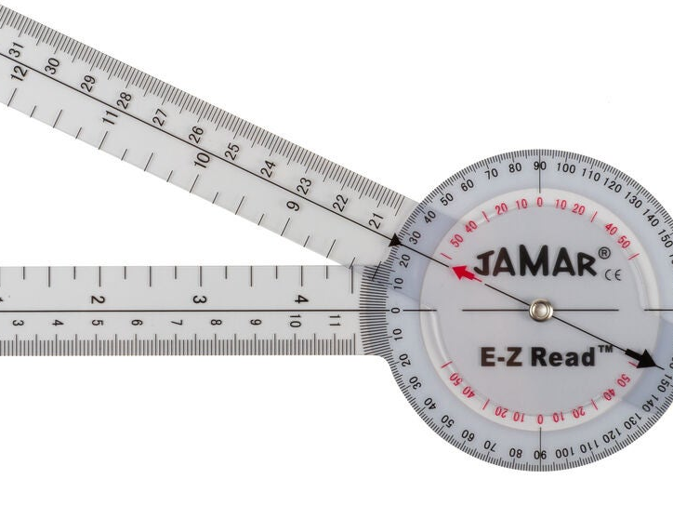

Angles
IM= 15$°$
HVA = 20$°$
HIA = 15$°$

Slide 15
What is your procedure of the choice?

Slide 16
Rapid fire questions
During a Z-osteotomy of the first metatarsal, what term describes collapse of the dorsal cortex into the plantar medullary canal?
What structure is commonly used to assess first metatarsal length?
Which hallux position is least tolerated after a first MTP joint fusion?
What is another name for first metatarsophalangeal joint fusion?
What deformity commonly occurs after removal of both sesamoids?
What is Moberg Procedure?
AVN of fibular sesamoid?

Slide 17
Rapid fire questions
11. Which sesamoid is most commonly displaced?
12. What nerve is commonly irritated in bunion surgery?
13. Which plane is hallux valgus primarily a deformity of?
14. What is the most common soft-tissue imbalance in bunion deformity?
15. What deformity occurs if both sesamoids are removed?
16. What sesamoid position grading system is commonly used?
17. What is the most common complication of bunion surgery?

Slide 18
Describe the Clinical Image
This clinical image demonstrates a severe forefoot deformity characterized by a prominent medial eminence at the first metatarsophalangeal joint consistent with advanced hallux valgus, with marked lateral deviation and rotation of the great toe, crowding of the lesser toes, and associated hammering/clawing deformities, resulting in a widened forefoot, altered toe alignment, and skin changes suggestive of chronic pressure and long-standing biomechanical imbalance.

Slide 19
Read Images
On the AP radiograph, the findings are consistent with severe hallux valgus. The hallux valgus angle (HVA) is markedly increased, estimated >40°, and the intermetatarsal angle (IMA 1–2) is significantly widened,
approximately >15–18°, indicating pathologic first-ray deviation. There is lateral subluxation of the proximal phalanx on the first metatarsal head with medial eminence formation and sesamoid displacement.
The lateral view demonstrates decreased calcaneal pitch and reduced talo–first metatarsal angle, consistent with pes planus, with no acute fracture identified.
L
R

Slide 20
What is your procedure of the choice? Chevron/Austin bunionectomy

Slide 21
Rapid fire questions
During a Z-osteotomy of the first metatarsal, what term describes collapse of the dorsal cortex into the plantar medullary canal? Troughing
What are the indications for Lapidus? Hypermobile first ray, Large IM angle and degenerative changes of midfoot
Which hallux position is least tolerated after a first MTP joint fusion? Dorsiflexion
What is another name for first metatarsophalangeal joint fusion? McKeever
What deformity commonly occurs after removal of both sesamoids? Cock up- Hallux
What is Moberg Procedure? It is a dorsal closing-wedge osteotomy of the proximal phalanx of the hallux performed to increase first metatarsophalangeal joint dorsiflexion, most commonly for hallux rigidus.
AVN of fibular sesamoid? Treves disease

Slide 22
Rapid fire questions
11. Which sesamoid is most commonly displaced? Tibial Sesamoid
12. What nerve is commonly irritated in bunion surgery? Dorsal Medial Cutaneous Nerve
13. Which plane is hallux valgus primarily a deformity of? Transverse Plane
14. What is the most common soft-tissue imbalance in bunion deformity? Lateral Capsule/ adductor hallucis contracture
15. What deformity occurs if both sesamoids are removed? Hallux Varus
16. What sesamoid position grading system is commonly used? Hardy- Clapham Classification
17. What is the most common complication of bunion surgery? Recurrence

