Slide 1


Pes Planus

Slide 2
HPI
A 20-year-old female who presents with left foot pain. Symptoms have been present for several years with gradual worsening. Pain is primarily along the medial foot and ankle, worsened by prolonged standing and walking, and improved with rest. She reports associated foot fatigue and intermittent swelling. Conservative treatments including supportive footwear, orthotics, activity modification, and NSAIDs have provided minimal relief. She denies trauma, numbness, or tingling.

Slide 3
What to do next?

Slide 4
PMH: No significant past medical history reported.
PSH: Denies any prior surgeries.
Social History: Physically active; participates in recreational soccer. Denies tobacco and illicit drug use. Reports occasional alcohol use.
Medications: None.
Allergies: Allergy to corticosteroids.
Review of Systems (ROS): Positive for left foot pain and inability to bear weight. Denies numbness, tingling, fever, chills, chest pain, shortness of breath, or other musculoskeletal complaints.

Slide 5
What to do next?

Slide 6
Physical Exam
Vitals: Temperature: 98.4°F (36.9°C), Blood Pressure: 118/72 mmHg, Heart Rate: 78 bpm, Respiratory Rate: 16 breaths/min, Oxygen Saturation: 99% on room air, Height: 5'5" (165 cm), Weight: 135 lb (61 kg), BMI: 22.5 kg/m²
VASC: Dorsalis pedis and posterior tibial pulses 2/4 with capillary refill <3 seconds; no ischemic changes.
NEURO: Protective and vibratory sensation intact; motor strength preserved except for mild weakness with inversion.
MSK: Left foot demonstrates collapse of the medial longitudinal arch with hindfoot valgus and forefoot abduction. There is tenderness along the course of the posterior tibial tendon and at the medial ankle. Single-heel rise is weak and painful on the left. Subtalar joint motion is increased and flexible.
DERM: Skin intact without ulceration or erythema; mild medial ankle swelling noted.

Slide 7
What Labs to order?

Slide 8
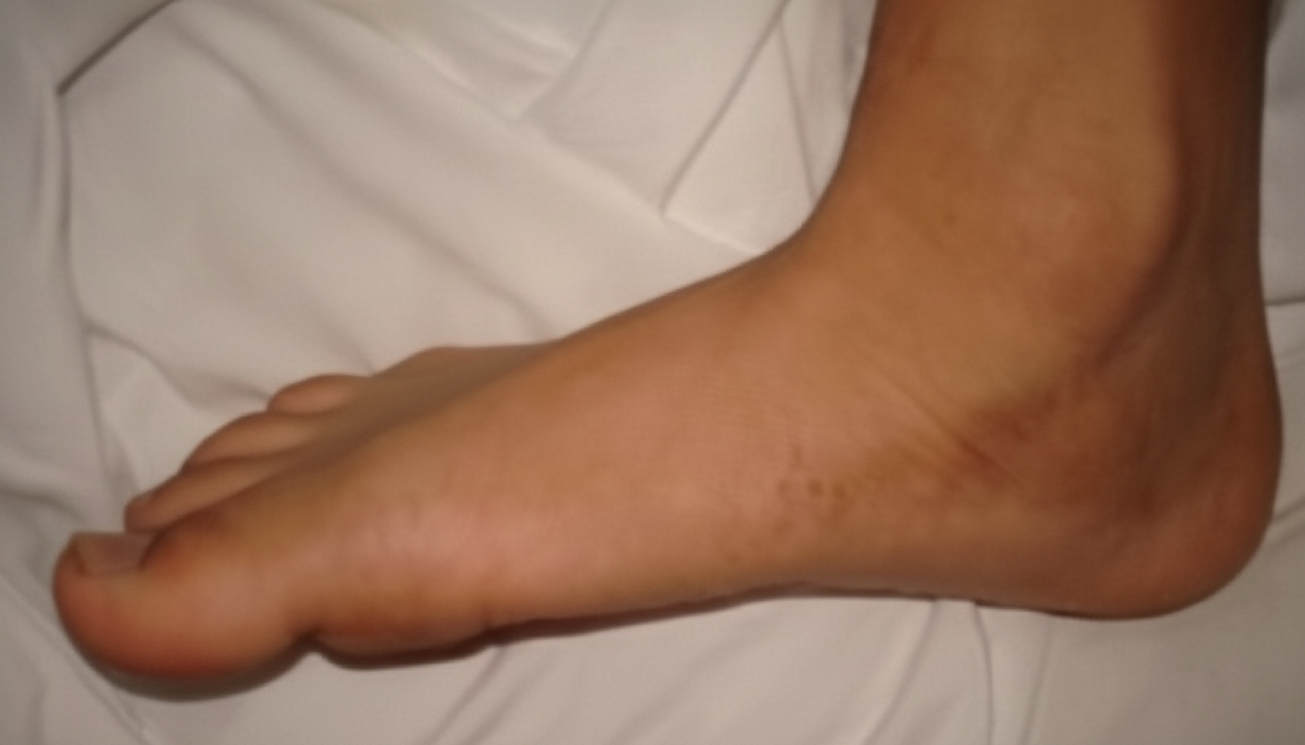
Describe The Clinical Image

Slide 9
What to do next?

Slide 10
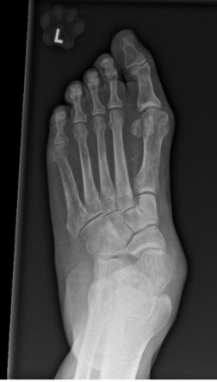
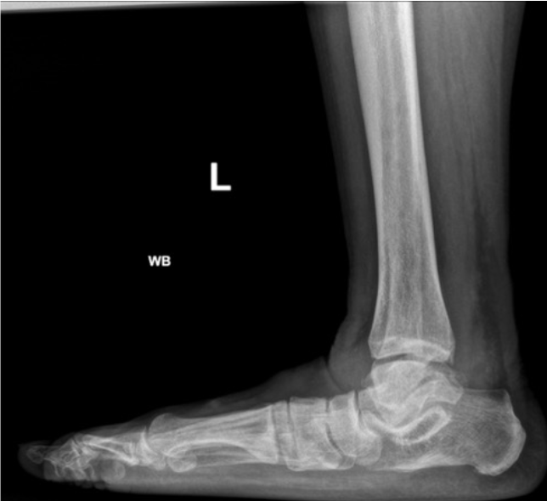
Read Images
L

Slide 11
What is your treatment plan?

Slide 12
Which classification system is used for PTTD?

Slide 13
Rapid fire questions
During TN fusion what is the most common site of non-union?
What is Bassett ligament?
Key goals of surgery of Pes Planus?
Procedure for forefoot abduction?
Primary tendon involved?
Tendon transfer used when PTT is insufficient?
Why address equines?
What calcaneal pitch angle suggests pathologic collapse?

Slide 14
Rapid fire questions
11. Definitive procedure for Stage III deformity?
12. What is dorsiflexory osteotomy of 1st metatarsal?
13. How many degrees of eversion we get with MBA implant?
14. Name different types of non-unions?
15. What is the appropriate classification for posterior tibial tendon based on MRI?
17. Which tendon is rerouted through a keyhole in the navicular during Young tenosuspension while maintaining its distal insertion to preserve dorsiflexion strength?

Slide 15
How long does a patient need to stay non-weight-bearing?

Slide 16
What Labs to order?
Urine Pregnancy Blood Test

Slide 17
Describe The Clinical Image The image demonstrates a weight-bearing foot with collapse of the medial longitudinal arch. There is hindfoot valgus with the calcaneus everted relative to the tibia, and from a posterior view there is a “too many toes” sign, indicating forefoot abduction. The medial border of the foot appears convex, and the arch is diminished or absent during stance. Overall alignment suggests a flexible flatfoot deformity consistent with pes planus.

Slide 18
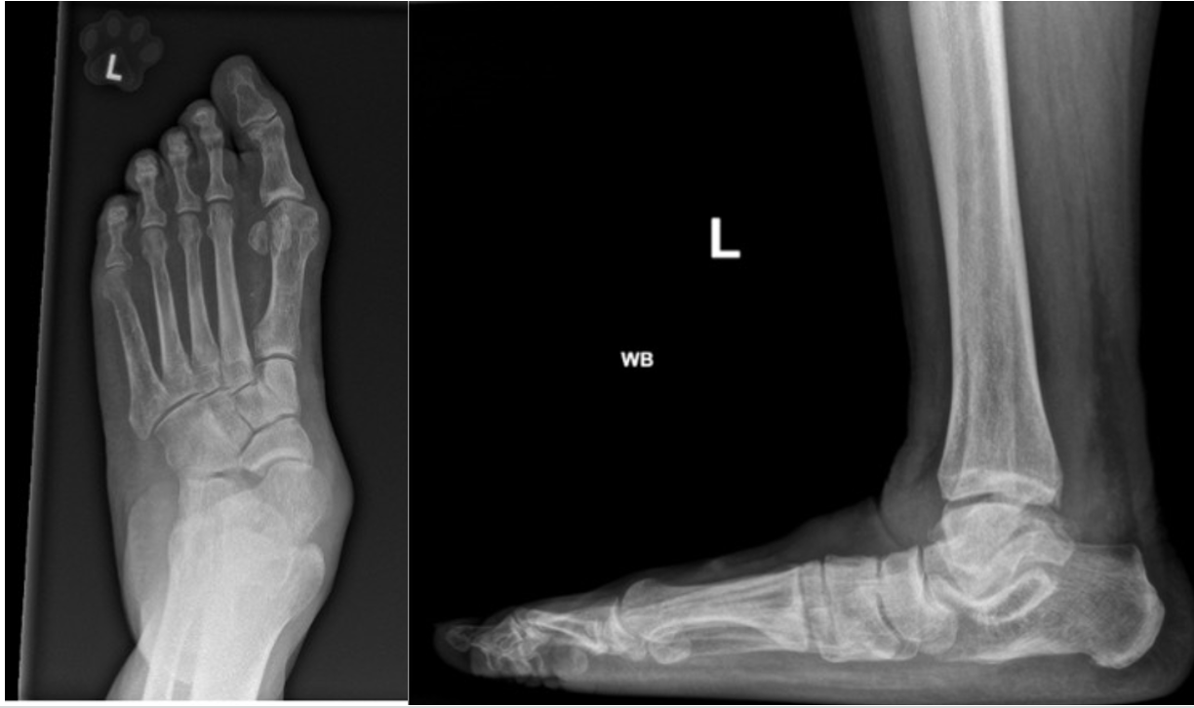
Read Images
The weight-bearing radiographs of the left foot demonstrate findings consistent with pes planus. On the AP view, there is forefoot abduction with increased talonavicular uncoverage and lateral deviation of the forefoot relative to the hindfoot. On the lateral weight-bearing view, there is collapse of the medial longitudinal arch, characterized by decreased calcaneal pitch and plantarflexion of the talus with increased talo–first metatarsal angle (Meary’s angle). Overall alignment is consistent with a flatfoot deformity, without obvious degenerative changes.
L

Slide 19
What is your treatment plan?

Slide 20
Which classification system is used for PTTD? Classification by Johnson & Strom (1989)

Slide 21
Johnson & Strom Classification (1989) (Posterior Tibial Tendon Dysfunction)
Stage I: Tenosynovitis of the posterior tibial tendon; no deformity, normal alignment
Stage II: Tendon dysfunction with flexible flatfoot deformity (hindfoot valgus, forefoot abduction)
Stage III: Rigid flatfoot deformity with subtalar arthritis
Stage IV: Stage III findings plus ankle involvement (valgus talar tilt / deltoid insufficiency)

Slide 22
Rapid fire questions
During TN fusion what is the most common site of non-union? lateral aspect of the talonavicular joint.
What is Bassett ligament? AITFL
Key goals of surgery of Pes Planus? Restore anatomic alignment, Correct hindfoot valgus, and Recreate the medial longitudinal arch
Procedure for forefoot abduction? Lateral column lengthening (Evans osteotomy).
Primary tendon involved? Posterior tibial tendon.
Tendon transfer used when PTT is insufficient? Flexor digitorum longus (FDL) transfer.
Why address equines? Tight gastrocnemius/Achilles worsens arch collapse.
What calcaneal pitch angle suggests pathologic collapse? <18°.

Slide 23
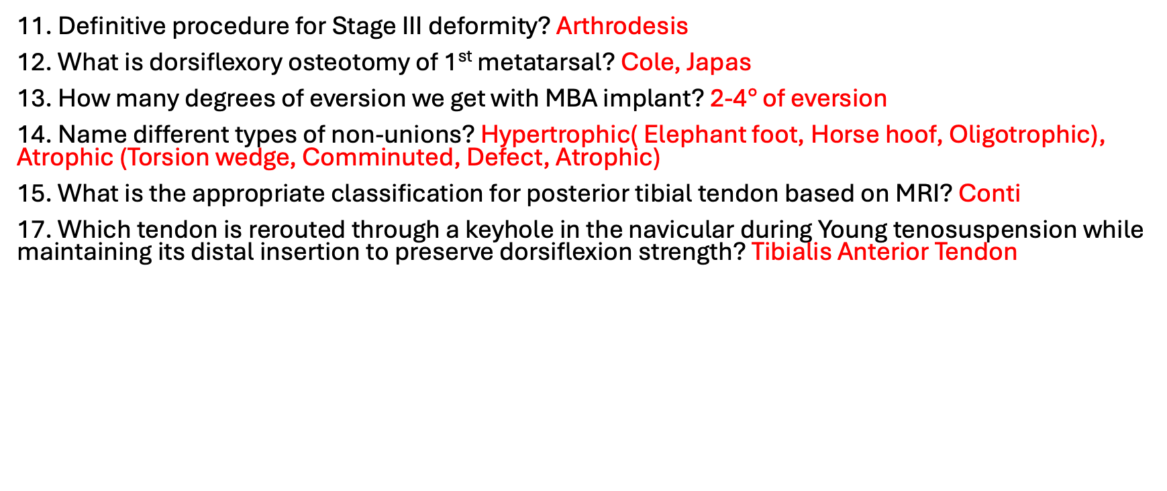
Rapid fire questions
11. Definitive procedure for Stage III deformity? Arthrodesis
12. What is dorsiflexory osteotomy of 1st metatarsal? Cole, Japas
13. How many degrees of eversion we get with MBA implant? 2-4$°$ of eversion
14. Name different types of non-unions? Hypertrophic( Elephant foot, Horse hoof, Oligotrophic), Atrophic (Torsion wedge, Comminuted, Defect, Atrophic)
15. What is the appropriate classification for posterior tibial tendon based on MRI? Conti
17. Which tendon is rerouted through a keyhole in the navicular during Young tenosuspension while maintaining its distal insertion to preserve dorsiflexion strength? Tibialis Anterior Tendon

Slide 24
How long does a patient need to stay non-weight-bearing? A patient typically remains non-weight-bearing for about 6–8 weeks.

