Slide 1


Talar Neck Fractures

Slide 2
HPI
A 23-year-old male who presents with acute right ankle pain following a snowboarding injury sustained earlier today while riding on-piste. He reports losing balance and landing awkwardly. He experienced immediate severe pain, swelling, and inability to bear weight. He denies head injury, loss of consciousness, or other trauma. No numbness or tingling is reported. Symptoms have remained constant since the injury, prompting evaluation.

Slide 3
What to do next?

Slide 4
PMH: No significant past medical history reported.
PSH: Denies any prior surgeries.
Social History: Physically active; participates in recreational soccer. Denies tobacco and illicit drug use. Reports occasional alcohol use.
Medications: None.
Allergies: No known drug allergies (NKDA).
Review of Systems (ROS): Positive for left foot pain and inability to bear weight. Denies numbness, tingling, fever, chills, chest pain, shortness of breath, or other musculoskeletal complaints.

Slide 5
What to do next?

Slide 6
Vitals
Blood Pressure: 134/86 mmHg
Heart Rate: 88 bpm
Respiratory Rate: 16 breaths/min
Temperature: 98.7°F (37.1°C)
Oxygen Saturation: 99% on room air
11
25
1.0

Slide 7
Physical Exam
DERM: Moderate edema with developing ecchymosis over the lateral ankle; skin intact without lacerations or fracture blisters.
VASC: Dorsalis pedis and posterior tibial pulses 2/4 with capillary refill <3 seconds; no signs of vascular compromise.
NEURO: Sensation intact to light touch and pinprick; motor function limited by pain but grossly intact.
MSK: Right ankle demonstrates significant swelling and diffuse tenderness, most pronounced over the lateral malleolus and anterolateral ankle ligaments. Range of motion is markedly limited due to pain. Pain is elicited with anterior drawer and inversion stress, and the patient is unable to bear weight.

Slide 8
What to do next?

Slide 9
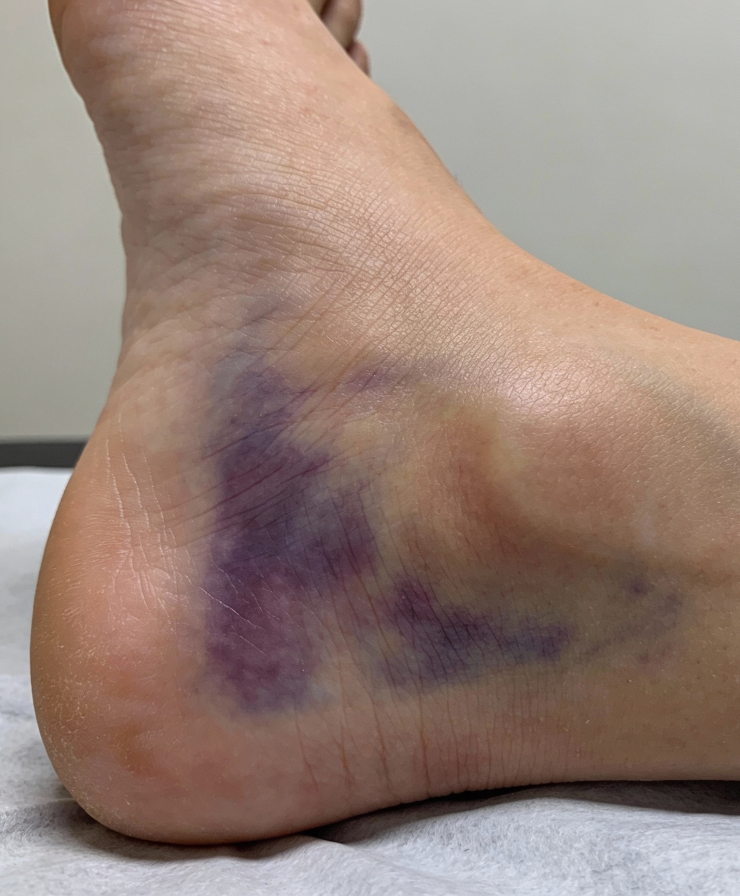
Describe the Clinical Image

Slide 10
What to do next?

Slide 11
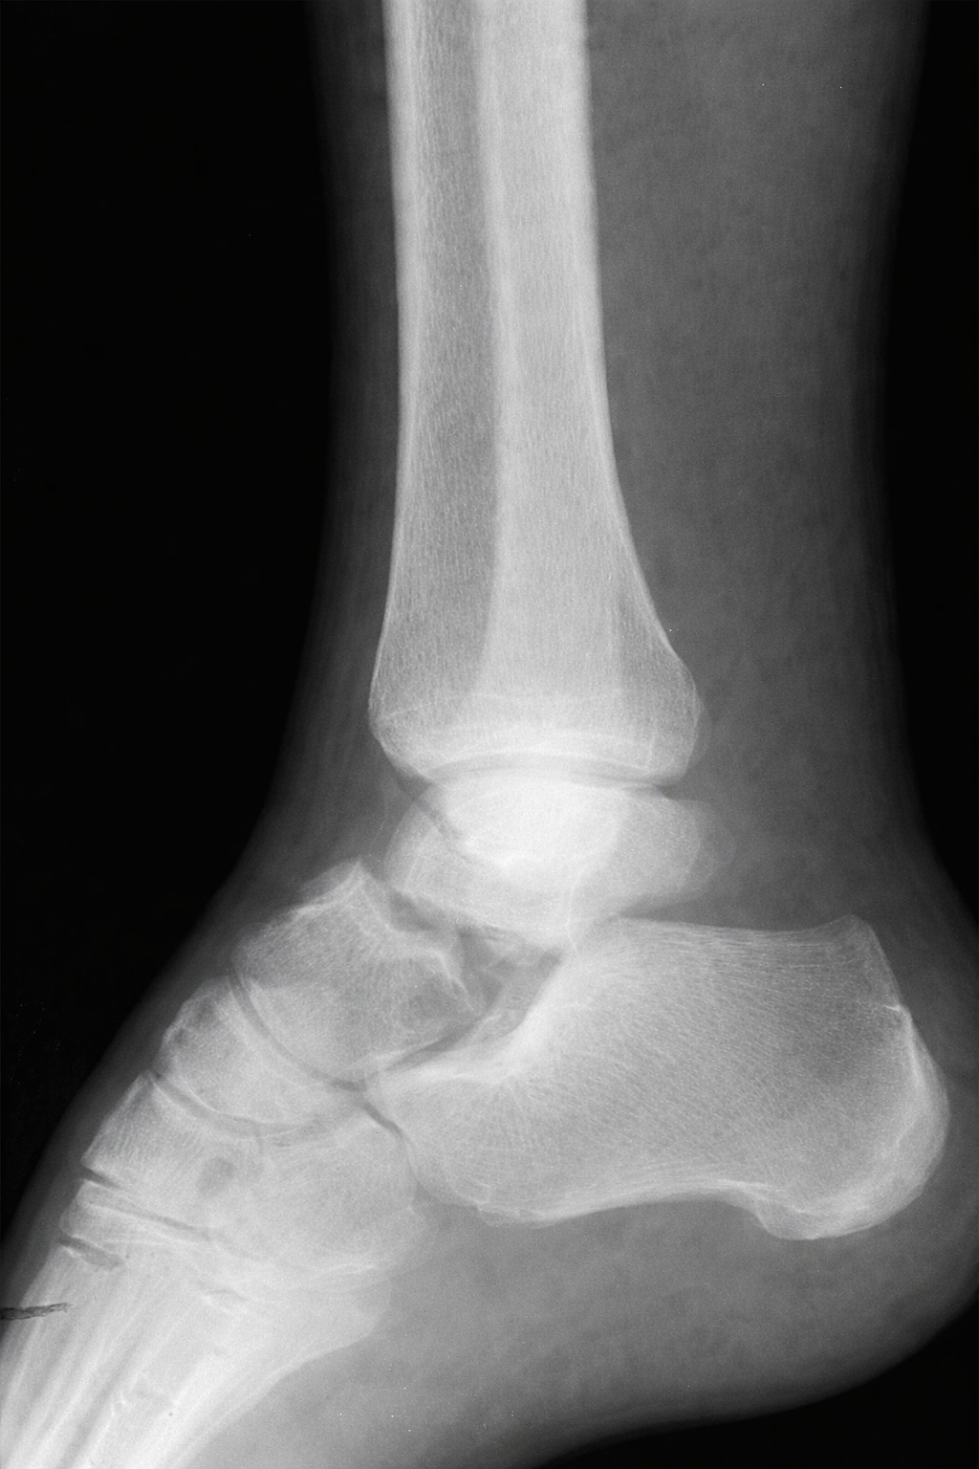
Read Images
L

Slide 12
What is your treatment plan?

Slide 13
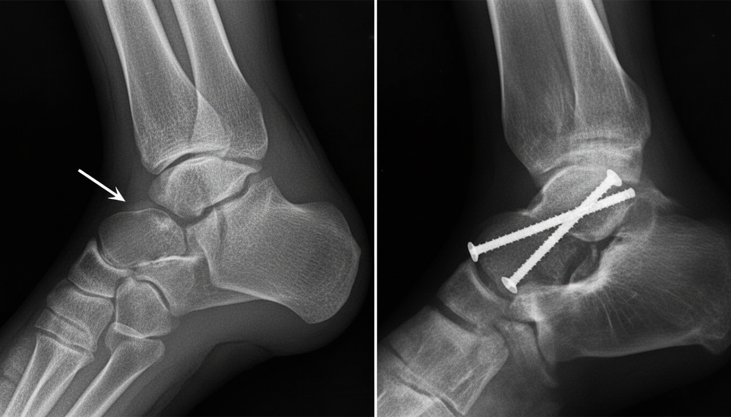
What Has Done?
L

Slide 14
Which classification system is used for Talar Neck Fracture?

Slide 15
Rapid fire questions
Most common mechanism of injury?
Why are talar neck fractures dangerous?
Primary blood supply at risk?
Most feared long-term complication?
Best imaging study after X-ray?
What does a positive Hawkins sign indicate?
When does Hawkins sign appear?
Classification system used?

Slide 16
Rapid fire questions
11. Hawkins Type I
12. Hawkins Type II
13. Hawkins Type III
14. Hawkins Type IV
15. Which Hawkins type has the highest AVN risk?
16. Treatment for displaced talar neck fracture?
17. Does perfect reduction eliminate AVN risk?

Slide 17
How long does a patient need to stay non-weight-bearing?

Slide 18
This clinical image shows the medial aspect of the ankle and heel with extensive purple and yellow ecchymosis and soft tissue swelling, consistent with a significant contusion or hematoma, most suggestive of an acute ankle injury such as a fracture or high-grade ligamentous rupture.
Describe this Clinical Image

Slide 19
Read Images
L
This lateral ankle radiograph demonstrates a talar neck fracture with displacement, showing disruption of the normal talar contour and incongruity at the tibiotalar and subtalar joints, consistent with a high-risk talar neck injury.

Slide 20
Which classification system is used for Talar Neck Fracture? Hawkin Classification

Slide 21
Rapid fire questions
Most common mechanism of injury? High-energy forced dorsiflexion of the ankle (e.g., MVC or fall from height).
Why are talar neck fractures dangerous? High-energy forced dorsiflexion of the ankle (e.g., MVC or fall from height).
Primary blood supply at risk? Posterior tibial artery (artery of the tarsal canal).
Most feared long-term complication? Avascular necrosis of the talus.
Best imaging study after X-ray? CT scan to evaluate fracture pattern and displacement.
What does a positive Hawkins sign indicate? Subchondral radiolucency = preserved talar vascularity (no AVN).
When does Hawkins sign appear? 6–8 weeks post-injury.

Slide 22
Rapid fire questions
9. Hawkins Type I : Nondisplaced talar neck fracture.
10. Hawkins Type II : Fracture with subtalar joint dislocation/subluxation.
11. Hawkins Type III : Fracture with subtalar + tibiotalar dislocation.
12. Hawkins Type IV : Fracture with subtalar + tibiotalar + talonavicular dislocation.
13. Which Hawkins type has the highest AVN risk? Hawkins Type IV.
14. Treatment for displaced talar neck fracture? Urgent ORIF (open reduction and internal fixation).
15. Does perfect reduction eliminate AVN risk? Vascular injury.

Slide 23
What Has Done? The image shows a talar neck fracture that has been treated with open reduction and internal fixation (ORIF), using two screws placed across the talar neck to stabilize the fracture.
L

Slide 24
How long does a patient need to stay non-weight-bearing? Strictly non–weight-bearing for about 8–12 weeks.

