Slide 1


Pes Cavus

Slide 2
HPI
A 15-year-old male presenting with long-standing high arches of both feet, noted for several years. He reports intermittent foot pain along the lateral foot and forefoot, worsened with prolonged activity, as well as frequent ankle sprains. He also notes callus formation and difficulty with shoe wear. No history of trauma, neurologic symptoms, or prior treatment is reported.

Slide 3
What to do next?

Slide 4
Past Medical History: Unremarkable; no chronic medical conditions.
Past Surgical History: No history of surgical procedures.
Social History: Active lifestyle; plays recreational soccer. Denies smoking or illicit substance use. Admits to occasional alcohol consumption.
Medications: Not currently taking any medications.
Allergies: No known allergies to medications.
Review of Systems: Reports left foot pain with inability to bear weight. Denies sensory changes, fever, chills, cardiopulmonary symptoms, or additional joint or muscle pain.

Slide 5
What to do next?

Slide 6
Vitals
146
100
16
Blood Pressure: 140/82 mmHg
Heart Rate: 95 bpm
Respiratory Rate: 17 breaths/min
Temperature: 98.4°F (36.9°C)
Oxygen Saturation: 98% on room air
110
4.1
24
1.2

Slide 7
Physical Exam
Derm: Skin intact bilaterally. Calluses at plantar 1st and 5th met heads and lateral heels. No erythema or open lesions.
Vascular: DP/PT pulses 2/4 bilaterally. Cap refill <2 sec. No edema.
MSK: Bilateral high arches with hindfoot varus. Forefoot plantarflexed. Mildly limited ankle dorsiflexion. Peroneal strength 4/5; others 5/5. Positive ankle instability with lateral column overload on gait.
Neuro: Light touch and vibration intact. Reflexes 2+ and symmetric. No sensory deficits.

Slide 8
What to do next?

Slide 9
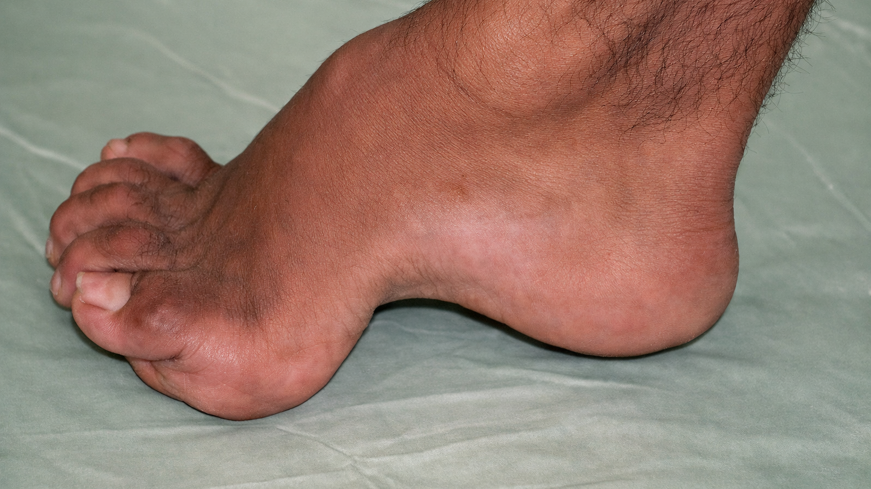
Describe the Clinical Image

Slide 10
What to do next?

Slide 11
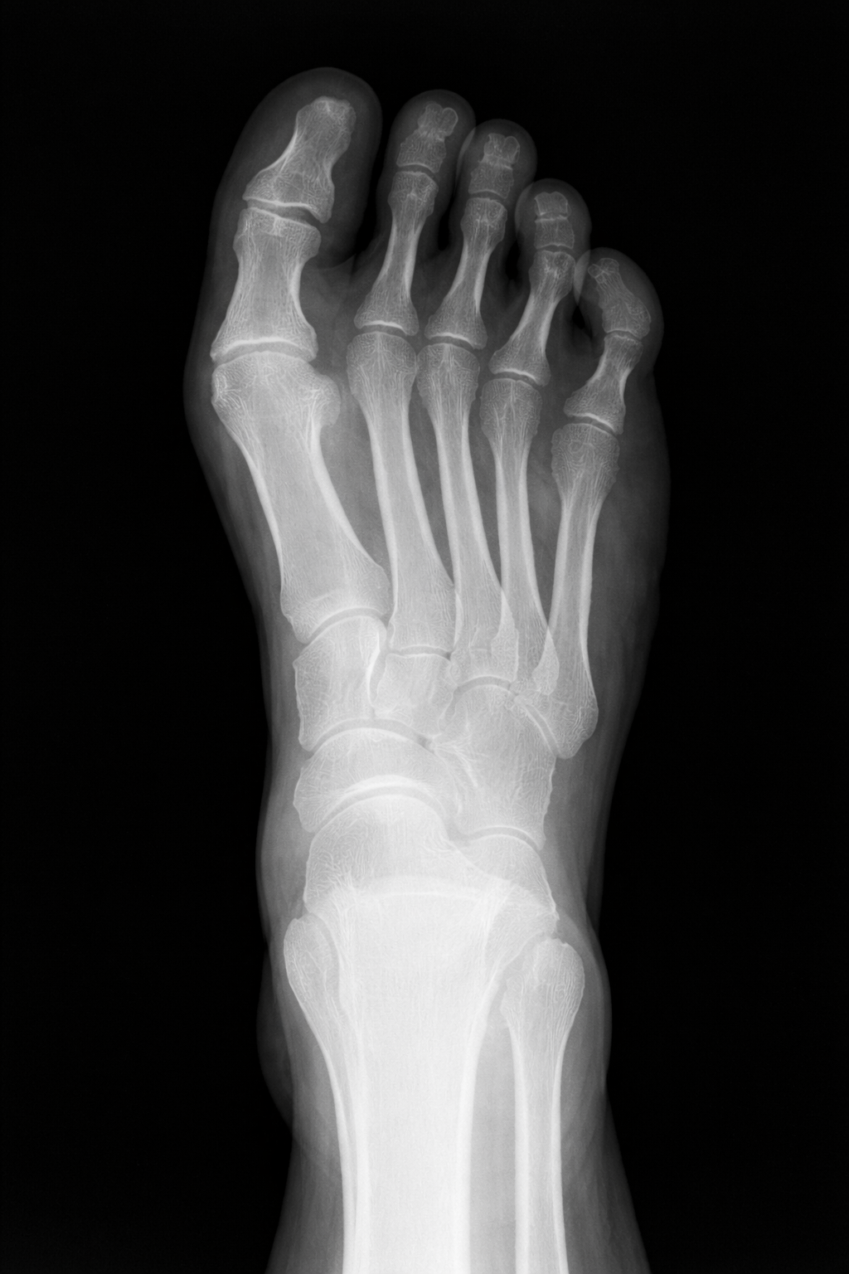
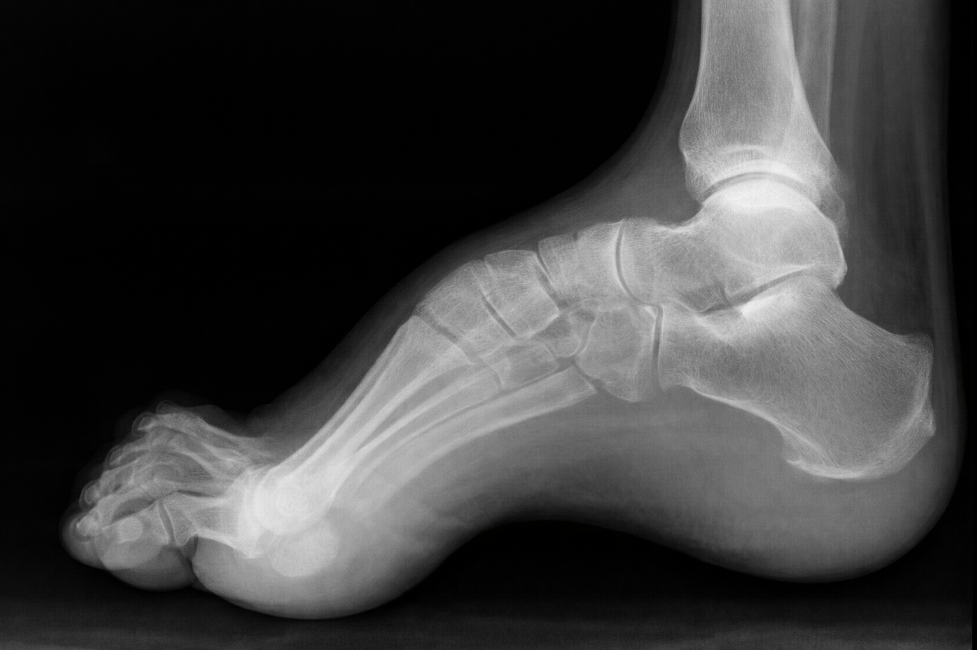
Read Images
L

Slide 12
What is your treatment plan?

Slide 13
What clinical test should be performed?

Slide 14
Rapid fire questions
What radiographic angle is increased on lateral view in cavus foot?
Which muscle imbalance most commonly produces a plantarflexed first ray in cavus deformity?
What neurologic disease is most commonly associated with bilateral pes cavus in adolescents?
What clinical finding distinguishes cavus from planus during weight-bearing?
In a Coleman block test, what does persistent hindfoot varus indicate?
Which nerve is most commonly involved in recurrent ankle sprains in cavovarus feet?
What plantar pressure pattern is expected under the metatarsals in cavus foot?

Slide 15
Rapid fire questions
8. Which tendon transfer is commonly used to rebalance cavovarus deformity?
9. What gait abnormality is most characteristic in cavus patients?
10. What is the most common overall foot type associated with chronic lateral ankle instability?

Slide 16
Describe The Clinical Image The image demonstrates a cavus foot deformity characterized by a markedly elevated medial longitudinal arch, a plantarflexed forefoot, and clawing of the lesser toes. The hindfoot appears prominent with reduced plantar surface contact, suggesting altered weight distribution and decreased shock absorption. These structural features are typical of a cavovarus-type foot and are commonly associated with lateral column overload and recurrent ankle instability.

Slide 17
Read Images
AP and lateral views demonstrate a cavus foot configuration. On the lateral projection, there is a markedly increased medial longitudinal arch with an elevated calcaneal pitch and plantarflexion of the forefoot relative to the hindfoot. The talo–first metatarsal alignment is increased, consistent with a cavus architecture. On the AP view, there is relative narrowing of the midfoot with lateral column overload and mild forefoot adduction. No acute fracture, dislocation, or destructive osseous process is identified. Joint spaces are preserved.
Impression: Findings are most consistent with pes cavus.
L

Slide 18
What is your treatment plan?
Custom functional orthotics with lateral posting, first-ray recess, and metatarsal offloading.
Ankle brace for recurrent instability.
Supportive footwear with cushioning and a wider toe box.
Physical therapy focusing on peroneal strengthening and gastrocnemius–soleus stretching.
Soft-tissue balancing (e.g., peroneus longus to brevis transfer).
Osseous realignment procedures based on deformity driver (e.g., first met dorsiflexion osteotomy, calcaneal osteotomy).

Slide 19
What clinical test should be performed? Coleman Block Test, Distinguishes forefoot-driven vs hindfoot-driven cavus.

Slide 20
Rapid fire questions
What radiographic angle is increased on lateral view in cavus foot? Increased calcaneal pitch.
Which muscle imbalance most commonly produces a plantarflexed first ray in cavus deformity? Overpowering peroneus longus with weak tibialis anterior.
What neurologic disease is most commonly associated with bilateral pes cavus in adolescents? Charcot-Marie-Tooth disease.
What clinical finding distinguishes cavus from planus during weight-bearing? Persistently high medial arch in both stance and non–weight-bearing.
In a Coleman block test, what does persistent hindfoot varus indicate? Hindfoot-driven (fixed) cavus.
Which nerve is most commonly involved in recurrent ankle sprains in cavovarus feet? Sural nerve.
What plantar pressure pattern is expected under the metatarsals in cavus foot? Increased pressure under the 1st and 5th metatarsal heads.

Slide 21
Rapid fire questions
8. Which tendon transfer is commonly used to rebalance cavovarus deformity? Peroneus longus to brevis transfer.
9. What gait abnormality is most characteristic in cavus patients? Lateral column overload with early heel-off.
10. What is the most common overall foot type associated with chronic lateral ankle instability? Cavovarus foot type.

