Slide 1
Integrated Care; Coming of A New Age? Robert E Feinstein MD Professor of Psychiatry UNIVERSITY OF COLORADO School of Medicine
Integrated Care: Coming of Age?
Robert E. Feinstein MD.
Professor of Psychiatry
Feinster@Rob FeinsteinMD.com

Slide 3
OBJECTIVES
1) Understand the Collaborative Care Model & its
relationship to the Primary Care Medical Home &
Medical Neighborhood
2) Describe 3 different models of Collaborative Care
3) Review a few guidelines & outcome measures
that may be useful in an integrated care setting

Slide 4
DISCLOSURE
I have no financial relationship or any
conflict of interest to report with the exception
I recommend
our New Edited Book
Notes:
NO OTHER CONFLIECT OF INTEREST

Slide 5
How Many of You Are Currently Working
in an Integrated Care Environment?
How Many of You Believe You will be Working
in an Integrated Care Enviroment?
How Many of You Want Nothing to Do
with Integrated Care Enviroments?

Slide 6
70% of Patient Primary Care Visits
Related to Behavioral Health
Integrated Care
System
1 in 5 Diagnosed with a
Mental Health /Substance Use
Disorder

Slide 7
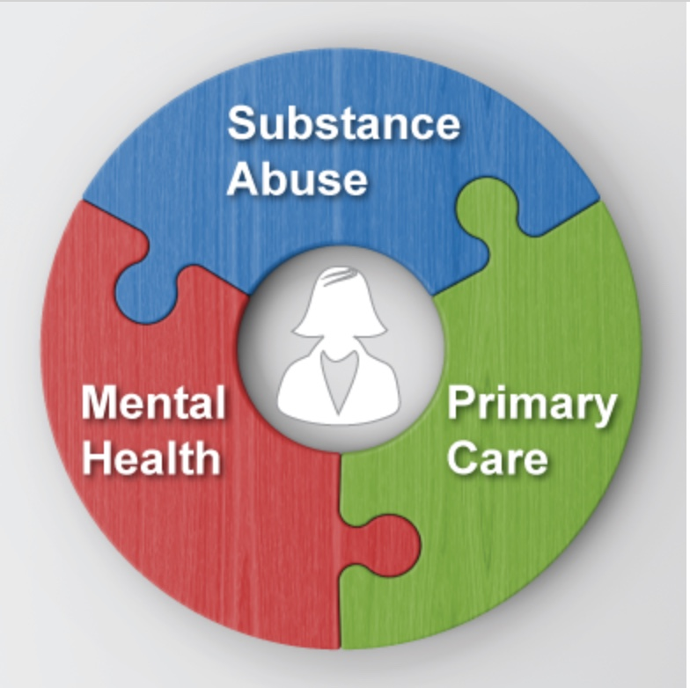
Primary Care Integration: Definition
Agency for Healthcare Research & Quality
“The care that results from a practice team of
primary care and behavioral health clinicians,
working together with patients and families,
using a systematic and cost-effective approach
to provide patient-centered care for a defined
population.”
Notes:
Care May Address
Mental health and substance abuse conditions
Health behaviors (and contribution to chronic medical illnesses)
Life stressors and Crises
Stress-related Physical Symptoms
Ineffective Patterns of Health Care Utilization

Slide 8
Patient-Centered Medical Home (PCMH)
2.
5.
3.
1.
6.
4.
PCP Direct Care
7.
Payment Reform
Notes:
The patient-centered medical home (PCMH) is a framework for integrated care based on 7 principles
1) Personal Physician:
2) Physician-Directed Medical Practice: MD leads a team
3) Whole Person Orientation: All of the patient’s health care needs.
4) Care is Coordinated and/or Integrated across the health care system.
5) Quality and Safety
6) Enhanced Access to Care through practice systems.
7) Increase capacity and Accountability leading to Payment Reform which recognizes the added value
to provide patient-centered, comprehensive, coordinated, and accessible care.
The PCMH is the hub of care, interfacing specialty care, behavioral health, hospitals, home health, nursing homes, and community services. Formal relationships with the medical neighborhood are essential.
The PCMH has been shown to decrease costs and improve outcomes of patients.
Payment models to support the PCMH are beginning to be implemented and include fee-for-service, a monthly maintenance fee, and shared savings.
The Triple Aim is the simultaneous pursuit of improved patient experience of care, improved population health, and reduced per capita health care costs. Integrated behavioral health care is both conceptually aligned with the Triple Aim and essential to the required systems transformation needed to achieve its intended outcomes.

Slide 9
Notes:
Agency for Healthcare Research and Quality (AHRQ) in 2011, Taylor et al²² describe the medical neighborhood as a not a geographic location, but rather a “set of relationships revolving around the patient.”
Care teams, typically anchored by the patient centered medical home develop individualized care plans for complex patients.
Clear agreement upon, and delineation of, the respective roles of neighbors in the system.Strong community linkages
agreement on care transitions, pre-referral arrangements, referral and follow-up guidelines from professional societies, or others).
3. Shared clinical information needed for effective decision-making and reduced duplication and waste in the system, supported by appropriate health Internet Technology (IT) systems.
4.Continuity of needed medical care when patients transition between settings, with active communication, coordination, and collaboration among everyone involved in the patient’s care, including clinicians, patients, and families.
5. A focus on the patient’s preferences, perhaps with the dedicated Primary Care Coordinator with the patient centered medical home playing a key role in interfacing with other clinicians to ensure that patient preferences are incorporated into decision-making.
Strong community linkages that include both clinical and nonclinical services (such as personal care services, home-delivered meals, school-based care, linkages with mental health and addiction services).

Slide 10
Notes:
1) Practice climates, cultures, and habits typical for each may clash at times which can make collaboration challenging
2) Each professional contributes meaningfully from his or her skillset in a manner that supports that management.
TEAM
Primary Care Clinicians NP
Medical assistants (MAs),
Licensed practical nurses (LPNs), registered nurses (RNs),
Care managers provide assistance to patients to both extend and deepen the care provided
Behavioral Health Specailist
Psychiatrist in Primary Care: Patient Consultation, Clinician Education, and Population Health
Teams: Level of Consultation & Collaboration Patient-specific PCP Education
Curbside” or “Hallway” Consultation
Formal Indirect Consultation Through the Care Manager
Formal Direct Consultation
E-Consults
Teamlets: 2 or more team member (Care manager & BHS)
PCP & Psychiatrist
Medical and Mental Health Team Meetings
Registry

Slide 11
Financing
Notes:
Fee for Service not sustainable
Much value in medical cost offset which is often not considered
Carve Care back in
Must targeting of individuals with greater severity and high frequency medical comorbidities
Global Budget; Value base payment non volume
Pay 4 performace – Base on quality measure
Bundled payments
Capitated plans for whole populations
Shared Savings: incentives for quality and cost control by transferring a portion of the risk onto healthcare providers and tying that risk to quality metrics

Slide 12
Formal Accreditation Integrated Care
The National Committee for Quality Assurance (NCQA)
The Joint Commission accredits organizations for PCMH
Utilization Review Accreditation Commission (URAC)

Slide 13
IMPACT STUDY
1. Team
Depression Clinical Specialist
PCP
Psychiatrist
2. Weekly Team Meeting
Registry Tracking
(Weekly & Monthly)
3. Stepped Care
Step 1: Meds/Problem Solving
Therapy
Step 2: Switch
Step 3: Psychiatrist Consult,
Multiple Meds + Therapy, Hospital. etc.
Improving Mood Promoting Access to Collaborative Treatment (IMPACT)
Notes:
JÜRGEN UNÜTZER, MD, MPH,* WAYNE KATON, MD,† J Improving Mood-Promoting Access to Collaborative Treatment (IMPACT)
1st major collaborative care program for late-life depression that includes four essential elements: It included 18 diverse primary care clinics within eight health care organizations across the United States, including one VA.
Include1) team PCP, 2) Depression Clinical Specialist (Care Manager) and 3)Psychiatrist 4) Step Care
STEPPED CARE
STEP 1- ANTIDEPRESSEANTS OR PROBLEMSOLVING THERAPY ( 8 TO 12 WEEKS)
STEP 2 alternative antidepressant, a switch from medications to PST-PC, or vice versa.( 6 TO 10 WEEKS)
STEP 3 ( 6 TO 12 WEEKS) psychiatric consultation and step 3 treatment. This often involves a combination of treatments (more than one antidepressant or an antidepressant plus PST-PC). In some difficult to treat cases, the psychiatrist may recommend inpa- tient hospitalization, electroconvulsive therapy, or other specialty mental health treatments not avail- able in primary care.
Results: At one year, about half of the patients receiving IMPACT care reported a reduction in depression symptoms of at least 50%, compared with only a 19% reduction for those in usual care. While physical functioning steadily declined in usual care patients, it improved in patients receiving IMPACT care.26

Slide 14
DIAMOND STUDY
Depression Initiative Across Minnesota, Offering a New Direction (DIAMOND)
Notes:
Solberg LI, Crain AL, Jaeckels N, Ohnsorg KA, Margolis KL, Beck A, Whitebird RR, Rossom RC, Crabtree BF, Van de Ven AH. The DIAMOND initiative: implementing collaborative care for depression in 75 primary care clinics. Implementation Science. 2013 Nov 16;8(1):135.Used
1) Used Core principles of the IMPACT Model
2) Practice Transformation Process

Slide 15
79
24,308
RCT
Patients
Results: Collaborative care is associated with significant improvement in
Depression & Anxiety Outcomes compared with usual care,
Reference: L Archer J, Bower P, Gilbody S, et al. Collaborative care for depression & anxiety problems.
The Cochrane Library. 2012 Oct 17.

Slide 16
37
RCT
Meta-analysis: Collaborative Care for Depression
12, 355 Patients with Depression
Received Supported Care Coordination
Superior to Practice as Usual
Gilbody S, Bower P, Fletcher J, Richards D, Sutton AJ. Collaborative care for depression: a cumulative meta-analysis and review of longer-term outcomes. Archives of internal medicine. 2006 Nov 27;166(21):2314-21.

Slide 18
Seen 1 integrated care practice…. you have seen 1 integrated care practice
Flexibly designed, locally tailored, serving a population
Team-based care, shared decision-making, care coordination
Population-based : Guidelines & Algorithms driven

Slide 19
No mind-body distinctions; Address Mental Health & Substance Use→ No Stigma
Stepped Care & Access to Care
Administrative support & new payment methods
Right Service, Right Time, Right Location, Right Staff

Slide 20
4 Stories of Integrated Care

Slide 21
Notes:
Appalachian region of east Tennessee for over 50 years.
Began as Mental Health Center of Morristown, TN in 1960 and grew in the scope ofn mental health service offered over 15 years
1980 School based psychology service and primary care was introduced
1982 supervised housing began for sever and persistent mentally ill
1983 merged with Blaine Medical and Dental Board to bring primary care to underserved largely medicaid population
1984 First primary care clinic was established in Blaine Tennesee
1987 Representative of federal government asked the mental health center to manage a 2nd medical health center and they opened primary care in Knoxville Tn
New practices were added and by 1993 became Cherokee Health System
By 2000 all there clinics were integrated clinic
In 2006 Discount Pharmancy service were added
In 2007 Knox County Health Department transitioned their primary care services into Cherokee’s Center City location and the pubic health perspective was added and they became a AHEC site adding primary care education and workforce recruitment
2008 opened 18 school based clinic via telemedicine which expand to telpharmacy shortly therafter
Currently Offers primary and some specialty medical care, comprehensive behavioral services, dental, pharmacy, school-based, social, and public health services, all within a deeply integrated, comprehensive system of clinics and care settings.
Now largest health care provider in east Tb. There philosophy is primary care at the hub delivering comeprehensive mental health services PCP
58 locations in 14 counties 66,000 patients, 16,00 new patient/year 604 employees
System wide they have 62 PCP, NP, PA; 67 social workers, 54 psychologist, 9 psychiatrist, 9 Psyhciatric NP, 37 community workers, 11 pharmacist, 2 dentists, 1 cardiologist, 1 nephrologist, 1 OBGYN
Parinda Khatri, PhD
Chief Clinical Officer, Cherokee Health Systems
building the plane while flying.
: no matter what the question, mission is the answer.

Slide 22
Notes:
Patients are at the center of everything we do.
Access is a right, and we will strive to offer equal access for everyone.
Health disparities are wrong, and we will eliminate them.
We go where the grass is browner.
We value wellness over health care.
We believe in personal responsibility.
We will create a common culture of values, behaviors, assumptions, and rules.
Trusting each other is vital to our collective success. We practice trust.
A group of people who have a family spirit can do amazing things together.
Put others first. Big egos won’t work, and don’t belong here.
People matter above all. There is healing power in relationship. We must connect with patients and each other in meaningful ways.
Communities matter. Health is won and lost in the community. We will measure, account for, and use community factors, and will think population health.
Our care will be synergistic. We will be greater than the sum of primary care plus behavioral health, by working well together.
Over-communicate. Communicate continuously. Practice effective communication, accurate transmission of information—with patients and each other.
We will adopt a culture of integration in all aspects of our organization.
Integration serves our mission, but it is not our mission.
Persistence pays off. Never give up on doing the right thing.
We will measure our outcomes and results, and make them known to everyone.
Stewardship is critical. We must do more with less.
We will be fanatical, creative, and unrelenting about efficiency.
We work from careful financial models, but doing the right thing is always more important than making money. “Do the right thing and the money will follow.”
The status quo is dangerous, so we need to be ready to change.
Risk-taking is encouraged. Take the initiative and try things. Search for solutions. “Ready, fire, aim.” Learn what works and adjust quickly. Experiment and fail fast.
Fast, imperfect implementation trumps slow, careful planning.
Have fun.

Slide 23
Care at Cherokee
Integrated Health Care > Primary Care Principles
Care = Comprehensive, Coordinated, Continuous
Encounters = Planned with Extreme Flexibility
Mature Team Members Frequently bleed into Others’ Territories
Encounters Routinely have More than One Clinician
Community Resources - Mobilized
Communication/Documentation (face-to-face, telehealth & HER)
Help the Entire Population

Slide 24
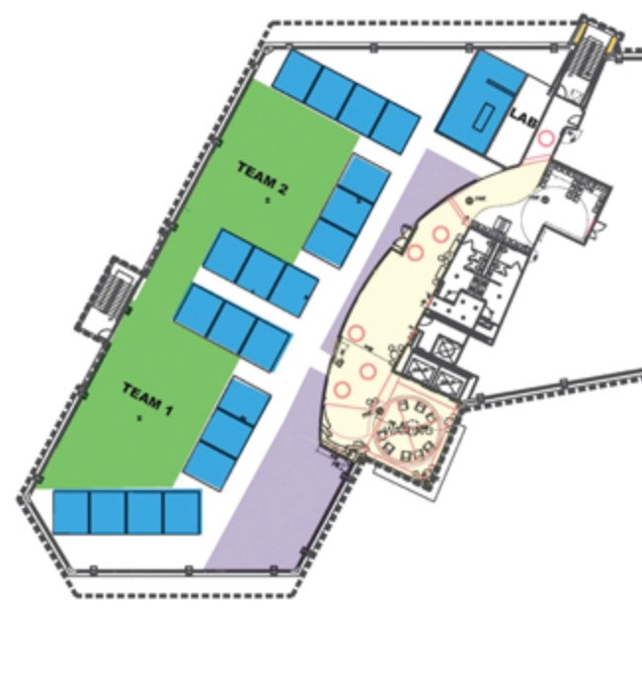
4 Cherokee Essentials
Behavioral
Health
Specialist
1.
2.
Care Coordinators
4.
3.
Notes:
1)Telehealth.
2)Developing Behavioral Health Clinicians Trained To Support Psychiatric Consultation in Primary Care.
3) Electronic Health Record
4) Pay Attention to the Physical Workspace.

Slide 25
Mental Health Pathways: Stepped Care
Pathway A: Pt - Managed in Primary Care
Pathway B: Pt - Briefly Managed by the Psychiatrist
Returned to Primary Care with a Care Plan
Pathway C: Psychiatrist Provides Long-Term Care

Slide 26
Cherokee Success
Notes:
Leadership. Culture C suite on down
Close Oversight. continuous, constructive scrutiny
Continuous Reinforcement.
Creative Approach to Problem-Solving.
Respond to Problems Quickly and Iteratively
Persistence.
Recruit for Fit, and Don’t Take Those Who Don’t Fit
Grow Our Own.
Detailed And Ever-Changing Job Descriptions.
Do Whatever It Takes To Make It Work

Slide 28
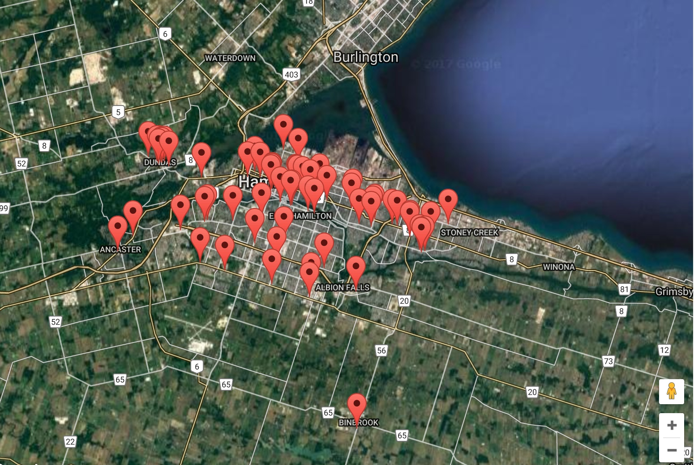
Notes:
170 physicans in small practice one or two md total of 86 practices.
Team PCP ,nurse, and other health professionals such as pharmacists or dietitians as well as a mental health counselor ( nurse or social worker) and visiting psychiatrist.
1 counselor for for every 7000 patients or 1.5 days per week of a counselor. 4 PCP will have a full time social workers
Psychiatrist ½ day per month per family physician
All attend team meetings and social events and see patient of any age.
Informal hallway or curbside consultations occur all the time
Not experts but team embers
Run psychoeducation and support groups for addictions though have a few addiction specaiists.
Short term treatment 5 session CBTor solution focus
Shared EMR with succinct mental health notes

Slide 29
Canada’s Patient Education
1) Bounce Back: combines Digital Video Discs (DVDs) & workbooks
for individuals/pts with depression (with/without anxiety)
2) Antidepressant Skills Workbook: teaches specific skills to improve
medication use & overall well-being
3) Cognitive Behavioral Interpersonal Skills (CBIS) Manual; for MDs
Organized, Guideline-Based System
Assist PCP: Assessing Pts
Developing Tx Strategies to teach Pt Self-Management Skills
General Practice Services Committee Adult Mental Health May 10 2016
http://www.gpscbc.ca/what-we-do/professional-development/psp/modules/adult-mental-health

Slide 30
Canada’s Education CME for MDs & Staff
Practice Support Learning Modules
Use of common screening scales
Diagnostic assessment interview tool
A tool for organizing patient issues
Cognitive-behavioral skills program, use of a patient self-management workbook
Group Training
(3) ½ day group-learning sessions - Mental Health & Addiction in Family Practice
Action period (8 -12 weeks): participants test learning in their own practices
Medical Assistants/Support Staff receive 2-day Mental Health First Aid training
offered by the Canadian Mental Health Association
General Practice Services Committee Adult Mental Health May 10 2016
http://www.gpscbc.ca/what-we-do/professional-development/psp/modules/adult-mental-health

Slide 31
Hamilton Family HealthTeam Success
Notes:
Sucesses;
Improving access to mental health care PCP refer 11X the number of mental health patient as they did before the program began and continues for 20 yrs
Improves detection of mental health issues and addiction
Reduce inpatient admission and length of stay.
Reduce depression score and improved functioning
Uses case based learning, presentations, workshops, CME etc increasing the skill of family MD
Use of evidence informed guidelines

Slide 32
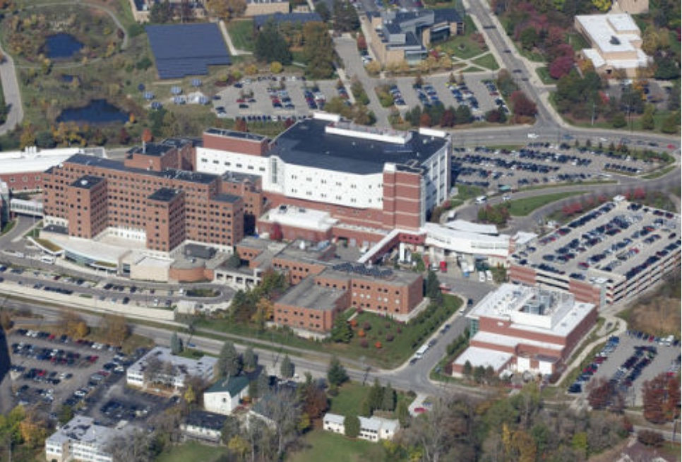
Notes:
Since 1930 VA has been committed as a mission to mental health care
WW II years Va provided urgent and ambulatory care ( not Primary care ) to an increasingly broader group of Veterans based on complex eligibility formulas. Laws and regulations governing VA facilities, however, prohibited provision of comprehensive primary care.
Up until the 1990s mental health care was the safety net for very ill and impoverished patients focused on serious mental illness inpatient care and some outpatient care directed at severe major depression, posttraumatic stress disorder, bipolar disorder, and schizophrenia. Rx focused on serious persistent mental illness, and was often intensive, long term, and difficult to access. Little routine interaction between mental health specialists and physical health providers.
Primary care service mandate for Vets and began in 1994
As of 2008, all primary care sites with at least 5000 patients are required to have at least one full-time equivalent mental health professional on site--either a psychiatrist, a psychologist, or a mental-health-trained social worker.³ includes mental-health-trained nurse practitioners, clinical nurse specialists, and physician assistants.

Slide 33
Notes:
2010 patient-centered medical home model (Patient Aligned Care Teams [PACT]) Teamlet is PCP, nurse manager, nurse or health technician, clerk (1200 patients) 5 05 6 teamlets linked to a larger team of social worker, pharmacist, dietitian, coach, and an integrated mental-health specialist, 2013 60% implemented
The team-based organization of primary care provides a strong basis for leveraging mental health specialty resources through integrated primary care teams.
VA currently manages 8 million vets in 150 hospitals with emergency care, nursing homes, specialist care, and primary care.
900 primary care practices linked to a hospital hub. Va is Single medical record and within a multi-level local, regional, and central (Washington DC-based) management system.

Slide 34
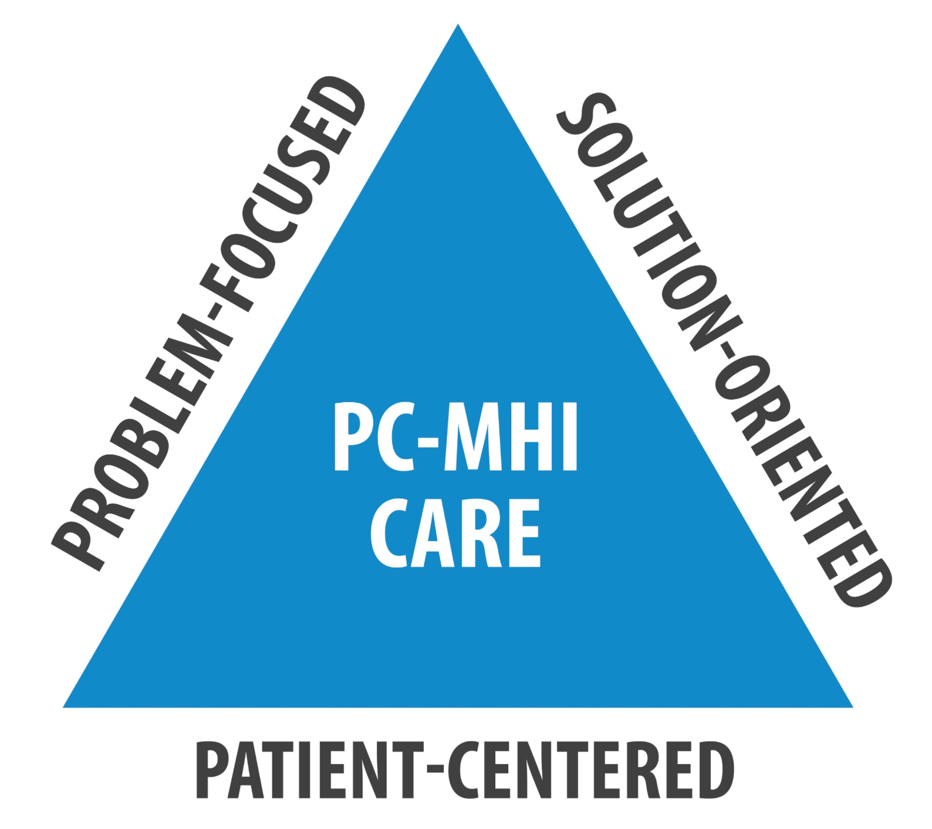
Veterans Affairs Largest Integrated Care System in US
Primary Care Team
Primary Care & Mental Health Integrated
Primary Care
Notes:
As of 2008, all primary care sites with at least 5000 patients are required to have at least one full-time equivalent mental health professional on site--either a psychiatrist, a psychologist, or a mental-health-trained social worker.³ includes mental-health-trained nurse practitioners, clinical nurse specialists, and physician assistants.
VA’s new mission is to fully integrating mental and physical health care a lager provider for transgender care.

Slide 35
VA Offices of Mental Health & Primary Care 2012
Seamless, high quality, accessible Integrated Care
Treat mild Depression, Anxiety, Alcohol Misuse
Design Pt centered & stepped care pathways
Develop Inter-Service Agreements specifying
services delivered, staff needs & referral to
specialized mental health services
EHR :Measurement Based & Guideline Concordant
Appropriate Training for, Staff & Providers
PC-MHI links to additional mental health services
Notes:
12 -Member Strategic Planning committee: PACT and PC-MHI

Slide 36
VA PACT & PCMHI
Successes
Notes:
Most results not yet in
FOUR YEAR RESULTS
Since implementation of PACT, the rate of face-to-face visits rates to mental health specialty has decreased significantly
This may reflect increased use of non-face-to-face visits, greater adoption of shorter-term PC-MHI modalities, or more engagement of primary care clinicians in treatment.
9 VISIN RESEARCH showed that 8% of Veterans visiting primary care per year are newly diagnosed with depression.⁵⁰
Over 70% of Veterans diagnosed with a new depression episode complete minimal appropriate treatment, defined as at least 60 days of appropriate antidepressant medicine or at least four psychotherapy visits during the following year.
Over 90% of Veterans with co-occurring depression and PTSD complete treatment
Alcohol NOT YETavailabe

Slide 37
Diagnosis & Care Pathways / Guidelines
Notes:
Based on Diagnosis & Problem

Slide 38
Quick PsychoDiagnostics Panel
1. Major Depression | 7. Post Traumatic Stress Disorder
2. Persistent Depressive Disorder | 8. Substance Use Disorder
3. Bipolar Disorder | 9. Binge –Eating Disorder
4. Generalized Anxiety Disorder | 10. Bulimia Nervosa
5. Panic Disorder | 11. Somatic Symptoms Disorder
6. Obsessive- Compulsive Disorder | 12. Psychosis ^{a (Upon Request)}
Shedler J, Beck A, Bensen S. Practical mental health assessment in primary care. Journal of Family Practice. 2000 Jul 1;49(7):614-22.
Major Depression | Posttraumatic Stress Disorder
Persistent Depressive Disorder | Substance Use Disorder
Bipolar Disorder | Binge-Eating Disorder
Generalized Anxiety Disorder | Bulimia Nervosa
Panic Disorder | Somatic Symptom Disorder
Obsessive-Compulsive Disorder | Psychosisª
Notes:
12 -Member Strategic Planning committee: PACT and PC-MHI

Slide 40
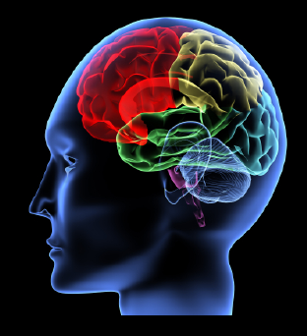

Slide 41
Bipolar
Mania
Psychosis
Anxiety
Sex Problems
Substance Abuse
Personality Disorders
Bipolar Depression
Somatic
Disorders
Chronic
Pain
Suicide &
Violence

Slide 42
1 Year Algorithms for Care
Screening & Diagnosis: QPD
Psychoeducation
Treatment Recommendations: Brief Interventions &
Meds; Long Term Referral for MH Tx Prn
Patient Self Management & Self Help
Referral to Community Resources
Relapse Prevention & Coping
Notes:
12 -Member Strategic Planning committee: PACT and PC-MHI

Slide 43
1 Year Algorithms for Care
ROLES Front Desk Medical Assistant PCP Nurse Behavioral Health Specialist Psychiatrist Health Coach

Slide 45
Is Integrated Care the Answer ?
Partial Answer
Addresses only Low-Moderate Psychiatric/SU Problems
Need 50 Inpatient Psych Beds/100,000; Massive Shortage
Addiction Epidemic Requires -
Massive Expansion of Addiction Treatment Services
Need a Continuum of Psychiatric Services to Tx the SPMI
Poverty & Homelessness
Social Equity & Equal Opportunity
Insurance/Reimbursement Reforms - Mental Health & Addictions
Notes:
Colorado 16.6 beds. 100,000

Slide 47
THE END
THE END

