Slide 1
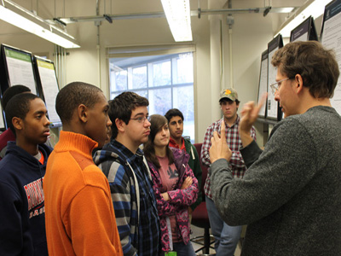
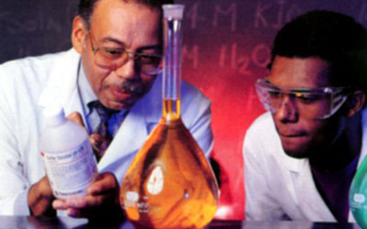
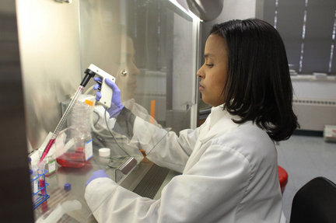
Beyond the Margins: Fortifying Mentoring Relationships with URM Students
Dr. Sharon Fries-Britt

Slide 2
Presentation Overview
Introduction & Context
Data Sources
    Key factors from the literature
Research on Minority High Achievers
Key aspects of mentoring
Fortifying mentoring relationships
Mentoring challenges and opportunities
  Race, Equity and Diversity Landscape

Slide 3
Introduction & Context
Research landscape on minority students has changed
Institutional context matters (TWIs, HBCUs & HSIs)
  Campus mission & commitment
  Campus climate
Access and Retention
    The Role of Faculty
    Role of Peers
    Institution practices
Issues of race, equity and diversity. What does is all mean and why is this even important?

Slide 4
Data Sources
Higher Ed
STEM
URM
Mentoring
Diversity

Slide 5
Key Factors from the Literature
Advising & Mentoring
Resources
academic
Personal
Social
Aspirations

Slide 6
Examples of Science Climate
  Unnecessarily perception that science is a “hard major”
  Competition and ‘weeding out’
  Fast pace
  Demanding work loads
  Large classes
  Unsupportive departmental cultures
  Poor pedagogy
  Bell curve grading
  Students feel faculty are focused more on research not teaching
  Students leave for non-academic reasons
  Separation of individual and work (balance for women in particular)

Slide 7
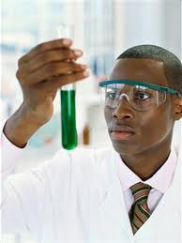
Research on Minority High Achievers
National Society of Black and Hispanic Physicists, Meyerhoff Scholars, Honors Students at several universities including HBCUs and TWIs.
The majority are Black, they tend to come from middle class families and most have two parent households but not all.

Slide 8
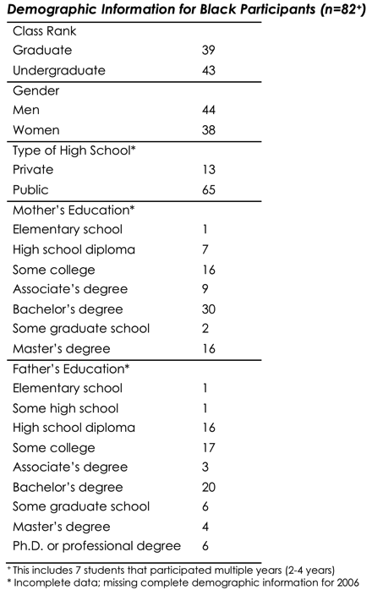
NSBP & NSHP
Annually from 2005-2009,Total 162 Black US participants.
Joint meeting of National Society for Black Physicists and National Society of Hispanic Physicists
Multiple bodies of research STEM, URM, Higher Ed an High Achieving URM
Focus groups and individual interviews
Students at various points in academic careers at multiple institutions

Slide 9
Major Themes
The role of parents, family (precollege experiences, exposure to science, parents educational experiences and SES) and access to other key adults.
Peers were essential to success and motivation
    Like type community of high achieving peers
Institutional context (TWIs and HBCUs) matters. Campus climate, isolation, connections, motivation to succeed.
Intersection of identity (science, race, gender)
Faculty advisors/mentors, attitudes and behaviors matter.
    International faculty experiences

Slide 10
Faculty Interactions
What faculty say and how they behave matters
Attitudes of faculty are conveyed in subtle and not so subtle comments (“someone will need to clean the lab equipment”)
    Students observe and “make meaning” out of verbal and non-verbal behaviors
Faculty are the bridge to professional experiences and connections
  Research invitations, connections on and off campus,
Interaction with international faculty (mixed experiences)
Good faculty mentors build self efficacy and science identity

Slide 11
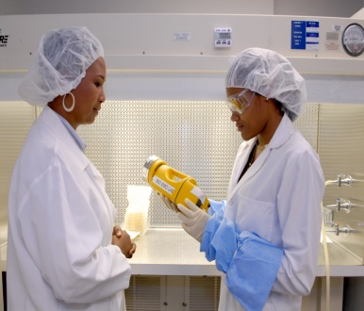
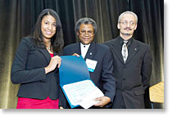

KEY ASPECTS OF MENTORING
FORTIFYING RELATIONSHIPS WITH URM

Slide 12
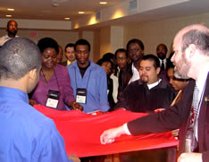

How Intentional is Your Mentoring?
What is your mentoring philosophy and style?
What “process” do you use to guide your interactions with students?
What strategies work?

Slide 13
Key Aspects of Mentoring
Technical aspects of mentoring
  Planning program and courses
  Help with conducting research, grants, presentations
  Prepare for exams and other department requirements
Social and Personal aspects
  Affirm students and their experiences
  Help to build as sense of self efficacy
  Help broaden their connections and resources ( on and off campus)
  Help to combat isolation

Slide 14
Key Aspects of Mentoring
Seek to humanize the educational experience
  Help with navigating the “cultural context” of the discipline
  Be proactive and provide holistic support, show empathy, so respect
Consider cross race/gender vs. same race/gender
  The race and gender of the faculty is not the most important factor for support.
  Most mentors in STEM are male and white. It is important to be self aware, culturally aware, demonstrate a genuine interest, proper guidance and commitment to students
  There are benefits to same race mentors (e.g. role models, understand campus climate and experiences, familiar with racial experiences).

Slide 15
Key Institutional Factors
Institutional differences matter (HBCUs, HSIs and TWIs)
    Climate of the dept, campus and extended community
TWIs are known for the competitive “weed out” process vs. collaboration emphasizing “everyone will all make it”!
Institutional deficiencies should be considered with any discussion of student deficiencies.
Dropout of URM at TWIs often has less to do with ability, being unprepared, not qualified and more to do with competitive peer culture, faculty focus on research and not teaching and limited role models.
  Demands of the academy vs. requirements of good mentoring often in conflict

Slide 16

To Fortify:
1. to make strong; impart strength or vigor to
2. to increase the effectiveness of, as by additional ingredients
3.to strengthen mentally or morally:
Is to move beyond the technical aspects of mentoring

Slide 17
Fortifying Mentoring Relationships
Set high expectations then invest in student success
  Think long term. You are investing in a student’s professional development.
  Value the unique perspectives and views of your students about research, philosophy of life and their aspirations.
  Be willing to share your own struggles (appropriate examples) and open the door to your own humanity.
Be honest with your feedback and praise and ask for student feedback as well.
Affirm student identity as scientists by acknowledging their abilities and achievements.

Slide 18
Fortifying Mentoring Relationships
Build good mentoring practices in your research team and/or other communities of student workers.
    Encourage collaboration vs. competition
    Spread opportunities for different tasks, prepare students to take on more challenging assignments
    Be sure that you note everyone’s contributions verbally and in writing
    These efforts will help students develop broader skills for working in an increasingly diverse world
Help students understand professional and “cultural” distinctions in the academy.
    Givens, Negotiate and Create

Slide 19
Challenges and Opportunities
Changing demographic landscape (race, age, gender, SES international etc)
  “Guess whose coming to college”?
  Utilizing all of the nation’s talent
Dynamics of power and privilege
  Racism, sexism and other forms of oppression are real
  There is a high cost for complaining
Avoiding diversity does not make it go away
  Develop a repertoire of skills and abilities beyond your current expertise
Think in terms of “intersectionality”

Slide 20
References
See attached document

