Slide 1

Step Up San Marcos General Membership Meeting January 13, 2026

Slide 2
Item 1. Welcome
Diane Phalen
Item 2. Treasurer’s Report
Diane Phalen

Slide 3
Item 3. Overview of 2026 SUSM Action Plan
Stephanie Korcheck
October Survey
Why Do We Need an Action Plan?
State what we want to accomplish
Prioritize the work
Identify who does what by when
Accountability!
Steering Committee Leadership

Slide 4
Item 3. Overview of Action Plan (continued)
Goal 1: Organize and Educate the Local Community to Champion Democratic Principles
Goal 2: Build Alliances with Other Organizations in San Marcos and Central Texas to Advance Democratic Principles
Goal 3: Deliver Consistent, Compelling Messaging within SUSM and throughout the Community to Support Democratic Principles
Goal 4: Build an Effective and Enduring Organization

Slide 5
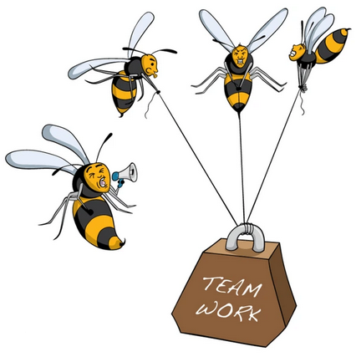

Item 3. Overview of Action Plan (continued)
What’s Next?
4-6 team members per goal
Fully develop plan for each goal
prioritized objectives
action steps for each objective – who and by when
Worker bees
Impact

Slide 6
Item 4. Reports from Action Plan Goal Teams
Goal 1: Organize and Educate the Local Community to Champion Democratic Principles
Team Leaders: Scott Henize, Melani Howard, Dick McBride
Objective 1 – Hold protests and rallies
Objective 2 – Rapidly respond to significant events
Objective 3 – Engage with voters to support like-minded state and national candidates
Objective 4 – Educate the community on targeted issues

Slide 7
Item 4. Reports from Goal Teams (continued)
Goal 2: Build Alliances with Other Organizations in San Marcos and Central Texas to Advance Democratic Principles
Team Leaders: Joe Sokal, Paul Murray
Objective 1 – Sync activities with national, state, and nearby Indivisible groups
Objective 2 – Enhance the diversity of voices and participants
Objective 3 – Build alliances with other groups, both within and outside the Indivisible network, to amend state laws on targeted issues

Slide 8
Item 4. Reports from Goal Teams (continued)
Goal 3: Deliver Consistent, Compelling Messaging within SUSM and throughout the Community to Support Democratic Principles
Team Leaders: Susan Hanson, Larry Mock
Objective 1 – Create a regular schedule, format, and content for SUSM newsletter
Objective 2 – Develop plans and procedures for use of social media
Objective 3 – Build technology infrastructure to manage member database and other SUSM functions

Slide 9
Item 4. Reports from Goal Teams (continued)
Goal 4: Build an Effective and Enduring Organization
Team Leaders: Diane Phalen, Betsy Robertson
Objective 1 – Monitor the implementation of the Action Plan and update, as necessary
Objective 2 – Hold and document regularly scheduled meetings of the Steering Committee and General Membership
Objective 3 – Develop organization bylaws and procedures

Slide 10
Item 5. Announcements from Membership
Item 6. Upcoming Events
Paul Murray

