Slide 1
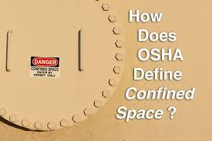
Confined Space
Is large enough and so configured that an employee can bodily enter and perform assigned work.
Has limited or restricted means for entry or exit (for example, tanks, vessels, silos, storage bins, hoppers, vaults, and pits are spaces that may have limited means of entry.
Is not designed for continuous employee occupancy.

Slide 2
Life-Saving Rules are essential for fostering a safe work environment and protecting the well-being of employees.
OSHA's life safety standards for confined spaces are crucial because they help protect workers from serious hazards that can lead to injury or death. Confined spaces, such as tanks, silos, and pipelines, often have limited entry and exit points and are not designed for continuous occupancy.

Slide 3
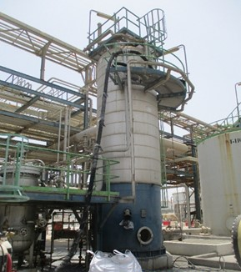
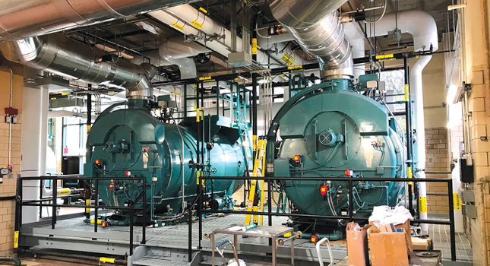
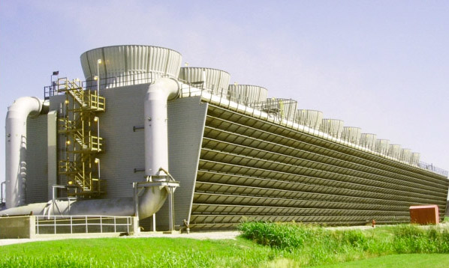
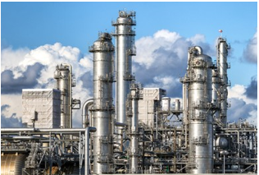
EXAMPLES OF CONFINED SPACES
Reactors and Pressure Vessels
Underground Tanks and Vaults
Boilers
Cooling Towers
Distillation Towers

Slide 4
Here are some key reasons why these standards matter:
Hazardous Atmospheres: Confined spaces can contain toxic gases, low oxygen levels, or explosive atmospheres. Proper ventilation and monitoring are essential to ensure safe entry.
Engulfment Risks: Workers can be engulfed by liquids or loose materials, leading to suffocation or crushing injuries.
Physical Hazards: Confined spaces may have inwardly converging walls or sloping floors that can trap or asphyxiate workers.
Permit Requirements: OSHA mandates a permit system for entry into confined spaces, ensuring that all safety measures are in place before workers enter.
These regulations are designed to prevent accidents and ensure that workers can perform
their tasks safely.

Slide 5
Confined Space work involves significant risks, and understanding these hazards is crucial for ensuring safety. Here are some of the main risks and common incidents associated with confined spaces:
Main Risks
Lack of Oxygen: Oxygen levels can be depleted due to chemical reactions, rusting, or the presence of other gases, leading to suffocation
Toxic Atmospheres: The buildup of toxic gases, fumes, or vapors can occur, especially in poorly ventilated spaces. These can be lethal if inhaled
Fire and Explosion: Flammable gases or vapors can accumulate, posing a risk of fire or explosion if an ignition source is present
Engulfment: Workers can be engulfed by loose materials such as grain, sand, or liquids, leading to suffocation or drowning
Physical Hazards: Confined spaces often have limited visibility, restricted movement, and the presence of sharp or moving parts, increasing the risk of physical injurie
Extreme Temperatures: High or low temperatures within confined spaces can cause heat stress, hypothermia, or other temperature-related health issues
Psychological Hazards: The confined nature of these spaces can cause stress, anxiety, or panic attacks, affecting a worker's ability to perform tasks safely
Common Incidents
Suffocation: Due to oxygen deficiency or inhalation of toxic gases.
Explosions: Resulting from the ignition of flammable gases or vapors.
Engulfment: Workers being buried or trapped by loose materials.
Falls: Due to slippery surfaces or limited visibility.
Heat Stress: From working in high-temperature environments without adequate ventilation.

Slide 6
Ensuring life safety during confined space
Conduct a Risk Assessment
Obtain a Permit
Ventilate the Space
Use Personal Protective Equipment (PPE)
Test the Atmosphere
Implement an Emergency Plan
Use a Trained Standby Person
Control Access

Slide 7
Ensuring life safety during confined space
Conduct a Risk Assessment: Identify potential hazards such as toxic gases, oxygen deficiency, and flammable atmospheres before entry
Obtain a Permit: Ensure a Confined Space Entry Permit is issued, confirming that all safety measures are in place
Ventilate the Space: Provide adequate ventilation to maintain safe air quality and prevent the buildup of hazardous gases
Use Personal Protective Equipment (PPE): Equip workers with appropriate PPE, including respirators, gloves, and protective clothing
Test the Atmosphere: Perform atmospheric testing to check for hazardous gases and ensure safe oxygen levels before and during entry
Implement an Emergency Plan: Have a detailed rescue plan in place, including trained personnel and necessary equipment for non-entry and entry rescues
Use a Trained Standby Person: Station a trained attendant outside the confined space to monitor the situation and initiate emergency procedures if needed
Control Access: Restrict access to the confined space to authorized personnel only

Slide 8
Life Safety Rules for Confined Space
Safety - Confined spaces often have hazardous conditions like toxic gases, low oxygen levels, and physical hazards. These rules help prevent accidents and fatalities.
Prevention of Injuries - The rules provide guidelines to minimize risks to workers entering these spaces, significantly reducing the likelihood of injuries.
Emergency Preparedness - They ensure that proper rescue plans are in place, allowing for quick action in case of emergencies, thus saving lives.
Worker Training - The rules mandate training for workers, equipping them with the knowledge to recognize hazards and respond appropriately.
Legal Compliance - Adhering to these rules helps employers comply with federal regulations, avoiding legal repercussions and potential fines.
Promoting a Safety Culture - Implementing these rules fosters a culture of safety within organizations, encouraging employees to prioritize health and safety in the workplace.
Overall, these life-saving rules are essential to ensuring the safety and well-being of workers in
potentially dangerous environments.

Slide 9
Controlling Hazards
Specifying acceptable entry conditions.
Isolating the permit space.
Providing barriers.
Verifying acceptable entry conditions.
Purging, making inert, flushing or ventilating the permit space.

Slide 10
Controlling hazards in confined spaces is crucial for ensuring worker safety. Here are key measures to consider:
Specifying Acceptable Entry Conditions
Define Safe Conditions: Establish the conditions that must exist for safe entry, such as acceptable oxygen levels, absence of toxic gases, and safe temperature ranges
Isolating the Permit Space
Isolation Techniques: Use methods like blanking or blinding, misaligning or removing sections of lines, pipes, or ducts, and implementing double block and bleed systems to prevent the release of hazardous materials into the space
Providing Barriers
Physical Barriers: Install barriers to protect workers from external hazards, such as pedestrian or vehicle traffic, and to prevent unauthorized entry
Verifying Acceptable Entry Conditions
Continuous Monitoring: Test atmospheric conditions before and during entry to ensure they remain within safe limits. This includes checking for oxygen levels, combustible gases, and toxic vapors
Purging, Making Inert, Flushing, or Ventilating the Permit Space
Atmospheric Control: Implement procedures to purge, inert, flush, or ventilate the space to eliminate or control hazardous atmospheres. This helps maintain safe air quality and prevents the buildup of dangerous gases

Slide 11
Entry Permits
Entry permits must include:
Name of permit space to be entered, authorized entrant(s), eligible attendants and individuals authorized to be entry supervisors.
Test results and tester’s initials or signature.
Name and signature of supervisor who authorizes entry.
Purpose of entry and known space hazards.
Measures to be taken to isolate permit spaces and to eliminate or control space hazards.
Name and telephone numbers of rescue and emergency services and means to be used to contact them.
Date and authorized duration of entry.
Acceptable entry conditions.
Communication procedures and equipment to maintain contact during entry.
Additional permits, such as for hot work, that have been issued authorizing work in the permit space.
Special equipment and procedures, including personal protective equipment and alarm systems.
Any other information needed to ensure employee safety.

Slide 12
Authorized entrant Authorized entrants are required to
Know space hazards, including information on the means of exposure such as inhalation or dermal absorption, signs of symptoms and consequences of the exposure.
Use appropriate personal protective equipment properly.
Maintain communication with attendants as necessary to enable them to monitor the entrant’s status and alert the entrant to evacuate when necessary.
Exit from the permit space as soon as possible when:
Ordered by the authorized person.
He or she recognizes the warning signs or symptoms of exposure.
A prohibited condition exists; or an automatic alarm is activated.
Alert the attendant when a prohibited condition exists or when warning signs or symptoms of exposure exist.

Slide 13
Attendant
The attendant is required to:
Remain outside the permit space during entry operations unless relieved by another authorized attendant.
Perform non-entry rescues when specified by the employer’s rescue procedure.
Know existing and potential hazards, including information on the mode of exposure, signs or symptoms, consequences and physiological effects.
Maintain communication with and keep an accurate account of those workers entering the permit space.
Order evacuation of the permit space when:
A prohibited condition exists.
A worker shows signs of physiological effects of hazard exposure.
An emergency outside the confined space exists; and
The attendant cannot effectively and safely perform required duties.
Summon rescue and other services during an emergency.
Ensure that unauthorized people stay away from permit spaces or exit immediately if they have entered the permit space.
Inform authorized entrants and the entry supervisor if any unauthorized person enters the permit space.
Perform no other duties that interfere with the attendant’s primary duties.

Slide 14
Entry supervisor
Entry supervisors are required to:
Know space hazards including information on the mode of exposure, signs or symptoms and consequences.
Verify emergency plans and specified entry conditions such as permits, tests, procedures and equipment before allowing entry.
Terminate entry and cancel permits when entry operations are completed or if a new condition exists.
Verify that rescue services are available and that the means for summoning them are operable.
Take appropriate measures to remove unauthorized entrants.
Ensure that entry operations remain consistent with the entry permit and that acceptable entry conditions are maintained.

Slide 15
Definitions
Acceptable entry conditions means the conditions that must exist in a permit space to allow entry and to ensure that employees involved with a permit-required confined space entry can safely withstand and work within the space.
Attendant means an individual stationed outside one or more permit spaces who monitors the authorized entrants and who performs all attendant's duties assigned in the employer's permit space program.
Authorized entrant means an employee who is authorized by the employer to enter a permit space.
Blanking or blinding means the absolute closure of a pipe, line, or duct by the fastening of a solid plate (such as a spectacle blind or a skillet blind) that completely covers the bore and that is capable of withstanding the maximum pressure of the pipe, line, or duct with no leakage beyond the plate.
Confined space means a space that:
(1) Is large enough and so configured that an employee can bodily enter and perform assigned work; and
(2) Has limited or restricted means for entry or exit (for example, tanks, vessels, silos, storage bins, hoppers, vaults, and pits are spaces that may have limited means of entry.); and
(3) Is not designed for continuous employee occupancy.

Slide 16
Double block and bleed means the closure of a line, duct, or pipe by closing and locking or tagging two in-line valves and by opening and locking or tagging a drain or vent valve in the line between the two closed valves.
Emergency means any occurrence (including any failure of hazard control or monitoring equipment) or event internal or external to the permit space that could endanger entrants.
Engulfment means the surrounding and effective capture of a person by a liquid or finely divided (flowable) solid substance that can be aspirated to cause death by filling or plugging the respiratory system or that can exert enough force on the body to cause death by strangulation, constriction, or crushing.
Entry means the action by which a person passes through an opening into a permit-required confined space. Entry includes ensuing work activities in that space and is considered to have occurred as soon as any part of the entrant's body breaks the plane of an opening into the space.
Entry permit means the written or printed document that is provided by the employer to allow and control entry into a permit space and that contains the information specified in paragraph (f) of this section.
Entry supervisor means the person (such as the employer, foreman, or crew chief) responsible for determining if acceptable entry conditions are present at a permit space where entry is planned, for authorizing entry and overseeing entry operations, and for terminating entry as required by this section.
Note: An entry supervisor also may serve as an attendant or as an authorized entrant, as long as that person is trained and equipped as required by this section for each role he or she fills. Also, the duties of entry supervisor may be passed from one individual to another during the course of an entry operation.

Slide 17
Hazardous atmosphere means an atmosphere that may expose employees to the risk of death, incapacitation, impairment of ability to self-rescue (that is, escape unaided from a permit space), injury, or acute illness from one or more of the following causes:
(1) Flammable gas, vapor, or mist in excess of 10 percent of its lower flammable limit (LFL);
(2) Airborne combustible dust at a concentration that meets or exceeds its LFL;
Note: This concentration may be approximated as a condition in which the dust obscures vision at a distance of 5 feet (1.52 m) or less.
(3) Atmospheric oxygen concentration below 19.5 percent or above 23.5 percent;
(4) Atmospheric concentration of any substance for which a dose or a permissible exposure limit is published in subpart G, Occupational Health and Environmental Control, or in subpart Z, Toxic and Hazardous Substances, of this part and which could result in employee exposure in excess of its dose or permissible exposure limit;
Note: An atmospheric concentration of any substance that is not capable of causing death, incapacitation, impairment of ability to self-rescue, injury, or acute illness due to its health effects is not covered by this provision.
(5) Any other atmospheric condition that is immediately dangerous to life or health.
Note: For air contaminants for which OSHA has not determined a dose or permissible exposure limit, other sources of information, such as Material Safety Data Sheets that comply with the Hazard Communication Standard

Slide 18
Hot work permit means the employer's written authorization to perform operations (for example, riveting, welding, cutting, burning, and heating) capable of providing a source of ignition.
Immediately dangerous to life or health (IDLH) means any condition that poses an immediate or delayed threat to life or that would cause irreversible adverse health effects or that would interfere with an individual's ability to escape unaided from a permit space.
Note: Some materials - hydrogen fluoride gas and cadmium vapor, for example - may produce immediate transient effects that, even if severe, may pass without medical attention, but are followed by sudden, possibly fatal collapse 12-72 hours after exposure. The victim "feels normal" from recovery from transient effects until collapse. Such materials in hazardous quantities are considered to be "immediately" dangerous to life or health.
Inerting means the displacement of the atmosphere in a permit space by a noncombustible gas (such as nitrogen) to such an extent that the resulting atmosphere is noncombustible.
Note: This procedure produces an IDLH oxygen-deficient atmosphere.
Isolation means the process by which a permit space is removed from service and completely protected against the release of energy and material into the space by such means as: blanking or blinding; misaligning or removing sections of lines, pipes, or ducts; a double block and bleed system; lockout or tagout of all sources of energy; or blocking or disconnecting all mechanical linkages.
Line breaking means the intentional opening of a pipe, line, or duct that is or has been carrying flammable, corrosive, or toxic material, an inert gas, or any fluid at a volume, pressure, or temperature capable of causing injury.
Non-permit confined space means a confined space that does not contain or, with respect to atmospheric hazards, have the potential to contain any hazard capable of causing death or serious physical harm.
Oxygen deficient atmosphere means an atmosphere containing less than 19.5 percent oxygen by volume.
Oxygen enriched atmosphere means an atmosphere containing more than 23.5 percent oxygen by volume.

Slide 19
Confined Space Fatalities
CSB Final Report on Xcel Energy Accident Finds Company and its Contractor Failed to Adequately Prepare for Hazardous Work Inside Confined Space of Hydroelectric Plant Tunnel; Xcel Had No Technically Qualified Responders on Duty - Investigations - News | CSB
CSB Issues Case Study in 2005 Valero Refinery Delaware City, DE, Accident; Report Notes Inadequate Nitrogen Asphyxiation Hazard Awareness Training and Improper Confined Space Rescue Actions - Investigations - News | CSB

