Slide 2
Training Objectives
Owned
Company vehicles
Explain key elements for the safe operation of:
Rented
Leased

Slide 3
Examples of Company vehicles
Passenger cars
Trucks
Buses
Motorcycles
Vans
These safety elements also apply to all personally owned vehicles operated for company business.

Slide 4
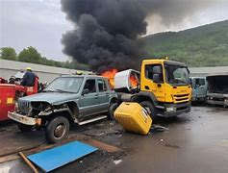
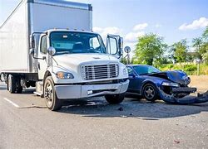
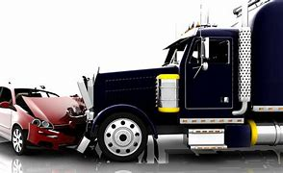
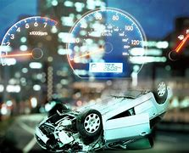
Why do we need a standard on Driving Requirements?
Driving is a hazardous activity which poses safety risks to our employees and the community around us
Company and personal vehicles need to be inspected and maintained in order to operate safely
When accidents happen, we need to understand why so we can try to prevent them from happening in the future

Slide 5
Reminder: “Safe Operation of Vehicles” applies to all drivers and passengers
All categories of vehicles must not be
operated unless: (this includes self-propelled mobile equipment)
Safety features are maintained in safe working order
The number of passengers does not exceed manufacturer’s specifications and legal limits for the vehicle
Loads are secure and do not exceed limits
ALL occupants wear seat belts when vehicle is moving
Drivers are trained, assessed and medically fit
Drivers are rested, alert and not impaired by any alcohol or drugs
Drivers use handheld communication devices in “hands-free” mode
Pedestrians must yield and stand clear
Drivers give way at designated walkways and crosswalks
Pedestrians always err on the side of caution

Slide 6
What does my site have to do?
THE BIG PICTURE
01 | Operator/passenger requirements for safe operation of the vehicle
02 | Vehicle requirements for managing the vehicle
Develop and implement a site-specific program that meets local regulatory
requirements and includes the following:
03 | Vehicle incident reporting and investigation
04 | Train employees and management
05 | Maintain records

Slide 7
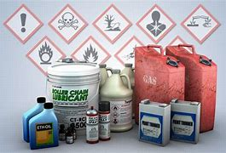
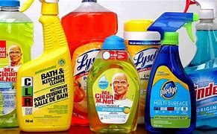
Let’s look at each one in more detail…
01 | Operator/passenger requirements for safe operation of the vehicle
Personnel who operate company owned, leased or long-term rented vehicles shall:
Maintain required licenses and training to operate the vehicle, at a minimum to meet local regulatory requirements
Be physically and mentally fit
Personnel shall always wear the vehicle-supplied restraint system (i.e. seat belt)
Local traffic regulations shall be obeyed at all times
Vehicles shall be operated within designated speed limits and at speeds that are safe for the current conditions
Personnel shall not conduct high risk behaviors while driving (e.g. aggressive actions such as yelling, making obscene gestures at other drivers, excessive use of vehicle horn, using handheld device)
Driving in a foreign country is permitted for personnel who are:
Licensed according to the specific country’s laws
Familiar with local driving conditions/ behaviors
Able to recognize and understand road signs / directions
Transportation of hazardous materials:
Vehicle and driver must be authorized to carry
Must be properly secured and documented
Small quantities of commercially available “off-the-shelf” products may be carried
This is not a comprehensive list of the requirements; see your specific site procedures for details.

Slide 8
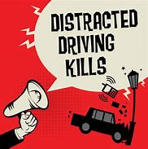
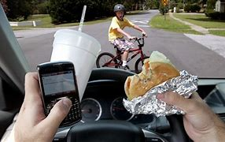
Let’s look at each one in more detail…
01 | Operator/passenger requirements for safe operation of the vehicle
Fatigue Management:
Personnel are expected to stop and rest if they are too fatigued to drive safely.
To maintain alertness, drivers should consider taking breaks at least every two hours. In addition, trips should be avoided that are over 500 miles (800 km) per day or approximately 8 hours.
Use of handheld devices while driving is prohibited. Navigation devices are allowed when:
The vehicle is stopped
The input is entered by a passenger
The device is mounted to maintain hands-free operation
This is not a comprehensive list of the requirements; see your specific site procedures for details.

Slide 9
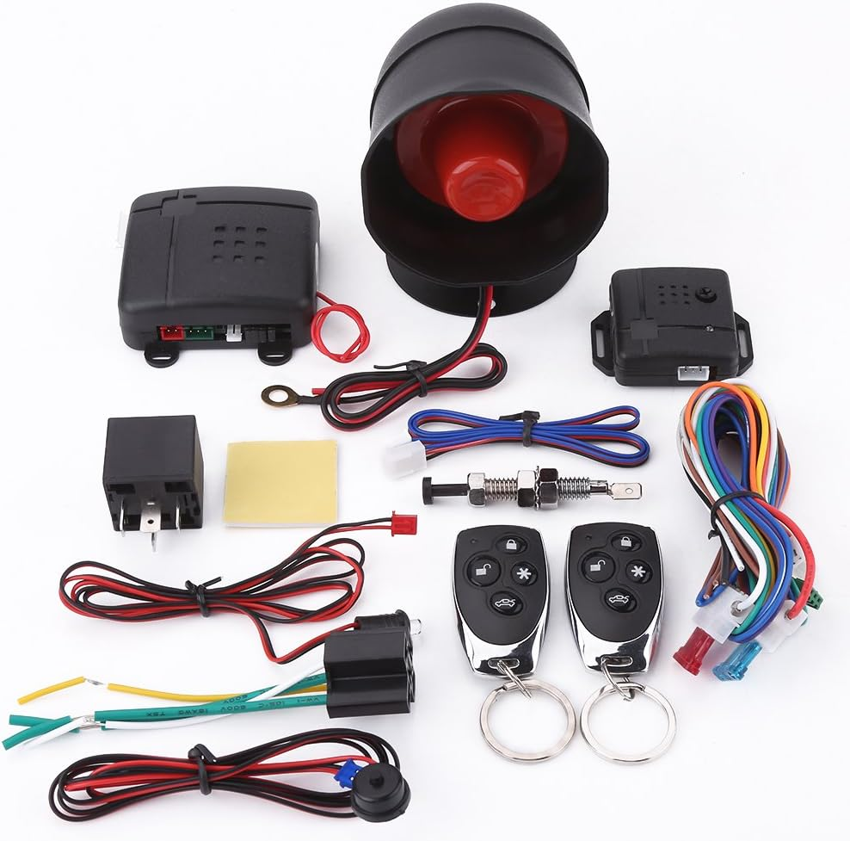
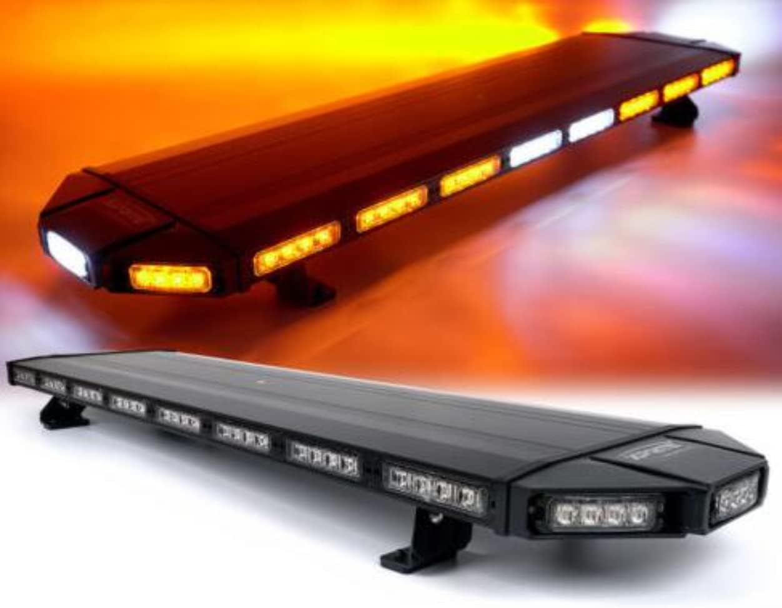
Let’s look at each one in more detail…
02 | Vehicle requirements for managing the vehicle
Vehicles shall be acquired and replaced based on the activities to be performed and according to criteria established by your company. Considerations include:
Suitability for the task(s) and loads
Cargo capacity and ability to secure objects
Towing capacity, if needed
Ergonomic considerations
Safety Features:
Lap/shoulder seatbelts for all occupants
Anti-lock braking system (ABS)
Supplemental restraint systems (airbags) if available
Additional items to consider:
Electronic stability control (ESC)
Rear vision and detection systems
Collision avoidance systems
Modifications:
Only made using manufacturer’s recommendation
Installed by licensed/certified technician
This is not a comprehensive list of the requirements; see your specific site procedures for details.

Slide 10
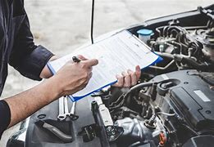
Let’s look at each one in more detail…
02 | Vehicle requirements for managing the vehicle
Emergency Equipment:
First Aid kt
Reflective safety vest
Reflective triangles
Additional Emergency Equipment:
Fire extinguisher
Non-perishable food and water
Flashlight
Tire inflator and/or sealant
Towing strap/rope
Survival blanket
Inspections:
Pre-Operation
Daily visual inspection of the vehicle prior to use
Tires properly inflated and not worn excessively
Windshield and windows
Headlights, taillights and turn signals
Fuel and gauges
Mirrors
Seatbelts
All loose items secured
Maintenance:
In accordance with manufacturer’s recommendations, industry standards, local requirements and based on operating environment
Service/maintenance must be completed by authorized technician at regular intervals based on miles driven, hours operated or time
Vehicles will be serviced promptly after any notice of a manufacturer recall
Repairs:
If defects are discovered during any inspection or during use, vehicle will be taken out of service and repaired by authorized technician
Any SAFETY related defects shall be repaired before the vehicle is returned to normal service
This is not a comprehensive list of the requirements; see your specific site procedures for details.

Slide 11
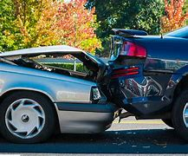
Let’s look at each one in more detail…
03 | Vehicle incident reporting and investigation
Documented procedure is required for reporting and investigating vehicle incidents involving:
Injury or fatality
Damage to vehicle or property
Near-miss that could have resulted in injury or property damage
Procedure should include:
Immediate reporting of the event
A documented investigation process
Reporting driving limitations to employee’s supervisor/manager (license suspensions, revocations, etc)
Documenting violations and corrective measures as necessary
This is not a comprehensive list of the requirements; see your specific site procedures for details.

Slide 12
Let’s look at each one in more detail…
04 | Train employees and management
All personnel shall receive initial awareness training that covers at a minimum:
Safe driving procedures
Vehicle inspection requirements
Accident procedures and reporting
Employees who operate company owned, leased or long-term rented vehicles:
Must maintain required licenses and training to operate according to local regulations
May be required to attend defensive driving safety courses
Refresher training must be provided:
periodically according to legal requirements
After a vehicle accident or incident
After changes to the site-specific program
This is not a comprehensive list of the requirements; see your specific site procedures for details.

Slide 13
Let’s look at each one in more detail…
05 | Maintain records
Records must be controlled and retained in accordance with regulatory or site business segment record retention requirements, whichever is more stringent. Examples of records to be maintained, include but not limited to:
Vehicle inspection, maintenance and repair records
Training records
Incident reports involving company vehicles and follow-up corrective actions
Policies, programs, procedures related to safe driving
This is not a comprehensive list of the requirements; see your specific site procedures for details.

Slide 14
Questions?

Slide 15
Quiz to Check Understanding
Q1
True or False:
Use of handheld devices while driving is not allowed.
Q2
Before using a company vehicle, visual inspections should be performed:
Daily
Monthly
Annually
Not required
Q3
True or False:
These Safety Tips don’t apply to personally- owned vehicles being driven on company business.
Q4
An investigation must be performed for any company vehicle incident involving (check all that apply):
An injury or fatality
Damage to the vehicle or other property
A near-miss that could have resulted in an injury or property damage
Q5
True or False:
Refresher training for a driver is required after a vehicle accident/incident.

