Slide 1

Energy Isolation

Slide 2
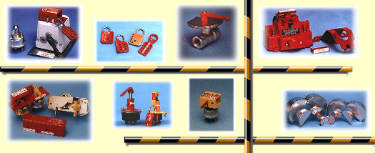
What is energy isolation
Purpose:
  To protect workers from the release of hazardous energy, and;
  To guard against the accidental start-up of equipment during service and maintenance.

Slide 3

What are Energy Sources?
Typical sources of energy that may need to be isolated, locked and tagged out include:
  Electrical (electric motors, batteries)
  Hydraulic (e.g., pressurized fluids in hoses/pipes)
  Pneumatic (e.g., pressurized air in hoses/pipes)
  Mechanical (e.g., gravity systems, or spring energy)
  Chemical (e.g. storage vessels or pipelines containing toxic/hazardous chemicals and hydrocarbon/petrol products)
  Thermal (e.g. hot oil lines used to heat heavy fuel oil tanks/pipe work)
  Pressurized Liquids/Gases (e.g. hydrocarbons/petrol, steam)

Slide 4
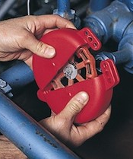
What are Isolations?
Isolation of all hazardous energy or toxic/flammable substances into equipment to be worked on.
  Two types of isolation used are:
    Closed isolation block valves or opening of circuit breaker and installation of Locks & Tags
    Positive Isolation
      Installation of a Blind (spade)
      Removal of a block valve or pipe spool
      Removal of circuit Breaker

Slide 5
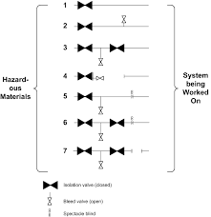
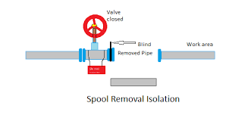
Positive Physical Isolation
Blinding (spading) is one method of positive physical isolation of equipment, lines and or vessels.
Equipment, lines and vessels can also be positive isolated by removal of a valve or pipe spool and installing a blank flange (blanking) of the live side of the line.
When should positive isolation (normally blinding is used) of equipment be considered?
    Whenever HOT WORK is to be performed on the equipment.
    Whenever a piece of equipment in any type of hazardous service is to be removed from the job site.
    Whenever a tank, vessel or other equipment is to be isolated for confined space entry.

Slide 6
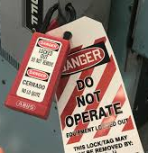
LOTO Requirements
LOTO is used to ensure equipment to be worked on can not be activated by locking out and tagging the equipment’s power source.
  For Electrically powered equipment its electrical breaker is to be opened, locked, tagged and verified by a qualified electrician of the absence of potential energy.
Lock Out and Tag Out should both be used, never use a tag alone
Test the equipment to ensure zero energy state
A hasp can be installed at the equipment's primary isolation point
  All isolation point(s) will be documented on a LOTO log sheet
If an isolation point cannot be locked out another isolation point further back in the system should be identified and LOTO performed there.
Only the maintenance person who fitted a lock and tag is authorized to remove it

Slide 7
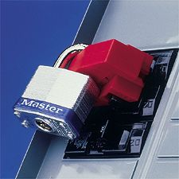
Locks
Each authorized employee/contractor required to perform LO/TO should be issued with their own lockout lock(s) and key(s).
Lockout locks should only to be used for LO/TO purposes.

Slide 8
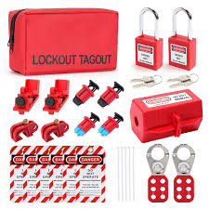
Locks (Cont.)
One key per lock is ideal. If a second key is available, it should be under strict control.
Only individual keyed locks are to be used, combination locks cannot be used.
Locks that are used for Lock-out and Tag-out can not be used for any other purposes

Slide 9
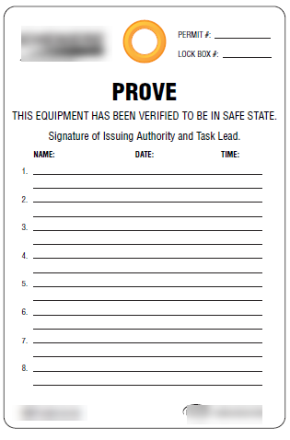
Tags Used For LOTO
LOTO Tags are generally to be utilised in tandem with locks.
“Danger Do Not Operate” tags to be installed on any vents and or drains that are left open to atmosphere.
Remember that tags only provide information and warnings to alert workers;
IMPORTANT - TAGS DO NOT LOCK OUT AN ENERGY SOURCE!

Slide 10


Tags (cont’d)
Tags shall provide warning to personnel not to energize the equipment.
Tags should be of a suitably durable material for the work environment in which they are installed.
Tag must securely fasten to prevent accidental removal using a sufficiently strong self-locking, non-reusable tie wrap

