Slide 1
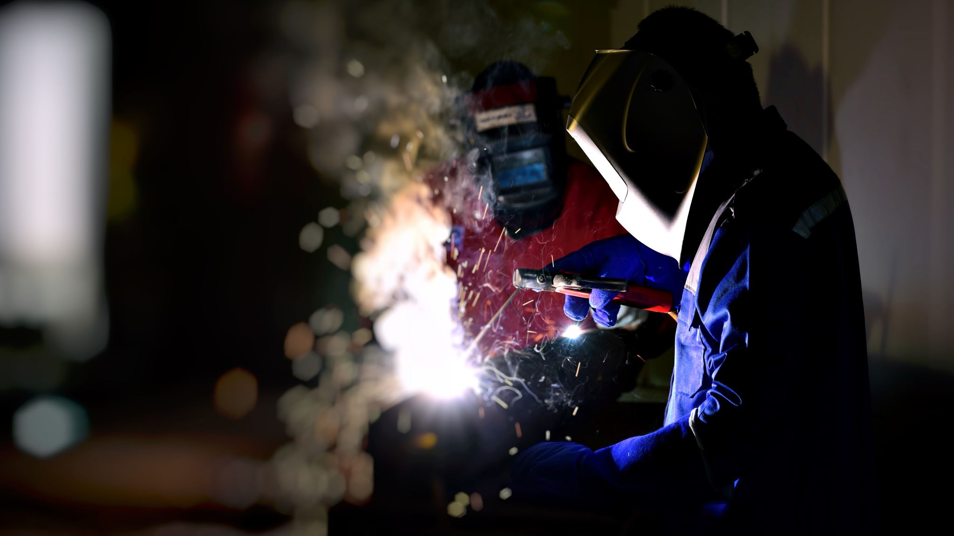
Hot Work
Welding and Cutting: These activities generate sparks and heat that can ignite flammable materials.
Heating and Hot Tapping: Involves applying heat to pipes or tanks, which can create ignition sources.
Burning: Using open flames for various purposes, such as torch cutting.
Drilling and Sawing: Mechanical processes that can produce sparks.
Buffers, Sanders, and Grinders: Abrasive activities that generate heat and sparks.

Slide 2
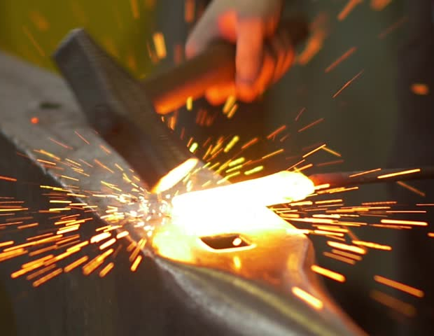
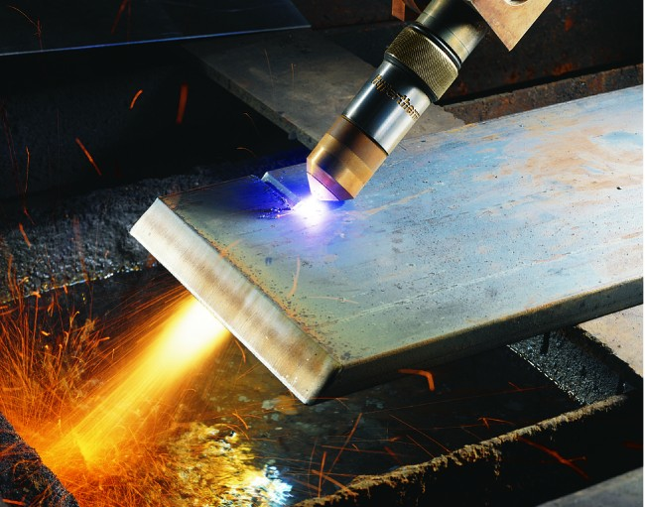
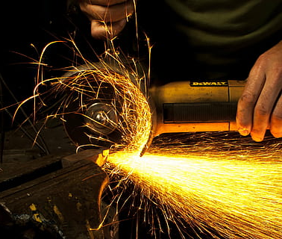
EXAMPLES OF HOT WORK SITUATIONS THAT COULD
LEAD TO A FIRE OR EXPLOSION
Welding
Torch Cutting
Grinding
Use of tools (hammer, spanner...) not adapted to the area
Bare Cable
Non intrinsically safe mobile phone and electronic devise
This Photo by Unknown Author is licensed under CC BY-SA-NC

Slide 3


Hot Work
Critical steps for ensuring Life Safety
Control Flammables and Ignition Sources:
  Identify and control all potential ignition sources before starting hot work.
  Ensure that flammable materials are removed or properly isolated.
Obtain Authorization:
  Secure the necessary permits and authorization before commencing hot work.
Gas Testing:
  Conduct a gas test in hazardous areas to confirm the absence of flammable gases or vapors.
Continuous Gas Monitoring:
  Implement continuous gas monitoring to detect any changes in gas levels and ensure ongoing safety.

Slide 4
Avoiding hot work accidents requires careful planning, adherence to safety protocols, and continuous monitoring. Here are some key strategies to prevent accidents:
Risk Assessment
Permitting Process
Training
Fire Watch
Clearance and Isolation
Flammable Gas Testing
Ventilation
Personal Protective Equipment (PPE)
Equipment Inspection
By following these strategies, you can significantly reduce the risk of hot work accidents and ensure a safer working environment. Have you implemented any of these measures in your workplace?

Slide 5
Avoiding hot work accidents requires careful planning, adherence to safety protocols, and continuous monitoring. Here are some key strategies to prevent accidents:
Risk Assessment: Conduct a thorough risk assessment before starting any hot work to identify potential hazards and implement appropriate safety measures
Permitting Process: Implement a permitting process to ensure that only authorized personnel perform hot work and that necessary precautions are in place
Training: Provide comprehensive training to workers involved in hot work to ensure they are knowledgeable about potential risks and safety procedures
Fire Watch: Assign a fire watch to monitor the area during and after the hot work. They should be equipped with fire extinguishing equipment and trained to use it
Clearance and Isolation: Ensure the hot work area is cleared of any flammable materials and properly isolated

Slide 6
Flammable Gas Testing: Conduct gas or vapor monitoring in the area used for hot work to ensure there are no flammable gases present
Ventilation: Ensure proper ventilation to prevent the accumulation of flammable gases and vapors
Personal Protective Equipment (PPE): Workers should wear appropriate PPE, including fire-resistant clothing, gloves, and eye protection
Equipment Inspection: Regularly inspect hot work equipment to ensure it is in good working condition
Emergency Response Plan: Have a clear emergency response plan in place in case of an accident
By following these strategies, you can significantly reduce the risk of hot work accidents and ensure a safer working environment. Have you implemented any of these measures in your workplace?

Slide 7
HOT WORK WITH OPEN FLAME
Torch cutting, welding, grinding, brazing, milling, deburring, chiseling
Dry sanding, hot tapping
Use of smoking accessories (matches, lighters…)
Use of machine with burner or open flame
Heating with electric resistance
Heat treatment

Slide 8
HOT WORK WITHOUT OPEN FLAME
Cathodic protection, wet blasting, static electricity generation
Extension cords without explosion-proof connectors, internal combustion engines, including motor vehicles and equipment
Opening live electrical panels or enclosures
Use of hand or power tools capable of producing a spark (wire brushes, compressed air or hydraulic tools)
Use of non-intrinsically safe (uncertified) electrical equipment: camera, computer, mobile phone, use of multimeter, continuous gas detector...
Use of or work on equipment/facilities containing pyrophoric materials

Slide 9
Hot work shall not be performed
In flammable or potentially flammable atmospheres:
On or in equipment or tanks that have contained flammable gas or liquid or combustible liquid or dust-producing material, until a designated person has tested the atmosphere inside the equipment or tanks and determined that it is not hazardous; or
Near any area in which exposed readily ignitable materials such as bulk sulphur, baled paper or cotton are stored. Bulk sulphur is excluded from this prohibition if suitable precautions are followed, the person in charge is knowledgeable and the person performing the work has been instructed in preventing and extinguishing sulphur fires.
Drums, containers or hollow structures that have contained flammable or combustible substances shall either be filled with water or cleaned and shall then be ventilated. A designated person shall test the atmosphere and determine that it is not hazardous before hot work is performed on or in such structures.
Before heat is applied to a drum, container or hollow structure, an opening to release built-up pressure during heat application shall be provided.

Slide 10

Non-sparking tools are essential for hot work environments to prevent ignition of flammable gases or vapors. OSHA recommends using tools made from materials like brass, bronze, or aluminum-bronze, which do not produce sparks when struck. Here are some key points about non-sparking tools:
Material: Non-sparking tools are typically made from alloys such as brass, bronze, or aluminum-bronze.
Usage: These tools are used in environments where flammable gases, vapors, or dusts are present to reduce the risk of ignition.
Maintenance: Regularly inspect and maintain non-sparking tools to ensure they remain effective and safe.
Training: Workers should be trained on the proper use and handling of non-sparking tools to maximize safety.
Using non-sparking tools is a critical component of hot work safety protocols. Have you had any experience using these tools in your work environment?

Slide 11
Hot Work Incidents
Motiva Enterprises Sulfuric Acid Tank Explosion | CSB
Death in the Oilfield - Safety Videos - Multimedia | CSB

