Slide 1
Working Around Mobile Equipment

Slide 2

What are the dangers of working around mobile equipment?
Moving Parts: People can be struck by moving parts of the equipment, such as blades, forks, or booms.
Blind Spots: Operators may have blind spots, making it difficult to see pedestrians or other equipment.
Falling Loads: Loads being lifted or transported can fall, causing serious injuries.
Crushed by Equipment: Workers can be crushed between the equipment and a wall, object, or another piece of equipment.
Equipment Overturn: Mobile equipment can overturn, crushing anyone nearby.
Forklifts: Forklifts can tip over or run into people, especially if not operated properly.

Slide 3

How do you stay safe around mobile equipment?
Personal Protective Equipment
Wear appropriate PPE, including hard hat high-visibility clothing and sturdy footwear
Utilize gloves and safety glasses when needed
Safe Work Practices
Never ride on equipment, this includes attachments
Stay clear of suspended loads
Follow designated walkways
Respect all barricades

Slide 4
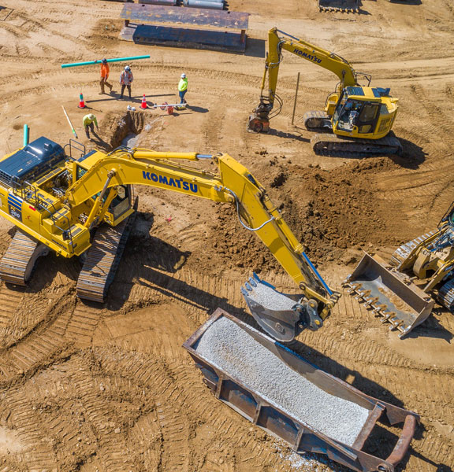
How do you stay safe around mobile equipment?
Operator Awareness/ Communication
Before approaching mobile equipment ensure you have the equipment operator's attention.
Be mindful of the equipment's movement and blind spots.
Never position yourself in an area not visible to the operator
If necessary, use clear hand signals to communicate with the operator
Pay attention to any audible warnings or signals from the equipment

Slide 5
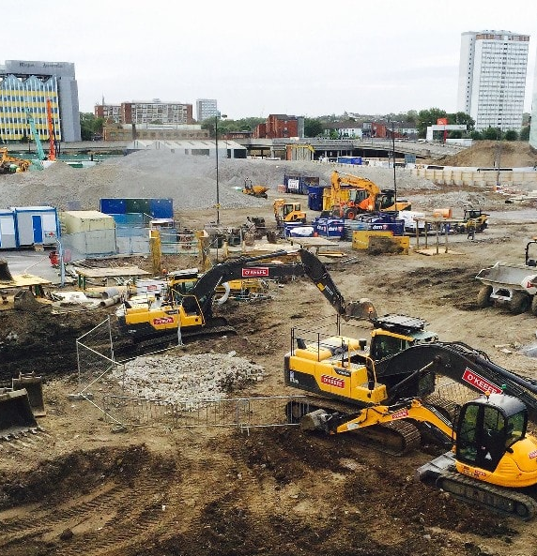
How do you stay safe around mobile equipment?
General Safety
Know the types of equipment being used at your site and be familiar with the hazards associated with that equipment.
Stop and look before entering an area where equipment is operating, make sure it is safe to proceed.

