Slide 1
Bypassing Safety Controls
Understanding the Importance of Authorization and Safety Compliance
Notes:
General Introduction along with this class is a very open and dialog course about bypasses, what they are and how they can effect them and their families .

Slide 2
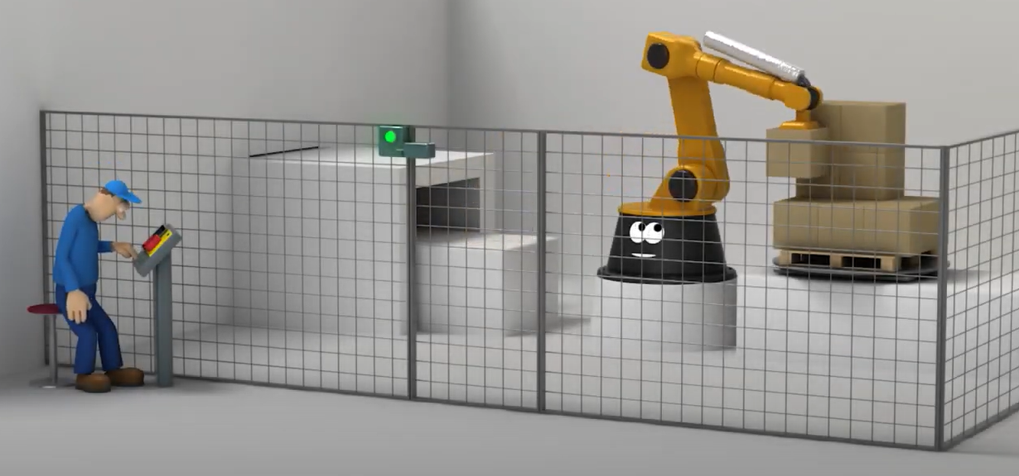
Safety Critical Controls
https://www.youtube.com/watch?v=-i40ewYhVnA
Notes:
During the video, stop in a few key areas to discus: steps he's taking that are safe and not bypassing safety systems and steps he taking that are bypassing safety systems. Also identify safety systems throughtout the video

Slide 3
Safety Critical Controls
Definition
A safety-critical system or life-critical system is a system whose failure or malfunction may result in one (or more) of the following outcomes:
Death or serious injury to people
Loss or severe damage to equipment/property
Environmental harm
Notes:
General discussion on safety critical controls defenition and the reasoning this could effect them

Slide 4
Safety Critical Controls
What could a bypass be:
Could be a valve
Could be a computer program
Could be a push button
Could be an electrical jumper
Notes:
Break each line down with a discussion on valves, computer programs, push button and electrical jumpers (class involvement is important)

Slide 5
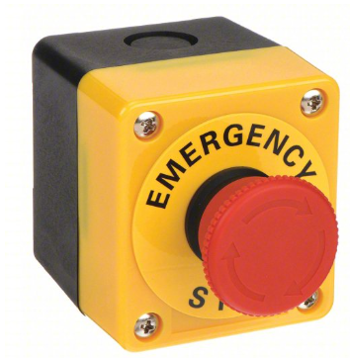
Safety Critical Controls?
Safety controls are engineering, administrative, and/or procedural measures designed to prevent hazards and incidents.
These may include:
Physical barriers
Safety interlocks
Emergency shutdown systems
Alarm systems
Pressure relief valve
Lockout/Tagout (LOTO) procedures

Slide 6
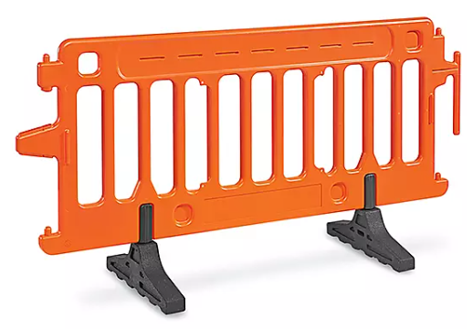
Examples of Safety Controls and Their Functions
Physical Barriers: Prevent access to hazardous areas (e.g., locked gates, confined space barriers, etc.)
General considered a weak control since they are used so frequent
Notes:
Discussion with the class on when they would use barriers and why they would be needed along with the effect of barriers

Slide 7
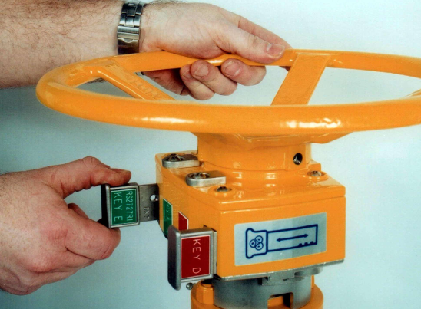
Examples of Safety Controls and Their Functions
Safety Interlocks: Ensure safe sequencing of operations (e.g., pressure release systems)
Notes:
Discussion with the class on when they would use Interlocks and why they would be needed along with there effect

Slide 8
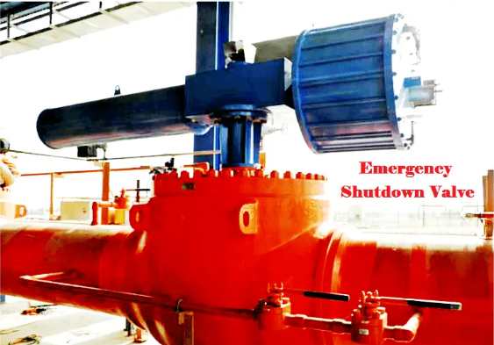
Examples of Safety Controls and Their Functions
Emergency Shutdown Systems: Rapidly shut down operations to prevent escalation (e.g., ESD valves)
Notes:
What is a ESD, where are they used, why are they used and what effect could bypassing them have on me and my family

Slide 9
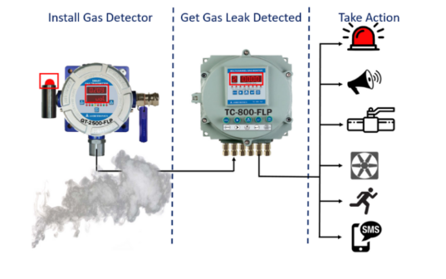
Examples of Safety Controls and Their Functions
Alarm Systems: Alert personnel of abnormal conditions (e.g., gas detection alarms)
Notes:
This is an industry example and something that needs to be discuss; what is the reasoning for this system, how does it keep me safe and what could happen is bypassed. Discuss the option of putting portable gas detection in place as a mitigation when bypassed. Also a good slide to discuss home safety alarms like smoke or CO2 detectors (why they are important in your home, why happens when you bypass them – like putting tape over the inlet or letting the batteries go dead

Slide 10
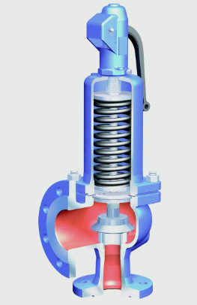
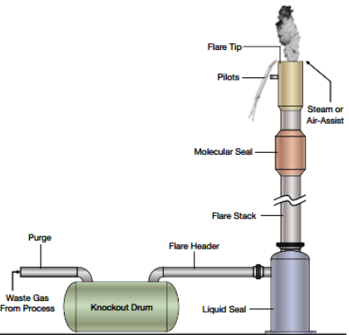
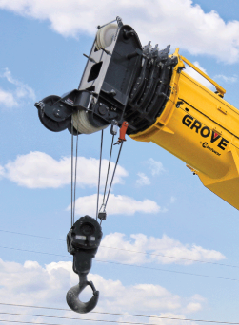
Safety Critical Controls
Other Examples Include:
Pressure Relief Valve
Industrial Flare System
Anti – Two Block
Notes:
Discuss each pic, what its function is and what cause and effect it could have on them if bypassed

Slide 11
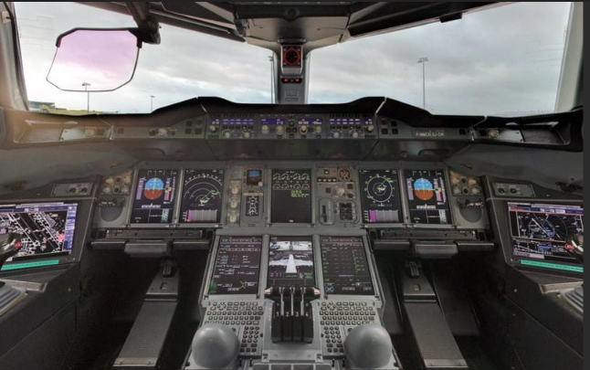
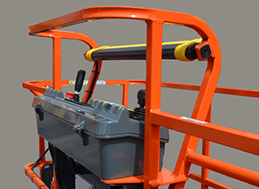
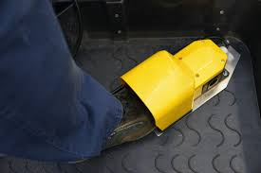
Safety Critical Controls
Other Examples Include:
Air Plane Controls
Powered Mobile Equipment
Notes:
Discuss air plane controls, what would happen if a pilot bypassed a critical landing safety system. Discuss man lift, how they operator and what he safety features do, along with what could happen is bypassed

Slide 12
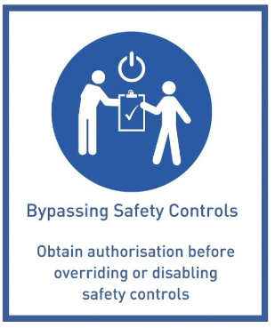
Bypassing Safety Critical Control's
What is the Meaning of Bypass Safety Controls?
A bypassed safety control is defined as an operation or a process used to temporarily stop the functioning of a component of a system or stops the entire system.
Obtain authorization before overriding or disabling safety controls
Notes:
Good slide to discuss different “life safety rules” for different sites (get input from students)

Slide 13
Bypassing Safety Critical Control's
Why Bypass Safety Critical Controls
Complete preventive maintenance or repair l
Verify calibrations
Known / planned work in the area might set the instrument into alarm
Notes:
Discuss reasons safety systems might be bypassed

Slide 14
Bypassing Safety Critical Control's
Before disabling or overriding safety equipment, the following should be completed:
Obtain authorization from the designated authority as outlined in each site’s policy and procedure (to possibly include):
  Risk assessment and justification for the action
  Implement temporary safety measures to compensate for the bypassed control
  Document the process and obtain written approval
  Restore the safety control as soon as possible

Slide 15
Bypassing Safety Critical Control's
Scenario 1: An operator disables a pressure relief valve to speed up maintenance without approval.
Consequences:
  Overpressure occurs, causing an explosion
  Worker injury/fatalities occur
  Impact to local community
  Regulatory fines / legal action
  Equipment damage and operational downtime
Notes:
Read the scenario, then discuss with the students on what the answers might be, then open each bullet

Slide 16
Bypassing Safety Critical Control's
Scenario 2: An operator needs to bypass an alarm for a scheduled maintenance task.
Steps Taken:
  Worker obtains written approval from the appropriate parties
  Alternative safety measures are implemented (e.g., increased monitoring, temporary guards)
  Work is completed safely
  Alarms are reinstated
Outcome: No incidents, compliance maintained, work completed safely.
Notes:
Read the scenario, then discuss with the students on what the answers might be, then open each bullet

Slide 17
Bypassing Safety Critical Control's
General Flow Chart
Safety Critical Control
Yes
No
Identify safety critical device
No action needed
Obtain authorization to bypass
Complete Bypass
Remove bypass and put back in service

Slide 18
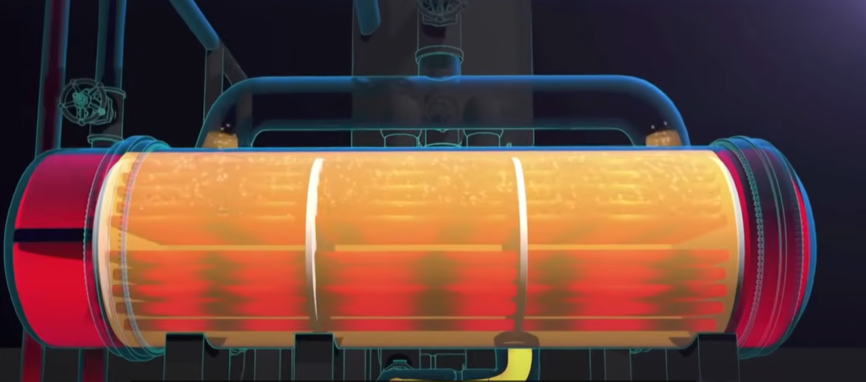
Bypassing Safety Critical Control's
CBT Video
https://www.youtube.com/watch?v=Z1KaykPaF8M
Notes:
Show video then discuss what system was bypassed, did the proper approval get completed and what was the end result

Slide 19
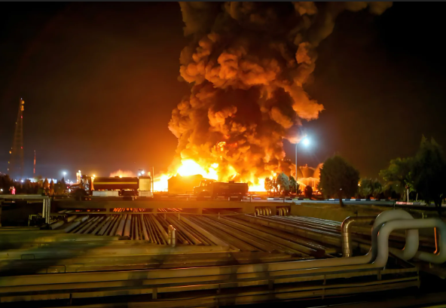
Summary and Key Takeaways
Safety controls prevent accidents and must not be bypassed without proper authorization.
Proper authorization could include:
  Risk assessment
  Temporary safeguards
Unauthorized bypassing leads to severe consequences, including:
  Injuries
  Property damage
  Legal penalties
  Downtime

