Slide 1

Line of Fire Safety

Slide 2
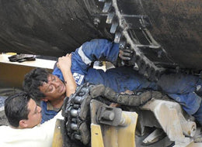
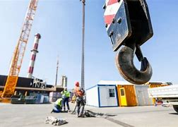
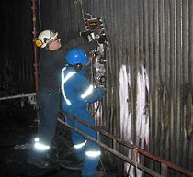
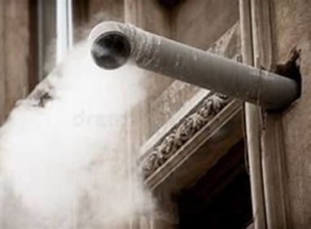
Three Categories of Line of Fire
Caught in Between
Struck By
Released Energy or Potential Energy
Notes:
Line of fire is when a person is located in the path that a moving object could take if it were to move. The three main categories are: caught in between (moving truck and wall), struck by (swinging crane hook, falling tool), and released or potential energy (cutting incinerator tubes, cutting wire under tension). OSHA reports that around 27% of workplace deaths are related to line of fire incidents. Indorama has unfortunately had our fair share of Line of Fire incidents in the last few years with some resulting in significant injuries. The latest two were the incident in Mexico which we will discuss some of the lessons learned and the train and truck incident at PNO which will be discussed later in the meeting. The good news is that with good situational awareness, line of fire incidents are completely preventable.

Slide 3
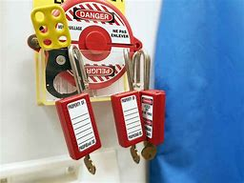
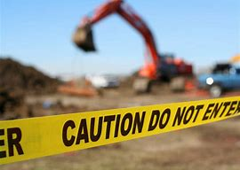
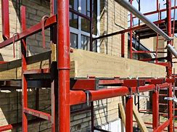
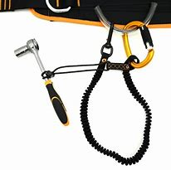
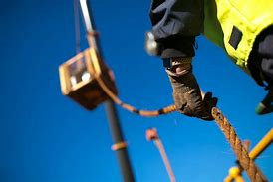
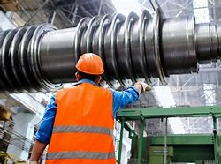
Recognition and Protection
Always perform a job walk to assess hazards and Reevaluate if conditions change
Ensure proper LOTO/EIP prior to work
Barricade areas to inform workers
Install toe boards on scaffolding
Use tool leashes/lanyards
Don’t move loads over individuals
Utilize taglines as needed
Don’t stand directly in front of piping outlets
Watch for pinch-points
Have a safe way out of tight spaces

Slide 4
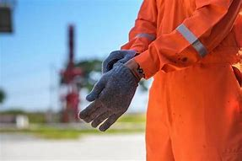
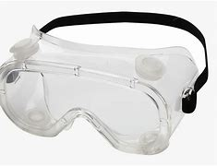
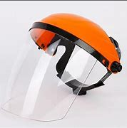


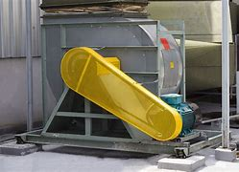
Recognition and Protection
Confirm vehicle warning lights/signals are functional
Make sure all vehicle operators are properly licensed
Always wear snug fitting gloves
Use proper safety glasses/goggles/face shields
Wear hard hats where overhead hazards exist
Install energy capture devices/bracing
Make sure machine guards are installed
Never sacrifice safety for speed or ease of task!!

Slide 5

Remember always identify a safe escape route before starting any work!

Slide 6
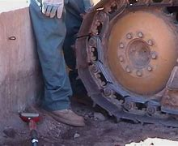
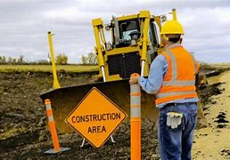
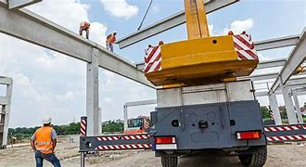

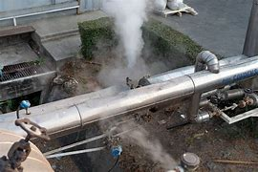
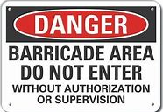
Expectations
Avoid positioning yourself between stationary and moving objects
When working around vehicles make direct eye contact with the operator/driver
Avoid areas where pressure releases can occur
Be aware of all overhead hazards
Always wear proper PPE
Always properly barricade hazardous areas and enforce their adherence
Watch out for your coworkers, we all can get complacent
If in doubt, stop work and report!!
Notes:
We can’t remove all line of hazards from the workplace so the key is situational awareness. Constantly reassess your work environment and look for objects that do or could possibly move and then identify their path of travel (line of fire). PPE will not protect you from every line of fire hazard. If the hazard can’t be removed, try using engineering controls such as barricades, spotters, hard barriers, etc.

