Slide 1
FINANCE 101

Slide 2
TABLE OF CONTENTS
About Us
Introduction: Fears in Finance
Process Optimization
Financial Oversight
Cash Management
Financial Modeling
Planning & Budgeting
Key Performance Indicators (KPIs)
Pitch Deck Support
Due Diligence Support
Board Support

Slide 3
ABOUT US
Unlock Your Business's Full Potential with Our Expert Advisory Services
Are you worried about your company's future?
Your Fears:
Financial Uncertainty: Concerned about making the right financial decisions?
Operational Inefficiencies: Struggling with processes that drain resources and reduce productivity?
Investment Challenges: Finding it hard to attract investors and secure funding?
Compliance Risks: Worried about staying compliant with ever-changing regulations?
We Are the Solution:
Financial Clarity: Our detailed financial modeling and planning services provide you with the clarity and foresight needed to make informed decisions, ensuring your business stays on the right path.
Operational Excellence: We optimize your business processes, enhancing efficiency and reducing costs, so you can focus on what matters most—growing your business.
Investor Confidence: With our expert pitch deck support and due diligence services, you'll be well-prepared to attract investors and secure the funding you need to innovate and expand.
Regulatory Compliance: Our ongoing financial oversight ensures your company remains compliant and financially sound, giving you peace of mind.
Imagine a Future Where:
Your business thrives with robust financial health and operational efficiency.
You confidently present to investors, knowing you have the support and insights to back your vision.
Your company navigates regulatory landscapes with ease, avoiding costly compliance issues.
You focus on strategic growth, knowing that your financial and operational foundations are solid.
Take the First Step Towards a Brighter Future: Contact us today to learn how our tailored advisory services can help you overcome your fears and achieve your business goals. Together, we can turn your challenges into opportunities and unlock your business's full potential.

Slide 4
INTRODUCTION: FEARS IN FINANCE
Process Optimization: Inefficient processes can drain resources, reduce productivity, and hinder your competitive edge.
Financial Oversight: Lack of financial oversight can lead to compliance issues, financial mismanagement, and potential legal troubles.
Cash Management: Poor cash management can lead to liquidity issues, threatening your company's financial stability.
Financial Modeling: Without accurate financial models, you risk making uninformed decisions that could jeopardize your company's future.
Planning and Budgeting: Poor planning and budgeting can lead to resource misallocation, financial shortfalls, and missed targets.
Key Performance Indicators (KPIs): Without tracking the right KPIs, you might miss critical insights into your business performance, leading to inefficiencies and lost revenue.
Pitch Deck Support: A poorly crafted pitch deck can fail to attract investors, stalling your growth and innovation.
Due Diligence Support: Inadequate due diligence can result in costly mistakes, such as overpaying for acquisitions or entering unfavorable partnerships.
Board Support: Without strategic support, your board may struggle to make informed decisions, impacting your company's direction and success.

Slide 5
PROCESS OPTIMIZATION
Corporate Systems Integration
Banking Partners

Slide 6
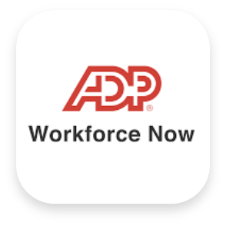
CORPORATE SYSTEMS INTEGRATION
Type | System we recommend | Comments on Systems
Financial Systems | Quickbooks Online Advanced (QOA) (for small business) Netsuite® Intaact® | First off, we recommend to move away from QB Desktop Enterprise as Intuit is phasing it out due to hosting. The closest online equivalent to Desktop is QOA. QOA offers many of same features as Enterprise, such as advanced reporting, multi-user access, inventory management, and robust support for larger businesses. NetSuite is the best choice when ready for system automation. Intacct is another cloud-based, but the user interface of Netsuite is similar to QBs and more user friendly.
HRIS and Payroll Partners | ADP run (for small business) ADP Workforce Now Bamboo HR | ADP Run can be used for simple integration of under 25 employees (but main variable depends on the # of states you have nexus). ADP Now is the upgrade to next phase when you need access to recruiting data > 50 employees. BambooHR is the most user-friendly and best look n feel, but it lacks complete integration with payroll process like ADP.
Equity Platform | Carta | Best Platform for management of cap tables, waterfall scenarios, certificate runs, and valuations. Now, Carta has SBA LLC capabilities for profits-interest and option like equity vehicles along with providing 409A valuations.
Expense Processing Systems | Expensify Ramp Netsuite® | To note, there will always be complaints on expense processing from employees. Find a system that works for your finance department. Netsuite expense processing is included with the financial package. However, if you are running QOA, then both Expensify and Ramp cost to use. In addition, Ramp is based on you using company credit cards to implement. So, if you don’t want to go that route. then Ramp is not for your company. Expensify is user friendly, however, hard to pull expenses if you have one account with several cards at AMEX as Expensify can only pull ALL accounts associated with an AMEX.
These 4 types of systems represent the infrastructure investments needed to automate your business!

Slide 7
BANKING PARTNERS
Banks issue several reports to the public that you can review prior to making them your custodian. With the banking collapse of Silicon Valley Bank, checking the health of banks is an important step towards a good banking partners. You can review the following reports to gain access to a bank’s health:
Call Report – filed quarterly, detailed info including assets, liabilities, income, and expenses
Uniform Bank Performance Reports (UBPRs) – offer comparative performance data across banks
CRA Rating (Community Reinvestment Act Ratings) - rates a bank’s performance to meet credit needs of its community
Star Ratings (up to 5 stars) – independent agencies like BauerFinancial provide start ratings based on financial data, offering an easy-to-understand assessment of a bank’s health
Bank | Small Business Friendly | Assets Size (1,000)** | Star Rating*** | CRA Rating** | Exam Method** | FDIC Cert No**
Amegy Bank* |  | $93,199,669 |  | Outstanding | Large Bank | 2270
Regions Bank |  | $146,476,000 |  | Satisfactory | Large Bank | 12368
Cadence Bank |  | $47,753,105 |  | Outstanding | Large Bank | 11813
Plains Capital Bank |  | $13,674,043 |  | Satisfactory | Large Bank | 17491
* Amegy is a subsidiary of Zions BankCorporation NA
** Source: CRA Ratings (ffiec.gov)
*** Source: BauerFinancial.com

Slide 8
BANKING PARTNERS (CONTINUED)
In addition to financial health, the suite of services a bank offers plays a key role in banking partner considerations:
Financial Services Offered: Evaluation the full range of services, such as checking and saving accounts, loans, lines of credit, treasury management, and specialized products like CDARS or sweep accounts.
Fees and Rates: Compare maintenance fees, transaction costs, loan interest rate, and hidden charges.
Customer Tech and Service Support: assess reputation on services, including response time, access to bank personnel and availability of local branches and digital support.
Technology and Convenience: Ease of integration with your operating system (QBO, NetSuite®), online apps and ease of performing wires, ACH limits and approvals.
Compliance and DACA Agreements: DACA agreements allow PE lenders to gain control over a borrower’s bank account to secure the funds in case of borrower default.
Diversification Requirements: Lastly, again due to the collapse of Silicon Valley Bank, many PE firms are requiring two banks being involved with one as local and one as a major bank (Chase, UBS, Morgan, etc.) to diversify the capital provided. Another reason to diversify involves if your funds get frozen by one bank, then you will need to ensure your business makes payroll needs with immediate access to other banking funds without having to go on credit.
Amegy is a subsidiary of Zions BankCorporation NA
** CRA Ratings (ffiec.gov)
*** BauerFinancial | We analyze banks and credit unions…. very carefully

Slide 9
FINANCIAL OVERSIGHT
Internal Controls Matrix
Finance Life Cycle
Financial & Accounting Roles
Operational Structure
CFO Support
Tax Compliance Support

Slide 10
INTERNAL CONTROLS MATRIX
1. **Segregation of Duties**: Ensure that no single employee has control over all aspects of a financial transaction. For example, the person who approves payments should not be the same person who reconciles bank statements. This creates checks and balances, making it harder for fraud to go undetected.
6. **Monitoring of Cash Flow**: Establish clear protocols for monitoring cash flow and use accounting software that flags unusual patterns in transactions, such as large withdrawals or payments to unknown vendors.
7. **Vendor Management**: Regularly vet and review all vendors to ensure that they are legitimate and that payments to them are for actual goods and services.
2. **Access Controls**: Limit access to sensitive financial systems and data to authorized personnel only. Implement strict user permissions for systems that handle financial transactions to minimize exposure to fraud.
5. **Reconciliation of Accounts**: Reconcile bank statements, accounts receivable, and payable regularly to ensure that all transactions are legitimate and accounted for. Discrepancies should be investigated immediately.
8. **Bank Account Reconciliation**: Have someone independent of cash disbursement and collection functions reconcile the bank accounts regularly to detect unauthorized transactions or discrepancies early.
3. **Dual Authorization for Payments**: Require two or more individuals to approve significant payments, especially wire transfers, to prevent a single person from initiating unauthorized transactions.
4. **Regular Financial Statement Review**: Conduct regular variance analysis of the budget vs actual along with prior vs actual with the CEO each month end close. In addition, there should be a preparer and a reviewer for each month’s financial production.
9. **Rotate Job Responsibilities**: Rotating roles or requiring employees to take vacations can help uncover fraud that someone might otherwise hide by having continuous control over a process.
To mitigate the risk of embezzlement or fraud within a business, a CFO can help with implementing robust financial controls that are essential to a business. See additional articles for sample recommendation by stage of business

Slide 11
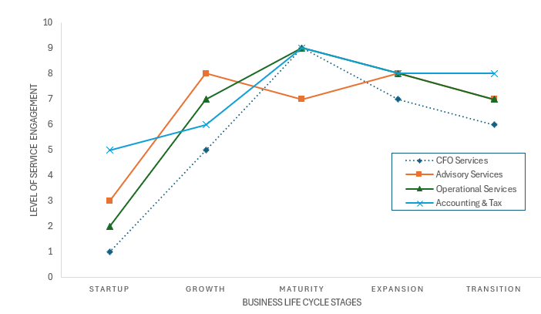
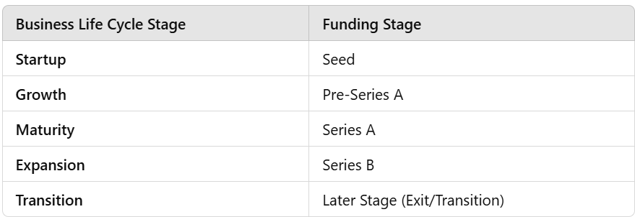
FINANCE LIFE CYCLE AND LEVEL OF SERVICE ENGAGEMENT
Investing in an operational team to meet your corporate governance needs is key in every stage of the finance life cycle.
A company should utilize accountants, lawyers, and investment advisors for governance at a fraction of the cost of in-house expertise as they make their way through the life cycle.
This shows the level of service engagement for CFO services, Advisory services, Operational services, and Accounting & Tax services across the different business life cycle stages. Each curve represents how the demand for these services changes from Startup to Transition.

Slide 12
FINANCE LIFE CYCLE LIST OF SERVICES ENGAGED
Core Business Process Optimization
Story Telling Support
Operational Challenge Support
What type of Service Support do you need at each stage of your business?
Fundraising Support
Financial Statement for accurate and timely reporting
Financial Models
Pitch Decks
Investor Meetings
Valuation
Negotiating Terms
Managing new funds
Cap Table, Waterfall and Equity Dilution Scenarios
Startup Stage
Basic Operational setup
Setup financial systems
Prepare financials to attract investors
Accrual Accounting
Banking Relationships
Corporate Tax Compliance
Customer Collections
Vendor Management
Internal Controls (SOPs)
Data Standardization
Growth Stage
Strategic Planning & Budgets
Cash Management
Optimize spending
Revenue targeting and analysis
Cap Tables, Valuations, and Fundraising Support
Compensation Structure and Comp Market Studies
Source & Uses
Closing Statements & Flow of Funds Analysis
Corporate Governance
Systems Automation
Maturity Stage
Monitor KPIs
Scenario Planning
Monthly PE Reporting Package
EBITDA monitoring
Predictive Analytics
Customer Segmentation Study
Advanced Equity Comp Structure
Cultural Gaps & Risk Management
Comprehensive Value Levers Analysis
Expansion Stage
Navigate financial complexities
Audit Prep
M&A
International Expansion
Manage Foreign exchange risk
Prep for Transition
Continued Fundraising Support

Slide 13
FINANCIAL AND ACCOUNTING ROLES
There are three main roles to be played on the responsibilities pyramid as you scale:
Bookkeepers – focus on daily transactional work and record-keeping
Controllers – oversee the accuracy of financial reporting, compliance, and manage staff
CFOs – develop strategies, oversees financial risk and works with C-suite on high-level business decisions
Controller
Bookkeeper
CFO
Develops Financial Strategies
Planning and risk management
Manages relationships with banks, investors, and financial institutions
Drives key decision making on M&A and expansions
Monitors liquidity, cashflow management, and capital structure
Oversee budget, forecast and resource allocation
Fundraising
Oversees all accounting operations
Oversees all aspects of financial
reporting (including budget, forecasting, and variance analysis)
Implements and maintains Internal Controls
Manages month-end close process
Compliance tax and reporting requirements
Manages external audit process
Maintains internal systems
and procedures
Records daily transactions
Payable
Billings and Contracting
Payroll Processing
Expense Management
Maintain General Ledger and track accounts
Reconciles the bank
Handle data entry related to
accounting tasks
Focus:
Strategic Force
Focus:
Oversees Reporting
Focus:
Day-to-Day

Slide 14
OPERATIONAL STRUCTURE
As a business enters both the growth & mature stages, department function build outs become the key for infrastructure investments. This way you have function areas in place allowing you to expand and acquire. Here is a sample functional map for a consulting business.
CFO Function
Sales Function
Entrepreneur Role
Strategist Role
Challenger Role
Storyteller Role
Expert Role
Generate outbound leads
F/U inbound leads with team
NDA/MGS execution
Quarterback SOW drafting process
Track Sales Opportunities
Facilitate internal SOW review process
Negotiate w/ clients
Obtain Client Feedback
07
01
IT Function
Accounting Function
Technology Assessment
Software Systems Mgmt.
Digital Infrastructure Mgmt
Data Mmgt
IT Maintenance
Solving Workflow Issues
06
02
Billing and Contract Mmgt
AP and Vendor Mgmt
Cash Mgmt
Asset Mgmt
Payroll Mgmt
Permanent File Mgmt
05
03
04
People Resources
Investors Relations Function
Talent Acquisition w/ CEO
EVP and Culture
Learning and Development
Performance Mmgt
Comp, Reward, Incentives & Recognition Mgmt.
Workforce Planning & Org Design
People Issues Mgmt
Workplace Diversity
Corporate Policies & Procedures Mgmt
Progress Reporting
Financial Reporting
Budget Reporting
Bank Reporting
Develop & Enforce Policies
Board & Shareholder Events
Legal & Compliance Function
Definitions:
EVP – Employee Value Proposition
SOW – Statement of Work
AP – Accounts Payable
Mgmt - Management
Client Contract Review
Vendor Contract Review
Contract Management & Maintenance
HIPPA Compliance
Banking & Financial Compliance
Employment Compliance

Slide 15
CFO SUPPORT
The factional CFO can help a business thrive along all stages of growth. At the core of any business success is to set up your internal systems, external relationships, and processes properly from the beginning. Then, especially at early stages, you can hire your external specialists (accountant, lawyers, and bankers) as part-time support at a faction of the cost for full-time support. Below represents a roadmap for financial success by headcount and general business staging.
Headcount | Business Stage | Financial Focus | Typical Roles | Outsourced vs In-House | Factional CFO
1-15 People | Startup / Seed | Simple bookkeeping, basic financial tracking | Bookkeeper | Outsourced (or part-time in-house) | Possible
15-30 People | Early Growth / Pre-Series A | Growth management, budgeting, preparing for fundraising | Controller, part-time CFO | Outsourced or Hybrid (mix) | Yes
30-50 People | Series A / Scaling | Structured financial oversight, regular reporting | Controller, fractional CFO | Mostly In-House with some Outsourced CFO services | Yes
50+ People | Series B / Expansion | Complex financial strategy, capital raising, scaling | CFO, Controller, FP&A | In-House (CFO), outsource FP&A, could still outsource for specific services (e.g., audit) | Yes
100+ People | Series C or Later / Maturity/Exit | Strategic planning, preparing for exit or acquisition | CFO, full financial team | Fully In-House financial team | Possible

Slide 16
TAX COMPLIANCE SUPPORT
Cleaning up missed tax deadlines and tax reporting requirements can be not only very costly, but also extremely time intensive to work through corrections with tax agencies.
It is important to establish a good team early as your company begins to grow. We strongly encourage the following:
Hire a tax firm or individual tax accountant that can get your forms filed and submitted timely and accurately
Seek out tax experts within your specific industry. Similar to getting a medical surgery, ask how many procedures they have performed and do they have experience in which states.
Ask about tax credits that are specific to startup business such as the Qualified Small Business Stock (QSBS) Exemption, R&D Credits, and Startup Cost Deductions (IRC Section 195) to name a few.
Ensure your corporate structure is setup for not only growth, but positioned properly as either a S-corp, C-corp, or LLC taxed as a partnership based on your growth plans. There can be substantial tax savings to owners based on the structure.
Sale Tax nexus is tailored and almost different for each state. Ensure you review the nexus requirements not only if you have a physical presence in a state, but do you have significant economic activity. CA, NY and others are very aggressive to get their money. Sale Tax can be a filing nightmare if not completed correctly.

Slide 17
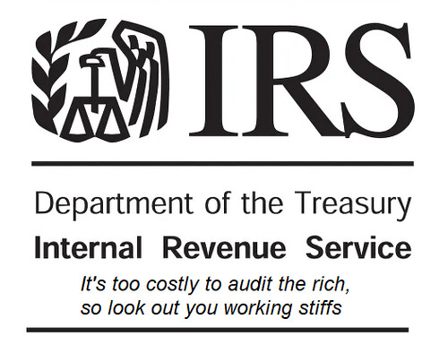
TAX COMPLIANCE SUPPORT (CONTINUED)
Payroll Processing Tax Issues to look out for:
In addition, HR experts should be consulted for paying people in the proper states and proper payroll tax filings. ADP can help setup states for $150 per state so you don’t have to complete the paperwork or phone calls. They can also ensure quarterly filings, power of attorneys, and annual payroll tax filings are completed timely and correspondence with each state.
Payroll taxes over a certain $ threshold will have to be deposited by wire the next day to IRS. If not in compliance, the business will get fined for late filing and accessed penalties. This usually triggers when a company is above 40 people.
This Photo by Unknown Author is licensed under CC BY

Slide 18
CASH MANAGEMENT

Slide 19
CASH MANAGEMENT
Cash and treasury management is critical for several reasons:
Liquidity: Ensures the business meets its immediate financial obligations without interruption.
Risk Management: Identifies and mitigates financial risks, especially interest rate changes. In addition, minimizes risks associated with cash shortages and enhances overall financial stability.
Cost Efficiency: Reduces borrowing costs by efficiently managing cash flow to manage draws on LOC.
CFOs can help to provide real-time visibility into cash positions, forecasts and transaction tracking with weekly cashflow models and liquidity scenario runs. Also, Here are treasury options used for risk mitigation (so excess cash can earn interest while still maintaining liquidity levels):
Treasury Options | Description
Insured Cash Sweep Accounts (ICS) | Automatically transfer excess cash into interest-bearing accounts, optimizing returns without manual efforts. Estimated 15-30% of small to medium business employ them.
Money Market Funds | Offer higher returns compared to traditional savings accounts, while maintaining liquidity and low risk. Estimated 20-30% of small businesses use as part of their cash management strategy.
CDARS (now part of IntraFI) | Allows businesses and individuals to access multi-million-dollar FDIC insurance coverage by spreading large deposits across multiple banks within a network, while maintaining a single banking relationship. Estimated10-20% of small businesses may utilize to ensure FDIC coverage for larger deposits.
CDARS is now part of IntraFi Network Deposits. IntraFi was formerly known as Promontory Interfinancial Network, which initially created CDARS. The rebranding to IntraFi Network occurred to encompass both CDARS and another product called ICS (Insured Cash Sweep) under a single brand.

Slide 20
FINANCIAL MODELING

Slide 21
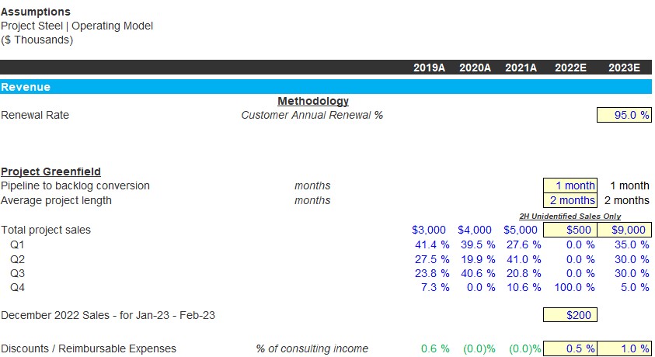
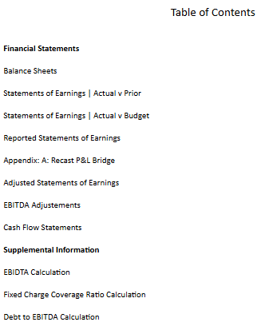
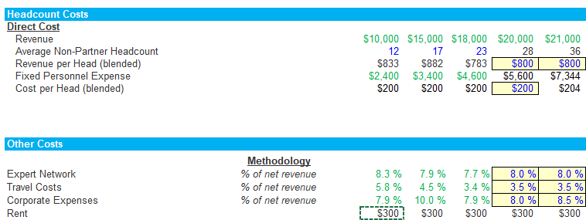
FINANCIAL MODELING
A fractional CFO can build detailed financial models that project the company’s future performance. This typically includes operating models, revenue forecasts, expense projections, sensitivity analysis, budgeting, and cash flow analysis. They help predict financial outcomes based on different business scenarios.

Slide 22
FINANCIAL MODELING (CONTINUED)
Reporting requirements will accelerate once you obtain investors and bank debt. Bank debt typically requires audit reporting, monthly close packages, quarterly meeting on forecast and variance analysis, annual budget report by financial statement, and compliance certifications. Board reporting will typically require quarterly reporting and a budget session. A business should establish automated reporting ahead of the curve to be ready for the demand reporting of private equity as investors will want to reference prior financials constantly during first few years to gain an understanding of your business and guide you where to put capital.
Companies should brainstorm on potential required reporting for supplement information to automate reporting through systems ahead of board requests, such as:
Customer segmentation
Headcount and human capital
Budgets into system reporting
KPIs that will be important metrics such as contribution margin, EBITDA, Revenue per client, days in sales, days in payables
Sales pipeline
Companies should start with the following processes to prepare for reporting requirements:
Develop a close checklist and 15-day maximum monthly close process
Develop a standard financial package with balance sheet, income statement, cashflow, budget vs actual, variance analysis, KPIs, EBIDTA reporting, and supplemental reporting.
This should all be done within the financial accounting system to automate the reporting process as excel gets overwhelming on the backend and pulling prior data becomes cumbersome if prior reports were generated in excel databases. Any frontend automation will reduce the close process substantially and increase efficiency response to pull prior reported data.
To note with modeling, we have the major assumption that the past will be a predictor of the future.

Slide 23
PLANNING AND BUDGETING
Scenario Planning
Runway Matrix
Budget Process

Slide 24
SCENARIO PLANNING
Scenario planning is a main key to success when you start into the growth stages of your business. To touch on how you would use this planning to help your business run on all cylinders, see below:
A fractional CFO can build models that stress test the business by evaluating worst-case financial scenarios (e.g., sales drop by 10%, major client attrition, economic downturn). Stress testing helps a business prepare for financial shocks and ensure there is a plan in place for survival in tough times.
Develop mergers and acquisitions (M&A) models or exit strategy models to plan for the financial implications of selling or merging the business. These models are vital for understanding the financial impact of M&A activity, including the effect on liquidity, tax liabilities, and shareholder value.
Prepare cash flow forecasts to ensure the business has enough liquidity for operations and growth under scenario runs. Specifically, it is recommended to create a runway matrix. This is discussed on the next page.
Typically, planning runs 3 scenarios with [1] optimistic, [2] pessimistic, and [3] realistic cases for the stress test and exit strategy model.

Slide 25
RUNWAY MATRIX
A runway matrix helps businesses understand how long they can operate with their current cash reserves by comparing projected revenues and costs to project the cumulative cashflow for a 24-month period. In addition, it is recommended to complete a 3-year financial model to help answer cash on hand and financial stability. The recommended steps would be to create the matrix with Python modeling to generated outcomes from a predictive model to see if the scenarios line up with the typical estimated run of your company. It may look something like the following:
 |  | Plan | -10% from Plan | -20% from Plan | -30% from Plan | No
 |  | Revenue | Revenue | Revenue | Revenue | Revenue
Plan | OPEX | 24 months | 18 months | 16 months | 12 months | 8 months
-10% from Plan | OPEX | 25 months | 24 months | 18 months | 16 months | 12 months
-30% from Plan | OPEX | 28 months | 25 months | 24 months | 18 months | 16 months
-40% from Plan | OPEX | 30 months | 28 months | 25 months | 24 months | 18 months

Slide 26
BUDGET PROCESS
The budget model helps to align financial resources with the company’s strategic goals. There are a few ways to approach a budget model; most use either the top-down approach or the bottom-up approach. Typically, you will see companies move to the top-down approach as revenue growth goals become the main KPI used to create enterprise value. In the top-down approach, you would start with the expected revenue growth and then build the COGS and then the OPEX needed to support the revenue growth. However, one of the most common mistakes in building a budget is overestimating revenue growth. It is recommended to not only use historical data, but benchmark to the industry. Find out what are your competitors doing? When running a budget always anticipate lower revenue and higher costs than expectated. Be conservative here to avoid financial instability and created unwarranted credit issues with your business. Since this is a model, you should follow the 3-pong approach of optimistic, pessimistic, and realistic budget runs.
Depending upon the industry, we would typically recommend starting the budget process early in September to start gathering data with the complete build in October and November for publication.
The budget will provide a roadmap for how the company should allocate its future resources while minimizing surprises or financial strains.
12 Common Startup Budgeting Mistakes to Avoid - Burkland (burklandassociates.com)
There is an amazing article link above which discussed the “12 Common Startup Budgeting Mistakes to Avoid” by Kate Adams at Burkland Associates.

Slide 27
KEY PERFORMANCE INDICATORS (KPIS)

Slide 28
KEY PERFORMANCE INDICATORS
Common financial KPIs were discussed earlier for financial specific metrics under the section “Financial Modeling.” In addition to reporting financial metrics, Companies should map out and set KPI targets for the company as a whole and at the employee-level. These are monitored during the year and reported on via dashboards, monthly reporting and Board reporting. Each year, the company can review the key indicators by employee/department to tie to the overall company financial KPI goals to trickle all the way down to individual performance. Mapping should be done to the company’s KPIs by department and amongst employee class once your growth stage demands a performance comp structure.
For example, in a consulting firm, you can relate a portion of team management year-end bonuses to the set KPIs measures they can influence such as:
Revenue Growth by Niche
Customer Retention Rates
Contribution Margin
EBIDTA Margin by Niche
Billable Rates and Utilization Rates
Employee Attrition & Headcount Growth
The sales team would have their own KPIs for example cross-selling, organic sales growth, sales growth goals, conversion rates, etc. In addition, you can set KPIs for your finance department with simple yes or no indications to encourage performance such as:
KPI | 24-Jan | 24-Feb | 24-Mar | 23-Apr
Financial Report to Management on time monthly | Yes | Yes | Yes | Yes
Board Meeting Package to Board on time | n/a | n/a | n/a | Yes
Close Process Completed in 10 days | Yes | Yes | No | Yes
Met Monthly Compliance Deadline with Bank | Yes | Yes | Yes | Yes
Implemented new system upgrade by Mar-24 | n/a | n/a | Yes | n/a

Slide 29
PITCH DECK SUPPORT

Slide 30
PITCH DECK SUPPORT
The finance support builds on each other. To create the proper story and sell your company for fundraising and investors, you will need to invest in:
Preparing realistic financial forecasting and projects for inclusion in the pitch deck. This should market a clear path to profitability grounded in reality
Highlighting KPIs such as EBITDA, gross margin, contribution margin, lifetime value (LTV), customer acquisition cost (CAC). Provides an understanding how efficiently the business operates and scales.
Articulating how much capital is needed, where it will be spent (R&D, infrastructure, operational needs, marketing, new product development), and expected return. Generally, you would want a 3x on marketing and monitor traffic to website and metrics via google analytics to start.
Establishing realistic valuation support, which is a critical point in investment discussions. CFO can provide comparable industry data and explain why and how a valuation was determined and be able to defend addbacks to EBITDA and run-rates.
Aligning the financial story board with the business model and market opportunities. Key here is to have over vision and mission of the company and follow the story from these themes.
Ensuring financial sections are accurate, well-presented and investor-ready. Identifying red flags that might deter investors
Be present during presentations to help answer the detailed financial questions and provide insights during negotiations.

Slide 31
DUE DILIGENCE SUPPORT

Slide 32
DUE DILIGENCE SUPPORT
During the going-to-market process, a fractional CFO can help get ready for sale. This starts from the beginning to build a central depository and folders to make you ready for upload at an instance. I have worked with companies that buried and used email as their main source of storage, and it can be a nightmare searching through archived email folders.
Systems: We would recommend to use Microsoft Sharepoint® for your central file storage. It comes with your email licenses and works as the main cloud storage to access files at the touch of a button. A company can also add zee drive through thinkscape.com to map drives to cloud systems which works similar Google Drive® or One Drive® from Microsoft. In addition, datasites can be used as the virtual data room during the diligence process to tag and process files during production.
Map OneDrive for Business as a Network Drive - Reliably (thinkscape.com)

Slide 33
DUE DILIGENCE SUPPORT
The Due Diligence Checklist can be overwhelming without proper data storage, internal controls, and quality control procedures to mitigate discrepancies in file management. You should expect the following requests:
Finance Due Diligence Request (for Buyside QofE)
Tax Request List – (prior returns, correspondence w tax agencies, exposures)
ESG Request –(census, diversity and inclusion program, client satisfaction scores, surveys, antibribery policy)
EH&B Request List – HR, Payroll vendors, ACA Compliance & IRS Filings, Welfare Plans, Insurance, open enrollment communication)
IT Request List – back office and front office documentation, IT infrastructure, IT Disaster Recovery plan, inventory of assets)
Retirement Request List – retirement plan audits, 5500s, Plan testing, summary plan description)
Property & Casualty Diligence Request List – (claims history, leases, property, surety bond, if applicable)
1099 Contractor Review Request List
Legal Request List
Corporate & Organization
Contracts & Commitments
Employment & Labor
Benefits
Intellectual Property
Real Estate
Corporate
Documents
Contracts
Employee/Contractor
Permanent File
Insurance
Leases
Litigation and
Claims
Taxes
Financial
Reporting
You can base your storage folders on what is expected to be requested in the future.

Slide 34
BOARD SUPPORT

Slide 35
BOARD SUPPORT
A fractional CFO provides significant support by leveraging financial expertise, infrastructure insights, strategic insights, and growth company experiences. The high-impact role helps to ensure financial decisions align with company goals. The main support entails:
In-person Meeting Support
Proving financial clarity
Developing long-term strategies for vision, growth plans, and market expansion
Fundraising and capital raise strategy
Scenario Planning
Budgeting and Forecasting (realistic revenue, cost, cashflow predictions)
Variance Analysis w/ regular and update variance runs on budget vs actual performance
Financial Due Diligence
Return on Investment (ROI) Analysis
Competitive Analysis
Reporting and Presentation
Prepare board-level financial reports
Simplify Complex Financial Data
Provide KPIs
Governance and Compliance
Ensure regulatory compliance
Recommend and implement strong internal controls
Board Liaison and Communication
Bridge between finance and board
Instill Board confidence
Compensation and Incentive Structing
Design and evaluate Executive Comp Plans
Provide insights on Equity and Stock Option Plans
Crisis Management and Turnaround Support

