Slide 1


Diversity, Inclusion & Equity
November 9, 2021 2021
Ansley Booker, Ph.D.
Director, Diversity and Inclusion

Slide 2

Mission Statement
“Developing the potential of women, and improving the community through effective action and leadership.”

Slide 3
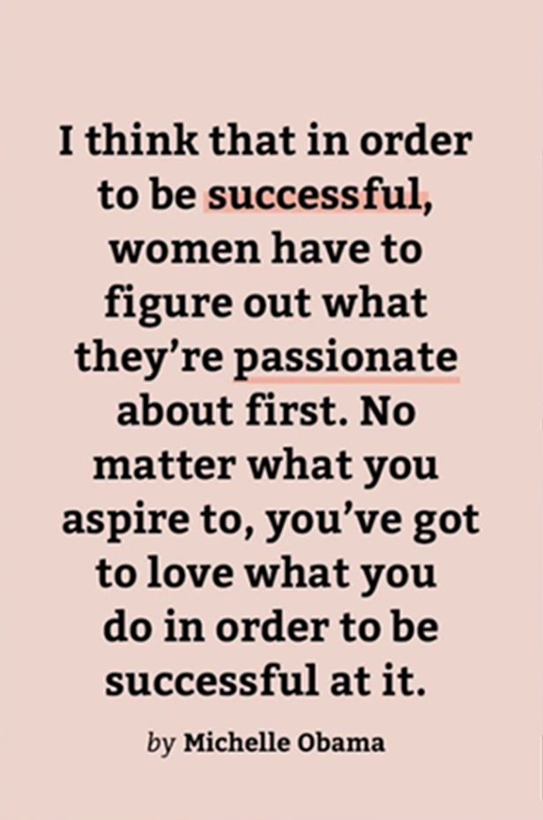
Overview
Who are you?
What do you care about?
What are you passionate about?
What is your purpose?
How do you become passionate about your purpose and position it to become apart of America’s promise?

Slide 4
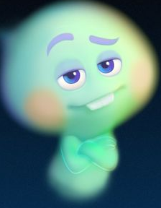
Connections
  What is your Spark?
  What is your purpose?
Personal Statement: As an inclusive leader in higher education, I passionately advocate for the removal of inequitable policies and practices that create barriers in communities, organizations and universities through social action and research.
What is your personal DEI Statement?

Slide 5
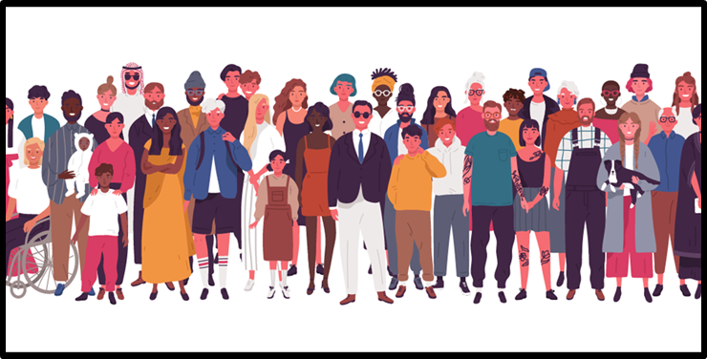
Diversity
Diversity is defined as the presence of differences within a given setting. This may include Race, Ethnicity, Nationality, Sexual Orientation, Ability, Age, Gender Identity, Religion /Spiritual Traditions, Veteran Status, Documented Status and Socioeconomic Class.

Slide 6
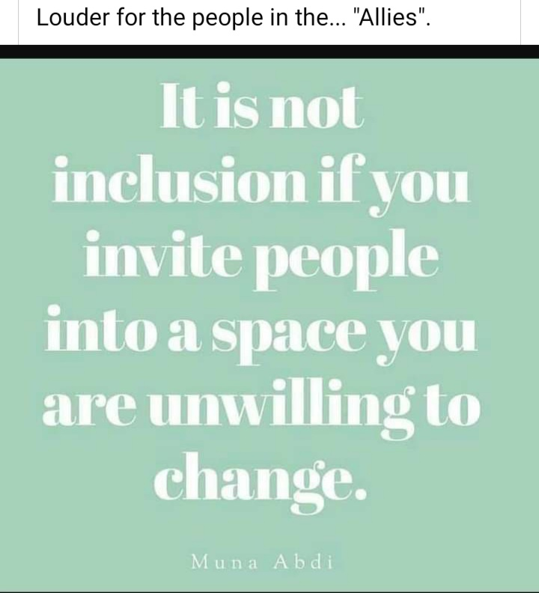
Inclusion
Inclusion is the action or state of including or of being included within a group or structure.
More than simply diversity and numerical representation, inclusion involves authentic and empowered participation and a true sense of belonging.
Authentically bringing traditionally excluded individuals and/or groups into processes, activities, and decision/policy making in a way that shares power.
SOURCE: OpenSource Leadership Strategies

Slide 7
Equity
Equity is defined as “the state, quality or ideal of being just, impartial and fair.”
The concept of equity is synonymous with fairness and justice. It is helpful to think of equity as not simply a desired state of affairs or a lofty value.
To be achieved and sustained, equity needs to be thought of as a structural and systemic concept.
https://www.aecf.org/blog/racial-justice-definitions/

Slide 8
DEI-Topics
Biases
Stereotypes
Prejudice
Discrimination
Inclusive Leadership
Microaggressions
Diversity
Inclusion
Equity
Access
Privilege
Justice

Slide 9
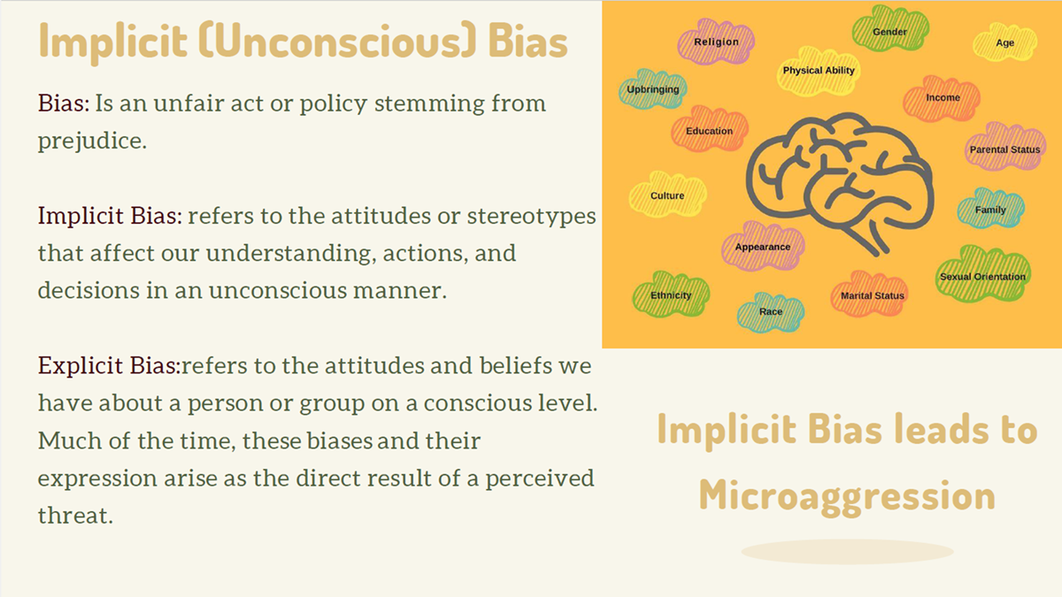
Forms of Bias
Racism
Sexism
Classism
Homophobia
Discrimination or Harassment based upon:
  Ethnicity
  Religion
  Weight
  Ability, Disability
  Documented Status
  Language or Accents
  Geography

Slide 10
Impact on
Careers
Concerns
Solutions
Race or Gender-Based Discrimination/Harassment
Economic Divide-Pay Gap
Mental Health
COVID-19
Glass Ceiling vs Glass Escalator
Toxic or Chilly Work Environment
Implicit Bias: Women and Family vs Men and Careers
Diversity drives innovation and increases profit margins
  Reduces Group think
Establishment of resource groups
Establishment of inclusive practices and policies to improve retention/employee satisfaction
(Remove Implicit Bias)-Promotion, Hiring, Recruitment, & Retention of diverse candidates
Equity Mindedness Approach
JEDI/Global Mindset Approach

Slide 11
How can I Help?
How can I help someone else achieve the America’s Dream or Promise? (Equitable life, liberty and Pursuit of Happiness)
  Celebrate Heritage and Identity Months: Indigenous Persons or Native American Heritage Month Nov. 1-30
  Embrace Allyship , Accountability, & Amplification of voices
  Mentor or network within underrepresented communities
  Engage in sustainable community change/projects
  Support and request DEI trainings at work & in the community
  Promote Inclusive Communities, Institutions, & Workplaces

Slide 12
Greater Macon Community
Wesleyan's Lane Center for Social and Racial Equity
"Crafting Democratic Futures"
Initial Interest Meeting: Tubman Museum, Tuesday, Oct. 19th, 6:00-7:30 p.m.
Contact: Mariana Furlin mfurlinga@gmail.com

Slide 13
Greater Macon Community
Macon Periods Easier Erin Hawkins erinhawkins84@gmail.com
Tubman Museum Richard Kyle Center for Social Justice
  Director: Harold Young
  Harold J Young
  Executive Director
  Tubman African American Museum
  310 Cherry Street, Macon GA 31201
  Office: (478) 845-3555 | Fax: (478) 743-9063
  hyoung@tubmanmuseum.com
  http://www.tubmanmuseum.com/
Rosa Jackson Center/Urban Leadership Academy
  Pastor Dominique Johnson
  478-390-3371

Slide 14
Greater Macon
Community
LGBTQ+ Youth Group/Macon Pride
  Scott Mitchell scott@travisjeanemporium.com
Storytellers Macon
  Koryn Young
  917-412-4661
  Koryn Young koryn13@gmail.com
  Storytellers Live at the Douglas Theatre & “The Heartbeat of Georgia” Podcast

Slide 15
Greater Macon
Community
Streets to Success
  Contact: Ray Rover
  478-284-8463
  https://www.stsuccess.org/
Cirrus Academy
  Ms. Hilary Moore
  Middle Grades STEM
  Cirrus Academy Charter School
  Hilary.Moore@cirrusacademy.org
  (478) 250-1376, Ext. 708
  (478) 318-2109
Real I.M.P.A.C.T Center, Inc.
  Contact: Geneva West
  478.714.6039
  http://www.realimpactcenter.org/home.html

Slide 16
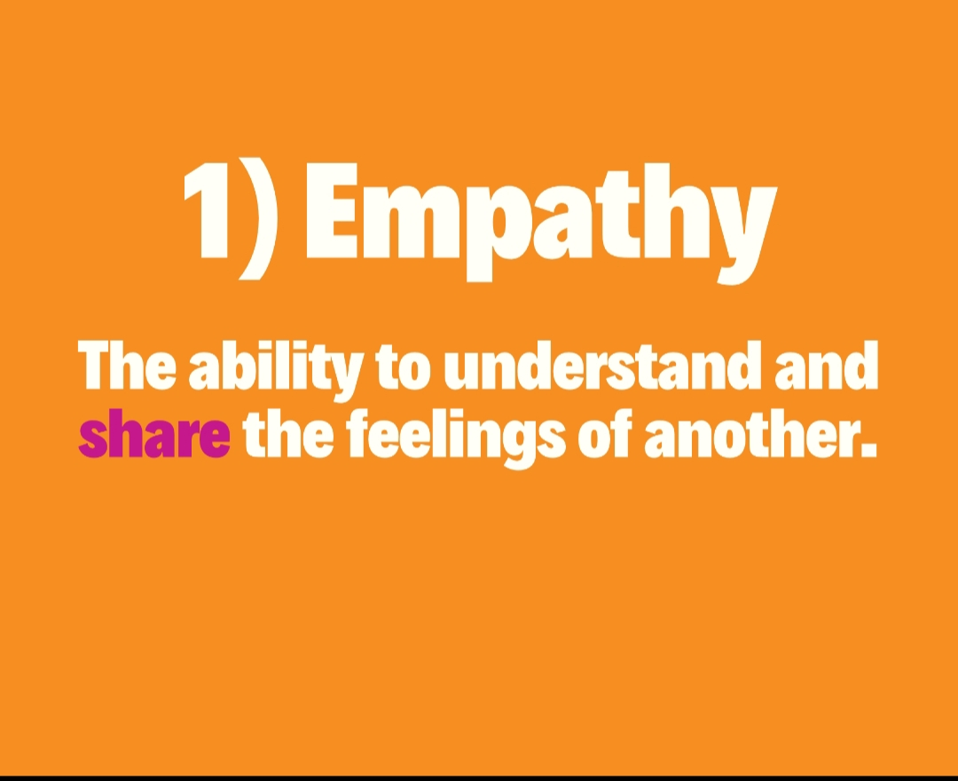
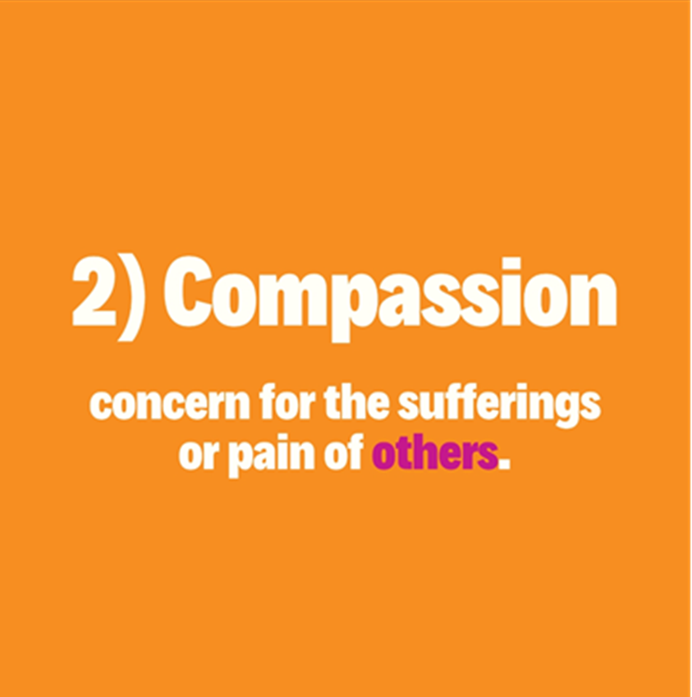


Slide 17
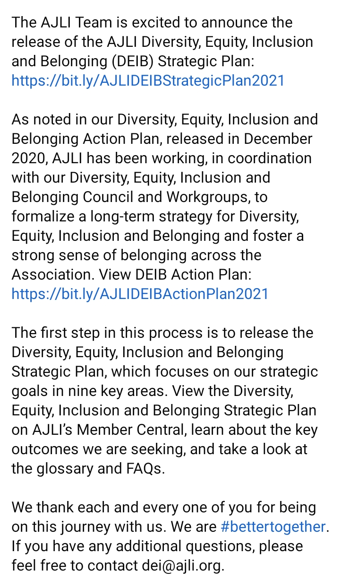
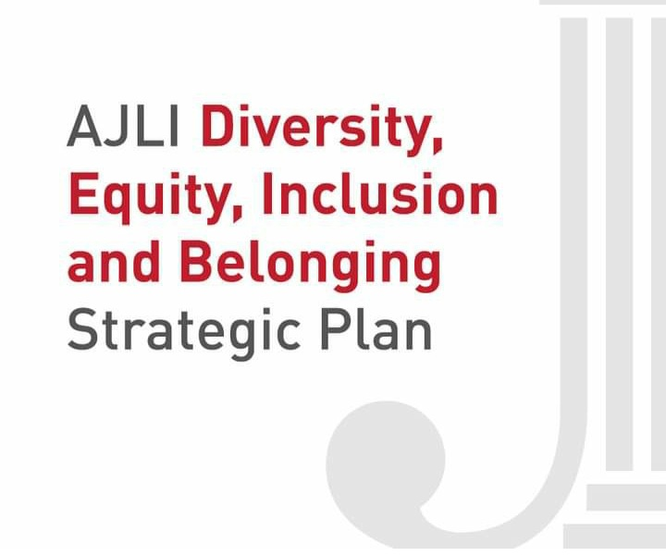
Junior League
Diversity and Inclusion Facebook Group

Slide 18
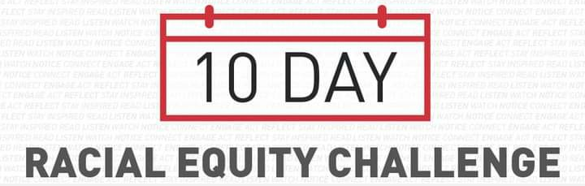
JL-Events and Programs
Guidelines for Equitable and Inclusive Community Partners
Junior League of Wilmington is hosting a virtual Menstrual Diversity panel to address issues related to health, age, gender identity, race, culture and religion
Action Items on DEI Plan is to provide an exit survey to our community partners after projects
Junior League of Springfield updated member bylaws to be more inclusive of All women and members of marginalized gender identities
Junior League Affinity Groups-WOC, LGBTQIA+
21-Day Racial Equity Challenge Training: Addressing Microaggressions
Allyship at Work: https://leanin.org/allyship-at-work-program-materials?utm_source=email&utm_medium=ActiveCampaign

Slide 19
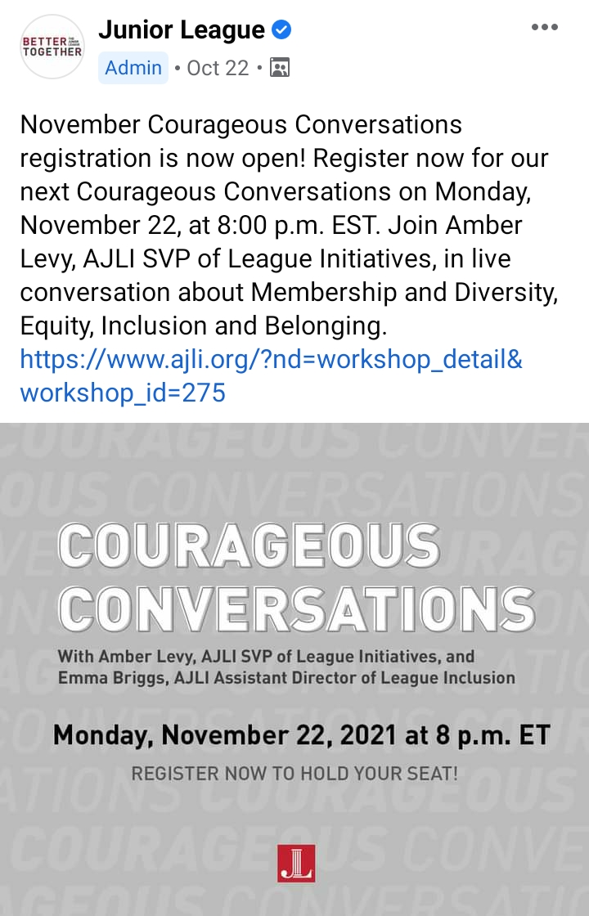
Events & Readings
Diversity and Inclusion Work for White Professionals in the Nonprofit Sector
Here are a few books that have recently helped me broaden my horizons:
1. “How to Be an Antiracist” by Dr. Ibram X. Kendi
2. “Decolonizing Wealth” by Edgar Villanueva
3. “Systems Thinking for Social Change” by David Peter Stroh
4. “Professional Troublemaker” by Luvvie Ajayi Jones
  Source: https://afpglobal.org/news/diversity-and-inclusion-work-white-professionals-nonprofit-sector

Slide 20

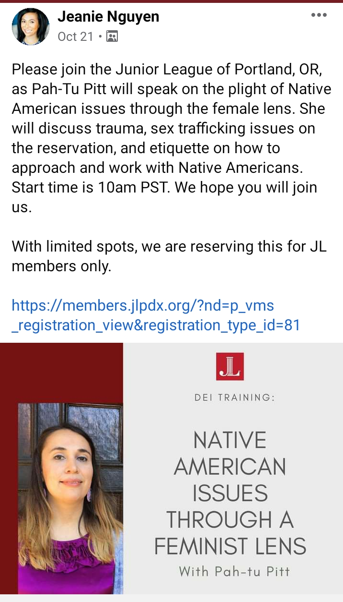

Slide 21
Questions
Contact information:
Office: Mercer University Macon Campus CSC 210
Email: Booker_aa@mercer.edu
Phone: 478-301-2856
Website: diversity.mercer.edu
Social Media: MUDiversityInclusion
LinkedIn: Ansley Booker

Slide 22

Thank You

