Slide 1
General Membership Meeting
September 7, 2021
6:30pm
Kick-Off to a Great Year!

Slide 2
Let’s Kick-Off a Great Year!

Slide 3
Provisional Spotlight
Amanda Stables Woody
Employer: First Choice Primary Care
Fluent in Spanish, worked in non profits, event planning & grant writing
Kimberly Seabrooks
Employer: Coliseum Medical Center
Hopes to utilize her skills with health related volunteer efforts in our community
Megan Greskovich
Employer: Mauldin & Jenkins
Enjoys working with children of all ages and has previously worked with Backpack Buddies and other women children’s health programs

Slide 4
Overview of the Year
To remain an active member in good standing you must:
Attend 4 GMMs
Volunteer at One Fundraiser
Volunteer at One Community Impact Project (CIP)
Complete your Placement

Slide 5
Digital Cheetah
Download the Digital Cheetah app for contact information for all League Members
Search Seeing Spot or Digital Cheetah in the App Store

Slide 6
Important Contact Information
Missed a membership meeting? Missed working your CIP or Fundraising Shift?
Katrina Spooner, Recording Secretary
Need a reimbursement or have a check cut for a JLM expense?
Maggie Discher, Treasurer
Want help getting a donation for your event?
Kaci Whiddon, Fund Development Chair
Need to change contact information, go on maternity leave or discuss membership status?
Sara Wood, Corresponding Secretary
Struggling with your Placement?
Contact Aimee Carter, Nominating/Placements Chair
Need to make an announcement?
Contact Dana Nicolazzi, Communications Chair

Slide 7
Community Impact Projects
Eryn Deiler, CIP Chair
eldunwody@gmail.com
Commonly referred to as “CIPs”
One Shift Per Year
Sign Up on Digital Cheetah

Slide 8
CIP Opportunities
Backpack Buddies Ministries
September 20th
October 18th
November 15th
Spring Dates TBD
Virtual Storytelling
Deadline September 30th
Open Streets Macon
October 24th
Big Brothers Big Sisters
Looking for Mentors. This is a year long Commitment. If you are interested contact Eryn for additional information

Slide 9
Backpack Buddies
Brenda Lambert at Forest Hills United Methodist Church founded the program in 2011
2020-2021
Served 16 schools and 1400 students
2021-2022
26 schools and 2000 students
The Pumpkin Patch helps fund Backpack Buddies
https://www.youtube.com/watch?v=po8_fG8NXnw

Slide 10
SPAC POSITION STATEMENT
The State Public Affairs Committee (SPAC) of the Junior Leagues of Georgia:
Supports, recognizes, and promotes responsible concepts, programs, policies, and legislation that advocate for:
The aid and protection of all women, children, families and vulnerable populations. (Aid and Protection)
Quality education which is critical for Georgia’s students to become college and/0r career ready for our global society. We are committed to excellence and safety in our education systems. (Education)
Improved access to health care for all women, children, and vulnerable populations. We recognize that we have a responsibility to shape Georgia’s health care policies for the future prosperity of our state. (Health care)

Slide 11
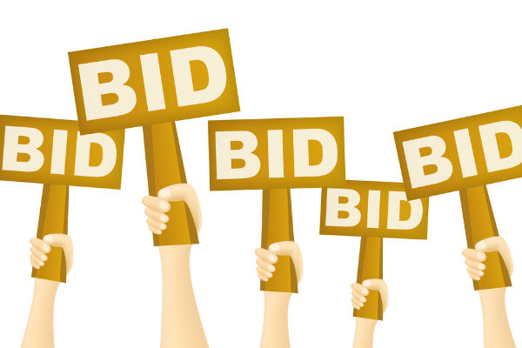
Virtual Silent Auction
Chelsey Hale, Silent Auction Chair
chelseythale@gmail.com

Slide 12
Important Announcements
If you have a key to the Junior League house and no longer need access please turn it in to me or arrange a time to drop it off with Casey.
Respond to the Google Survey requesting the best e-mail for calendar invitations
Download the Digital Cheetah App!

Slide 13
General Announcements

Slide 14
Fall 2021 Important Events
September 23, 2021 Kinjo Happy Hour
October 12, 2021 Social Supper
October 21, 2021 Kinjo Happy Hour
November 9, 2021 GMM
December 7, 2021 JLM Holiday Party

