Slide 1
Day In The Life Media
Brand-Driven Storytelling Expertise and Content Creation from Bestselling Writers

Slide 2
“Marketing is no longer about the stuff that you make, but about the stories that you tell.” –Seth Godin

Slide 3
Every brand has a story. How should yours be told?
Expectations
Emotional Connection
Brand Placement
Natural Use
Drive Engagement

Slide 4
If you want to engage a group at a dinner party you wouldn’t shout out your accomplishments…

Slide 5
You’d tell them a story.

Slide 6
Story is another layer of language—it’s way of giving meaning to ideas and values.

Slide 7
Story creates an emotional connection.
“Great marketers don't make stuff. They make meaning.”
–Seth Godin

Slide 8
We’ll use a length of climbing rope to illustrate the difference between shouting your accomplishments and telling a story with emotional resonance.

Slide 9
This rope is 9.5 millimeters in diameter, light enough to take into the mountains, and more durable and easier to handle than skinnier ropes.

Slide 10
How do you feel about this length rope? Do you have any emotional connection to it?
The answer most likely is, no. Because rope is rope. Or is it?

Slide 11
This is Jackie.
She’s a mountain climber.
Many decades ago, Jackie’s grandfather had tried to summit Mount Everest and failed.

Slide 12
In her grandfather’s honor, Jackie is trying to fulfill a life-long dream by planting the flag her grandfather had carried during his failed climb on the summit of Mount Everest.

Slide 13
On her way up, a strong wind blew Jackie off a rugged crag. If it were not for a length of climbing rope, 9.5 millimeters in diameter, Jackie would have died.

Slide 14
Instead, she got to send this picture to her grandfather on his 80th birthday.

Slide 15
How do you feel about that length of rope now? Yeah, us too.

Slide 16
When it comes to brand-storytelling think of your product or service as the rope and the hero of your story as Jackie.

Slide 17
The best stories are those that focus on a hero’s journey. They show triumph over adversity and illustrate how the journey changed the hero for the better.

Slide 18
Storytelling is an entirely different skill than marketing, branding, or social media promotion. And that’s where we come in.

Slide 19
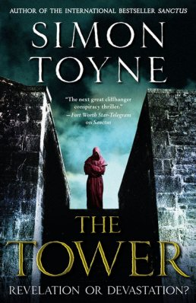
We are a unique partnership made up of best-selling novelists and scriptwriters with millions of books in print and thousands of hours of scripted television behind us.

Slide 20
Our half and full-day seminars will train your sales and marketing teams to use story to better connect with your clients and prospects in ways that directly impact the bottom line. Together, we can discover your brand’s heroes and turn your product, or service into a compelling, emotionally resonant video story quickly and inexpensively.
Our video stories are used for:
Website content
Presentations
Sales tools
Social Media marketing
Webinars
Digital advertising
And more...

Slide 21
Our Services
Sales and marketing team training (half and full-day sessions)
Consultation and story creation
Video production: casting, shooting, editing, sound, music, etc.
Distribution: geo-targeting and market segmentation to disseminate videos across multiple channels social/online (Facebook, YouTube, Instagram etc.) with links and tags back to the brand
Outcome based measurements of story’s engagement/effectiveness

Slide 22
Let Day In The Life Media take your brand storytelling to the next level. Show us your rope and we’ll help you find your Jackie.
Day In the Life Media
2 Ash Street
Hollis, New Hampshire 03049
Phone: 781-640-9984
Web: www.dayinthelifemedia.com
Email: storyhelp@dayinthelifemedia.com

