Slide 1
CSA - Hackney Trainers 2020
Rofique
Notes:
Understand trainers - have ST3, failures, who has sat the CSA, been on a course.

Slide 2
Outline
Observations on CSA training
Develop shared ideas on how to approach CSA training in hackney
My experience of the CSA
Tower Hamlets Trainer
2009- supporting the CSA
31 Trainees who have failed more than 1
Approx 70 first time CSA
Note
Experience (not evidence or expertise)
Interest in design thinking
Notes:
I also completed the csa in 2008 - pilot group
Story - gadson
Group that failed - there were no problems with clinics, around the uk.
I used to meet them but with technology and development of the iphone - progressed to video calls and most recently I have supported someone over whatsapp
Deep understanding of the issues - how they felt about the failure, course, trainers. Very intense.
There were similarities and differences

Slide 3
What I learned (and teach)
Extremes to mainstream
CSA mindset
Consultation skills
Acting and role playing - games like the CSA relay
Drafting cases
Group formation - developing a high performance team
Coaching/supervision/facilitating

Slide 4
What’s the point in this ICE thing!!
Notes:
Interesting example of how strong beliefs that limit trainees in the extreme groups have led to insights for the mainstream
What's the point of ICE
I am a doctor
Going back to basics - attrition theory, beliefs etc.
Together with the trainees I develop a way to explain the ICE.
ICE is a symptoms (like chest pain)
The health belief drives the ice (eg IHD)
Caused atherosclerosis, risk factors
A patient who requests antibiotics in the CSA - could have a story
Whats the point.
Consultation has two functions - diagnosis/management, therapeutic
Integrate ICE into management

Slide 5
The CSA mindset
Stress and anxiety - anxiety, depression, PTSD
I have the CSA in 2 weeks and my trainer wants me to do an audit
Anxiety leads to negative thoughts
Adopting a unhealthy lifestyle
Notes:
Tears, distress. Direct them to the GP. Same with the first time trainees.
Medicine and surgery - consultants would have sat the professional exams, short cases, there is a recognition (empathy), finding cases, inspiring learning
From 6-8 weeks - there is a gradually focus towards the CSA. Use the CSA to base other learning.
Constructive alignment
Recognise that they are stressed and this takes priority over everything else.
Understanding the CSA - videos, courses etc

Slide 6
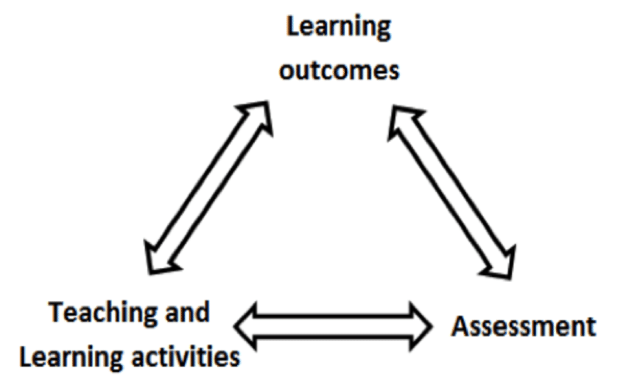
Constructive alignment - biggs
Notes:
I learnt most of my useful updates from the groups
There was no need to attend any courses until last year (red whale cancer course)

Slide 7
Beliefs that create conflicts
CSA is like seeing patient in clinic (so you must do in 10 min)
Actors are like real patients
It's only for the exam (CSA is for life)
Seeing patients is better than role play (attend the practice meeting on QI instead of meeting your peers)
Don’t use checklists (the Karate kid principle)
Notes:
Role play - supplements the learning, creates a safe space for experimentation, internalising concepts and ideas

Slide 8
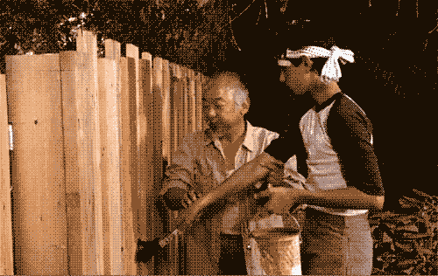
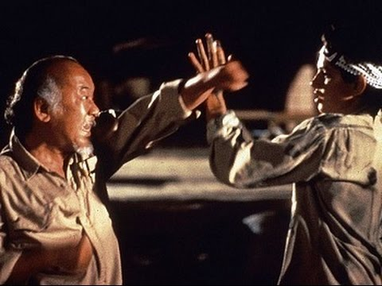
The karate kid principle
The alternative explanation one the nobel prize
Notes:
Like the Medical student clerking - use routines to move to a flexible approach

Slide 9
Structuring and navigating the CSA under stress
Agenda setting
History/examination
Explaining the problem
Shared decision making
Ending the session
Notes:
Interesting - explaining the simplest concepts asthma tends
I dont think they will get much marks but it stops them in the track.
Causes more distress, loss of confidence and spiralling performance

Slide 10
BAD IDEAS - to define
BAD = best applied definition
 | eg | Eg asthma. This is a…..
Incidence | Common/rare | Common
Duration | acute/chronic (LTC) (relapsing/remitting) | Chronic **you can omit this for some conditions eg genetics or cancer
Etiology/Essence | What is it? Infective/inflammatory/malignant/degenerative etc disease/condition/syndrome/symptom | Inflammatory disorder
Anatomy (or system) | (disease/disorder) of the... | of the bronchial airways *be specific
Salient (features) | Characterised by (hx, ex, Ix, Rx, cause, complication | Characterised by hypersensitivity, reversibility and presents with cough, wheeze, sob

Slide 11
Questions/discussions

