Slide 1
Deep Adaptation and GP training under pressure

Slide 4
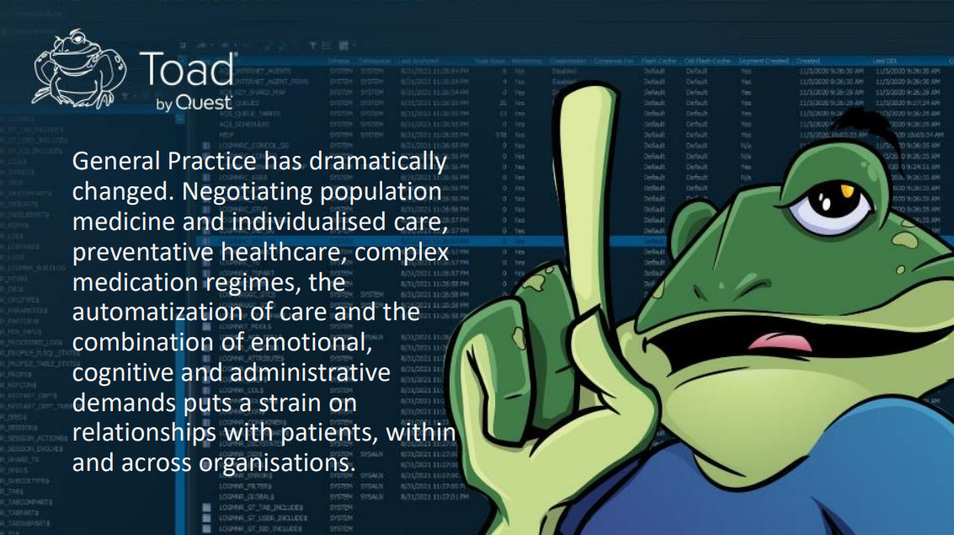

Slide 8
In your role as an educator / GP trainer, What have you, or would like to …
Start doing
Stop doing
Keep doing

