Slide 1
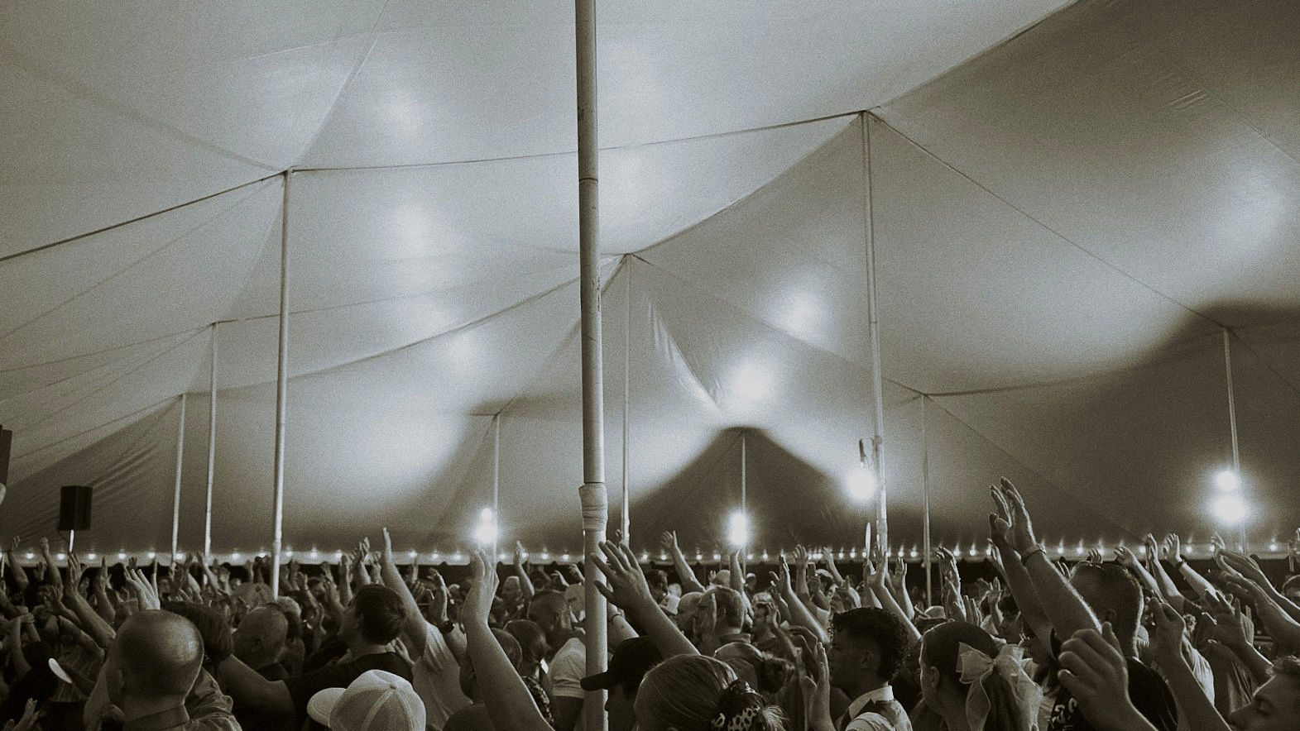
A CULTURE OF
EVANGELISM
Dr. Braden Andersen
JESUSTENTREVIVAL.COM
Notes:
Acts 1:8 But ye shall receive power, after that the Holy Ghost is come upon you: and ye shall be witnesses unto me both in Jerusalem, and in all Judaea, and in Samaria, and unto the uttermost part of the earth.
Not a singer, not a preacher, not a giver, not greeter – A WITNESS
This has got to be our first fundamental culture.
Embedded in everyone of us, everytime we meet, every role we have, every place we go, everything we d..

Slide 2
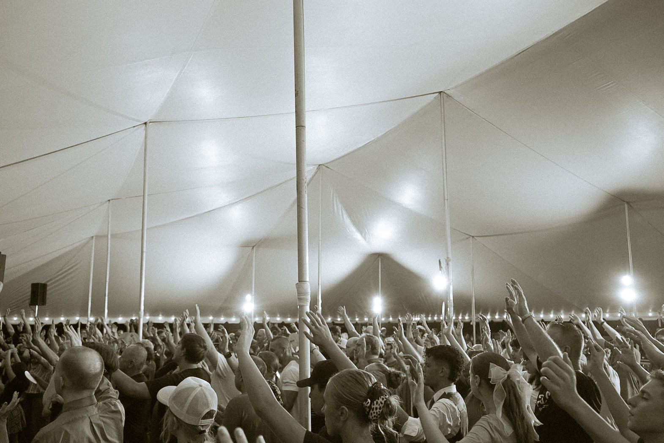
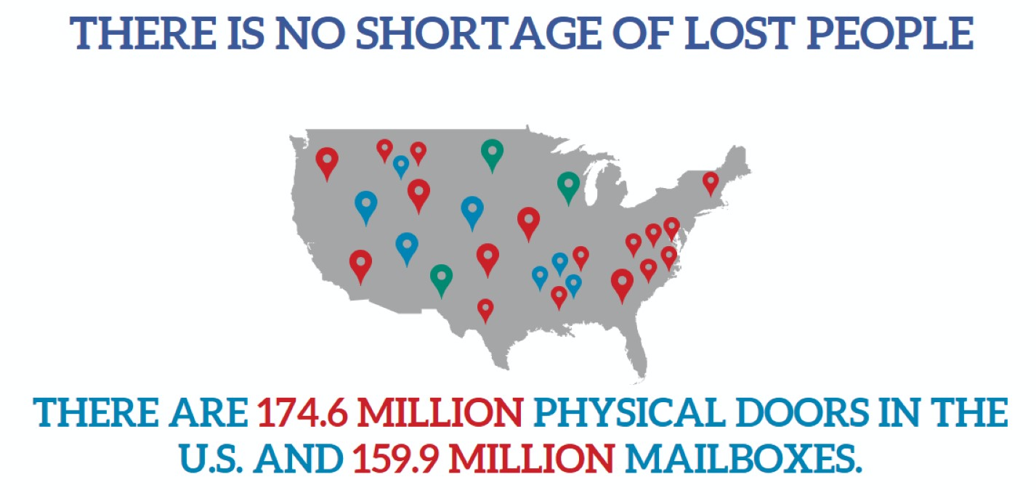
THERE IS NO SHORTAGE OF LOST PEOPLE
Notes:
THERE IS NO SHORTAGE OF LOST PEOPLE. . . And look where they are…
THERE ARE 174.6 MILLION PHYSICAL DOORS IN THE U.S. … AND 159.9 MILLION MAILBOXES.

Slide 3
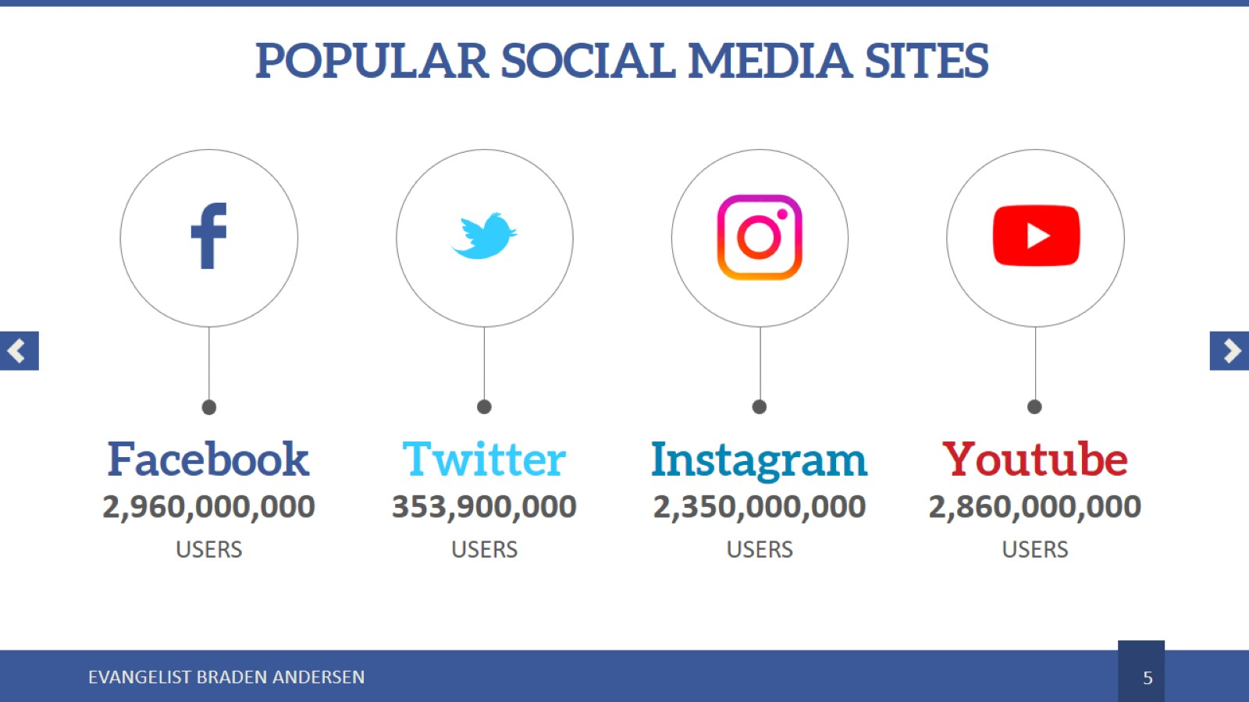
THERE IS NO SHORTAGE OF LOST PEOPLE
Notes:
And BILLIONS are on social media!
3.07 billion.
415 million
3 billion on Instagram
2.8 billion on youtube.
TODAY ALONE 432,000 will sign up for facebook.
The average person will spend 2.5 hours a day on social media (20% of their waking free time)

Slide 4




1 Cor 3:6
“I have planted, Apollos watered; but God gave the increase”
WHAT IS EVANGELISM?
SEED WORK
Notes:
The world NEEDS EVANGELISM. . . . What is Evangelism? It’s SEED WORK.
1 Cor 3:6 is Paul’s entire understanding of growth continuum condensed into 1 verse.
Simplicity in the illustration, but also: a clear sequential progression, implied personal effort, and ongoing care.
We must plant (Evangelism),
Water (care for what is planted),
and have an environment God can bring an increase.
Never mutually exclusive. Not competitive. We can have all. At it’s most fundamental level evangelism is the SEED WORK.

Slide 5

Notes:
The concept of evangelism as a seed lends right into our understand of the SCALE of revival we want to see.
The Principle of Proportionality – if you sow sparingly you reap sparingly. So do more evangelism, not less.
The law of the harvest
Do little, get little.
Do more, get more!

Slide 6
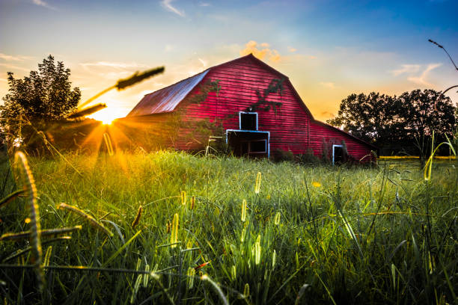
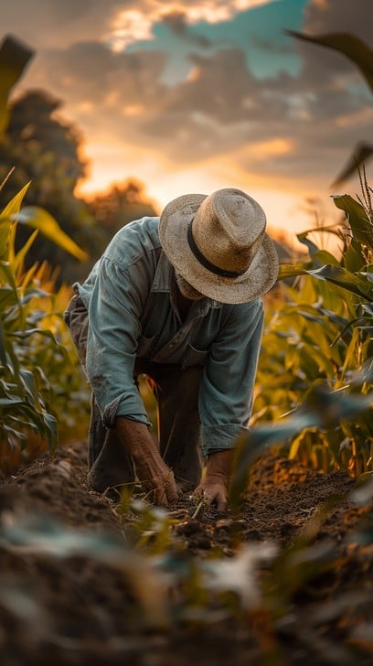
BARN
\
FIELD
Jn 4:35“- lift up your eyes, and look on the fields”
WHERE IS EVANGELISM
Notes:
WHERE IS EVANGELISM?
Paul uses the analogy because they understand enough agriculture to know → Seeds are not planted in the BARN they are planted in the field!
You will never win your city by what happens in the barn, you win by what happens in the field.

Slide 7
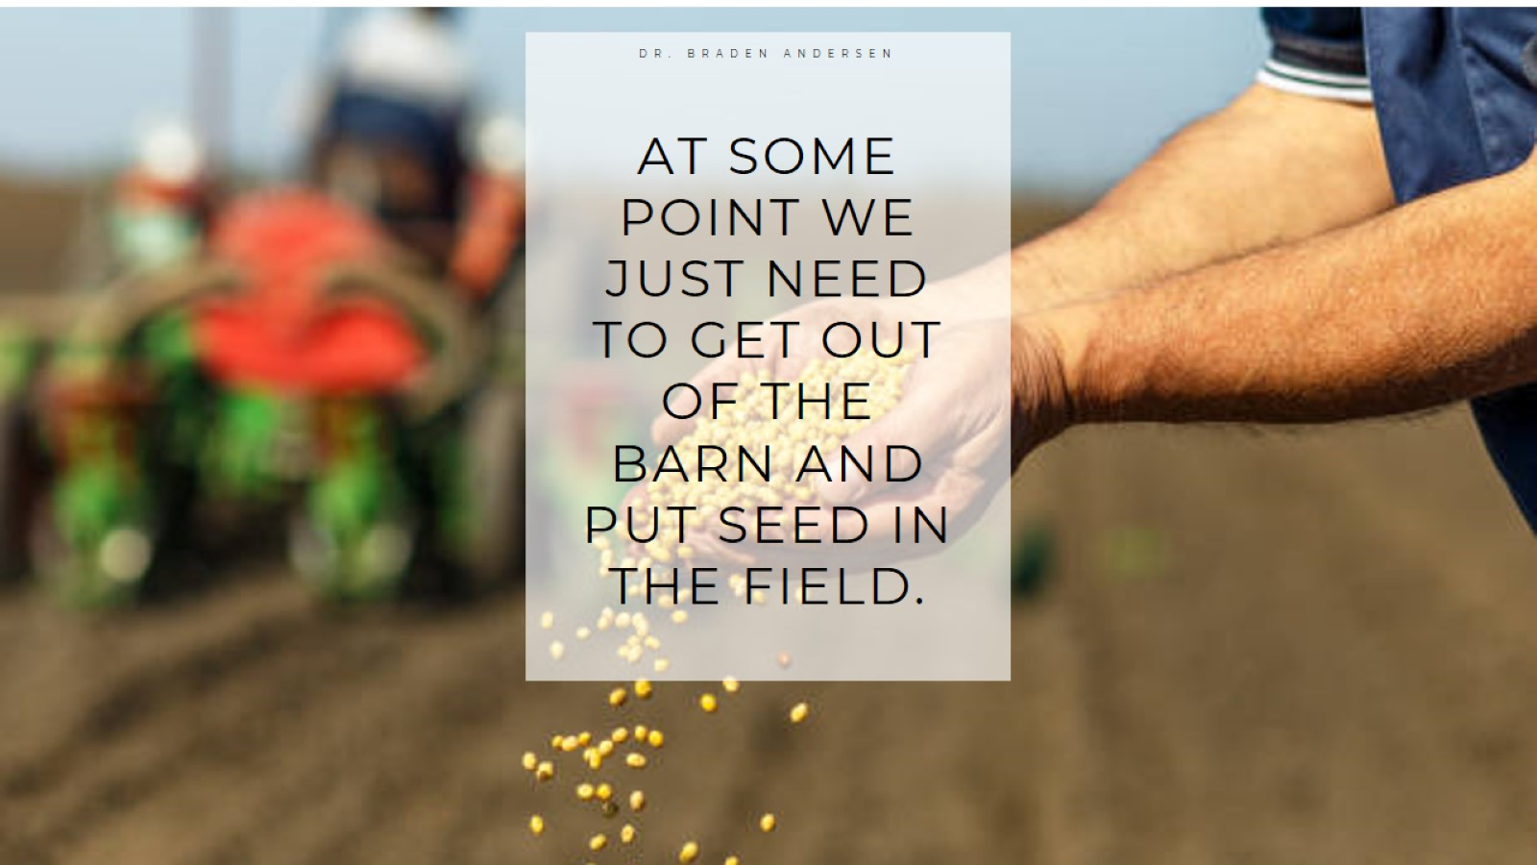
Notes:
AT SOME POINT WE JUST NEED TO GET OUT OF THE BARN AND PUT SEED IN THE FIELD.

Slide 8
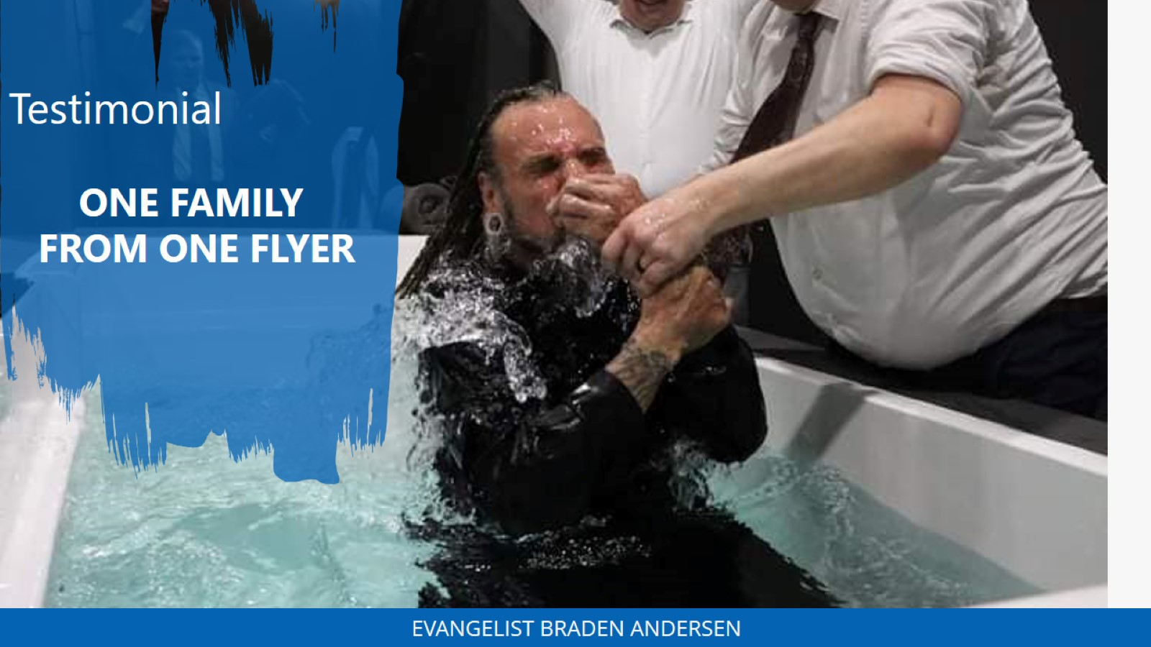
Notes:
(SHAWN) He heard about us from a parking lot outreach.
Literally finding a flyer someone else discarded.
He’s been coming for 3 years and brought his whole family.
We miss stories like these if we fail to evangelize.

Slide 9
WHO IS
EVANGELISM
Acts 1:8 “ -and ye shall be witnesses unto me”
Notes:
YOU SHALL BE.
NONE are Too unqualified
NONE are Too qualified
NONE are Too busy
NONE are Too lazy – “its not my personality” – it’s not my interest – it’s not my ministry- it’s not my gifting
Reminder: Personality is subject to change.
If He loves this, I’ll love this.
If He did this, I’ll do this.
Before we are preachers, singers, introverts, or extroverts – we are FIRST witnesses!

Slide 10
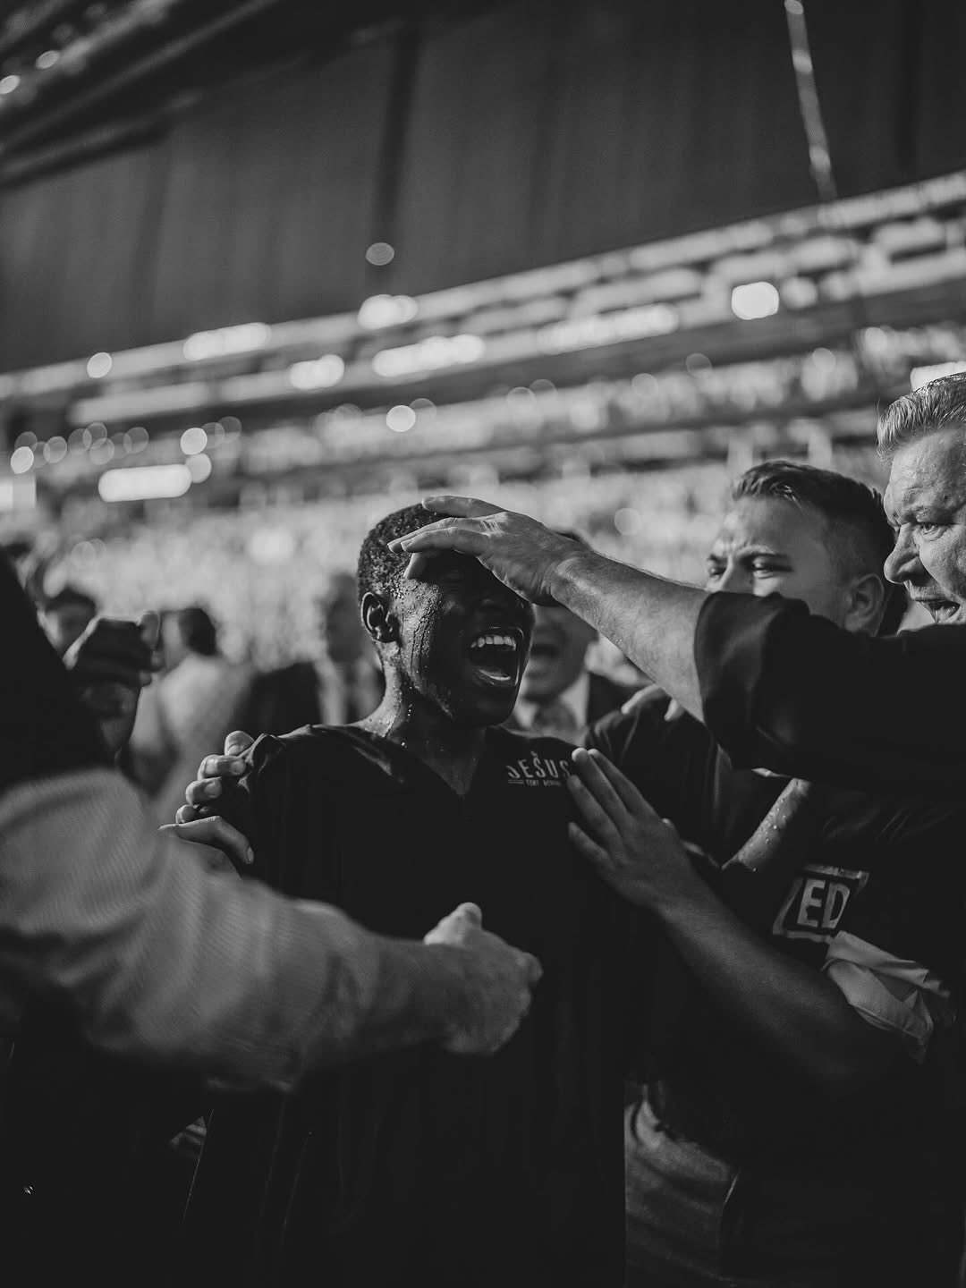
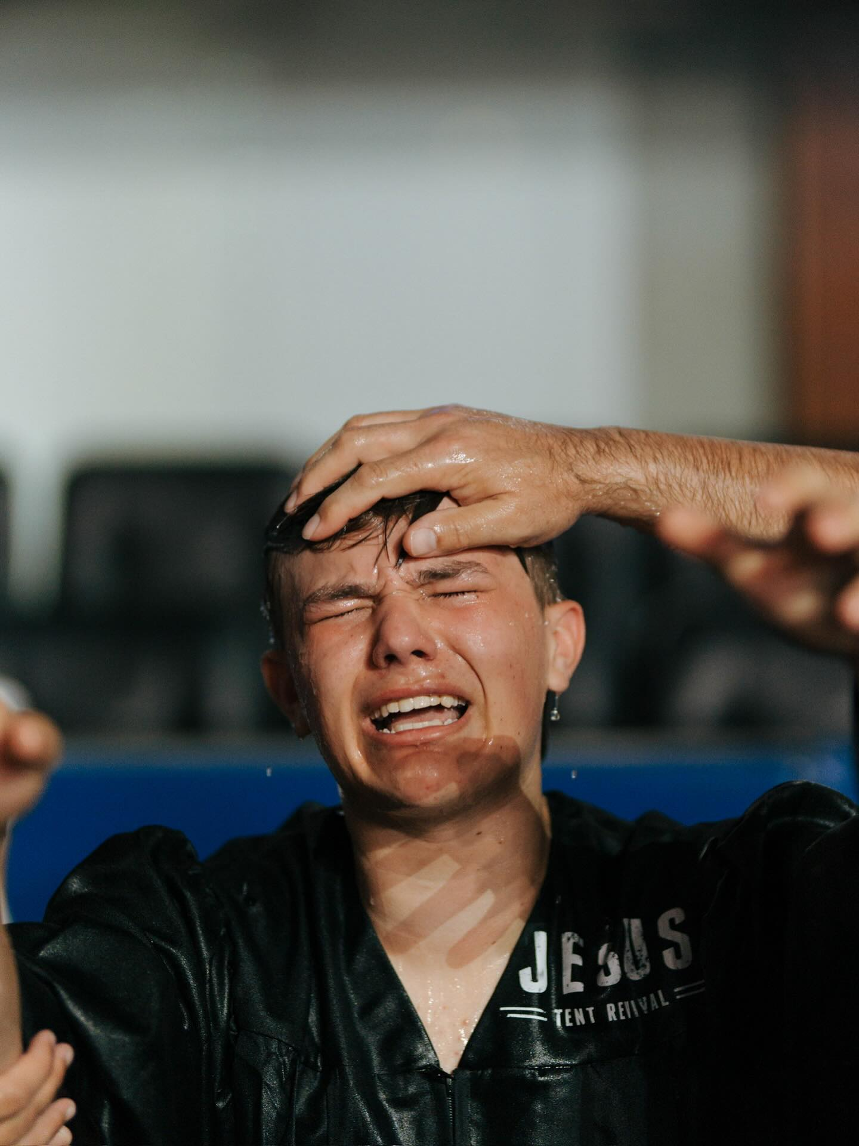
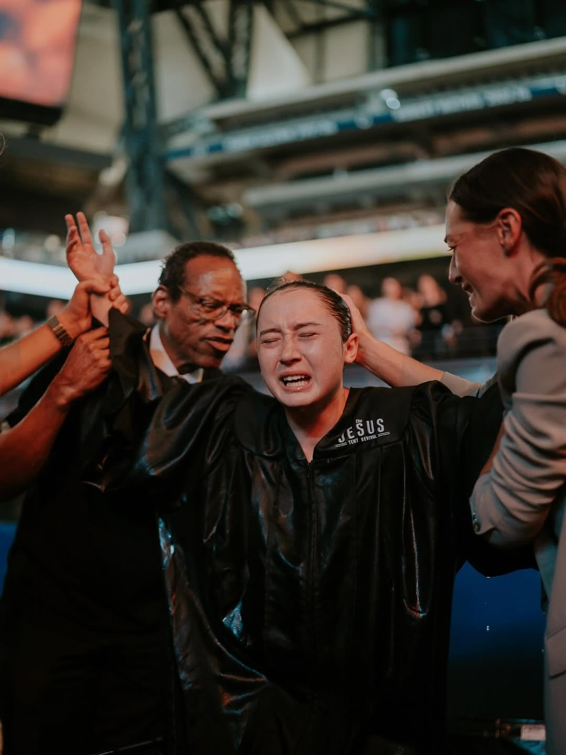
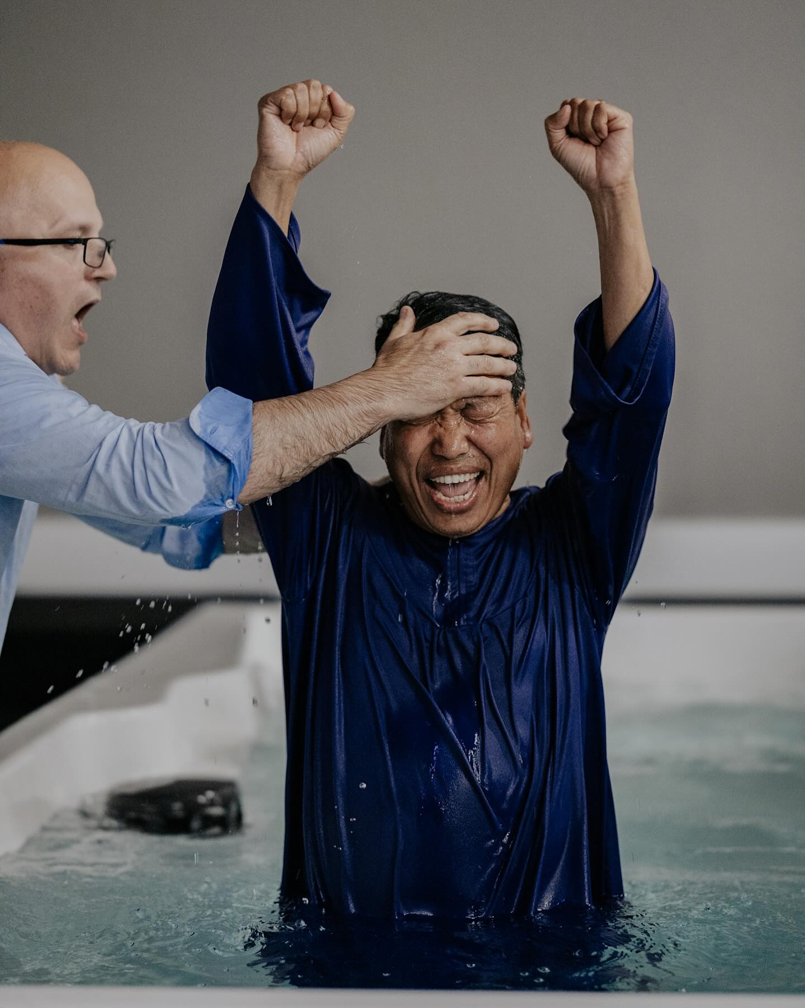
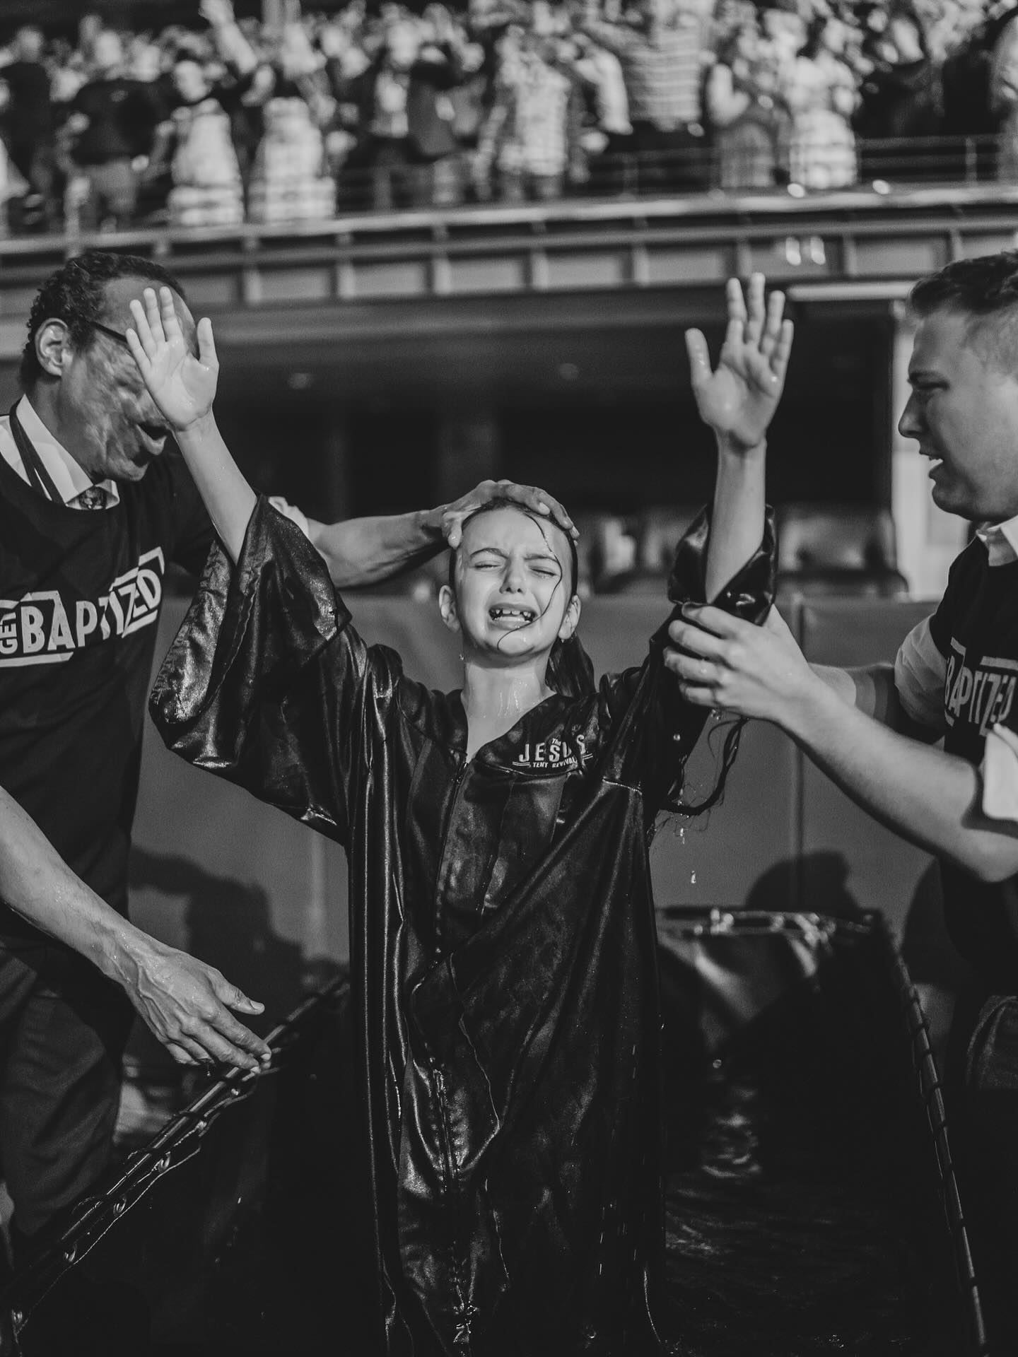
HOW
A CULTURE OF EVANGELISM
Notes:
We want it in our church, in our youth, in our families, in our kids.
We want evangelism in our church, our section, & our district!
We want it in the schools and workplaces, in the apartments and doctor offices!

Slide 11
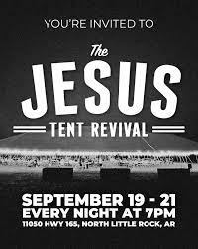

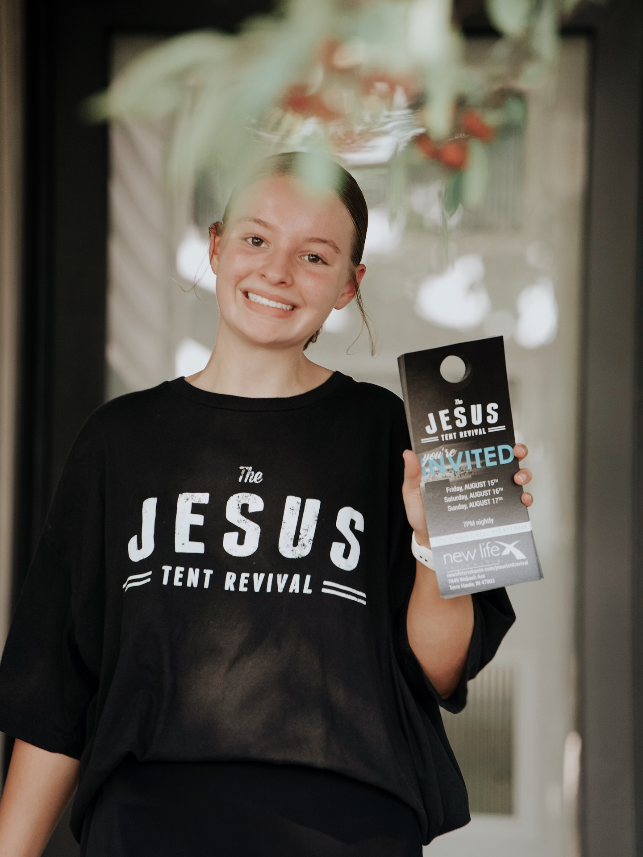
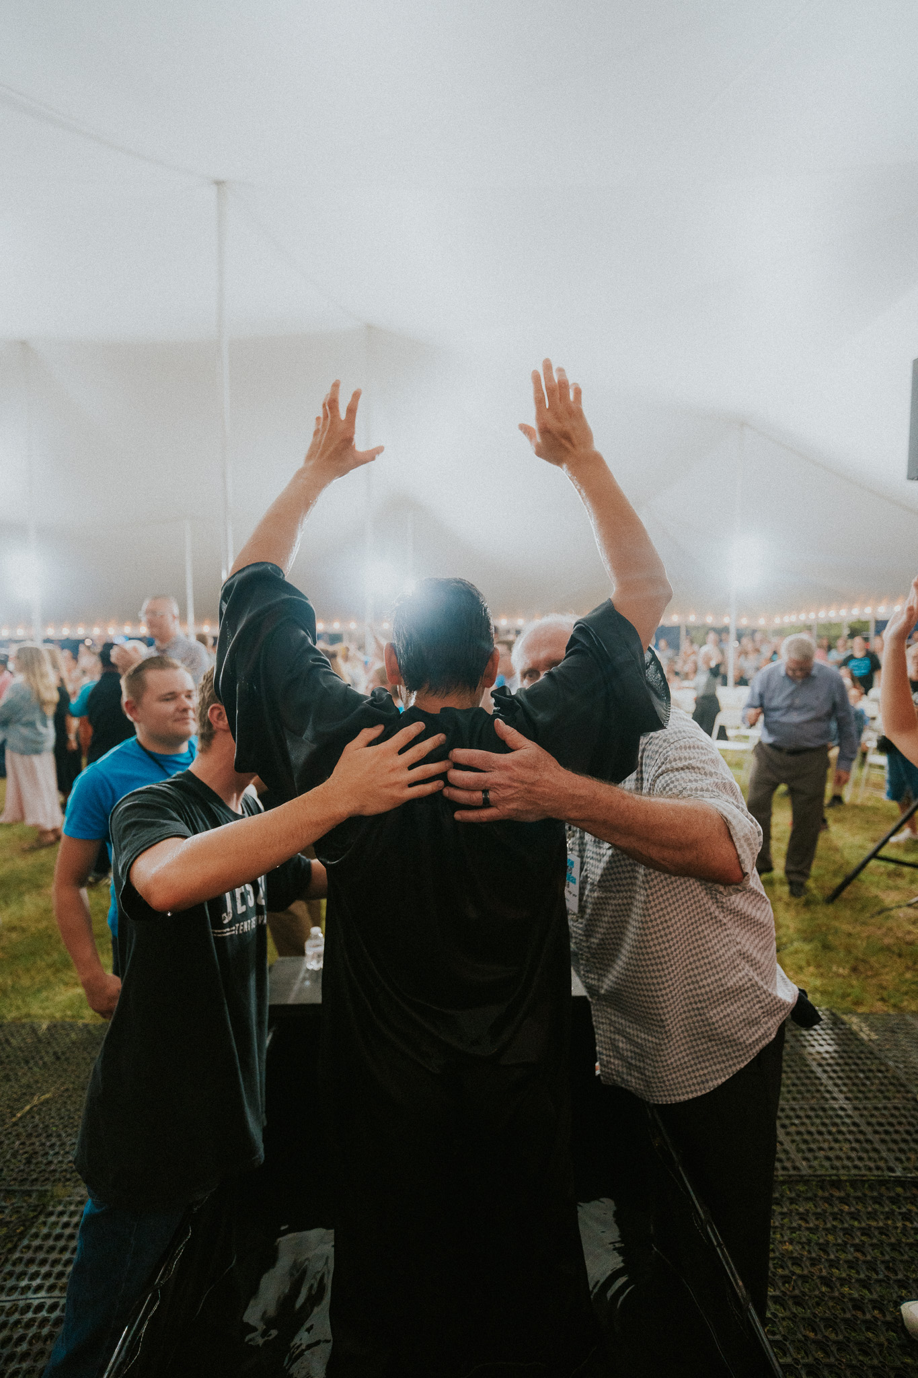
MARKS OF EVANGELISM CULTURE
1. MARKETING
2. LIFESTYLE
Dream.
Design.
Invest.
Everyone.
Everywhere.
Everyday.
3. SCHEDULED
4.MASS EVENTS
Systematic.
Significant.
Scheduled.
Crusades & Campuses.
Block Parties & Programs.
Tents & Revival Events.
Notes:
As we travel the country the fastest growing churches have ALL 4 of these present. I would contend Acts examples these.
1.Marketing. (don’t overestimate your brand. Gone are the days of posting the pic of a speaker and they come out. The lost want a real experience with God. Showcase Jesus. Baptism. )
2.Lifestyle (Ie: 2 per week)
3.Scheduled (You can accomplish 10 years of lifestyle, in one day, as a group. Door hang, Walmart, fair, college, farmers market, mall, prayer tents, umbrellas).
4.MASS EVENTS. There are many options, but if you can master the 3 basics, you can reach and keep them by the hundreds.
SIDE NOTES:
How to Invite to Church
→ Smile, don’t be weird.
→ Start with where you already go (restaurant, work, walmart). Expand to wherever people are.
→ Read body language.
→ Look for open people to break 15 secs. But also focus on volume.
How to Tell Your Testimony (4 Parts)
→Before Christ.
→ When I met him.
→ How he changed me
→ Call to action.
Scheduled Evangelism
Why: It’s 1000x more exposure.
Where:
Fairs
Campuses
Malls
Parking lots
Dense neighborhoods
Community events
Parks
How: Door hangers, flyers hand-to-hand, block parties, prayer tents—anything high volume.

Slide 12
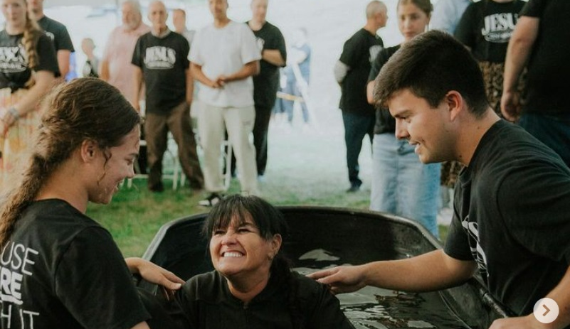
Notes:
(OHIO) She saw us on facebook.
But the flyer brought it home.
We miss these if we fail to evangelize.

Slide 13
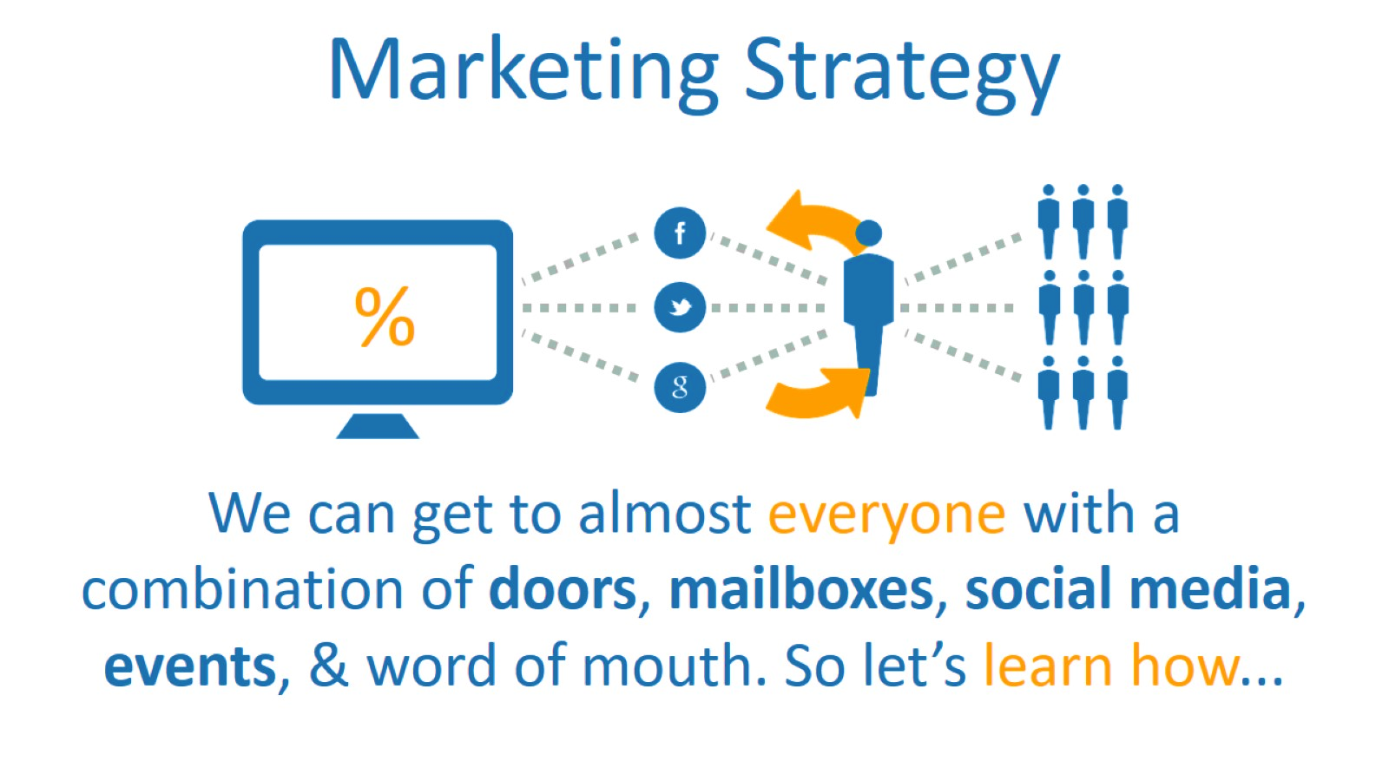
Notes:
Marketing Strategy
We can get to almost everyone with a combination of doors, mailboxes, social media, events, & word of mouth. So let’s learn how...
There is a SYNERGISTIC EFFECT to marketing!

Slide 14
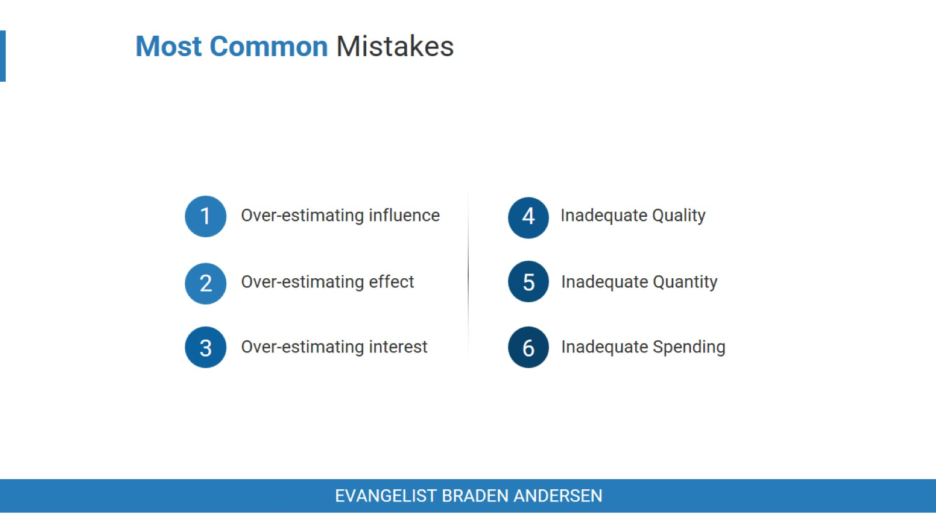
Notes:
Most Common Mistakes
Over-estimating influence
You are not as well known as you think you are. People move, people forget, churches look the same from the outside.
Over-estimating effectiveness
The live stream is not enough to do it. And an annual Easter program won’t do it.
Over-estimating their interest
Some are ready now, some aren’t – how can we get them interested.
Inadequate quality
Poor audio or video. Or none at all.
Inadequate quantity
200 flyers a year won’t do it. Great harvest requires great seed.
Inadequate spending
Your gong to have to design, order, post, and boost.
This money isn’t wasted. In my prior secular company for ever $1 spent on FB advertising, I made $2. Marketing, outreach, and evangelism spending is the most important line-item of the church. It is a necessity and fuels tomorrow’s revival. You will recoup your losses and some.

Slide 15
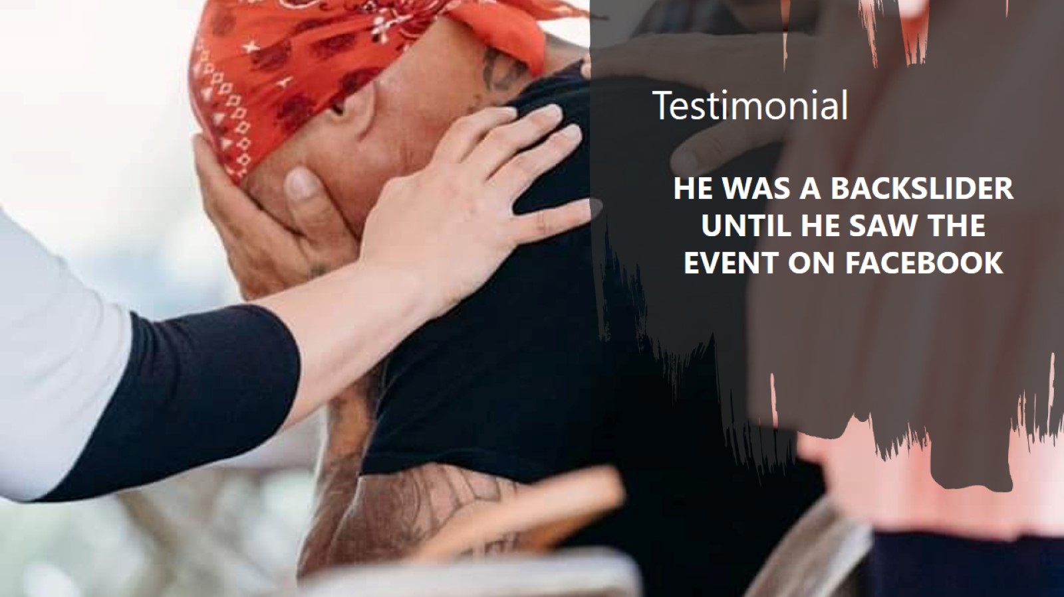
Notes:
Testimonial
HE WAS A BACKSLIDER UNTIL HE SAW THE EVENT ON FACEBOOK!
Another should have been there but they backslid for years, went on vacation in Florida.
Came to the tent there, prayed through, back in church in Michigan.

Slide 16
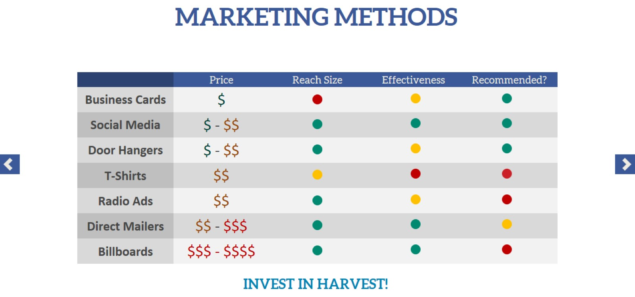
MARKETING METHODS
Notes:
Methods **ADD YARD SIGNS**
Social Media
FB,
IG,
Google,
YT
Mailers
Door Hangers
P2P Event Invite Cards
Business Cards
Promotional T-Shirts
Radio Ads
Billboards

Slide 17
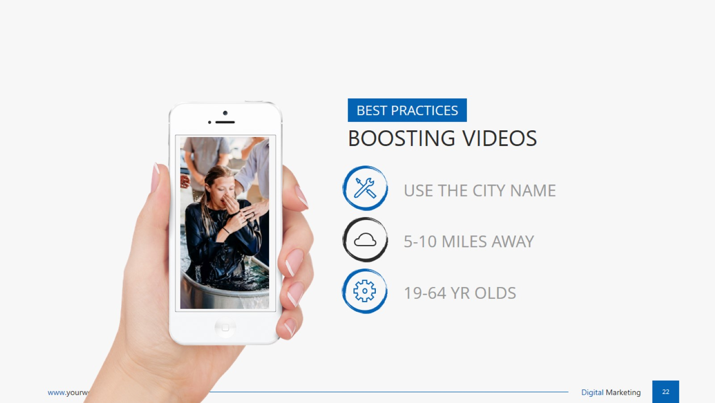
Notes:
Boosting
Use the city name in the post.
Display 5 to 10 miles.
19-64 years old
On google – pair the keywords they search (ie: “Church in Little Rock”)

Slide 18
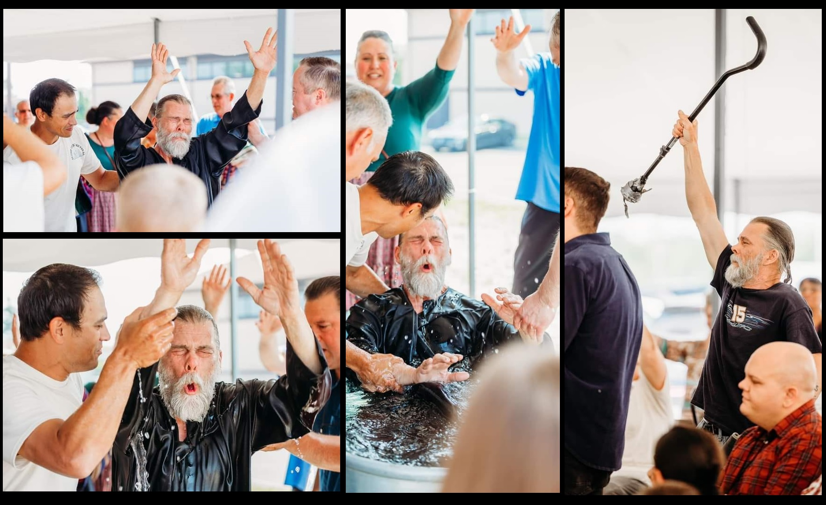
Notes:
You have no idea how many hungry there are

Slide 19
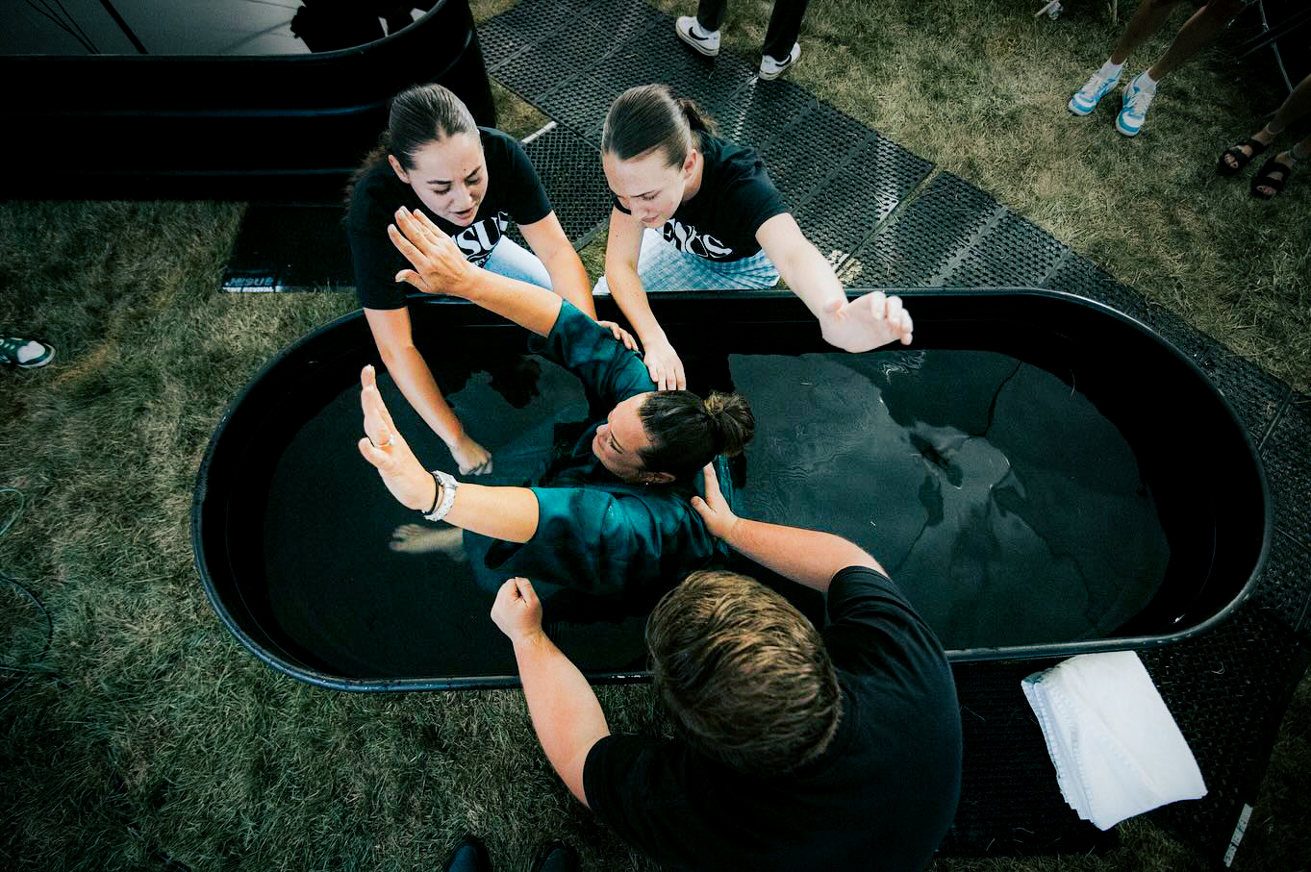
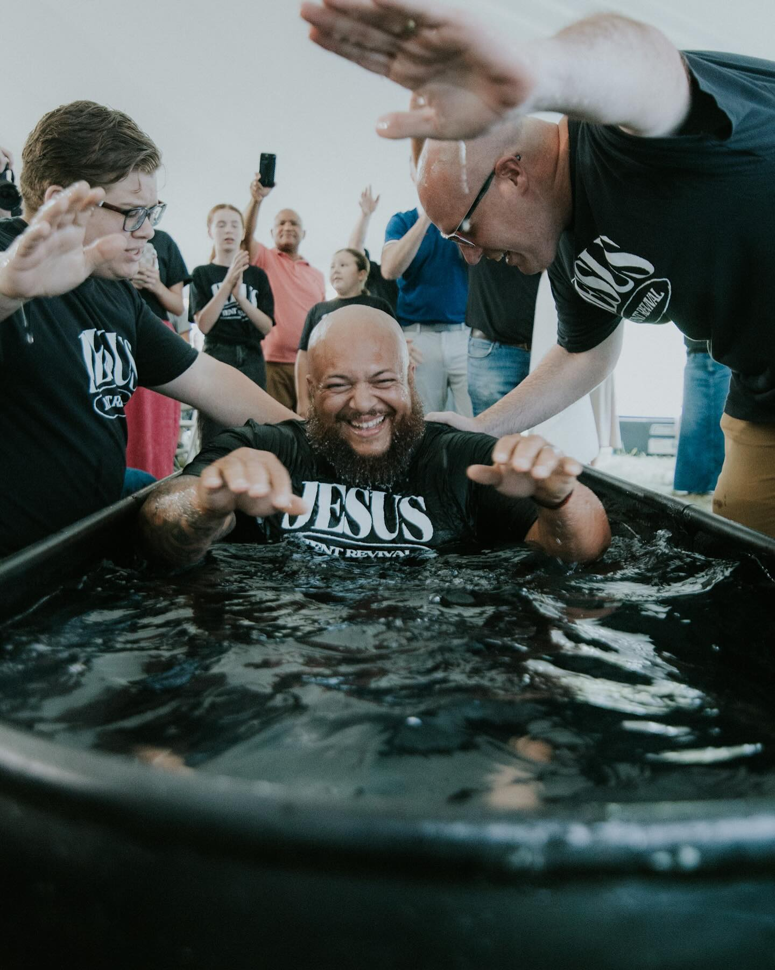
IN THE
SERVICES
Streamline
Keep services focused and intentional. Inspire faith with minimal interruptions.
Notes:
A CULTURE OF EVANGELISM, IT CHANGES HOW WE HAVE CHURCH TOO.
Streamline:
Keep services focused and intentional
Inspire Faith
Minimal interruptions

Slide 20
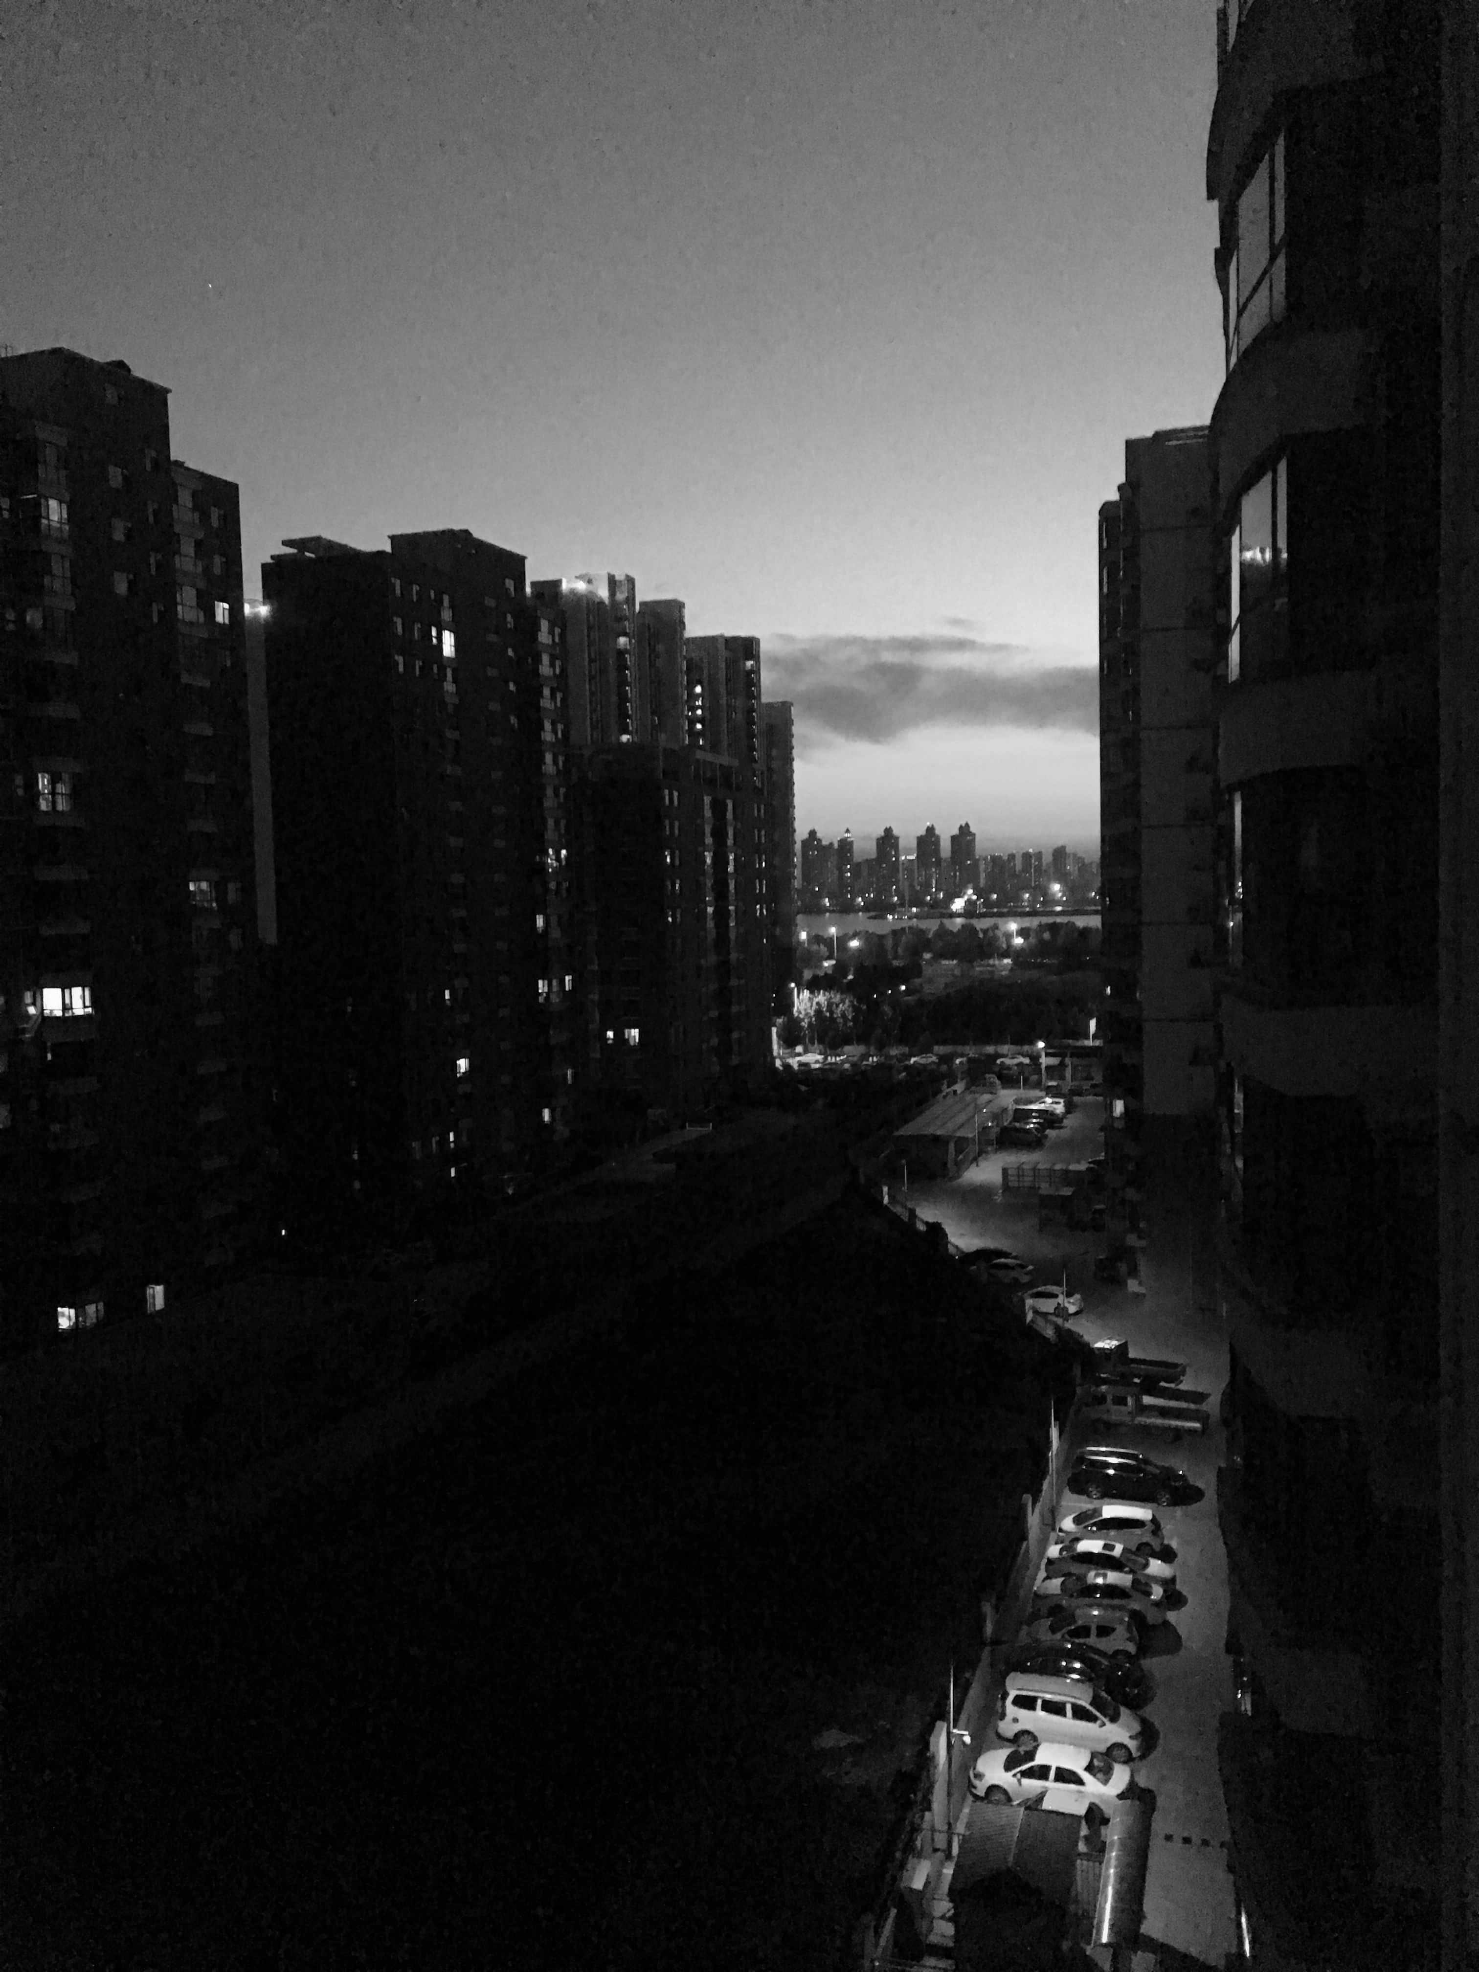
CELEBRATE WINS & SPOTLIGHT GROWTH
Share what God has done and build excitement for where you are going.
Notes:
Celebrate Wins & Spotlight Growth
Tell the story. Why?
The retelling of the story teaches the church: encourages altar working
This happened in ohio, the retelling of the story won someone in Florida.

Slide 21
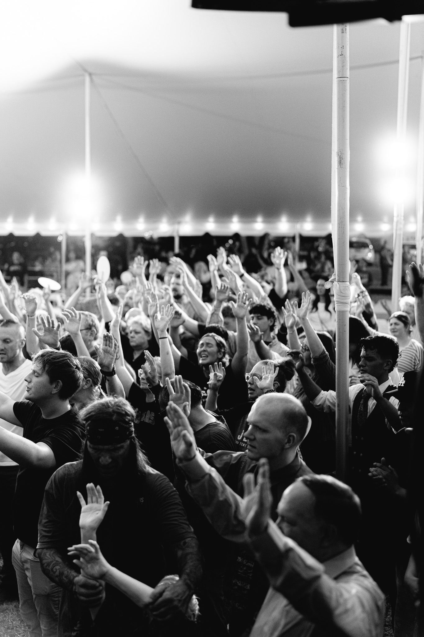
PREACH
EVANGELISTIC
IN THE SERVICE
Preach Simple.
Preach Jesus.
Preach New Birth..
A simple gospel message that elicits faith and calls for response, will change their life forever.
Notes:
PREACH EVANGELISTIC
Preach Simple.
Preach Jesus.
Preach New Birth..

Slide 22
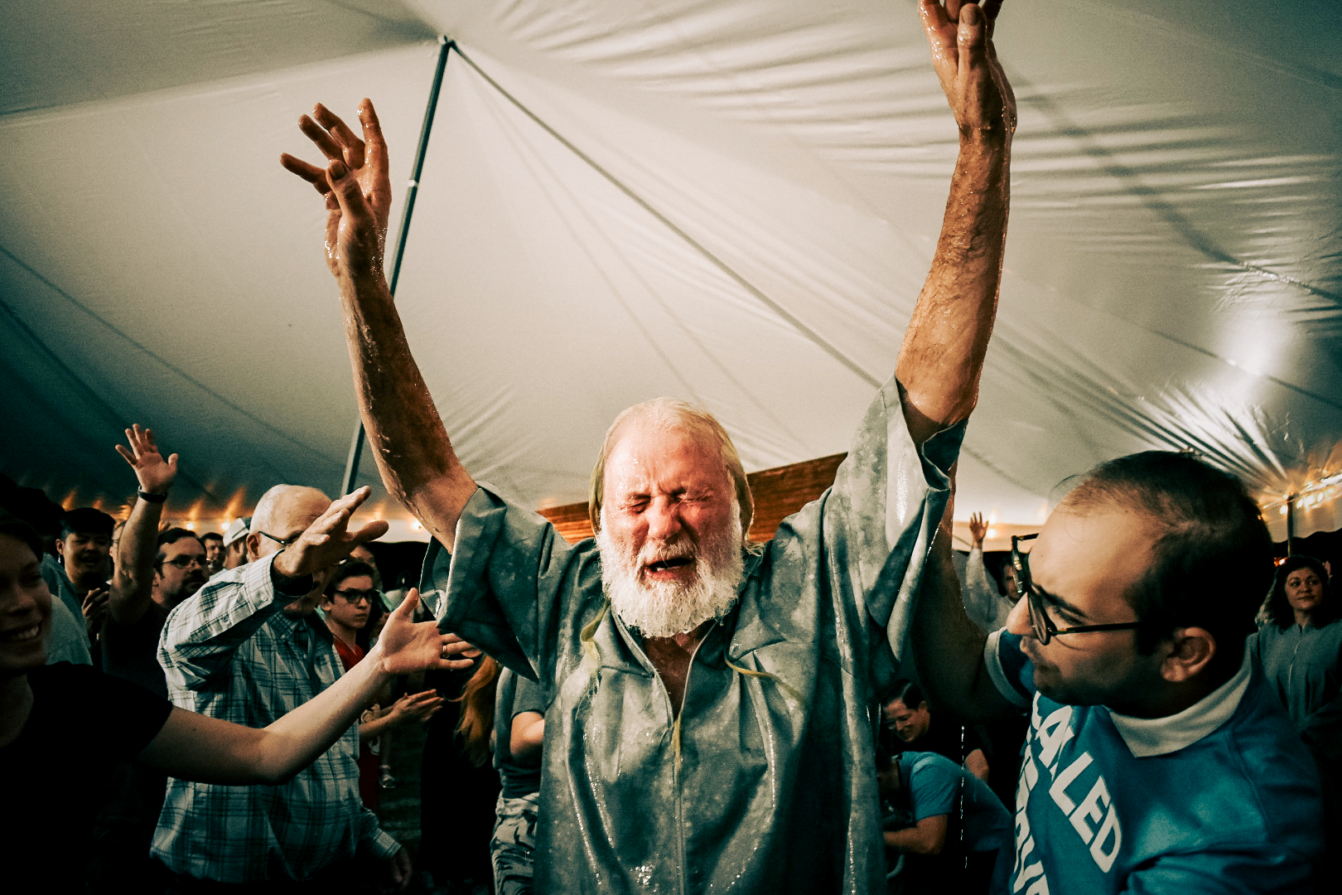
IN THE
SERVICE
BAPTISM
HOLY GHOST
A CLEAR CALL TO BE BORN AGAIN
NEW BIRTH CENTRIC SERVICES
Notes:
There should be a CLEAR CALL TO BE BORN AGAIN
Baptism, & HG

Slide 23

Notes:
One of three pastors baptized in this one revival.
Over 15 that year.

Slide 24
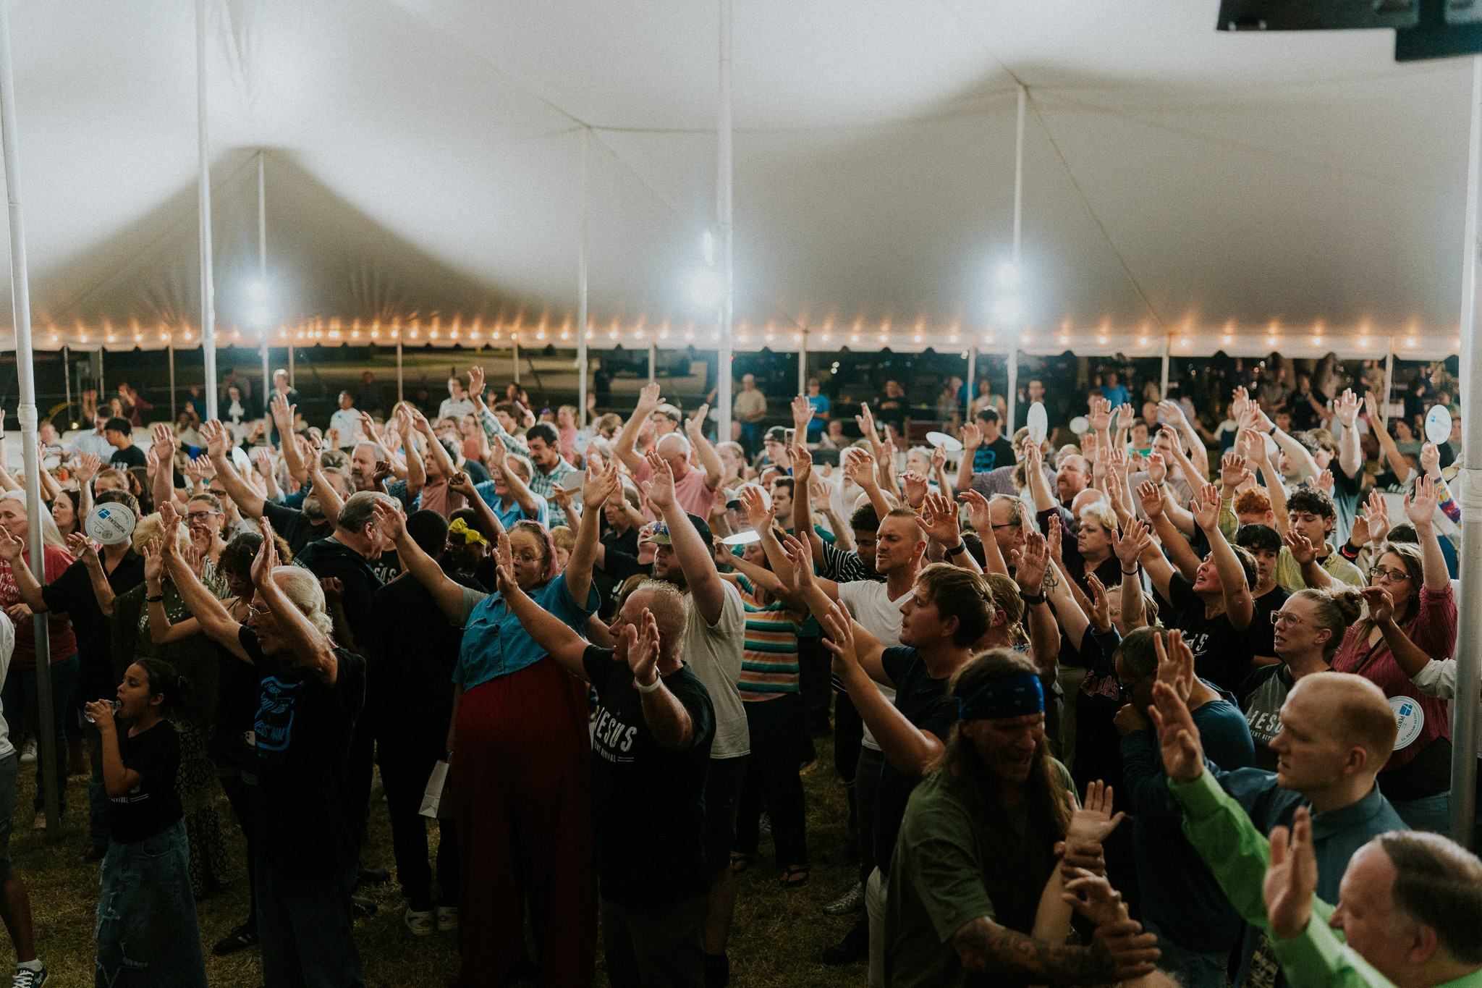
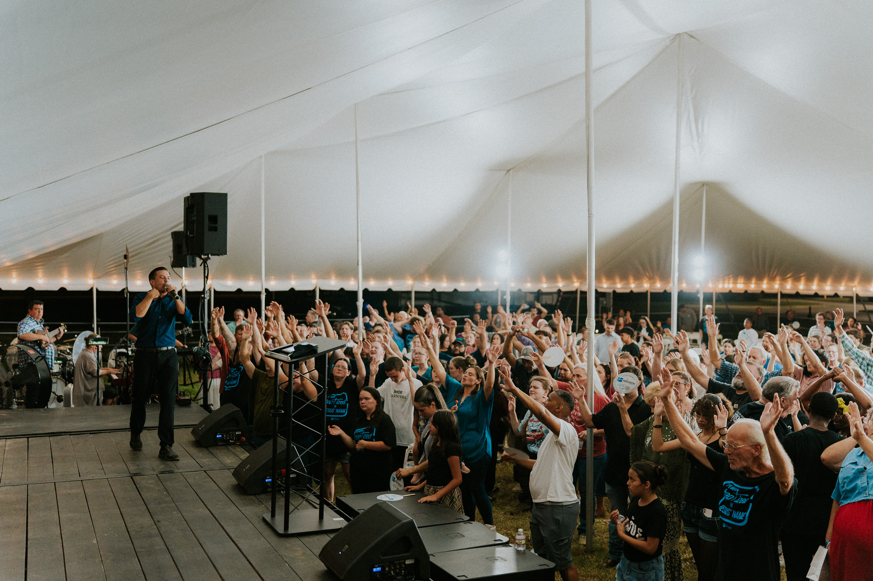
IN THE
SERVICE
STRONG ALTAR WORKING
Foster wide involvement and heavy impact. Miracles and infillings are the expectation, not exception!
Notes:
WE NEED STRONG ALTAR WORKING
We want to be synonymous with where miracles happen, addict are free, the empty are filled.
Where you can still get baptized and get the HG in your FIRST SERVICE.
Miracles and infillings are the expectation, not exception!

Slide 25
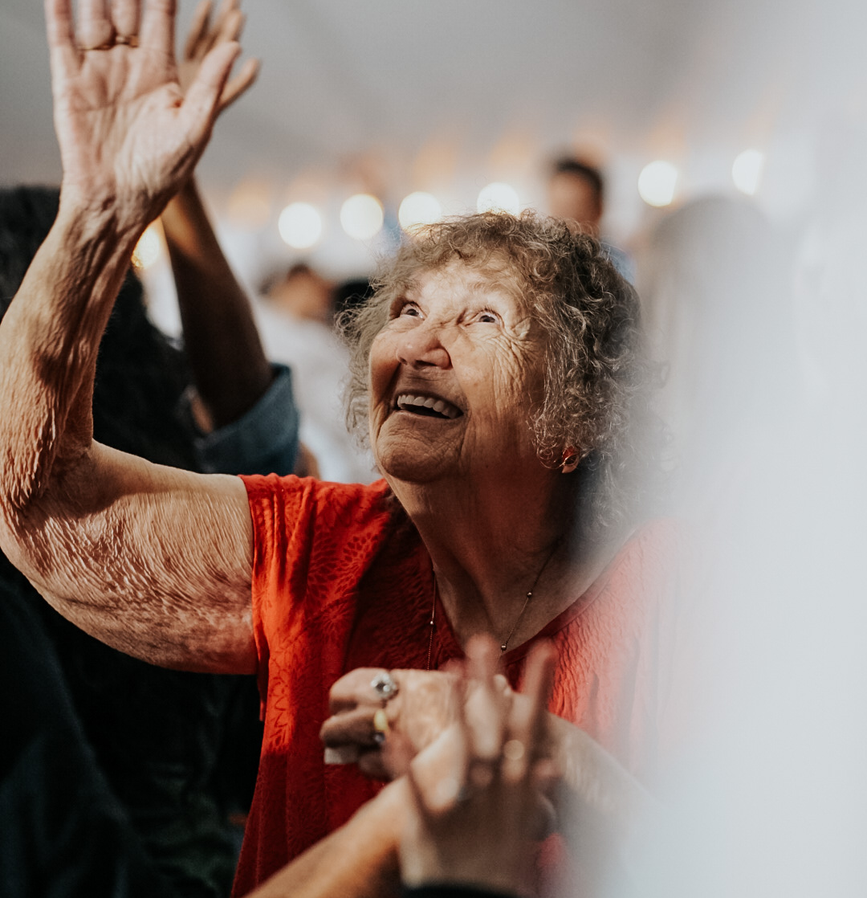
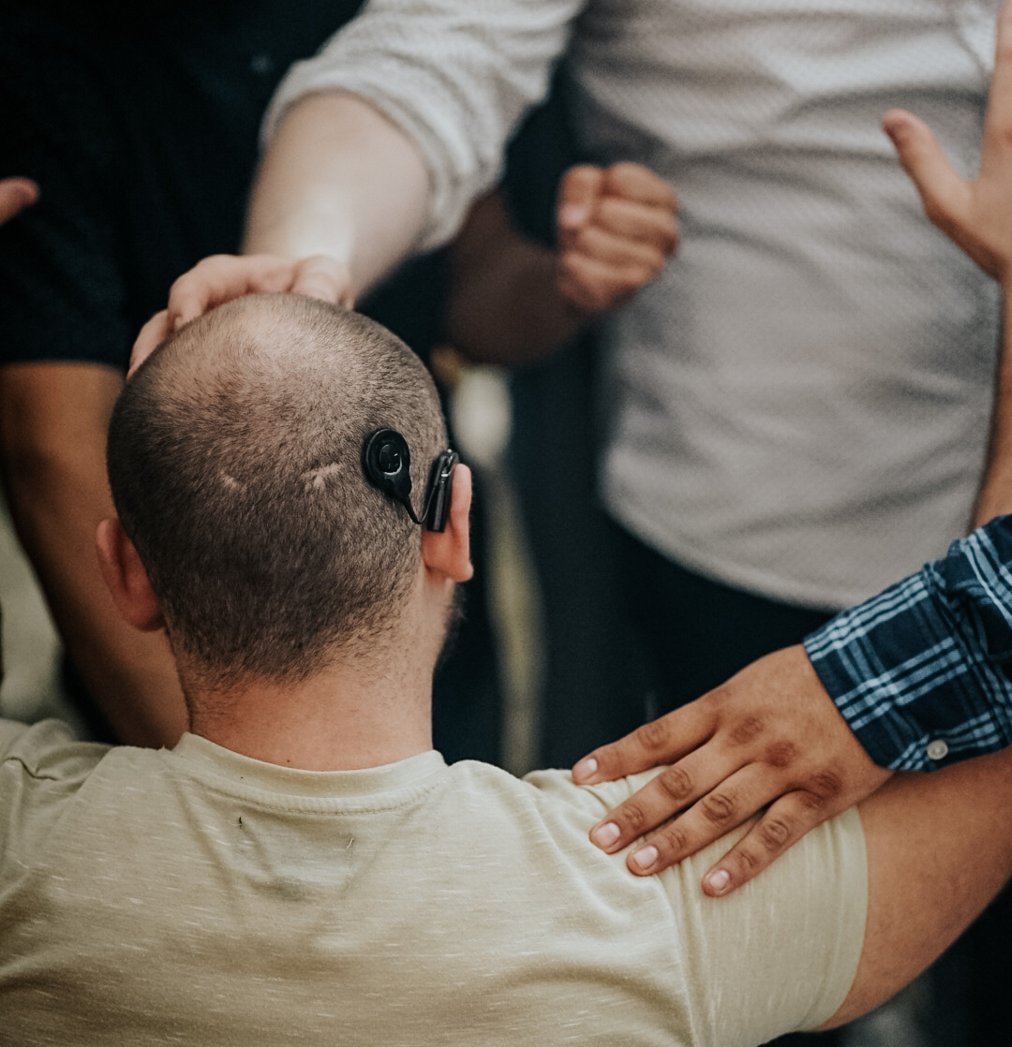
Notes:
Left: BLIND
Right: DEAF

Slide 26

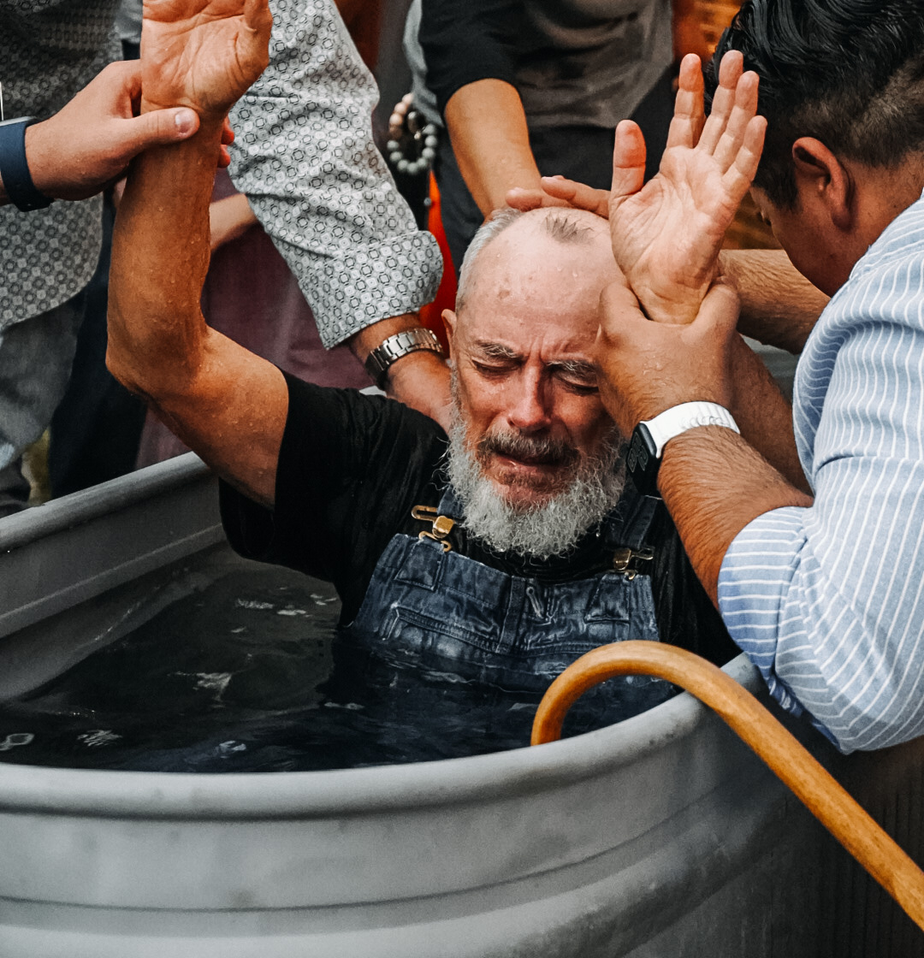
Notes:
LEFT: Wheelchairs (5x that year)
RIGHT: Blind (From door hangers)

Slide 27
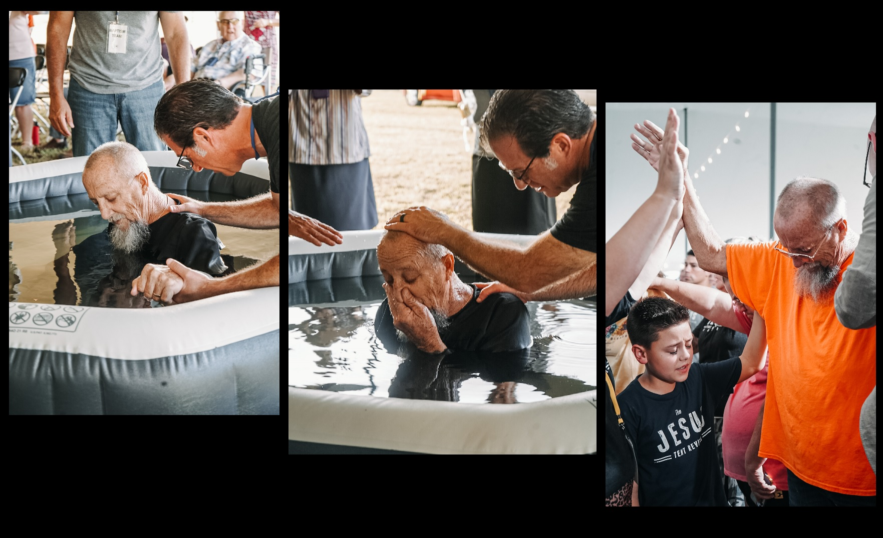
Notes:
Terminal man – from facebook

Slide 28
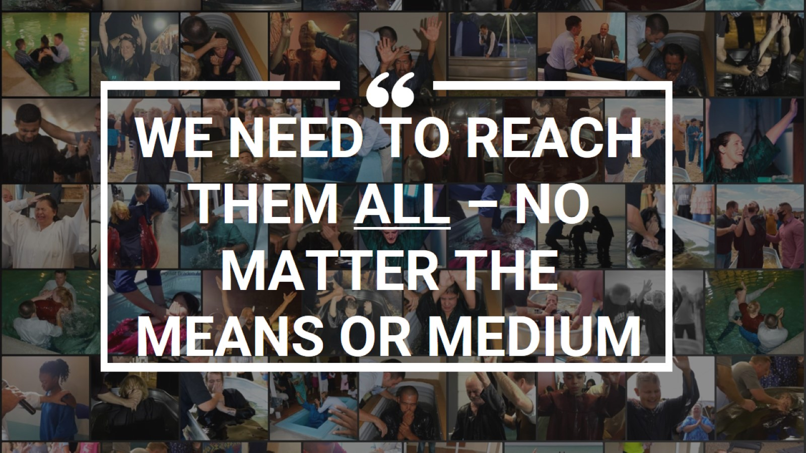
Notes:
WE NEED TO REACH THEM ALL – NO MATTER THE MEANS OR MEDIUM

Slide 29
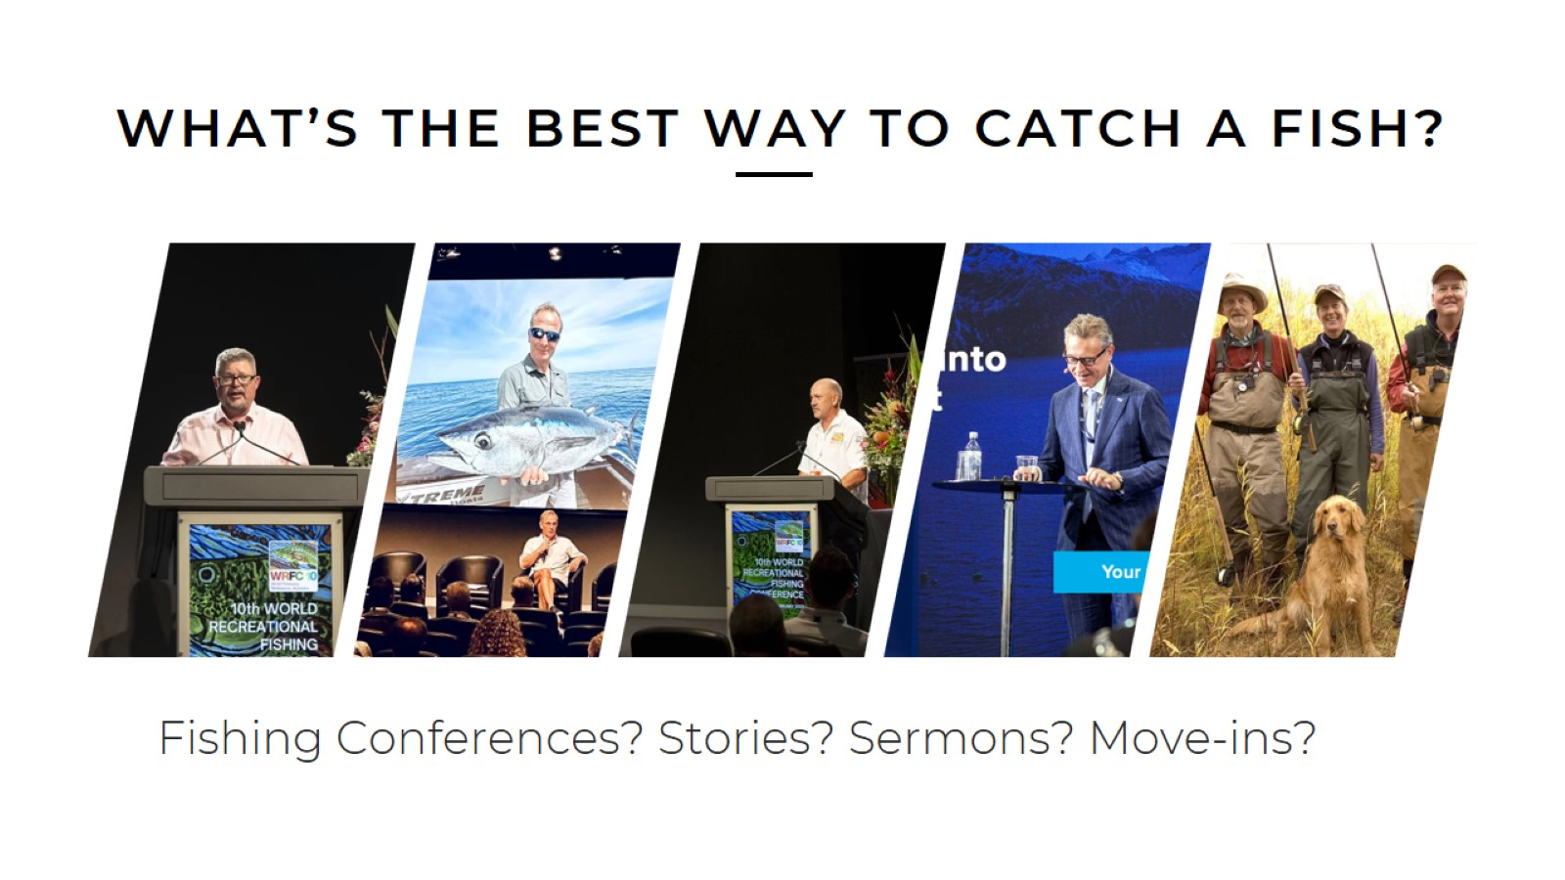
Notes:
What’s the best way to catch fish?
Fishing conferences
Fishing stories
Fishing sermons
Fishing move-ins
Go fishing

Slide 30
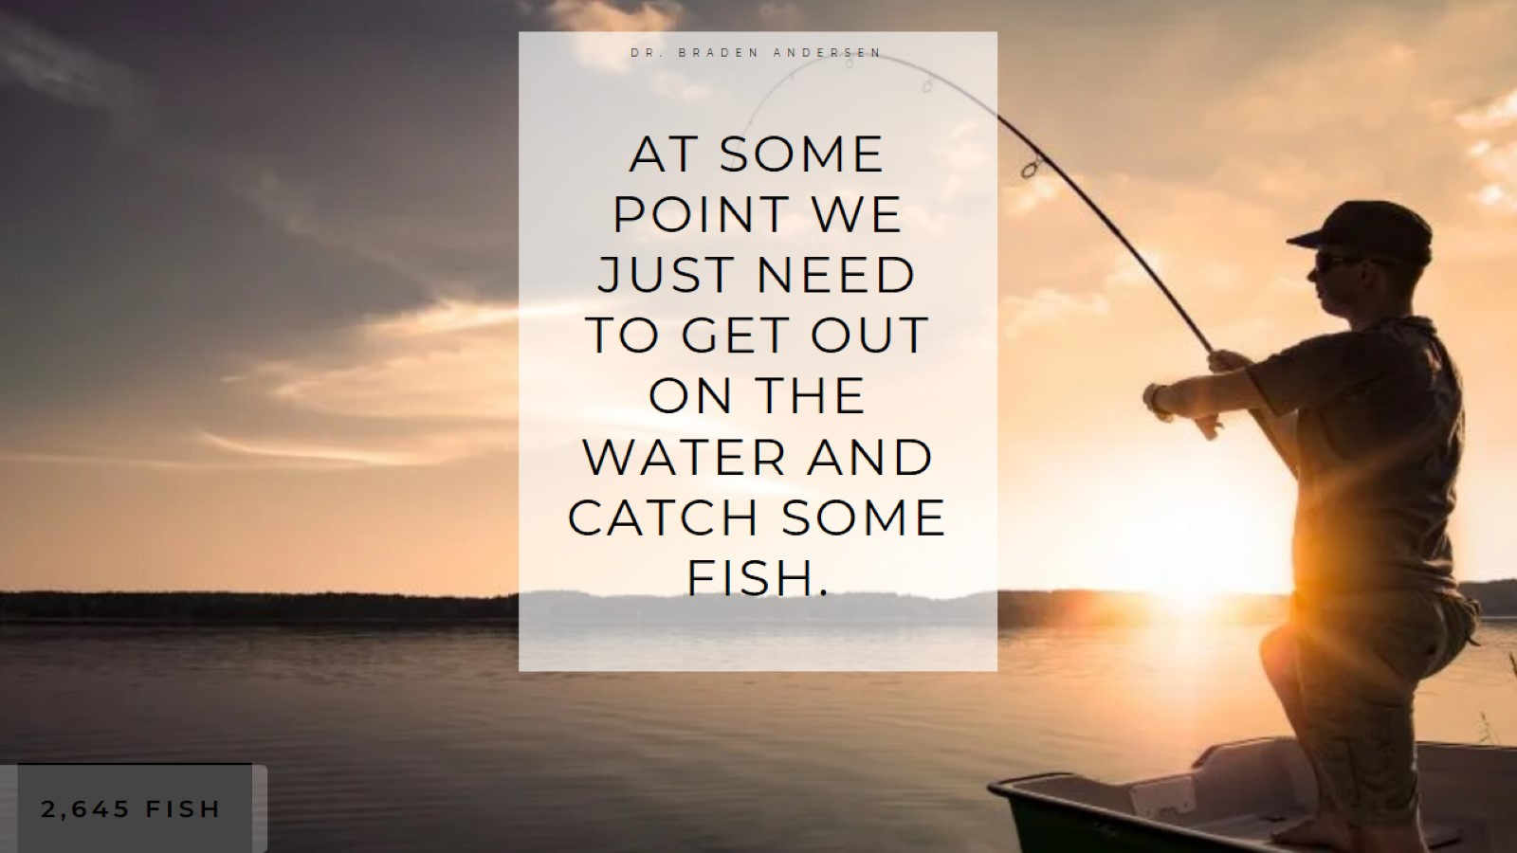
Notes:
Illustration – The Record Fisherman
Man broke the 24-hour record of fish caught.
Not from:
Fishing conferences
Fishing TV
Fishing books, magazines, or stories
From fishing.
Record: 2,649 fish. Then again – 2,977 fish.
One man, one boat, but he kept fishing
AT SOME POINT WE JUST NEED TO GET OUT ON THE WATER AND CATCH SOME FISH.
A bad fisherman fishing catches more fish than the fisherman who’s not. Just go fish!

Slide 31
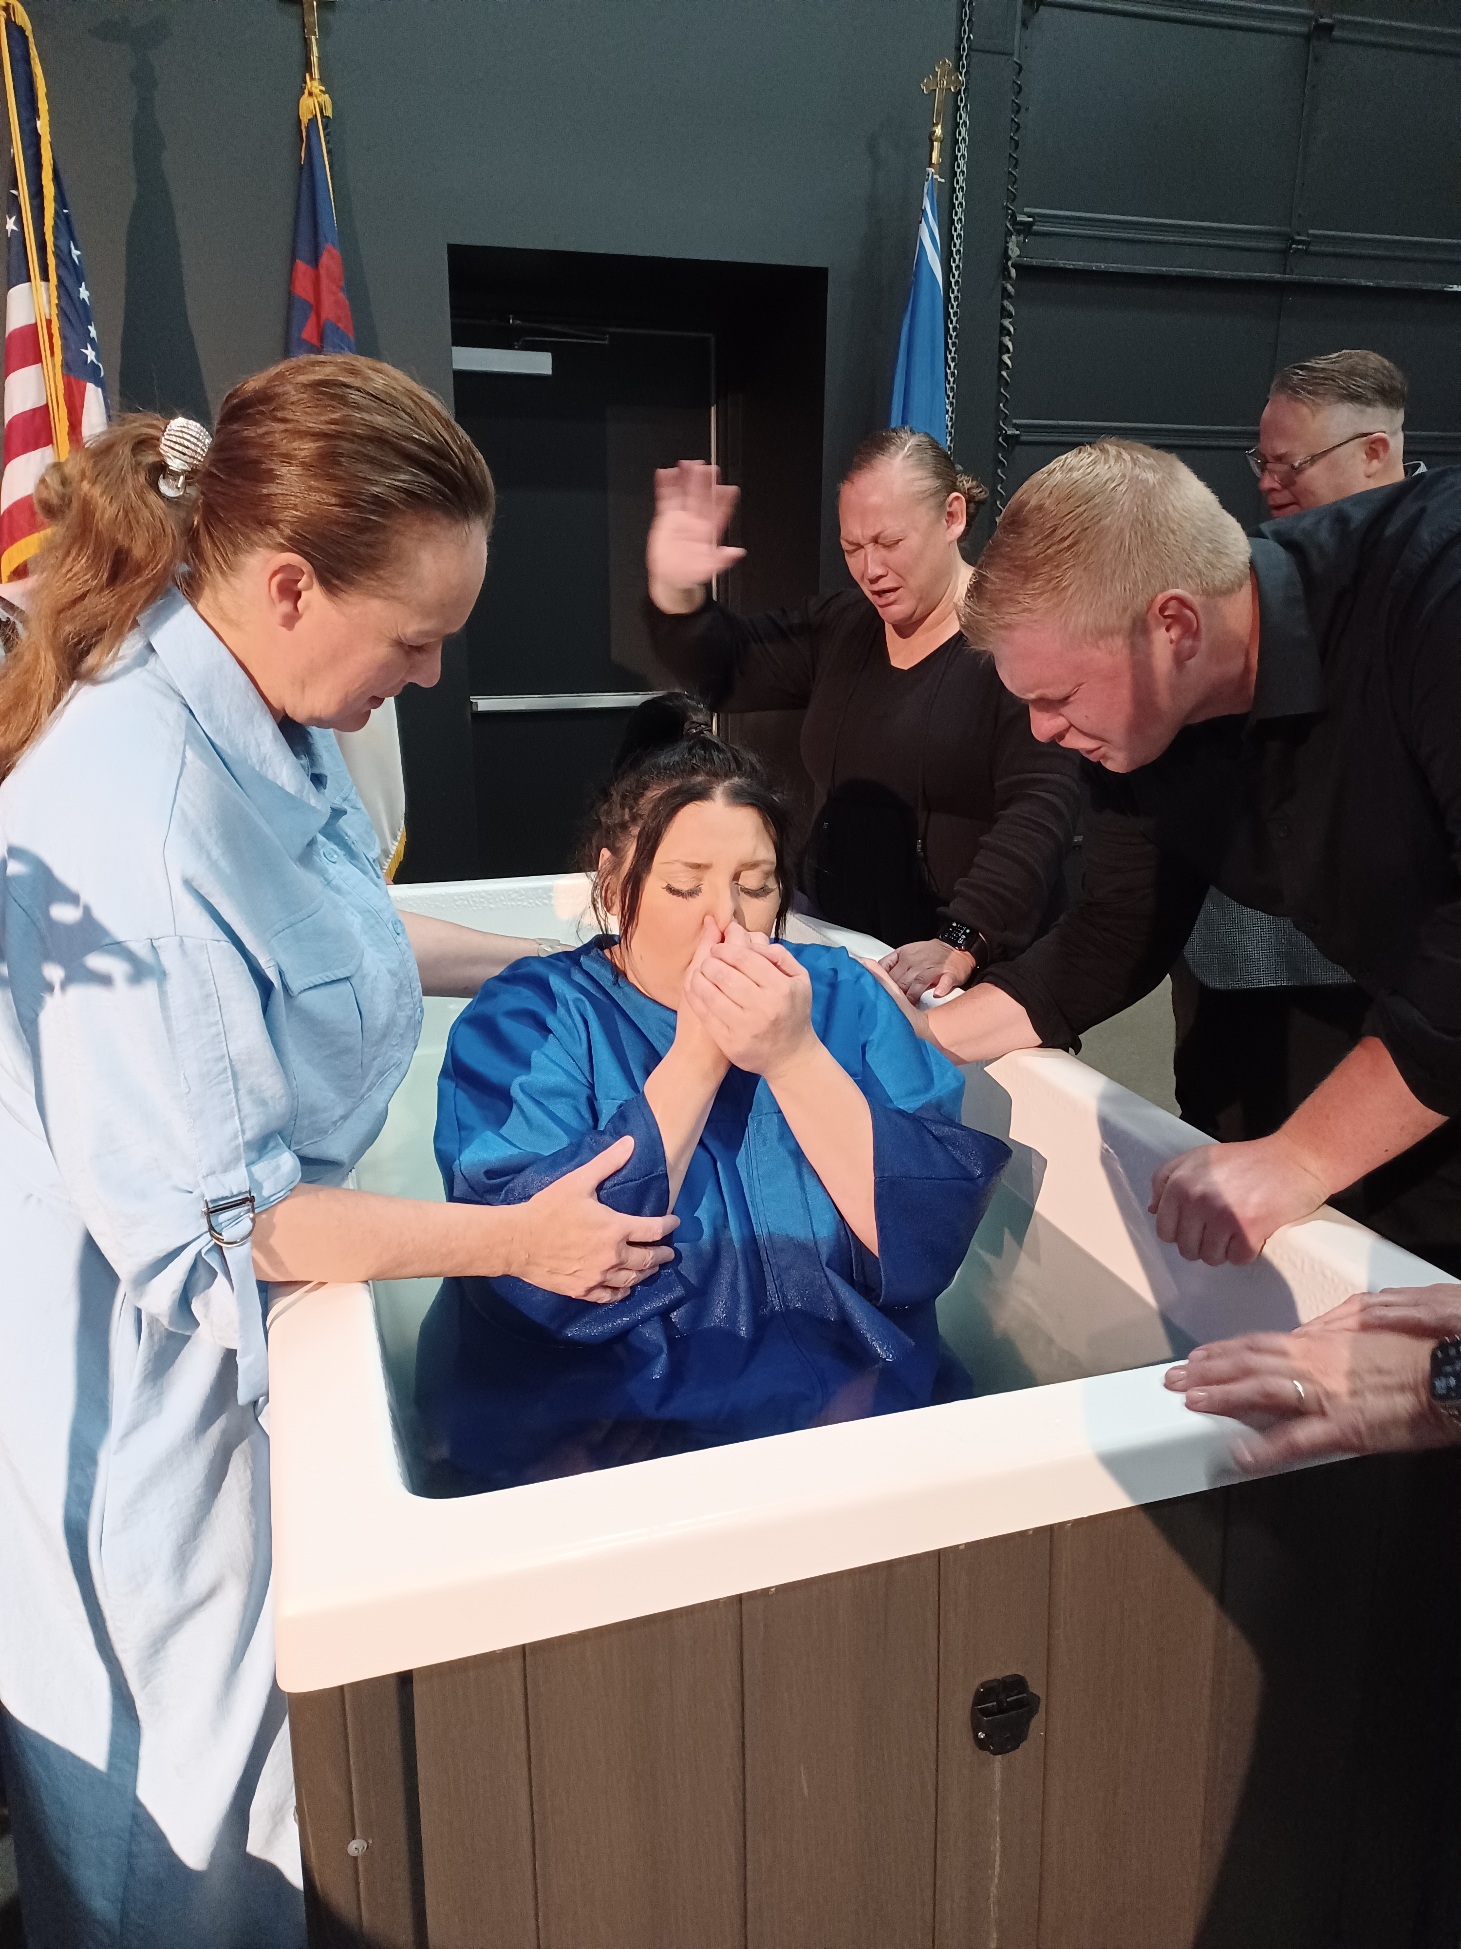
Notes:
(Indiana) Souls are in the balance.
(Texas) Guy from marketplace sale. With gun / vodka, tent revival invite

Slide 32
A CULTURE OF
EVANGELISM
Dr. Braden Andersen
JESUSTENTREVIVAL.COM

