Slide 1
Notes:
SCAN TO DOWNLOAD THESE SLIDES
https://outreachandgrowth.com/resources-1

Slide 2
Notes:
SCAN TO DOWNLOAD THESE SLIDES
https://outreachandgrowth.com/resources-1

Slide 3
Notes:
The law of the harvest
Do little, get little.
Do more, get more!

Slide 4
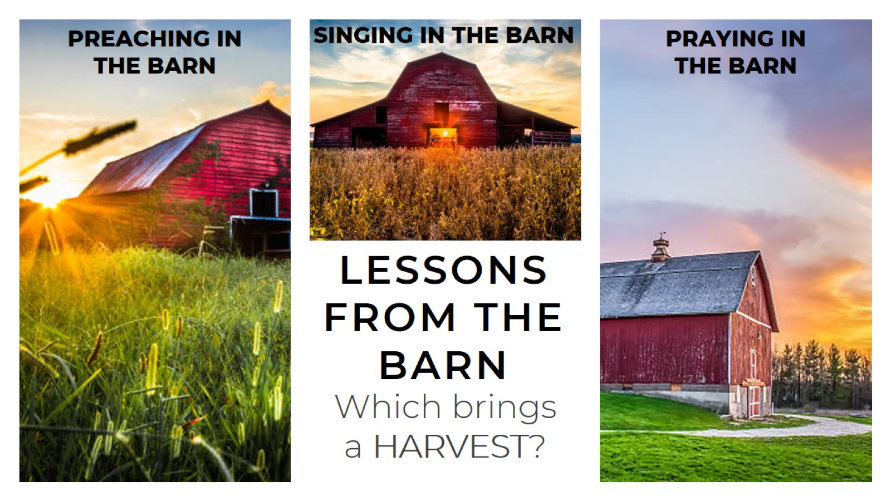
Notes:
A lesson from the barn – which bring a HARVEST?
Preaching in the barn
Singing in the barn
Praying in the barn

Slide 5
Notes:
AT SOME POINT WE JUST NEED TO GET OUT OF THE BARN AND PUT SEED IN THE FIELD.

Slide 6
Notes:
THE ONLY PRAYER REQUEST OF JESUS
“Lift up your eyes, and look on the fields; for they are white already to harvest.” John 4:35
“The harvest truly is plenteous, but the laborers are few; Pray [...] that he will send forth laborers into his harvest.” Mat 9:37-38

Slide 7
Notes:
HOW CAN WE BRING IN A GREAT HARVEST?
EVANGELISM

Slide 8
Notes:
The 4 types of outreach
1.. STRATEGIC MARKETING
2.. LIFESTYLE EVANGLISM
3.. SCHEDULED EVANGELISM
4.. EVENT EVANGELISM
The fastest growing churches in America do all 4 !!

Slide 9
Notes:
The 4 types of outreach
1 of 4… STRATEGIC MARKETING – BE EVERYWHERE PEOPLE ARE
Social Media
Video Invites
Highlight Reels
Websites
Direct Mailers
Billboards
T-Shirts
Radio Ads
Our other presentation discusses how to develop your marketing and social media more in depth.

Slide 10
Notes:
2 of 4.. LIFESTYLE EVANGLISM – THE FREE STUFF
If we can’t carry a Church card in our pocket, we won’t go much further.
Have a culture of personal evangelism. Cards say:
“You’re Invited”
“This will change your life”
“Welcome Home”
“Saving You a Seat”

Slide 11
Notes:
3 of 4.. SCHEDULED EVANGELISM - Not delegated to a few, but a church-wide effort. We schedule group outreaches “to help the saints obey the great commission.”
Door hangars (homes)
Door knocking (apartments, trailer parks)
Parking Lot Cars / Fairs / fireworks / Sports Events / Colleges

Slide 12
Notes:
TESTIMONY
MISSISSIPPI
“WE HAVE NEVER DONE OUTREACH IN THAT PART OF TOWN”
→15O Members
→230 Guests
→68 Baptized

Slide 13
Notes:
4 of 4… EVENT EVANGELISM – THE HIGH RISK, HIGH RETURN
Giveaway services, Block Party – Outdoor Services
Crusades
Tent Revivals

Slide 14
Notes:
TESTIMONY - TENNESSEE
“COULD WE TRY SOME BLOCK PARTIES?”
→4O Members
→80 First Time Guests
→16 Baptized

Slide 15
Notes:
TESTIMONY- IOWA
“YOU THINK A TENT REVIVAL WOULD WORK IN IOWA?”
→150 Member Church
→Great Attendance →46 Baptized, 38 HG

Slide 16
Notes:
What’s the best way to catch fish?
Fishing conferences
Fishing stories
Fishing sermons
Fishing move-ins
Go fishing

Slide 17
Notes:
AT SOME POINT WE JUST NEED TO GET OUT ON THE WATER AND CATCH SOME FISH.
The man pictured caught a world record this day – 2,645 fish in 24 hours. One man fishing can catch more than one hundred talking about it, singing about it, or preaching about it.

Slide 18
Notes:
THE CALL OF EVERY APOSTOLIC
“[..] ye shall be witnesses unto me both in Jerusalem, in all Judaea, in Samaria, & unto the uttermost part of the earth.” -Acts 1:8
“He saith unto them, Follow me, and I will make you fishers of men. “ Mat 4:19

Slide 19
Notes:
I also have a MBA with an emphasis in marketing and market forecasting. Here’s what you need to know from market forecasting:
START WITH THE HUNGRY PEOPLE
Population dense
Large family size
Low income
Markers of need (drug, alcohol, anxiety, depression, unemployment)
Then we hit them multiple ways. It always works.
Luk 14:21
(21) So that servant came, and shewed his lord these things. Then the master of the house being angry said to his servant, Go out quickly into the streets and lanes of the city, and bring in hither the poor, and the maimed, and the halt, and the blind.

Slide 20
Notes:
HOW DO WE PULL OFF A REALLY BIG EVENT?
REALLY BIG OUTREACH
To break records, it’s not unusual to start months in advance. And the outreach budget usually exceeds the event itself.
Big events are worth it, we’ve seen thousands of FTGs at single events.
REALLY BIG PLANNING
- Scan the QR code for an example planning guide to a large event. The more you work it, the more it works!

Slide 21
Notes:
TESTIMONY
RHODE ISLAND
“WE WANT TO BEAT OUR ALL-TIME ATTENDANCE RECORD”
→4 Months Planning
→Attendance RECORD
→Baptism RECORD
NOT BECAUSE OF US, we weren’t on the flyer. It was their work! You can do this right where you are!

Slide 22
Notes:
TESTIMONY
“WHAT IF WE TRIED SOMETHING IN THE FIELD?”
→Weeks of prep
→Outreaches & Social Media
→1,000 FTG

Slide 23
Notes:
HOW DO WE START AT THE GROUND FLOOR.
“IN ALL LABOR THERE IS PROFIT” - Pro 14:23
Many of the days of outreach I was alone or with just one person at this church in Houston. But this works if you work it. The woman in the bottom right came back to the church on outreach, was baptized, and HG filled. It only takes one to invite one. Start somewhere.

Slide 24
Notes:
TESTIMONY- CALIFORNIA
“COULD WE DO SOMETHING AT A CHURCH PLANT?”
→10 Members, with 8 on outreach!
→16 First Time Guests
→11 Baptized

Slide 25
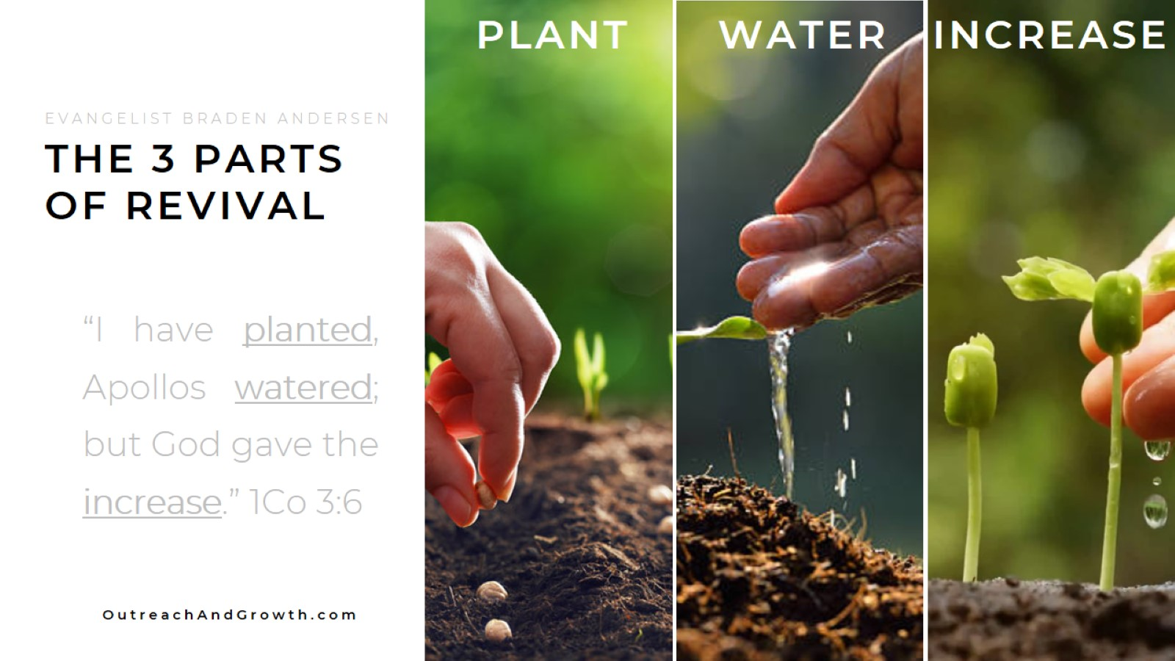
Notes:
3 parts of Revival
Plant,
Planting is EVANGELISM. But after evangelism, we’re not done.
Water,
Watering involves caring for the seeds. No seed survives without care and no convert will either. Don’t expect them to bring themselves back each week. Love them, mentor them, disciple them.
This can be done personally vs. corporately (small groups)
Know that to the post-modern convert, relationship is paramount! This works! (16v72)
Increase
We need to create an atmosphere where God can bring an increase.
Atmosphere of faith & expectation
Preach: Acts 8 “What would stop you from being baptized?”
Pray: Acts 19 “Have you received the Holy Ghost yet?”
Believe: Mk 16 “THESE SIGNS SHALL FOLLOW THEM THAT BELIEVE!”

Slide 26
Notes:
EVANGELIZING CHURCHES REACH PEOPLE
During an unexpected snowstorm in Arkansas, we still had groups go on outreach for the Church Plant in Calico Rock. I wasn’t even there, and this lady got the HG on outreach. She, along with several others, were baptized that night – despite the snow.

Slide 27
Notes:
SCAN TO DOWNLOAD THESE SLIDES
https://outreachandgrowth.com/resources-1

