Slide 1
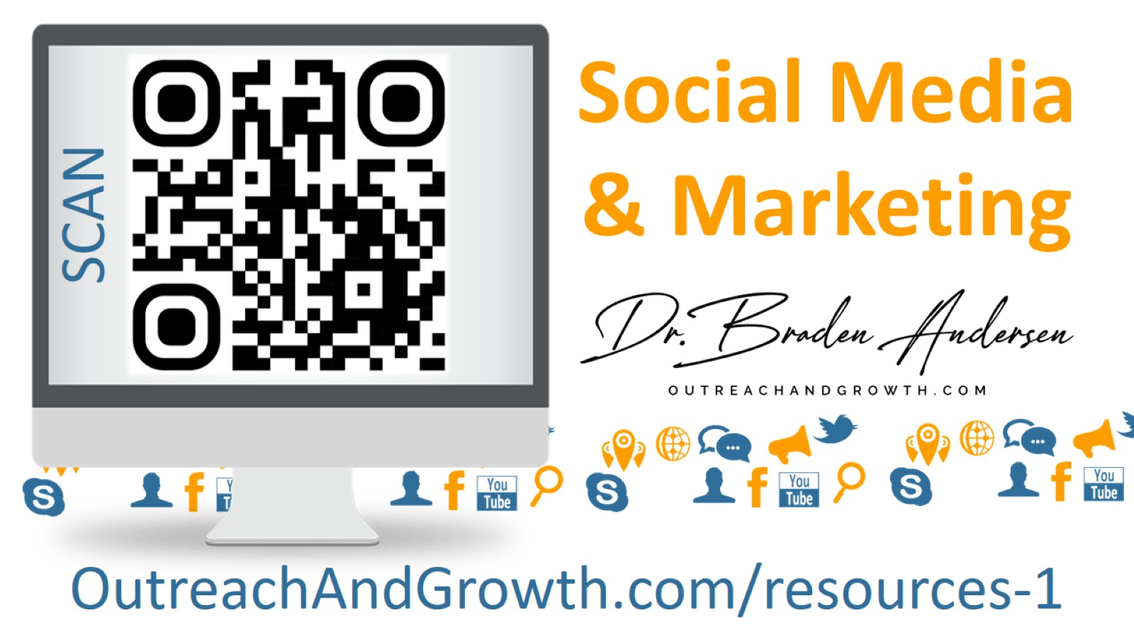
Notes:
Dr. Braden Andersen | Outreach Evangelist | 253.217.0609
FB.com/OutreachAndGrowth ǀ Instagram.com/upci_evangelist ǀ JesusTentRevival.com ǀ OutreachandGrowth.com

Slide 2
Notes:
Dr. Braden Andersen | Outreach Evangelist | 253.217.0609
FB.com/OutreachAndGrowth ǀ Instagram.com/upci_evangelist ǀ JesusTentRevival.com ǀ OutreachandGrowth.com

Slide 3
Notes:
Dr. Braden Andersen | Outreach Evangelist | 253.217.0609
FB.com/OutreachAndGrowth ǀ Instagram.com/upci_evangelist ǀ JesusTentRevival.com ǀ OutreachandGrowth.com

Slide 4
THERE IS NO SHORTAGE OF LOST PEOPLE
Notes:
THERE IS NO SHORTAGE OF LOST PEOPLE THERE ARE 174.6 MILLION PHYSICAL DOORS IN THE U.S. AND 159.9 MILLION MAILBOXES.

Slide 5
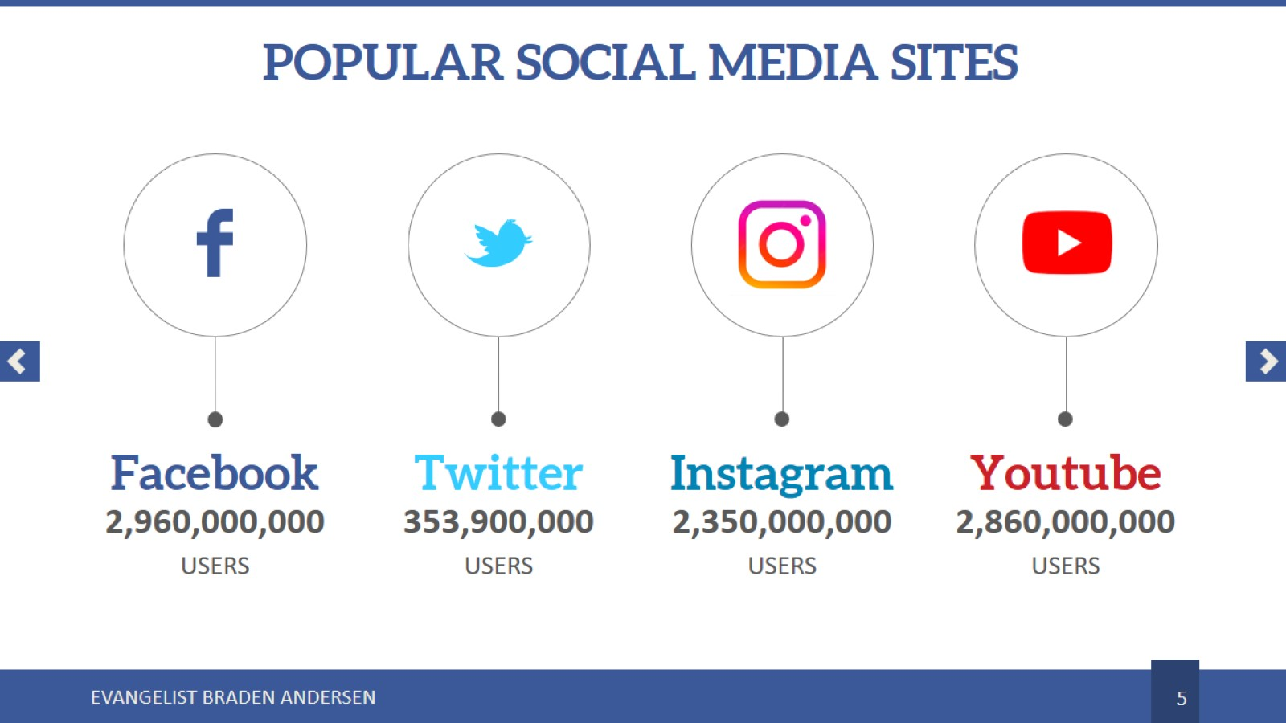
POPULAR SOCIAL MEDIA SITES
Notes:
POPULAR SOCIAL MEDIA SITES HAVE BILLIONS OF USERS

Slide 6
WHY MARKETING?
Notes:
Why marketing? They might not know you exist
They might not know what you offer
So, they might not know… You have what they need!

Slide 7
Notes:
So the goal of marketing
To be known and seen by all
To offer a unique experience
To effectively invite participation

Slide 8
Notes:
Marketing Strategy
We can get to almost everyone with a combination of doors, mailboxes, social media, events, & word of mouth. So let’s learn how...

Slide 9
Notes:
Most Common Mistakes
Over-estimating influence
You are not as well known as you think you are. Most people don’t know you exist.
Even in a single given apartment complex. The majority of residents turn-over every 6-9 months. They forgot you since last year’s outreach.
Over-estimating effectiveness
The live stream is not enough to do it. (And in most cases it’s very ineffective at reaching new people; turning off more than it will bring in).
Just having an annual Easter program won’t do it.
Over-estimating their interest
Offering too much – prayer drives, midweek services, etc. Non Christians have little interest in that.
Assuming they’ll remember, wake up early, find a ride, etc. Don’t make church hard for them!
Inadequate quality
Using paragraphs of text instead of videos and other media.
Poor audio or video.
Inadequate quantity
200 flyers a year won’t do it. Having a few stacks of church cards sitting in the lobby won’t do it. Great harvest requires great seed.
Every year we distribute of 250,000 flyers and generate over 1,000,000 social media views.
Inadequate spending
A $15 boost on FB won’t do it.
This money isn’t wasted. In my prior secular company for ever $1 spent on FB advertising, I made $2. Marketing, outreach, and evangelism spending is the most important line-item of the church. It is a necessity and fuels tomorrow’s revival. We’ve seen enough stories to confidently say, with even a little sense and prayer, you will recoup your losses and some.

Slide 10
Notes:
He heard about us from a parking lot outreach. Literally finding a flyer someone else discarded. He’s been coming for over a year and brought his whole family. We miss stories like these if we fail to evangelize.

Slide 11
PICK A PRIMARY MARKETING & MEDIA GOAL
Notes:
PICK A PRIMARY MARKETING & MEDIA GOAL
WHAT ARE WE REALLY TRYING TO DO?
There is no “one-size fits all” marketing. You need to have extreme intentionality in what you do. From how you edit videos to design flyers, and even in your facebook posts - there should be a clear “primary audience.”
Are we trying…
To communicate with members?
To gain Apostolic engagement, viewers, popularity, and move-ins?
To reach “stay-at-home” viewers? …or…
To see more visitors and converts?

Slide 12
Notes:
He heard about us from a Facebook invitation video. He walked in with a cane and back brace. Received the spirit during song service, was baptized at the start of the preaching, and left without a cane or back brace. We miss stories like this if we fail to market.

Slide 13
MARKETING METHODS
Notes:
Methods
Social Media
FB,
IG,
Google,
YT
Mailers
Door Hangers
P2P Event Invite Cards
Business Cards
Promotional T-Shirts
Radio Ads
Billboards

Slide 14
WHY USE DIFFERENT METHODS
Notes:
WHY USE DIFFERENT METHODS You can’t use one bait for all fish! But we need to reach them all!
High Income – Mailers, Radio Ads, Billboards, (Outreaches: Programs, Camps, Educations, Networking, & Seminars)
Middle Income – Social Media & Door Hangers, Direct Mailers, Cards (Outreaches: Large Events, Revivals)
Low Income – Social Media, Door knocking, Cards (Outreaches: Compelling, Giveaway services)

Slide 15
Notes:
Key Suggestions
BUILDNG INFLUENCE
Hit areas multiple times, multiple ways, by multiple people.
BUILDING EFFECTIVENESS
Coordinate your schedule and teams towards events and evangelism
Develop a plan to always be promoting the next evangelistic event
BUILD THEIR INTEREST
Offer only the event you’ll hazard their single try on.
Build excitement surrounding the event.
Lower barriers: Reminders, later services, nursery and SS, rides, etc.
BUILD QUALITY
Develop high quality invitations and recap videos.
Develop high quality flyers
Work to improve video and audio
BUILD QUANTITY
If you do more you will get more. Start with 5,000 flyers per special weekend (if church <150, or 10,000 for >150).
BUILD A BUDGET
A boost should land around at least $250 to $500.

Slide 16
Notes:
Testimonial
HE WAS A BACKSLIDER UNTIL HE SAW THE EVENT ON FACEBOOK!

Slide 17
Notes:
Best practices
Flyer & Mailer design
Pick ONE EVENT – even if it’s every Sunday – refer to it as “THIS SUNDAY”
Where? (Location)
When? (Date, time)
Why? (What’s special)
How? (rides)
Talking about mailers again – they work the best, but they cost a little more and take a while to set up. Use outreach.com for mailers and ask for a non-profit shipping rate.

Slide 18
Notes:
Invite Cards
Have a culture of personal evangelism. Cards say:
“You’re Invited”
“This will change your life”
“Welcome Home”
“Saving You a Seat”

Slide 19
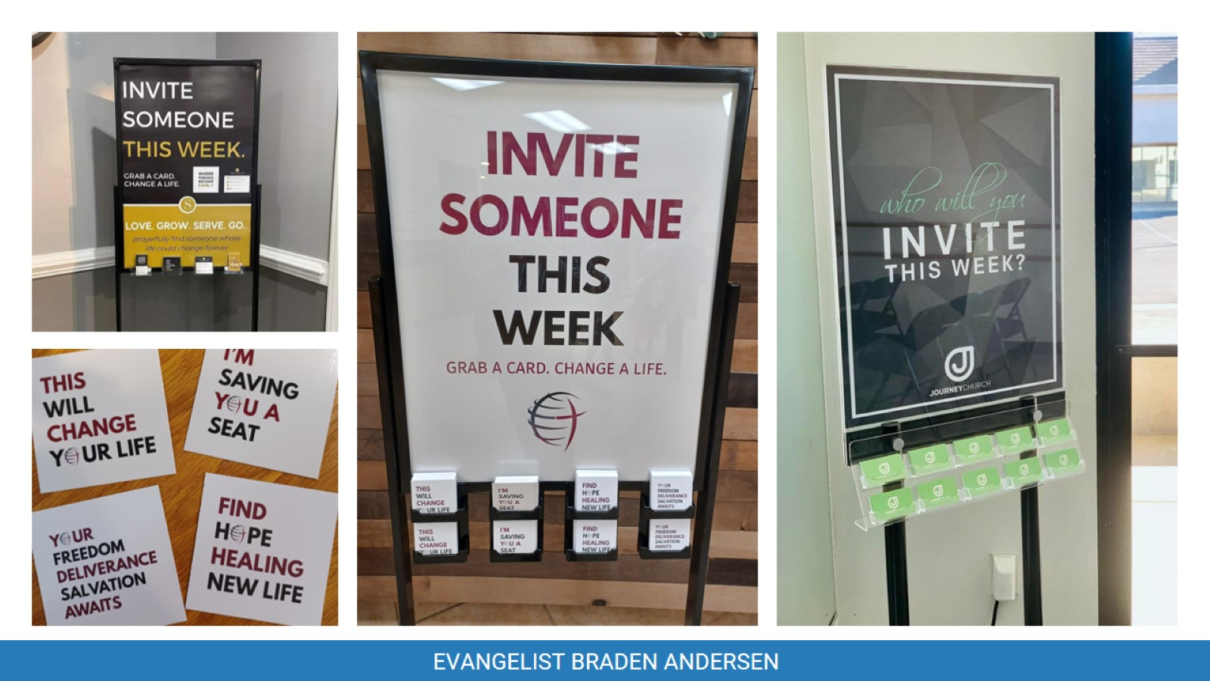
Notes:
A parking lot can eat up 500 invites in an hour on outreach. But 250 people can also invite TWO people through their week and errand, with ZERO added time.
Encourage every person to hand out TWO invite cards per week, then grab TWO more on the way out every Sunday.
Personal evangelism must be part of our culture. Put invite cards at every door leading out of the sanctuary and building.

Slide 20
Notes:
This next section is highly subject to change!

Slide 21
Notes:
Social Media
Short video content – move toward church “previews” and away from church “replacements” (full service live-streams)
Use high quality video and audio
Videos should fall into the category of “invite” or “highlight”
Don’t appeal to Pentecostal culture and excessive intensity – see it as they do: as n unchurched first time guest.
Don’t highlight the speaker, highlight “the experience with God”
Showcase your church’s strengths, worship, and people.
Spotlight what you want from them (baptism, etc)
Vary your subjects and style
Don’t false advertise, it only hurts
Have everyone share, like, and comment.
Keep internal church communication separate (like a closed facebook group)

Slide 22
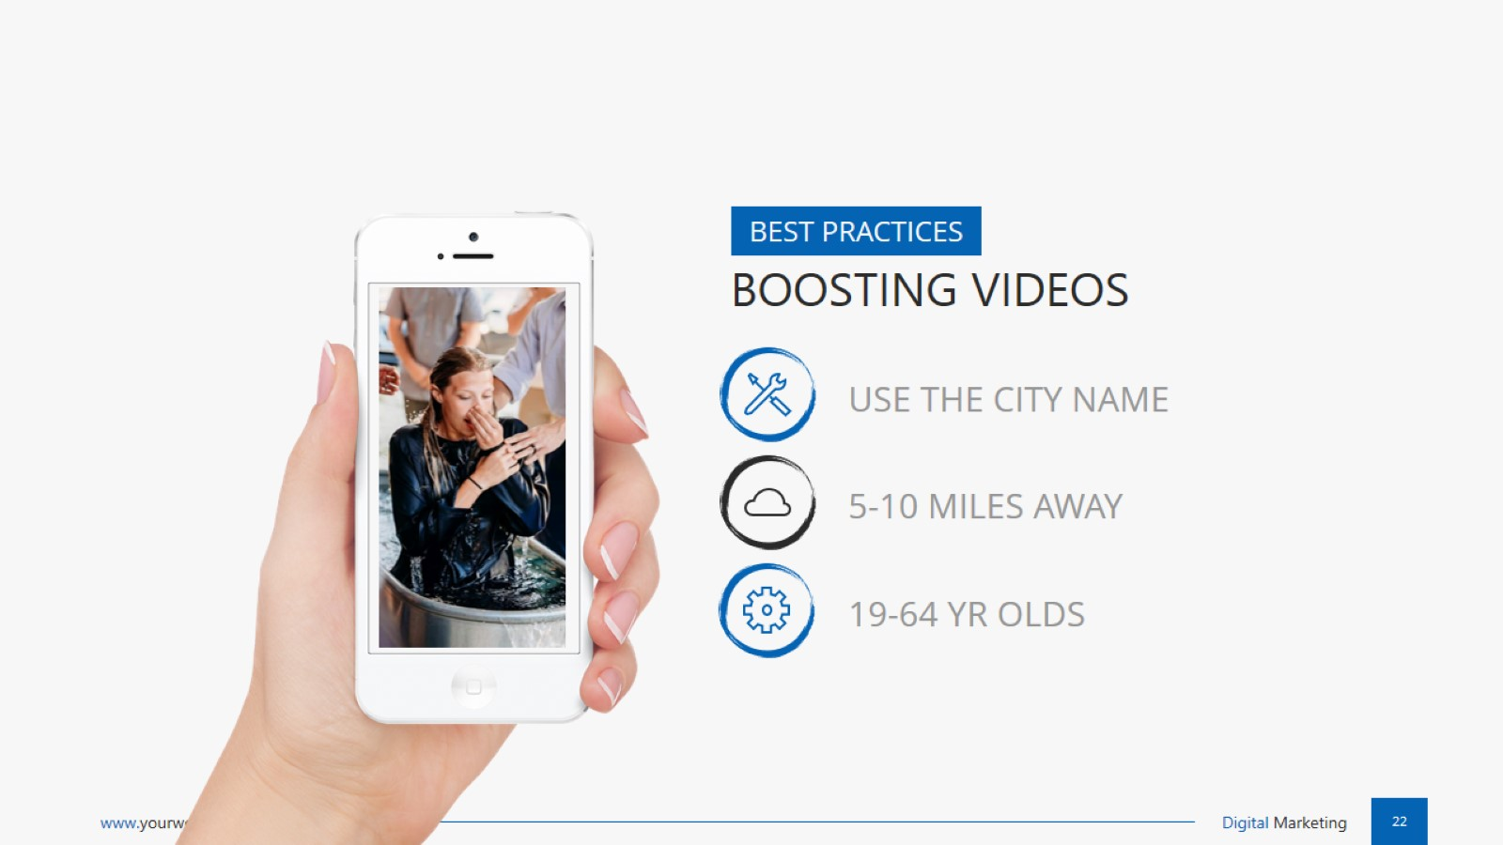
Notes:
Boosting
Use the city name in the post.
Display 5 to 10 miles. 19-64 years old
On google – pair the keywords they search (ie: “Church in Little Rock”)

Slide 23
Notes:
Special events
Plan on a promotion spend that equals or exceeds the event cost.
We’ve done events for $5K and we’ve been part of events that were $50K.

Slide 24
EXAMPLE SPECIAL EVENT MARKETING
Notes:
Sample event marketing plan. (ie: 47 , 238 gue – 68 bapt, etc)
Example Spend
10,000 Door Hangers
$1,500 in Facebook boosts
$1,500 in mailers

Slide 25
EXAMPLE ANNUAL MARKETING PLAN
Notes:
Sample annual plan
Order 30,000 “Come THIS SUNDAY” flyers
Knock every door within 1 mile, and every apartment in the city.
Distribute at major events, fairs, rodeos, flea markets, apartments, parking lots on Saturdays.
Pick major events: Easter, Pentecost, All Nations Sunday, Crusade/Revival X (Back to school Sunday, giveaway Sunday, Tent revival)

Slide 26
Notes:
MARKETING IS WORTH IT – AT ALL SIZES EVEN A SIMPLE FLYER CAN CHANGE A LIFE FOREVER
In both of these small churches, lives were impacted.
In Poteau OK one of those baptized was simply from a flyer left on his windshield.
In Texas, a woman was one of countless guest and 30 baptized. She held up her flyer at the end of service, tearfullly saying “Thank you for this”

Slide 27
Notes:
WE NEED TO REACH THEM ALL – NO MATTER THE MEANS OR MEDIUM

Slide 28
Notes:
Dr. Braden Andersen | Outreach Evangelist | 253.217.0609
FB.com/OutreachAndGrowth ǀ Instagram.com/upci_evangelist ǀ JesusTentRevival.com ǀ OutreachandGrowth.com

