Slide 1
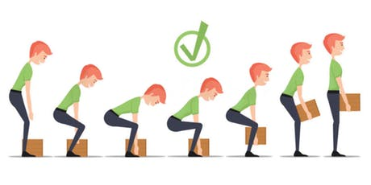
Manual Handling
THE BASICS

Slide 2
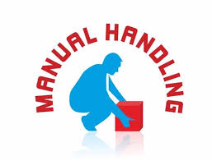
What can be done to help prevent manual handling injuries?
Risk assess… does the load need to be moved at all?
If so, can it be moved another way?
If manual lifting is the only option then there are a number of things that can be done to reduce the risk, including;
making the load smaller or lighter and easier to lift,
breaking up large consignments into more manageable loads,
modifying the workstation to reduce carrying distances, twisting movements, or the lifting of things from floor level or from above shoulder height,
improving the environment – e g better lighting, flooring or air temperature can sometimes make manual handling easier and safer,
ensuring the person doing the lifting has been trained to lift as safely as possible.

Slide 4
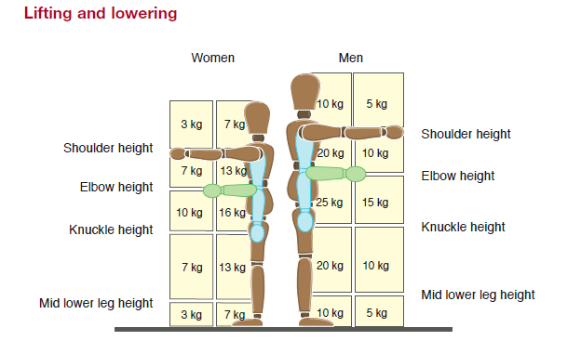
Women/men chose the weight based on your size and build!

Slide 5
How secure is the load you are carrying?
Is it slippery? Hard to hold?
Are their handles?
Is the load secure underneath?
Can you see over what you are carrying?
Is the load even?
Is the load solid or liquid?
Will the load change weight by the end of the day? i.e. heavier when wet or muddy.
Would it be better to carry the load with two people? Or on its side?

Slide 6
Other things to consider:
Will the texture of the object hurt your hands? i.e. cause splinters?
Does it have sharp parts to it or is it hot?
Does the object require you to hold it way from you?
Repetitive handling?
Does it involve strenuous pushing or pulling?
Does it require twisting or reaching?

Slide 7
Brain storming… What can we do better?
What do we regularly lift?
What can we do to minimize injury?
How can we make our lives easier?
How can we adapt what we do and create safer ways of working?

Slide 8
