Slide 1

AsiaBaseMetals Inc.
CEO & Chairman’s Investor Update
TSX.V: ABZ A Futura Capital Group company Effective Date : October 1, 2026
Forward-looking statements — see disclaimer. Not an offer or solicitation. Public disclosure filed on SEDAR+.
Notes:
ITEMS TO CONFIRM before distribution:
1. Gnome distance to Cardiac Creek: source says '5 km SW' and '15 km SE' — confirm distance + direction.
2. Insider ownership: stated ~75% — confirm exact figure and basis (issued vs fully diluted).
3. Sandfire market cap: $225M (main body) vs $300M (one letter).
4. Valhalla market cap: $220M vs $100M across versions.
5. Incorporation/reporting dates inconsistent: Sep 1 2020 / Sep 30 2009 / Sep 2 2020.
6. Prior financing reference price ($0.65 vs $0.50) — confirm.
7. COMPLIANCE: remove or have counsel review the predicted financing price 'meaningfully above current trading level.'

Slide 2
THE OPPORTUNITY
A patient junior, positioned for the upturn
AsiaBaseMetals is a Canadian explorer focused on polymetallic VMS systems — copper, zinc, silver, gold — across the Americas (Canada, USA, Mexico, Argentina, Chile).
Through a decade-long downturn the Company minimized spending and dilution, waiting for the cycle to turn.
The senior upturn began in 2025; the junior-exploration upturn has now arrived in 2026 and is gaining momentum.
Dec 2025
Jervis Project acquired
Q1 2027
Drilling planned at Jervis
100%
Ownership of both projects
AsiaBaseMetals Inc. • TSX.V: ABZ
2

Slide 3
WHY COPPER, WHY NOW
Rising Demand Meets Constrained Supply
Demand Drivers
Supply Constraints
Population & Middle-Class Growth Led by India and China
Electrification and AI-driven Power Demand
Replacement of Aging Infrastructure in Developed Economies
Tariff and Trade Pressures on the Movement of Metal
A Long-running Shortage of New Discoveries
Multi-Year Lead-Times to Bring Mines Online
Tightening Environmental and Permitting Requirements
Industry Leaders (Friedland, McEwen, Henry/BHP) point to a structural shortfall
AsiaBaseMetals Inc. • TSX.V: ABZ
3

Slide 4
FLAGSHIP ASSET
The Jervis Project
VMS-style — Cu, Zn, Ag, Au — 100% owned, British Columbia.
Located within the VMS-prospective Gambier Group trend that also hosts the historic Britannia mine and Kenorland Minerals’ Rox project (TSX.V: KLD).
A coherent 2 km mineralized anomaly was outlined by a 1993 soil-sampling program.
Prior work targeted surface showings without a modern VMS model. The team will advance Jervis with modern VMS-targeted technology — drilling planned for Q1, 2027
2 km
mineralized anomaly identified
Rox Project context
Held by Kenorland Minerals; notable shareholders include Sumitomo Metal Mining and John Tognetti (Chairman Emeritus, Haywood Securities).
AsiaBaseMetals Inc. • TSX.V: ABZ
4

Slide 5
JERVIS PROJECT
Sampling highs vs. Britannia production
Britannia mine
Once one of the world’s largest copper mines and the largest in the British Commonwealth (In B.C. Canada).
47.8 Mt produced over a ~70-year life (Now a Museum).
Mineralization on nearby properties is not necessarily indicative of mineralization on Jervis.
Jervis Au: no reliable data. Britannia Au: 0.6 g/t.
AsiaBaseMetals Inc. • TSX.V: ABZ
5

Slide 6
SECOND PROJECT
The Gnome Project
Zn / Co — 100% owned, ~1,800 hectares, British Columbia.
Located in the Kechika Trough of the Selwyn Basin, a district hosting several significant deposits.
~35 km southeast of the Cirque deposit (Teck / Korea Zinc JV, 50% each), and near ZincX Resources’ Cardiac Creek deposit.
Advancement will follow the regional permitting timeline for the adjacent Cirque and Cardiac Creek projects.
~1,800 ha
contiguous claims, 100% owned
⚑ Distance to Cardiac Creek conflicts in source (“5 km SW” vs “15 km SE”) — please confirm.
AsiaBaseMetals Inc. • TSX.V: ABZ
6

Slide 7
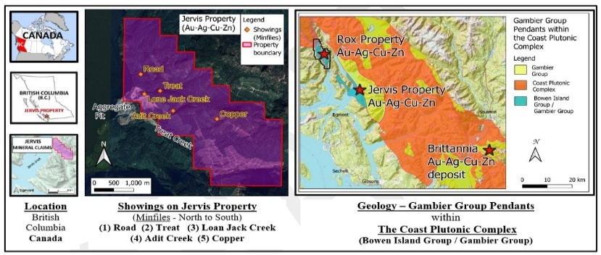
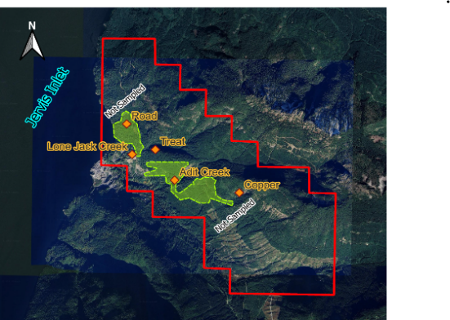
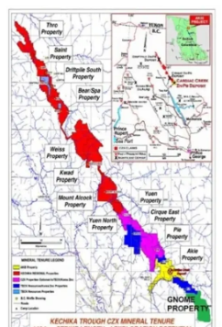
PROJECT LOCATIONS
Jervis and Gnome — British Columbia, Canada
Jervis — geological setting along the Gambier Group VMS trend.
Gnome — claims (green) in the Kechika Trough.
Note: mineralization on adjacent or nearby properties is not necessarily indicative of mineralization on the Company’s projects.
AsiaBaseMetals Inc. • TSX.V: ABZ
7

Slide 8
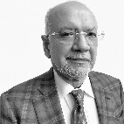
OUR TEAM
Award-winning, invested, proven
Led by Rajinder Chowdhry (CEO & Chairman). Proven across discovery, capital raising, permitting, development, operations, and value creation — and significant shareholders.
Sun
Black Butte
Gahcho Kué
Raj Chowdhry, CEO
Kolwezi
VMS-style
Copper
Diamond Mine
Copper Mine
Alaska, USA
Montana, USA
NWT, Canada
DRC
Valhalla Metals
(Market Cap: $220 Million)
June 11, 2026
Sandfire Resources America
(Market Cap; $190 Million)
June 11, 2026
Mountain Province Diamonds
America Mineral Fields
⚑ Insider ownership stated as ~75% in source — please confirm figure and basis.
AsiaBaseMetals Inc. • TSX.V: ABZ
8

Slide 9
PEER VALIDATION
Two Companies Built by Team Previously
Sandfire Resources America
TSX.V: SFR
Valhalla Metals
TSX.V: VMXX
Market cap ~$225M ⚑ confirm ($225M vs $300M)
Market cap ~$220M ⚑ confirm ($220M vs $100M)
Completed Pre-Feasibility Study (PFS) for Black Butte Copper (Dec 16, 2025)
Received Final Construction Permits; Advancing Toward Build-out
Announced Smucker Project Transaction with Teck American (Apr 21, 2026)
Closed Oversubscribed $15M Financing (Jun 1, 2026)
AsiaBaseMetals Inc. • TSX.V: ABZ
9

Slide 10
THE PLANNED FINANCING
Private placement — unit offering
CAD $2,000,000
Each unit: 1 common share + ½ warrant
Not yet announced — pricing and final terms pending determination by the Company.
Expected to be non-brokered; participation limited to accredited investors (verify rules with your advisor).
⚑ Source predicts pricing “meaningfully above current trading level” — recommend removing / counsel review before publication.
AsiaBaseMetals Inc. • TSX.V: ABZ
10

Slide 11
USE OF PROCEEDS
Where the financing goes
1
Advance Jervis
Exploration programs at the Jervis Project, including drilling commencing Q1 2027.
2
Acquisitions
Review and acquisition of additional projects across the Americas — several at advanced negotiation.
3
Working capital
Working capital and general corporate purposes.
AsiaBaseMetals Inc. • TSX.V: ABZ
11

Slide 12
INVESTMENT HIGHLIGHTS
Why AsiaBaseMetals
High-Grade VMS Exposure
Cycle Leverage
Favourable Geology and Historical Assays Consistent with Polymetallic Sulphides.
Positioned for Strengthening Copper, Zinc, and Base-Metals Demand.
Execution-Focused Team
Disciplined Structure
Proven across discovery, financing, permitting, and development.
Limited Dilution through the Downturn Boosts Lverage to Recovery.
Strong Insider Ownership
Near-Term Catalysts
Management, Board, and Shareholders Aligned.
Jervis Drilling (Q1 2027), Additional Acquisitions, and Financing Execution.
AsiaBaseMetals Inc. • TSX.V: ABZ
12

Slide 13
CAPITAL STRUCTURE
Share capital (as of October 1, 2026)
Item | Amount
Common Shares (Issued & Outstanding) | 50,562,871
Stock Options - Outstanding | 3,125,000
Warrants - Outstanding | 2,712,143
Fully Diluted Shares | 56,400,014
~56.4M
fully diluted shares —
a tight, disciplined structure
Listed on TSX.V (ABZ). Regulatory filings on SEDAR+.
AsiaBaseMetals Inc. • TSX.V: ABZ
13

Slide 14
LOOKING FORWARD
The Cycle has Turned — and We are Ready
Advance Jervis toward drilling in Q4 2026.
Progress Gnome in step with regional permitting.
Diversify through acquisitions across the Americas at today’s favourable prices.
Continue strengthening the team — while minimizing dilution.
Raj Chowdhry
CEO & Chairman of the Board, AsiaBaseMetals Inc.
AsiaBaseMetals Inc. • TSX.V: ABZ
14

Slide 15
IMPORTANT INFORMATION
Cautionary Disclaimer
Forward-looking statements. This presentation contains forward-looking information within the meaning of Canadian securities laws — including statements about acquisitions, financing and use of proceeds, exploration plans, and potential mineralization. Such statements are not guarantees; actual results may differ materially due to risks including regulatory approvals, financing, exploration, commodity prices, and permitting. Readers should not place undue reliance on them.
Technical information. Mr. Helgi Sigurgeirson, a consultant to the Company and a Qualified Person under NI 43-101, has reviewed and approved the scientific and technical information herein. Historical results referenced are non-compliant with NI 43-101 and are not treated as current resources or reserves. Mineralization on adjacent or nearby properties is not necessarily indicative of mineralization on the Company’s projects.
Notice. Neither the TSX Venture Exchange nor its Regulation Services Provider accepts responsibility for the adequacy or accuracy of this material. This is not an offer or solicitation. Full Legal Information & Cautionary Disclaimer is available on the Company’s website.
AsiaBaseMetals Inc. • TSX.V: ABZ
15

