Slide 1



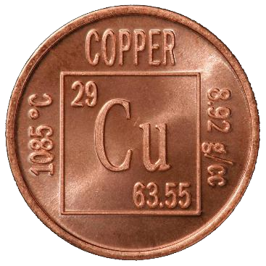

AsiaBaseMetals
Listed and Trading: TSX Venture Exchange
Trading Symbol: TSX.V: ABZ
Corporate: Investor Presentation
Effective: October 1, 2026
CEO Presentation
Website
EXPLORATION TO PRODUCTION
We Find, Acquire and Advance World-Class Critical Mineral Projects
AMERICAS FOCUS: CANADA, U.S.A., MEXICO, ARGENTINA, CHILE, BRAZIL, COLOMBIA AND VENEZUELA
CAPITAL STRUCTURE
As at October 1, 2026
Shares Outstanding
50,562,871
Stock Options
3,125,000
Warrants
2,712,143
Fully Diluted
56,400,014
Market Cap
$4,550,586
Cash
Minimal
Up to CDN$2,000,000 Financing Planned
INVESTOR PRESENTATION · OCTOBER 2026
Copper-Focused Exploration to Production in the Americas
Jervis Project
VMS Cu-Zn-Ag-Au · B.C.
Gnome Project
Zn-Co · Kechika Trough
Award-Winning Team
~75% of issued stock
World Needs More Copper in Next 18 Years Than All Copper Mined in Last 10,000 Years
Contains forward-looking statements; see the Cautionary Disclaimer on the Company’s website. Public disclosure is filed on SEDAR+.
Notes:
Welcome. AsiaBaseMetals is a TSX Venture-listed exploration company advancing two 100%-owned projects in British Columbia: our flagship Jervis copper-zinc-silver-gold VMS project on trend with the historic Britannia Mine, and our Gnome zinc-cobalt project in the Kechika Trough. We are led by an award-winning team that owns about 75% of our issued stock. In the next ten minutes I will cover why copper, why now, our projects, our team, and our planned financing. (about 30 seconds)

Slide 2
Forward-Looking Statements & Technical Disclosure
CAUTIONARY NOTE
Forward-looking statements
This presentation contains forward-looking information within the meaning of Canadian securities laws, including statements about the anticipated financing and use of proceeds, acquisitions, exploration plans and potential mineralization. Actual results may differ materially. Readers should not place undue reliance on forward-looking statements.
Technical information
Mr. Helgi Sigurgeirson, a consultant to the Company, is a Qualified Person under NI 43-101 and has reviewed and approved the scientific and technical information herein. Historical results are non-compliant with NI 43-101 and are not treated as current mineral resources or reserves.
Not a solicitation
This presentation is not an offer or solicitation to buy or sell securities. Mineralization on adjacent or nearby properties is not necessarily indicative of mineralization on the Company’s projects. Full disclaimer: asiabasemetals.com/disclaimer
Notes:
Our standard cautionary language - please read the full disclaimer on our website. (Do not read aloud; about 10 seconds.)

Slide 3
Positioned for the Copper Upturn
WHY ASIABASEMETALS – WHY NOW
1
Flagship on a Proven Trend
2
A 2 km Anomaly to Test
Jervis sits 55 km NW of, and on trend with, the Britannia Mine – once the largest copper producer in the British Commonwealth.
Historic sampling highs of 1.92% Cu, 24.9% Zn and 283 g/t Ag; prior owners never applied a modern VMS model.
3
Team Is Invested
4
Tight Structure, Near-Term Catalyst
Award-winning team with world-class discoveries holds approximately 75% of issued stock.
56.4M shares fully diluted; drilling planned on Jervis Q1–Q2 2027.
~75%
held by Team
56.4M
shares fully diluted
$4.55M
market cap
Up to $2M
financing anticipated
Notes:
Four reasons to look at us now. First, Jervis is on the same Gambier Group trend as Britannia. Second, there is a coherent 2 km anomaly that has never been tested with a modern VMS model. Third, our team owns about three-quarters of the company - our interests are your interests. Fourth, we kept dilution low through the downturn, so our share structure is tight going into a catalyst-rich 2027. (about 60 seconds)

Slide 4
Copper: Demand Is Rising, Supply Isn’t
MARKET OUTLOOK
~10 Mt
projected copper deficit by 2040
~40%
decline in average ore grades since 1991
“We have to mine the same amount of copper in the next 18 years as we have mined in the last 10,000 years.” — Robert Friedland
Sources: IEA / Carbon Credits (demand); S&P Global (2040 gap). Third-party estimates, subject to change.
Notes:
Demand for refined copper grows from about 27 million tonnes in 2024 to 37 million by 2050, driven by electrification, AI data centres and population growth led by India and China. S&P Global projects a gap of roughly 10 million tonnes by 2040. Ore grades have fallen about 40% since 1991, and new mines take many years to permit. That is the structural setup we are positioned for. (about 60 seconds)

Slide 5
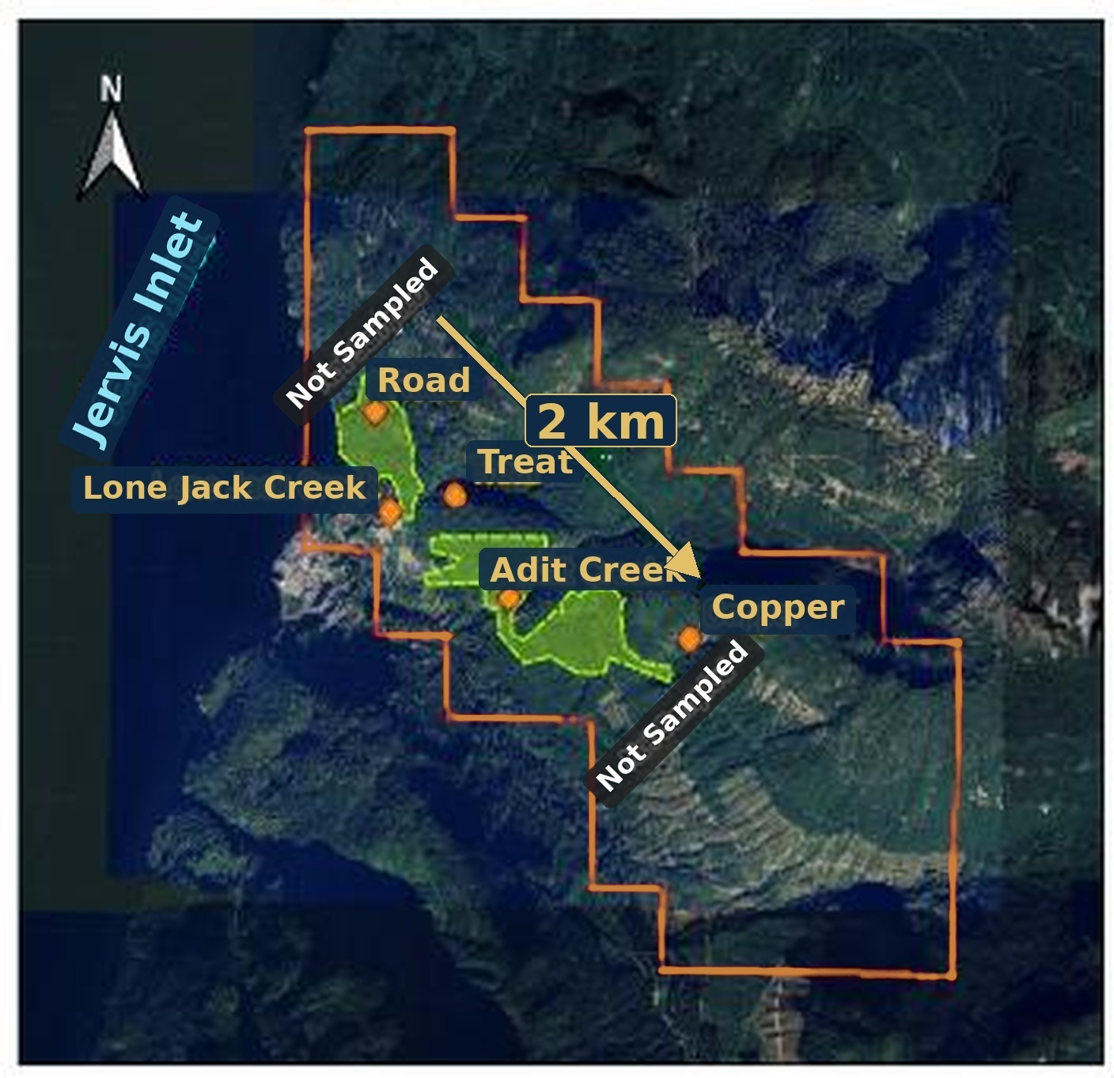
Jervis Project – VMS-Style Cu-Zn-Ag-Au
FLAGSHIP PROJECT · BRITISH COLUMBIA
Ownership
Project Size
Jervis Property
(Au-Ag-Cu-Zn)
100%
owned
~1,000 ha
two mineral claims
Legend
On Trend With Britannia
Anomaly Identified
Property outline
(pending consultation)
55 km
NW of Britannia Mine
2 km
coherent anomaly
Minfiles
Soil anomalies
(Zn-Cu-Ag overlap)
Within the VMS-prospective Gambier Group rocks – the same trend that hosts Britannia and the Rox project (Kenorland Minerals, TSX.V: KLD)
80 km NW of Vancouver; 11 km north of Egmont on the Sunshine Coast
Mineral Claims Consultation Framework complete for the whole Project (July 22, 2026)
2 km anomaly trend
* The soil anomaly is open to the northwest and southeast
0
1
2 km
Within the traditional territory of the Shíshálh First Nation
Notes:
Jervis is our flagship: 100% owned, about 1,000 hectares, 55 km northwest of Britannia on the same Gambier Group trend that also hosts Kenorland's Rox project. The 1993 soil program outlined a coherent 2 km anomaly. With the consultation framework complete, the project is ready for work. (about 50 seconds)

Slide 6
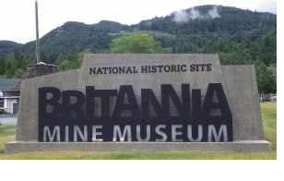
Jervis Sampling vs. Britannia Production Grades
ANOTHER BRITANNIA?
Metal | Jervis – Sampling Highs | Britannia – Production Grade
Copper (Cu) | 1.92% | 1.1%
Zinc (Zn) | 24.9% | 0.65%
Silver (Ag) | 283 g/t (9.98 oz/t) | 6.8 g/t
Gold (Au) | Reliable data not available | 0.6 g/t
Historic Jervis results are non-compliant with NI 43-101. Mineralization on nearby properties, including Britannia, is not necessarily indicative of mineralization on the Jervis Project.
47.8 million tonnes
produced over a ~70-year mine life – once the largest copper mine in the British Commonwealth (now a museum)
Click-image videos on our website: asiabasemetals.com/britannia-mine-video
Notes:
Here is why the Britannia comparison matters. Historic sampling at Jervis returned highs of 1.92% copper, 24.9% zinc and 283 grams silver. Britannia produced 47.8 million tonnes over about 70 years. These are historic samples, not resources - but on trend with a world-class past producer, they justify a modern VMS program. (about 50 seconds)

Slide 7
THE OPPORTUNITY
Prior Work Never Tested the VMS Model – Our Award-Winning Team Will
Prior Owners: 1920s – 1993
AsiaBaseMetals: Planned Program
Open cuts and adits from the 1920s
~1,371 m of drilling, late 1960s – early 1970s
Rock/soil sampling, MAG & VLF surveys (1989, 1993)
Targeted limited surface showings only
Award-winning team applies a modern VMS exploration model
Modern technology designed for VMS-style mineralization
Phased work – surveys then drilling
Test an exceptional VMS-style opportunity
Failed to target and test a VMS-system
Drilling planned Q1 – Q2 2027
Earlier programs did not prioritize the stratigraphic analysis essential for effective VMS targeting.
Notes:
Past work at Jervis chased surface showings and never applied a VMS model or the stratigraphic analysis VMS targeting requires. Our team will apply modern VMS exploration technology in phases - surveys first, then drilling planned for the first half of 2027. (about 45 seconds)

Slide 8
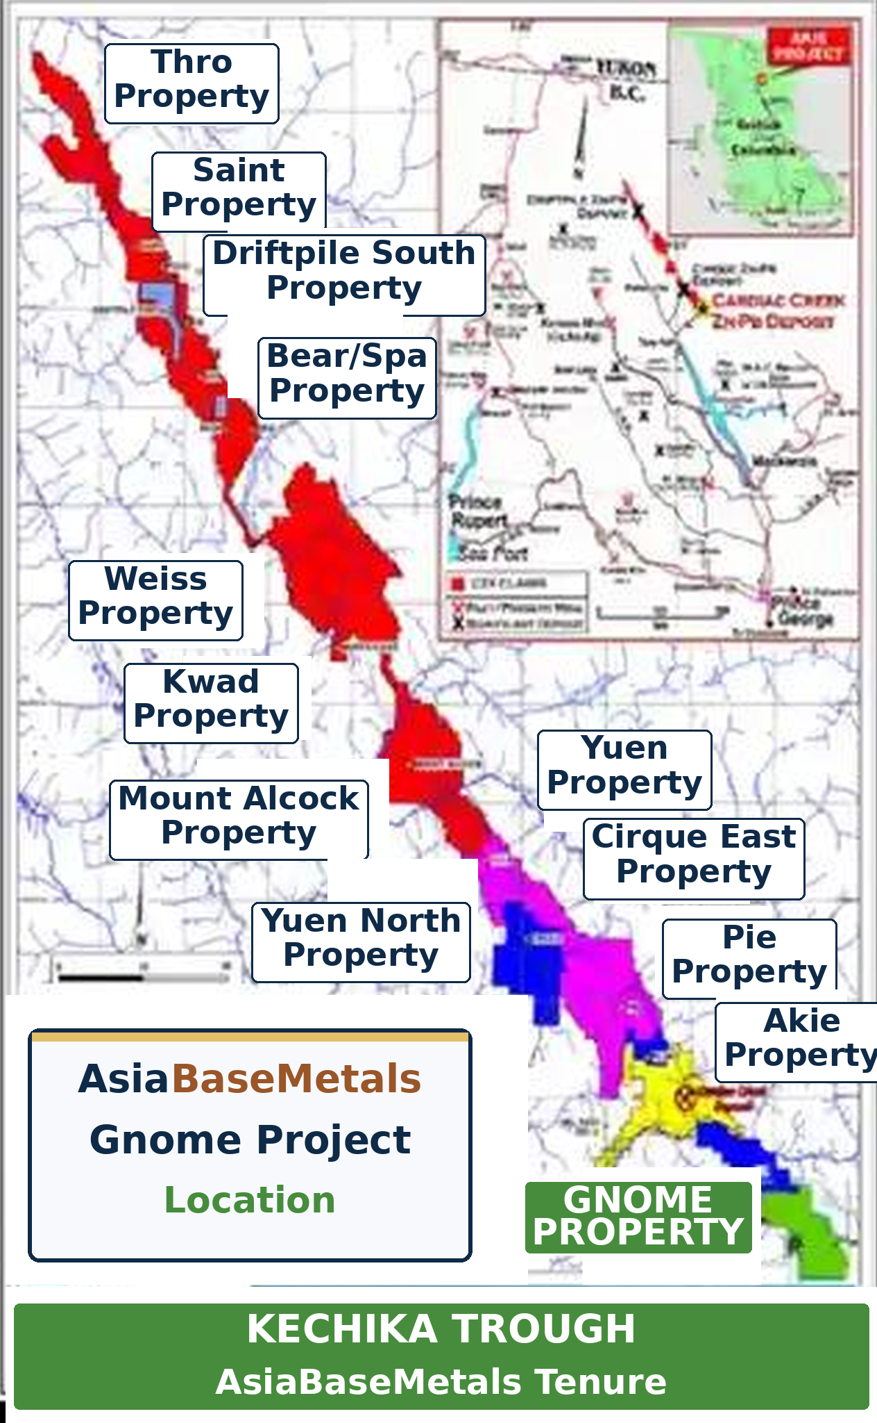
Gnome Project – Early-Stage Entry in a Great Neighbourhood
ZINC-COBALT · KECHIKA TROUGH, B.C.
Mineral Tenure Legend
100% owned, held since 2008, in the Kechika Trough of the Selwyn Basin
~35 km SE of Cirque (Teck / Korea Zinc JV) and near ZincX’s Cardiac Creek deposit
2018 – 2019 programs delivered the first documented cobalt discovery in the region
Six of seven target areas remain untested by drilling
Gnome Property
AsiaBaseMetals
Akie Property
Cardiac Creek – ZincX
ZNX Properties
ZNX optioned to
Teck / Korea Zinc
Teck / Korea Zinc
< $1M
spent on Gnome
$80M+
Cirque (Teck / KZ JV)
$100M+
Cardiac Creek (ZincX)
Teck
Pie Option JV
Driftpile Prospectors
Exploration spending to date (estimates, current-day rates). The Company plans to advance Gnome prudently, guided by permitting on Cirque and Cardiac Creek. Nearby mineralization is not necessarily indicative of mineralization on Gnome.
Kechika Trough, Selwyn Basin, northern British Columbia
Notes:
Gnome gives us zinc and cobalt exposure in a district with two advanced deposits - Cirque and Cardiac Creek - where well over $180 million has been spent. We have spent under $1 million. We will advance Gnome patiently, in step with permitting on the neighbouring projects. (about 40 seconds)

Slide 9


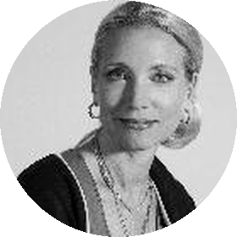
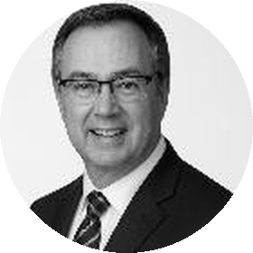
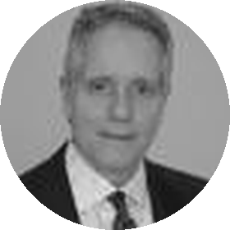






A Track Record of World-Class Discoveries
AWARD-WINNING TEAM
BOARD OF DIRECTORS & MANAGEMENT
ADVISORY BOARD
Rajinder
Chowdhry
CEO & Chairman
Henry
Park
Director
Terrylene
Penstock
Director & CFO
Bruce
Bragagnolo
Director
Andrew
Bowering
Advisory Board
Joe
Piekenbrock
Advisory Board
Bob
Jacko
Advisory Board
Sorin
Posescu
Advisory Board
Yuvraj S.
Solanki
Advisory Board
Akbar
Hassanally
Advisory Board
Paul
Gibbons
Advisory Board
Discovery | Type | Location | Company | Market Cap High
Smucker & Sun | VMS-style | Alaska, U.S.A. | Valhalla Metals Inc. | $181 million (2026)
Black Butte | Copper | Montana, U.S.A. | Sandfire Resources America Inc. | $320 million (2021)
Gahcho Kué | Diamonds | NWT, Canada | Mountain Province Diamonds Inc. | $550 million (2011)
Kolwezi | Copper | Congo, DRC | America Mineral Fields Inc. | $500 million (1997)
TEAM MEMBER AWARD WINNER
2009 Thayer Lindsley Award
2015 Colin Spence Award
Joe Piekenbrock – for Donlin Gold and the high-grade Bornite copper deposit
Click on a photograph to view the full profile on the Company website.
Notes:
Our team has done this before - discovery, permitting, building and operating mines. Prior ventures include Smucker and Sun, Black Butte, Gahcho Kue and Kolwezi. Our advisor Joe Piekenbrock received the Thayer Lindsley and Colin Spence awards for international discovery. And the team holds about 75% of the stock. (about 50 seconds)

Slide 10
A Tight Share Structure, Aligned with Shareholders
CAPITAL STRUCTURE · AS AT OCTOBER 1, 2026
Shareholders – % Ownership
Shares outstanding | 50,562,871
Stock options (avg. $0.20) | 3,125,000
Warrants (avg. $0.14) | 2,712,143
Fully diluted | 56,400,014
Market cap | $4,550,586
5%
75%
Team
6%
14%
14%
Long-term Shareholders
75%
owned by
Team
6%
Float
75%
5%
Institutions
Listed on TSX.V (ABZ) since November 3, 2009 · Filings on SEDAR+
Notes:
Through the downturn we minimized expenditure and dilution. We have about 50.6 million shares outstanding and 56.4 million fully diluted, with a market cap of about $4.5 million. The team owns 75%, long-term shareholders 14%. (about 35 seconds)

Slide 11
ANTICIPATED FINANCING · NOT A SOLICITATION
Anticipated - Planned - Staged - Private Placement - Up to CAD $2 Million
OFFERING
SIZE
UNIT
INVESTORS
Private placement – likely non-brokered
Up to CDN $2,000,000, in stages
One common share + ½ warrant
Accredited investors
Price, number of units, warrant terms and agents’ option to be set at announcement via news release.
USE OF PROCEEDS
Jervis Exploration
VMS-focused program, including drilling
New Acquisitions
Advanced projects in the Americas under review
Working Capital
Corporate and general purposes
Q4 2026 – Q1 2027
Staged financing
Post-financing
Phased surveys – target VMS-system
Q1 – Q2 2027
Drilling planned on Jervis
Notes:
We anticipate a staged private placement of up to two million dollars, likely non-brokered, for accredited investors, with final terms to be announced by news release. Proceeds go to the Jervis program including drilling, to advanced acquisitions under review, and to working capital. This is not a solicitation - please see our disclaimer. (about 50 seconds)

Slide 12



AsiaBaseMetals
JOIN US & PARTICIPATE
Power of Discovery for Projects of Tomorrow
Listed and Trading: TSX Venture Exchange
Trading Symbol: TSX.V: ABZ
Corporate: Investor Presentation
Effective: October 1, 2026
The World Needs More Copper – and AsiaBaseMetals is Positioned for the Opportunity
SCAN OR CLICK TO LEARN MORE
CONTACT
Raj Chowdhry
CEO & Chairman
Tel: +1 (604) 765-2030
contact@asiabasemetals.com
www.asiabasemetals.com
c/o DuMoulin Black LLP, 1111 West Hastings St., 15th Floor, Vancouver, B.C. V6E 2J3
Planned Financing
Jervis Project
CEO & Chairman Message
Website
World Needs More Copper in Next 18 Years Than All Copper Mined in Last 10,000 Years
Not an offer or solicitation. Contains forward-looking statements; see the Cautionary Disclaimer. Public disclosure is filed on SEDAR+.
ABZ · 12 / 12
Notes:
Thank you. Scan the codes for the planned financing page, the Jervis Project and my latest CEO and Chairman message, or contact me directly. I'm happy to take questions. (about 20 seconds)

