Slide 1



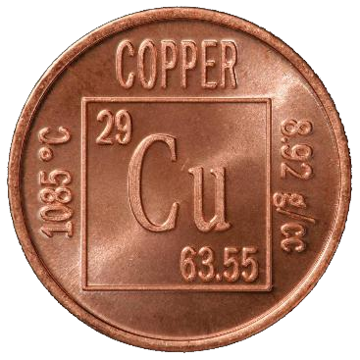

AsiaBaseMetals
Listed and Trading: TSX Venture Exchange
Trading Symbol: TSX.V: ABZ
Corporate: Investor Presentation
Effective: October 1, 2026
CEO Presentation
Website
EXPLORATION TO PRODUCTION
We Find, Acquire and Advance World-Class Critical Mineral Projects
AMERICAS FOCUS: CANADA, U.S.A., MEXICO, ARGENTINA, CHILE, BRAZIL, COLOMBIA AND VENEZUELA
CAPITAL STRUCTURE
As at October 1, 2026
Shares Outstanding
50,562,871
Stock Options
3,125,000
Warrants
2,712,143
Fully Diluted
56,400,014
Market Cap
$4,550,586
Cash
Minimal
Up to CDN$2,000,000 Financing Planned
INVESTOR PRESENTATION · OCTOBER 2026
Copper-Focused Exploration to Production in the Americas
Jervis Project
VMS Cu-Zn-Ag-Au · B.C.
Gnome Project
Zn-Co · Kechika Trough
Award-Winning Team
~75% of issued stock
World Needs More Copper in Next 18 Years Than All Copper Mined in Last 10,000 Years
Contains forward-looking statements; see the Cautionary Disclaimer on the Company’s website. Public disclosure is filed on SEDAR+.
Notes:
Welcome. AsiaBaseMetals is a TSX Venture-listed exploration company advancing two 100%-owned projects in British Columbia: our flagship Jervis copper-zinc-silver-gold VMS project on trend with the historic Britannia Mine, and our Gnome zinc-cobalt project in the Kechika Trough. We are led by an award-winning team that owns about 75% of our issued stock. In the next ten minutes I will cover why copper, why now, our projects, our team, and our planned financing. (about 30 seconds)

Slide 2
Forward-Looking Statements & Technical Disclosure
CAUTIONARY NOTE
Forward-looking statements
This presentation contains forward-looking statements. Actual results may differ materially.
Technical information
Reviewed and approved by Helgi Sigurgeirson, Qualified Person (NI 43-101). Historical results are not current resources or reserves.
Not a solicitation
This presentation is not an offer or solicitation to buy or sell securities.
Full cautionary disclaimer: asiabasemetals.com/disclaimer
Notes:
Full wording (do not read aloud): This presentation contains forward-looking information within the meaning of Canadian securities laws, including statements about the anticipated financing and use of proceeds, acquisitions, exploration plans and potential mineralization. Actual results may differ materially. Mr. Helgi Sigurgeirson, a consultant to the Company, is a Qualified Person under NI 43-101 and has reviewed and approved the scientific and technical information herein. Historical results are non-compliant with NI 43-101 and are not treated as current mineral resources or reserves. This presentation is not an offer or solicitation to buy or sell securities. Mineralization on adjacent or nearby properties is not necessarily indicative of mineralization on the Company's projects. (about 10 seconds)

Slide 3
Positioned for the Copper Upturn
WHY ASIABASEMETALS – WHY NOW
1
Flagship on a Proven Trend
2
A 2 km Anomaly to Test
55 km NW of, and on trend with, the historic Britannia Mine
Sampling highs: 1.92% Cu · 24.9% Zn · 283 g/t Ag
3
Team Is Invested
4
Near-Term Catalyst
Award-winning team owns ~75% of issued stock
Drilling planned on Jervis Q1 – Q2 2027
~75%
held by Team
56.4M
fully diluted
$4.55M
market cap
Up to $2M
financing planned
Notes:
Four reasons to look at us now. First, Jervis is on the same Gambier Group trend as Britannia. Second, there is a coherent 2 km anomaly that has never been tested with a modern VMS model. Third, our team owns about three-quarters of the company - our interests are your interests. Fourth, we kept dilution low through the downturn, so our share structure is tight going into a catalyst-rich 2027. (about 60 seconds)

Slide 4
Copper: Demand Is Rising, Supply Isn’t
MARKET OUTLOOK
~10 Mt
copper deficit by 2040
~40%
lower ore grades since 1991
“More copper in the next 18 years than in the last 10,000 years.” — Robert Friedland
Sources: IEA / Carbon Credits; S&P Global. Third-party estimates.
Notes:
Demand for refined copper grows from about 27 million tonnes in 2024 to 37 million by 2050, driven by electrification, AI data centres and population growth led by India and China. S&P Global projects a gap of roughly 10 million tonnes by 2040. Ore grades have fallen about 40% since 1991, and new mines take many years to permit. That is the structural setup we are positioned for. (about 60 seconds)

Slide 5
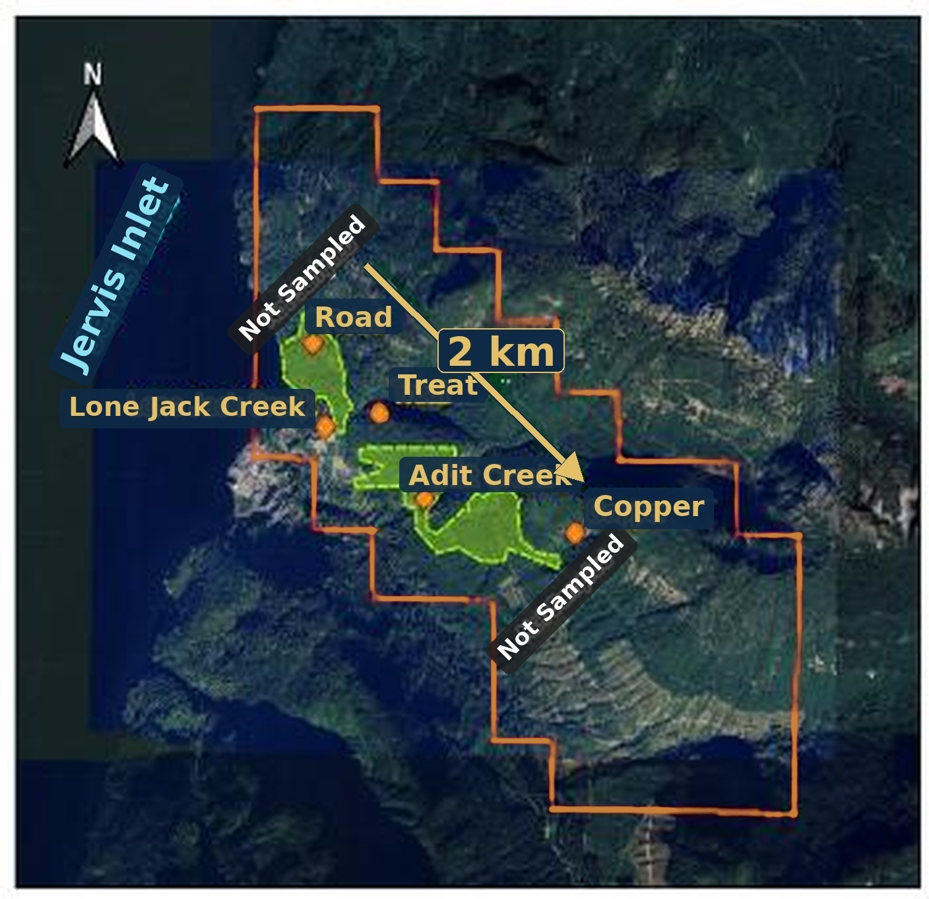
Jervis Project – VMS-Style Cu-Zn-Ag-Au
FLAGSHIP PROJECT · BRITISH COLUMBIA
Ownership
Project Size
100%
owned
~1,000 ha
two claims
On Trend With Britannia
Anomaly Identified
55 km
NW of Britannia
2 km
coherent anomaly
Map Legend
Property outline
Minfiles
Soil anomalies
2 km anomaly trend
Same Gambier Group trend as Britannia · MCCF complete
Notes:
Jervis is our flagship: 100% owned, about 1,000 hectares, 55 km northwest of Britannia on the same Gambier Group trend that also hosts Kenorland's Rox project. The 1993 soil program outlined a coherent 2 km anomaly. With the consultation framework complete, the project is ready for work. (about 50 seconds)

Slide 6
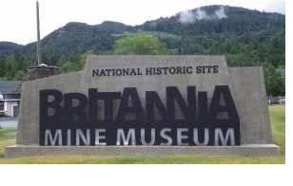
Jervis Sampling vs. Britannia Production Grades
ANOTHER BRITANNIA?
Metal | Jervis – Sampling Highs | Britannia – Production
Copper (Cu) | 1.92% | 1.1%
Zinc (Zn) | 24.9% | 0.65%
Silver (Ag) | 283 g/t | 6.8 g/t
Gold (Au) | No reliable data | 0.6 g/t
47.8 million tonnes
~70-year mine life – once the largest copper mine in the British Commonwealth
Historic results – not NI 43-101 compliant. Nearby mineralization is not indicative of Jervis.
Notes:
Here is why the Britannia comparison matters. Historic sampling at Jervis returned highs of 1.92% copper, 24.9% zinc and 283 grams silver. Britannia produced 47.8 million tonnes over about 70 years. These are historic samples, not resources - but on trend with a world-class past producer, they justify a modern VMS program. (about 50 seconds)

Slide 7
THE OPPORTUNITY
Prior Work Never Tested the VMS Model – Our Award-Winning Team Will
Prior Owners: 1920s – 1993
AsiaBaseMetals: Planned Program
Surface showings only
~1,371 m of shallow drilling
No VMS model applied
Modern VMS exploration model
Surveys first, then drilling
Award-winning team
Never tested as a VMS system
Drilling planned Q1 – Q2 2027
Earlier programs skipped the stratigraphic analysis VMS targeting needs.
Notes:
Past work at Jervis chased surface showings and never applied a VMS model or the stratigraphic analysis VMS targeting requires. Our team will apply modern VMS exploration technology in phases - surveys first, then drilling planned for the first half of 2027. (about 45 seconds)

Slide 8
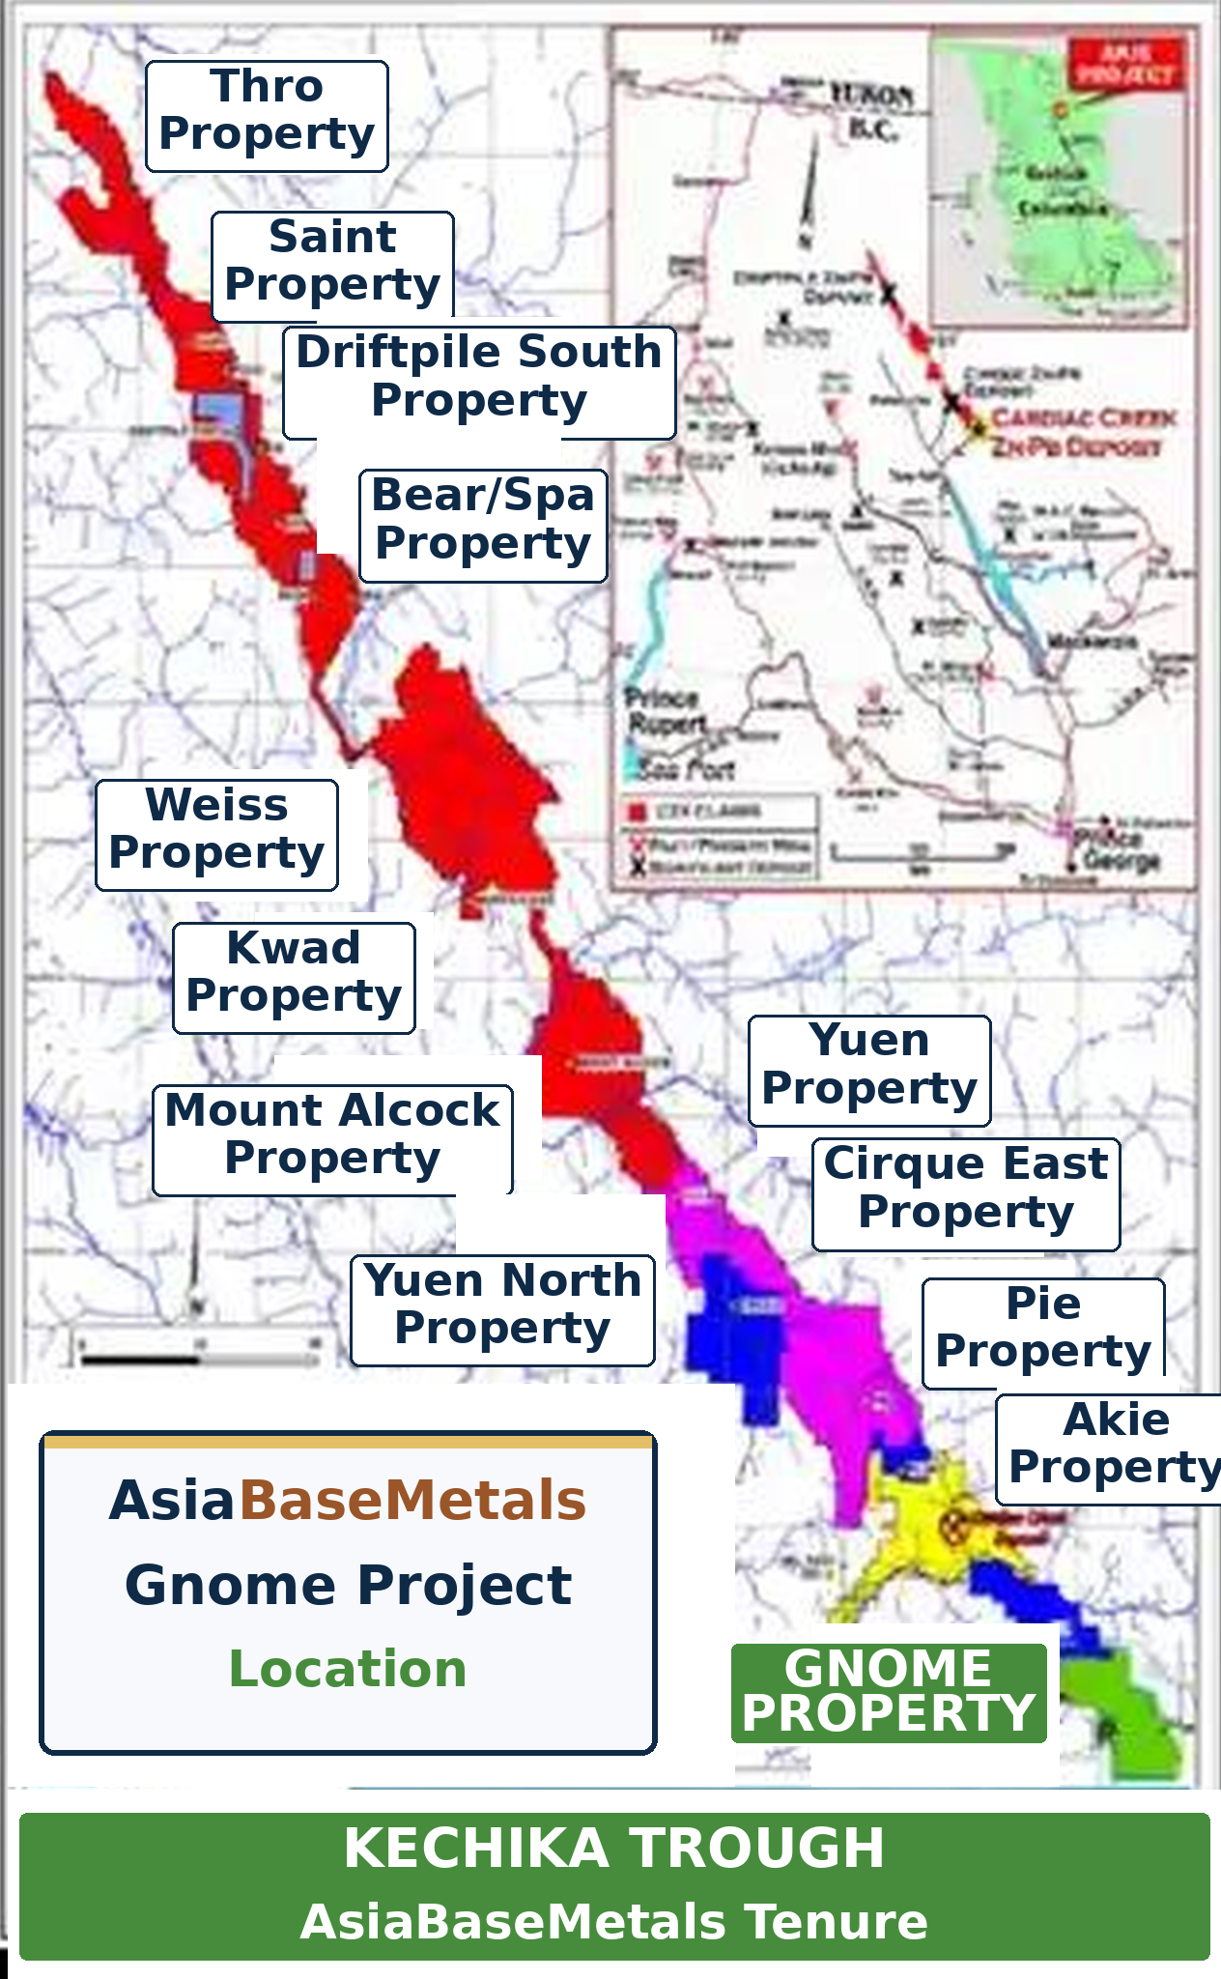
Gnome Project – Early-Stage Entry in a Great Neighbourhood
ZINC-COBALT · KECHIKA TROUGH, B.C.
Map Legend
100% owned since 2008 – zinc & cobalt
Near Cirque (Teck / KZ) and Cardiac Creek (ZincX)
First documented cobalt discovery in the region
Gnome Property
Akie – Cardiac Creek
ZincX properties
Teck / Korea Zinc
< $1M spent on Gnome
Kechika Trough, Selwyn Basin, northern B.C.
$80M+ at Cirque
$100M+ at Cardiac Creek
Notes:
Gnome gives us zinc and cobalt exposure in a district with two advanced deposits - Cirque and Cardiac Creek - where well over $180 million has been spent. We have spent under $1 million. We will advance Gnome patiently, in step with permitting on the neighbouring projects. (about 40 seconds)

Slide 9



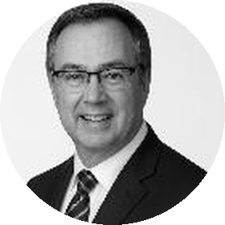







A Track Record of World-Class Discoveries
AWARD-WINNING TEAM
BOARD & MANAGEMENT
ADVISORY BOARD
Rajinder
Chowdhry
CEO & Chair
Henry
Park
Director
Terrylene
Penstock
Dir. & CFO
Bruce
Bragagnolo
Director
Andrew
Bowering
Joe
Piekenbrock
Bob
Jacko
Sorin
Posescu
Yuvraj
Solanki
Akbar
Hassanally
Paul
Gibbons
Discovery | Type | Location | Market Cap High
Smucker & Sun | VMS-style | Alaska, U.S.A. | $181M (2026)
Black Butte | Copper | Montana, U.S.A. | $320M (2021)
Gahcho Kué | Diamonds | NWT, Canada | $550M (2011)
Kolwezi | Copper | Congo, DRC | $500M (1997)
TEAM MEMBER AWARD WINNER
2009 Thayer Lindsley
2015 Colin Spence
Joe Piekenbrock – Donlin Gold & Bornite discoveries
Click a photo to view the full profile online.
Notes:
Our team has done this before - discovery, permitting, building and operating mines. Prior ventures include Smucker and Sun, Black Butte, Gahcho Kue and Kolwezi. Our advisor Joe Piekenbrock received the Thayer Lindsley and Colin Spence awards for international discovery. And the team holds about 75% of the stock. (about 50 seconds)

Slide 10
A Tight Share Structure, Aligned with Shareholders
CAPITAL STRUCTURE · AS AT OCTOBER 1, 2026
Shares outstanding | 50,562,871
Stock options ($0.20) | 3,125,000
Warrants ($0.14) | 2,712,143
Fully diluted | 56,400,014
Market cap | $4,550,586
Shareholders – % Ownership
75%
Team
6%
5%
14%
75%
owned by
Team
14%
Long-term
6%
Float
75%
5%
Institutions
Listed on TSX.V (ABZ) since Nov. 3, 2009
Notes:
Through the downturn we minimized expenditure and dilution. We have about 50.6 million shares outstanding and 56.4 million fully diluted, with a market cap of about $4.5 million. The team owns 75%, long-term shareholders 14%. (about 35 seconds)

Slide 11
ANTICIPATED FINANCING · NOT A SOLICITATION
Anticipated - Planned - Staged - Private Placement - Up to CAD $2 Million
OFFERING
SIZE
UNIT
INVESTORS
Private placement – likely non-brokered
Up to CDN $2,000,000, in stages
One common share + ½ warrant
Accredited investors
Price and final terms to be set at announcement via news release.
USE OF PROCEEDS
Jervis Exploration
VMS program incl. drilling
New Acquisitions
Advanced projects – Americas
Working Capital
General corporate purposes
Q4 2026 – Q1 2027
Staged financing
Post-financing
Surveys – VMS targets
Q1 – Q2 2027
Drilling on Jervis
Notes:
We anticipate a staged private placement of up to two million dollars, likely non-brokered, for accredited investors, with final terms to be announced by news release. Proceeds go to the Jervis program including drilling, to advanced acquisitions under review, and to working capital. This is not a solicitation - please see our disclaimer. (about 50 seconds)

Slide 12



AsiaBaseMetals
JOIN US & PARTICIPATE
Power of Discovery for Projects of Tomorrow
Listed and Trading: TSX Venture Exchange
Trading Symbol: TSX.V: ABZ
Corporate: Investor Presentation
Effective: October 1, 2026
The World Needs More Copper – and AsiaBaseMetals is Positioned for the Opportunity
SCAN OR CLICK TO LEARN MORE
CONTACT
Raj Chowdhry
CEO & Chairman
Tel: +1 (604) 765-2030
contact@asiabasemetals.com
www.asiabasemetals.com
c/o DuMoulin Black LLP, 1111 West Hastings St., 15th Floor, Vancouver, B.C. V6E 2J3
Planned Financing
Jervis Project
CEO Message
Website
World Needs More Copper in Next 18 Years Than All Copper Mined in Last 10,000 Years
Not an offer or solicitation. Contains forward-looking statements; see the Cautionary Disclaimer. Public disclosure is filed on SEDAR+.
ABZ · 12 / 12
Notes:
Thank you. Scan the codes for the planned financing page, the Jervis Project and my latest CEO and Chairman message, or contact me directly. I'm happy to take questions. (about 20 seconds)

