Slide 1

Business Leadership Training: Covey’s Circle of Influence
Enhancing leadership by focusing on areas of control
Notes:
---

Slide 2
Understanding Covey’s Circle of Influence
Notes:
Introduction to Circle of Influence and Control, Video Introduction and Reflection

Slide 3

Introduction to Circle of Influence and Control
Conceptual Framework
  The model differentiates Circle of Concern, Influence, and Control to focus efforts effectively.
Importance of Proactivity
  Proactive behavior expands the Circle of Influence by taking responsibility for actions and attitudes.
Leadership Application
  Leaders empower others by focusing on actionable areas instead of external concerns.
Personal Accountability
  Reflecting on personal experience helps identify areas within each circle to foster accountability.
Notes:
The Circle of Influence and Control is a foundational concept in Stephen Covey’s framework for personal and professional effectiveness. This model distinguishes between three areas: the Circle of Concern, which includes all the things we care about; the Circle of Influence, which encompasses the things we can affect; and the Circle of Control, which includes the things we can directly manage. Understanding these distinctions helps individuals focus their energy and efforts on areas where they can make a meaningful impact. Proactivity is key to expanding one's Circle of Influence. By taking responsibility for one's actions and attitudes, individuals can increase their influence over time. This concept is particularly relevant in leadership training, as it encourages leaders to empower themselves and others by concentrating on actionable areas rather than being overwhelmed by external concerns. Participants are encouraged to reflect on their own experiences and identify which aspects of their lives fall into each circle, fostering a mindset of strategic focus and personal accountability.

Slide 4

Video Introduction and Reflection
Video as Learning Catalyst
  The video illustrates the importance of being proactive, sparking reflection and discussion among participants.
Reflective Discussion
  Participants share thoughts on proactivity and its impact on personal and academic challenges.
Application of Concepts
  Discussion helps bridge theory with practice, encouraging identification of proactive behaviors in real life.
Notes:
To deepen understanding of Covey’s concept, participants watch a short video that illustrates the importance of being proactive. The video serves as a catalyst for reflection and discussion, prompting learners to consider how the principles apply to their own lives. After viewing, participants are asked to share their thoughts and reactions, focusing on what it means to be proactive and how this mindset can influence their personal and academic challenges. This activity helps bridge theoretical concepts with real-world application, making the learning experience more engaging and relatable. The discussion encourages learners to identify specific behaviors and attitudes that demonstrate proactivity, and to consider how these can be cultivated in various contexts. By analyzing the video content and discussing its implications, participants gain a clearer understanding of how to apply Covey’s model in practical scenarios.

Slide 5
Interactive Group Activities
Notes:
Applying the Circle Model in Group Settings, Personal Reflection and Journaling

Slide 6
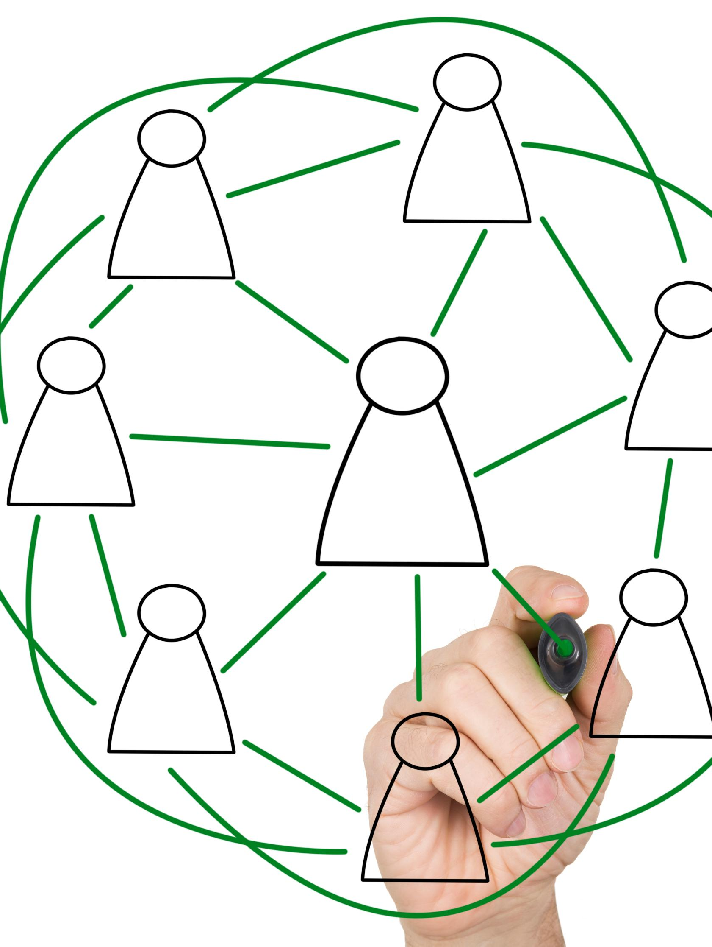
Applying the Circle Model in Group Settings
Visualizing the Circle Model
  Facilitators use visual aids to explain Circles of Concern, Control, and Influence through real-life scenarios.
Collaborative Breakout Sessions
  Participants work in breakout groups to analyze unique issues using the circle framework, promoting teamwork.
Sharing and Applying Insights
  Scribes present group findings to main room, highlighting strategies to influence outcomes and manage concerns.
Notes:
Participants engage in a group activity designed to illustrate how Covey’s Circle of Influence and Control operates in real-life situations. Using tools like Zoom’s screen sharing or whiteboard, facilitators draw the three circles and walk through a scenario involving a student concerned about a group project. The activity categorizes elements into the Circle of Concern (e.g., project deadline), Circle of Control (e.g., personal study habits), and Circle of Influence (e.g., coordinating with group members). This hands-on approach helps learners visualize the model and apply it to their own experiences. Following the demonstration, participants are divided into breakout rooms to brainstorm similar scenarios. Each group is assigned a facilitator and a scribe, and given a unique issue to analyze using the circle framework. After the breakout sessions, scribes present their group’s findings to the main room, highlighting strategies for influencing outcomes and managing concerns. This collaborative exercise fosters critical thinking, teamwork, and practical application of leadership principles.

Slide 7

Personal Reflection and Journaling
Journaling for Reflection
  Participants write journal entries identifying what they can control, let go, and influence, deepening self-awareness.
Applying Circle of Influence
  The exercise helps internalize the Circle of Influence model by applying it to personal and academic challenges.
Promoting Emotional Intelligence
  Reflection and journaling foster emotional intelligence and proactive mindset, essential for effective leadership.
Encouraging Peer Sharing
  Participants share reflections in small groups to create a supportive environment and enable peer feedback.
Notes:
In this segment, participants engage in an individual activity that encourages personal reflection. They are asked to make a journal entry identifying one item they can control, one they can let go, and one they can influence. This exercise helps learners internalize the Circle of Influence model by applying it to their own lives. The reflection serves as a foundation for a future homework assignment, where students will develop actionable steps based on their journal entries. By focusing on specific aspects of their personal or academic challenges, participants learn to prioritize their efforts and adopt a proactive mindset. The journaling activity also promotes self-awareness and emotional intelligence, key components of effective leadership. Participants are encouraged to share their reflections in small groups, fostering a supportive learning environment and enabling peer feedback. This activity bridges the gap between theory and practice, reinforcing the importance of focusing on what one can control and influence.

Slide 8
Developing Actionable Plans
Notes:
Creating and Evaluating Actionable Steps, Using Backwards Chaining for Planning

Slide 9

Creating and Evaluating Actionable Steps
Understanding Actionable Steps
  Actionable steps are specific, achievable tasks that help break down goals into manageable parts for effective progress.
Interactive Learning Activity
  Participants engage in an interactive tool to generate and share creative actionable steps in response to scenarios.
Evaluating and Prioritizing Steps
  Learners focus on assessing step feasibility, setting priorities, and anticipating challenges to improve plans.
Building Confidence and Commitment
  Practicing actionable steps enhances clarity, commitment, and leadership skills in strategic planning and decision-making.
Notes:
Participants are introduced to the concept of actionable steps, which are specific, achievable actions that contribute to reaching a goal. The session begins with a group example to illustrate how to break down a goal into manageable tasks. Learners then participate in a Top Hat activity or similar interactive tool, where they share ideas for actionable steps in response to a given scenario. This activity encourages creativity and practical thinking, helping participants understand what makes a step actionable and how to ensure follow-through. The discussion focuses on identifying realistic steps, setting priorities, and anticipating potential obstacles. Participants learn to evaluate the feasibility of their plans and adjust them as needed. This segment emphasizes the importance of clarity and commitment in goal setting, reinforcing leadership skills such as strategic planning and decision-making. By practicing the creation of actionable steps, learners build confidence in their ability to influence outcomes and achieve personal and professional goals.

Slide 10

Using Backwards Chaining for Planning
Concept of Backwards Chaining
  Backwards chaining maps steps in reverse order from the goal to necessary actions, clarifying the path to success.
Collaborative Breakout Activity
  Participants work in groups selecting facilitators to brainstorm plans using backwards chaining, fostering collaboration.
Enhancing Strategic Thinking
  Using backwards chaining improves strategic thinking, goal setting, and adaptability for long-term success.
Notes:
Backwards chaining is introduced as a method for mapping out actionable steps in reverse order, starting from the desired goal and working backward to identify necessary actions. This technique helps learners visualize the path to success and ensures that each step is aligned with the end objective. The session includes a video or instructional materials to demonstrate the concept, which may be assigned as homework due to time constraints. Participants then engage in breakout room activities where they choose from multiple examples and brainstorm a plan using backwards chaining. Each group selects a facilitator and a scribe to guide the discussion and document the plan. The activity promotes strategic thinking and collaboration, as learners identify key milestones and dependencies in their plans. By practicing backwards chaining, participants develop a structured approach to goal setting and problem solving, enhancing their leadership capabilities. The exercise also reinforces the importance of planning and adaptability in achieving long-term success.

Slide 11
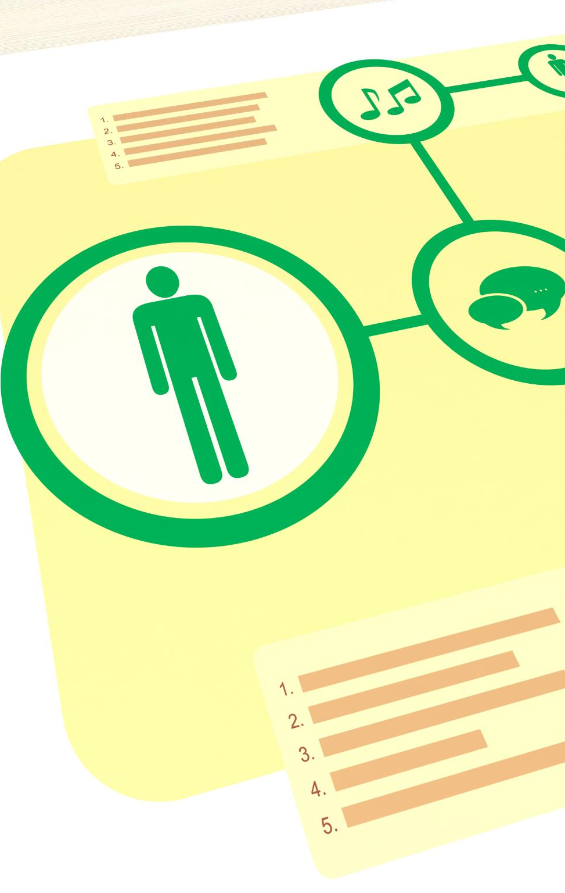
Homework: Mapping Personal Actionable Steps
Personal Reflection and Focus
  Participants identify one thing to let go, one to influence, and one to control for focused personal growth.
Actionable Step Mapping
  Learners map specific actions with timelines and anticipate challenges using structured backwards planning.
Accountability and Leadership
  The exercise fosters accountability, self-management, and prepares learners for effective leadership.
Ongoing Feedback and Improvement
  Homework supports future discussions, feedback, and continuous refinement of personal strategies.
Notes:
As a culminating activity, participants are assigned homework to create a map of actionable steps based on their personal reflection. They focus on three items: one to let go, one to influence, and one to control. This task reinforces the application of Covey’s Circle of Influence model and encourages learners to take ownership of their personal development. The mapping exercise involves identifying specific actions, setting timelines, and anticipating challenges. Participants are encouraged to use backwards chaining to structure their plans, ensuring that each step contributes to the overall goal. This activity promotes accountability and self-management, key traits of effective leaders. By translating abstract concepts into concrete plans, learners deepen their understanding and prepare to implement changes in their lives. The homework also serves as a basis for future discussions and feedback, allowing participants to refine their strategies and celebrate progress. This final step solidifies the training’s impact and empowers learners to lead with intention and clarity.

Slide 12
Applying Learning to Personal Goals
Notes:
Homework: Mapping Personal Actionable Steps

