Slide 1
Ultrasonic Thickness Gauging and Ultrasonic Flaw Detectors
By: Dillon Tynes
Evident NDT Sales Representative
North, East, and West Texas

Slide 2
Biography
My name is Dillon Tynes with Evident Scientific (formerly Olympus). I have been working in the NDT industry for just shy of 10 years and I am currently the NDT Sales representative covering the East, West and North Texas areas. I have been with the company for 3 months now.
I have been an ASNT Level 3 in ultrasonics and magnetic particle testing for 3 years and an AWS CWI for 2 ½ years. I also have my AAS in robotics and automation from TCC.
Previously I worked for Sabre Industries out of Kennedale, Texas. I worked there for 9 ½ years, 6 years as a technician/inspector. In 2020 I obtained my ASNT level 3 certifications and became their corporate level 3. I was responsible for managing all aspects of the NDT program to include testing, training, qualification and certification. I also assisted with vendor/supplier audits, welding certification and testing, R&D, and more.

Slide 3
Ultrasonic Thickness Gauges
27 MG
45 MG
38 DL
Magna Mike 8600
35 RDC
72 DL Plus

Slide 4
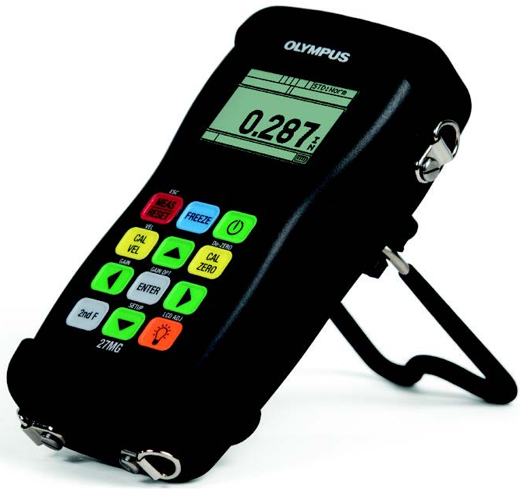
27 MG
The Olympus 27MG is an affordable ultrasonic thickness gauge designed to make accurate, measurements from one side on internally corroded or eroded metal pipes, tanks, and other equipment.
Weighs only 12oz (340g)
The durable, rugged 27MG is battery-operated and features a large, backlit LCD with easy-to-read numerals, and an intuitive color-coded keypad with direct access to many key features.
Standard features include:
Auto probe recognition
Auto Zero compensation to enhance the accuracy of measurements on hot surfaces
Gain Adjust to improve measurements on sound-attenuating materials such as cast metals
Differential mode
Hi-Low Alarm settings
Min./Max. mode that captures the minimum or maximum thickness at 20 measurements per second.
The 27MG is designed for inspectors and maintenance engineers that need to monitor the wall thickness in metal pipes, tanks, beams, and structural supports that are susceptible to corrosion on the inside surface. An ultrasonic thickness gauge provides a quick, cost-effective solution by transmitting sound into the material from the outside, making it unnecessary to damage the part.

Slide 5
45 MG
The 45MG is an advanced ultrasonic thickness gauge packed with standard measurement features and software options. This unique instrument is compatible with the complete range of Olympus dual element and single element thickness gauge transducers, making this innovative instrument an all-in-one solution for virtually every thickness gauge application.
Easy to use and requires minimal operator training to tackle most common thickness gauging applications.
With additional optional software options and transducers however, the 45MG can become significantly more advanced and take on applications well beyond that of a typical entry-level gauge
Compatible with full line of Olympus dual element transducers for thickness measurements on internally corroded metals
Min./Max. mode
Two Alarm modes
Differential mode
Time-based B-scan
Reduction Rate
Gain Adjust (standard, high, and low)
Password instrument lock
The 45MG offers five code-activated software options that makes it one of the most versatile thickness gauges in the industry.
Echo-to-Echo and thru Coat
Single element
Single Element-High Penetration
Data Logger
Live A-Scan with Waveform Adjust

Slide 6
45 MG
Built for Tough Environments
Rugged, designed for IP67
Explosive Atmosphere: Safe operation as defined by Class I, Division 2, Group D, as found in the National Fire Protection Association Code (NFPA 70), Article 500, and tested using MIL-STD-810G, Method 511.4, Procedure I.
Shock tested using MIL-STD-810G, Method 516.5, Procedure I, 6 cycles each axis, 15 g, 11 msec Half sine.
Vibration tested using MIL-STD-810G, Method 514.5, Procedure I, Annex C, Fig. 6, general exposure: 1 hour each axis.
Wide operating temperature range
Optional protective rubber boot with gauge stand
Designed for Easy Operation
Simple keypad for right hand/left hand operation
Easy operator interface with direct access to most functions
Internal and removable microSD memory card storage
USB communication port
Optional alphanumeric data logger with 475,000 thickness readings or 20,000 waveforms
Default/Custom single element transducer setups (optional)
Password protected instrument lock
Color transflective QVGA display with indoor and outdoor color settings for superior clarity

Slide 7
38 DL PLUS
Key Features:
Dual and single element transducer compatibility
Wide thickness range: 0.08 mm (0.003 in.) to 635 mm (25 in.) depending on material and transducer selection
Corrosion thickness gaging with dual element transducers
THRU-COAT® and Echo-to-Echo measurements on painted and coated surfaces
Internal Oxide/Scale software option
Standard resolution of 0.01 mm or 0.001 in. for all transducers
The 38DL is our most advanced thickness gauge that is ideally suited for almost every ultrasonic thickness application.
The versatile 38DL PLUS can be used in applications ranging from wall thinning measurements of internally corroded pipes with dual element probes to very precise thickness measurements of thin or multilayer materials with single element transducers.
sealed case is designed to meet IP67 requirements to withstand the rigors of very wet or dusty environments.
Simple, ergonomic keypad that can be operated with the left or right hand for easy access to all functions.

Slide 8
38 DL PLUS
Additional features and software options
High Resolution software option of 0.001 mm or 0.0001 in. with single element transducers 2.25 MHz to 30 MHz
Multilayer software option for measurements of up to four layers simultaneously
High Penetration software option for attenuating materials such as fiberglass, rubber and thick casting
Thickness, Velocity, and time-of-flight measurements
Differential mode and Reduction Rate mode
Time-based B-scan mode; 10,000 reviewable readings per scan
Olympus High Dynamic Gain technology with digital filters
V-Path Builder for custom V-path compensation

Slide 9
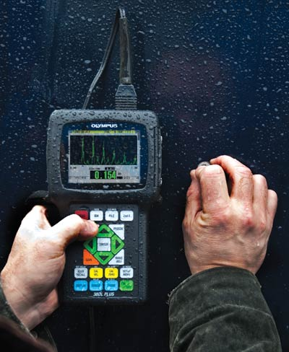
38 DL PLUS
What make this thickness gauge different from others?
Designed to meet the challenges of demanding applications and built to withstand tough conditions in the field and on the production floor.
Compact, weighs only 0.814 kg (1.80 lb)
Rugged, designed for IP67
Explosive Atmosphere: Safe operation as defined by Class I, Division 2, Group D, as found in the National Fire Protection Association Code (NFPA 70), Article 500, and tested using MIL-STD-810F, Method 511.4, Procedure I.
Shock tested using MIL-STD-810F, Method 516.5, Procedure I, 6 cycles each axis, 15 g, 11 msec Half sine.
Vibration tested using MIL-STD-810F, Method 514.5, Procedure I, Annex C, Figure 6, general exposure: 1 hour each axis.
Wide operating temperature range
Protective rubber boot with gauge stand
Color transflective VGA display with indoor and outdoor color settings for superior clarity
Additional software capabilites
Data Logger and PC interface
GageView interface program

Slide 10
Magna Mike 8600
The Magna-Mike® 8600 is a portable thickness gauge that uses a simple magnetic method to make reliable and repeatable measurements on nonferrous materials.
Measurements are made when its magnetic probe is held or scanned on one side of the test material and a small target ball (or disk or wire) is placed on the opposite side or dropped inside a container
The probe's Hall Effect sensor measures the distance between the probe tip and target ball. The measurements are instantly displayed on the large color thickness display as an easy-to-read digital thickness reading.
New Features include:
Three new durable probe designs: Straight, Right Angle, and Low-profile Articulating
Replaceable wear caps: Standard, Chisel Tip, and Extended Wear ( for 86PR-1 and PR-2 only)
Expanded target selection: 3/16” and ½”magnetic target balls and .045” in/.026” in diameter wire target
Expanded thickness range up to 1” (25.4mm)
RS-232, USB and VGA outputs
Fast measurement update rate of 60Hz
Expanded alphanumeric data logger.
Save and recall stored calibration files
Ability to export file to MicroSD card in .txt and CSV formats
Measures from .0001 in. to 1 in. (.001 mm- 25.4mm)

Slide 11
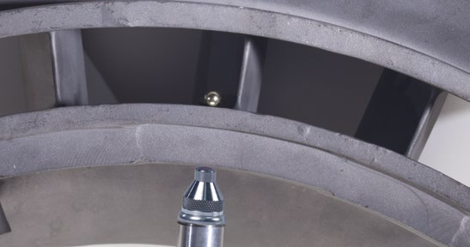
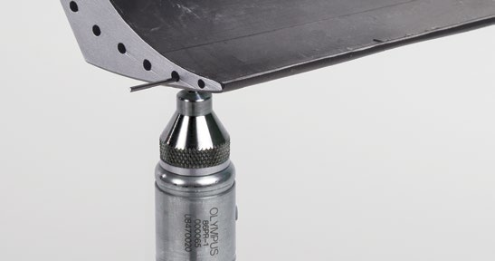
Magna Mike 8600
Applications-
Plastic and glass bottles and packaging
Automotive tear seams( target disks available for measurements in a thin channel or groove)
Aerospace applications- Castings thickness, composites and nonferrous material measurements, inserted into cooling holes in turbine blades.

Slide 12
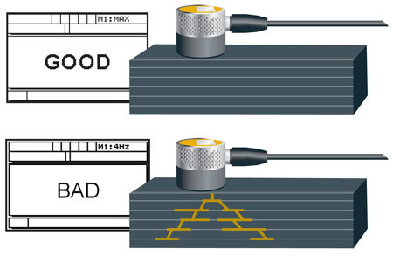
35 RDC
Ultrasonic composite damage checker
Handheld, simple, go-no go ultrasonic instrument designed to detect subsurface defects caused by impact damage on solid laminate aircraft composite structures.
Features a backlit LCD that displays the word “GOOD” if no subsurface damage is found or the word “BAD” when it detects subsurface damage.
Uses an ultrasonic transducer that can be placed or scanned on the area of composite material suspected of having impact damage.
Weighs only 8.5 oz (0.24Kg), rugged, easy to operate and require minimal training.
Features:
For use on solid laminate structure aerospace composites
Simple one-button calibration
Thickness range 0.63 mm to 22.8 mm (0.025 in. to 0.900 in.)
Simple Good/Bad/Beyond Cal display readout
Back light matrix display with user help text
AA battery operation
Handheld, weighing only 0.24 Kg (8.5 oz.)
Energy saving Auto Power off feature
Long battery life, 150 hours typical
Battery life indicator

Slide 13
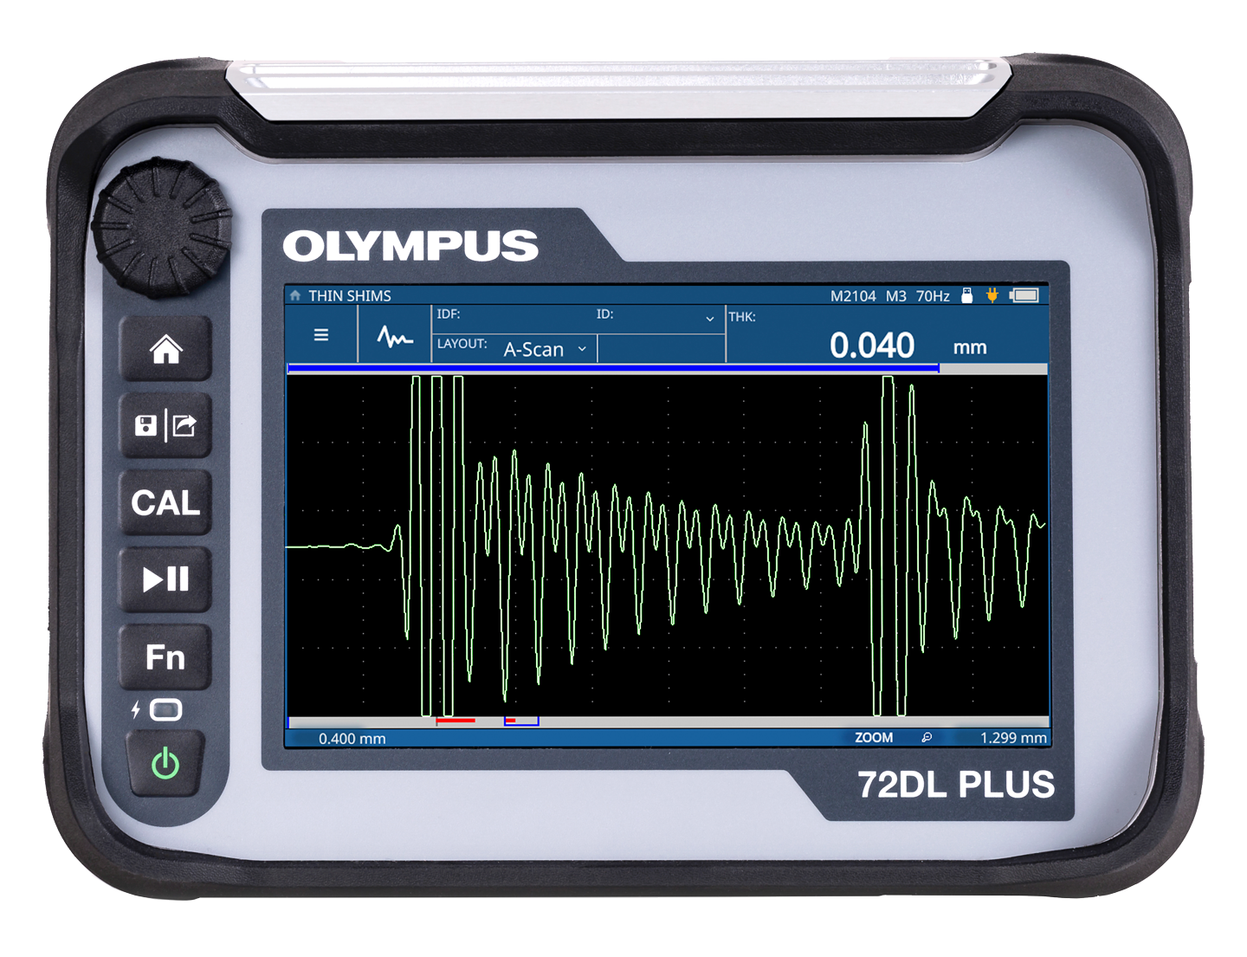
72DL PLUS
High-Speed, High-Frequency, High-Precision Measurements
Fast scanning, advanced algorithms, and our lowest-ever minimum thickness capability, you can confidently measure the thickness of very thin layers in the most challenging applications.
Available in Standard Frequency and High-Frequency
Standard- 0.2-30 Mhz
High-Frequency- 20-125 Mhz
The High-Frequency model can measure ultra-thin materials, including multilayer paint, plastics, metals, and coatings, and the Multilayer Measurement Software can simultaneously display the thickness of up to six independent layers.
Versatile Layouts: A-scan, B-scan, A/B-scan, Trend, and Zoom measurement layouts provide and accurate picture of thickness changes.
Guided inspections: Interactive part map with thickness measurement locations (TML’s) show a quick view of the inspection status and quality.
Long Battery Life: Up to 8 continuous hours.
Cloud enabled: wireless connection to the Olympus Scientific Cloud (OSC)
7” high resolution touch screen.

Slide 14
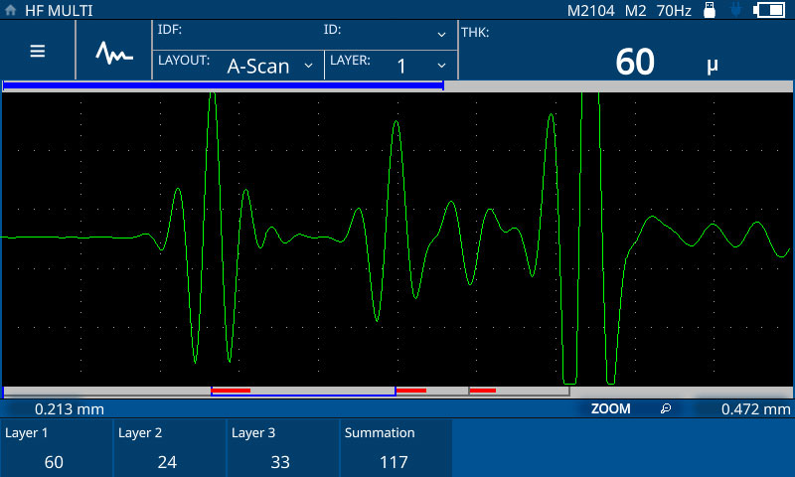
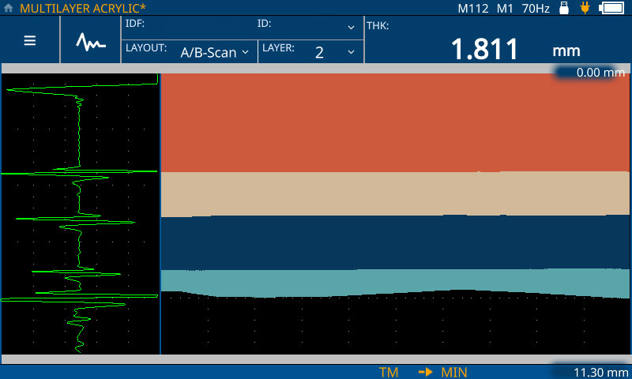
72DL PLUS
Measure the Thickness of Up to Six Layers for Multilayer Coatings, Paint, Plastics, and Other Materials
The Multilayer Measurement Software offers multilayer thickness measurements of up to six layers. Measurement settings for each layer—including material, velocity, target thickness ranges, and alarm thresholds—are easily accessible through the configuration workflow and touch-screen controls.

Slide 15
EPOCH 650
The EPOCH 650 Digital Ultrasonic Flaw Detector combines Olympus’ industry leading conventional flaw detection capabilities with the efficiency of a highly portable, intuitive instrument.
Designed for use in nearly any inspection environment, from bench top testing in a laboratory to extreme outdoor and hazardous conditions. Designed for IP rating in either knob (IP66) or navigation pad (IP67) configurations, and tested to very high environmental and reliability standards.
Simple and comfortable operation- design is focused on providing a very high level of flaw detection with the simplicity of a basic instrument and to be ergonomic, intuitive, and practical for both experienced and novice ultrasonic inspectors
User interface is based on the EPOCH 600 flaw detector.

Slide 16
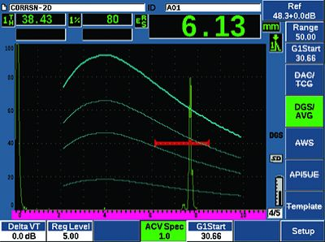
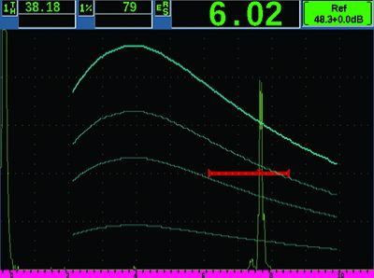
EPOCH 650
Key Features
Designed to meet the requirements of ISO 22232-1
PerfectSquareTM tunable square wave pulser
Full screen A-scan mode
Digital high dynamic range receiver
Thirty digital filters for enhanced signal-to-noise ratio
2 kHz PRF for rapid scanning
Knob or navigation pad adjustment configurations
Large, full VGA sunlight readable display
15+ hours of battery life
Standard dynamic DAC/TCG and onboard DGS/AVG
Multiple on-board report formats
MicroSD memory card for data transfers
Optional Corrosion Module software with Encoded B-scan
USB On-The-Go (OTG) for PC communication
Alarm and VGA outputs
Optional analog output

Slide 17
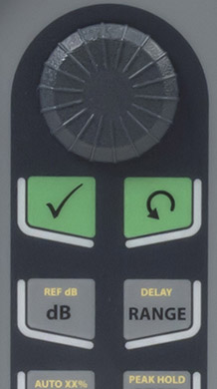
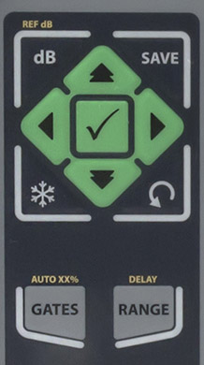
Options for comfortable navigation
Knob-
Used along with the CHECK and ESC keys to adjust parameter values in either coarse or fine increments. You have the ability to lock the knob to prevent accidental parameter value changes during an inspection.
Designed to meet IP66
Navigation Pad-
The up and down arrows on the navigation pad are used for coarse parameter adjustment, and the left and right arrows for fine adjustment. The navigation pad also contains additional functions and frequently used parameters such as gain, save, and the CHECK and ESC keys.
Designed to meet IP67

Slide 18
Standard Software Features
Dynamic DAC/TCG: Calculates signal amplitude as a percentage or decibel level compared to a DAC curve or a reference echo amplitude fixed at a time-varied gain. DAC versions include Standard, ASME 3, JIS, and Custom. Also includes several key features: dynamically adjustable DAC curves, switchable DAC and TCG views, custom DAC warning curves, and 20-80% DAC views.
DGS/AVG: This flaw sizing technique allows echo signals to be evaluated with a DGS/AVG diagram associated to a particular type of probe and material. The DGS/AVG diagram illustrates the relationships between echo height, flaw size, and distance from the transducer.
AWS D1.1 and D1.5: Provides a dynamic reflector indication rating for various AWS weld inspection applications. This allows more efficient inspections by eliminating manual calculations.
Optional Software Features
Interface Gate: This optional third measurement gate enables real-time tracking of a variable interface echo in order to maintain consistent digital measurements.
Corrosion Module: Simplified corrosion mode allowing automatic ultrasonic setups based on transducer selection, Automatic Gain Control (AGC), thickness gage measurement algorithm, V-Path correction, and transducer wear compensation using an automatic zero function (“Do Zero”). Also features color-coded Grid View and encoded B-scan
Template Storage: Allows on-screen comparison of a live waveform with a saved reference waveform. Saved templates can be dynamically toggled on and off with a single key press for fast waveform comparison. Excellent for spotweld analysis and other applications.
Backwall Echo Attenuator (BEA): Attenuates the backwall of an inspected part using the screen region defined by Gate 2.
API 5UE: Allows defect sizing according to API Recommended Practice 5UE. Uses the Amplitude Distance Differential Technique (ADDT) to measure the size of potential defects during the prove-up process of OCTG pipe.
Waveform Averaging: This feature allows live A-scan averaging 2X, 4X, 8X, 16X, and 32X.

Slide 19
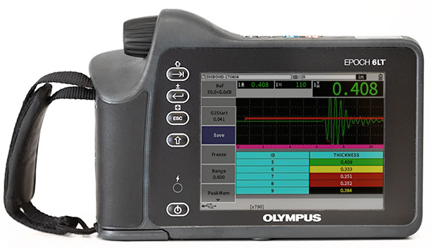
6LT
Reliable Flaw Detection in the Palm of your Hand
Portable and easy to use, the EPOCH 6LT flaw detector is an ergonomic, rugged instrument that delivers user comfort and more uptime.
Weighs just 1.95 lbs. (890g) with a grip-oriented weight distribution for one handed operation.
Rotary knob and simple button design make it easy to use even when wearing gloves.
Engineered to IP65/67 and drop tested.
Offers all the core functionality of the EPOCH 650 flaw detector in a small, portable instrument
Meets the requirements of ISO 22232-1
Optional corrosion software with center-pin transducer ID
Optional Wireless LAN connectivity

Slide 20
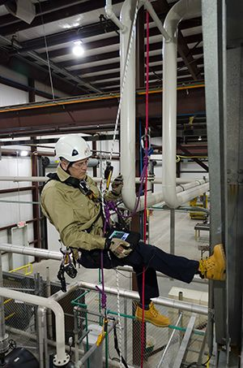
6LT
Designed for Rope Access and Ultra-High Portability Applications
For rope access technicians, the EPOCH 6LT flaw detector offers features to help keep you safe during challenging inspections.
With the optional rope access accessory kit, secure the instrument to your leg with a strap or attach it to your harness, leaving your hands free to maintain balance or adjust the probe.
Rotate the display from portrait to landscape to properly view the A-scan and readings.
For greater flexibility, the 1/4-20 threaded insert enables you to connect the flaw detector to a wide variety of Olympus and third-party accessories.

Slide 21
Transducers and Accessories
Evident offers a variety of transducers and accessories to fit your needs.
Precision single element transducers
Contact transducers
Delay Line
Immersion
Test blocks
Cables
Standard
Waterproof
Heavy duty-Teflon
Heavy duty- Armored silicone jaket
Heavy duty- Armored PVC jacket
Heavy duty- Stainless Steel
Corrosion gaging transducers
Dual transducers
Single element transducers for corrosion

Slide 22
Contact Information
Dillon Tynes
NDT Sales Representative
469-744-4670
Dillon.tynes@evidentscientific.com

