Slide 1
Lake Management District (LMD) vs
Special Utility District (SUD)
Information Briefing
• LMD vs SUD Similarities
• LMD vs SUD Significant Differences • Summary of SUD Process
• Summary of LMD Process
• LMD Formation Process
• Helpful POC’s
• Sample Rate Payer Breakdown
• Offut Lake Parcel Map

Slide 2
LMD vs SUD Similarities
Provide substantial public process in their creation.
Created by a simple majority vote of the property owners.
Require at least 10 property owners to petition the Board of County Commissioners to start the process. More is better.
District members (property owners) have a clear understanding of what the rate (cost) is going to be and what activities are going to occur when they vote.
District boundaries are determined by the same process for each.
County Treasurer collects assessment on property taxes and disperses funds based on authorized warrants (vouchers).

Slide 3
LMD vs SUD Differences
LMD
Governed by RCW 36.61.
One vote per $1 of annual assessment.
Requires renewal every 3-10 years.
County has responsibility for administering LMD – delegated to Public Works – subdelegated to Water Resources – subdelegated to Noxious Weed. With significant input by the LMD Advisory Board (Steering Committee).
Lake programs contingent on fixed assessments with annual vote by Steering Committee to increase assessments 0-5% – cannot borrow money for emergencies or needed issues.
County controls budget and uses 25-35% of assessments for administrative costs of managing program. We have no say on these costs and they do fluctuate depending on how much assistance you receive from County personnel/resources.
SUD
Governed by RCW 85.38.
Two votes per property owner regardless of assessment.
Unlimited life-time district unless majority of property owners vote to dissolve.
Self governing by a board (3 Commissioners) elected every six years by property owners. Commissioners must live within the district. More responsive to members. But costs money to hold valid elections through County Elections.
Some flexibility in assessments. Can borrow money and take care of issues that arise.
Operational/Administrative Costs can be 30-40% of assessments. Elected Commissioners from your lake control budget and determine what administrative costs to incur (legal, accounting, admin, consultant). Elected Commissioners are paid $128 for each meeting they attend.

Slide 4
LMD vs SUD Differences- continued
LMD
County controls contractors – very little input from members. Members not allowed to talk with contractors.
Thurston County has very stringent controls on chemicals used to treat lake issues – currently only two authorized for use (Sonar and Aquathol). Limits treatment options.
Expensive process to change/add chemicals that can be used ($5,000+ per chemical). Called a prescription approval.
SUD
Elected Commissioners make contractor decisions based on needs of the lake/members with direct member input.
Not being under County control more treatment options/chemicals are available as long as they are on the State EPA authorized use list. More responsive to treat problems.
No cost to change/add treatment options to control nuisance vegetation in the lake.

Slide 5
Summary of SUD PROCESS
Governed RCW 85.38. SUD’s must adhere to all applicable Washington State RCW’s and WAC’s. Two of the more prominent ones are RCW 42.30 (Open Public Meetings Act) and RCW 42.56 (Public Records Act).
RCW 85.38 Summary
85.38.20 – Requires at least ten owners of land within the district to petition the Board of County Commissioners (BoCC). Petition needs to be accompanied by
A bond of 5K to defray costs incurred – this money is put up by the citizen group trying to form the SUD.
85.38.030 – Investigation of proposed boundaries and districts – Report. Done by County Engineer within 90 days of BoCC receiving petition.
85.38.040 – Proposed special district – Public Hearing Notice. Scheduled by BoCC, notice placed in local newspaper. Cost comes out of posted bond money.
85.38.050 – Public Hearing – Elections. After hearing BoCC would require an election to authorize the SUD.
85.38.060 – Elections – Notice – Costs. Election on SUD can be done at any time after hearing – Cost paid by posted bond – simple majority of votes needed to approve.
85.38.070 – Governing board – Terms of office – Election –SUD requires three commissioners with 6 yr terms. Highest # of votes gets 6 yr term, next 4 yr, next 2 yr. Election held every 2 years by County Auditors. Cost is $5,000 if election needed. Any qualified voter of the SUD district can run for office.

Slide 6
RCW 85.38 Summary - continued
85.38.075 – Governing Body – Compensation and expenses. Commissioners may each receive up to $90 per day for attending official meetings. Secretary or other staff can be hired. Any member may waive all or any portion of his or her compensation.
85.38.100 – General elections. Shall be held on the 1st Tuesday after the 1st Monday in February in each even-numbered year.
85.38.105 – Voting rights. No parcel shall receive more than two votes.
85.38.115 – Elections – When not required. If no one or only one-person files for the position. If no one runs for a position the county BoCC can appoint someone to fill the vacancy and that person would serve for the term of that vacant position.
85.38/140 – Rates and charges. The SUD fixes the rates and charges.
85.38.150 – Special Assessments –The BoCC shall hold a hearing on the assessment system.
85.38.170 –Collection fee. Shall be collected by the county treasurer and can charge a fee for doing so (which the county currently does).
85.38.180 – Special districts – Powers.
  Engage in lake restoration, aquatic plant control, and water quality enhancement activities.
  Accept funds and property by loan, grant, gift, from the US, State, or any public or private source.
  Hire staff, employees, or services, or use voluntary labor. Sue and be sued.
  Enter into contracts. WOULD BE A NORMAL BID PROCESS FOR AQUATIC PESTICIDE APPLICATORS (THERE ARE THREE IN WA STATE) AND ALSO CONSULTANTS, IF NEEDED

Slide 7
Summary of LMD Process
Governed by RCW 36.61
96 Page guide to Thurston County LMD Formation. https://www.co.thurston.wa.us/tcweeds/lakes/general/docs/LMD%20Formation%20Gui delines.pdf
Form a exploratory committee – determine if you want to do this.
Initiate petition process – get signatures of at least 20% of parcel owners. My
recommendation – get 51%.
Public hearing held by County Commissioners.
Property owners vote on formation of LMD.
If approved by simple majority vote another public hearing is held on the list of parcels to be charged an assessment and the amount to be charged – referred to as the roll.
The County Treasurer collects the LMD charges, which will appear as a separate line on your property taxes “LMD Assessment”.

Slide 8
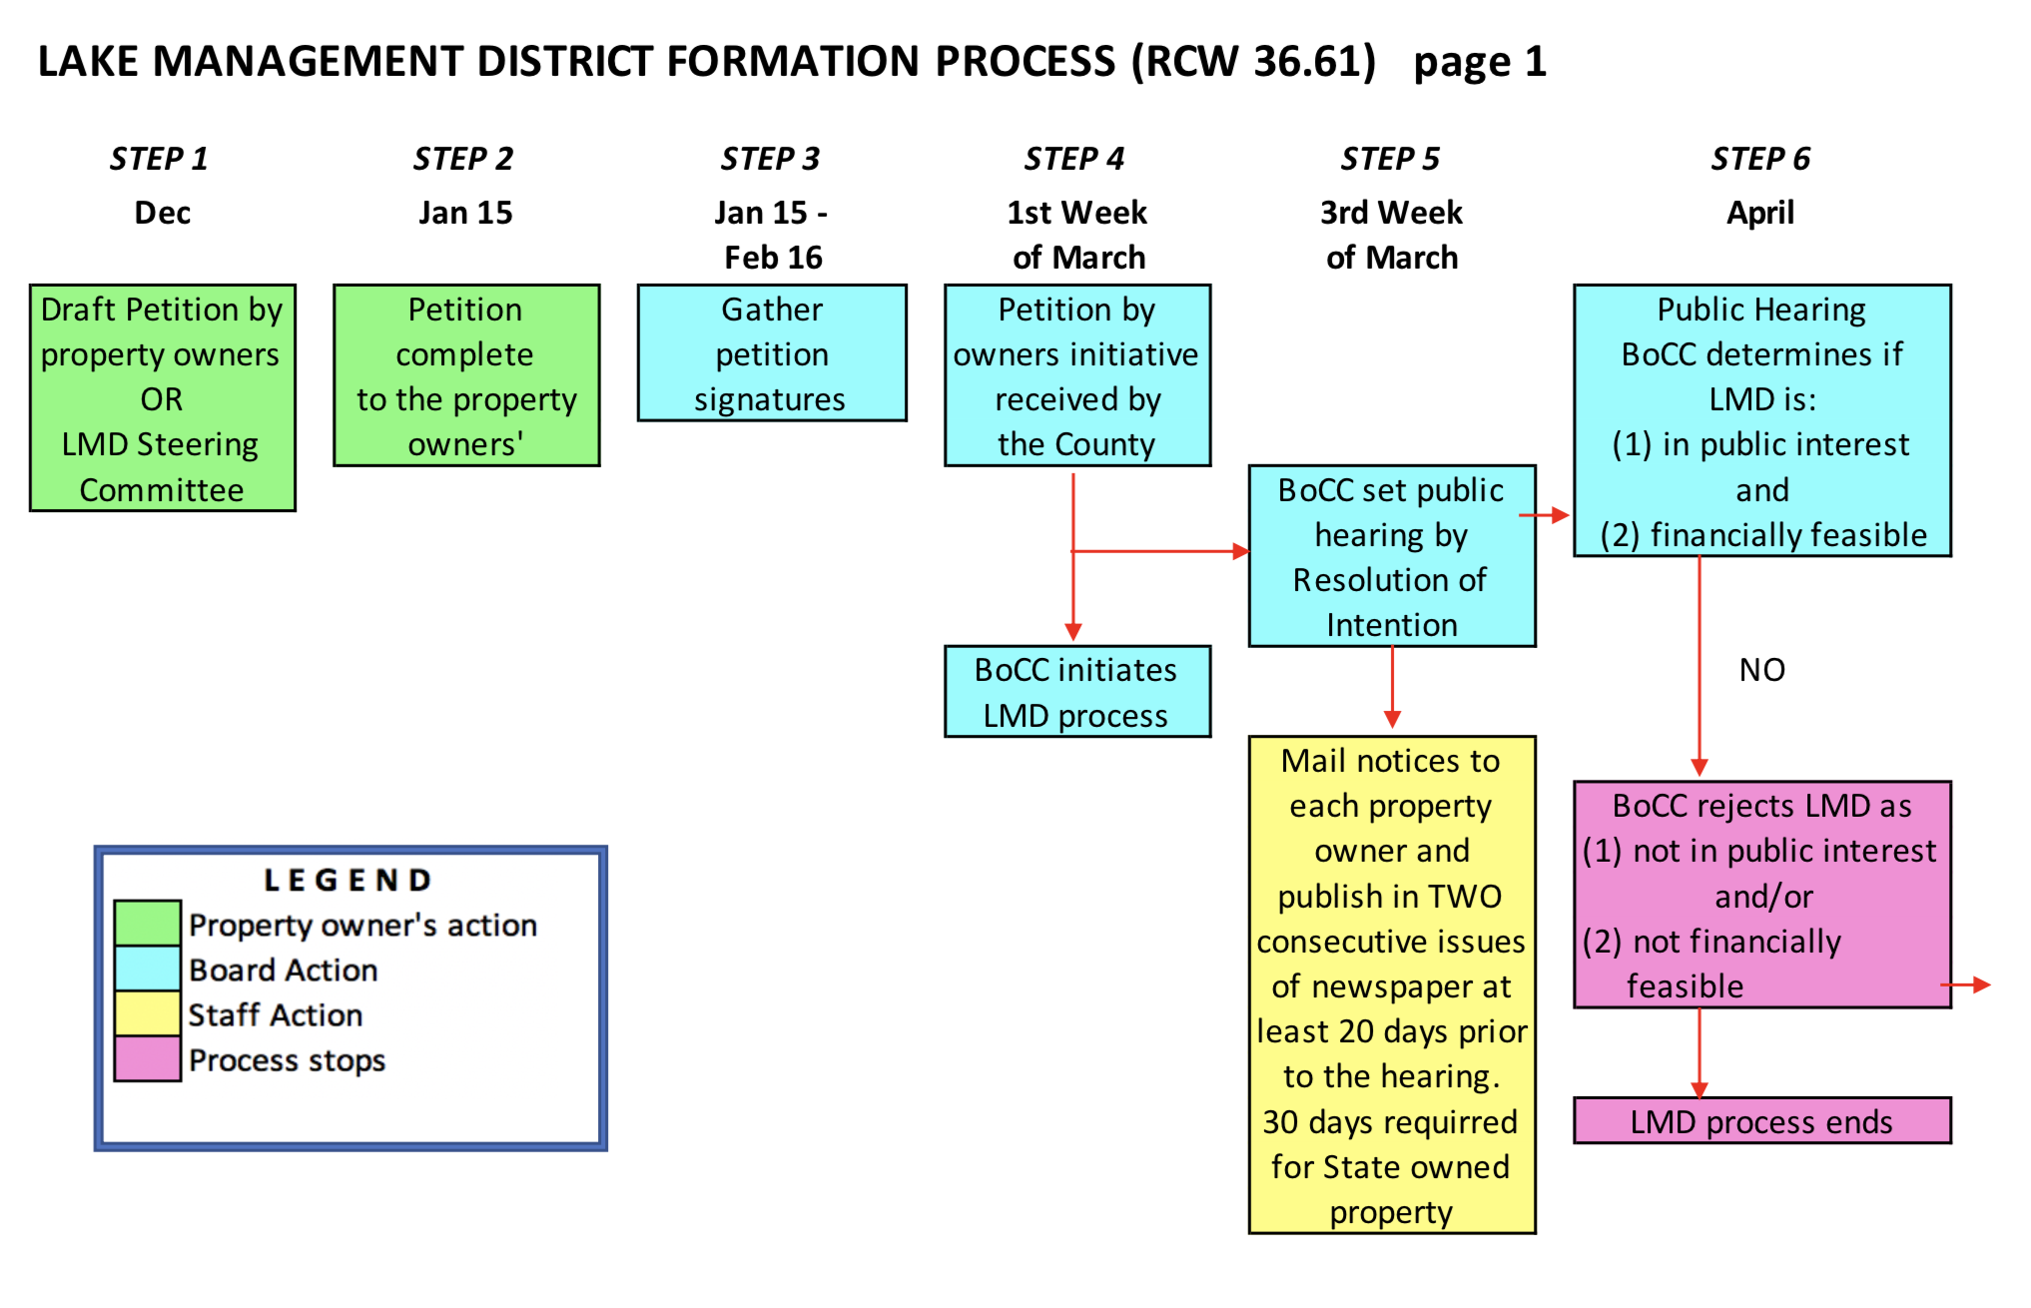

Slide 9
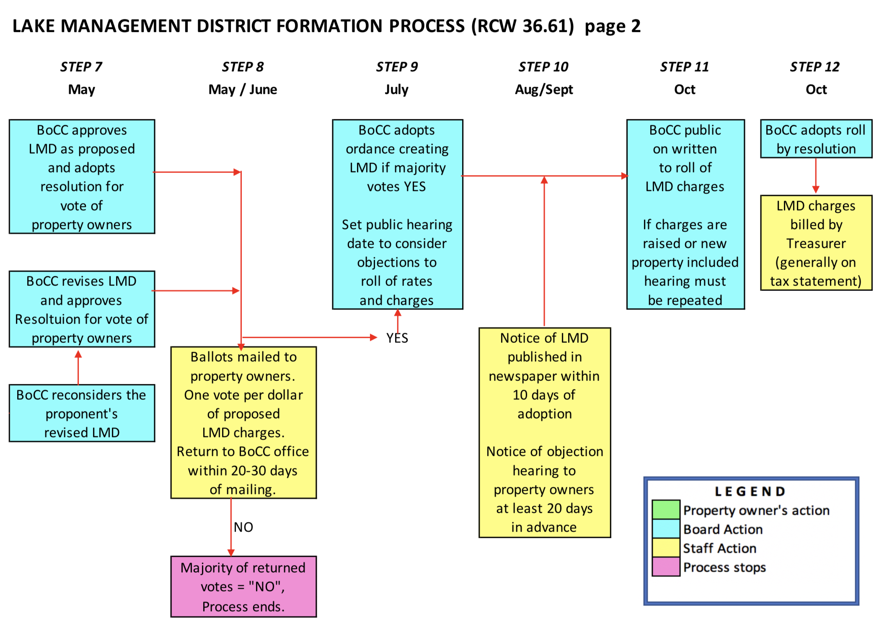

Slide 10
Helpful POC’s
Thurston County Aquatic Resource Specialist – Paula Cracknell, 360-628-1420, paula.cracknell@co.Thurston.wa.us
Black Lake Special Utility District Operations Support Manager, Craig Ottavelli, 360-753-7442, Craig@orgsupport.com . When
emailing Craig also cc: lakinfo@orgsupport.come@blacklagespecialdistrict.org
Black Lake Special Utility District Commissioner, Lake Stintzi, 360-867-8814,
Lake Lawrence Lake Management District Committee, Barry Halverson, 253-341-6059, halversonloma@hotmail.com
Long Lake Lake Management District Committee, Doug Karman, 360-413-5152, doug.karman@comcast.net
Consultants:
  Herrera Environmental Consultants, Inc., 206-441-9080
  Petera Tech, Lake Consultants, Harry Gibbons, 206-728-9655 ext. 107
Lake Treatment Contractors:
  Aqua Technex, Kyle, 360-330-0152, kyle@aquatechnex.com
  NW Aquatic Mgmt Inc., Kyle Steelhammer, 360-870-4362, kyle@nwaqua.com
  NW Aquatic Ego Systems, Doug Dorling, 360-357-3285, pondweeds@comcast.net
  Washington State Department of Ecology Aquatic Plant Specialist, Lisbeth Seebacher, 360-407-6938, lisbethseebacher@ecy.wa.gov
  Washington Department of Fish and Wildlife:
  WDFW Boat Launch Manager – Brian Mitchell, 360-789-4633, brian.Mitchell@wdfw.wa.gov
  WDFW Regional Fish Biologist, Riley Freeman, 360-810-0724, riley.freeman@wdfw.wa.gov

Slide 11
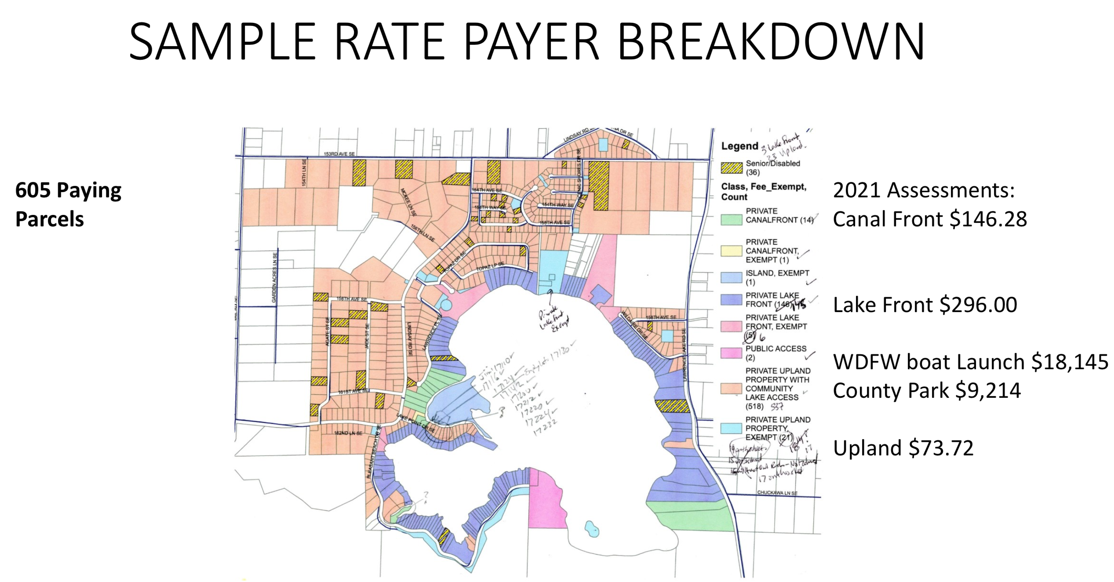

Slide 12
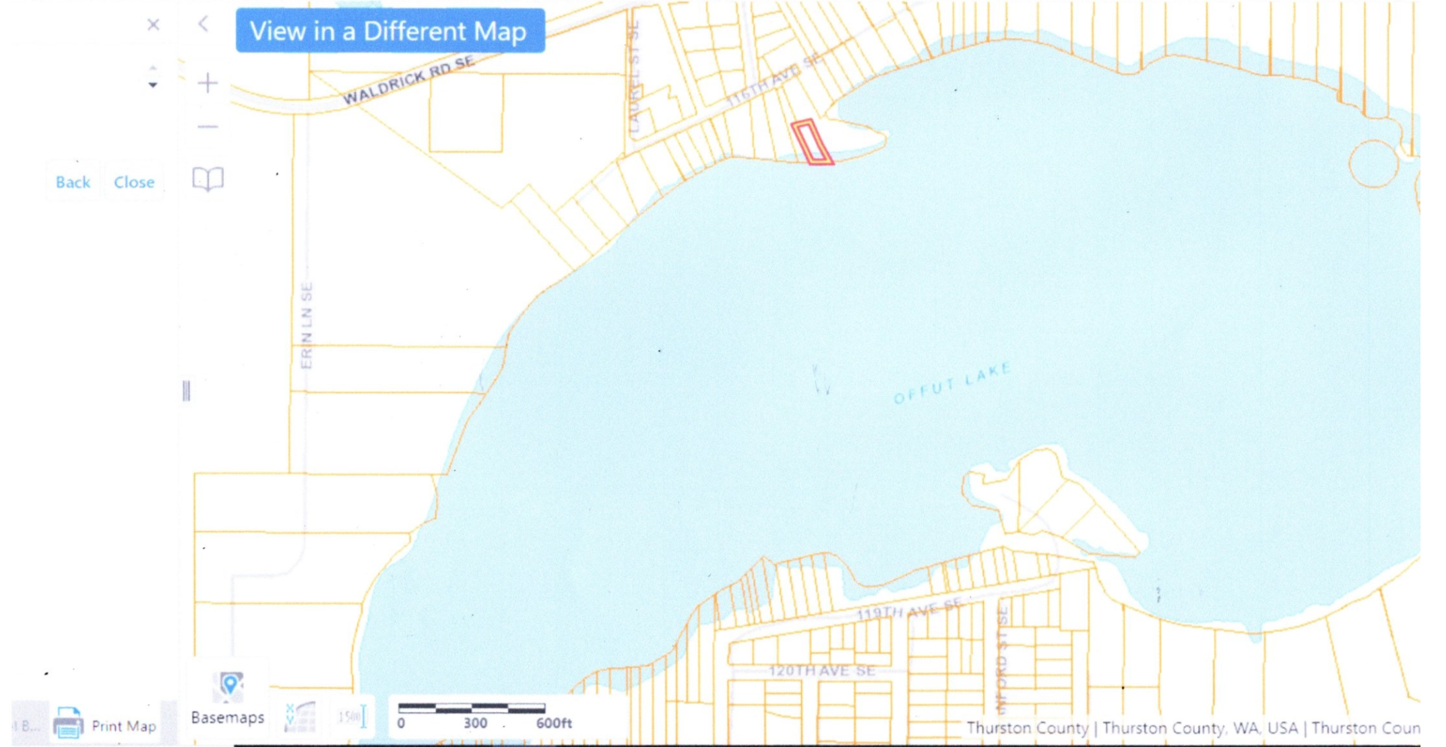

Slide 13
Kathi, this came in last nite. Hopefully some information to help us with our LMD.
From: tmcnabb@aquatechnex.com
To: fishfintwo@aol.com
Cc: kyle@aquatechnex.com, scott@aquatechnex.com, oneilb@aquatechnex.com
Sent: 9/16/2021 7:46:33 AM Pacific Standard Time
Subject: RE: Offut Lake
We are in the field finishing up treatment programs for this summer. Basically, costs are as follows:
Obtain permit to treat from Ecology, that cost is about $1,000.00 to file paperwork, publish legal notices, etc., and then Ecology has an annual permit fee that this year is $682.00, it goes up about $20-40 each year it seems like.
Survey work to determine control zones and species present, about $2,000.00 for this size lake.
Application costs are based on a per acre of what is actually treated. The permit does not allow for controlling all of the vegetation in the lake and you wouldn’t want to, cost ranges per acre actually treated are from $400-800 depending on herbicides needed. There is also a annual cost for permit compliance mailings, and shoreline posting that would probably be another $1000.00.
So the key think to understand is how much area you are going to treat.
We can schedule meeting with your group in the coming weeks after field season is over if you are interested.
Terry McNabb, CLM, Aquatic Biologist/Certified Lake Manager

