Slide 1
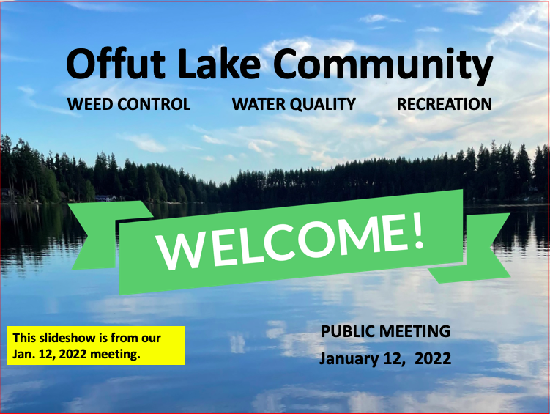
In the top Menu Bar, click Slide Show > Play from Start to view

Slide 2
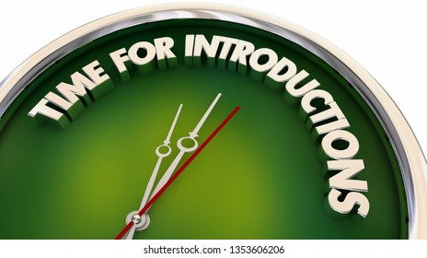

Slide 3
SPEAKER – DIANE PERLMAN
Thanks for attending our in-person or our virtual meeting viz Zoom tonight.
Steering Committee members that are here tonight are: myself, Gary Witley, David and Laura Sommers, and James Burkhardt.
Thanks to our other steering committee members that are viewing from home: Kathleen Nolte, Rich and Kathi Durkin.
Our Zoom meeting is being facilitated by our wonderful tech team: Vannessa Blea and Isaid Orozco.
We began meeting last August and have met weekly most of the fall and winter. As we began to study the regulations that govern lake management and learn about lake management plans, we came to appreciate how huge of a task we are undertaking. Our hope is to share some of that process with you tonight and get your input in how we move forward.

Slide 4
Our Mission
Offut Lake Steering Committee
We are a group of concerned Offut Lake citizens whose mission is to restore, preserve and protect the natural beauty, recreational activities and wildlife habitat of Offut Lake through cooperative weed management, water quality projects, community awareness, and educational programs for the benefit of all.

Slide 5
Agenda
Welcome and introductions
Why are we here?
What do we want to do?
What have we done so far?
Three non-scientific maps of Offut Lake
Guest Speaker – Barry Halverson
What do we still need to do?
Feedback Opportunity
How can you help?
Questions

Slide 6
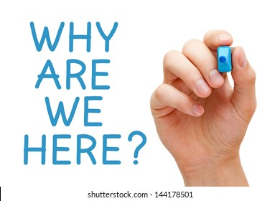

Slide 7
SPEAKER – DIANE PERLMAN
Last August, Kathy Durkin responded to a post on Facebook of the weeds we had just taken out of the shoreline near our dock. Having been swimming here for over 70 years, I have seen huge changes in the amount of weeds. So let’s take a few moments to talk about WEEDS!

Slide 8
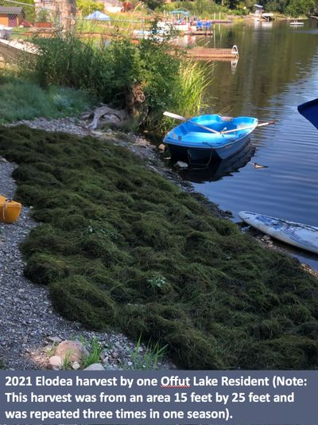
Why are we here?
Weed Problem
The amount of uncontrolled growth of aquatic vegetation in Offut Lake has created an environment where it is increasingly difficult, and in some cases impossible, for residents and visitors to enjoy the benefits usually enjoyed by lake residents.

Slide 9
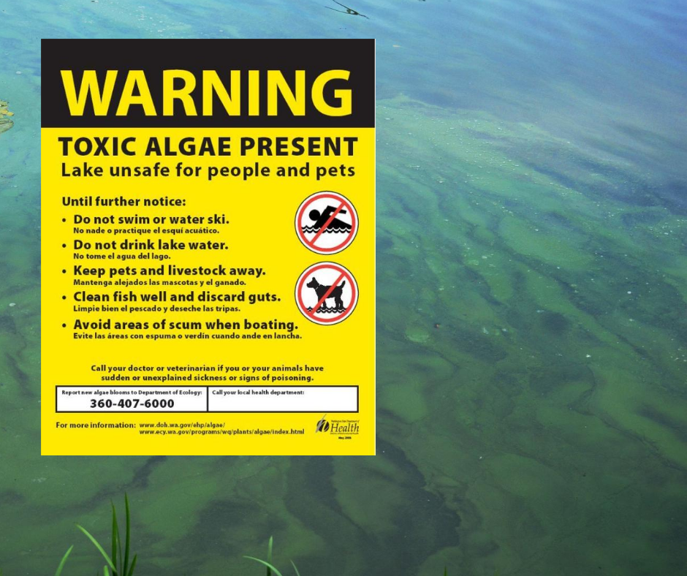

Slide 10
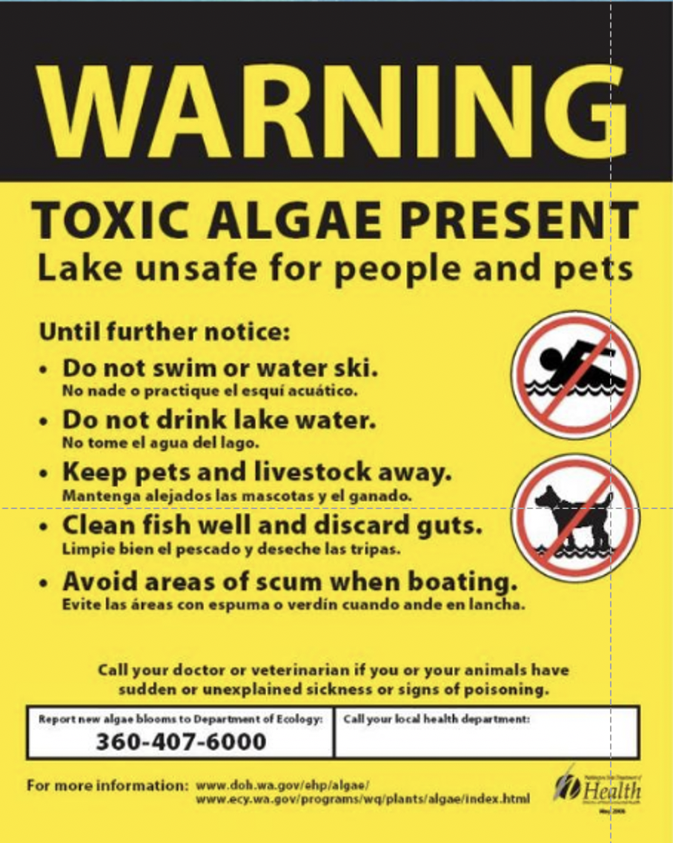
SPEAKER – DIANE PERLMAN
In addition to uncontrolled weed growth interrupting our enjoyment of the lake, the increase of toxic algae has been evident to all residents. We do not want Offut Lake to become Offut Swamp. That is why we are here tonight.

Slide 11
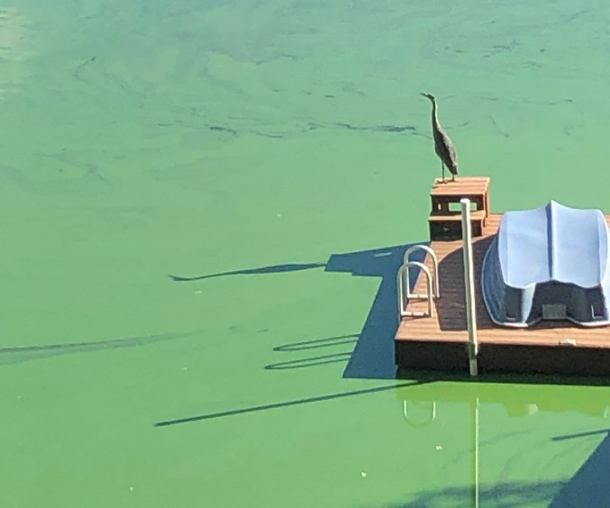
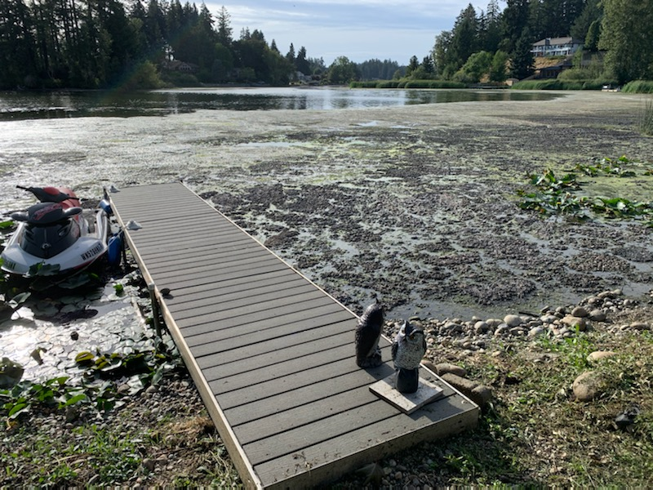
Toxic Algae Blooms
Diane
2020 Offut Lake Algae example
2020 Long Lake Algae example
Harmful algae (sometimes called blue-green algae) can produce toxins (poisons) that can make people and animals sick and affect the environment.

Slide 12


Slide 13
SPEAKER – GARY WITLEY
So far you have heard about the problems we have identified.
Now I’d like to share our thoughts about what we think we could do together...

Slide 14
What do we want to do?
Goals
  1. Maintain and sustain long-term recreational opportunities such as fishing, boating & swimming.
  2. Reduce aquatic plant vegetation that impedes
  our ability to use the lake.
  3. Work with area residents/owners to educate
  them about maintaining and restoring the lake environment to ensure enjoyment for years
  to come.

Slide 15

SPEAKER – GARY WITLEY
Next, I’ll share with you what our
committee has done in the last 6 months.

Slide 16
What have we done so far?
Formed a volunteer Steering Committee and met weekly since last summer.
Researched: Lake Management Districts (LMD), Special Utility Districts (SUD), Legal Requirements (RCW), Grants and Funding Strategies
Started to draft a plan
  Outlined Goals and objectives
  Researched past efforts
  Described beneficial uses
  Mapped aquatic growth patterns and potential treatment areas
  Researched funding strategies

Slide 17
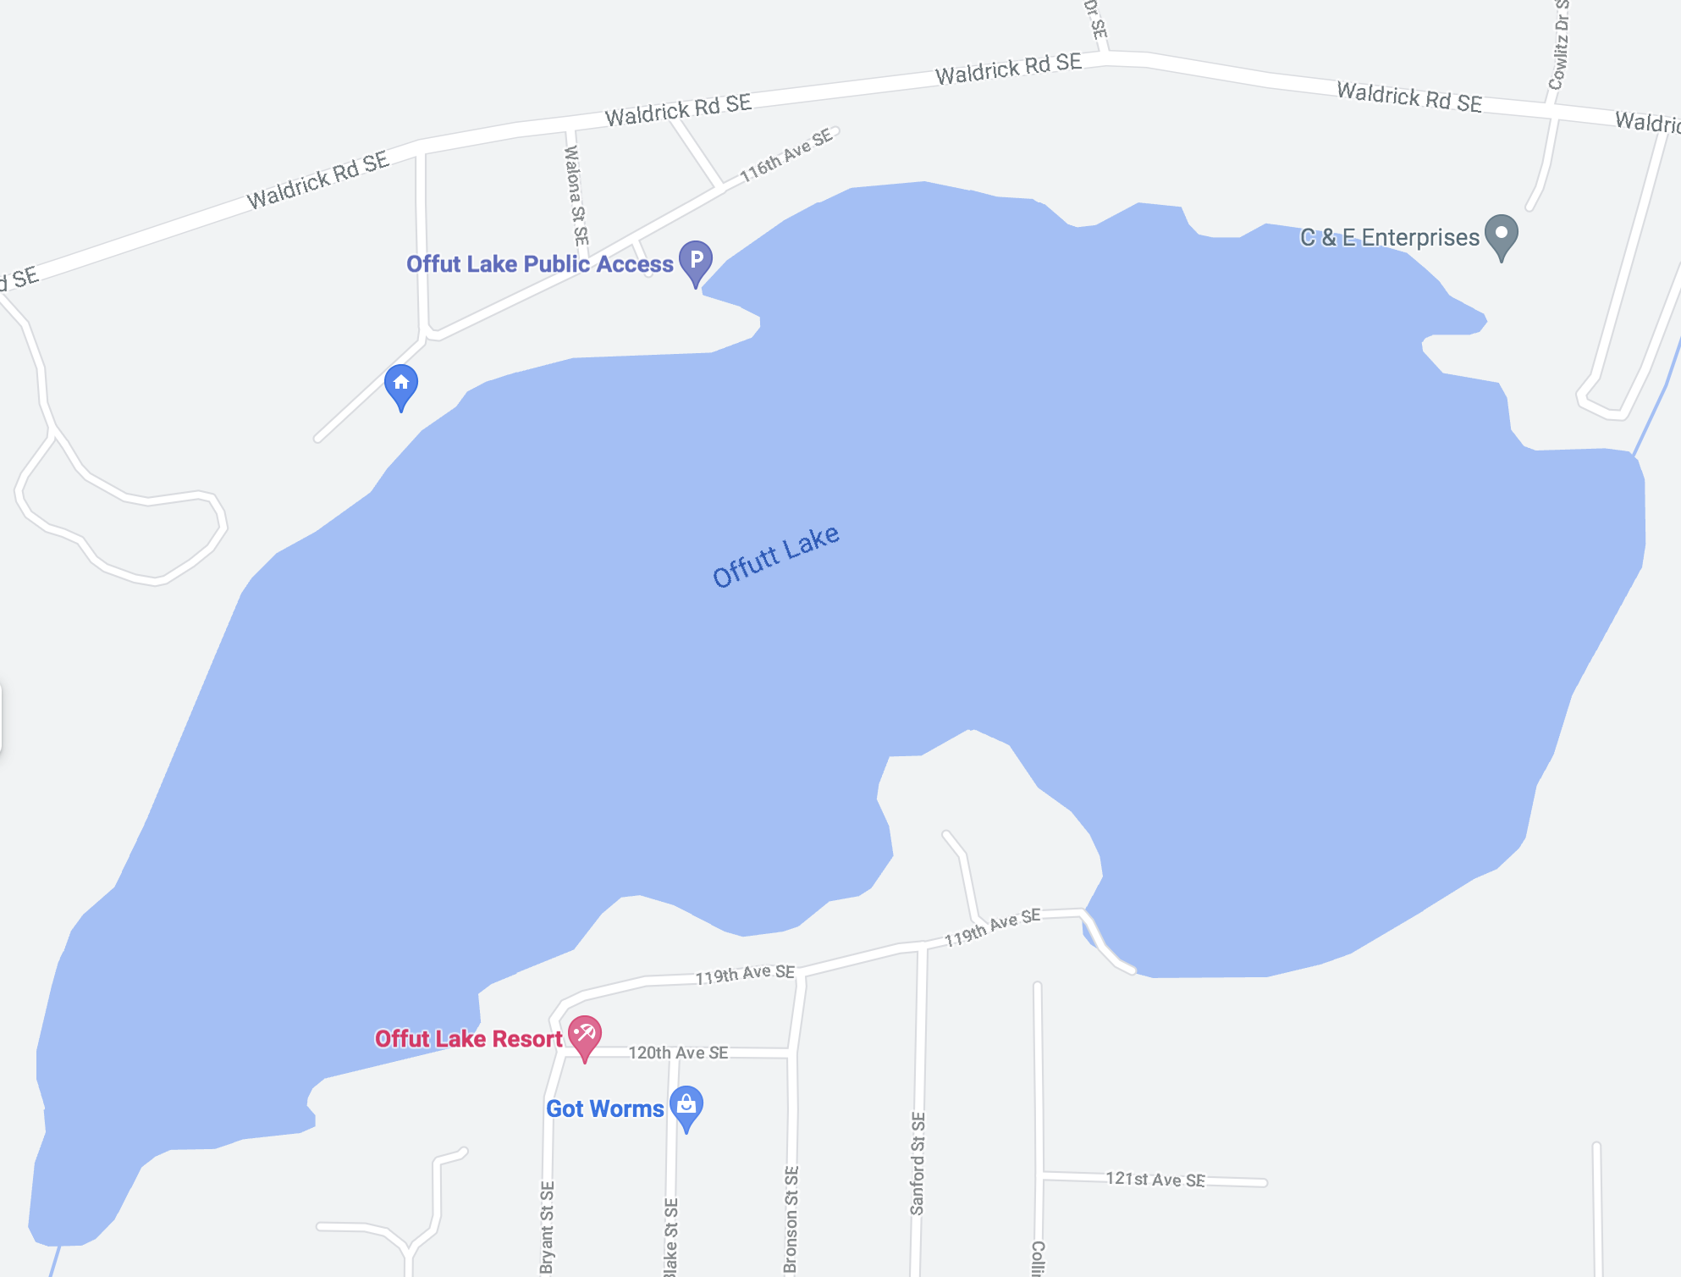
SPEAKER – DIANE PERLMAN
The next three non-scientific maps are
only intended to give an overview of what we have learned the past several months.
So why do we even care? What do we hope to have happen in the lake for ourselves, and just as importantly, for future generations to come? Why even do anything? We hope you know the answers by the end of our presentation.
The next slide represent the variety of activities that we currently enjoy on Offut Lake.

Slide 18
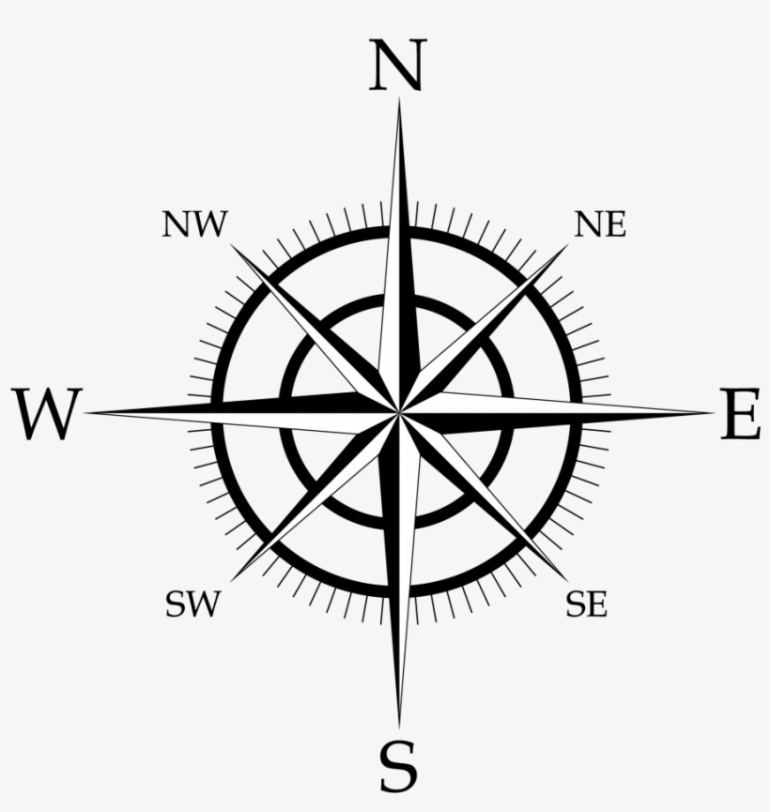
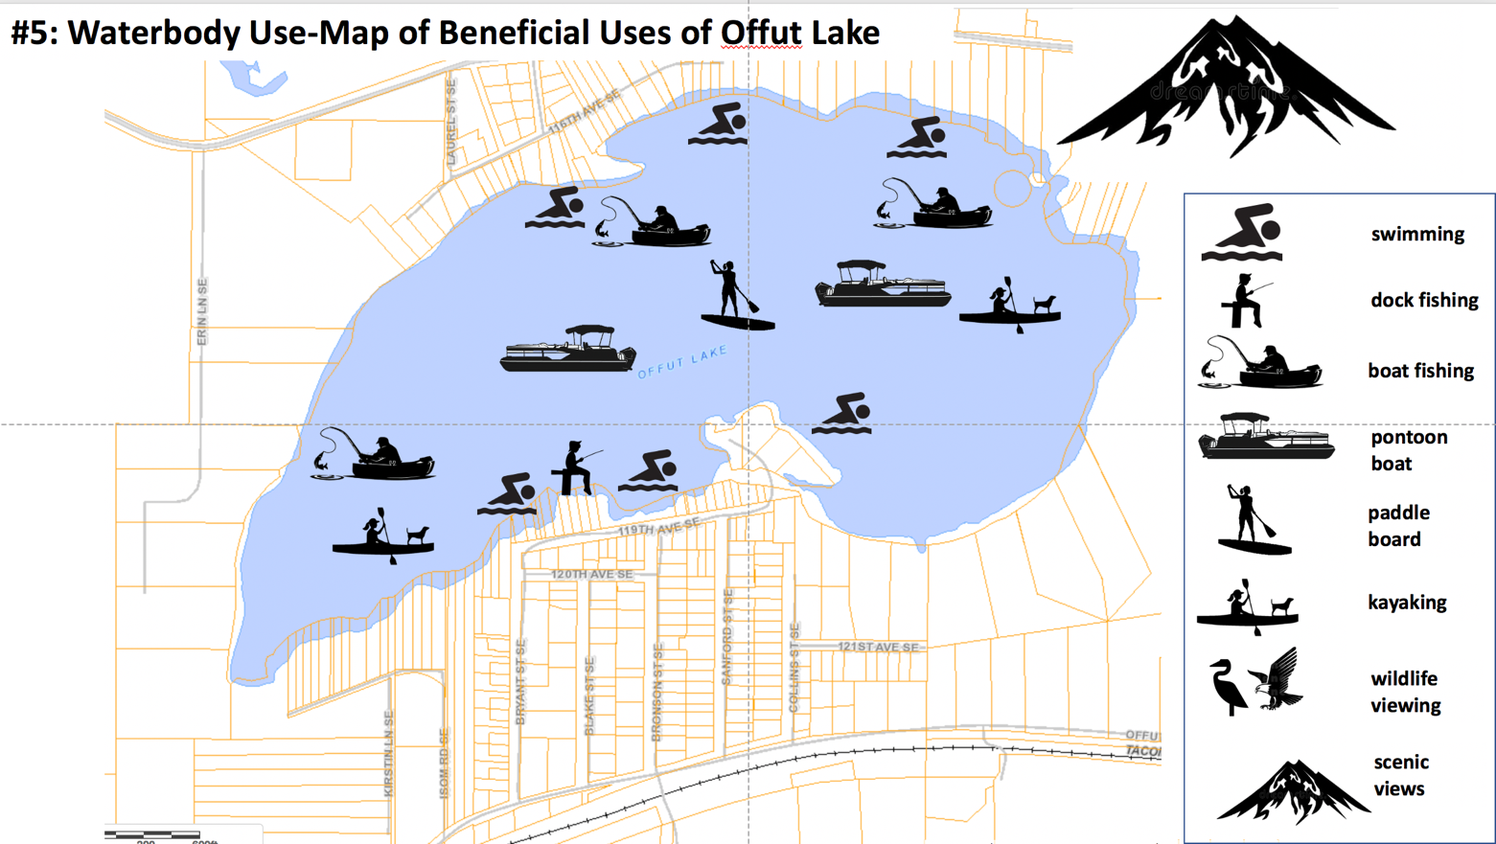
Offut Lake Beneficial Uses
DRAFT
For discussion purposes only
These are the types of activities that our lake residents enjoy.

Slide 19
SPEAKER – DIANE PERLMAN
The next slide is our non-scientific attempt to represent the current aquatic plant growth that is interfering with the activities mentioned in the previous slide.

Slide 20
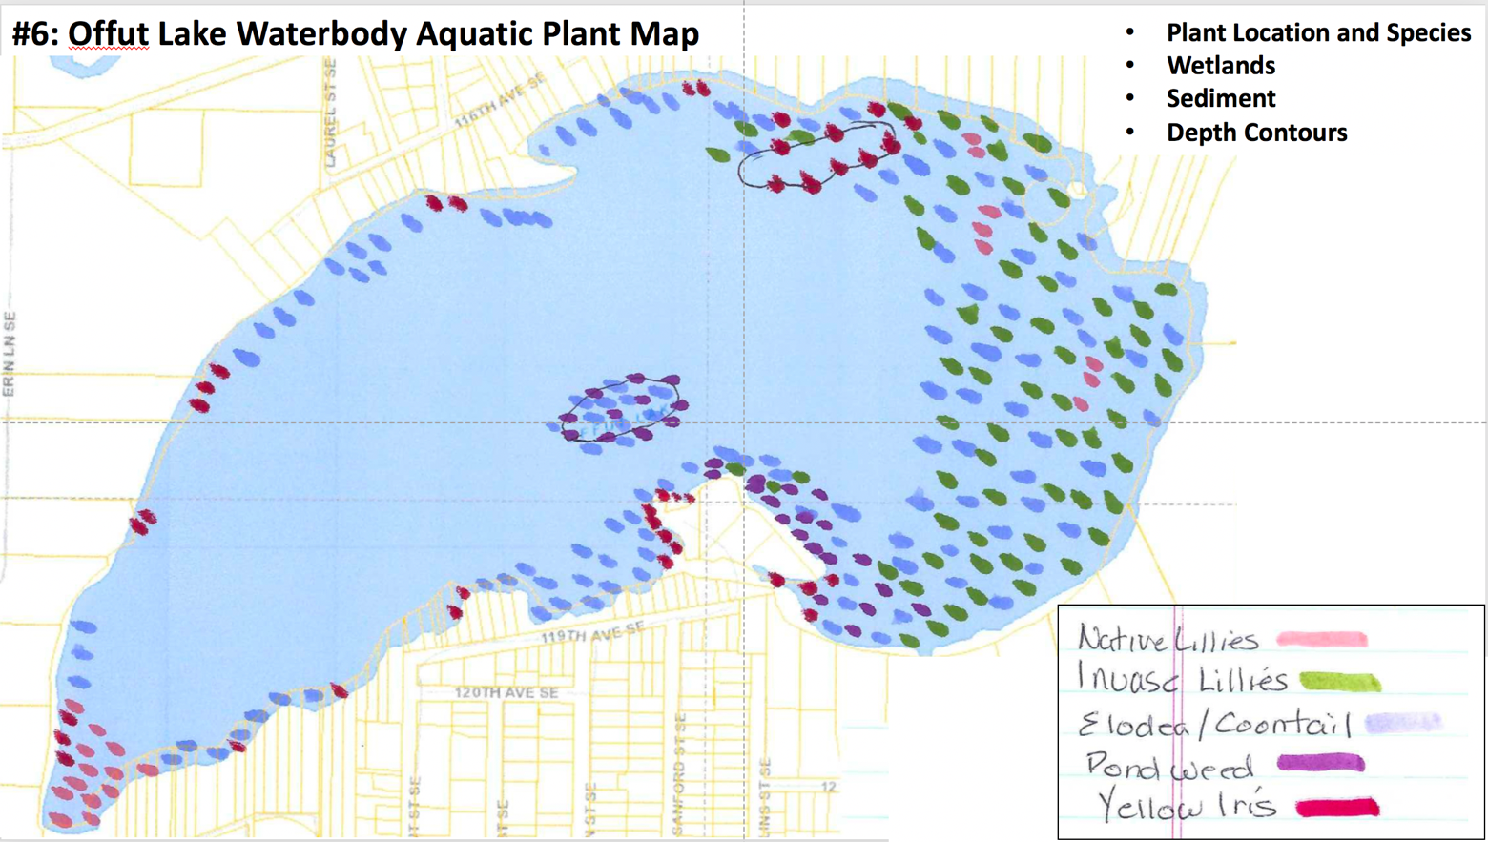
Offut Lake Aquatic Map
DRAFT
For discussion purposes only

Slide 21
SPEAKER – DIANE PERLMAN
This next slide is an example of how
different areas could require different treatments. The actual treatment plan will be determined by our contracted experts after assessing our weeds and treatment options.
As you can see, shoreline areas that are residential or commercial would most likely be the highest priority for treatment. Most of the middle of the lake, except the floating island, would not need to be treated. The shorelines where there are wetland or undeveloped property could be the last to be treated.

Slide 22
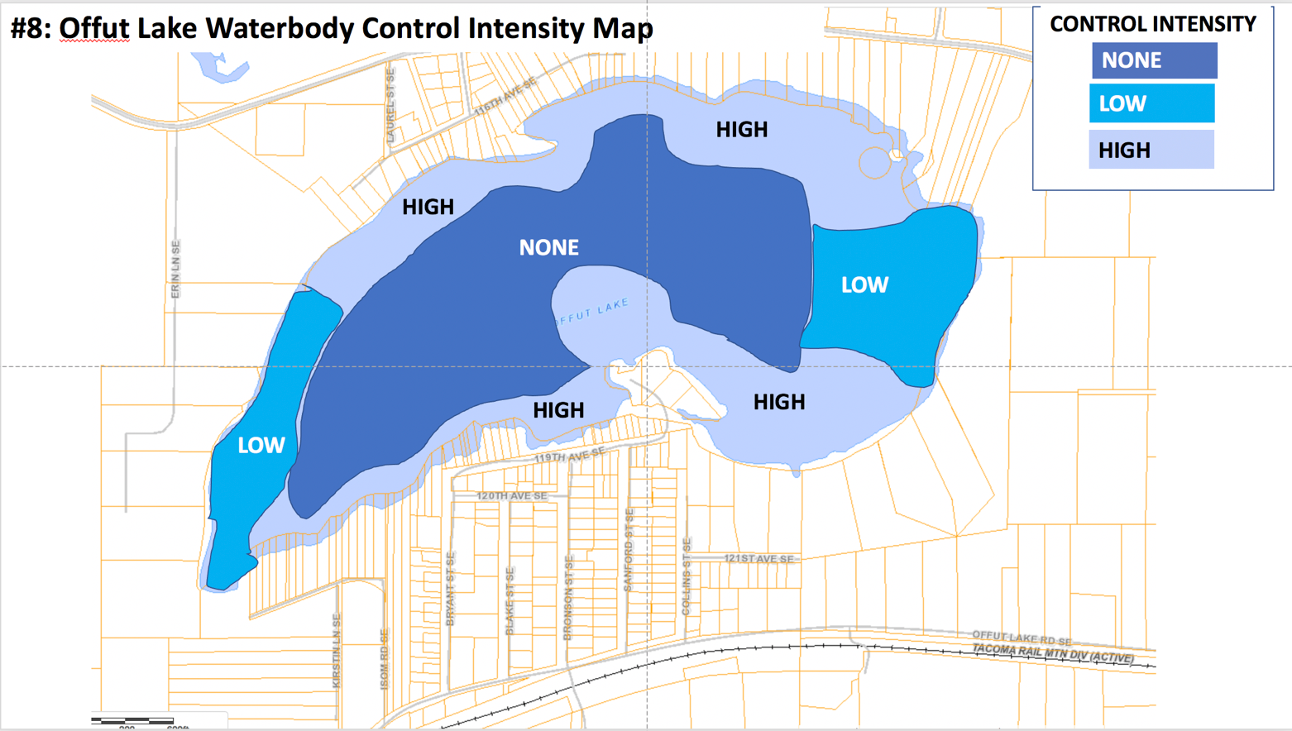
Offut Lake Treatment Areas
DRAFT
For discussion purposes only
This is NOT the actual treatment plan. It is just an example.

Slide 23

Barry Halverson

Slide 24
Barry Halverson retired in 2005 as a US Army Colonel with 33 years active duty. For the last 15 years he has volunteered at the American Lake Veterans Hospital working with disabled soldiers. He is also a Pesticide Supervisor for the American Lake Veterans Golf Course and is a Washington State Pesticide/SPI License Holder since 2012. Barry is on the Lawrence Lake LMD Steering Committee and has been the Budget & Lake Survey lead since 2016.
He has been very instrumental in Thurston County working with the Board of County Commissioners to promote and improve all our lakes. And he has provided a lot of help and guidance to our steering committee. Please welcome, Barry Halverson.

Slide 25
Facts About Thurston County Lakes
SPEAKER – BARRY HALVERSON
A Lake Management District (LMD) is one tool that can be used to improve lake quality by financing weed management activities and educational programs.
In Washington State, any county or city can create an LMD to Improve and maintain lakes located in the county.
An LMD is an independent special taxing district that is managed like other tax assessments through the Thurston County Assessor.
NOTE: The Offut Lake Steering Committee is exploring this option but NO final decision has been made.

Slide 26
What are the benefits of an LMD?
SPEAKER – BARRY HALVERSON
A financial means to improve water quality, lake environment, habitat, recreational activities that is fair and equitable to all LMD members – those that have the greatest stake (waterfront parcels pay the most) – those that don’t live on the lake, but have access to it and use it (upland parcels pay considerably less).
WDFW pays into your LMD funds for a public boat launch facility (~$14,000 a year) with no strings attached to how that money is spent – your steering committee decides how it is spent. That is ~ 20% of all your revenue, each year, being paid by the state to help your lake. That is a bargain you don’t often get.
More benefits→

Slide 27
LMD Benefits continued...
SPEAKER – BARRY HALVERSON
You get a 50% reduction in storm water fees
(~$37 a year) for every parcel owner in the LMD.
If you have 95 parcel owners in the LMD that would
be a combined savings of ~ $3,515 back in the pockets
of parcel owners every year.
Access to State Grants to hire consultants for Integrated Aquatic Vegetative Management Plan (IAVMP) – could be 50-80% of IAVMP cost (~$30,000+).
Access to other State Grants (DNR, WSDA, etc.)
More benefits→

Slide 28
LMD Benefits continued...
SPEAKER – BARRY HALVERSON
Control over chemicals put into the lake. Without an LMD you do not have any control on what type of chemicals, what quantity of chemicals or how frequently chemicals are put into your lake.
A way to prevent your lake from becoming a marsh/wetland.
Offut Lake is a eutrophic lake (dying lake), which means it is only a matter of time (100 years) before your lake will no longer exist – An LMD provides the financial means to prevent this for future generations.
More benefits→

Slide 29
LMD Benefits continued...
SPEAKER – BARRY HALVERSON
Prevents your lake from becoming a toxic waste land (Toxic Algae).
Board of County Commissioners (BoCC) just authorized $10,000 for 2022 and 2023 to assist lakes forming LMD’s (could pay for $5K Bond).
BoCC also just authorized reimbursement of Interfund Costs for Long Lake and Lake Lawrence for 2022 and 2023. This could apply to other lakes forming LMD’s during these years. That could amount to $7 – 14K
a year depending on your Interfund Costs.

Slide 30
Washington State LMD’s as of 2021
What other LMDs exist?
SPEAKER – BARRY HALVERSON
There are 17 LMD’s in Washington State – 4 in Thurston County (Lawrence, Long, Hicks and Barnes).
Lawrence Lake – 339 acres – Thurston County
Long Lake – 311 acres – Thurston County
Hicks Lake – 4 acres – City of Lacey (YES, cities can have LMD’s if the lake is entirely within their jurisdiction)
Barnes Lake – 27 acres – City of Tumwater
Big Lake -512 acres – Skagit County
Lake McMurray – 128 acres – Skagit County
Lake Campbell – 390 acres – Skagit County
Clear Lake – 220 acres – Skagit County
Beaver Lake – 72 acres – Skagit County
Steel Lake – 46 acres – City of Federal Way
North Lake – 55 acres – City of Federal Way
Geneva Lake – 28 acres – King County
Beaver Lake – 60 acres – King County
Island Lake – 105 acres – Mason County
Spencer Lake – 212 acres – Mason County
Mason Lake – 965 acres – Mason County
Deer Lake – 1,146 acres – Stevens County

Slide 31
Lakes In Thurston County
What other LMDs exist?
SPEAKER – BARRY HALVERSON
According to the Thurston County Shoreline Master Program there are 108 lakes/ponds in Thurston County.
79 of those lakes/ponds are smaller than 20 acres.
Top 10 Largest Lakes in Thurston County:
  Alder Lake – 1,118 acres
  Black Lake – 576 acres (SUD)
  Skookumchuck Reservoir – 550 acres
  Summit Lake – 523 acres (past LMD, tried to start an SUD in 2019)
  Lawrence Lake – 339 acres (LMD since 1986)
  Capitol Lake – 328 acres – (City of Olympia for jurisdiction)
  Long Lake – 311 acres (LMD since 1986)
  Pattison Lake – 257 acres (past LMD) Applying to start new LMD
  St. Clair Lake – 245 acres (used to have an LMD)
  Offut Lake – 192 acres

Slide 32

Questions for Barry?
Barry took many questions from the audience. We will type those up and share them at our next meeting on January 26th.

Slide 33

SPEAKER – JAMES BURKHART

Slide 34
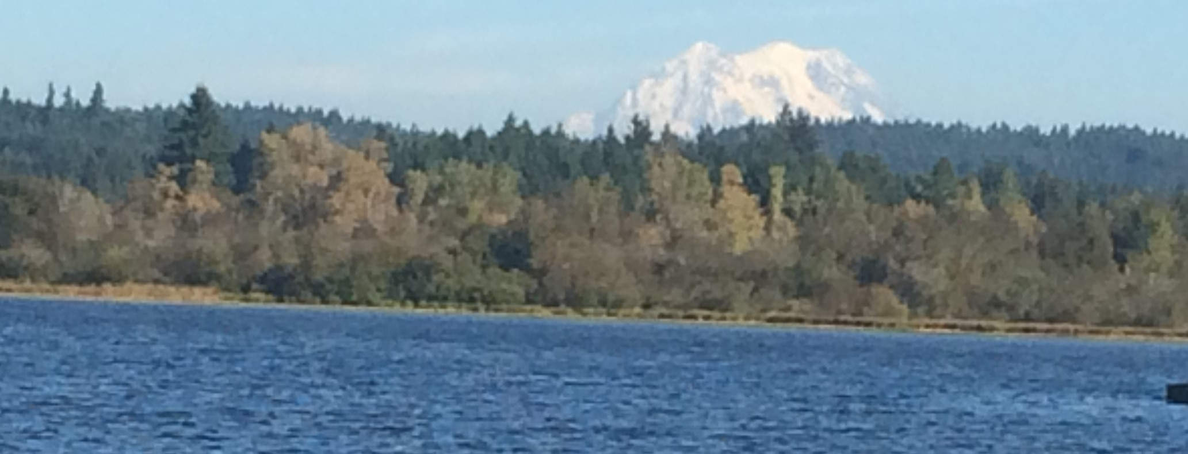
What do we still need to do?
Get input from the Offut Lake Community via public meetings, emails, talk to committee
Apply for grants
Complete a draft budget (lake boundaries, parcel categories and assessment levels)
Gather petition signatures

Slide 35
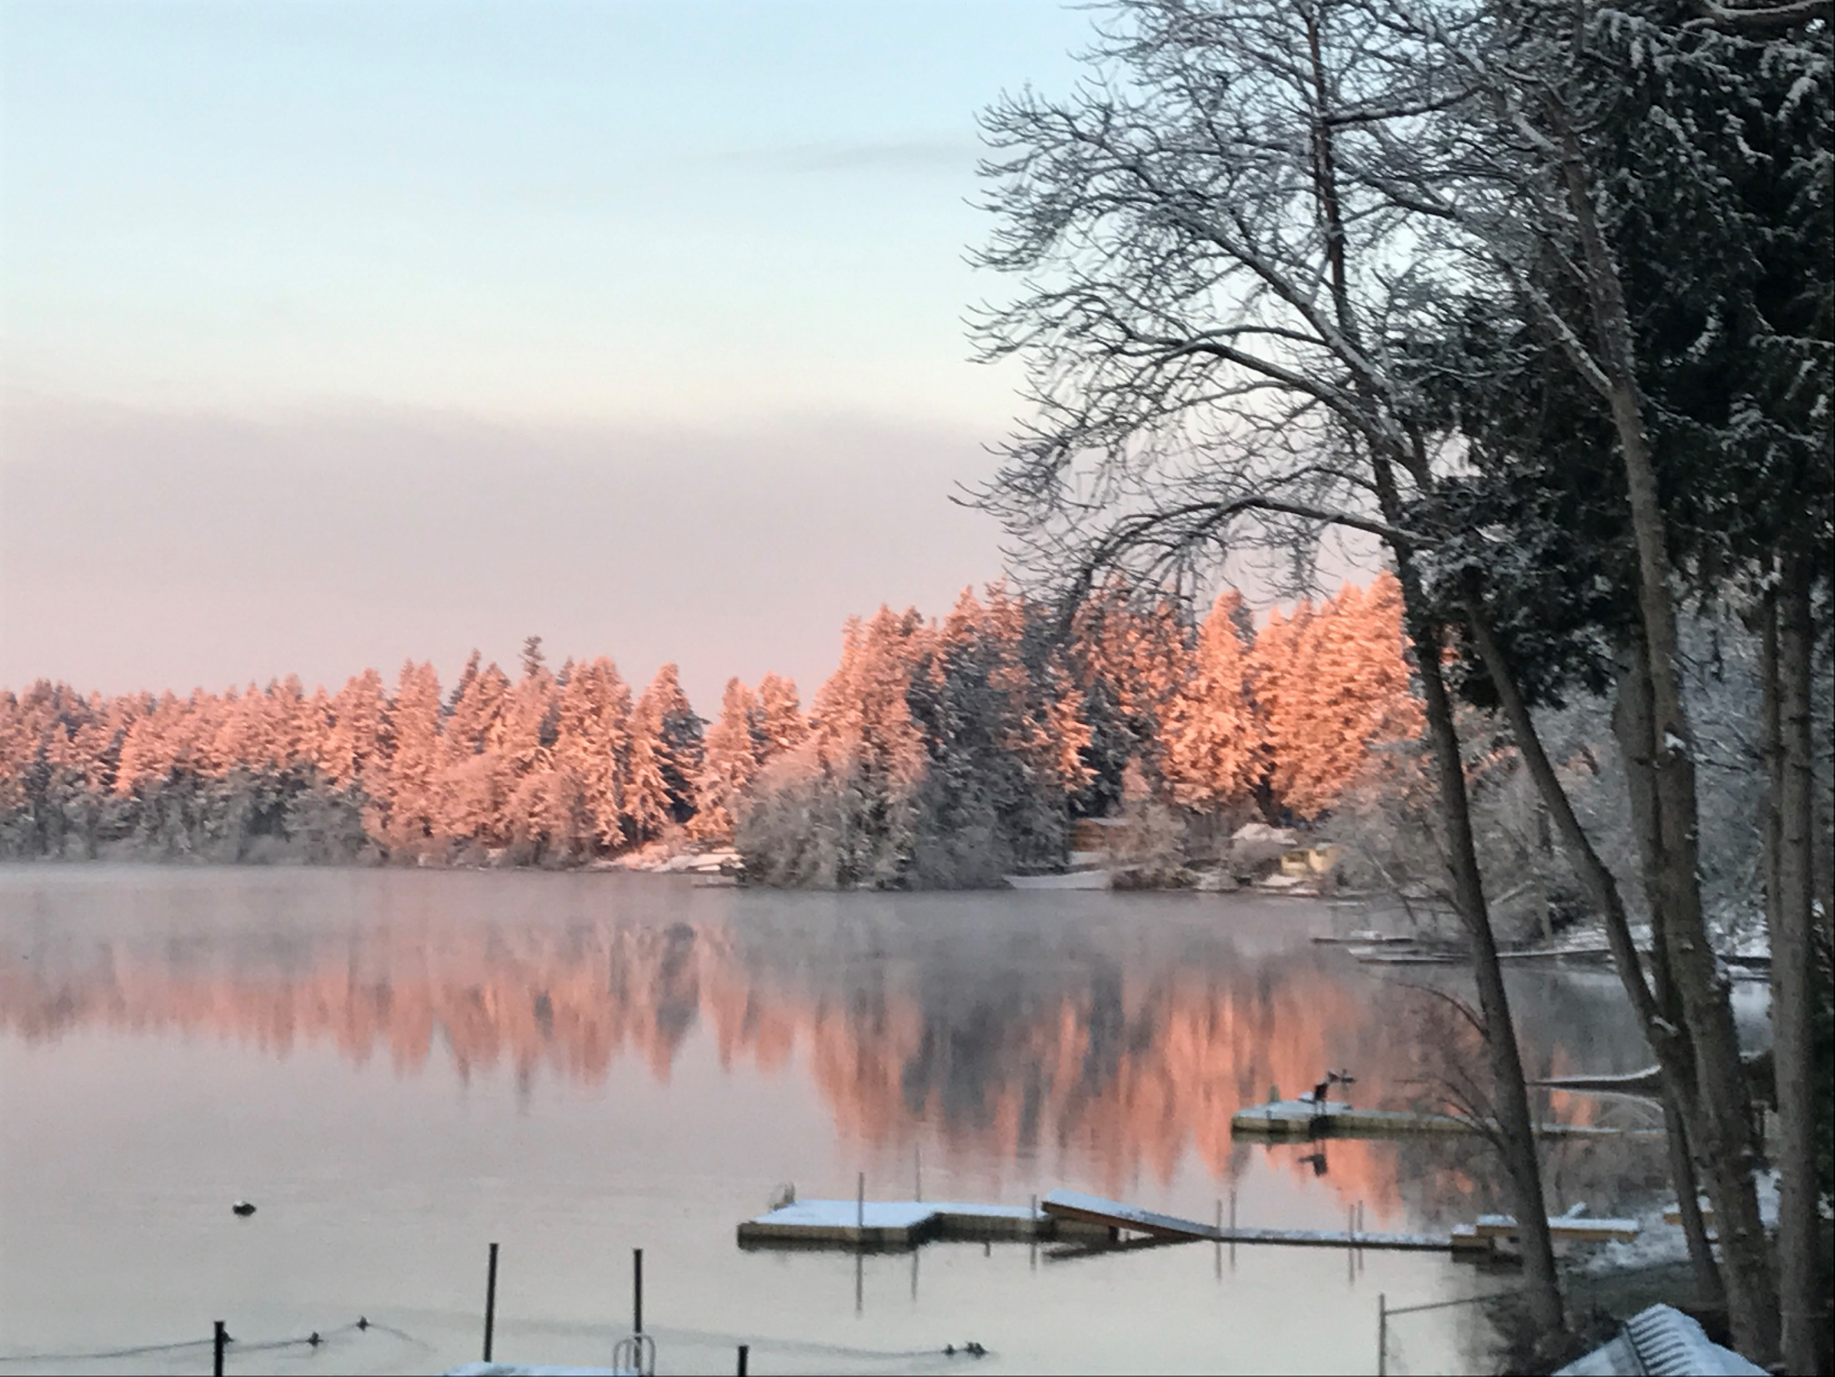
Community
Input
Diane

Slide 36
SPEAKER – DIANE PERLMAN
We have come to the most important part of the meeting. We need your input, your thoughts, hopes, fears, plans, dreams . We will be dividing in groups to do this.
Before we look at the questions we have prepared for you, we realize you may have additional questions either for Barry or the committee. There will be a time for those in a few minutes before we leave tonight. We do not pretend to have all the answers. WE WISH WE DID! We have learned a lot and realize there is much more to learn. You can help us by asking the questions and helping us find the answers.
If you are viewing zia Zoom and wish to provide input, please email us at: info.offut.lake@gmail.com
We will be sending all Zoom participants a copy of this slideshow, all that was shared in groups, and other information distributed at the meeting.

Slide 37
What are your thoughts?
What are your top three
concerns about the lake?
What are your proposed solutions?
What other questions do you have?
These are the questions each group was asked to address.

Slide 38
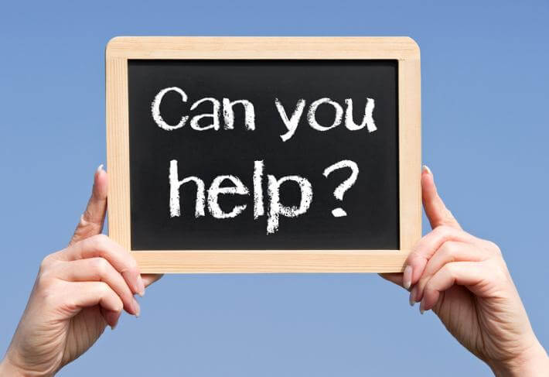
SPEAKER – LAURA SOMMERS

Slide 39
How can you help?
Volunteer!
Share your thoughts with our steering committee.
Sign-up for our e-newsletters
Review materials on our website
Visit our website:
Offutlakecommunity.godaddysites.com
Contact us: info.offut.lake@gmail.com
Skills/Experience Needed
Biology/Botany
Water management
County government
Accounting/budgets
Volunteers to get weed assessment training

Slide 40

SPEAKER – GARY WITLEY
Well, we are almost done for the evening. In spite of our best efforts, I’m pretty sure we have not yet answered all the questions you may have.
So let’s take a few moments to deal with that...

Slide 41
Questions for Steering Committee?
We collected remaining questions from the audience. Zoom participants were encouraged to email us their questions. We plan to collate all of those questions and research answers to be shared at our next meeting on January 26th.

Slide 42

SPEAKER – DIANE PERLMAN
Thanks to everyone, here and on Zoom, for your time and thoughtful input this evening.
You can help us by telling your neighbors who were not here tonight about our next meeting two weeks (January 26th).

Slide 43
We hope to see you at our next meeting right here on Wednesday, January 26, 6:30pm.
Diane

