Slide 1
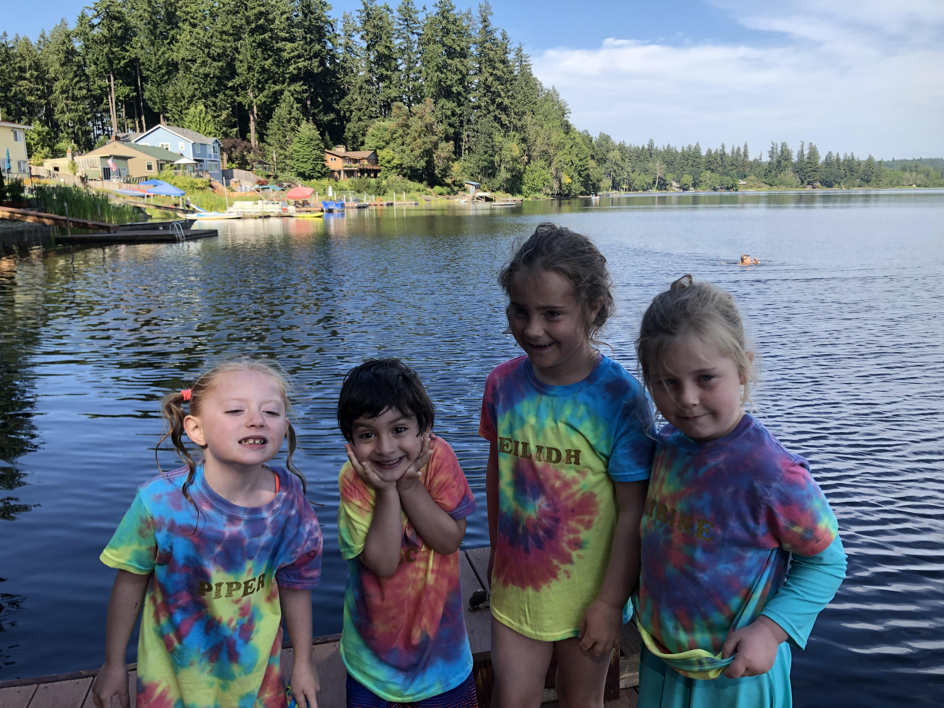
Offut Lake Public Meeting
6:30PM - January 26, 2022
WE L C O M E !

Slide 2

The Offut Lake Steering Committee welcomes you!
Our Steering Committee members are:
Diane Perlman, Gary Witley, David and Laura Sommers, Kathleen Knolte, Rich and Kathi Durkin, James Burkhart, Rob Pogue, Mary Kempfe, Patty McGuire, and Pat Petersen.
We are glad you are here to help us move further along in the process.

Slide 3
Agenda
Review Mission Statement
Rationale for choosing LMD
Guest Speaker: Paula Cracknell
Budget
Assessment vs Action
Discussion
Questions?
Wrap-Up

Slide 4
Review—Our Mission Statement
Offut Lake Steering Committee
We are a group of concerned Offut Lake citizens whose mission is to restore, preserve and protect the natural beauty, recreational activities and wildlife habitat of Offut Lake through cooperative weed management, water quality projects, community awareness, and educational programs for the benefit of all.

Slide 5
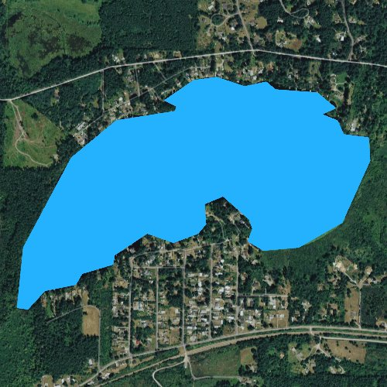
Lake
Management
District

Slide 6

Our Steering Committee has voted
to proceed with forming a Lake Management District (LMD) instead
of a Special Utility District (SUD).
At the last meeting Barry Halverson spoke to the advantages of an LMD. We’d like to share why we chose LMD.

Slide 7
LMD RATIONALE
More Washington lakes have chosen LMD (17) over SUD (1).
SUDs can be sued. LMDs cannot.
SUDs require a huge amount of work from the committee, including three elected commissioners. Knowing how much work it has taken the Steering Committee to get this far, we do not believe an SUD would be sustainable.
LMDs protect members because it cannot borrow. SUDs can borrow money and go into debt for all owners.
LMDs provide more safety for people, pets and wildlife with control over chemicals/frequency and what happens in our lake.
The BoCC just authorized $10,000 for 2022 and 2023 to assist lakes forming LMD’s (not for SUDs).
LMDs are given priority for State grants such as: WSDA/DNR/WDFW.

Slide 8

Paula Cracknell

Slide 9
Paula Cracknell is the County’s Aquatic Resource Specialist. She manages Lake Districts and conducts aquatic weed investigations in lakes and the county river systems. She holds an M.S. in Environmental Science. Her academic research focused on nutrient transport from river systems into the Puget Sound and how this influences Algae Blooms.
An expert in her field for algae and chemistry related issues, Paula frequently works with students and volunteer groups to clean up water systems.
Paula is also an aquatic weeds expert and creates training and educational materials to educate the public with her work at Thurston County and the Washington State Lakes Protection Association. When she isn’t chasing water quality
issues, Paula enjoys spending time
with her teenage daughters and
working on the never-ending list
of house projects.

Slide 10
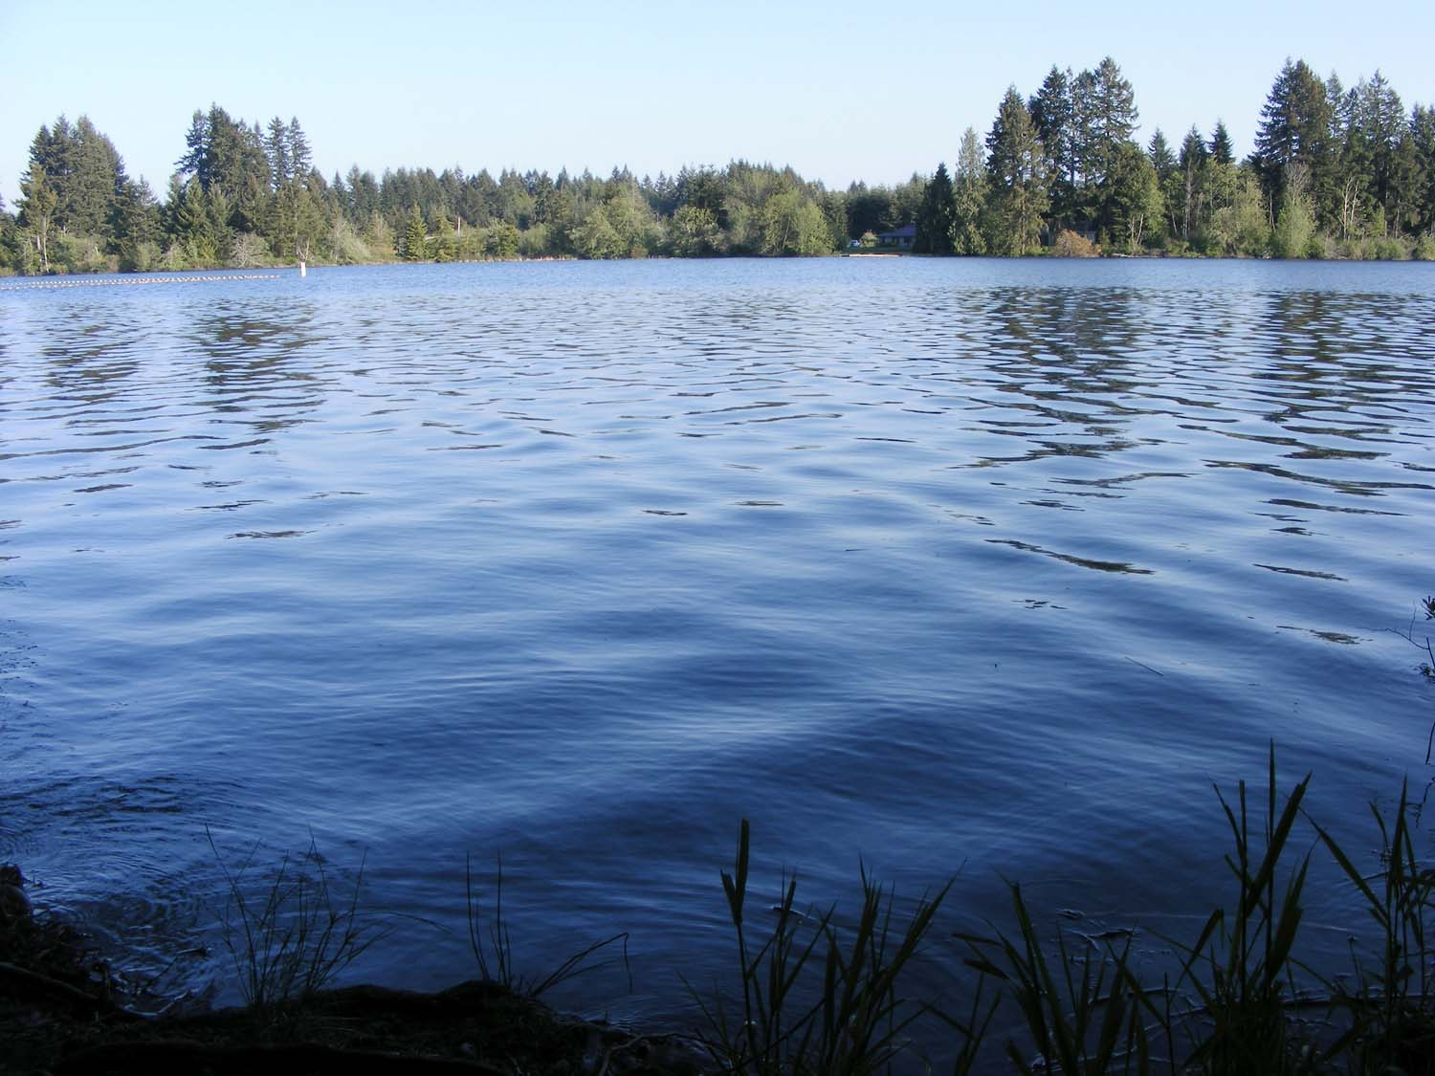
Thurston County Lakes Management Program
Paula Cracknell
Aquatic Resource Specialist

Slide 11
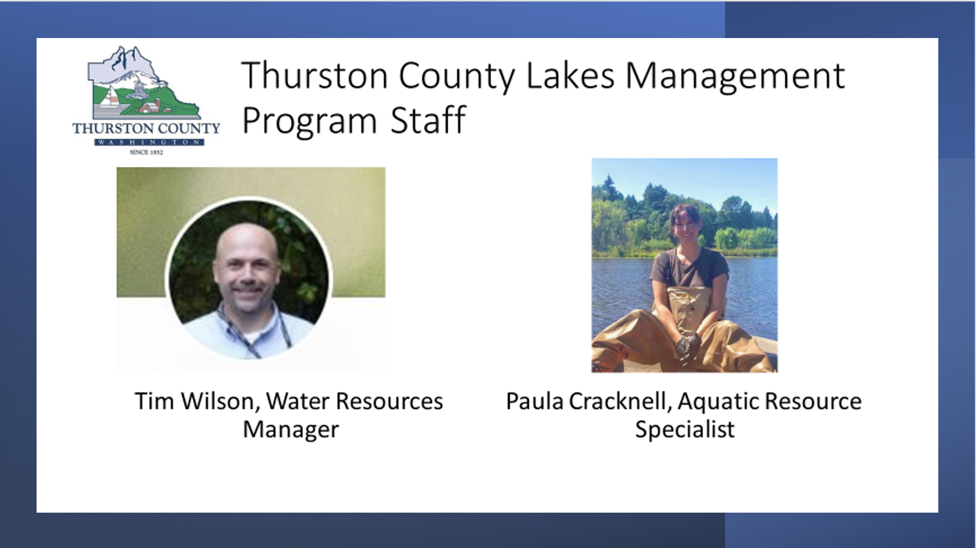
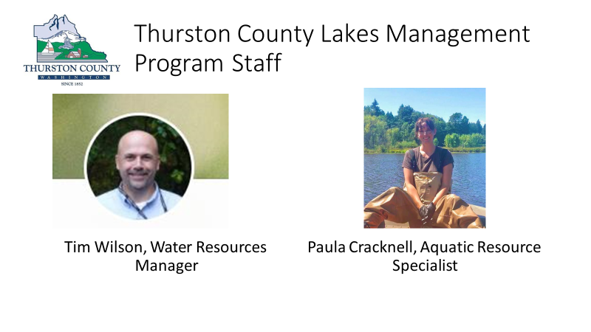

Slide 12
Why Form a Management District – Who Takes Care of the Lake?
Why Form a Management District- Who Takes Care of the Lake?
All lake waters are considered waters of the state and are governed by Washington State Department of Natural Resources
All permitting for aquatic pesticide applications are governed by Washington State Department of Ecology and Washington State Department of Agriculture, activities must adhere to permit requirements
Shoreline development is governed by both Ecology and Thurston County codes and ordinances
Lake projects for water quality and vegetation management are organized by lake residents… governmental organizations do not own the land.

Slide 13
ORGANIZING A LAKE DISTRICT
Lake Management Districts (LMDs) are formed by a petitioning process with County or City elected officials and residents.
LMDs are a partnership between County or City departments and residents who reside within the LMD boundary.

Slide 14
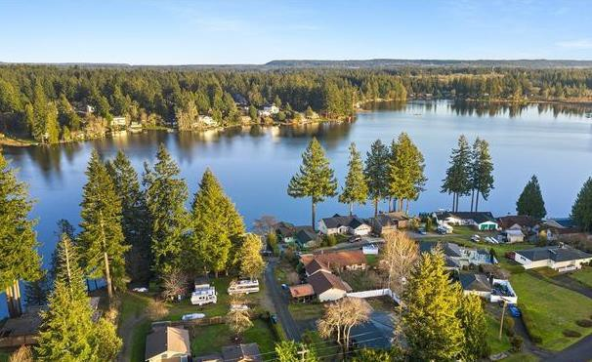
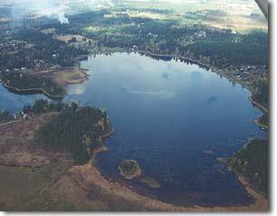
EXAMPLES OF LAKE MANAGEMENT DISTRICTS
Long Lake
Lake Lawrence
Established in the 1990’s
Established in the late 1980’s

Slide 15
Aquatic vegetation control
Phosphorus Management
Water quality improvement, including control of stormwater and agricultural runoff
Lake water-quality studies to pinpoint problems and identify solutions
Ditch or stream maintenance
Measures to maintain lake levels
Education and outreach materials
An LMD is a long-term funding source for lake improvement projects
What Can a District Finance?

Slide 16

Developing Work Plans for Offut LMD (OLMD)
Initiating a new LMD begins a process of program development
Steering Committee members represent neighbors and meetings are held to develop plans- Be involved in the process
Steering Committee implements plans with input from the county and other experts
Roles and responsibilities are defined
County oversees and implements work plans and development
First step for Offut Lake- Develop Integrated Aquatic Vegetation Management Plan
  IAVMP is a complete habitat assessment of the lake
  All plants are identified and aquatic species of importance to the system
  Input from residents is considered when developing treatment plans
  Treatment plans are presented for consideration
  Contact Paula Cracknell to see an example Long Lake IVAMP

Slide 17
COUNTY LAKE MANAGEMENT DISTRICT
The county Aquatic Resource Specialist acts as a consultant for LMDs
  Work plans are developed, and FTE is agreed upon between county and steering committee depending on work plan.
Research best management practices
Design studies for plant and nutrient management- including in field research, data collection and analysis of data
Apply aquatic herbicides
Secure NPDES permit and ensure all contractors hired are compliant
Act as point of contact with hired contractors
Mapping and reporting
Community outreach and educational materials
Write contracts and present to the Board of County Commissioners
Represent the LMD and county on political or policy issues
Manage budget and planning for future work

Slide 18
HOW TO BEGIN THE PROCESS OF FORMING A DISTRICT?
Forming a committee of interested lake residents is the best way to begin.
The first formal step in the LMD process is to submit a petition to the BoCC
The owners of at least 20 percent of the acreage in the proposed district must sign the petition in support of the proposal.
It’s important to work with consultants and county (or city) staff in writing the petition; this will ensure that all legal requirements are met and that the proposed budget is feasible.
The petition should identify:
  Proposed lake management activities;
  Amount of money to be raised;
  Proposed assessment formula;
  Boundaries of the district; and
  Duration of the district (up to ten years).
  Financial security of up to $5,000 may be required with the petition.

Slide 19
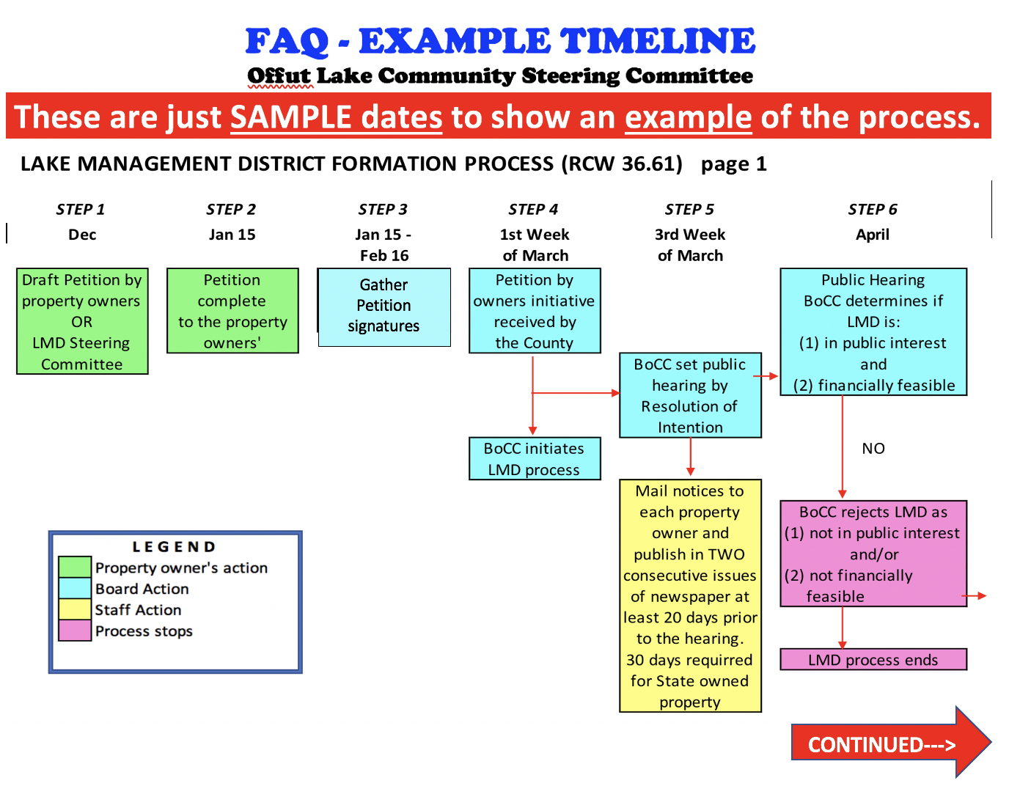

Slide 20
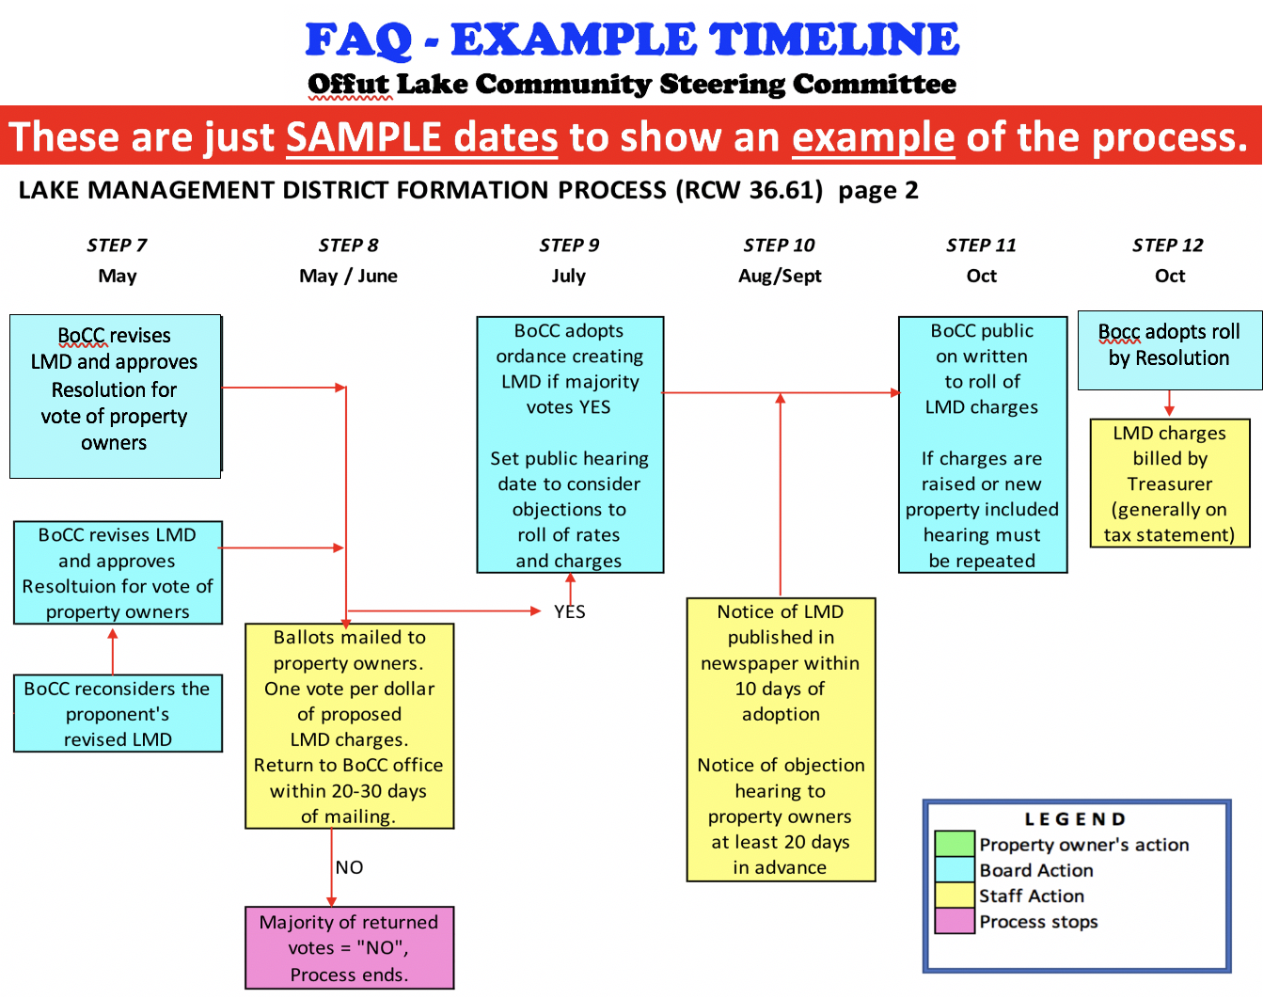

Slide 21

Questions for Paula?

Slide 22


Slide 23

We know one of the biggest concerns is
“How much is this going to cost me?”
This has been an ever-present concern for the Steering Committee from the beginning.
Our guiding principle comes from the RCW mandate to be “fair and equitable.”
So, let’s talk briefly about a
“Budget 101” principle.

Slide 24
BUDGET 101
Less $ = less work we can do.
More $ = more work we can do.

Slide 25

Our proposed budget has the similar challenges to your home budget. We need to plan for both expected and unexpected costs and some things increase in price.
Contracted services in our budget are estimates. The actual costs will be known once we go out to bid.
We want to generate enough funds to do something but low enough so that it is affordable and the petition passes.

Slide 26

Offut Lake

Slide 27
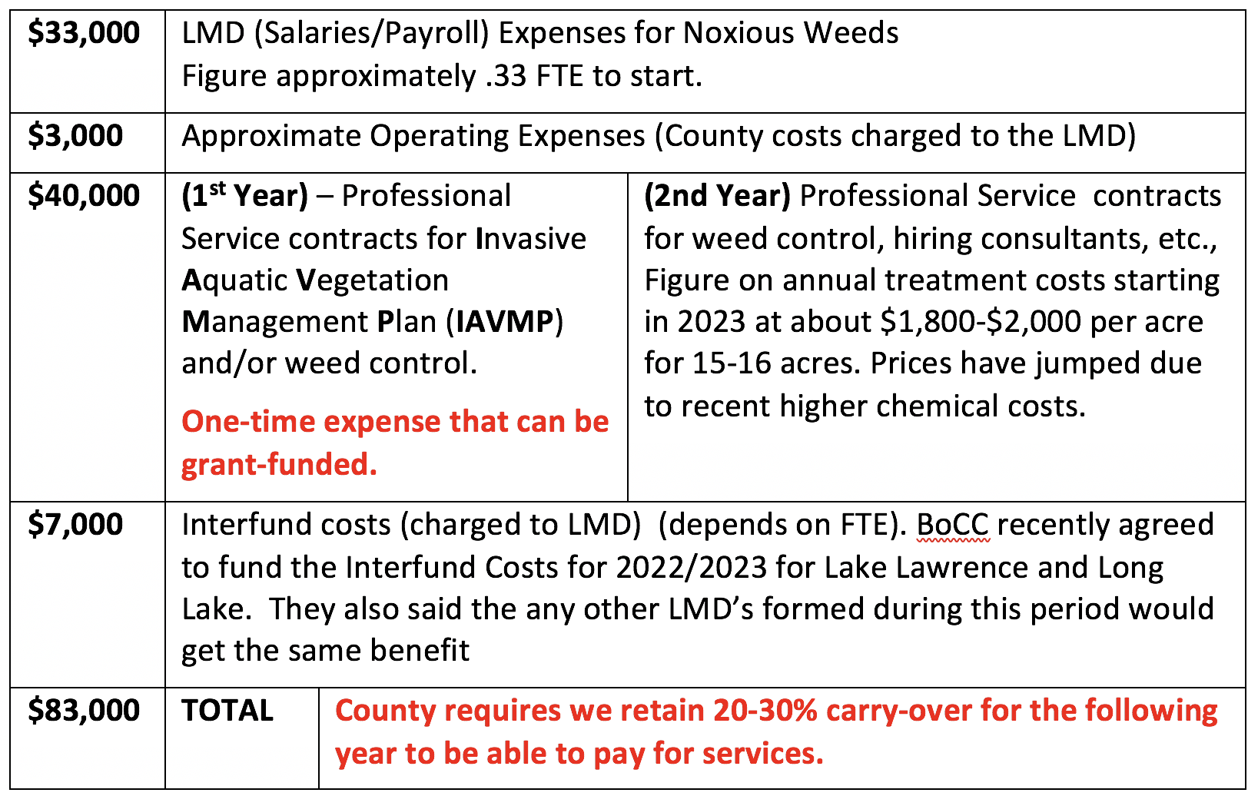
Updated draft BUDGET

Slide 28

So, we have a budget. How soon can work begin? That is determined by assessment. Here is what we know.

Slide 29
ASSESSMENTS = ACTION
HIGHER
LOWER
A S S E S S M E N T S
1 Year
2 Years
3 Years
SOONER
LATER
A C T I O N

Slide 30

The money raised in our LMD comes from an annual assessment collected, like property taxes, twice a year: April and October.
The amount of money we raise determines what work we can accomplish.
Let’s look at at our proposed assessment model.

Slide 31
ASSESSMENT OPTIONS
LMDs are free to set their assessments based upon chosen criteria.
The assessments must be considered fair and equitable by BoCC and then the voters.
The basis for assessments could be: lakefront footage, dwellings, lakefront access, tax assessed property value, etc.
The Steering Committee has chosen tax assessed property value as our criteria.

Slide 32
Why we chose this assessment method.
All lake parcels are not the same, so it seems unfair to assess them equally. Some are small, large, developed with nice houses, developed with simple cabins, and some undeveloped.
If we assess a flat rate per parcel, owners of multiple parcels could pay more than owners of more developed single parcels. About 10% of the owners have more than one parcel. Some have more than three.
An assessment based 100% on property taxes puts an outsized burden on the top taxpayers. Therefore, we put a “cap” on the maximum assessments that we think is more fair and equitable.

Slide 33
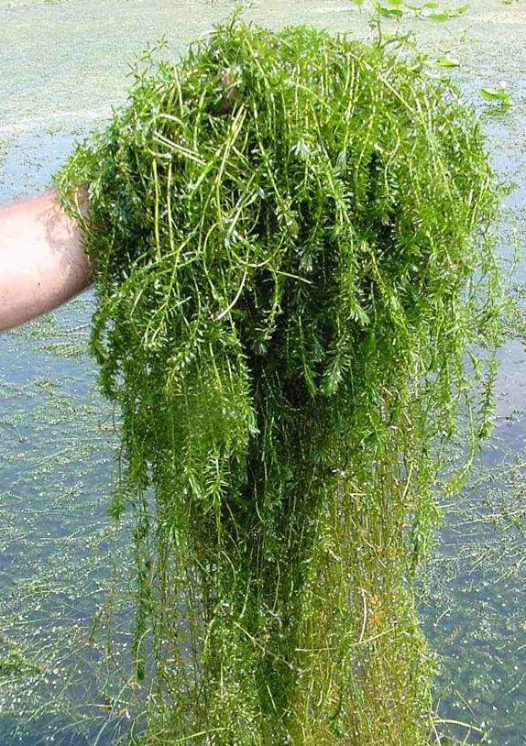
Let’s get into the budget “weeds”...

Slide 34
So now it is time to get into the
“weeds” of our proposed
assessment model.
We will look at three different
assessment rates and get your
feedback during the group discussion.
Let’s first look at an overview of all three
and then dive into each one individually.
Remember, our estimated budget
total is $83,000.

Slide 35

QUESTION: Why not make our proposed assessment equal to the proposed budget of $83,000?
ANSWER: We felt that doing so would produce an annual assessment that was too high
and would not be supported
by the voters.

Slide 36
QUESTION: What happens if the total assessment collected is less than the budget?
ANSWER: We will have to have more than one assessment year to accrue enough money to begin.
This is part of the Assessment=Action continuum mentioned earlier. Let’s take a look at three assessment levels.

Slide 37
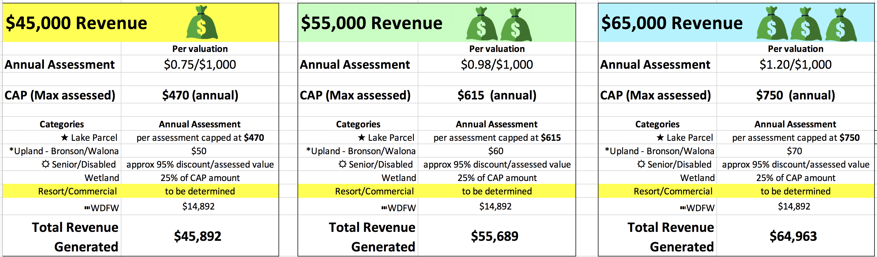
THREE ASSESSMENT SCENARIOS

Slide 38
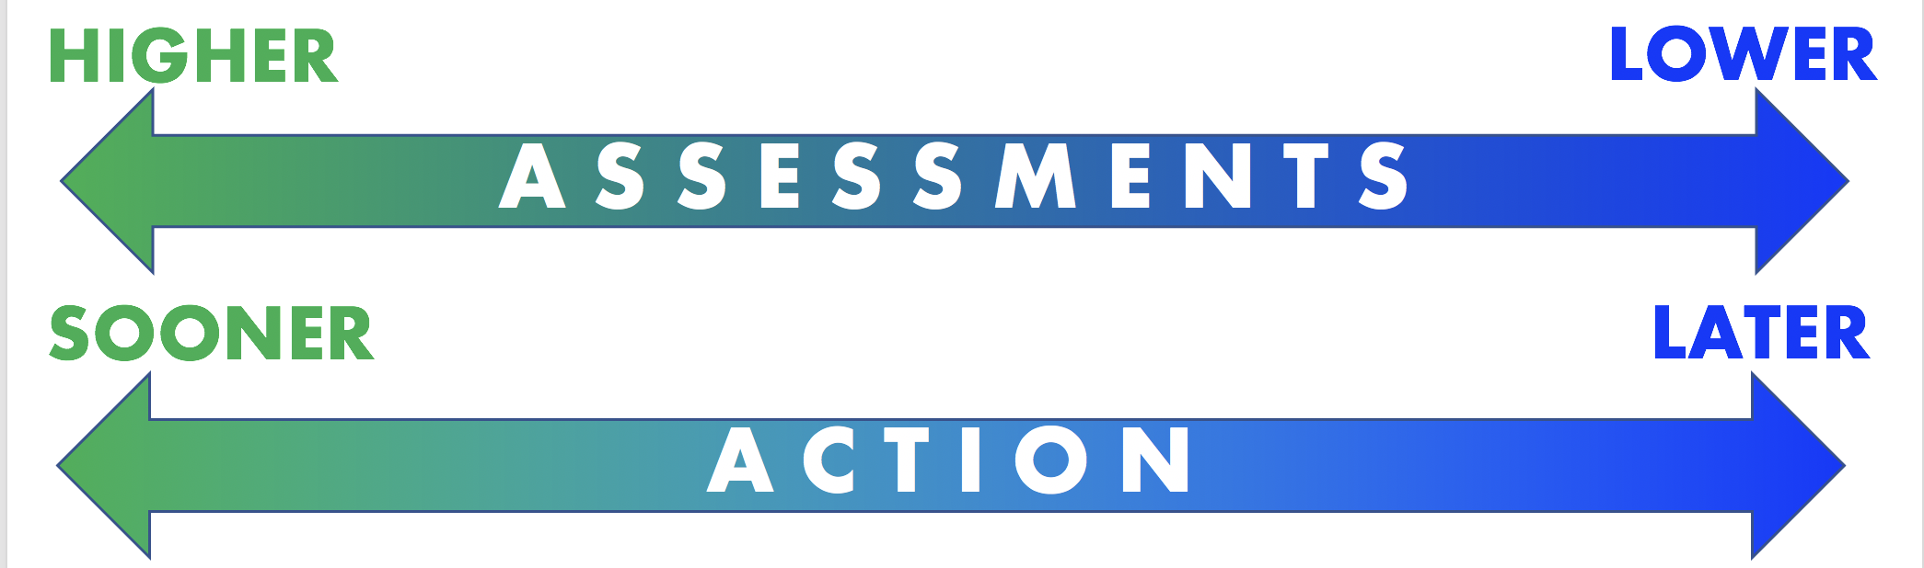
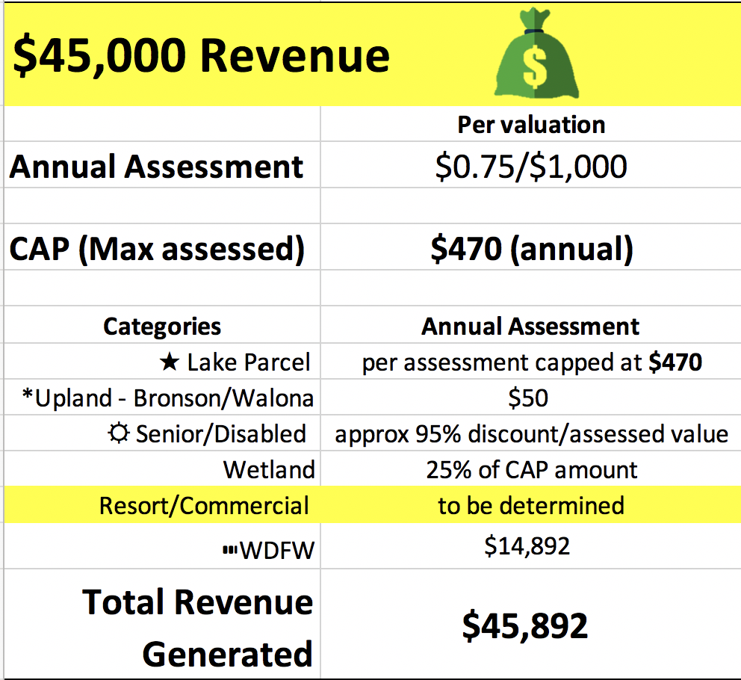
Draft Budget $83,000

Slide 39
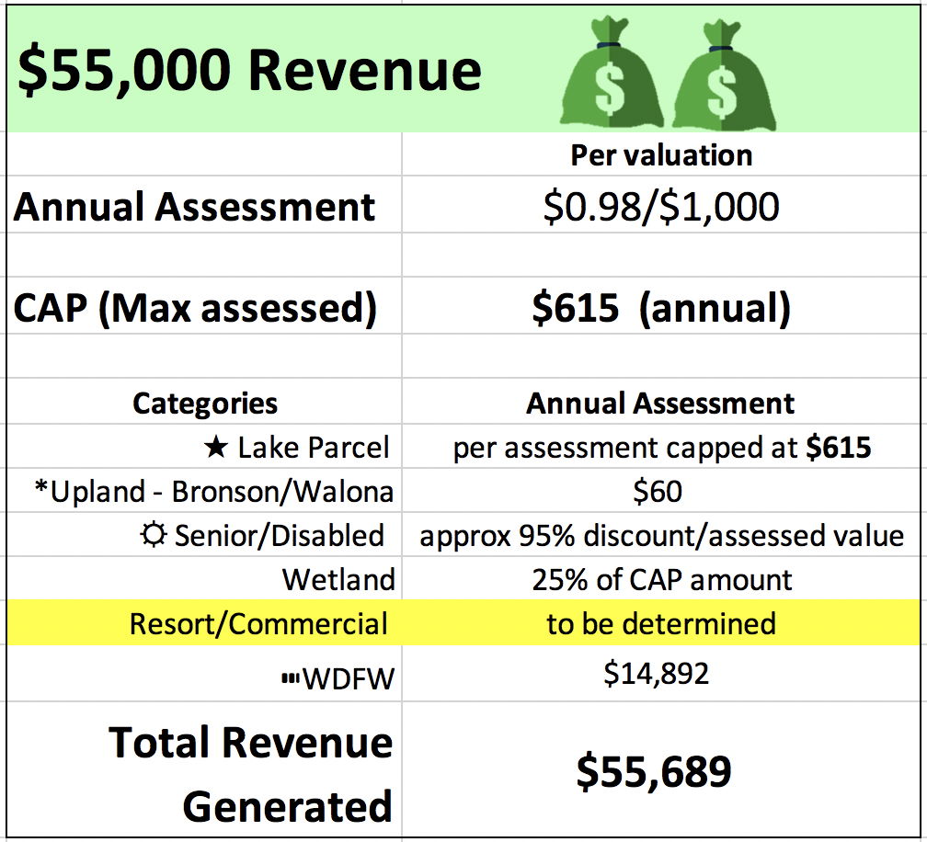
Draft Budget $83,000

Slide 40
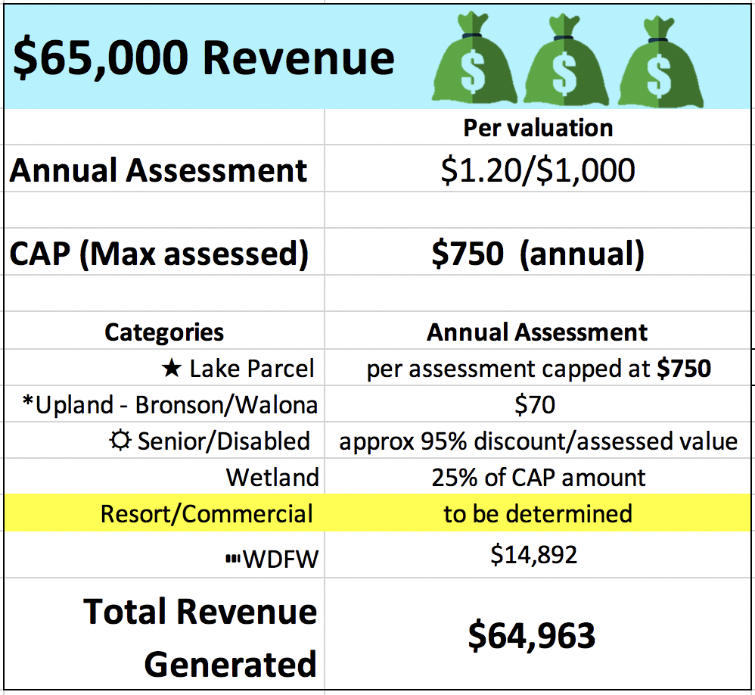
Draft Budget $83,000

Slide 41

QUESTIONS?

Slide 42
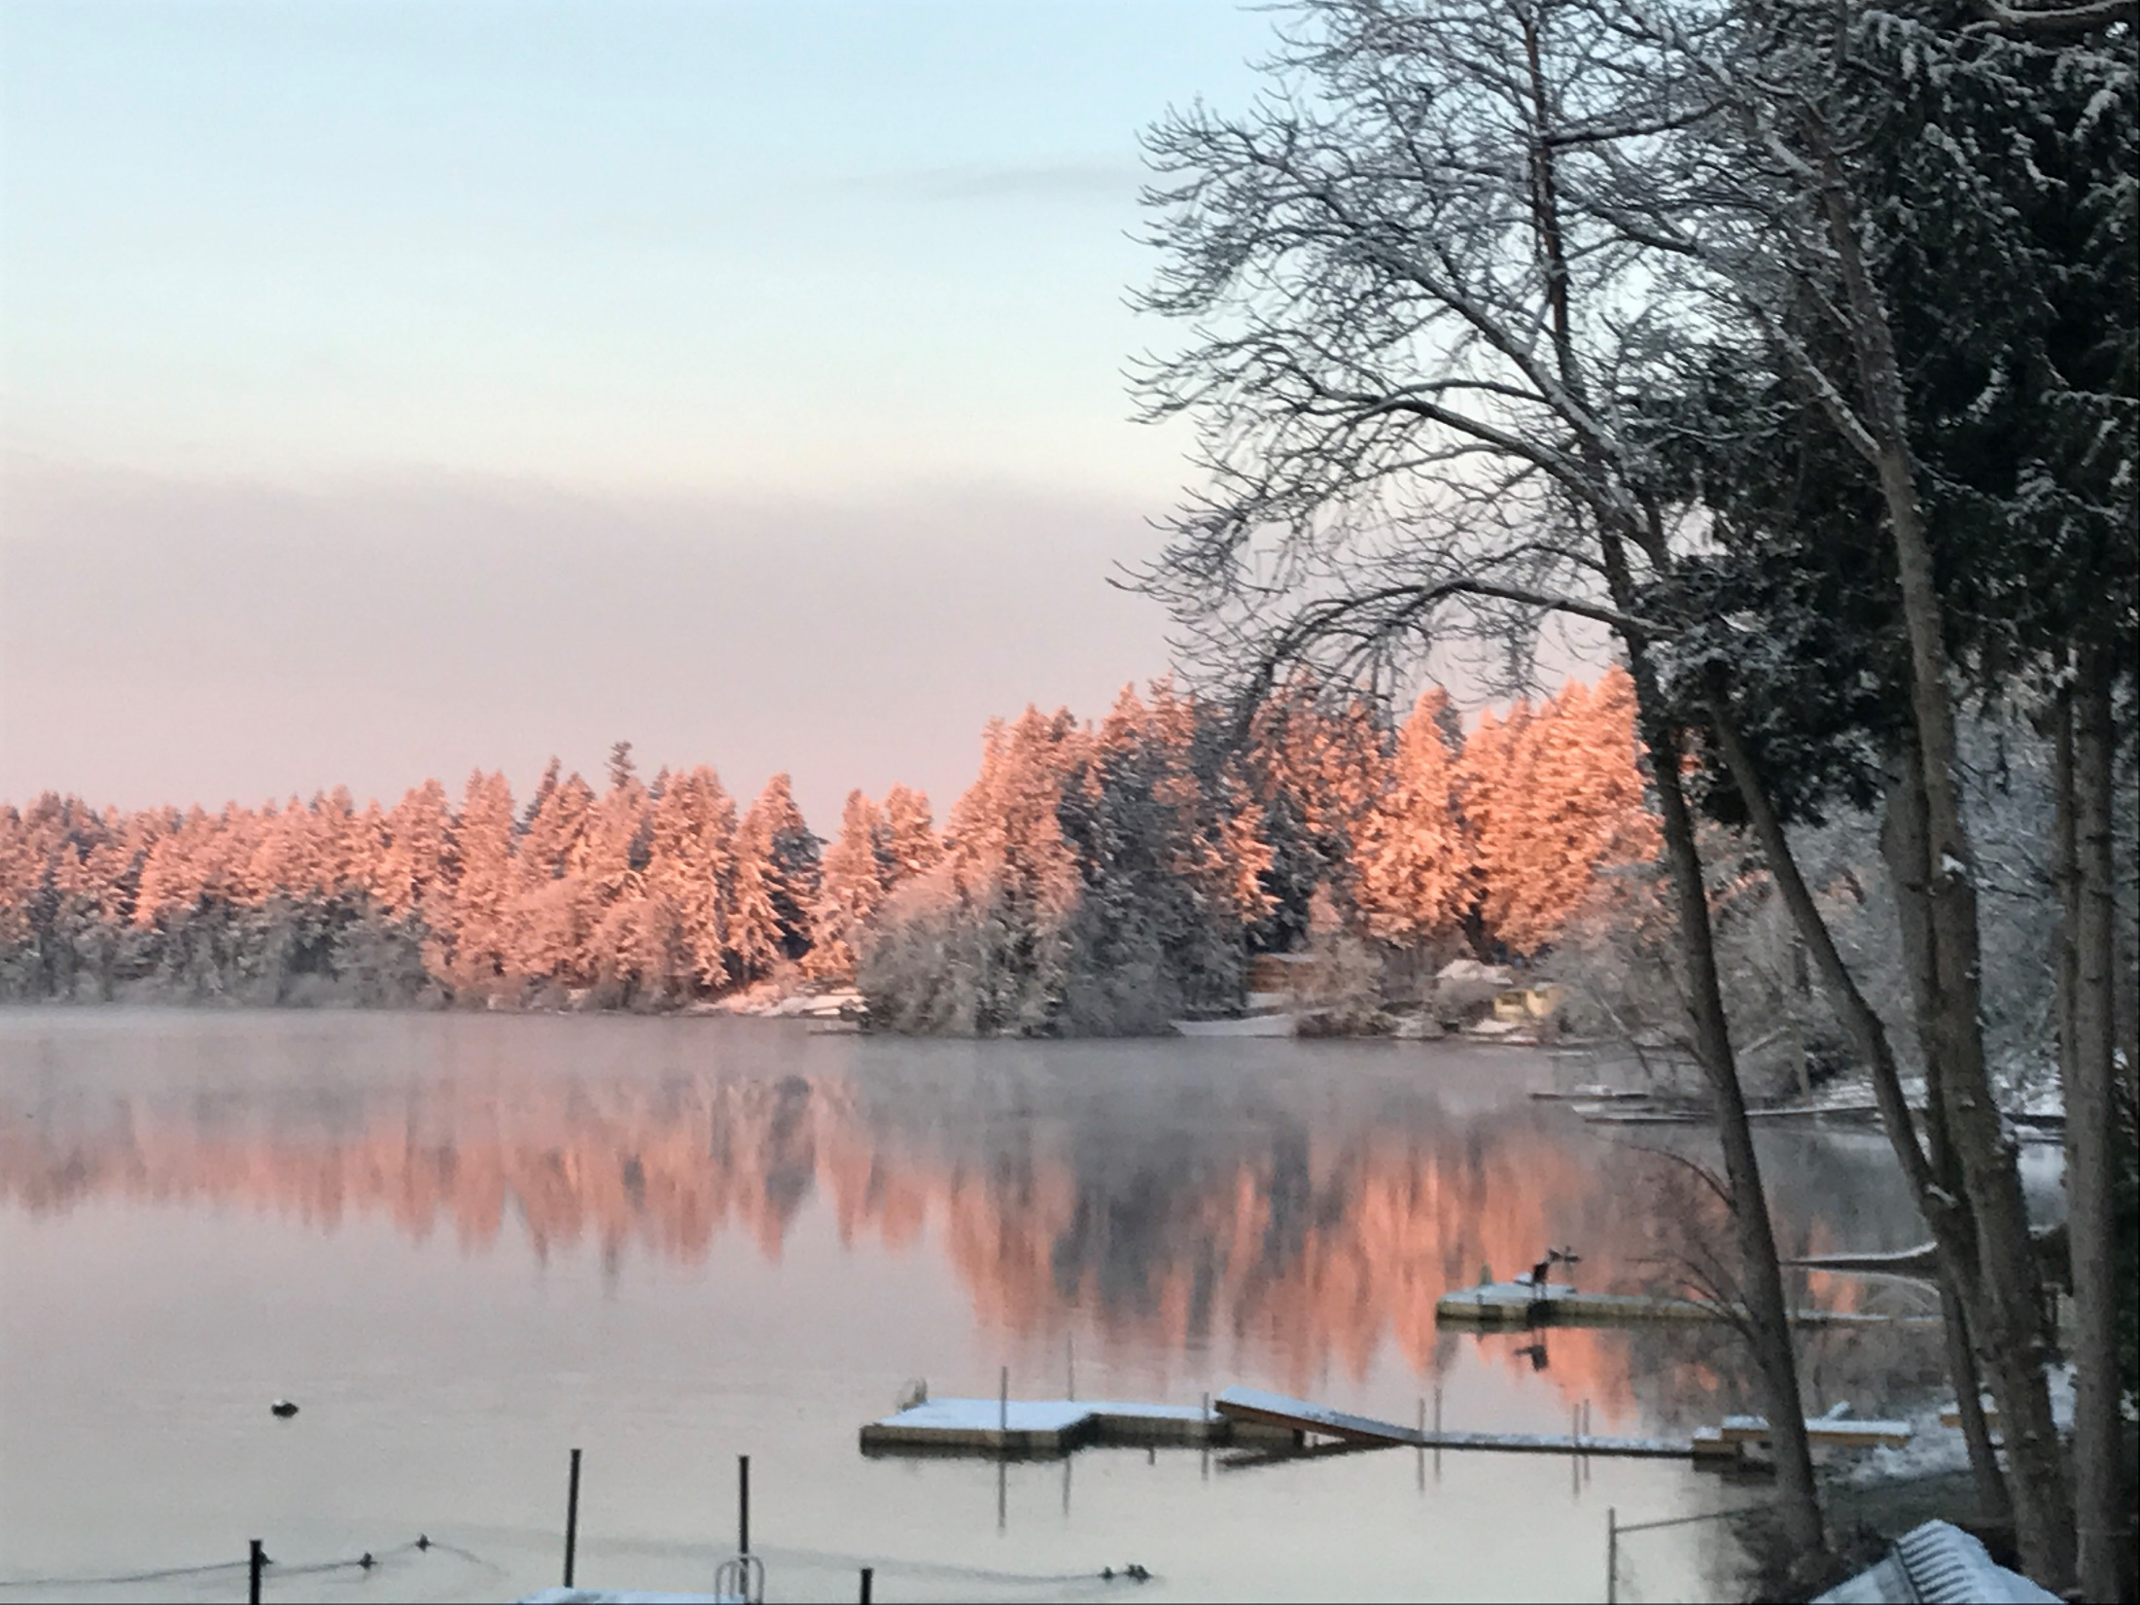
Community
Input

Slide 43

At our in-person meeting we divided up into discussion groups.
Each group was given a sheet with questions and directed to write their responses for sharing at the completion of the discussion time.
Zoom participants were encouraged to respond either in the chat or by email.

Slide 44
Discussion
1. Write down any questions you have about what we have presented tonight.
The Steering Committee must choose an assessment level as part of submitting our petition.
2. Share your thoughts on the proposed three levels of assessments you prefer?
(Low-$45K, Medium- $55K, High- $65K)
Zoom participants share in the chat or email us at:
Info.Offut.Lake@gmail.com

Slide 45
FOR ZOOM AUDIENCE (please type in Chat or email us)
1. Write down any questions you have about what we have presented tonight.
2. Share your thoughts on the proposed three levels of assessments you prefer? (Low-$45K, Medium- $55K, High- $65K)

Slide 46

GROUP SHARING TIME
The Steering Committee takes verbal questions.

Slide 47
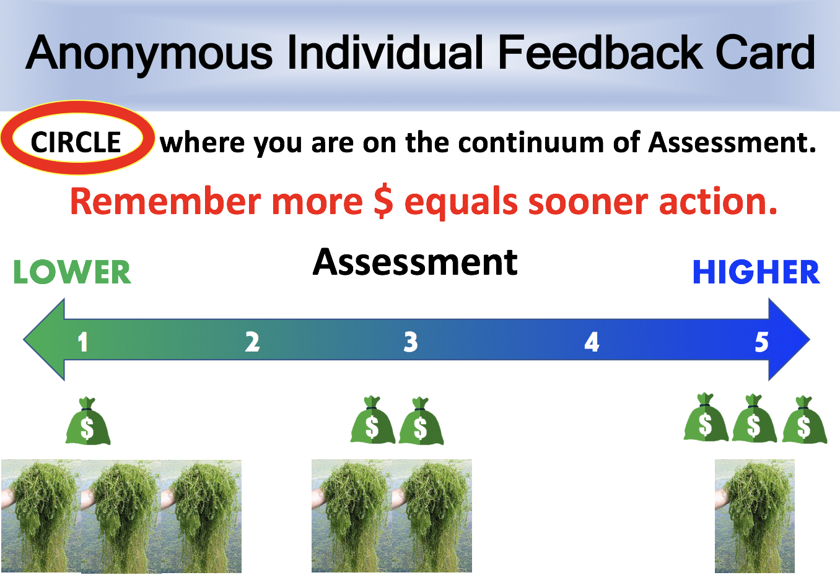
We distributed index cards to participants so they could anonymously show us where they were on the assessment continuum.
We collected these cards to help guide our decision making process.

Slide 48

Anonymous Individual Feedback Card
CIRCLE where you are on the continuum of Assessment.
Remember more $ equals sooner action.
Assessment
LOWER
HIGHER
1 2 3 4 5

Slide 49


Slide 50
We will be meeting with the County to help us with the petition process.
We are hoping to have the petition ready to gather signatures in April.
Watch our website for any updates.
We will email everyone with updates
as we have them.
We encourage you to contact us via email with your ideas or questions.

Slide 51


