Slide 1
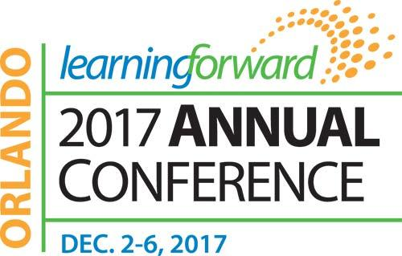
Session 2206
Tuesday, 5th December 2017 - 9.30 to 11.30 AM
Schools Can Change in India: A Case Study
Presenters: Karl Clauset & Sandeep Dutt
Notes:
Learning Forward India is the first International Affiliate of Learning Forward outside of Canada.

Slide 2

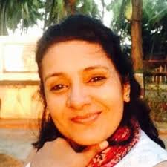
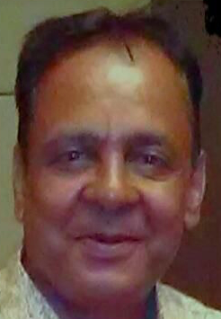
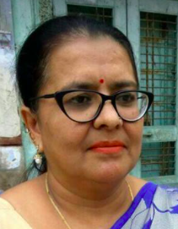
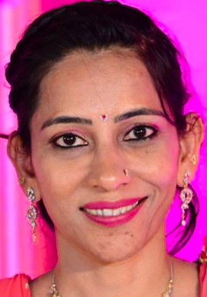

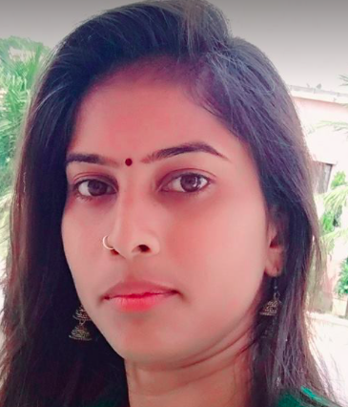

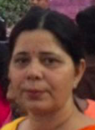

Acknowledgment
Our Sponsor
Volunteers from The Fabindia School who helped bring the case study together...
Rajeshree Shihag Principal | Ajay Vijayvargi Teacher | Bharti Rao Teacher | Prerna Rathod Teacher
Ishu Chauhan Teacher | Urmila Rathore Teacher | Kusum Sharma Teacher | Devyani Dutt Volunteer
Fabindia is India's largest private platform for products that are made from traditional techniques, skills and hand-based processes.
Our Inspiration
Notes:
In five years visiting professionals, staff and students all have worked together to build the professional learning community.

Slide 3
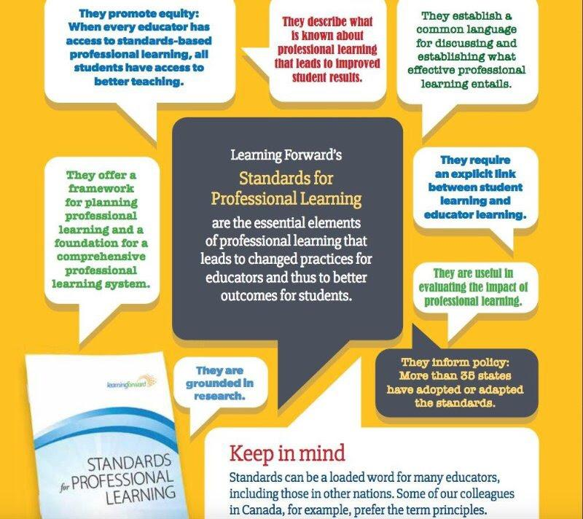
Learning Communities
Professional learning that increases educator effectiveness and results for all students requires skillful leaders who develop capacity, advocate, and create support systems for professional learning.
Notes:
STANDARDS OF PROFESSIONAL LEARNING
Learning Communities
Professional learning that increases educator effectiveness and results for all students occurs within learning communities committed to continuous improvement, collective responsibility, and goal alignment.
Leadership
Professional learning that increases educator effectiveness and results for all students requires skillful leaders who develop capacity, advocate, and create support systems for professional learning.
Resources
Professional learning that increases educator effectiveness and results for all students requires prioritizing, monitoring, and coordinating resources for educator learning.
Data
Professional learning that increases educator effectiveness and results for all students uses a variety of sources and types of student, educator, and system data to plan, assess, and evaluate professional learning.
Learning Designs
Professional learning that increases educator effectiveness and results for all students integrates theories, research, and models of human learning to achieve its intended outcomes.
Implementation
Professional learning that increases educator effectiveness and results for all students applies research on change and sustains support for implementation of professional learning for long term change.
Outcomes
Professional learning that increases educator effectiveness and results for all students aligns its outcomes with educator performance and student curriculum standards.

Slide 4
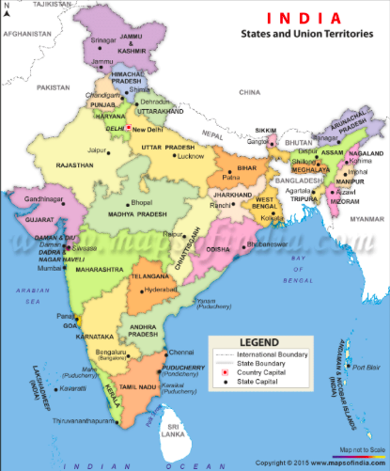


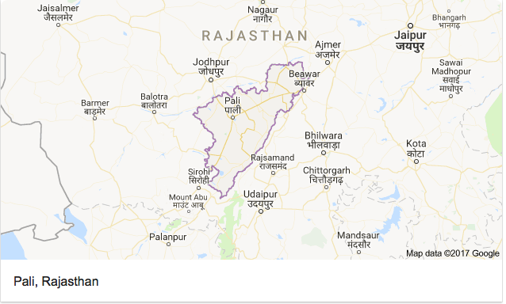
The Fabindia School, Bali...located in Pali District of Rajasthan
Notes:
Bali is a remote village in the southern part of Rajasthan, and is located in the Pali district, in the Godwar region, west of the Aravali mountain range.

Slide 5
Setting the Context
What do you know about India?
Why do you think that rural areas are the key to reform of the education system?
What would you like to learn about The Fabindia School in this session?
Notes:
Activity
Table Conversation - each group will talk and then share out their ideas
We will put up the same in the walls, for review.

Slide 6

Fabindia Mission
The Challenge:
Rajasthan had one of the highest illiteracy rates.
Parents who can afford an English medium school only sent their sons.
Education of girls is considered unnecessary.
The Solution:
Provide scholarships for girls through a partnership with John Bissell Scholars Fund.
Parents have willingly started sending their daughters to school.
The School Management Committee today comprises local residents, housewives, and professionals.
The ex-students are spread far and wide, work as professionals in urban India, and have added value to Bali and development of Rajasthan. Some are back in Bali too, and are working with us!
The people have a huge sense of pride and students are called Fabindians!
Notes:
Leadership
Professional learning that increases educator effectiveness and results for all students requires skillful leaders who develop capacity, advocate, and create support systems for professional learning.
The scholarships enable girls to attend. Now they are more than 50% of the student body. The School Management Committee promotes shared decision-making and collaboration with the community.

Slide 7
About The Fabindia School...
Established in 1992 by the Bissell Family (founders of Fabindia), in Bali Village in Pali district of Rajasthan
Under supervision of Bhadrajun Artisan Trust (focused on welfare activities for the artisan community)
The Fabindia School began operating with 11 students on a barren piece of land outside the village
Due to a lack of schools in the area, school began to cater to students from villages within 45 km
The school promotes education of girls by offering subsidized tuition fees and merit scholarships
Since 2012, after 20 years of establishment, the school began its transformation, and has come a long way…
  No longer a small village school, but an educational institution providing affordable quality education
  With best possible infrastructure providing an ecosystem to enable learning
  Has capacity for 500 students, from ages 3 to 18 (nursery to class 12), more than 50% are girls
  Like mainstream city schools, it is affiliated to the Central Board of Secondary Education (CBSE)
  The school now offers Class 10 and 12 CBSE Examinations, with Arts, Commerce and Science Streams.
  The school has attained ‘Green School Certification’ - developed a forest area, set up a solar farm, and harvests rainwater
Notes:
In 2010, the School had a capacity of 100 students, with the main K-12 school and five feeder pre-primary schools. Due the lack of trained staff and limited resources, the feeder schools could not deliver the quality education. The Board took the call to shut the feeder schools and concentrate efforts to build the 500 students main campus.
The Feeder School system did not work as we did not have the Staff and this led to dissatisfaction amongst the people. The villages did not have the property/idea locations. Need to think are the Feeder Schools diluting our brand and undermining the mission?
The Board took a courageous decision to shut the five Feeder Schools and phased them out by 2013, instead now concentrate on a Pre-Primary wing within the main campus.

Slide 8
Growth of the School...from 1992 to 2017...
1992: School opens with 11 students 1997: School obtains CBSE affiliation 2008: Commerce Stream added to the curriculum 2009: Number grew to 703 students 2010: Five feeder schools opened in the hinterland 2012: Landmark year...transformation begins… Number of students touched 1000 Sandeep Dutt joins as new BAT Chairman BAT Website setup School leadership development and transition From here on...each year marked a significant development…first infrastructure and then focus on training & soft skills. | 2013: School infrastructure continued to grow… English Language & Science Labs setup 3 year Campus Development Plan launched New Junior Campus setup New School Management System - Fedena First ever School Video released Science Stream added to the curriculum 2014: Restructuring of School Management Committee...new Principal appointed 2015: Introduced a curriculum for PDP (3 year long structured growth initiative for professional learning and growth) 2016: My Good School Program - personal & social development for students 2017: New Principal appointed, and renewed focus on the overall development of the students Dec 2017: LF Annual Conference, Orlando
Notes:
BAT - Bhadrajun Artisans Trust (the trust that runs the school)
PDP - Professional Development Program (structured curriculum for all round growth and development of school teachers, enabling them to adopt new teaching and learning techniques)
The PDP focuses on professional learning for learning communities of teachers.
Learning Communities
Professional learning that increases educator effectiveness and results for all students occurs within learning communities committed to continuous improvement, collective responsibility, and goal alignment.

Slide 9
Funding and Support
The Fabindia School is a co-ed private school, and receives no grants from the government or other non-governmental agencies.
⅔ of the annual funding needed to run the school is in the form of fees collected from the students
The balance, financial support to cover infrastructure development, is contributed by Fabindia, a leading retailer of Indian ethnic products and the key sponsor, as a part of their corporate social responsibility commitment to build better livelihoods for the families of micro-artisans, who are their suppliers.
Scholarships Program with a focus on girls and support from John Bissell Scholars Fund (USA). 25% of the students receive full scholarship.
Local community and other partners provide occasional sponsorship and support for events/projects.
Notes:
The additional funding the school receives provides resources that support high-quality professional learning for educators, including time to meet and technology tools to support collaboration.
Resources
Professional learning that increases educator effectiveness and results for all students requires prioritizing, monitoring, and coordinating resources for educator learning.

Slide 10
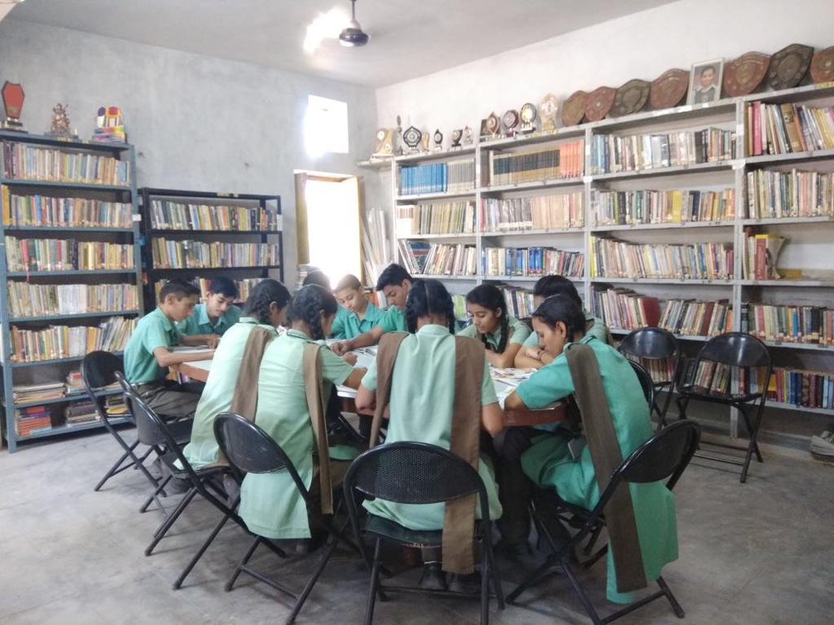
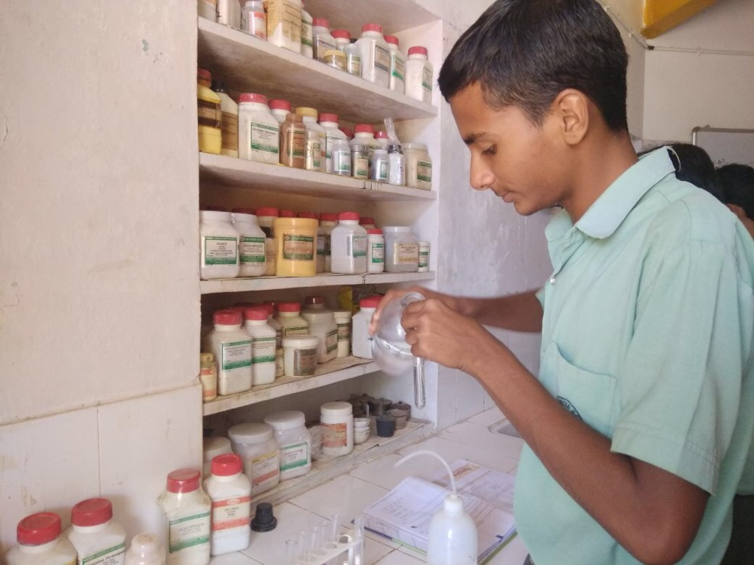
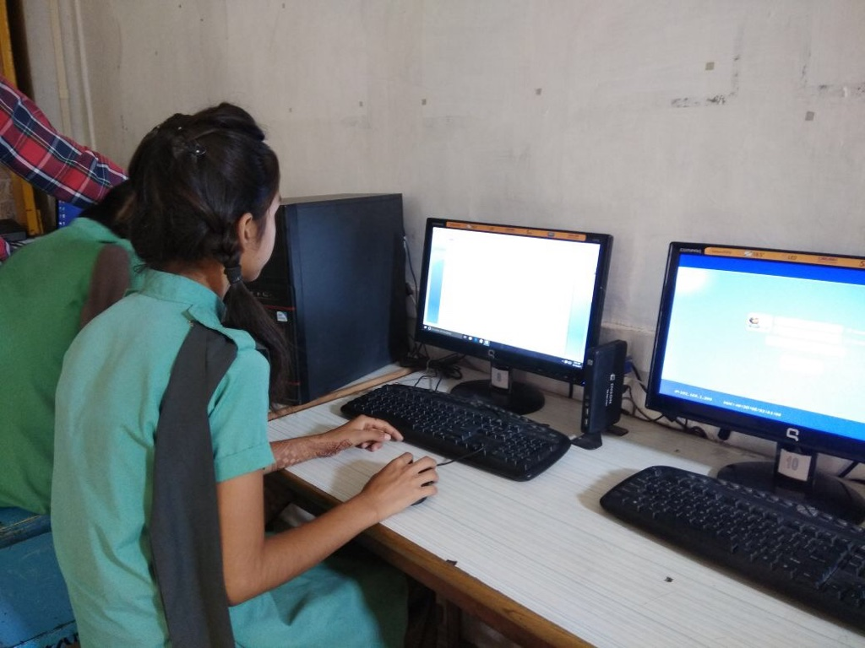
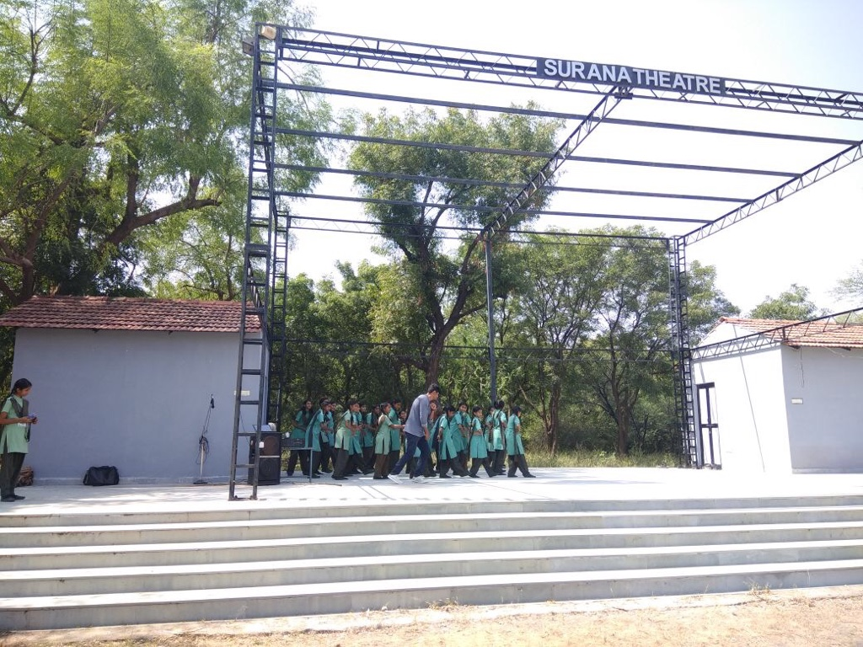
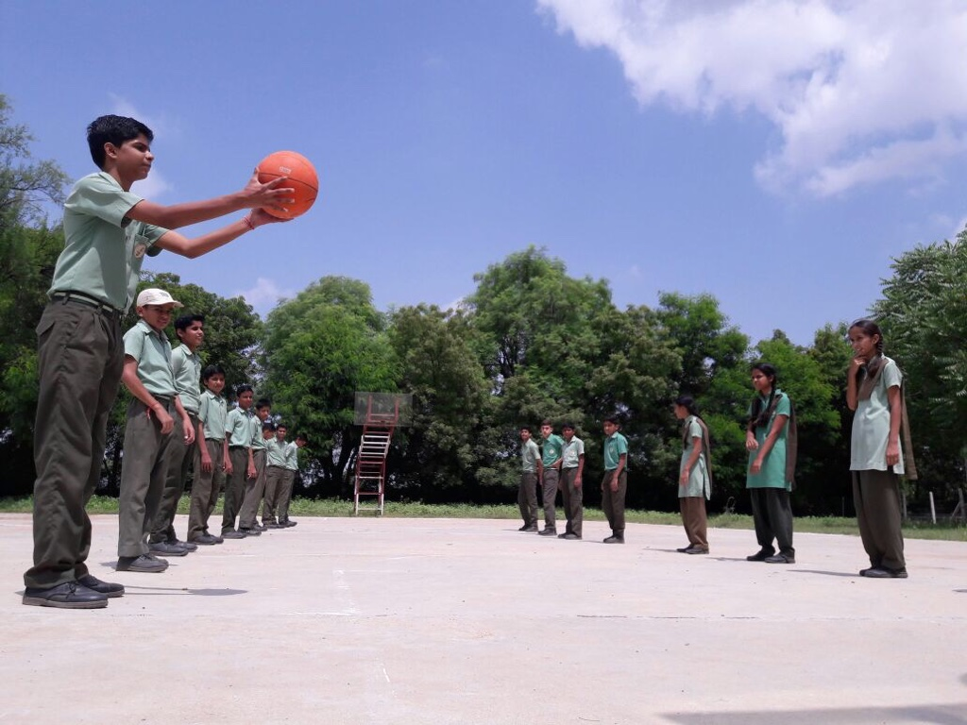
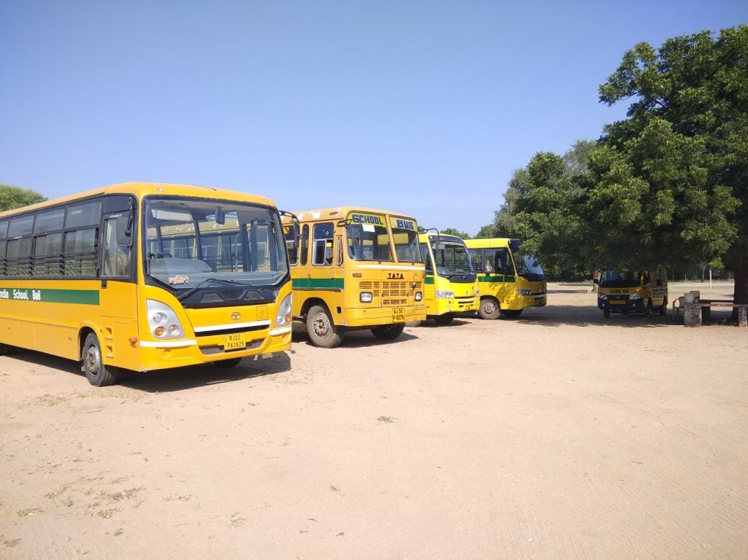
Glimpses of Infrastructure as it stands today…
Library | Science Laboratories | Computer Centre
Open Air Theatre | Sports Fields | Transport Fleet
Notes:
20 acres of land, with a forest area and play fields to help deliver experiential learning for the community.
The school also has a professional library for learning communities.

Slide 11
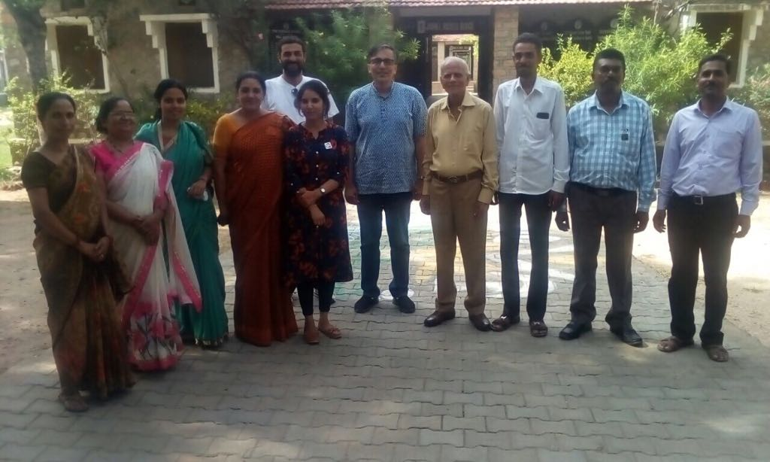
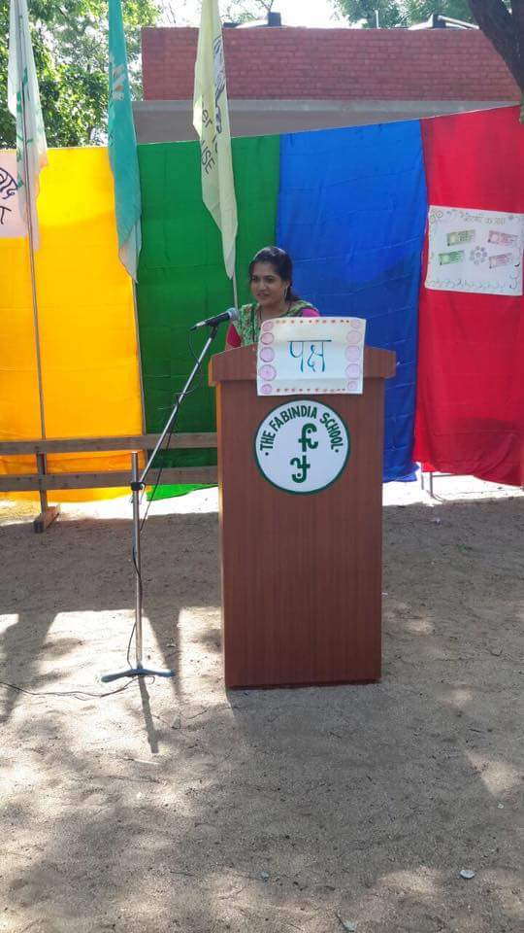
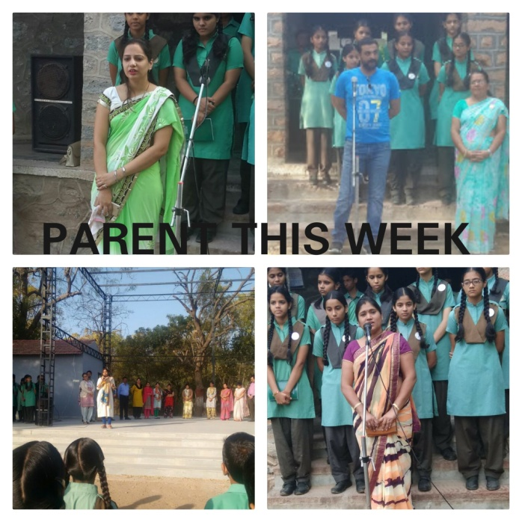
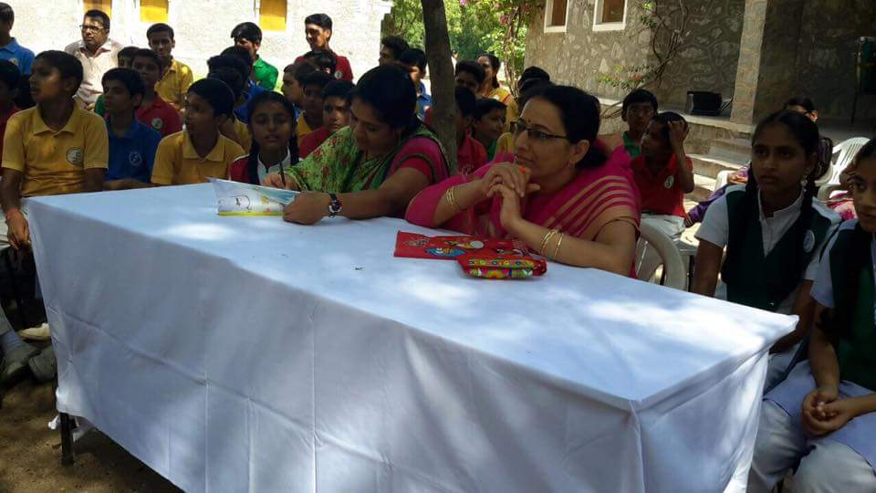
Partnership with Parents
Transport is provided to parents to attend the ongoing Parent Teacher Meetings (PTM)
Under an initiative ‘Parent this week’, parents are invited to the school assembly to give a speech and are also interviewed by the editorial board of the school magazine
Inter-house and inter-class competitions in school are judged by parents
School Management Committee (SMC) meetings are attended by representatives from parent community
Facebook Community Group www.Facebook.com/groups/fabindia
Notes:
The Fabindia school promotes learning communities among parents and people in the villages it serves.
Learning Communities
Professional learning that increases educator effectiveness and results for all students occurs within learning communities committed to continuous improvement, collective responsibility, and goal alignment.

Slide 12
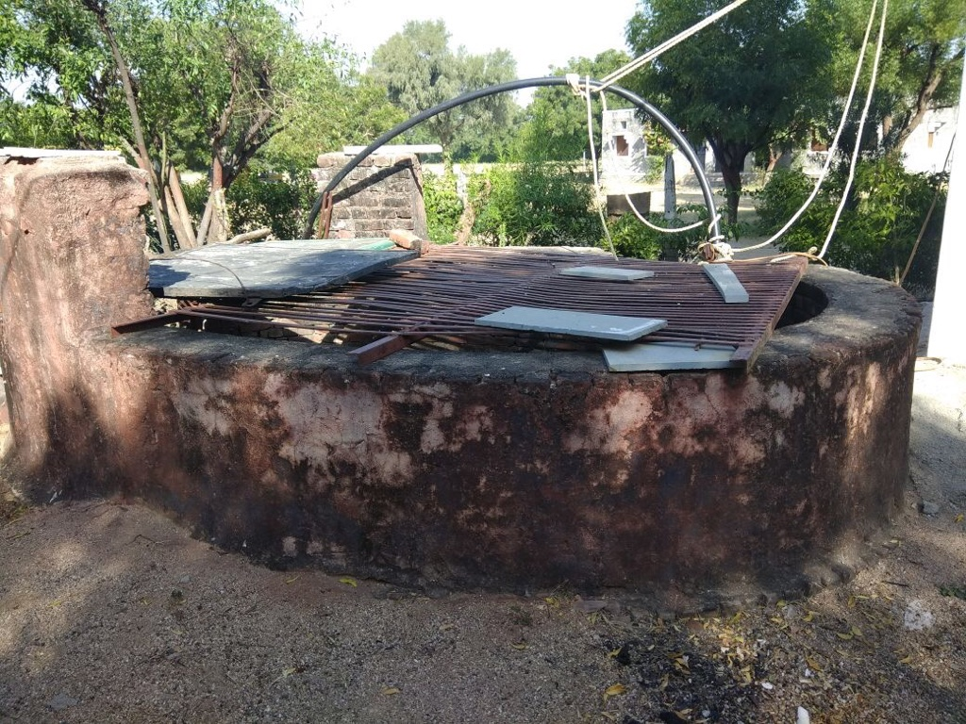
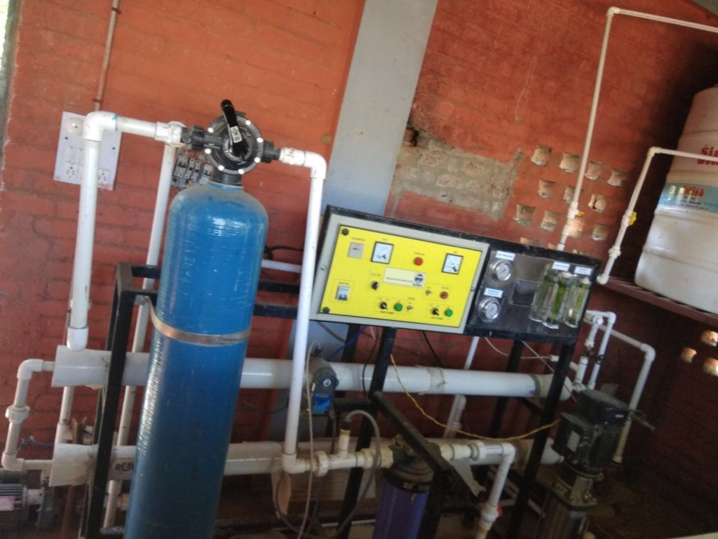
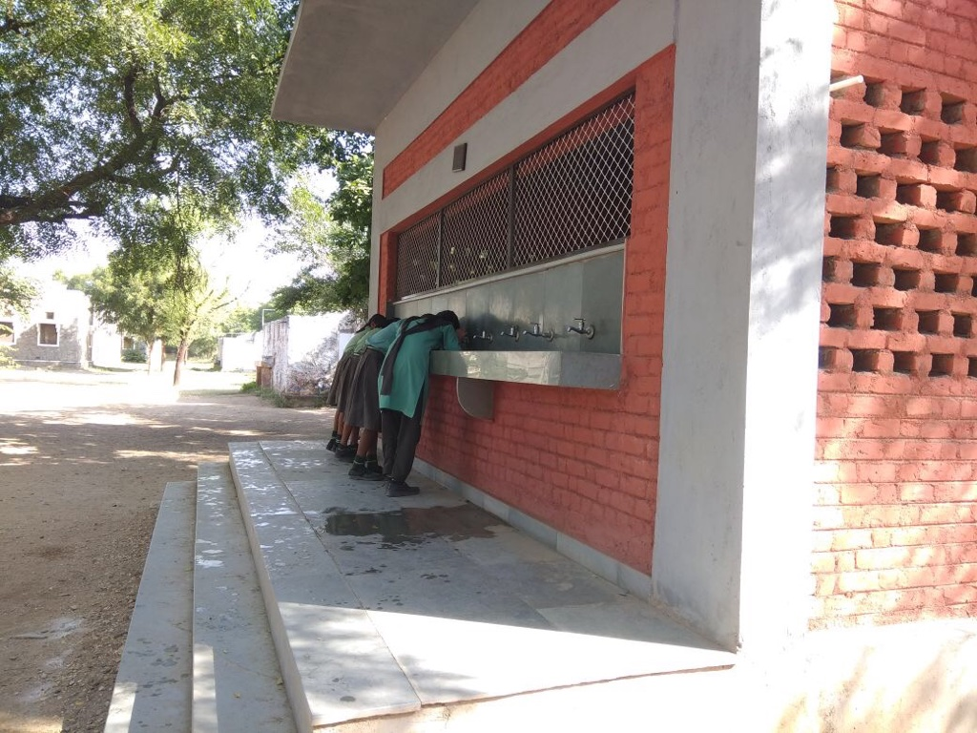
Community Development -
In 2014, the school adopted a nearby village called Punariya. Ever since the students and teachers continue to work on development of the village and its inhabitants. They distribute books and take language lessons for the villagers, targeted at enabling them to read and write.
The students carry out awareness rallies in nearby villages to educate the locals on issues of the environment, waste management and rainwater harvesting.
Rural livelihood study to gauge the aspirations of the people and see if the school is working to meet the same.
Notes:
Mr. Dutt can elaborate during the presentation
The Fabindia school promotes learning communities with people in the villages it serves.

Slide 13
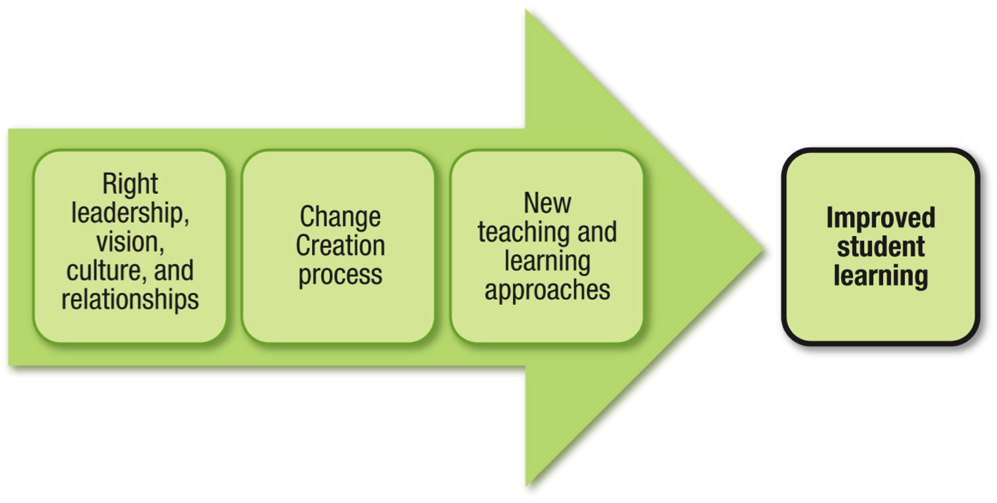
The Transformation Framework - Schools Can Change
Notes:
The Change Creation System is a framework for transforming schools. It was developed from twenty years of work with schools and districts to strengthen teacher collaboration and improve student learning by Karl Clauset, Carlene Murphy, and Dale Lick. The framework is at the heart of the latest book we’ve written, Schools Can Change.
Our work with schools and districts has led us to reflect on a major challenge - why it is hard to sustain effective teacher and staff collaboration that improves student learning. While everyone talks about collaboration and professional learning communities, we know that effective collaboration that leads to action doesn’t happen spontaneously.
This framework lays out the components that school and district leaders need to put into place.
In order for teacher collaboration to generate new approaches to teaching and learning and increased student learning, there are two components that leaders need to address – key conditions of right leadership, vision, culture, and relationships and a structured collaboration process that engages the school staff in inquiry, job-embedded professional learning, and action.
The framework addresses all components of the Learning Forward Standards for Professional Learning:
Learning Communities - Teacher Action Teams and Administrative Teams
Leadership - Transformational leadership
Resources - Allocating resources to support Action Teams engaging in cycles of learning, inquiry, and action
Data - Action Teams collecting and using data to improve their practice and their students’ learning
Learning Designs - The Action Team design is built on research about high-quality professional learning and promotes active engagement
Implementation - The Change Creation System incorporates the research on accomplishing real change over time with regular opportunities for reflection and improvement.
Outcomes - Action Teams establish SMART goals and design their work to achieve their goals.

Slide 14
4 Key Pillars of Change…
Right Leadership… Trust comprises of a diverse set of professionals Chairman of the Trust himself, drives change initiatives Experienced principal from mainstream city school Initiatives enable teachers to be change sponsors and use their talent to the fullest (PDP) | Right Vision… Build and strengthen an ecosystem to foster overall development of children within the community Drive excellence in academics & extracurricular activities Provide equal education opportunities to all children (school has offered 100+ scholarships, 70% to girls)
Right Culture… Disciplined thinking & action, doing the right things Exposure to a range of learning resources and experiences to develop children into self-confident individuals Inculcate a sense of responsibility in teachers and students, towards the community & society | Right Relationships… Initiatives foster collaboration, trust, respect, interaction, and mutual accountability between and within key stakeholders (students, teachers, parents) Efforts targeted at building networks (professional learning communities) of external and internal experts
Notes:
These 4 Key Pillars of Change connect with many of the LF Standards:
Learning Communities
Professional learning that increases educator effectiveness and results for all students occurs within learning communities committed to continuous improvement, collective responsibility, and goal alignment.
Leadership
Professional learning that increases educator effectiveness and results for all students requires skillful leaders who develop capacity, advocate, and create support systems for professional learning.
Resources
Professional learning that increases educator effectiveness and results for all students requires prioritizing, monitoring, and coordinating resources for educator learning.
Data
Professional learning that increases educator effectiveness and results for all students uses a variety of sources and types of student, educator, and system data to plan, assess, and evaluate professional learning.
Learning Designs
Professional learning that increases educator effectiveness and results for all students integrates theories, research, and models of human learning to achieve its intended outcomes.
Implementation
Professional learning that increases educator effectiveness and results for all students applies research on change and sustains support for implementation of professional learning for long term change.

Slide 15
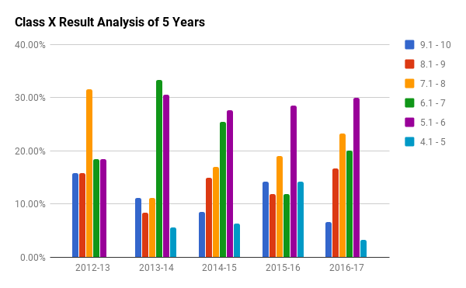
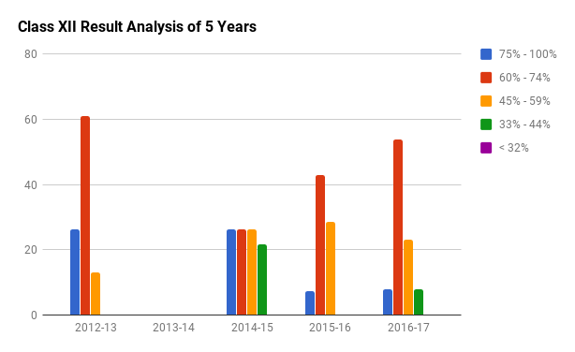
Acute need for staff training and professional development:
The school got Affiliation from the Central Board of Secondary Education (CBSE) in 2009, and opened the 10+2 Science Stream in 2012. Non-availability of trained staff in rural areas is a big challenge; overcame this by upgrading skills and use of technology.
English is not the local language, the school is English medium and there is the need to strengthen the language and communication skills of the staff and students alike.
The students are mostly first generation learners, thus the need for remedials and extra effort to overcome the limitations of the lack of education within the community.
Explanation for the bar charts:
Class X, Y axis shows percentage of students who got the grades/ scores from 1 to 10
Class XII, Y axis scores percentage of students who got an aggregate scores between 1 - 100, in all subjects.
X axis shows the academic years.
Notes:
Data
Professional learning that increases educator effectiveness and results for all students uses a variety of sources and types of student, educator, and system data to plan, assess, and evaluate professional learning.
The need for transformation and to ensure that we meet the aspiration of delivering better academic scores.
Schools that pledge their allegiance to the mission of learning for all will definitely have plans when a student is not learning. In year three we have introduced the book WHATEVER IT TAKES- Richard DuFour to our teachers during a PDP session, they have listed the need for better learning outcomes as follows:
Involvement of every child in the class.
Connect and identify the child, understand and find a way for that child.
Develop emotional attachment with the child.
Extra attention to be given to slow learners.
Setup action plans/teams to help the child.
This is from the progress report as of November 2017, where the Educators/ Teachers are having the conversation. The key part of the work as from SCHOOLS CAN CHANGE, and establishes the fact that change happens when the teachers work together and take the lead as ‘action teams’. The Educators today work in six groups of 4 each and all have the single mission ‘better student learning outcomes’ as part of the year three of the PDP (2015-18).

Slide 16
Change Creation Process…
Mr. Sandeep Dutt (Founder of Learning Forward India Academy, set up by EBD Educational Pvt. Ltd.), took over as Chairman of the Bhadrajun Artisans Trust (BAT), and stepped in to lead the Change…
The Professional Development Program (PDP) was launched to develop school teachers to drive ‘affordable quality education’…contours of the program listed below…
Leadership Development Program for school teachers
Enabling active learning through problem solving
Encouraging collaboration with internal and external experts
Providing access to array of resources and opportunities for experiential learning…workshops, retreats, conferences, exchange programs, and research studies
Three year structured PDP 2015-18, work-in-progress as of December 2017
Program Construct…
Program has 3 successive levels: 2015-16 The Joy Of Learning Level 1 - 90 hours (45 structured, 45 unstructured) 2016-17 Staff Leadership Development Level 2 - 120 hours (55 structured, 65 unstructured) 2017-18 Better Student Learning Outcomes Level 3 - 150 hours (60 structured, 90 unstructured) | Assessment Criteria: 25 marks every year (10 for Participation; 10 for Industry & Innovation; 5 for performance in the classroom)
Notes:
The PDP incorporates key elements from the LF standards on Learning Designs and Implementation in the design of PDP learning opportunities each year and the developmental progression from Level 1 to Level 3
Learning Designs
Professional learning that increases educator effectiveness and results for all students integrates theories, research, and models of human learning to achieve its intended outcomes.
Implementation
Professional learning that increases educator effectiveness and results for all students applies research on change and sustains support for implementation of professional learning for long term change.
The program is for school teachers only, and not all school staff.
Sandeep's work for The Fabindia Schools Programme to demonstrate excellence in school operations, involving the community and establishing a sustainable model for delivering good education in the villages of India, is now being replicated on a larger scale. His belief is that the happiness of young people is in our hands, and we must do all to help them live their dreams by providing them with the best possible education. Taking ahead his vision and mission, he is working to provide affordable quality education in rural and urban India.

Slide 17
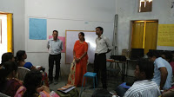
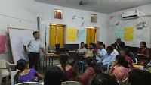
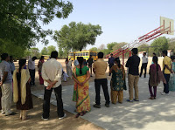
Glimpses of PDP Interventions…Workshops
From the Joy of Learning to Better Learning Outcomes, some important steps:
Year 1 of the PDP The English Learning Workshop enabled teachers to take the center stage and gain confidence: From resistance to leading the learning process, a quantum leap.
Mithilesh Patro (soft skills trainer from Jodhpur), conducted a workshop on English Language proficiency
Teachers engaged in public speaking exercises and discussion on social evils such as dowry. They worked as a Choir to sing on the Annual Day with students playing instruments.
They were given spot feedback after every presentation, so they could strengthen their next performance
Year 2 of the PDP: Debates, team games, visits to schools and traveling out from the village to other parts of the country have been fantastic experiences, for all the staff members.
Year 3 of the PDP: Weekly meetings to share, discuss and work on real life challenges.
Notes:
The medium of instruction at the school is English, but since they converse in regional languages at home - extra effort needs to be made to increase proficiency of spoken english
Learning Designs
Professional learning that increases educator effectiveness and results for all students integrates theories, research, and models of human learning to achieve its intended outcomes.

Slide 18
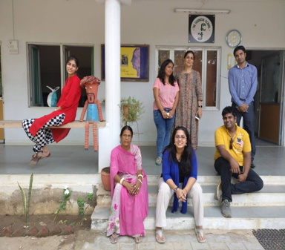
Glimpses of PDP Interventions…LFIN Retreat
First Learning Forward India (LFIN) Retreat was held at The Fabindia School in October 2016
Attended by 12 delegates (7 school teachers + 5 professionals from different walks of life)
Agenda focused on transforming modern day education by empowering teachers…
Overview of PDP and how it works (Prerna Rathod, Fabindia School Teacher)
Child a Special Mind (Venus Upadhyay, Independent Professional)
New Age Education Techniques (Meenakshi Uberoi, Founding Director, De Pedagogics)
Best HR Practices (Manoj Jeyraj Albert, Head of HR PRAX a leading medical BPO)
My Good School Philosophy (Sandeep Dutt, Chairman, Learning Forward India)
“The Retreat helped us in implement the PDP sessions and understand our role as educators in helping children learn and discover the role of the My Good School Program, for better learning outcomes”
- Prerna Rathod, PDP Coordinator at The Fabindia School LFIN Academy
Notes:
The LFIN Retreat was focused on brainstorming how education in India can change for the better - Fabindia School can then implement these ideas and act as a model school for others in India
Leadership
Professional learning that increases educator effectiveness and results for all students requires skillful leaders who develop capacity, advocate, and create support systems for professional learning.

Slide 19

Personal & Social Development
My Good School program for the personal and social development of an individual:
The experiential learning possible through activities beyond just study help consolidate and bring to life learning which would otherwise be theoretical and uncoordinated.
Encouraging students to become involved in activities with the community outside the confines of the school curriculum helps them develop their confidence, knowledge and contacts. This greatly enhance the opportunities for their personal and social development.
With teachers’ encouraging young people, they benefit fully from what both the school and outside interests offer, this is the key factor in their progressing successfully through adolescence into a rewarding and fulfilling adult life.
Notes:
While the focus of the My Good School program is on the personal and social development of individual students, The Fabindia School has designed the PDP professional learning program for teachers to promote their individual personal and social development so that they, in turn, can better promote the personal and social development of their students. The learning design for the PDP supports the learning design for the My Good School program.

Slide 20

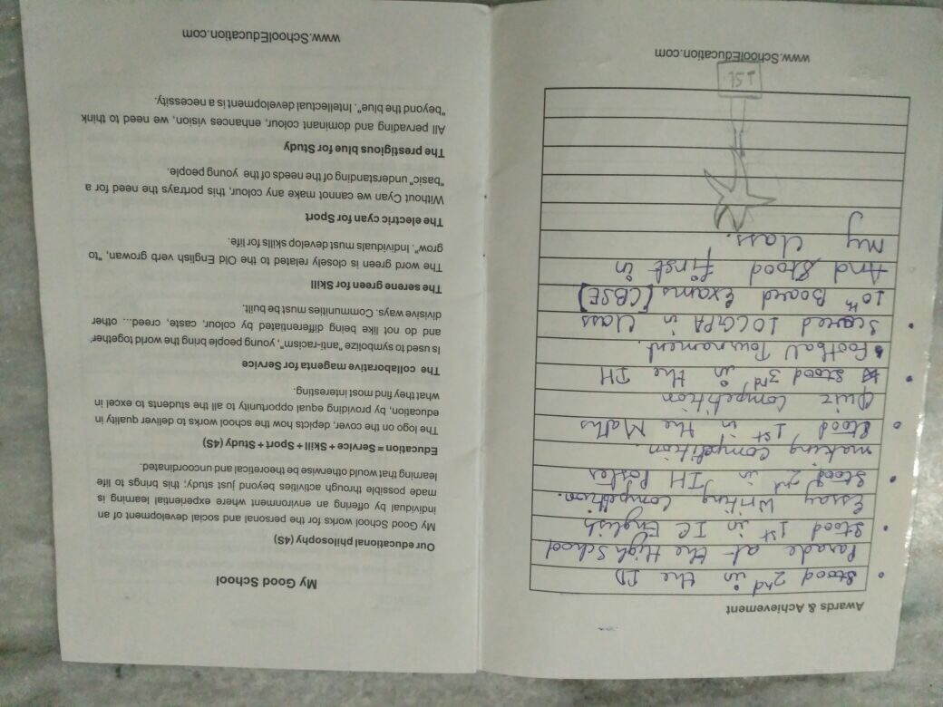
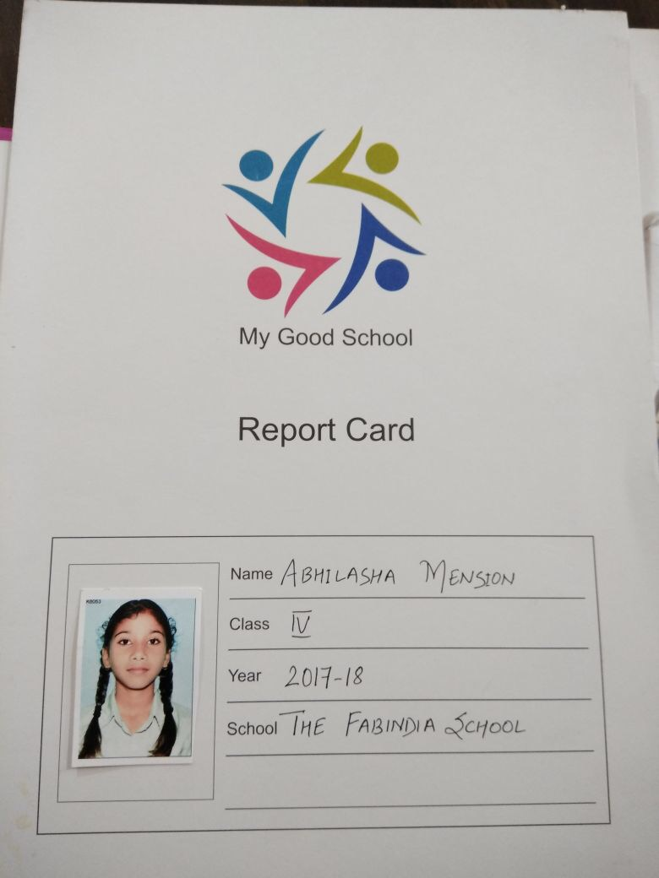
My Good School Program
The program is designed around the 4S philosophy, targeted at ‘all-round development of children…
  Service
  Skill
  Sports
  Study
Students are given handbooks in which they keep a record of activities they participate in across the 4 areas…the record is reviewed and signed off by their teachers
At milestones over the course of the program, students are awarded for their achievements, this in addition helps measure student learning outcomes.
Notes:
Mr Dutt can explain this program in detail - sharing a link to the website: http://www.schooleducation.com/p/quality-in-education.html
The 'My Good School' designation shows the value a school places on professional learning and student achievement. The school works for the personal and social development of an individual, by subscribing to our philosophy of quality in education, offering an environment where experiential learning is made possible through activities beyond just study; this brings to life learning that would otherwise be theoretical and uncoordinated.
We are not working to build an ‘alliance’ of the schools who share the philosophy and deliver the My Good School Program.

Slide 21
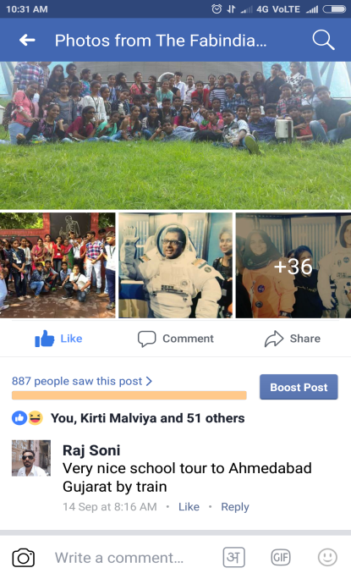
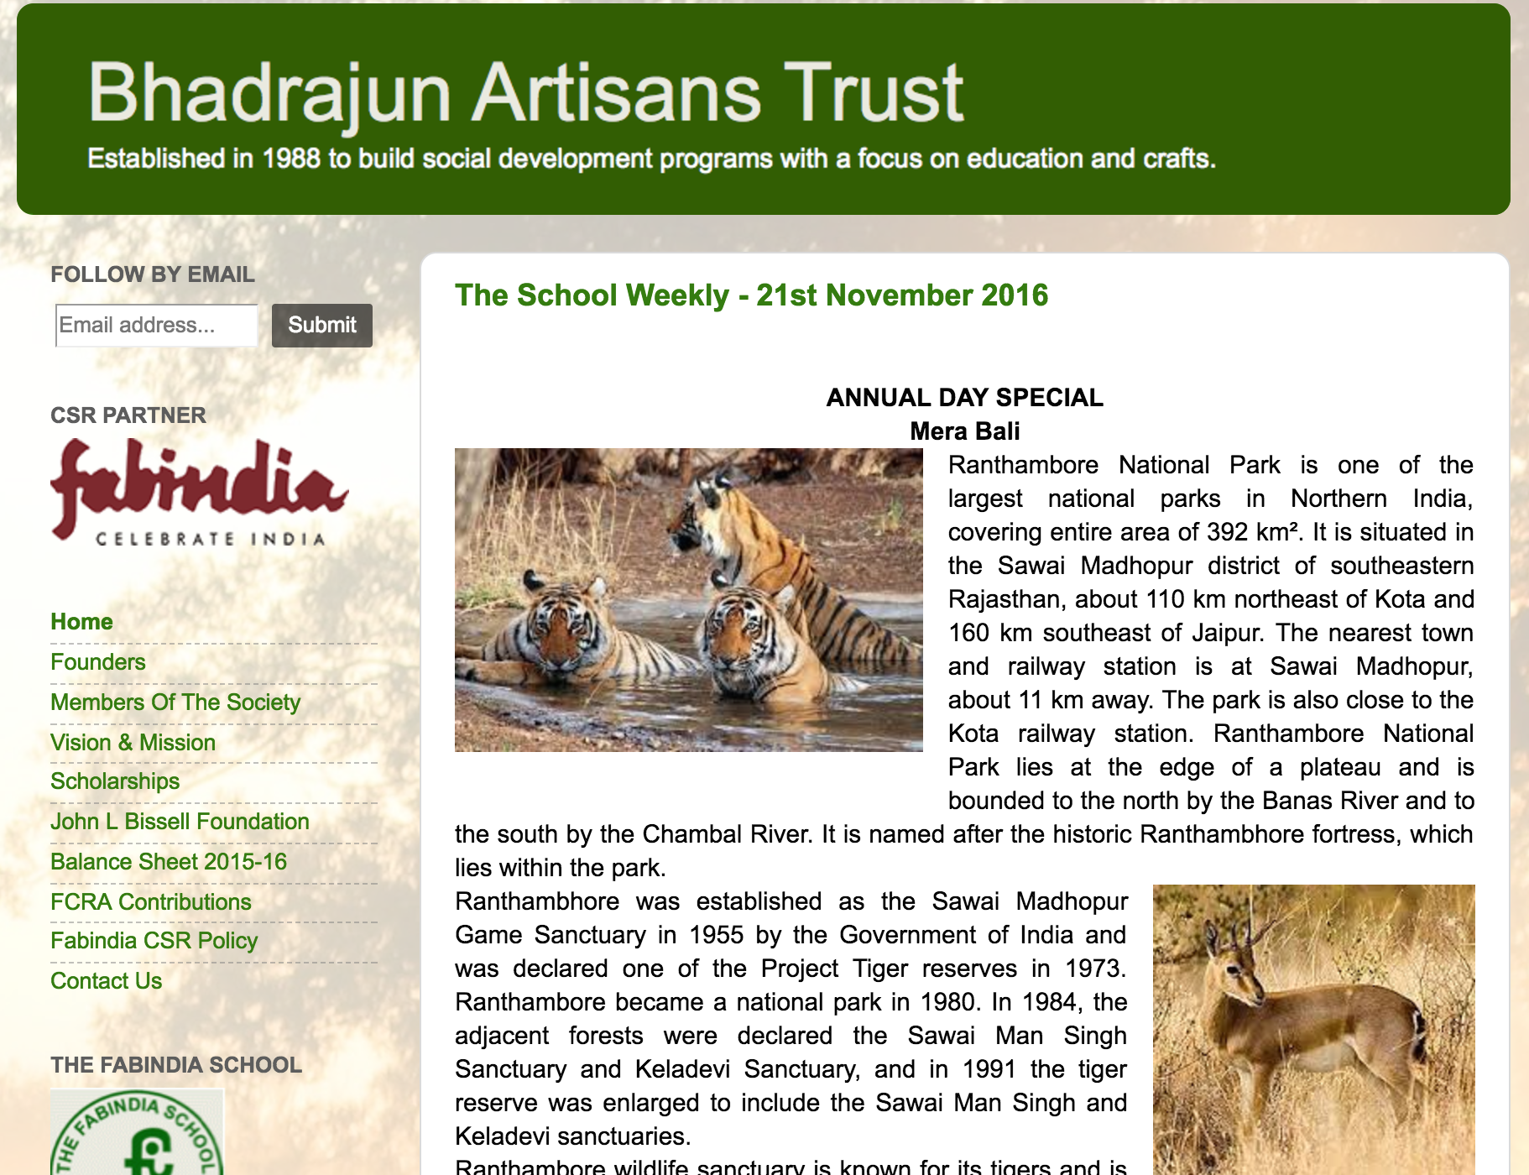
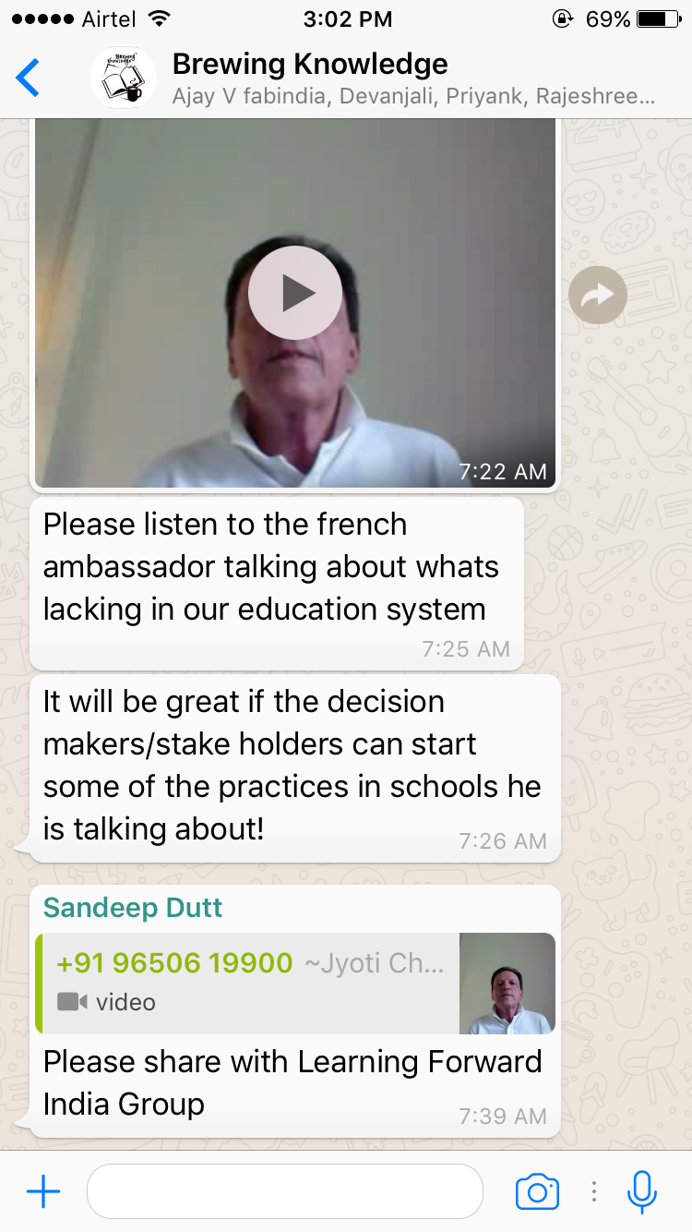
Glimpses of PDP (2015-18) Intervention & Use of Social Media
Professional Learning Communities (PLCs) on social media…enabling professionals share articles and learning resources…Brewing Knowledge, LFIN Community, SchoolEducation.Com & Youtube Channel.
Regular blog posts, weekly newsletters, skype meetings, online library on google drive…
Online Learning Platform www.LearningForward.Org.IN
Facebook Page www.Facebook.com/fabindiaschool
Blog Page www.Bateducation.com
Whatsapp Group
Notes:
Today, the students and the educators manage the social media and outreach efforts, which strengthen Learning Communities.

Slide 22
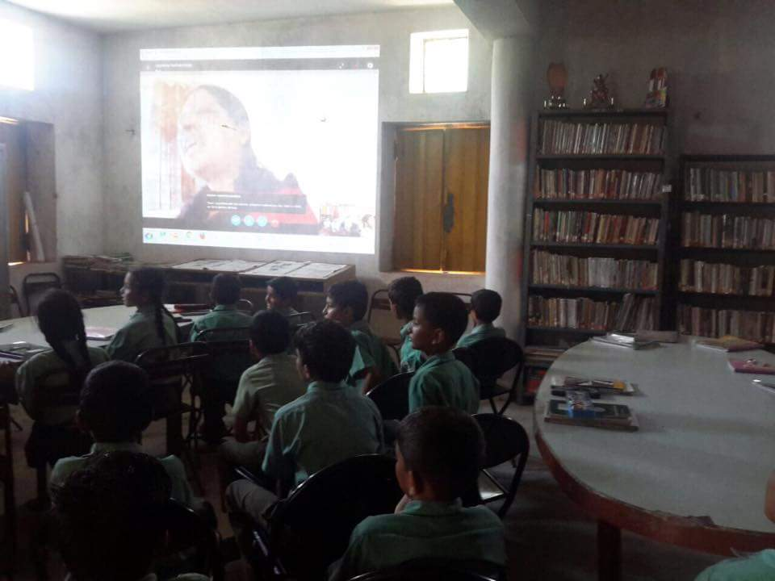
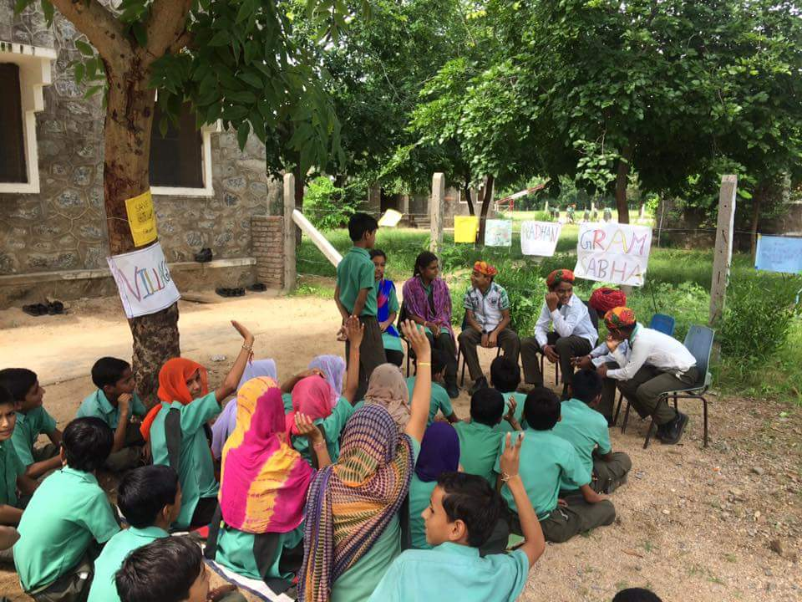
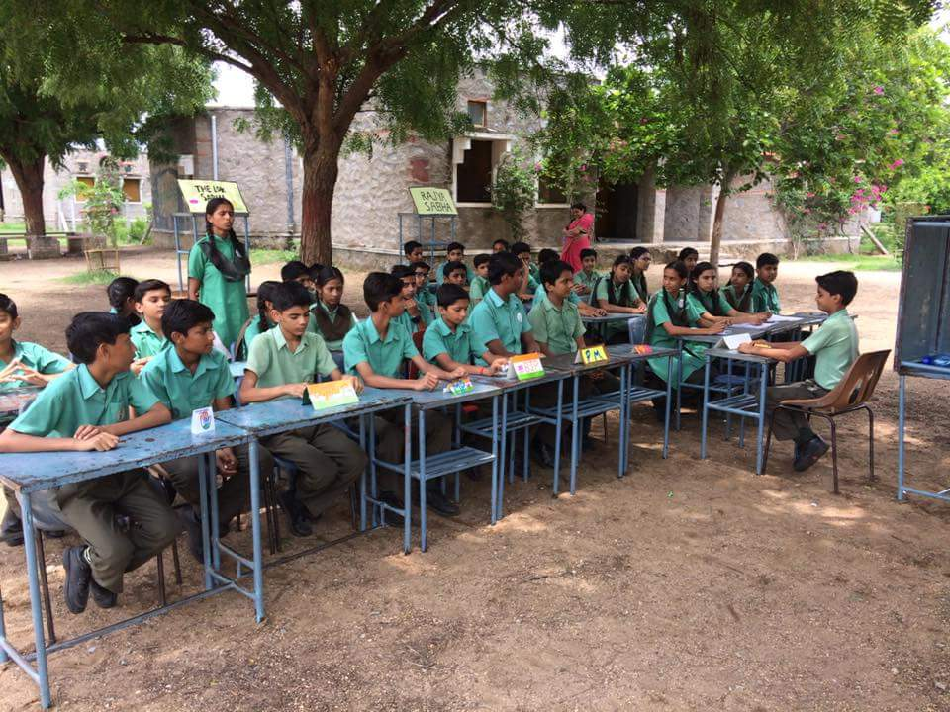
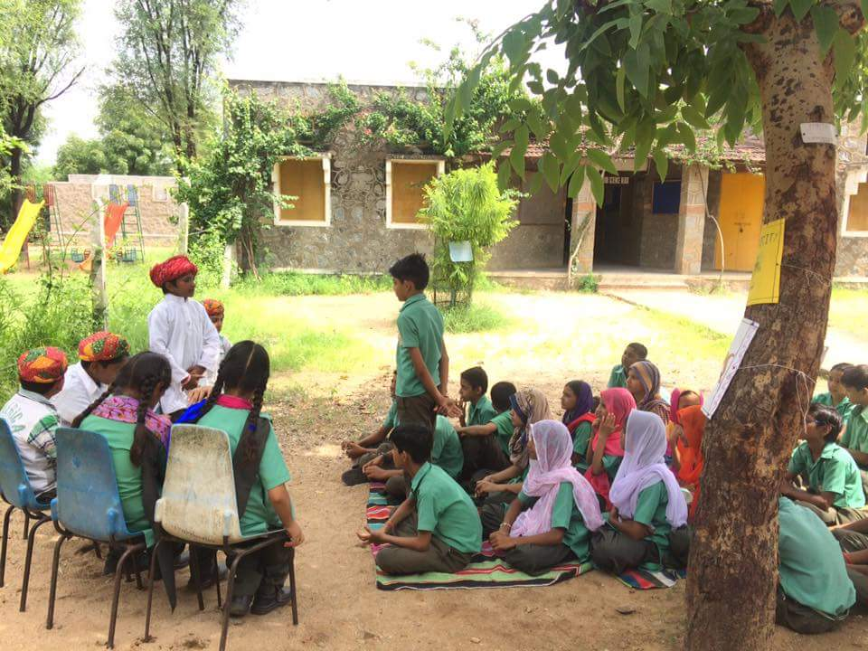
Use of Technology
Powerpoint presentations, Videos, Radio Shows and Role Plays are being used as teaching aids in classrooms
Students are being given an opportunity to learn better use of technology through computer workshops with experts…
  10 students participated in Kshitij – a workshop held at Pathways School Gurgaon, focused on ‘celebrating innovation’. 6 students from The Fabindia School worked with students from other mainstream city schools on innovative ideas, and won trophies for their skills displayed at the event.
  Students also participated in a remote workshop on Microsoft 365 on Yammer
  The school is today a certified Microsoft Showcase School
Notes:
Use of technology strengthens learning communities and enables the school to connect with experts across India and overseas.

Slide 23
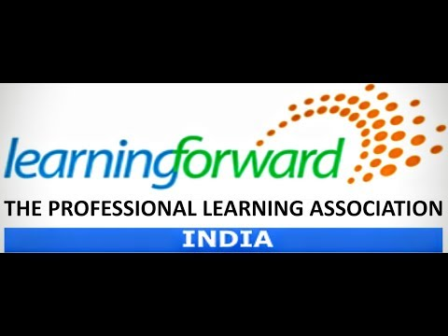
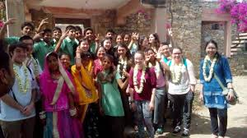
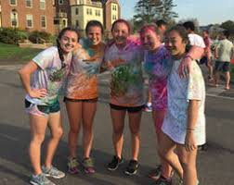
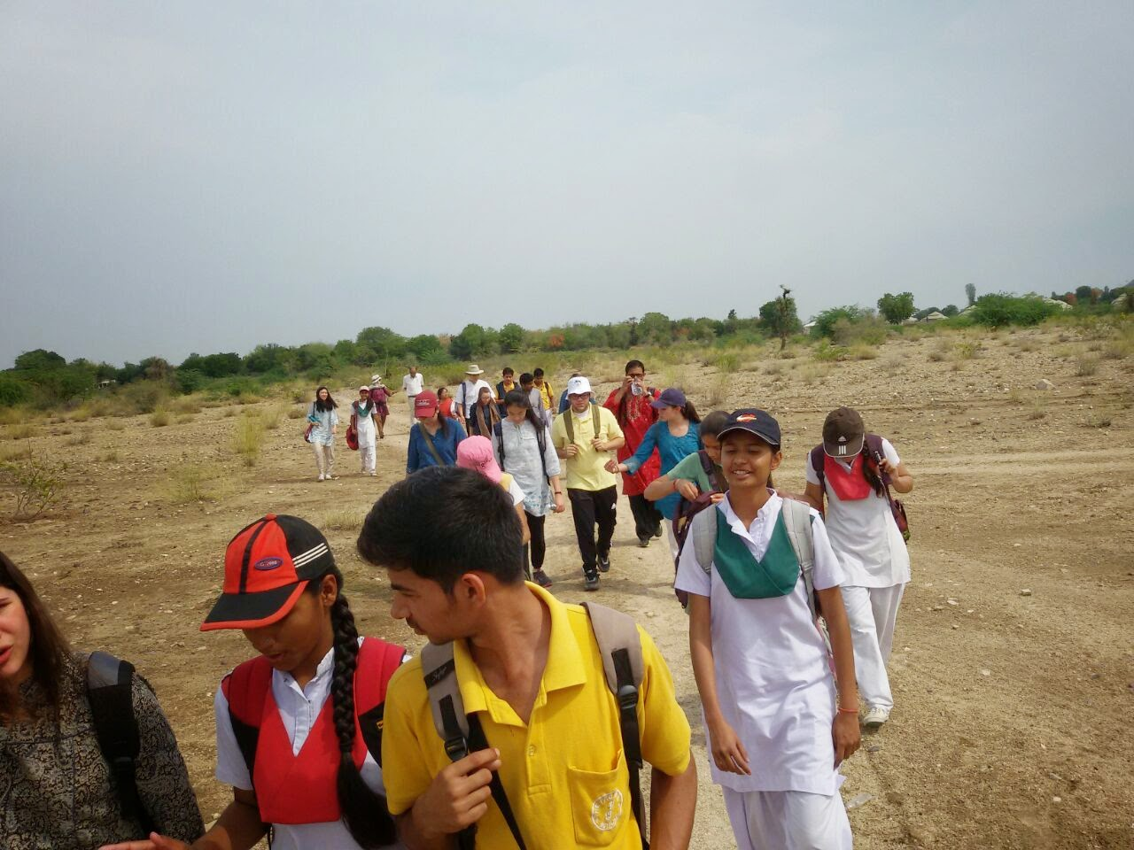
External Engagement
Student Exchange Programs (Foreign and Indian Schools)…
  Loomis Chaffee School, Connecticut, USA
  Hotchkiss School, Connecticut, USA
  Maharani Gayatri Devi (MGD) School, Jaipur, India:
  Scindia School, Gwalior, India
  The Putney School, UK
  Mayo College Girls’ School, Ajmer
International Indian Model United Nations (IIMUN)
  Held at the Heritage School, Udaipur
Watch video https://youtu.be/8GBGYyU9-Tg
Notes:
Community engagement at a level beyond the local area, is very essential to help the people with a better worldview and gives them a goal as well.

Slide 24
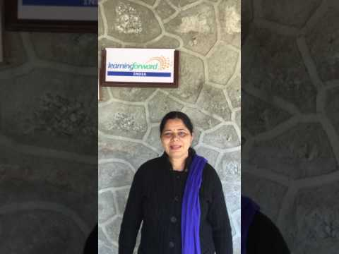
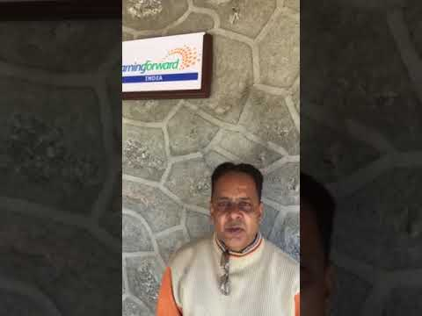
PDP has enabled staff to learn, grow and succeed…
PDP Participants at The Fabindia School Speak…
“PDP has improved my performance at external workshops and conference. I recently attended CBSE workshops on Soft Skills and Math. At both, I engaged meaningfully with fellow delegates and led group presentations.”~ Ajay Vijayvargi
“PDP sessions have enabled me to develop leadership qualities and become a more responsible professional. I have more confidence in my ability to communicate and work with groups to accomplish tasks given to us.” ~ Monika Vaishnav
“The PDP program has helped me build confidence, team spirit and leadership capabilities. I have begun using new teaching techniques, embedded in value based education. I am now also more comfortable using technology.”~Urmila Rathod
Watch video https://youtu.be/DvCpqRIMJe8
“When the base is poor, it is indeed a very big challenge to help deliver mainstream quality education. We at The Fabindia School are committed to build a professional learning community to overcome the limitations and partner with the local community to empower them”. ~ Rajeshree Shihag, Principal
Watch video https://youtu.be/xeMHwTDZKlI
Notes:
http://www.schooleducation.com/p/our-teacher-training-centre.html
Outcomes
Professional learning that increases educator effectiveness and results for all students aligns its outcomes with educator performance and student curriculum standards.

Slide 25

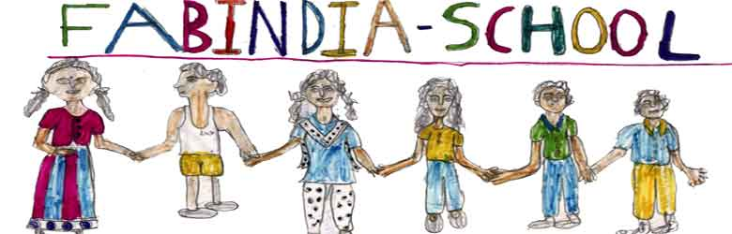
Improved student learning
“…There are many facilities in my school. There are many improvements in my life. We are getting here very good education.…I have become good in studies. We have a computer lab, a science lab and more. I think in future I will become a good person because of this school”.
-Swabhi Parmar, Class VII student at The Fabindia School
https://drive.google.com/a/ebd.in/file/d/1CGPSin4YB5tzq5APNNfvyy5bIa16bt-M/view?usp=drivesdk
Follow link to read the book, please
http://www.fabindiaschools.org/bali/studentcrea.html
Listen to the student voices and find out for yourself, how their lives are being transformed.
Notes:
Outcomes
Professional learning that increases educator effectiveness and results for all students aligns its outcomes with educator performance and student curriculum standards.
Remind participants that they can download the Fabindia book from the conference mobile app under session 2206

Slide 26

Student Voices
Watch video https://youtu.be/SFandhZBdIg
www.fabindiaschools.org
Notes:
The students speak from their heart, and the film talks of larger numbers than we currently have, as it adds up the Feeder Schools program which was being run when the film was made, however to deliver better quality and focus on PD we have intentionally reworked our strategy to first invest in the PDP and have a better Student-Teacher ration (1:10), to deliver better learning outcomes.

Slide 27
What do we do now?
How does the development of the PDP at The Fabindia School, compare with the development of PDP’s in schools and districts in other counties?
What do you think are the key learnings about the Fabindia PDP?
Students in rural areas have their own needs, have we addressed their needs?

Slide 28
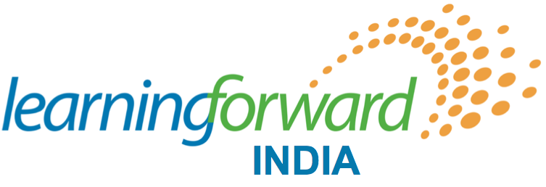
Learning Forward India (LFIN) is an affiliate of Learning Forward (LF). The association provides high-impact consulting services for partners with the tools to transform professional learning, increase educator capacity, and improve student achievement. LFIN works closely with partner schools and assists in the Monitoring and Evaluation of the school improvement process.

Slide 29
Learning Forward India Programs & Services
School leadership development;
My Good School programme for the personal and social development of an individual;
Learning Forward India professional development program;
The YES Way Workshops for empowering young people;
Communication and brand management;
Monitoring & Evaluation of the development plan; and
School Management Services/ School Development Consulting

Slide 30
School Development Consulting
LFIN is working with schools in India:
- use the existing curriculum to deliver better;
- assist young people to identify and plan their challenges;
- support young people in enhancing their skills;
- work within operational and administrative challenges;
- find available opportunity for youth in the community;
- build relationships at the different level; and
- help deliver affordable quality education.

Slide 31
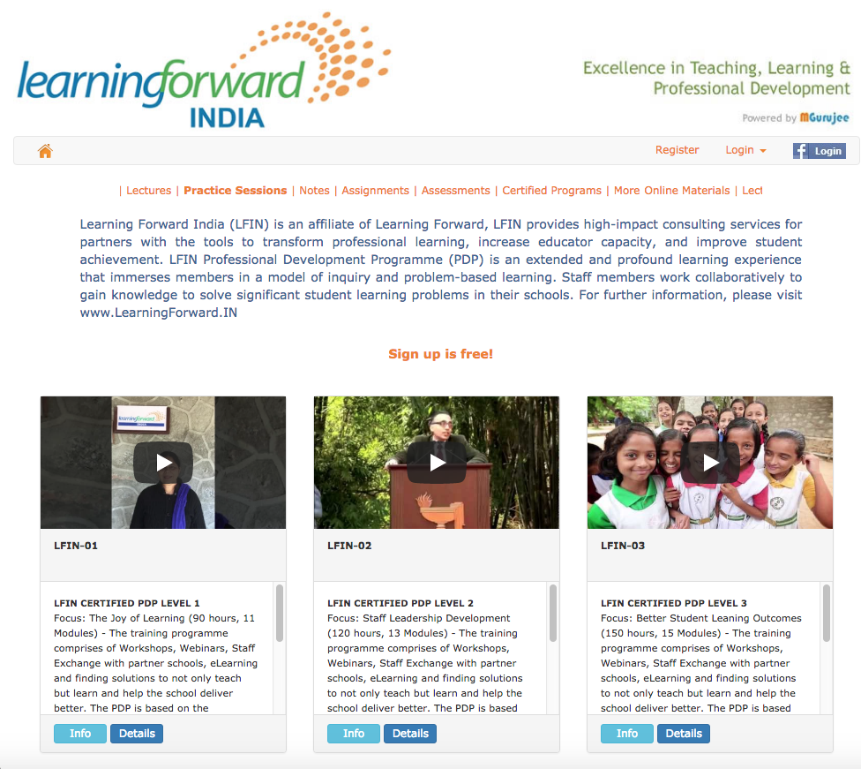
LFIN Professional Development Program
The future of the LFIN 3 year PDP
Online School Education Platform
www.LearningForward.Org.IN
Growth of the PDP and the spread of My Good School Programme:
DBN Amarvilla School (Jammu & Kashmir)
SNS Vidya Mandir (Jammu & Kashmir)
DBN Mubarak Mandi (Jammu & Kashmir)
The Iconic School (Madhya Pradesh)
Prita Lee Lesson School (Punjab)
My Good School Alliance and a list of our clients:
http://www.schooleducation.com/p/blog-page_21.html
Notes:
William Bissell and Sandeep Dutt are now working on a joint venture to help grow The Fabindia Schools Program.
Share the slides with Karl and add a slide to explain the action plan.

Slide 32
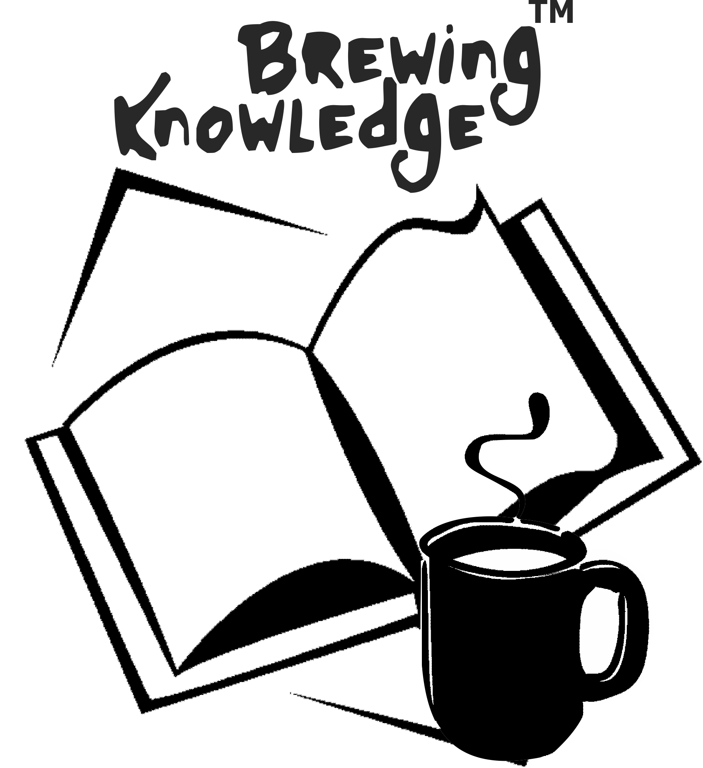

Partnering for future ready schools
Fabindia is helping the Private Sector and NGOs transform the existing school system and develop solutions like the LFIN PDP and the My Good School Program, to help deliver affordable quality education.
Training & Staff Leadership Development.
School Management Services
Scholarships Program
www.LearningForward.IN
Learning Forward India
Notes:
Closing remarks and evaluation

Slide 33
Reflection
What is going on in other countries that can help us grow the program in India?
What have you got from us today about the Program in India, that will help you grow the Schools Program in your country?
What role does technology have to play for taking learning forward?

Slide 34
Closing & Feedback
Please use the LF mobile app to download our slides AND leave your feedback about our session # 2206
Schools Can Change in India: A Case Study
Karl Clauset - khclauset@comcast.net
Sandeep Dutt - sd@ebd.in
Notes:
Closing and Feedback

