Slide 2
Day 1 – Thursday, July 18
Arrival Day
Dinner – JOI and Oratorical Contestants
Icebreaker/Mixer – JOI and Oratorical Contestants
JOI Summit Kickoff!
Day 3 – Saturday, July 20
Wings of Hope (off-site event)
Online Election Voting
Keynote Speaker
Breakout Sessions
Building Bridges with Optimism
Day 2 – Friday, July 19
Oratorical World Championship Contest
Teambuilding Activities
International Candidate Speeches/Forum
Networking
JOI’s Got Talent
Day 4 – Sunday, July 21
Teambuilding Activities
City Museum (off-site fun adventure)
Breakout Sessions
JOI Summit Celebration!
Day 5 – Monday, July 22
Departure Day

Slide 3
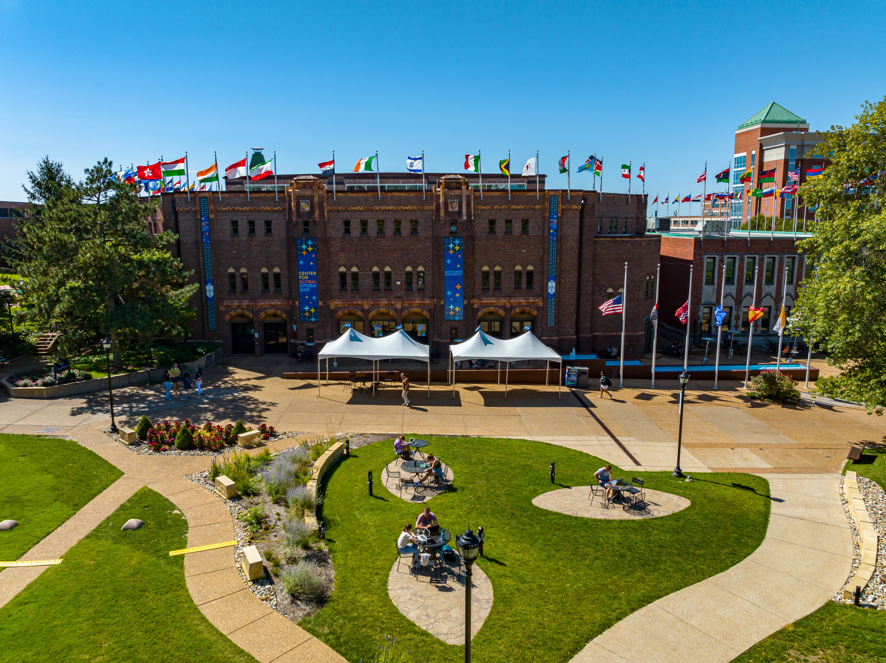
Saint Louis University and the Center for Global Citizenship
Private institution, founded in 1818
280+ Acre Campus
2nd oldest Jesuit University in the United States
Multi-Purpose Cultural Center
Elevated Communication and Technology
70,000 square foot building
Jumbotron
Top-of-the-line AV system
Unlimited Wi-Fi

Slide 4
What to Expect

Slide 5
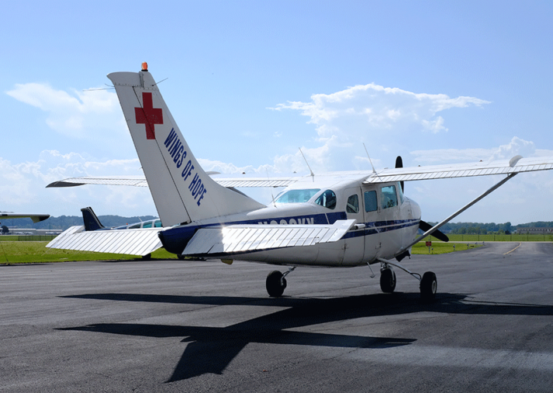
Wings of Hope Changing and saving lives through the power of aviation.
Humanitarian Aviation - Helping connect people to the health care they need.
Hangar Tour
Pilots and Aviation experts onsite

Slide 6
City Museum
25 years of weirdly wonderful fun
29K+ Artifacts from all over the world
600K Square-feet of possibility

Slide 7
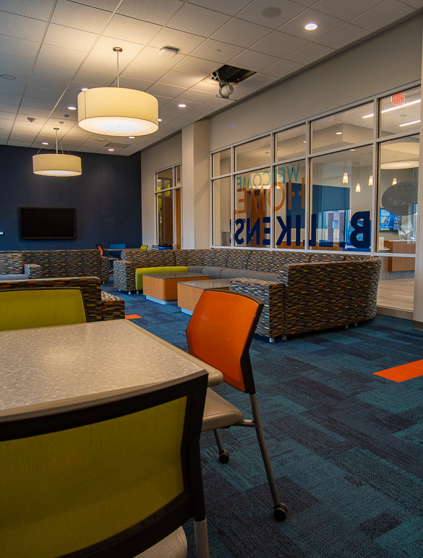
On-Campus Resident Halls
Lounge
Student Housing: Double room; suite style (2 rooms per suite)
Extra-long twin beds with 9” memory foam mattress, desks, wardrobes
Bedding, towels, washcloths (pillow/pillowcase not provided)
Chaperone and Volunteer Housing: Single Room, suite style (2 rooms per suite)
Free Parking on Campus
Secured Facility
Bathroom in each suite

Slide 8
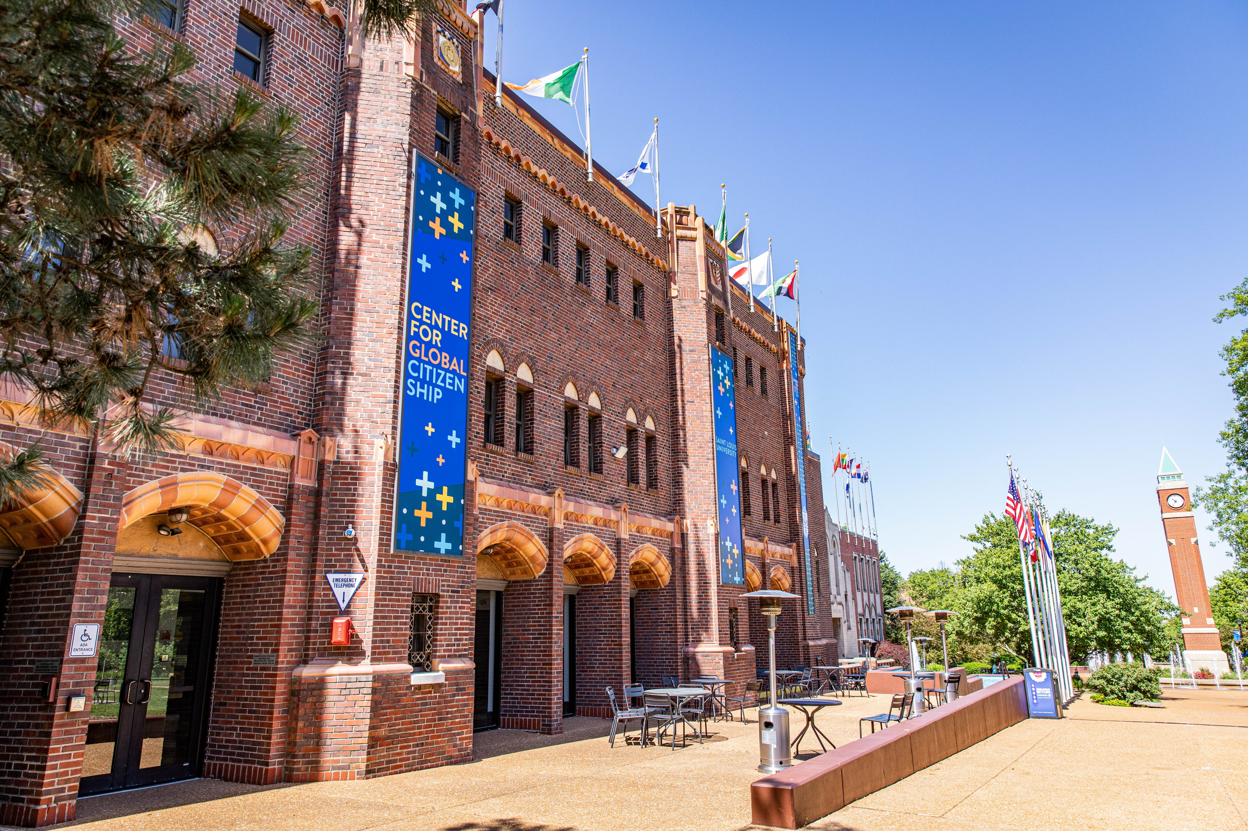
All-Inclusive Registration
$450 per person
4 nights on campus (July 18-21)
10 meals & snacks (Thursday – Sunday)
2 off-site activities w/ transportation
All program materials
Keynote speakers
Professional development sessions
Track It Forward membership
Full access to the Center for Global Citizenship
JOI Summit T-shirt
Free gated parking
Campus-wide WiFi

Slide 9
Volunteer Opportunities
Group Leaders (21+)​
You'll be assigned a group of students for the duration of the program that you will work with and help facilitate program elements. This role is perfect for JOI Alumni looking for an opportunity to stay engaged and serve as a mentor for the weekend program!

Slide 10
Questions?

