Slide 1
Relationships: Past, Present and Future Members
Notes:
Hello, I am Michael Shue, Chair of the Optimist International Membership Engagement Committee and a member of the New York-New England Optimist District.
Today, we’ll explore the importance of relationships in our Optimist Clubs. To help illustrate this, you will be visited by three ghosts—the Ghosts of Optimist Members Past, Present, and Future. Just like in the classic story, these visits will remind us that relationships are the heart of our Optimist clubs. They determine whether members stay, grow, and contribute—or drift away. Strong relationships are the foundation of a thriving, engaged club.

Slide 2
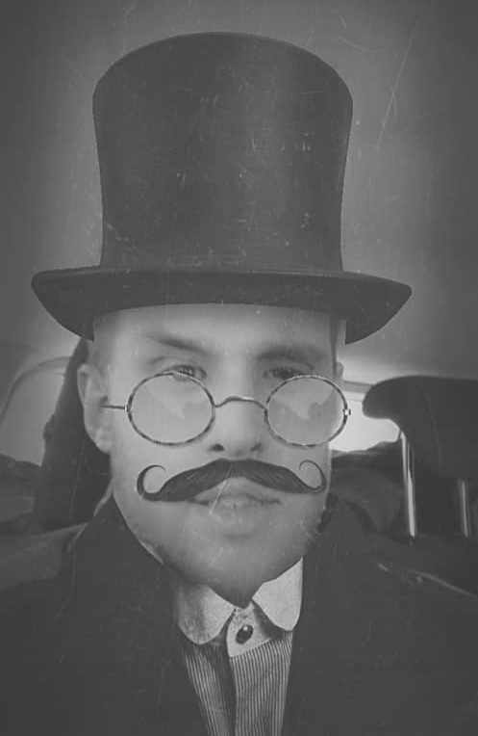
Ghost of Members Past

Slide 3
Past Members –
Life Happens
Notes:
Over time, some members become less engaged or leave our Optimist Clubs altogether. Life happens—personal responsibilities, time constraints, and even club-related challenges can pull people away. However, many still believe in our mission; they just no longer feel connected. That disconnect often stems from feeling unappreciated, experiencing a negative club culture, or struggling with poor communication that makes them feel uninformed or excluded. In the end, sometimes it’s not just about busy schedules—it’s about relationships.

Slide 4
Past Members –
Personal outreach and check-ins.
Invite them to special events.
Recognize their past contributions.
Notes:
People stay where they feel valued. When relationships within the club fade, so does engagement. But the good news is that relationships can be rebuilt. A simple act of personal outreach—a phone call, email, or handwritten note—can reignite that connection. Inviting them to social gatherings, fundraisers, or service projects reminds them of the friendships they once cherished.
Publicly recognizing their past contributions in newsletters, on social media, or through awards reinforces their importance to the club. When we nurture relationships, we don’t just bring members back—we bring back their passion, leadership, and energy.

Slide 5
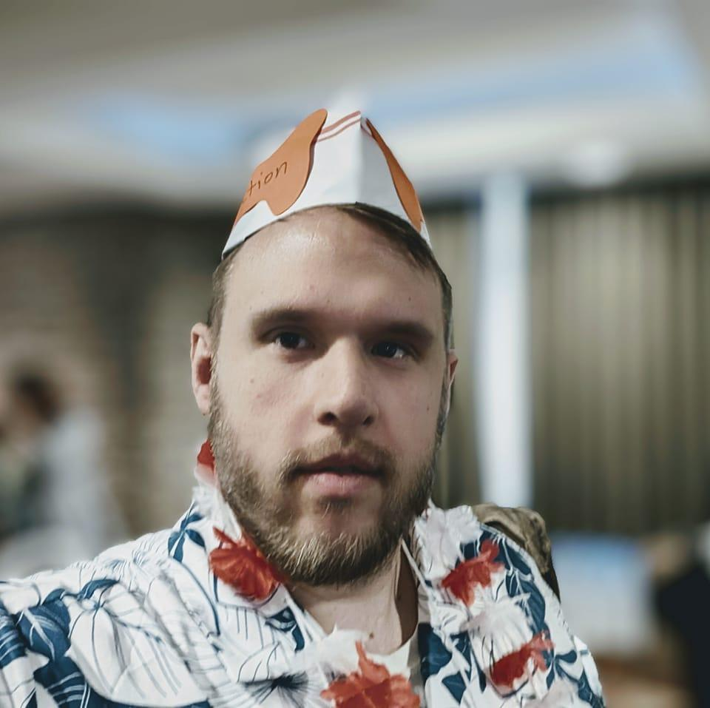
Ghost of Members Present

Slide 6
Present Members –
Celebrate and Recognize Members
Notes:
Relationships aren’t just important for bringing members back; they’re also essential for keeping our current members engaged. People don’t stay in clubs because of meetings or projects—they stay because of the connections they’ve built with others. When members feel appreciated, they are more likely to stay involved and committed to our mission.
Recognition plays a big role in strengthening these bonds. Personalized thank-you notes, awards, and public acknowledgments—whether in meetings, newsletters, or on social media—help foster a sense of belonging.

Slide 7
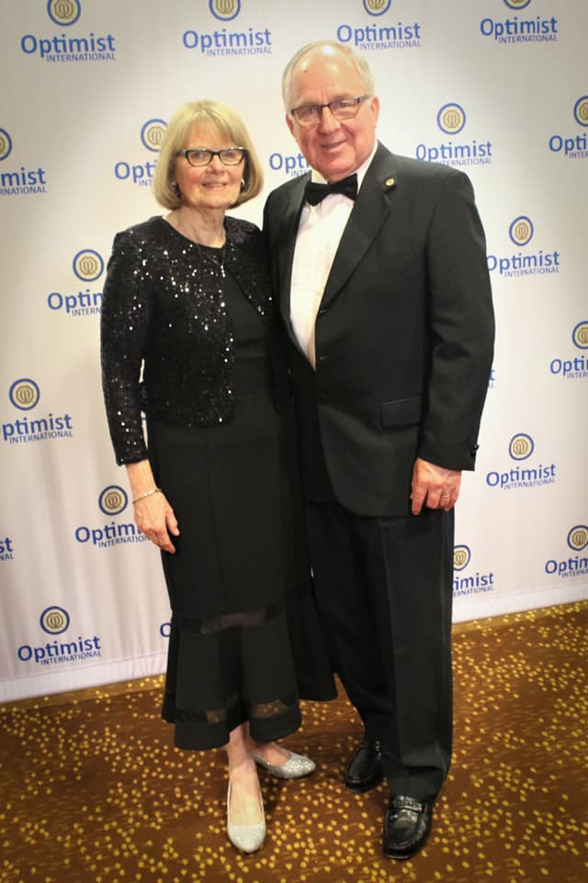
Present Members –
Notes:
I use the example of Penny McFadyen. If you get to know Penny, you’ll quickly learn that she loves Starbucks and has a favorite drink. Imagine if Penny were recognized with a Starbucks gift card—something that shows we truly know her and appreciate her as an individual. That’s the difference between generic recognition and relationship-driven recognition.

Slide 8
Present Members –
Celebrate and Recognize Members
Personal Connections
Encourage Active Involvement
Notes:
Acknowledging milestones, such as birthdays and anniversaries of service, strengthens a member’s personal connection to the club. But recognition alone isn’t enough—people also need meaningful roles that align with their skills and interests. When members are given opportunities that suit their strengths, they feel valued not just for their presence but for their contributions. Relationships thrive when people feel like they belong and have a purpose.

Slide 9
Present Members –
Celebrate and Recognize Members
Personal Connections
Encourage Active Involvement
Meeting Experiences
Notes:
Club culture plays a significant role in these relationships. Meetings should be more than routine gatherings—they should be experiences that strengthen connections. Kicking off meetings with an icebreaker or motivational story sets a welcoming tone. Rotating themes, such as "S.S. Optimism" or "Optimist Bingo," keeps things engaging and fun. Inviting guest speakers—whether local leaders, motivational figures, or youth speakers—adds inspiration and fresh perspectives. Assigning greeters at the door ensures every member and guest is welcomed with a smile. Most importantly, when members live by the Optimist Creed, they create a culture of encouragement, inclusivity, and positivity—a culture where people want to stay.
With a vibrant and welcoming club culture, members don’t just attend meetings out of obligation. They come because they don’t want to miss out on seeing their friends, sharing stories, and being part of something bigger than themselves. That’s the power of relationships.

Slide 10
Present Members –
Member Feedback through the C.A.R.E. Program
Notes:
To maintain engagement and strengthen club health, the C.A.R.E. Program provides a simple yet effective framework rooted in relationships:
Celebrate members by acknowledging and appreciating their efforts.
Address concerns proactively to ensure members feel heard and valued.
Recognize individual and group achievements to boost morale and motivation.
Excel by continuously improving club culture and engagement strategies.
A big part of strengthening relationships is listening. Surveys and conversations help us understand how members feel and what they need. But simply collecting feedback isn’t enough—we must also take action. When members see their suggestions lead to real improvements, they know their voices matter. When they feel heard, relationships grow stronger.

Slide 11
Present Members –
Celebrate and Recognize Members
Meeting Experiences
Personal Connections
Encourage Active Involvement
Communication
Member Feedback through the C.A.R.E. Program

Slide 12
Ghost of Members Future

Slide 13
Future Members –
Warm Welcome & Personal Connection
Provide a New Member Packet
Assign a Mentor
Encourage Immediate Involvement
Incorporate Feedback
Notes:
A warm welcome and personal connection are the foundation of any strong relationship, especially with new members. The first impression they get from our club can determine whether they become lifelong Optimists or fade away after a few meetings. Formally welcoming them and having the entire club recite the Optimist new member induction promise together creates an immediate sense of unity. Providing a New Member Packet—including the Optimist Creed, club purpose, and social media information—helps them feel informed and included.
But welcoming a member isn’t just about handing them an interest form—it should feel personal. Think about how friendships are formed. Do they start by filling out paperwork? No! They start with conversations, shared experiences, and genuine interest in each other’s lives. Instead of just asking new members to check boxes on a form, take them out for coffee, get to know their interests, and find ways to involve them in the club in ways that excite them. Assigning small but meaningful tasks early on helps them feel like an essential part of the club from day one. Strong relationships are built through real connections, not paperwork.

Slide 14
Notes:
By focusing on relationships—past, present, and future—we can build stronger Optimist Clubs, foster deeper engagement, and ensure that every member feels valued and inspired. When relationships thrive, our clubs thrive and so does the organizrtion.

