Slide 1
Club Secretary-Treasurer Education
August 2021

Slide 2
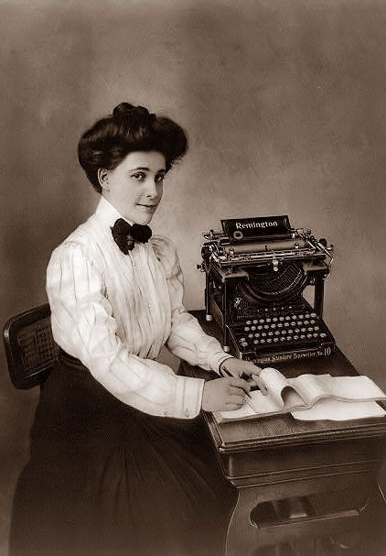

Slide 3
1 - Secretary-Treasurer Welcome
2 - Setting Goals
3 – Records and reports
4 - Importance of Finances
5 - Fees & Dues
6 – Resources for Success

Slide 4
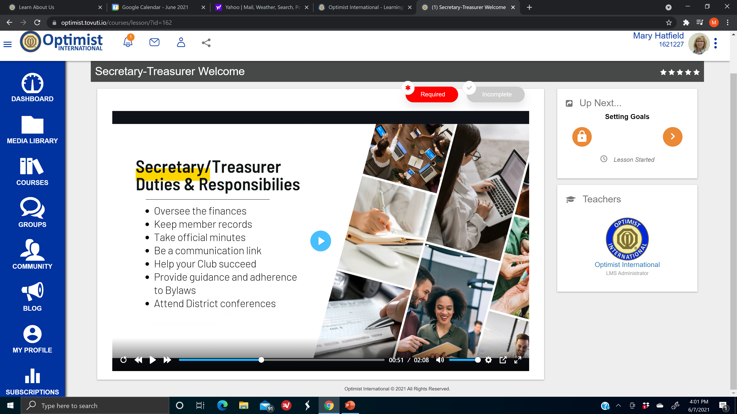
Right arm to pres

Slide 5
Assist president
Duties of the Secretary • Keep and maintain the minutes of all meetings of the Board of Directors and business meetings. • Maintain all records of membership, attendance and service to the Club in the form and manner prescribed by the Board of Directors. • Prepare and file all reports required by Optimist International and the District. File Registration with MO Secretary of State • Send out notice of board meeting at least 1 week in advance per bylaws
Duties of the Treasurer • Keep and maintain all records of dues and monies collected and disbursed. • Submit regular financial statements in the form, manner and frequency prescribed by the Board of Directors. • Prepare an annual statement for the annual meeting of the Club. Submit records for audit at end of year. File 990 with IRS
Notes:
General correspondence – use club letterhead

Slide 6
Your Role in Board Meetings:
Secretary: Read minutes of last meeting. Keep minutes. Read names of prospective members for vote (after required screening). Ask Board approval of Members to be dropped.
Treasurer: Present bills for approval. Present complete financial report.

Slide 7
Materials You Need
Secretary: Leadership Hotline and other Optimist International publications, District publications, Club Bylaws and Policies, Club Bulletins, Club Reports (completed and upcoming), Records of Club meetings, Minutes of Board meetings, Roster (including names, addresses, phone numbers, classifications, birthdays), Committee assignments, Attendance records
Treasurer: Unpaid invoices and statements, Paid bills, cancelled checks and bank statements, Financial records, checkbook (should require 2 signatures on each check or other debit - bylaws)

Slide 8
Banking Matters
Treasurer, together with new President, needs to get new signature authorizations with bank; this may require the minutes where the President was elected and the treasurer appointed
Might also require Certificate of Good Standing from MO Secretary State

Slide 9
So now you have added some new members and maybe even dropped one or two. Now what?
Maintain the club roster on the Optimist International (OI) Optimist Leaders Website Why?
Be sure your club is paying dues for the correct number of members
Be sure all members are covered under the insurance
Be sure all members are receiving emails
Be sure all members are receiving the Optimist Magazine
Be sure all officers are properly listed
Be sure all officers are receiving their emails
Be sure all officers are receiving their training

Slide 10
Adding and deleting members; updating officers... How do you do that?
Using the email address you provided to OI and the password OI gave you, click on the Optimist Leaders - Login in upper left of the Optimist International website (optimist.org) and login.
On the next screen, scroll down to enter your club’s number in the box at the bottom of the page.
To add a member, scroll down to the bottom of the page below the list of current club members and click the add member button and follow the instructions. Please note that a valid email address for the new member is required. When all of the information has been entered, hit submit.

Slide 15
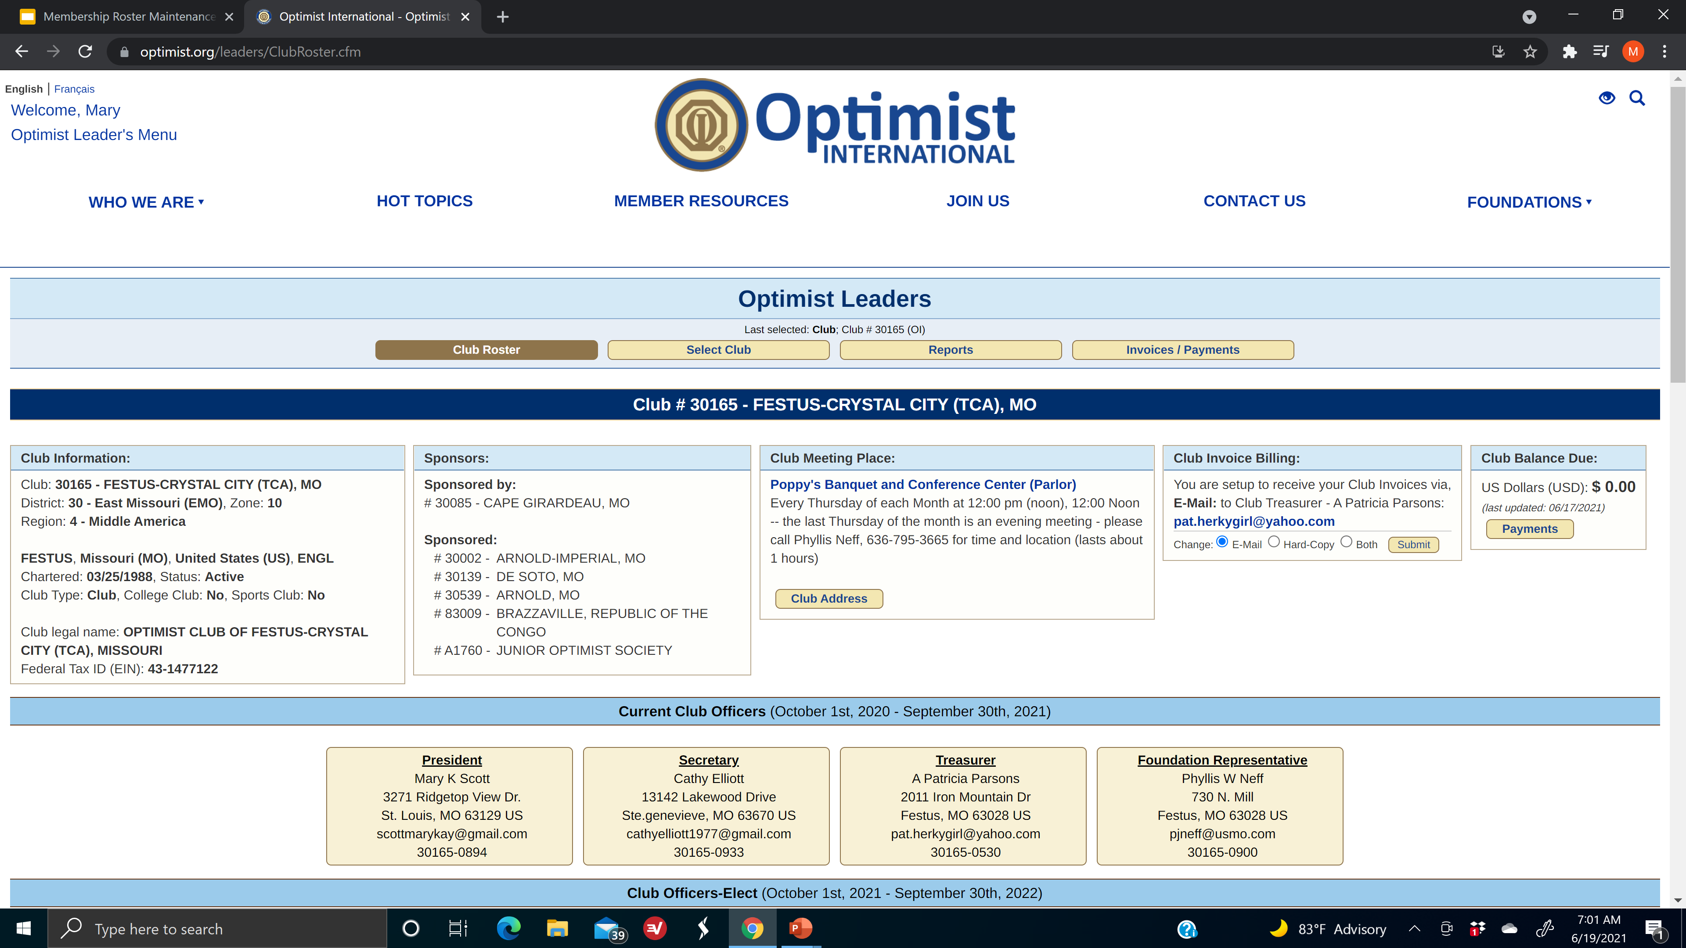
Looks like this

Slide 16
To add a member, scroll down to the bottom of the page below the list of current club members and click the add member button and follow the instructions. Please note that a valid email address for the new member is required. When all of the information has been entered, hit submit.
Add Member
Notes:
Also, be sure all information for current members is up to date

Slide 17
Paying Dues

Slide 18
Pay Dues and Fees and CRA Adds: ACH Direct Debit Authorization Program
https://www.optimist.org/member/administration2.cfm
The Automated Clearing House program – or ACH – allows Optimist Clubs to pay their bills electronically. It’s an easy and efficient way for Clubs to handle their financial obligations to Optimist International. Best of all, the program is secure!
To initiate the ACH direct debit bill form of payment for a Club, Optimist International needs the following two items:
1. A completed "authorization agreement for direct debits" form. You must choose the agreement applicable to your Club: US Dollar ACH Debit Authorization Agreement
Canadian Dollar Pre-authorized Payment Agreement
2. A voided check or bank draft (or copy) for the bank account from which you would like us to withdraw money (debit). Please do not use a deposit slip. Note: Only one bank account per Club can be assigned for ACH.
You can fax both the completed authorization agreement form and a voided check image to the attention of Michele Ervin at (314) 371-6006.
Or scan the documents and email them to Michele Ervin at michele.ervin@optimist.org
Or mail the information to: Optimist International c/o Accounting Department 4494 Lindell Blvd. St. Louis, MO 63108

Slide 20
Speaking of Dues…
$66.65 per member goes to OI annually
The above amount is payable quarterly
$14 per member goes to EMO annually
The above amount is payable twice a year
$___ for club use
$30 is the suggested new member application fee; $15 per new member Club Roster Adjustment (CRA) goes to OI immediately
Lifetime membership option

Slide 21
Which leads us to…
Budgets
Accounting

Slide 22
Sample Budget Established Club
General Operating Fund |  |  | Youth (Service Projects) Fund
Income |  |  | Income
Description |  |  | Description
50/50 raffle | $ 1,000.00 |  | Koeze Nuts | $1,000.00
brags, fines | $ 100.00 |  | Christmas trees | $2,000.00
dues @ $100 x 20 members | $ 2,000.00 |  | Trivia Night | $1,000.00
New member fee @ $30 ea | $ 300.00 |  | Fall Gala | $1,000.00
20% fee from service Projects Fund | $ 1,400.00 |  | 5K Run | $1,000.00
other | $ 100.00 |  | Paint Night | $1,000.00
total income | $ 4,900.00 |  | total income | $7,000.00
Expenses |  |  | Expenses
Description |  |  | Description
Fellowship (cards etc..) | $ 50.00 |  | Youth appreciation | $ 500.00
Installation dinner | $ 500.00 |  | Oratorical contest | $ 100.00
Printing/copying | $ 100.00 |  | Essay contest | $ 100.00
NOW / WOW meetings | $ 200.00 |  | Respect for Law | $ 500.00
OI new member fees | $ 150.00 |  | Bicycle Rodeo | $ 250.00
OI dues $66.65 x 20 members | $ 1,333.00 |  | scholarship | $1,000.00
EMO dues $14 x 20 members | $ 280.00 |  | OIF | $ 100.00
OI Convention registration | $ 300.00 |  | OI Childhood Health & Wellness | $ 50.00
EMO Conferences | $ 300.00 |  | 20% transfer to General Operating account | $1,400.00
Special meetings/programs | $ 100.00 |  | total expenses | $4,000.00
Website | $ 100.00
Supplies | $ 50.00
Postage etc. | $ 25.00
total expenses | $ 3,488.00
Notes:
No special type of accounting software required – Wave, Excel, Google Sheets, etc..

Slide 23
Which brings us to …
minutes

Slide 24
Minutes of Optimist Club
Board Meeting September 1, 2020
PRESENT: Board Members Bob, Sally, Carl, Brenda
Guests Joe, Heather, Kristi, Mary
President Brenda called the meeting to order at 7:00p.m., noting that a quorum was present.
SECRETARY’S REPORT: Bob presented the minutes of the last meeting. Sally moved to approve the minutes as presented. Carl seconded. Motion carried.
TREASURER’S REPORT: Bob presented the financial report. Carl moved to accept the report as presented. Sally seconded. Motion carried.
President Brenda noted Joe is being nominated as the Rookie Rock Star.
OLD BUSINESS: none
NEW BUSINESS:
Presentation of the Budget for the new year. Sally moved to approve the budget as presented. Bob seconded. Motion carried.
New Member Application: Jane Doe, sponsored by John Doe. New member Application fee was attached. Sally moved to approve the new member. Carl seconded. Motion Carried.
Next month’s meeting will be on October 3, at the home of Sally.
There being no further business to come before the board, Carl moved to adjourn. Sally seconded. Motion carried. Meeting was adjourned at 7:30p.m.
Submitted by Bob, Secretary/Treasurer

Slide 25
Sample Club Financial Report as of ___date |  |  | Year to Date | Budget Amount | Variance
Income General Operations
Description
50/50 | $ 10.00 |  | $ 50.00 | $ 100.00 | $ 50.00
Brags | $ 8.00 |  | $ 32.00 | $ 100.00 | $ 68.00
total Income | $ 18.00 |  | $ 82.00 | $4,900.00 | $4,818.00
Expenses General Operations
Description
Meals speakers / special meetings |  | $ 25.00 | $ 25.00 | $ 100.00 | $ 75.00
copies |  | $ 15.00 | $ 15.00 | $ 100.00 | $ 85.00
EMO Conference |  | $ 75.00 | $ 75.00 | $ 300.00 | $ 225.00
Total Expenses |  | $ 115.00 | $ 115.00 | $3,488.00 | $3,373.00
Income Youth (Service Projects) Fund
Description
5K run | $ 10.00 |  | $ 800.00 | $1,000.00 | $ 200.00
Paint Night | $ 20.00 |  | $1,020.00 | $1,000.00 | $ 20.00
Total Income | $ 30.00 |  | $1,820.00 | $7,000.00 | $5,180.00
Expenses Youth (Service Projects) Fund
Description
Christmas Trees |  | $ 750.00 | $ 750.00 | $ - | ($750)
Paint Night |  | $ 200.00 | $ 200.00 | $ - | ($200)
Total Expenses |  | $ 950.00
Reconciled Checkbook Balance | $8,500.00
Notes:
Go back and amend the original budget

Slide 26
More minutes
Note that in this example the club forgot to plan for paying for the Christmas trees and Paint Night supplies. This requires modifying the original budget as of today's date and another motion must be made.
Budget is a guide

Slide 27
General Membership Meetings no minutes required
EXCEPT
Election of Officers
Amendment to Bylaws
Dues matters

Slide 28
Dues billing…
Call your absent members in October and again about July or August just to chat
Mail the dues notice
If no payment received, call that member to remind them
Consider different types of payment methods: check, credit card, Venmo, Square, PayPal…

Slide 29
Sample Dues Invoice

Slide 30
Sample Dues Collection Follow-Up Letters
August 30, 2021
Dear John:
I have just come from our Club meeting and want you to know that we again missed you. Your friendly smile and your presence contributes something to the Club that no other member can replace. Your absence leaves a vacuum that your fellow members feel. Why not join us next Monday at noon?
By the way, did you misplace the dues statement that was recently sent to you? If so, I am enclosing a duplicate copy, and for your convenience, there is a stamped, addressed envelope.
We will be looking for you on Monday. Please join us!
Optimistically yours,
Sallie Brown
President

Slide 31
September 10, 2021
Dear John:
As Finance Chair of our Club, I feel a great responsibility to the Club for its financial condition. There was an expression of confidence in me when I was selected, and among other things, I was given the duty of keeping the Club’s finances strong and healthy.
As of today, your check for your dues has not been received. The Club counts on your friendship and support to accomplish its activities and projects.
As you know, it costs money to pay for meals for our speakers, the rental of the audio-visual equipment, the printing and mailing of our Club bulletin, etc..
Your check will complete payment of your dues.
Since you may have lost your dues statement, I am enclosing another and an envelope for your reply. I look forward to hearing from you.
Optimistically yours,
Paul Brooks
Finance Chair

Slide 32
September 20, 2021
Dear John:
At its meeting, the Board of Directors instructed me to notify those Members who have not paid their past due Club dues that they will be deleted from the Club’s membership if they have not paid their dues prior to September 30.
The Bylaws of the Club require that we follow the procedure of deleting current Members who have not paid their dues.
Nearly every Member of the Club has paid his/her dues, and we are striving for 100 percent participation. I vividly recall your many contributions to the Club and Anytown. I look forward to hearing from you soon.
Sincerely,
Ed Graves
Secretary-Treasurer

Slide 33
What do you do with all of those budget, financial reports and minutes?
Financial Review or Audit
Corporate records are kept permanently

Slide 34
GUIDELINES FOR PREPARING A CLUB REVIEW
A Club Review is considered to be a certified statement of receipts and disbursements, and an accountability statement, including an analysis of all monies on deposit or invested in securities, supplemented by statements of receipts and disbursements on the conduct of (a) Club meetings and conferences, (b) fundraisers, (c) service projects. Such review shall be performed by an independent Certified Public Accountant, a Certified Managerial Accountant, a Certified General Accountant, a Chartered Accountant, or a review committee*, as of 30 September each year.
All statements of receipts and disbursements, budgets and supplements thereto, shall be prepared and submitted in the form and manner of and shall correspond with the Standard Club Chart of Accounts, and the numbers and definitions of those accounts, provided by Optimist International or of a similar form.
* An Independent Review Committee will be a committee of at least three people who have either a professional background in a financial field and/or experience as a secretary/treasurer at either the Club or District level. The members of this committee should not be a Club officer or secretary/treasurer currently or in the preceding Optimist Year or any other persons with signatory authority of the Club accounts for those years. These members should also not be a business partner, marital partner, romantic partner, parent, sibling, child, stepchild, step-parent, or in-law of any Club officer or secretary-treasurer of the current or immediate proceeding year or any other persons with signatory authority of the Club accounts for those years. It is suggested that this be a rotating committee appointed by the President each year and the committee is approved by the Club’s Board of Directors.

