Slide 1
EMO Club Secretary Treasurer Training 2022 Part B

Slide 2
Government Filings

Slide 3
Visit irs.gov and search for 990-N; Small tax-exempt organizations generally are eligible to file Form 990-N to satisfy their annual reporting requirement, if their annual gross receipts are normally $50,000 or less. Electronic filing required. Due February 15 annually.

Slide 5
Usually Feb. 15

Slide 6
MO Secretary of State: Registration Reports https://www.sos.mo.gov/fileonline/reports
Annual and Biennial Reports:
We recently upgraded to a new enhanced filing system. With the new system, all customers must have a user account associated with a valid email address. Make sure to confirm your account with the message emailed to the account provided at registration before attempting to log in to the system. If you have a confirmed account and are needing directions for filing your report see below:
To file a biennial report
After creating an account/logging in, go to your dashboard:
On the left hand side select New Filing
Then click Update a Company
Enter the name or charter number in the search box
Then select the entity
Select Biennial Registration Report and click Start.
To file an annual report
After creating an account/logging in, go to your dashboard:
In the center column under Update a Company
Enter the charter number or name of the entity for which you are filing a registration report
Click the blue button File Return/Renewal.

Slide 7
Sample Annual Registration Report
This is public information
Due Date: For corporations incorporated or qualified on or after July 1, 2003, the annual report is due at the end of the month that the corporation incorporated or qualified. For corporations existing prior to July 1, 2003, the annual report will be due at the end of the month indicated on their last annual report. Missouri statutes do not allow a non-profit corporation to change the month that the annual report is due.

Slide 8
Good Standing Certificate: https://www.sos.mo.gov

Slide 12
Optimist International Filings

Slide 13
Club Officer Elect Report (COER)

Slide 14
Scroll down until you get to the Club Officer Elect Report
Due by May 20

Slide 15
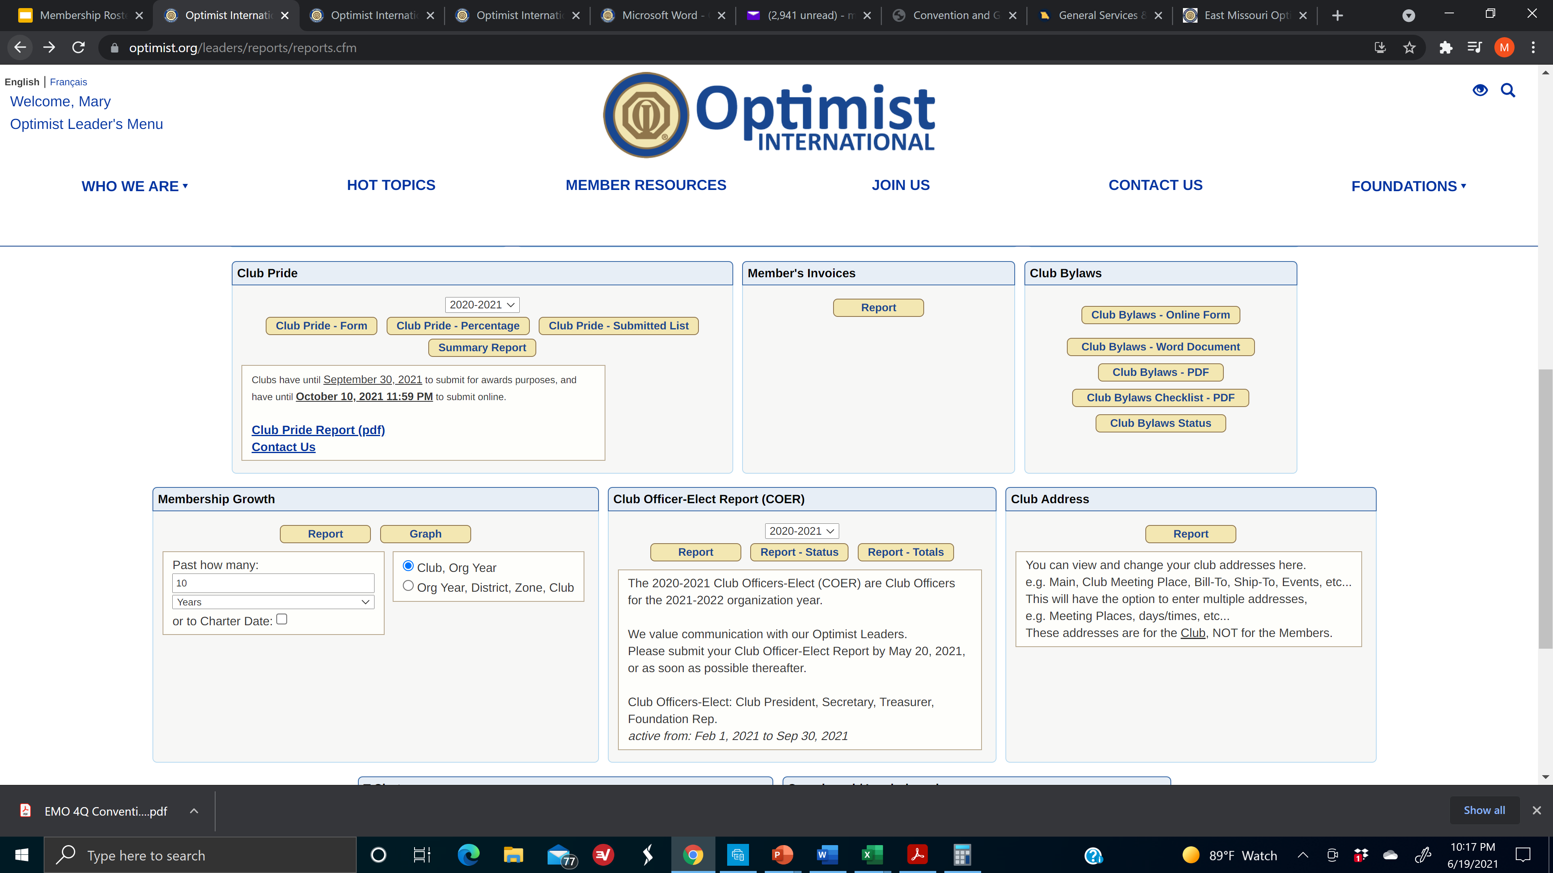
Bylaws review
Notes:
Screen 1 of 4

Slide 16
Where are the standard club bylaws forms with required wording? Here…

Slide 19
Club Pride Report

Slide 20
What goals can a Secretary or Treasurer set?
Be present
Honor Club Tracking Form
OIF grant applications
Logos
SUCCESS = Commitment & Effort

Slide 21
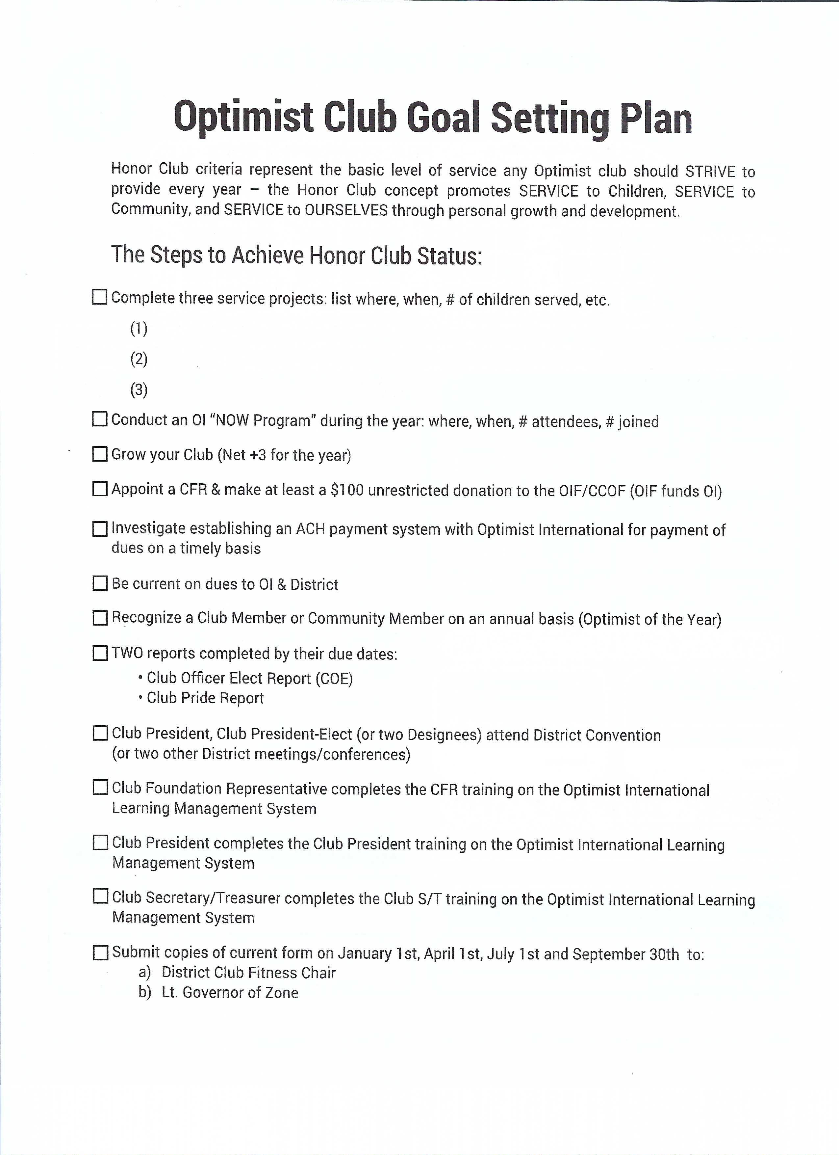

Slide 22
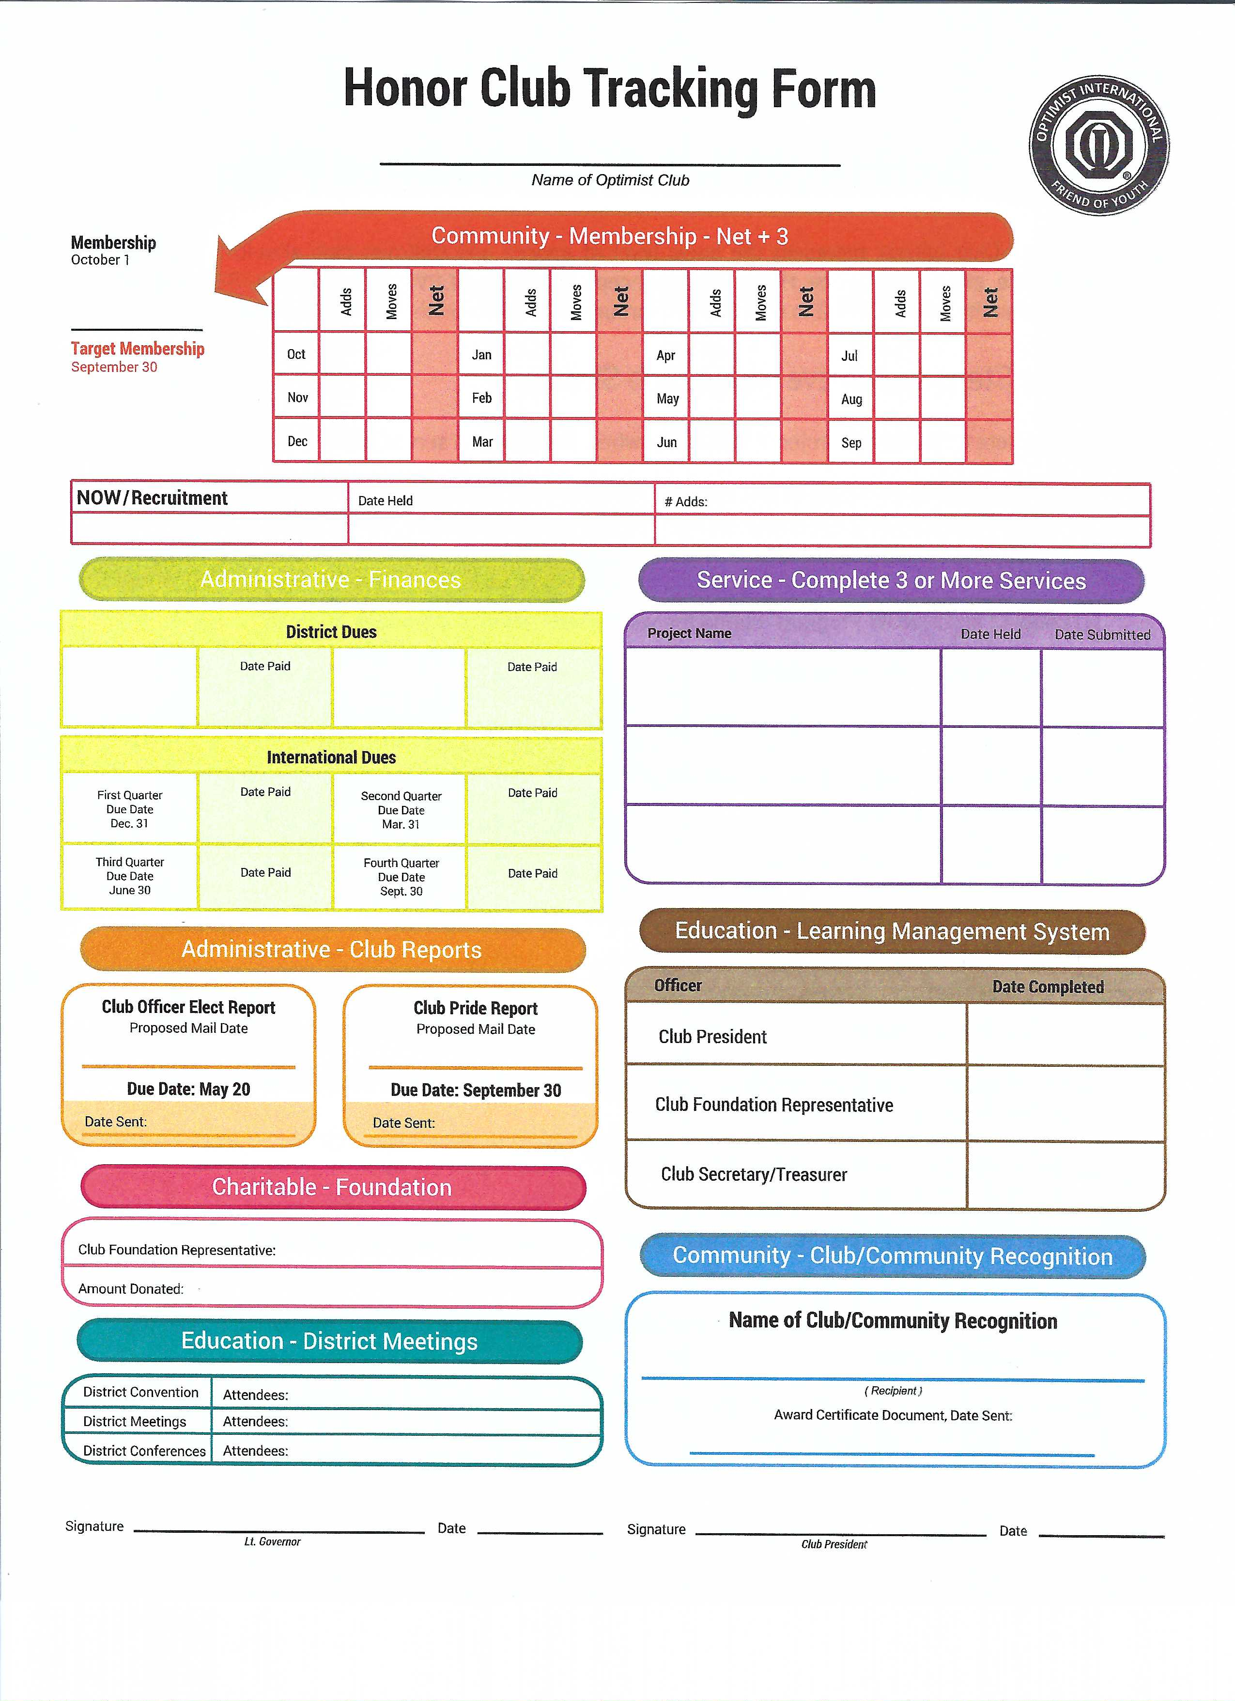

Slide 23
Logos

Slide 24
Logos

Slide 25
Club Logos

Slide 27
Program Logos

Slide 28
Many resources here!

Slide 29
Last year’s secretary & treasurer are great resources

Slide 31
LMS / Optimist Institute

Slide 32
LMS / Optimist Institute

Slide 33
Questions
Notes:
EMO website? OI website?

Slide 34
You can do this!

Slide 35
Mary Hatfield
314-835-7524 (c)
636-937-7240 (h)
mhat123@yahoo.com
hatfieldme73@gmail.com

