Slide 1
Optimist Tech Talk
Hybrid Meetings

Slide 2
What is a Hybrid Meeting?
Face-To-Face
Virtual Meeting
Hybrid
Notes:
Hybrid meetings integrate technology with traditional event practices to create new types of attendee experiences and content delivery tools. They include any meeting or event with at least one group of face-to-face participants that digitally connect with participants in another location or multiple locations.
What is the most important aspect to consider when planning a hybrid meeting?

Slide 3
Why A Hybrid Meeting?
Reach more people
Allowing virtual delegates to participate alone or in small groups
Presenters and Facilitators can come from anywhere.
Connecting multiple events that occur concurrently or at different times or locations
Including people who could not otherwise attend.
Notes:
Meetings deliver value when participants do something as a result of having attended…. Learn something, implement an Optimist Program in their club, recruit a member, build a club. Hybrid events are no difference in that sense from live events. They give you opportunity to provide value to a larger audience.
Let’s talk about some of the benefits.
Reach more people: I heard a myth lately…actually repeated several times… If we offer virtual, people won’t come to the in person. This is simply not true. Optimists who come to in-person meetings will continue to do so as long as they are able. It is the ones that have NOT been coming that we want to reach as well. Optimists have seen the increased participation with the implementation of Zoom. New leaders are emerging …virtually. They have not attended in person meetings in the past for a variety of reasons… As leaders, it is not our place to judge those reasons or to imply they have misguided priorities. However, it is our place to provide them with opportunities… A Hybrid meeting does just that.
Virtual participation: Hybrid meetings do not mean there are people on the Zoom who are sitting at a computer all alone. There could be multiple locations. You could have four or five regional sites. Have a large geographical area to represent? Have multiple locations and connect them virtually. Instead of having attendees travel to a single location in one city, you can invite them to a shorter conference at restaurants in their own city.
Presenters – Have you seen a presentation and you want that person to come present at your meeting but it is not in the budget? Why not Zoom them in at no cost? Want a variety of Optimist presenters? Why not?
They can’t come: That member who just had foot surgery and can’t yet drive. That single mother who has to take the kids to a soccer game. That homebound member who can’t get out due to illness. That career minded individual who has to work part of the weekend. That young family of four who just does not have it in the budget to travel once a quarter.

Slide 4
Event Format Types
Live Main Event – speakers and attendees in the same venue
Notes:
Live Main Event – speakers and attendees in the same venue. This is our traditional conference.
Blue circle – live main event

Slide 5

Event Format Types
Live Main + Virtual Participants
Notes:
Live Main Event with virtual participants. This is the simplest form of hybrid event where the content is already being delivered and it streams to the individuals who are watchin sessions online. It is one-way communicate from the event to the virtual participants.
Blue circle for our live main event and individuals logged in on a computer

Slide 6
Event Format Types
Main + One Way Pods
Notes:
Some of the virtual viewers may get together in groups and watch the event together. Here, PODS watch the content in four groups. Each has its own “live event” in other locations. This is often used when room capacity at live events is insufficient, or when you want to connect groups of people who can’t travel. You capture the essence of the video and audio onsite at the live event and stream it out to the pods. They can watch it love or with a delay depending on time zones.
Blue circle for our live main event and gold circle for our pods that can listen.

Slide 7
Event Format Types
Main + 2 Way Pods
Notes:
Today’s technology makes it much more affordable to set up two-way communication between pods and remote sies. This allows attendees to actively contribute to the content and dialog. Speakers from one pod can present to the live event, or do callouts to the pother pods to get their perspectives. This format is much more engaging for the pos participants but requires two-way streams from the live event to the pods for both audio and video. The level of complexity and coordination goes up significantly, but so does the engagement and value.
Blue circle for our live main event and gold circle for our pods that can listen and participate

Slide 8
Event Format Types
Main + 1 way Pods + Virtual participants
Notes:
It Is also possible to combine the elements of the the prior formats. You can have a live event, a number of pods, and individuals participate.
Blue circle for our live main event , some pods and some individuals… still one way

Slide 9
Event Format Types
Studio+2 way pods
Notes:
Another hybrid format uses a studio to create and broadcast content. The Face-to-face delegates attend in small groups in remote pods watching the broadcast. These attendees then have the chance to ask the speaker questions or give feedback.
Beige circle for our studio and several gold circle pods

Slide 10
Event Format Types
Studio+ 2way pods + virtual participants
Notes:
From the studio – we could also combine pods and individual virtual participants. Imagine Optimist International broadcasting from St Louis. Clubs, Zones, or Districts could meeting locally in person to participate or individually.
Beige circle for our studio and several gold circle pods as well as individuals and two way communication.

Slide 11
Event Format Types
Equal Pods
Notes:
The last configuration is equal pods – you can have independent events that are interconnected during which each pod has its own programming and connects with other pods for join sessions.
4 gold circle pods that can connect with each other at various times and share content.
Think Zone meetings or a Zone WOW event. Or even multiple districts connecting within a region.

Slide 12
Hybrid Event Process
Strategy
Pre-Production
Onsite
Post Production
Notes:
There are four phases in planning a Hybrid event. Lets walk through them.

Slide 13
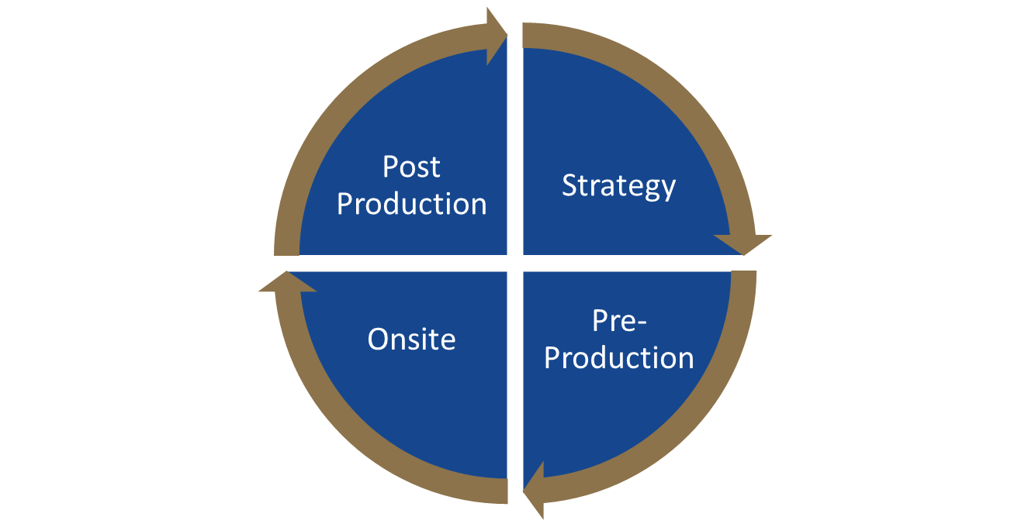
Strategy
Define Meeting Objectives
Consider External Factors
Develop a Budget
Expand Your Reach
Reduce Costs
Improve member satisfaction
Expand education
Bring in speakers who can’t travel
What Optimist Programs or themes need to be included?
Equipment
Internet connectivity
Streaming services
Virtual platforms
Decor
Measure Success
Analyze Your Audience
Outline Your Event Execution Strategy
Collect statistical data and measure the digital tracks of participants and content.
Consider the key success factors and determine how you will measure them.
Time Zones
Travel Time
Planned white space or down time
Options to view content live or in near real time or on demand
Event format
Creating opportunities for connection
Recording and rebroadcasting

Slide 14
Pre-Production
Marketing
Content Design
Digital Communications
Speaker Selection and Briefing
Key Hybrid Team Roles
Engagement
General Hybrid Host
Production Team
Streaming Vendor
Platform Vendor
Internet Engineer
Pod Hosts
Technical Director
Creative Director
Stage Manager
Video Director
Camera Person
Audio Technician
Notes:
These are not much different than an in person event. You want to reach all your members so they are aware and want to come, You want your content to be fun and engaging, and You want to communicate in a variety of ways to reach your audience. You speakers do need to be skilled in engaging both remote and face-to-face members. Make sure you prepare them!
The Hybrid team size will vary depending on the scope of the event. Some common roles you may find on a Hybrid team would be the General Hybrid Host who oversees the event, The Production Team which may include a technical director, creative director, stage manager, video director, camera person and audio technician, A streaming Vendor, a Platform Vendor, Internet Engineer, and a Pod Host.
Let’s take a deeper dive into engagement.

Slide 15
Engagement Strategies
Switch between multiple video cameras
Use a virtual emcee
Customize programs
Providing hard-copy participant booklets
Using audience response/collaboration systems
Featuring chat rooms or Q&A moderators
Holding special Q&As for virtual speakers only
Creating digital breakout rooms
Hosting leader boards and gaming
Providing airtime and recognition for remote pods
Enabling photo and video sharing from remote attendees with everyone
Creating awards and badges
Create activities and teambuilding for local pods.
Notes:
Capturing and maintaining the attention of virtual or remote attendees can be different because you don’t control their environments. So it is important to pay attention to the engagement as much as you would when they were in the room. People do not want to simply watch virtually as if it were television. If so, it could simply be recorded and they could watch at any time. They want to participate.
As a presenter, if you notice that most are looking at their phones, you can adjust and try to engage the audience in the content. Virtually, you can take cues from people turning their camera off…

Slide 16
Onsite
Lighting
Video
Audio
Décor
Testing and Rehearsal are key
Notes:
Once you are onsite, there are a few things to make sure you have just right for your in person attendees as well as your virtual.

Slide 17
Post-Production
Ensure content is online and available
Conduct a Lessons Learned
Review post-event metrics
Notes:
Once you are done – the follow up is just as important as the planning.
Put your content out for reference on your website.
Lessons learned, post mortem, whatever you want to call it… Talk about what went well first… then talk about what could be worked on for next time. Remember that no event is perfect, especially right out of the gate. Don’t throw the baby out with the bath water if things are not exactly right. - HOA meeting.
Review metrics – send a survey – get feedback. What did people like and what did they not? Listen to this feedback as an input for your next meeting.
Now, lets look at some helpful Technology

Slide 18
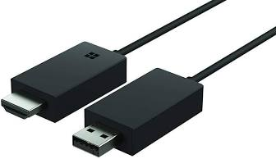
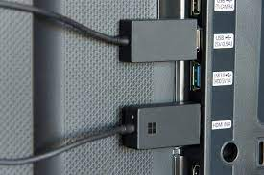
Technology
Microsoft Wireless Display Adapter
Notes:
This is about $45 on Amazon. This device will allow you to connect your computer to a TV across the room. It works through WIFI and both ends of the device plug into the TV. If you have a projector that has an HDMI AND USB ports, it will work with that as well. No more tripping on cords OR worrying that it is not long enough.

Slide 19
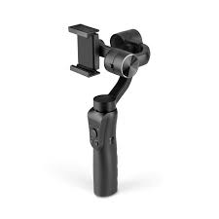
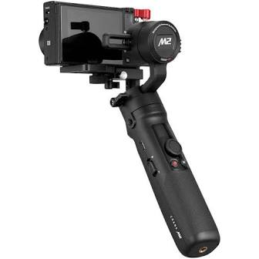
Technology
Gimbal
Notes:
The price on these range from $50 to hundred depending on the brand and functionality. This device keeps your cell phone or camera steady and level. It is often used for video bloggers and video production. It is useful for breakout sessions and times between sessions to connect your virtual and in person participants on a more personal level.

Slide 20
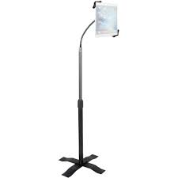
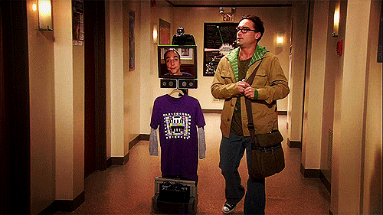
Technology
Tablet or Laptop Telescoping Cart
Notes:
If you are a big bang theory fan, you may remember the episode where Sheldon was a robot. He participated in the In person office setting virtually. Of course, he needed Leonard to help with things like doors, etc…. The telescoping stand is useful with a tablet to allow in person participants to chat and connect with the virtual participants. Remember – it is about people and engagement.
Technology is always changing and improving. With the events over the last few years, the need for Hybrid events is increasing and most experts believe it is here to stay. We wont go back to only meeting in person. We lose a significant portion of our audience. So technology is continuing to improve for this market and event menus are working to meet the demand.
Talking about venues – lets take a look at some room configurations…

Slide 21
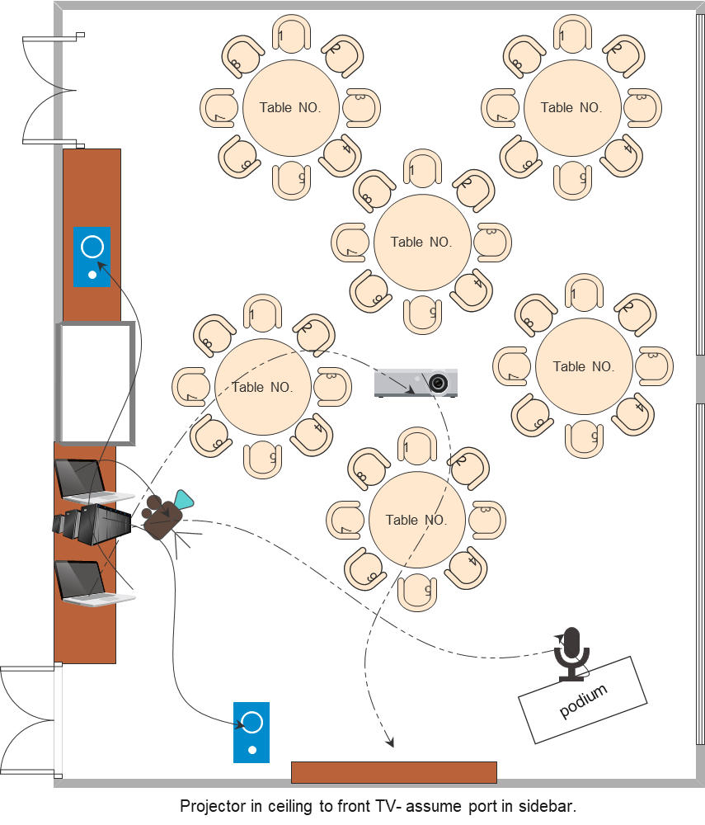
Sample Configuration

Slide 22
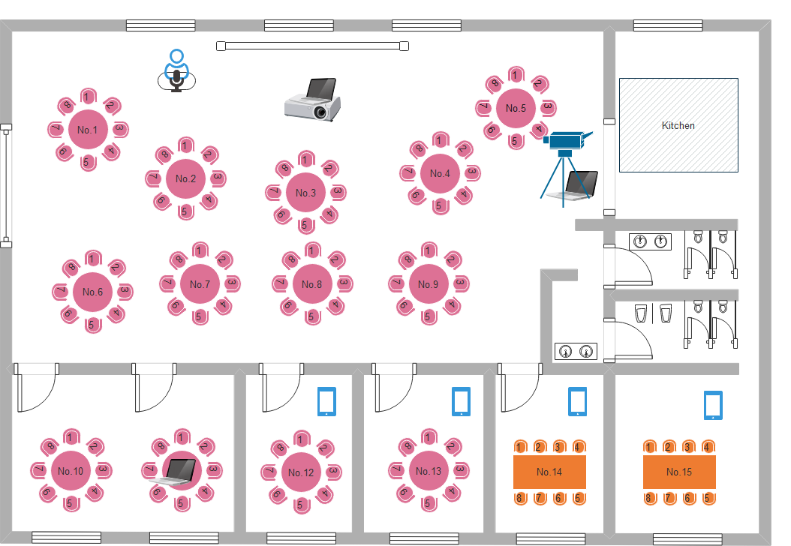
Sample Configuration

Slide 23

Sample Configuration
Studio in St Louis
PSW
Gateway
SCOD
EMO

Slide 24
Take - Aways
Engagement is key
Connect your members
Gather a team
Develop a Strategy
Be Flexible

