Slide 1
It’s a Team Effort!
Notes:
Play the ribbon activity before continuing with this presentation: First Place Ribbon
In this activity, one team gets clear instructions that the objective / goal is to create a colorful bow made of ribbon for a wrapped birthday gift for a child. The other team leader is NOT allowed to say what the outcome is supposed to be (create a bow) nor is he/she allowed to use the word ribbon.
Place several items on a table, including the different ribbons necessary to create a bow. The tables should be spread apart and there should be an obstacle course of some type in between that table and the table where the bow should be created. Each member must choose a different path to get his/her ribbon and return to the finishing table. Set a up a similar course for the other team.
Each team chooses a team leader and then the leaders are presented with their instructions. Allow 15 minutes for the entire activity.

Slide 3
Team building is about providing the skills, training and resources that your people need, so that they can work in harmony

Slide 6
Work Toward a Common Goal
Notes:
You can unite your members by inspiring them to get behind a shared vision or goal. Having a clearly identified destination can prevent individuals from pulling in different directions, which is frustrating and ineffective.

Slide 7
You can unite your members by inspiring them to get behind a shared vision or goal
Having a clearly identified destination can prevent individuals from pulling in different directions, which is frustrating and ineffective.
Notes:
If you’ve trained your members to exude passion for the mission and you’ve brought them into the process, there’s no question that they will be successful. You will create members who will own the goal

Slide 8
Get to know your team
Do team members need to get to know each other?
Notes:
Your team is made up of different people with different needs, ambitions, and personalities. Getting to know them, and helping them get to know each other, can build a happy, trusting team. This will help you identify how well you all work together and to find out which areas need improving. Attending social events is a great way to build relationships. People will more likely open up and reveal more of their personalities in a relaxed setting. Also, research has shown that sharing aspects of your personal life increases your likability, as it shows others that you can be an empathic, compassionate and authentic manager

Slide 9
Communication is key
Notes:
Refer to chaos in “bow” exercise. Help your members communicate more effectively. Clearly provide your goals to the team. Give clear instructions. In this time of virtual meetings, the key to building an effective team lies more in how its members communicate than the technology used. Help your members communicate more effectively. Clearly provide your goals to your club or committee; give clear instructions. Call, text, email, meet in person, use Zoom – whatever it takes. Frequency matters – often but not overbearing.

Slide 11
Notes:
In this way you’ll build a firm foundation of purpose, trust, respect, and rapport.

Slide 12
Motivate
Inspire

Slide 13
Focus on the good
Accentuate the positive

Slide 14
Rebecca Butler Mona, Past Optimist International President:
recognition of a member’s effort and accomplishments has many benefits including increasing morale, creating bonds, driving engagement, & attracting new members to the team.
Notes:
Building comradery

Slide 15
Team building is about providing the skills, training and resources that your club members/committee members need, so that they can work in harmony.
The purpose of these team building suggestions is to help you motivate your people to work together, to develop their strengths, and to address any weaknesses. So, any team building effort should encourage collaboration rather than competition.

Slide 16
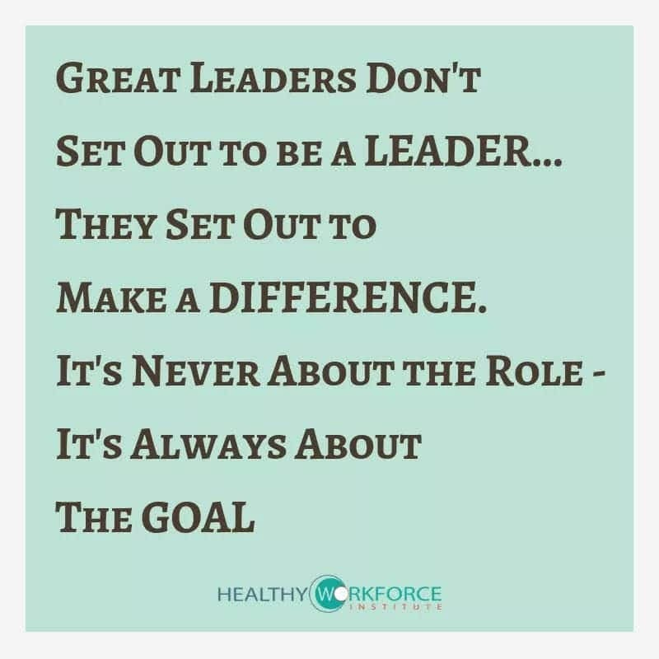
Notes:
Our goal: bring out the best in youth, our community, & ourselves

