Slide 1

Setting Up a Free Zoom Account
Mary Hatfield
1st Quarter Conference 2020-2021

Slide 2
Creating your own account
To sign up for your own free account, visit zoom.us/signup and enter your email address. You will receive an email from Zoom (no-reply@zoom.us). In this email, click Activate Account.
Signing in to your Zoom account on the web
You can login to your Zoom account on the web at any time, at zoom.us/signin. Once you're logged in, use the panel on the left side to navigate the Zoom web portal. You can update your profile, schedule a meeting, edit your settings, and more.

Slide 3
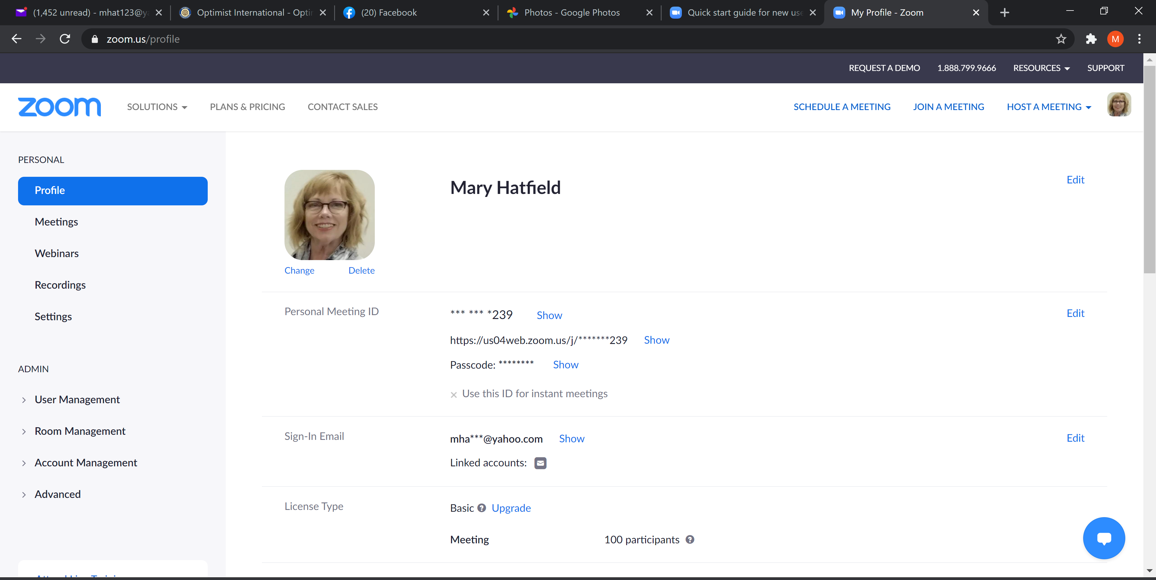
Updating your profile
You can update your profile by adding a profile picture, set your time zone, update your password and more. To access your Zoom profile, sign in to the Zoom web portal and click Profile.

Slide 4
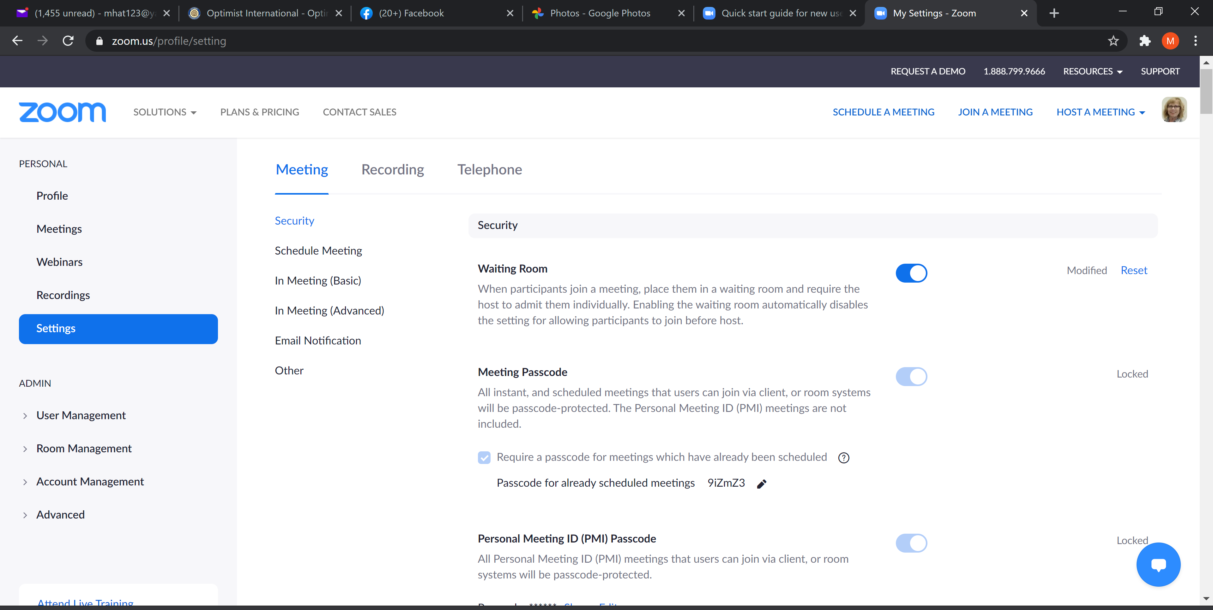
Settings

Slide 5
    Start with Video and Audio off – Let folks turn them on after they come into the meeting.
    Do NOT use a personal meeting ID – This means the meeting ID will be used over and over again. You want the Meeting ID to change each time making it harder for Zoom bombers. Use a unique ID.
    Only authenticated Users Can Join – People will have to log in to Zoom to enter the meeting or click on the email invitation that you send. You can enable a “join from browser link” when going through settings. No anonymous guests.
    Require a password when scheduling a new meeting.
    Do not embed the password in the meeting link. Users will have to find the password and type it in. Bad actors don’t like to jump through hoops.

Slide 6
    Do NOT allow file transfer. Not everyone is tech savvy and some may inadvertently pass malware through the chat.
    Unless you anticipate needing to send files, just turn this off.
    Screen Sharing – only allow the host to share, unless you have a specific need.
    Do not allow removed participants to rejoin. If you remove a bad actor, he will not be able to rejoin.
    Enable the Waiting Room – This has been set by Zoom as default. You will need to monitor the participants list and add people to the meeting from the waiting room as they appear.

Slide 7
Downloading the Zoom client
You can download the Zoom Desktop Client for Mac, Windows, ChromeOS and Linux, as well as the Zoom Mobile App for iOS and Android from our Downloads page.
Starting the Zoom Desktop Client
Overview
While meetings can be started and scheduled from the Zoom web portal, you can also schedule/start meetings directly from the Zoom application. It is also important to access the Zoom application to set certain in-app settings, including Virtual Background, Audio/Video settings, as well as other options.
Note: The Zoom Desktop Client and Mobile App have different features than the Zoom web portal. The Zoom web portal is primarily used for changing your meeting settings and Zoom Phone settings. You can also use the web portal to customize your profile.
Prerequisites
Latest version of the Zoom Desktop Client

Slide 8

To download the Zoom Client / Zoom app:
Windows 10
Click on the windows icon on the task bar
In your apps list, scroll down until you get to Zoom
Click on the Zoom folder
Double click on start Zoom to launch the application

Slide 9
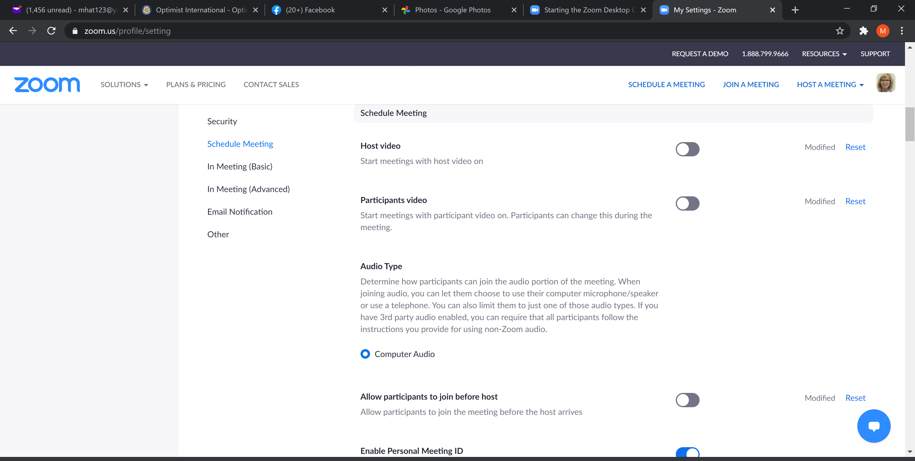
Schedule a Meeting
Do this through the Zoom.us and not through the Zoom Client/app. More settings are available through this method.

Slide 10
  Meeting Settings
    Select Registration Required
    Select Generate automatically for Meeting ID
    Select Require Meeting Password.
    Make sure Host and participant video and audio is turned off
    Under Meeting Options
      Mute participants upon entry
      Enable waiting room (automatically set by Zoom)
      Only Authenticated users can Join

Slide 11
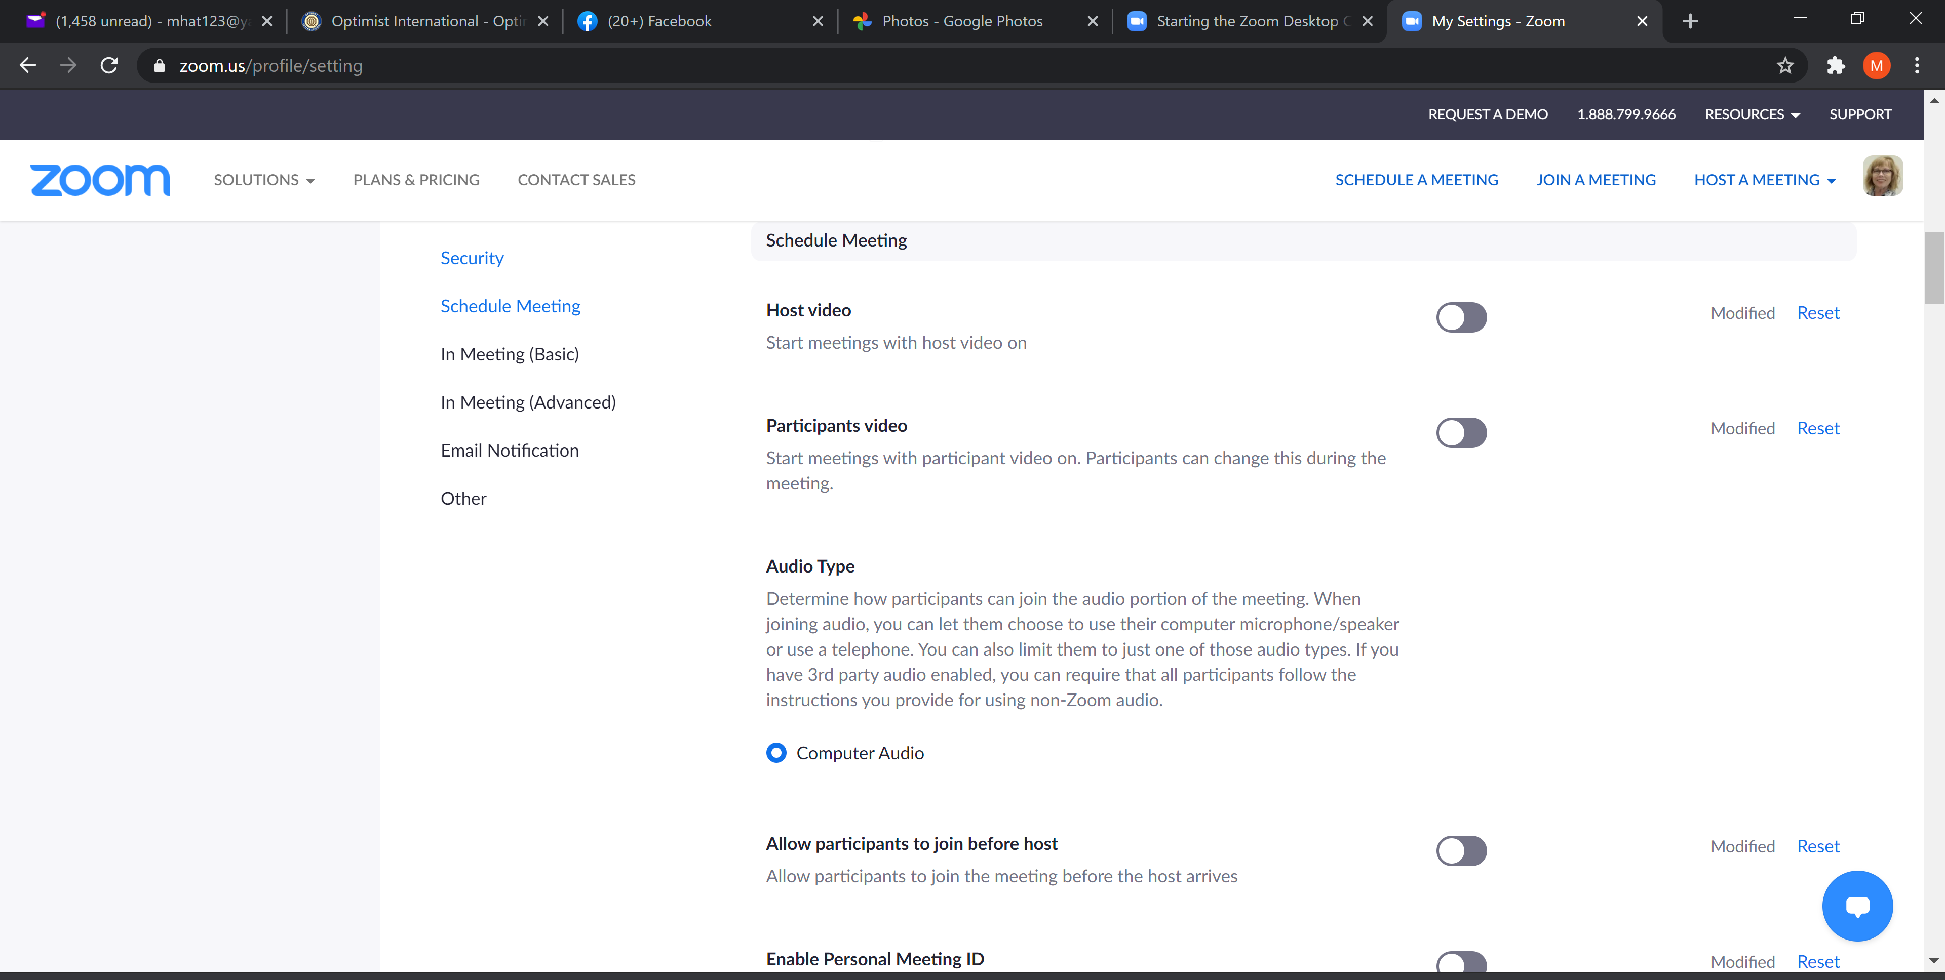
Settings for scheduling meetings

Slide 12
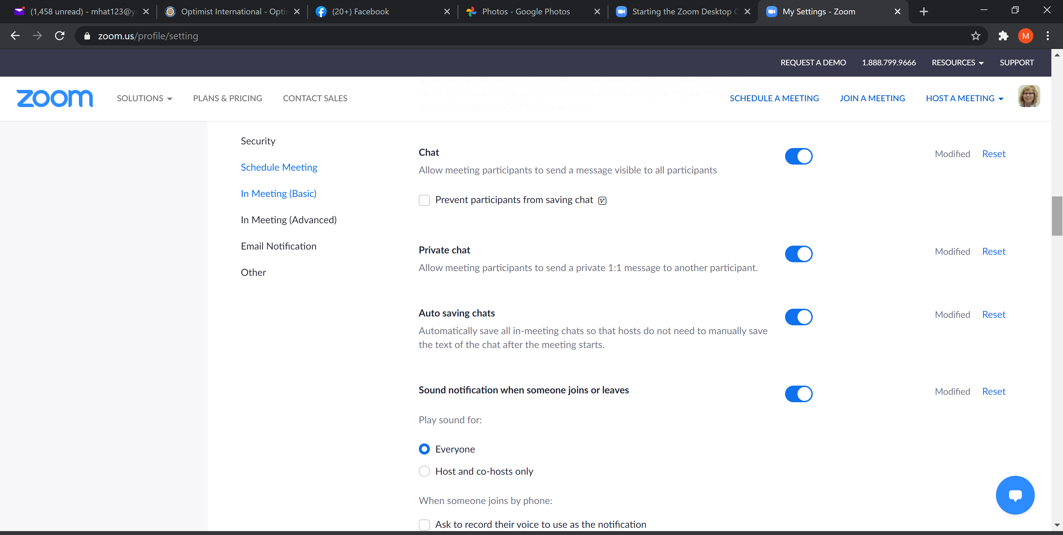
More settings for meetings

Slide 13
Continued
You might want to allow the host (you) to share your screen
You also might want to enable the white board so that you can create during the Zoom meeting
You might want to allow non-verbal reactions using icons
If a person is not using video, you could set up to allow their profile photo instead; otherwise it will just be the participant’s name

Slide 14
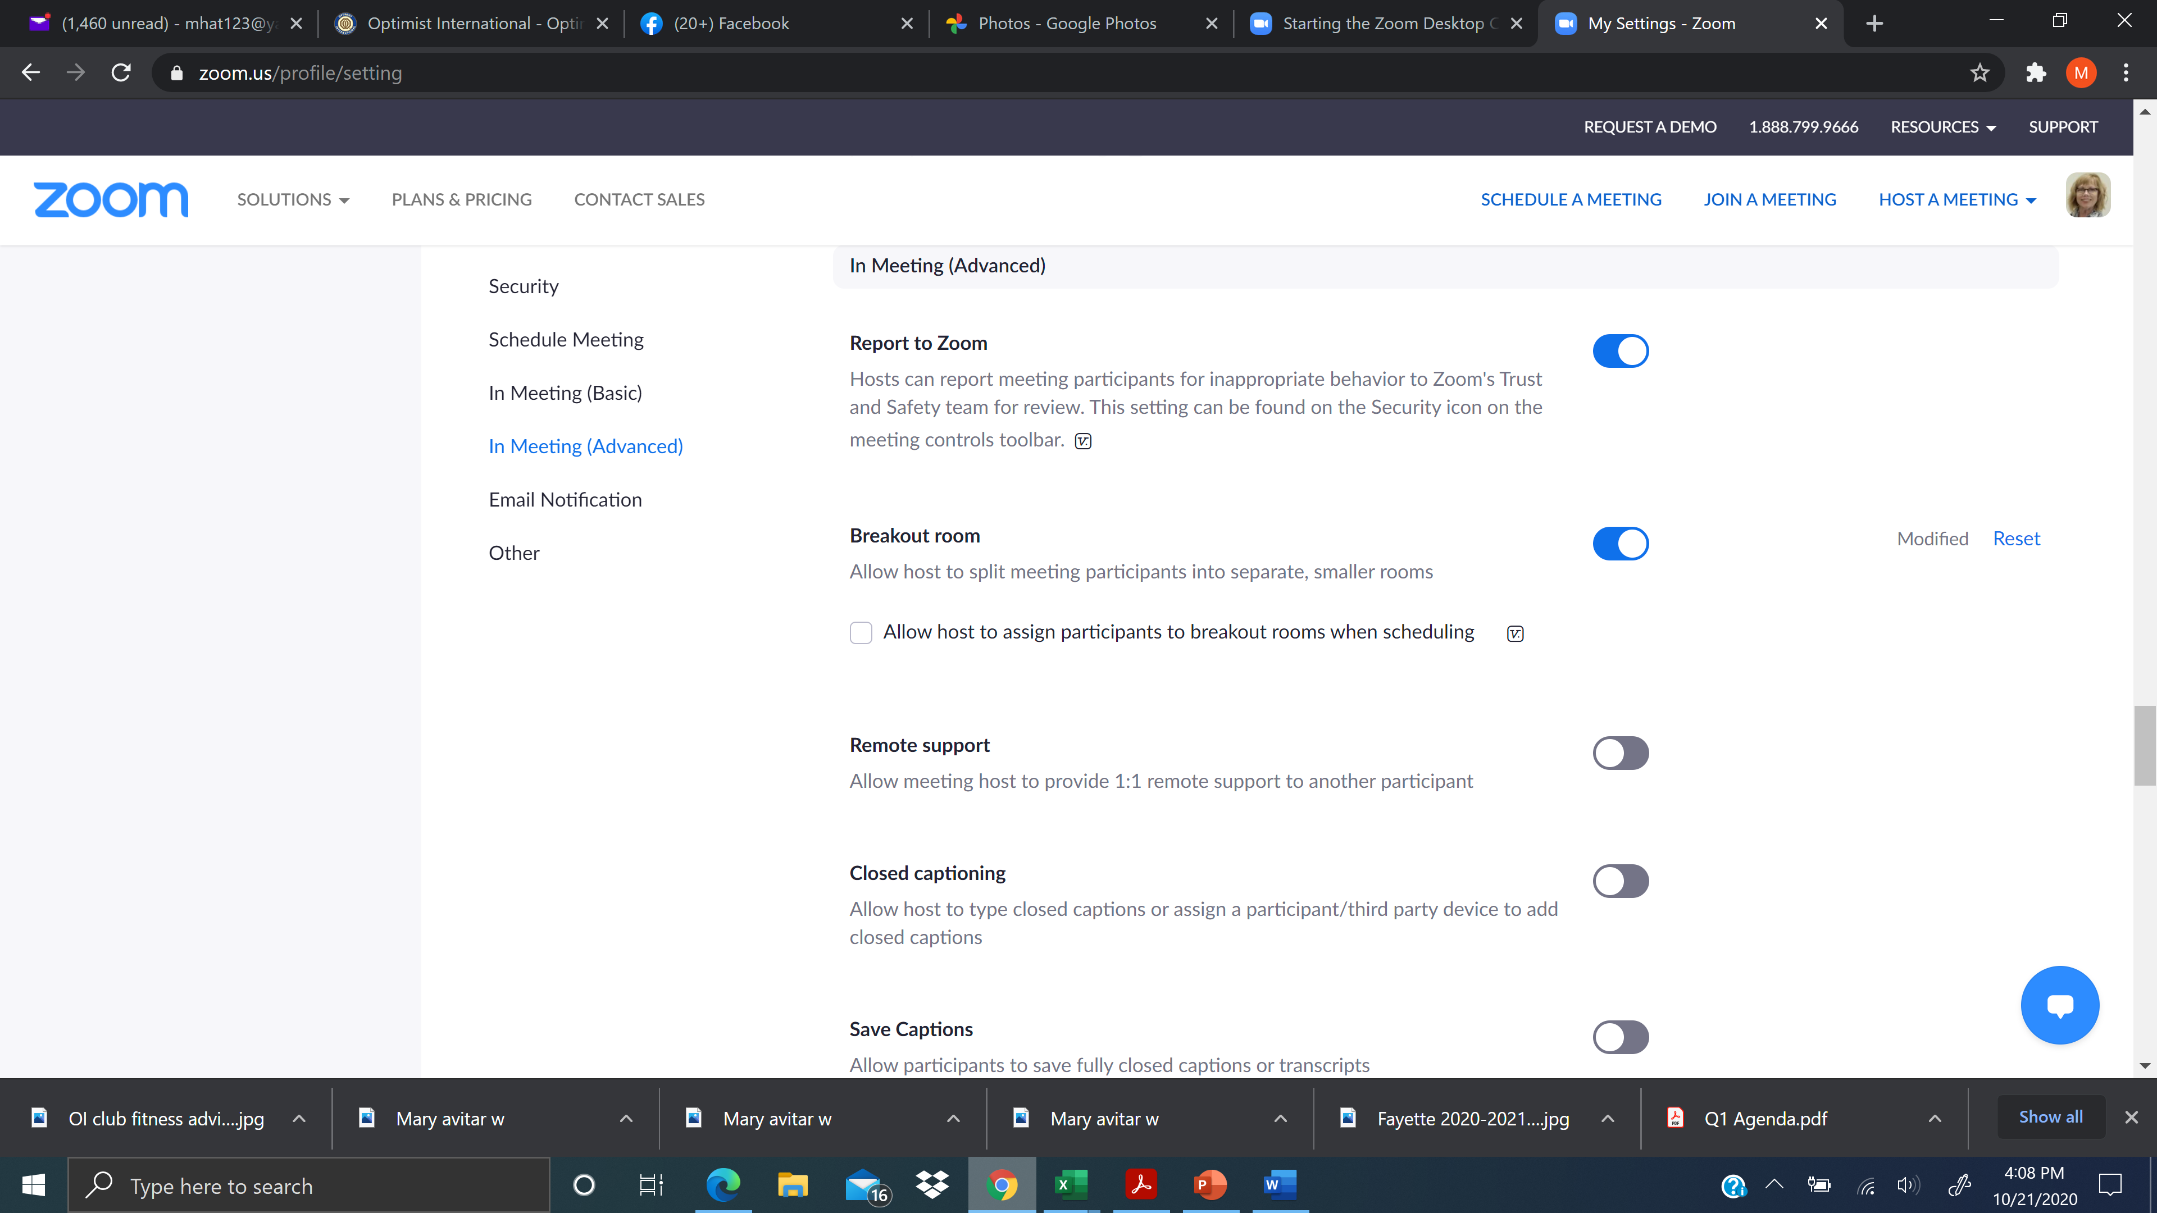
More settings

Slide 15
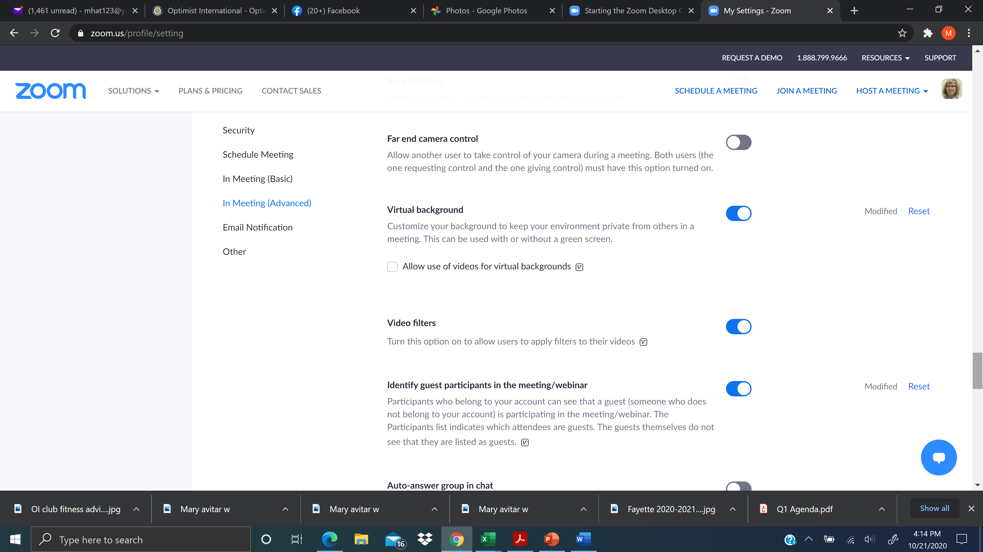
More…

Slide 16

Finally
Show a "Join from your browser" link
Allow participants to bypass the Zoom application download process, and join a meeting directly from their browser. This is a workaround for participants who are unable to download, install, or run applications. Note that the meeting experience from the browser is limited
NOW YOU ARE DONE WITH THE SET UP! YOU PROBABLY WILL NOT NEED TO CHANGE THESE SETTINGS EVER AGAIN!

Slide 17
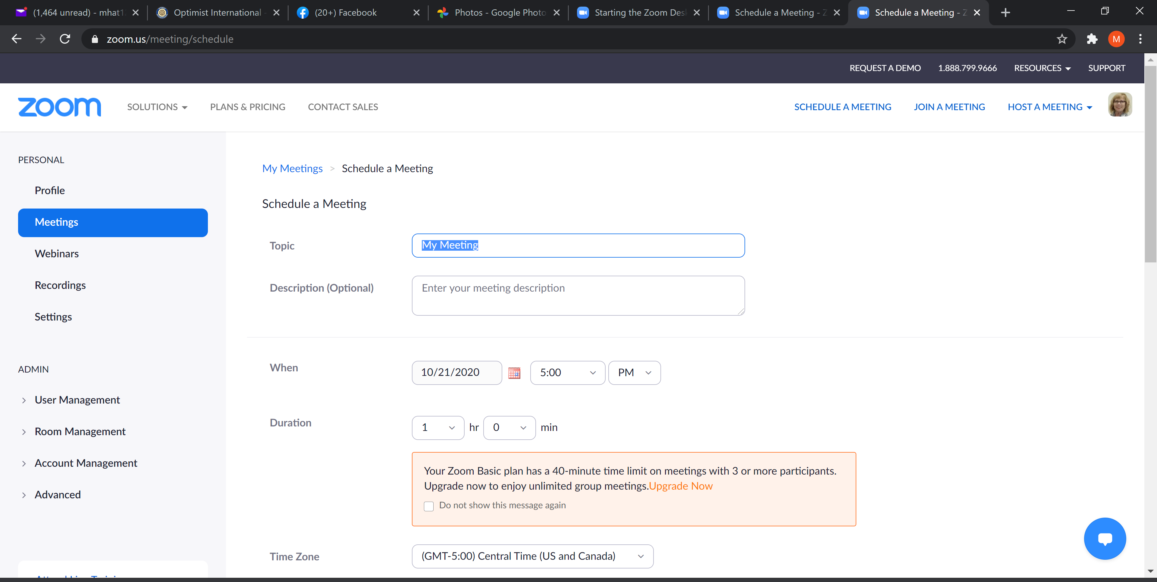
Schedule a meeting
Remember, when you scroll down, you want the meeting ID & passcode to generate automatically and the waiting room should be enabled. Video off and mute on. CLICK SAVE.

Slide 18
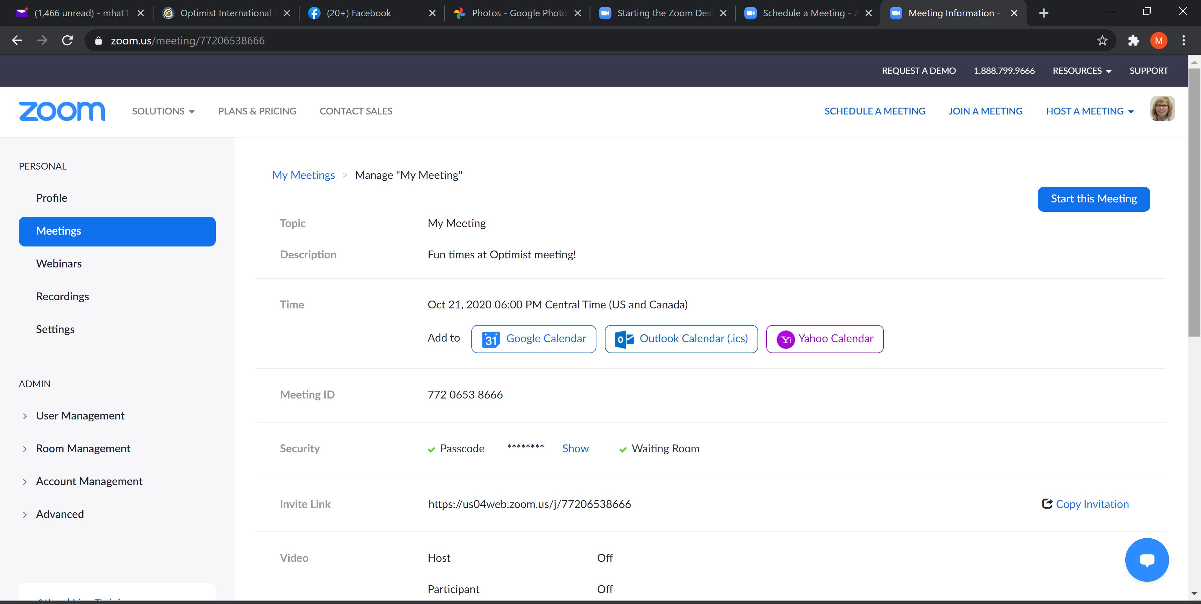
Now the meeting is set up.
Click on Copy Invitation

Slide 19
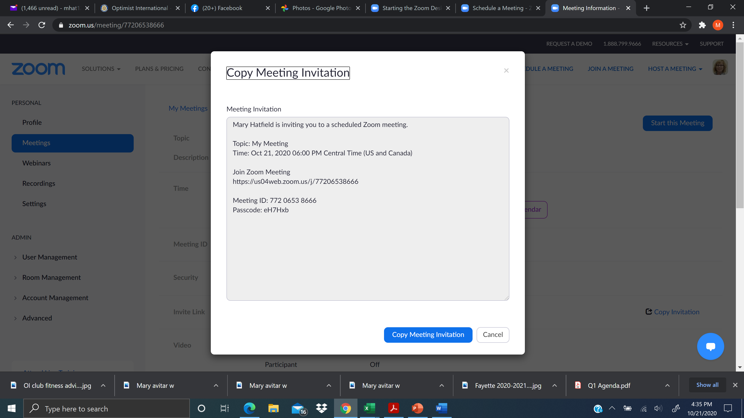
To invite someone, click on Copy Invitation. This pops up.
Click on the blue Copy Meeting Invitation button and paste it in the email you are sending to invite the participants.

Slide 20
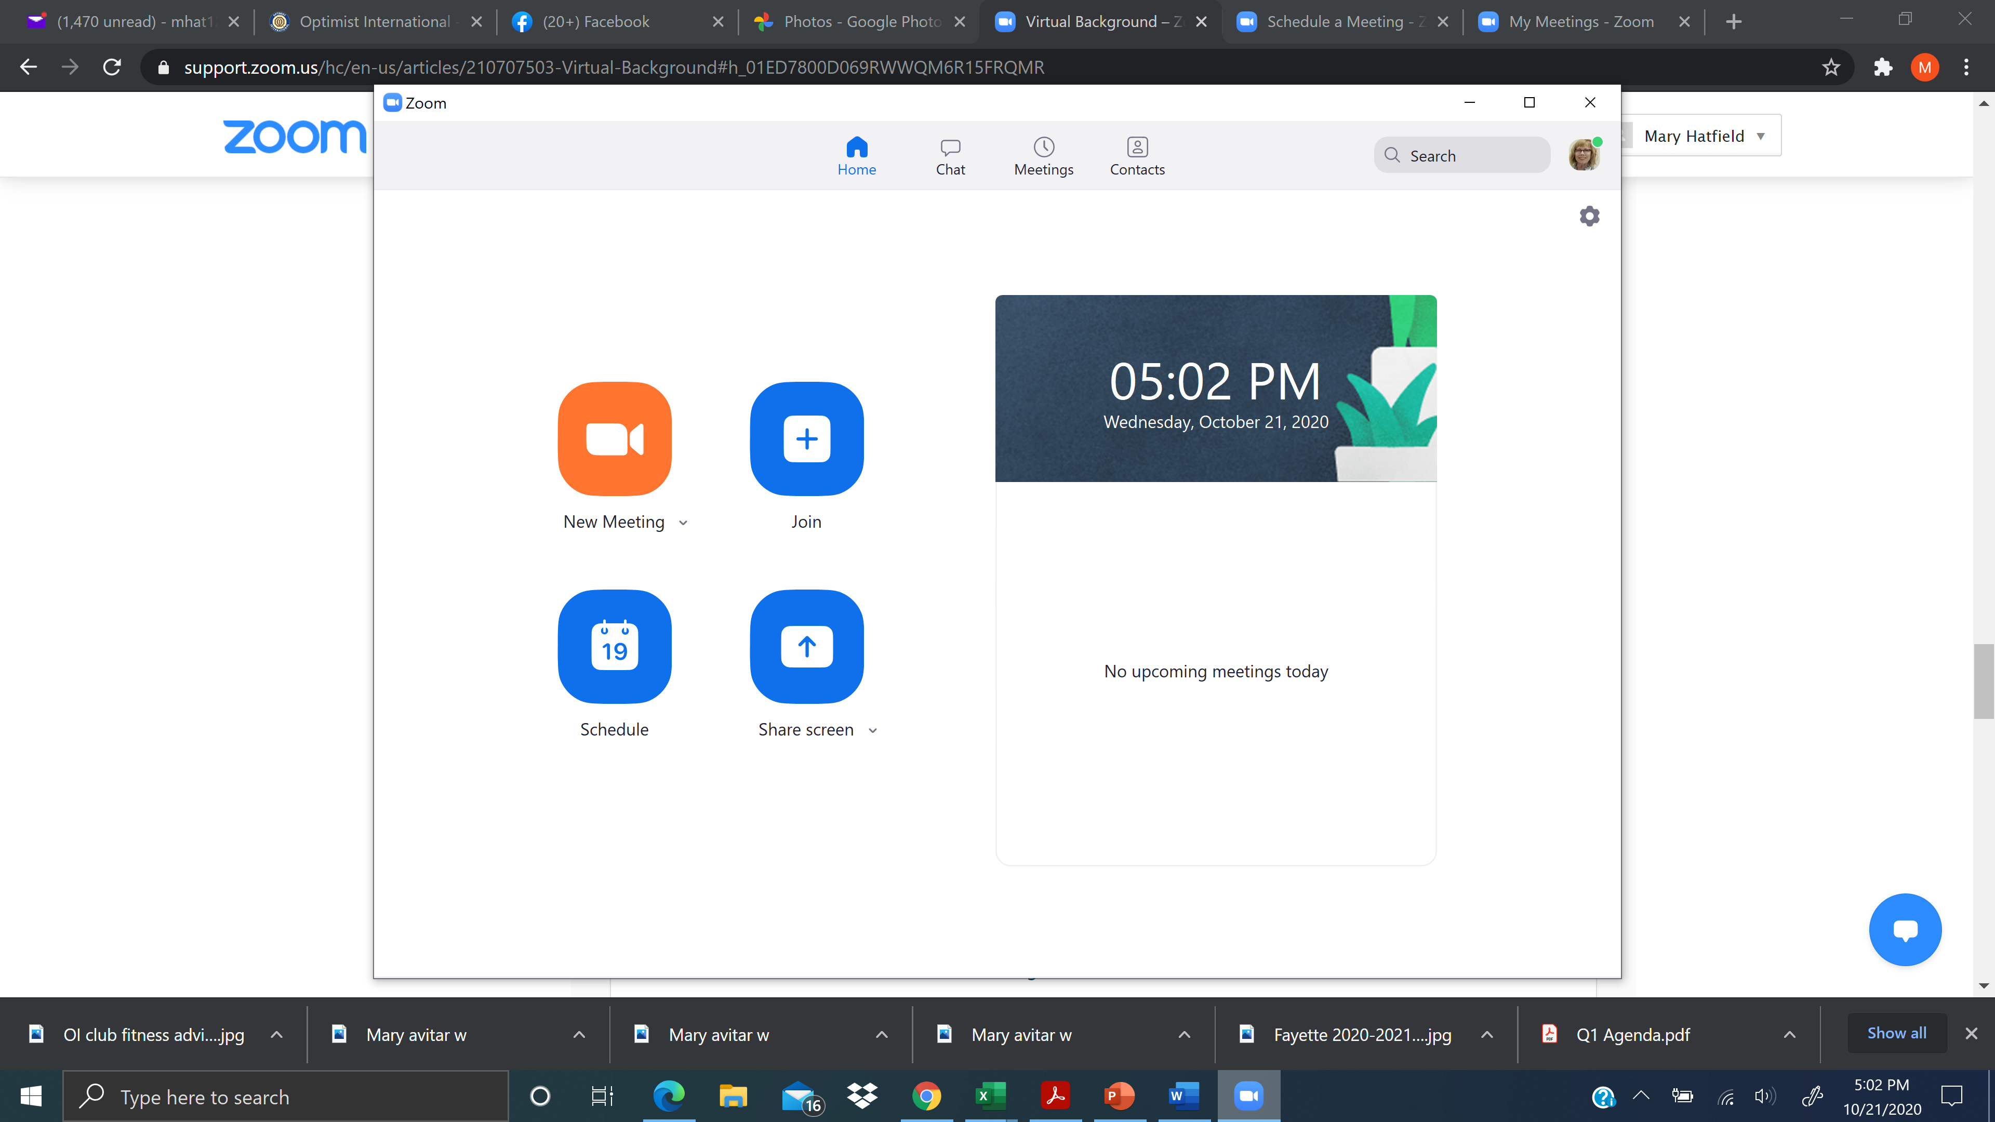
Virtual Background
Open your Zoom Client app
Click on your profile photo

Slide 21
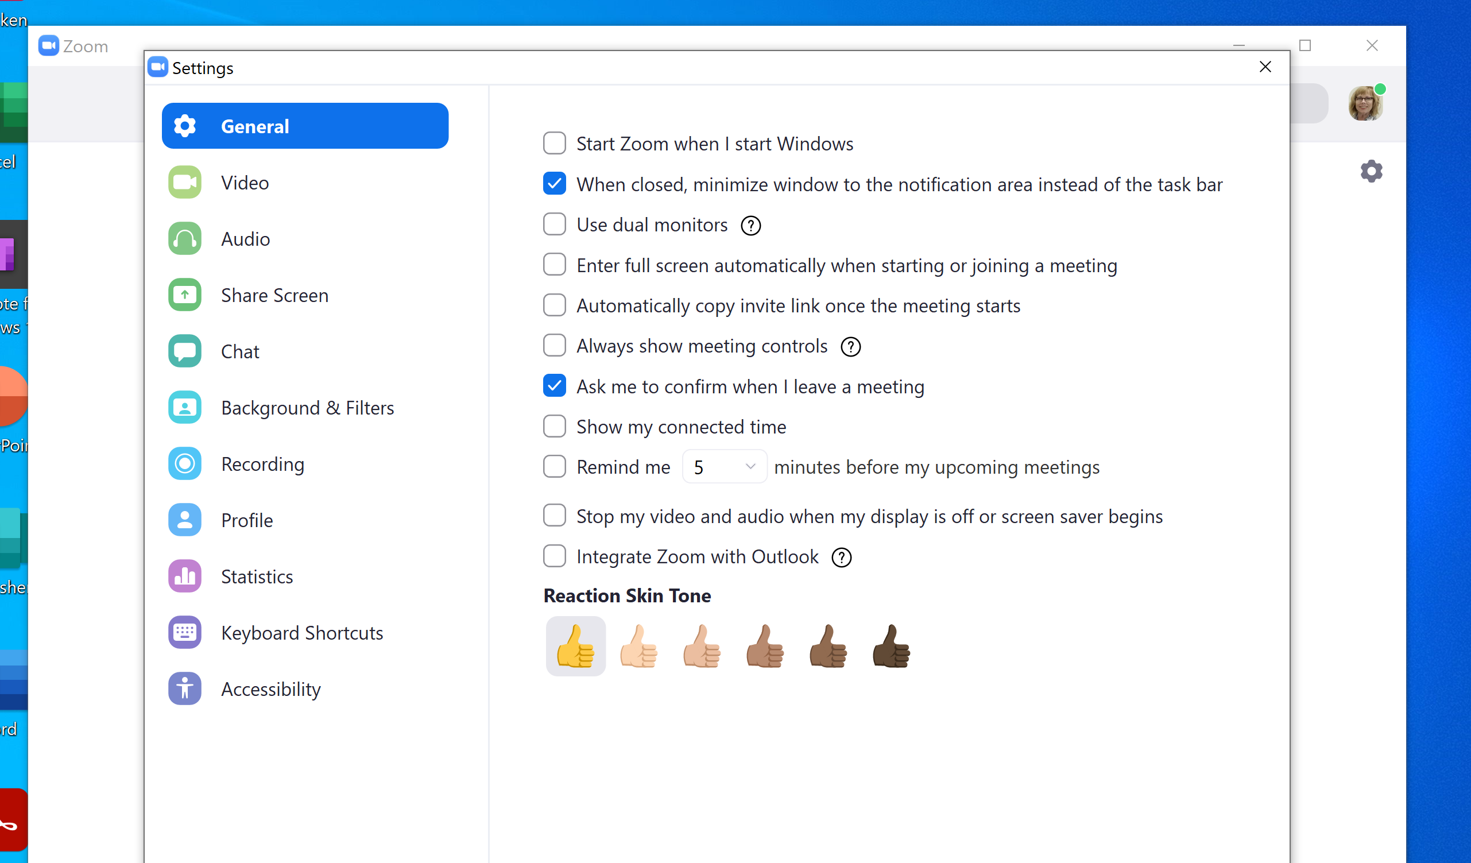
Click on your picture, then choose settings
Click Background & Filters

Slide 22
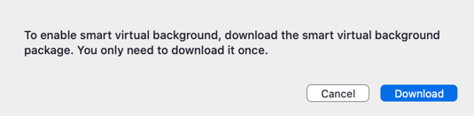
If prompted, click Download to download the package for virtual background without a green screen.

Slide 23
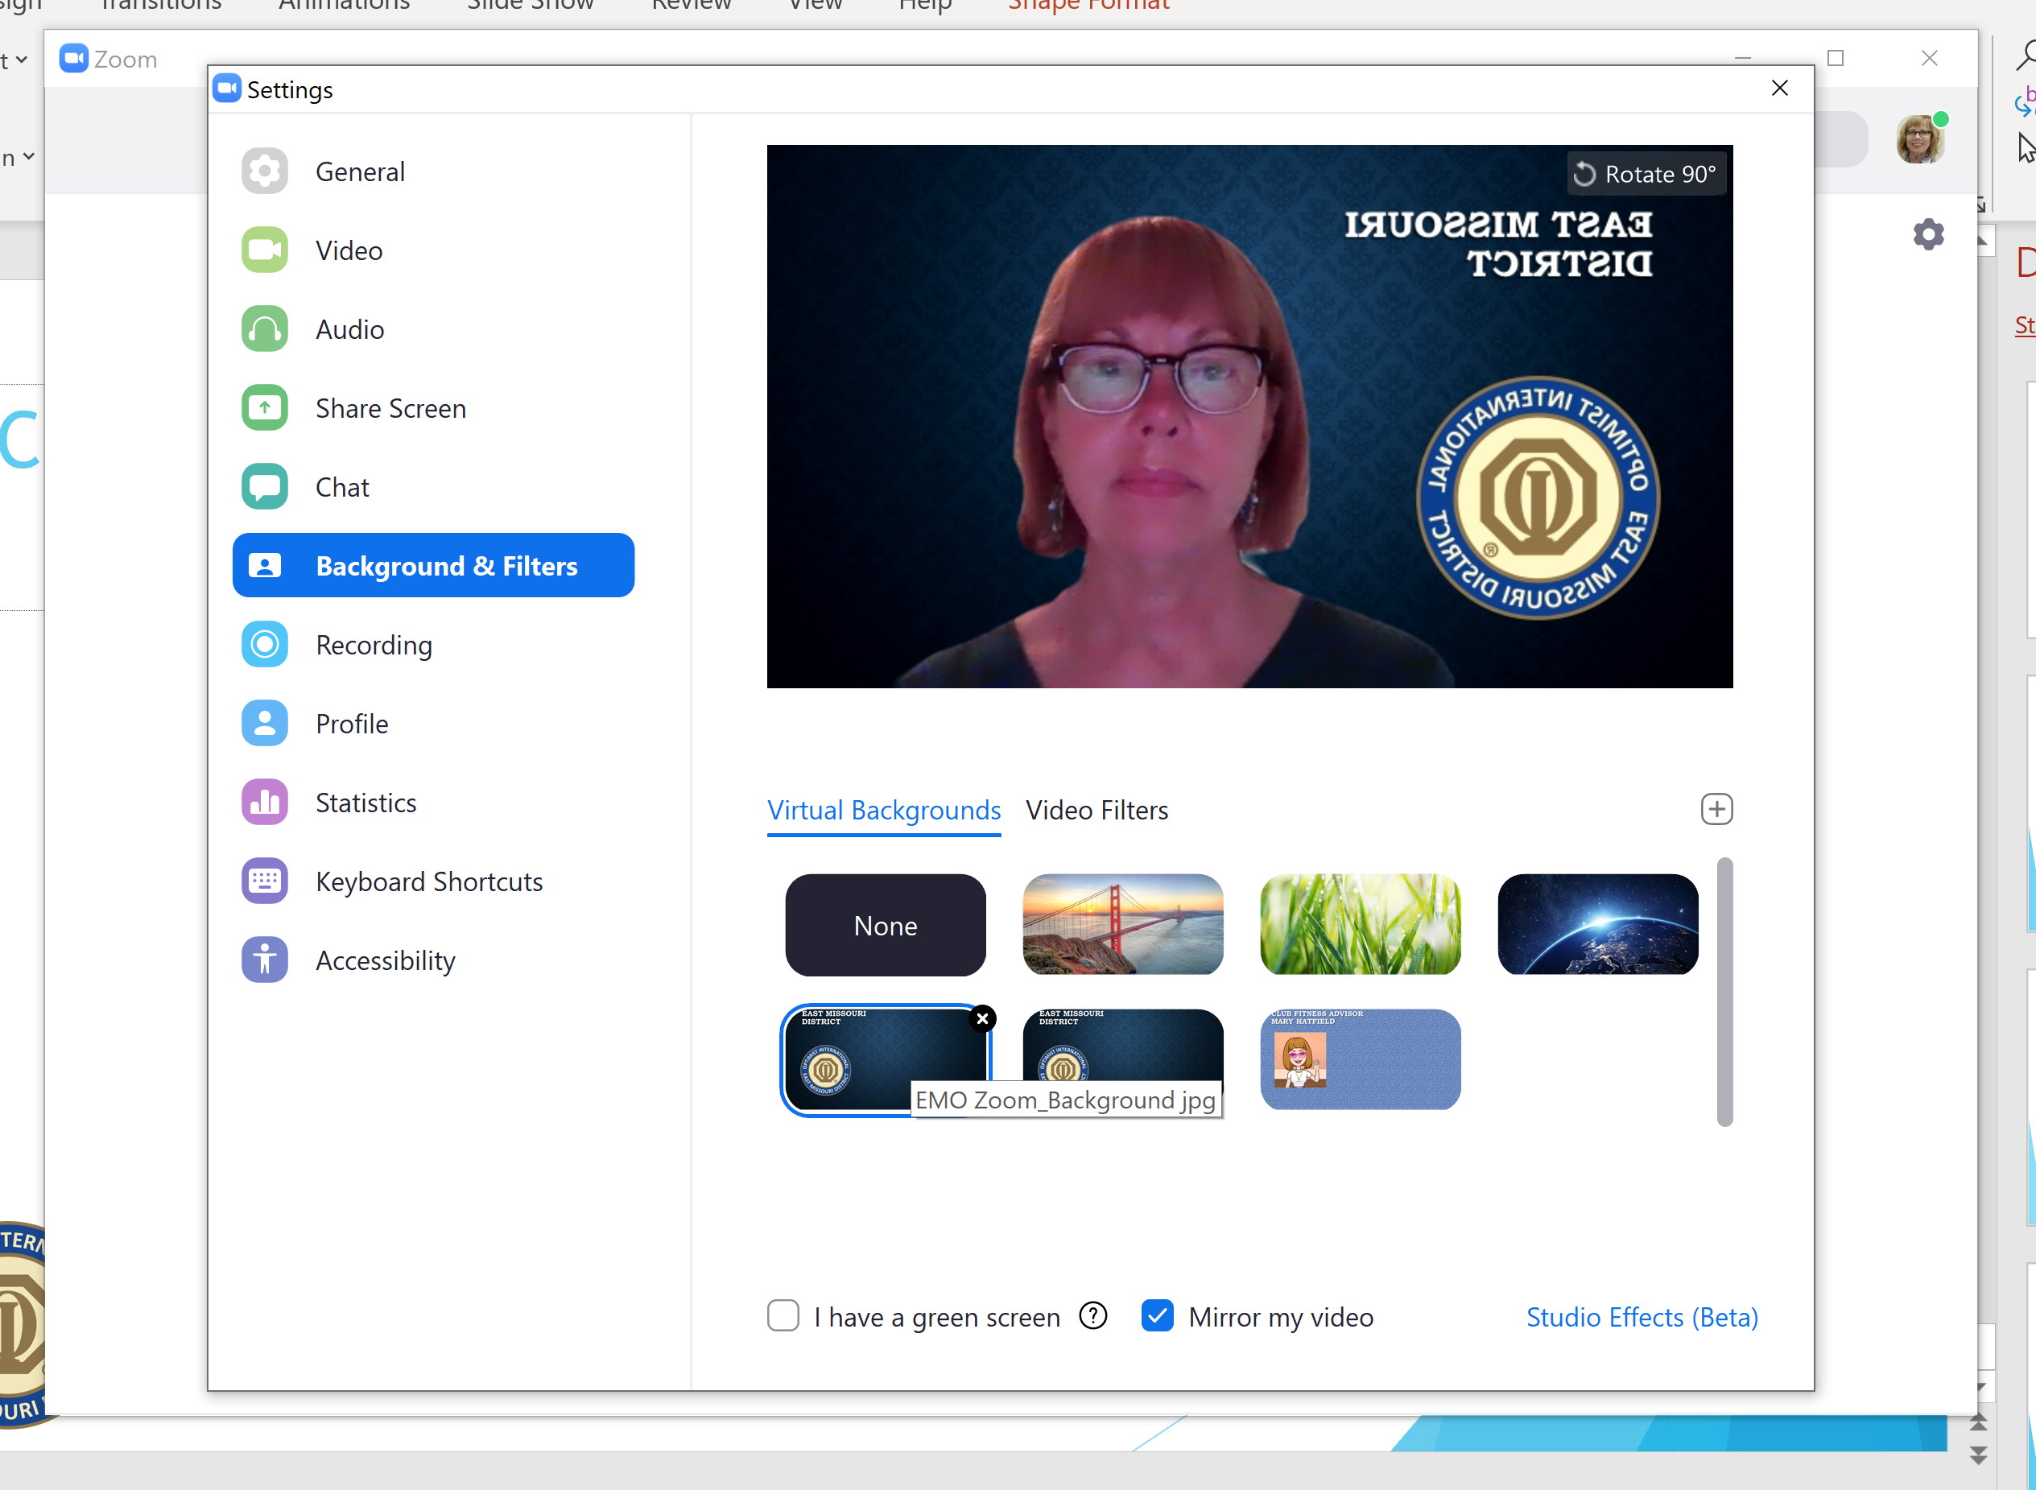
Here you can select the background you want.

Slide 24
But wait, there’s more. How do I create a custom background?
Directions to make a Zoom background.
In PowerPoint, create the background you want.
In the file menu, select SAVE AS
Under File Type, change the file Type to JPG File Interchange Format
When prompted, select “just this one” for the slide you want to save.
Upload the JPG file to Zoom under the Virtual Background Option

Slide 25
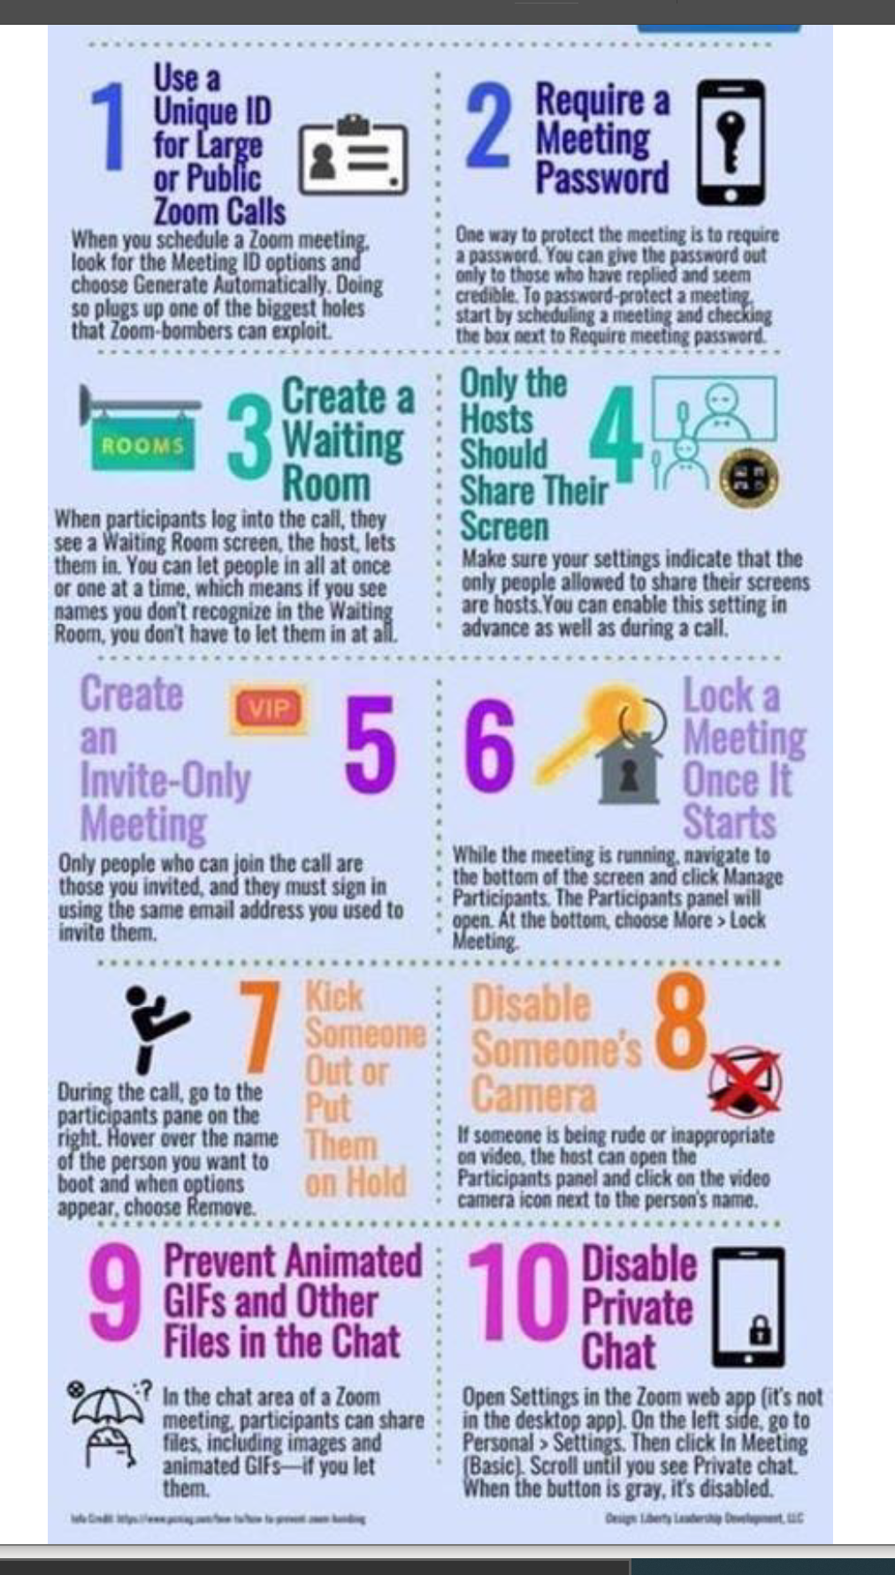
10 Ways to Secure Zoom

Slide 26
Help Line
Mary Hatfield
636-937-7240 (h)
314-835-7524 (c) mhat123@yahoo.com hatfieldme73@gmail.com

